Slide 1

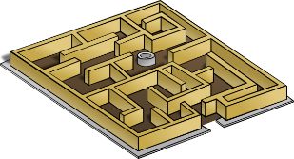
Maze
Represent a maze using 2-D arrays

