Slide 1

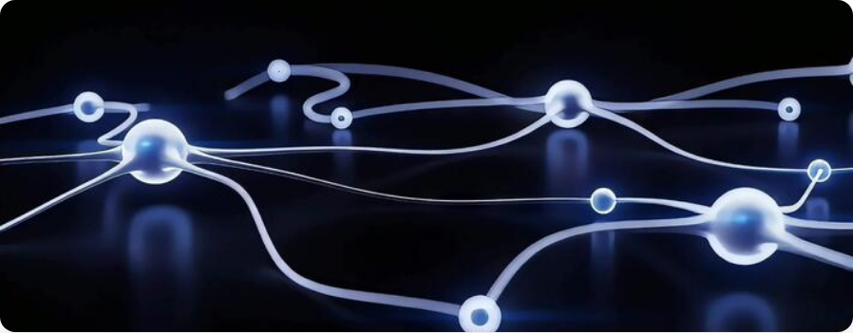
RECOMMENDATION SYSTEMS 101
Modern RecSys Architecture:
From Data to Decision
A Data Scientist's Perspective on Deep Learning Pipelines

Slide 2




Why Recommendation Systems?
The Problem: Overload
Users are drowning in an ocean of content. Navigation is impossible without a compass.
The Business Impact
35%
of revenue from recommendation engine
Goal: Right Content, Right Person, Right Time.
80%
Concept: Serendipity (Happy Accident - Discovery) vs Relevance (Accuracy).
of content watched comes from recommendations

Slide 3
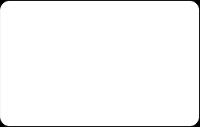
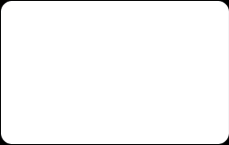
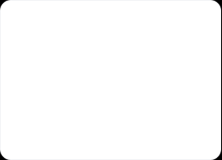

The Evolution of RecSys
Gen 1
Gen 2
Gen 3
Gen 4
Non-Personalized
Content-Based
Collaborative
Deep Learning
Trending, Top Sellers
Item Attributes, Metadata
Matrix Factorization, User Behavior
Neural Networks, Two-Tower, LTR

Slide 4
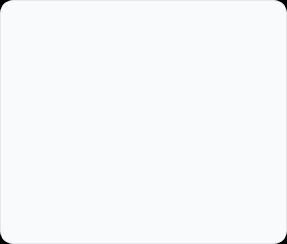
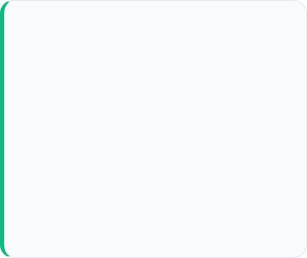
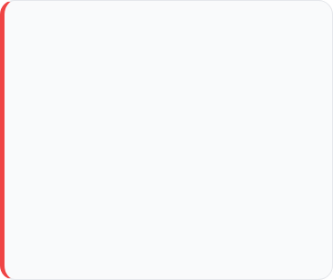





Gen 1: Non-Personalized
Logic
Pros
Cons
"Best Sellers", "Trending Now". Showing the same list to everyone based on global popularity.
• Easy to implement
• Solves Cold Start problem for new users
• High traffic drivers
• Zero personalization
• Ignores niche preferences
• "Horror fan gets RomCom"

Slide 5
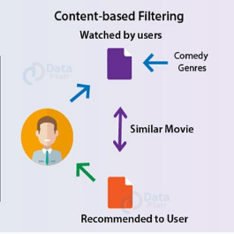

Gen 2: Content-Based Filtering
"You liked X, so you'll like Y"
Uses item metadata (Genre, Cast, Description) to find similarities.
No User Data Needed: Works purely on item properties.
Explainable: "Recommended because you watched Terminator 1".
Filter Bubble: Users get trapped in the same genre. No discovery.

Slide 6

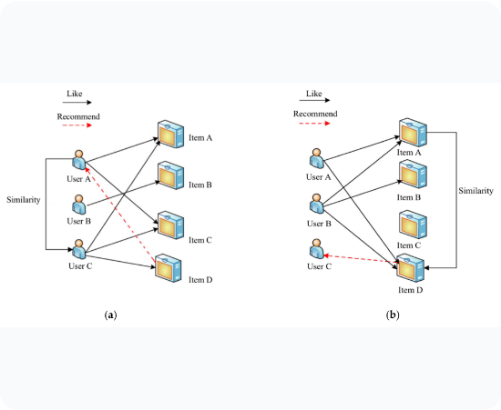
Gen 3: Collaborative Filtering (CF)
Collective Intelligence
"People who bought this also bought that."
Serendipity: Finds surprise connections you wouldn't find yourself.
Content Agnostic: Doesn't need to know what the item is.
Scalability: complexity. Slow with millions of users.

Slide 7
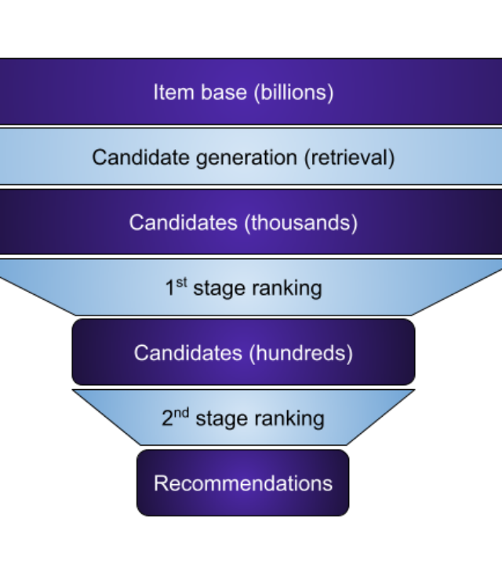



The Modern Funnel Strategy
Latency vs. Accuracy
How to sort millions of items in 200ms? By cascading multiple stages.
1. Candidate Generation (Retrieval)
Fast. Millions -> Thousands.
2. Scoring & Ranking
Precise. Thousands -> Dozens.
3. Re-Ranking
Business Logic. Dozens -> Final List.

Slide 8

Stage 1: Retrieval (Candidate Gen)
Goal: High Recall
Amaç: Olası tüm ilgili adayları kaçırmadan getirmek (Recall).
Yöntem: Deep Learning tabanlı Two-Tower Architecture.
Özellik: Milisaniyeler içinde milyonlarca aday arasından arama.
Logic
> Query: User Vector
> Space: 10 Million Item Vectors
> Action: Find nearest K neighbors
> Time: < 10ms
> Result: Top 1000 Candidates
The Technology
We don't use SQL `WHERE` clauses.
We use Vector Databases
Faiss (Meta)
Qdrant

Slide 9
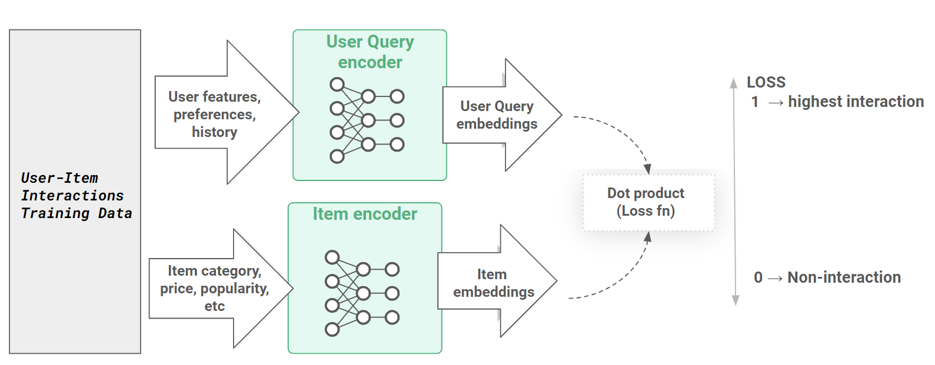
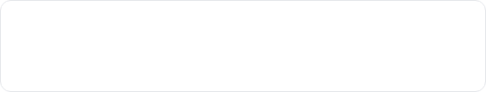
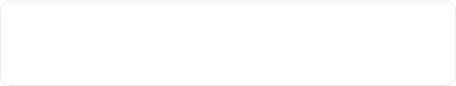
Deep Dive: Two-Tower Architecture
Independent Learning
The industry standard for retrieval (YouTube, Google Play).
Left Tower (User)
Input: History, Demographics, Geo.
Output: User Embedding.
Right Tower (Item)
Input: ID, Image, Text, Category.
Output: Item Embedding.
Goal: Maximize dot product (similarity) in vector space.

Slide 10


Stage 2: Scoring & Ranking
~500
pCTR
Input Candidates
Predicted Click-Through Rate
From Retrieval Phase
The Metric that Matters
Here we use heavy, complex models (DLRM, XGBoost) because we are only scoring a small subset. The goal is pure Precision.

Slide 11






Advanced: Learning to Rank (LTR)
Pointwise
Pairwise
Listwise
Scores each item independently. "Is this item good?"
(Regression/Classification).
Loss: MSE (Mean Squared Error) veya Cross-entropy Loss
Industry Standard. Compares pairs: "Is Item A better than Item B?" (RankNet, LambdaMART).
Loss: BPR (Bayesian Personalized Ranking) veya Hinge Loss
Optimizes the entire list order at once. Maximizes NDCG directly. Computationally expensive.
Loss: Soft-Max Cross Entropy
En yaygın kullanım: LambdaMART
Loss Function Amacı: Eğer A ve B öğelerinin yerini değiştirirsem, listenin toplam kalitesi (NDCG) ne kadar artar?
XGBoost ve LightGBM modülleriyle kullanılabilir.

Slide 12
The Magic: Feature Engineering
Feature Type | Description | Example
Dense | Continuous numerical values. | Age, Watch Time, Price, Video Duration.
Sparse | Categorical IDs with high cardinality. | Video_ID, User_ID, Genre, Country.
Cross Features | Captures non-linear interactions between features. | (User=Mobile) x (Content=Shorts) (Time=Morning) x (Content=News)
"The model doesn't just know who you are; it learns context through cross features."

Slide 13









Stage 3: Re-Ranking & Business Logic
The raw model output isn't always the best user experience. We apply business rules.
Diversity
Inventory
Freshness
Bias/Safety
Don't show 10 red shirts in a row. Shuffle similar items.
Filter out out-of-stock items or expired content.
Boost new content to ensure the system doesn't become stale.
Remove sensitive or inappropriate content regardless of score.

Slide 14
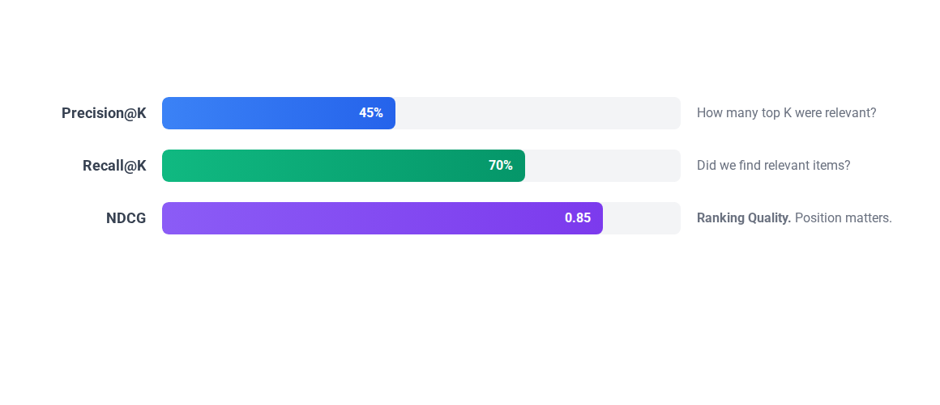
Offline Metrics (Lab)
We test models on historical "Hold-out" data before they ever see a real user.

Slide 15
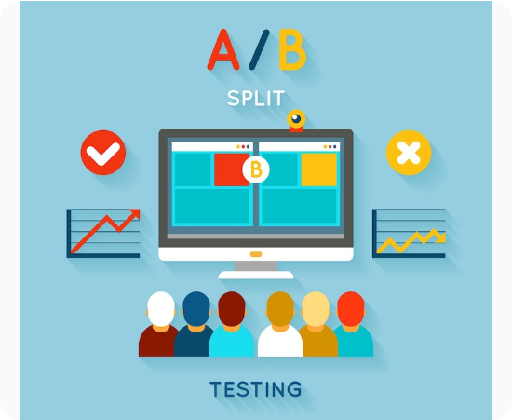
Online Metrics (Production)
A/B Testing
The moment of truth. Comparing Model A vs Model B on live traffic.
CTR (Click-Through Rate): Simple engagement.
Conversion Rate: Purchase or Watch Completion.
Time Spent: Time spent in the session.

Slide 16
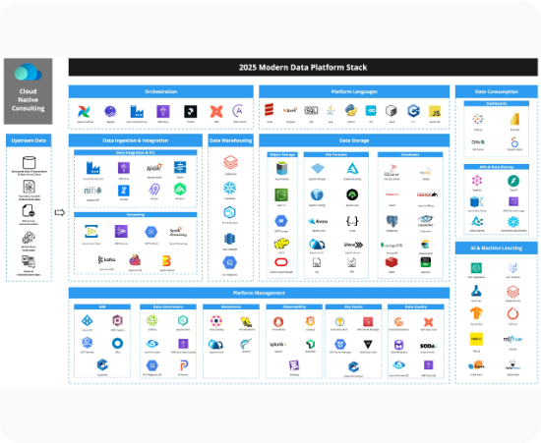




The Engineering Backbone
Big Data
BigQuery
Modeling
Python (Sklearn, PyTorch, TensorFlow)
Serving
Redis (Feature Store), FAISS (Vector DB)
Pipeline
Apache Airflow, Docker, Kubernetes

Slide 17
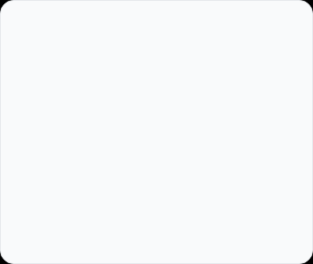
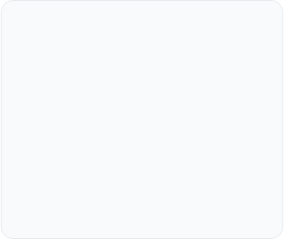
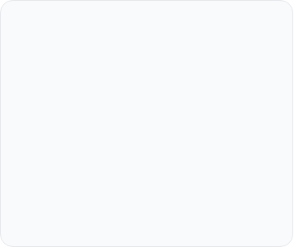





Key Challenges
Cold Start
Sparsity
Feedback Loops
New users or items have no interaction history.
Solution: Fallback to non-personalized or content-based.
Matrix is 99% empty. Hard to find patterns.
Solution: Embeddings / Deep Learning.
Model only suggests what it knows, creating an echo chamber.
Solution: Exploration strategies.

Slide 18

The Future of RecSys
Beyond Static Lists
The future is conversational, generative, and real-time.
Generative AI: LLMs creating recommendations through natural conversation ("Suggest a movie for a rainy Tuesday").
Session-Based: Reacting to your mood in the last 5 seconds, not just the last 5 months.
"Good technology is invisible. It just understands you."

