Slide 1
CUSTOMER SEGMENTATION
CAPSTONE PROJECT
OZGE USAL

Slide 2
TABLE of CONTENTS
PROJECT CONCEPT
CUSTOMER SEGMENTATION
BUSINESS QUESTIONS
DATA COLLECTION AND INFORMATION
ML PROCESS WORKFLOW
DATA EXPLORATIONS & FEATURES
MODELLING
CONCLUSION

Slide 3
Project Concept
The purpose is to understand customer response to different offers in order to come up with better approaches to sending customers specific promotional deals.

Slide 4
Customer Segmentation
The goal of segmenting customers is to decide how to relate to customers in each segment in order to maximize the value of each customer to the business.

Slide 5
Business Questions
How the offers determined according to specific customer groups?
How the approaches of offers are enhanced?

Slide 6
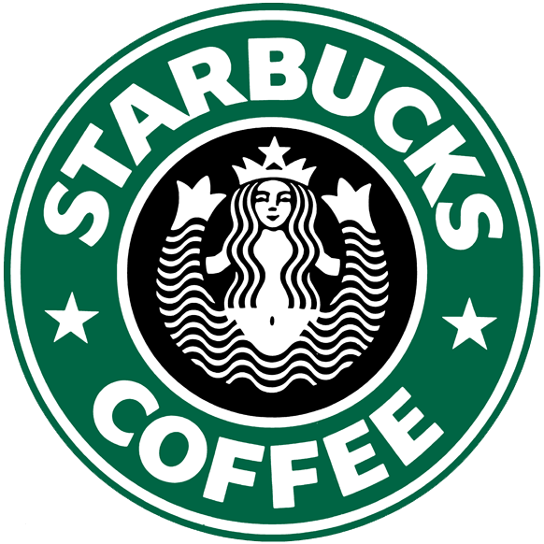
DATA SET
Dataset contains three .csv files in Kaagle and it is provided by Starbucks Company
portfolio.csv - data about offers sent to customers (10 offers x 6 columns)
profile.csv - demographic data of customers (17,000 customers x 5 columns)
transcript.csv - customer response to offers and transactions made (306,648 events x 4 columns)
https://www.kaggle.com/datasets/ihormuliar/starbucks-customer-data

Slide 7
PROFILE.csv contains customers information like:
Gender
Age
Member date
Income
PORTFOLIO.csv contains offers information like:
Reward
Channels
Difficulty
Offer type
TRANSCRIPT.csv contains customer responses and transaction details like:
Person id
Event
Offer ID

Slide 8
ML PROCESS WORKFLOW
DATA PREPARATION
FEATURE ENGINEERING
MODEL PERFORMANCE
1
3
5
2
4
6
EXPLANORY DATA ANALYSIS (EDA)
ML MODELING
CONCLUSIONS AND VISUALIZATIONS

Slide 9
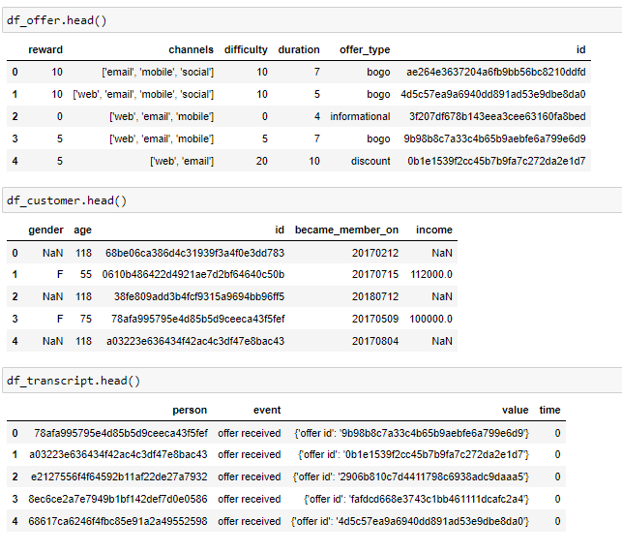
DATA PREPARATION
Data cleaning are applied for three files. Missing values are checked, data types are checked.
For data transformation process, new columns are created, some columns are prepared for suitable format

Slide 10
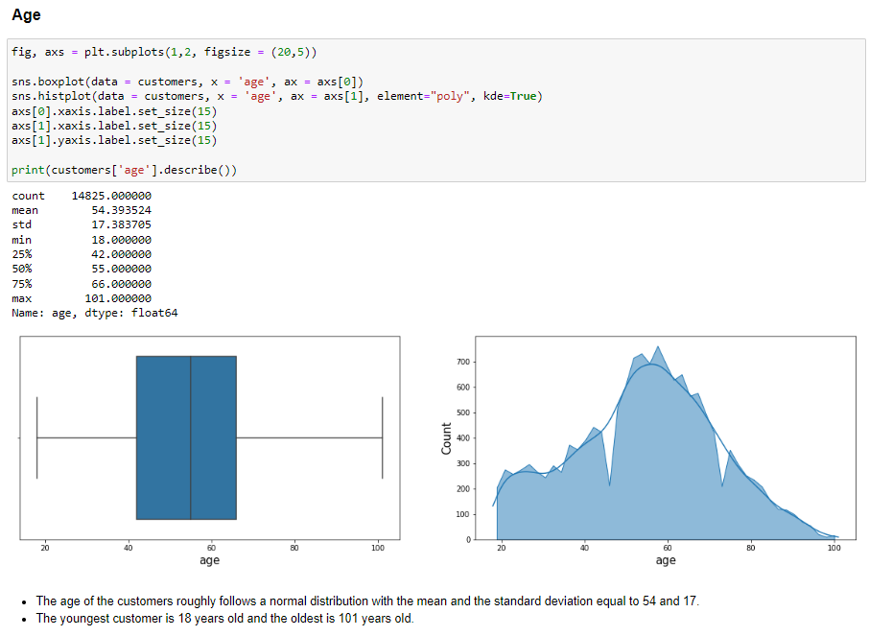
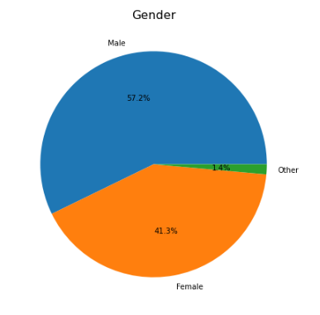
EXPLANORY DATA ANALYSIS

Slide 12
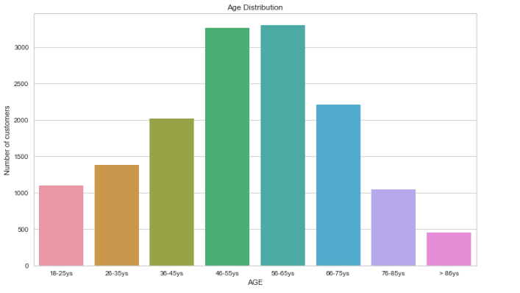
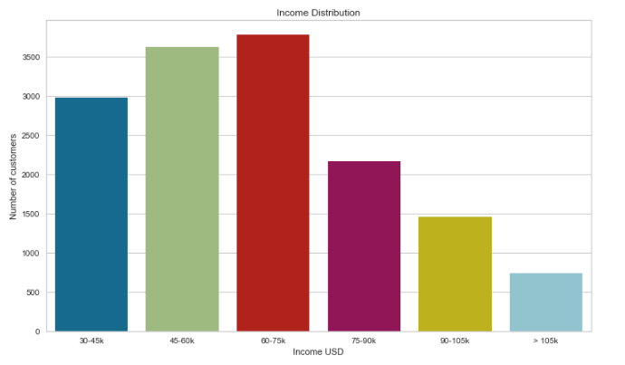
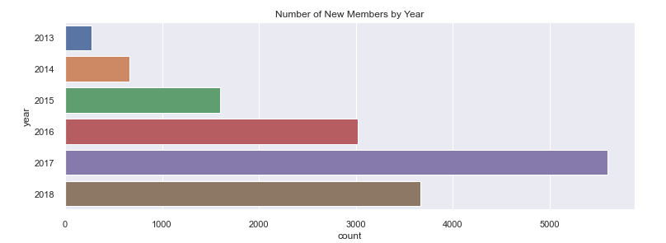

Slide 13
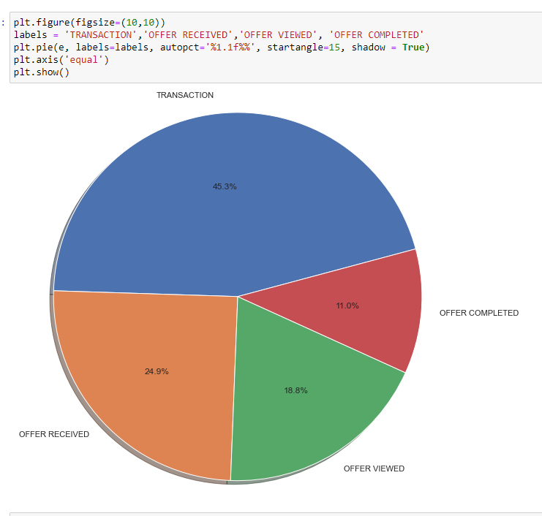
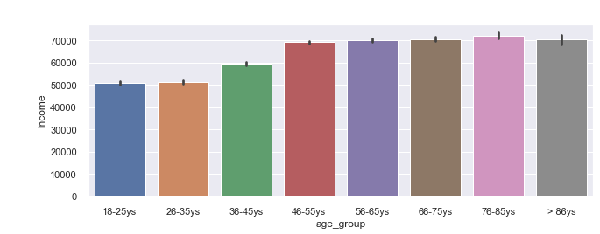
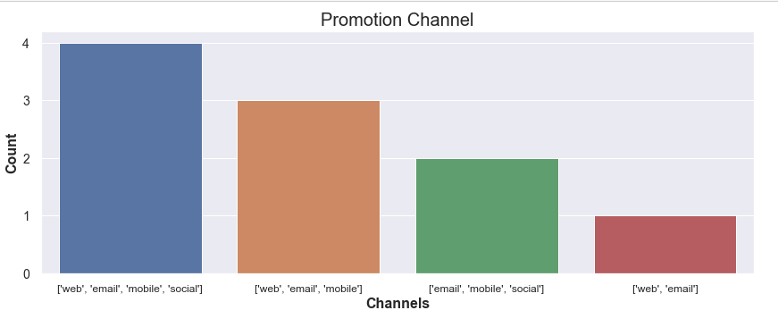

Slide 14
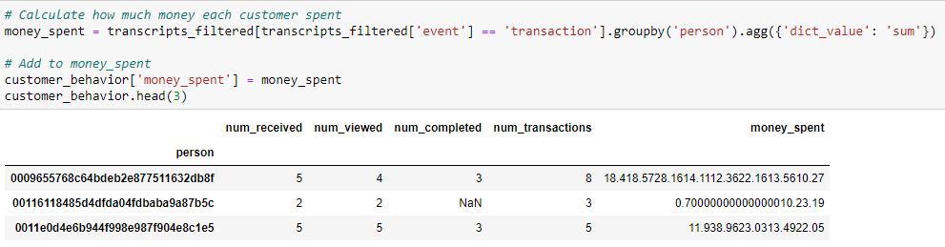
Extracting Customer Behavior Features
New table is created using transcript table. Number of received offers, viewed offers, completed offers, transactions and spending money are calculated for each customers.

Slide 15

Modelling
Firstly, K-Means clustering algorithm are used to determined customers groups. After that, CatBoostClasssifier and Random Forest Algorithms are applied and compared. Pycaret Library are used for clustering and classifications.

Slide 16
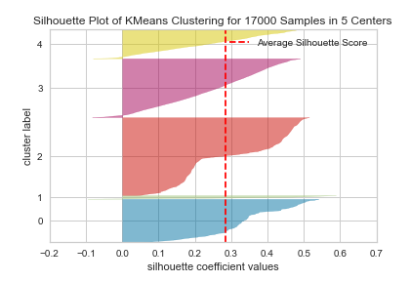
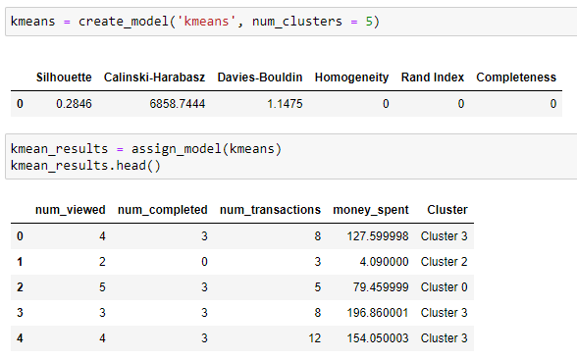
Modelling

Slide 17
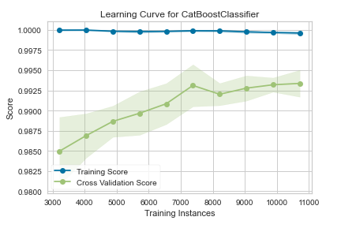
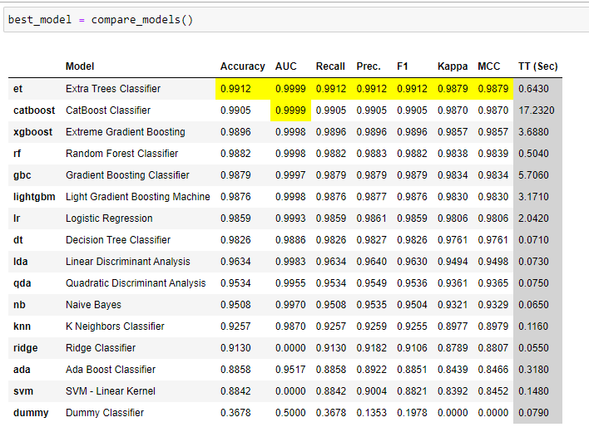
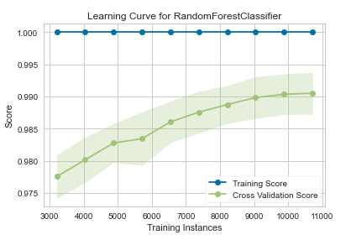
Modelling

Slide 18
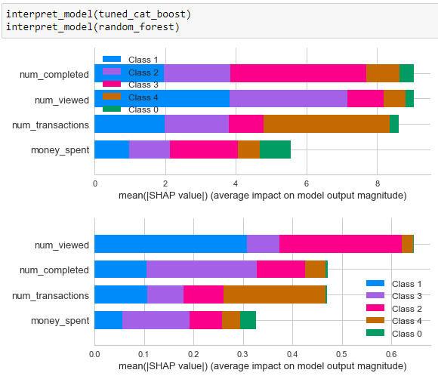
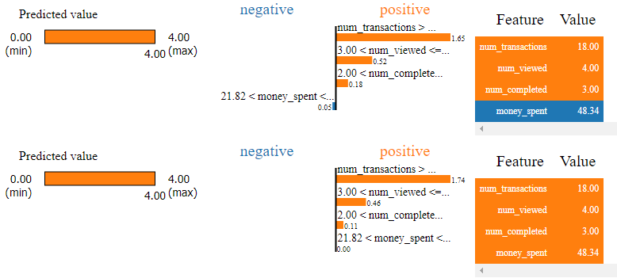
Modelling
SHAP and LIME are used for explanations of models.

Slide 19
CONCLUSION
Costumer are grouped according to their behaviors. It is important to analysis customers. Company enhances offers according to customer group behaviors. They can make prediction related with costumer age, income, gender. We can see distribution of customer properties according to behavior groups
https://www.kaggle.com/datasets/ihormuliar/starbucks-customer-data

Slide 20
THANKS!

