Slide 1

Note: The data and information in this document is reflective of a hypothetical situation and client. This document is to be used for KPMG Virtual Internship purposes only.
Sprocket Central Pty Ltd
Data analytics approach

Slide 2
Note: The data and information in this document is reflective of a hypothetical situation and client. This document is to be used for KPMG Virtual Internship purposes only.
Agenda
Introduction
Data Exploration
Model Development
Interpretation

Slide 3
Note: The data and information in this document is reflective of a hypothetical situation and client. This document is to be used for KPMG Virtual Internship purposes only.
Introduction
Approach for New Customer Data analysis
Age distribution
Bike purchase
Job industry
Number of cars owned

Slide 4
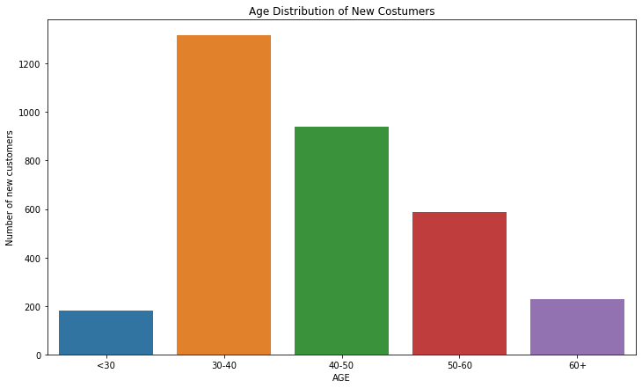
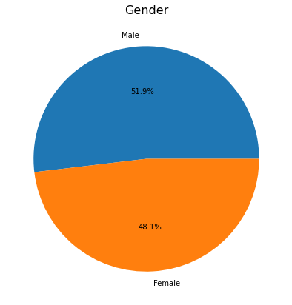
Note: The data and information in this document is reflective of a hypothetical situation and client. This document is to be used for KPMG Virtual Internship purposes only.
Data Exploration
Age and Gender Distribution
New customers are more from the age group of 30-40 and followed by 40-50
48.1% of them are Woman and 51.9% are Man.

Slide 5
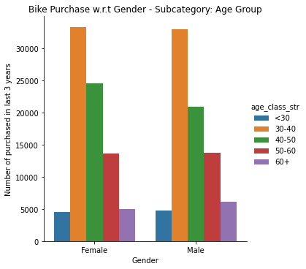
Note: The data and information in this document is reflective of a hypothetical situation and client. This document is to be used for KPMG Virtual Internship purposes only.
Data Exploration
Bike Purchases
Data shows age group 30-40 has high count in terms of bike purchased in last 3 years with a slightly greater female ratio.

Slide 6
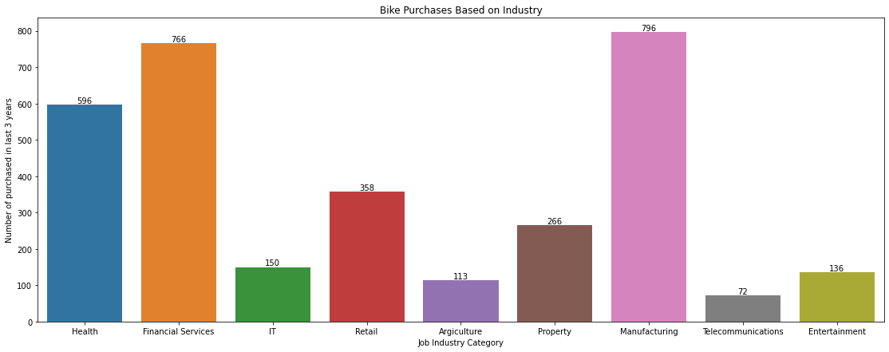
Note: The data and information in this document is reflective of a hypothetical situation and client. This document is to be used for KPMG Virtual Internship purposes only.
Data Exploration
Job Industry
Financial Services, Manufacturing, and Health are the top three profit-generating industries, followed by retail and property.

Slide 7
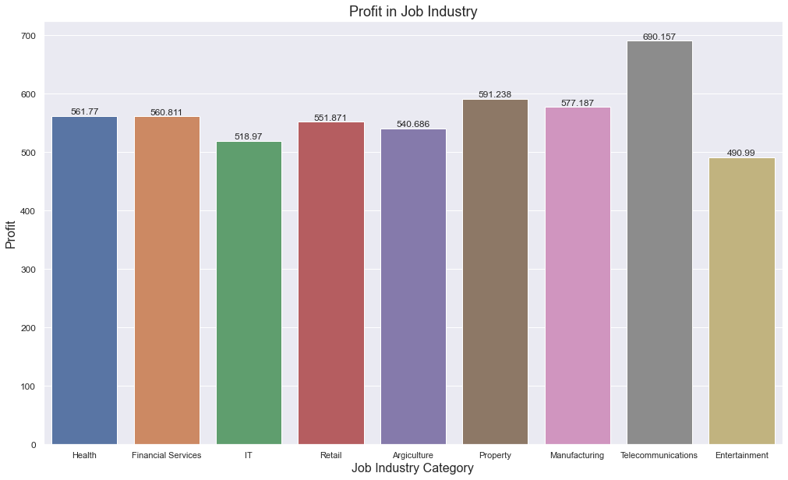
Note: The data and information in this document is reflective of a hypothetical situation and client. This document is to be used for KPMG Virtual Internship purposes only.
Data Exploration
Job Industry
The highest profits are also Financial Services, Manufacturing, and Health

Slide 8
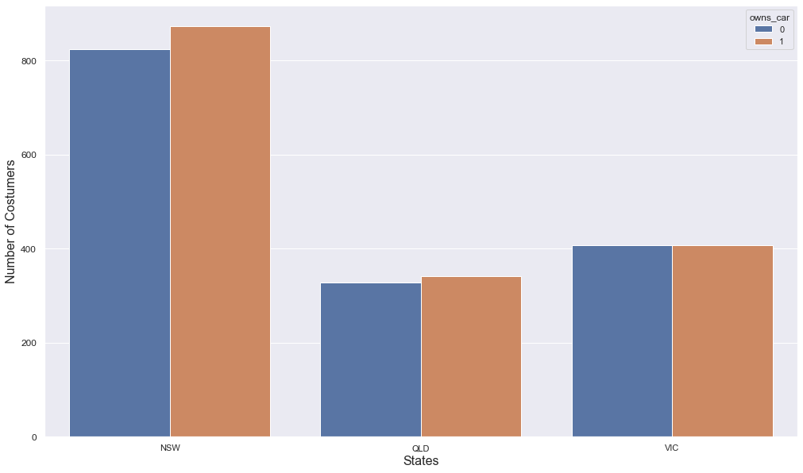
Note: The data and information in this document is reflective of a hypothetical situation and client. This document is to be used for KPMG Virtual Internship purposes only.
Data Exploration
Number of cars owned
New South Wales has the biggest potential since the number of people who own vehicles is nearly equal to the number of individuals who do not own cars, indicating that there is room for value customers there.

Slide 9
Note: The data and information in this document is reflective of a hypothetical situation and client. This document is to be used for KPMG Virtual Internship purposes only.
Model Development
CUSTOMER CLASSIFICATION – Targeting High Value Customers
Aged between 30 – 40.
Most of the high value customers are female compared to male
Working in Financial Service, Manufacturing and Health.
Who are currently living in New South Wales and\or Victoria.

Slide 10
Note: The data and information in this document is reflective of a hypothetical situation and client. This document is to be used for KPMG Virtual Internship purposes only.
Interpretation
HIGH-VALUE CUSTOMER SUMMARY TABLE
 | gender | age_class_str | job_industry_category | past_3_years_bike_related_purchases | state | rfm_class | customer_title
 | Male | 30-40 | Health | 19 | VIC | 111 | gold
 | Male | 50-60 | Financial Services | 87 | VIC | 111 | gold
 | Female | 30-40 | Health | 46 | VIC | 111 | gold
 | Female | 50-60 | Financial Services | 52 | VIC | 111 | gold
 | Male | 30-40 | Health | 69 | VIC | 111 | gold
 | Male | 40-50 | Telecommunications | 9 | VIC | 111 | gold
 | Male | 30-40 | Health | 18 | NSW | 111 | gold
 | Female | 30-40 | Financial Services | 44 | VIC | 111 | gold
 | Male | 30-40 | Financial Services | 68 | NSW | 111 | gold
 | Female | 60+ | Manufacturing | 21 | NSW | 111 | gold
 | Male | 30-40 | Telecommunications | 12 | VIC | 111 | gold
 | Male | 30-40 | Health | 54 | QLD | 111 | gold
 | Male | 30-40 | Health | 5 | NSW | 111 | gold
 | Male | 30-40 | Argiculture | 61 | NSW | 111 | gold
 | Female | 40-50 | Manufacturing | 61 | QLD | 111 | gold

Slide 11
Note: The data and information in this document is reflective of a hypothetical situation and client. This document is to be used for KPMG Virtual Internship purposes only.
Appendix

