Slide 1
BIG DATA PROJECT TWITTER SENTIMENT ANALYSIS
OZGE USAL
JANUARY 2023

Slide 2
Sentiment analysis
Sentiment analysis also referred to as opinion mining, is an approach to natural language processing that identifies the emotional tone behind a body of text.
This is a popular way for organizations to determine and categorize opinions about a product, service, or idea.
It involves using data mining, machine learning, and artificial intelligence to mine text for sentiment and subjective information.

Slide 3





Data set
Twitter data set in CSV format:
Expressing opinions about Thanksgiving
Data is scrapped by using Twitter API and deployed on Amazon EC2 Instance.
Data is loaded in Amazon Simple Storage (Amazon S3) bucket by Amazon Kinesis data Firehouse

Slide 4
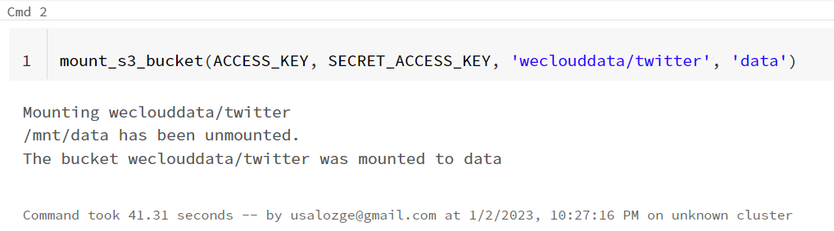
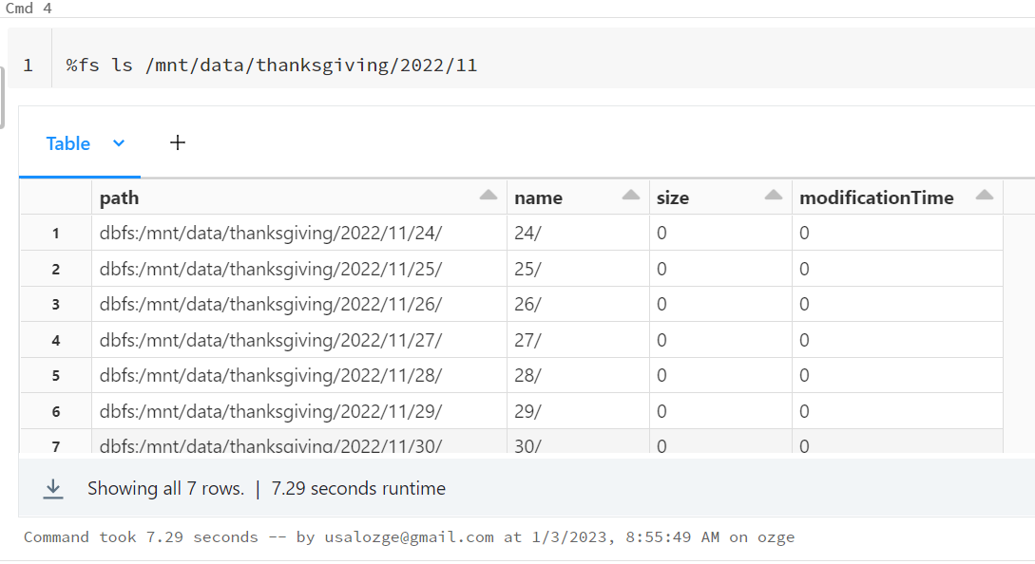

Data Process
The data is mounted in Databricks by using SparkSession

Slide 5
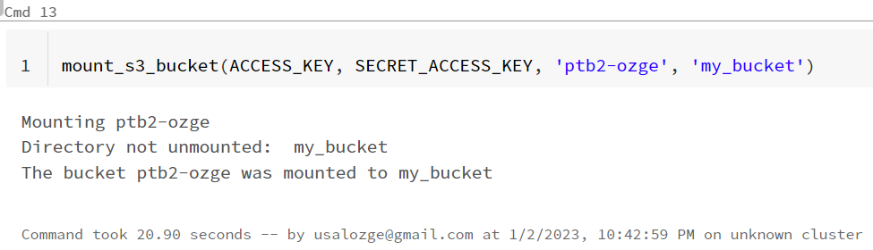
The data is mounted in Databricks by using SparkSession and written personal S3 bucket

Slide 6
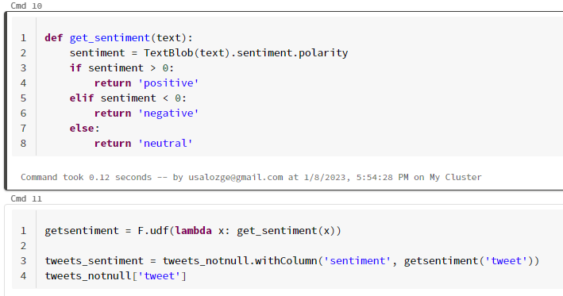
Data manipulation process applied before Machine learning Analyses.
TextBlob is used for sentiment labeling

Slide 7
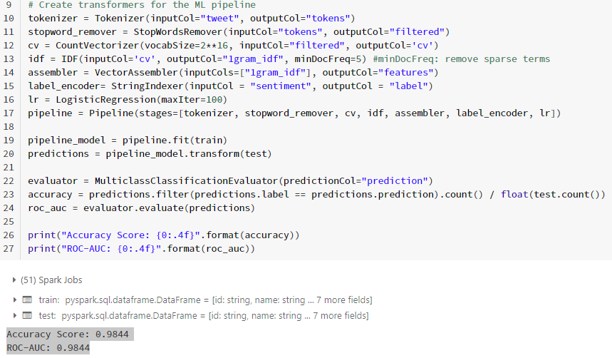
Ml pipeline is created for Logistic Regression supervised, and model accuracy is calculated
Prediction data is written personal S3 bucket

Slide 8


Two data table is creating in Amazon Athena by using Thanksgiving twitter data and Precision data from S3 bucket
Amazon QuickSight is used to manipulate and visualize twitter prediction data by using Amazon Athena dataset connection.

Slide 9

WORKFLOW
DATABRICKS
TWITTER STREAMING API

Slide 10
VISUALIZATIONS

Slide 11
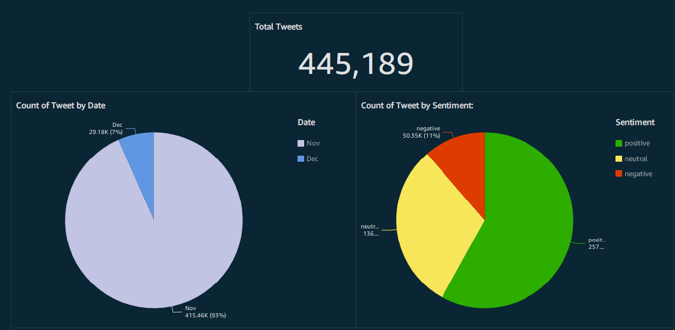

Slide 12
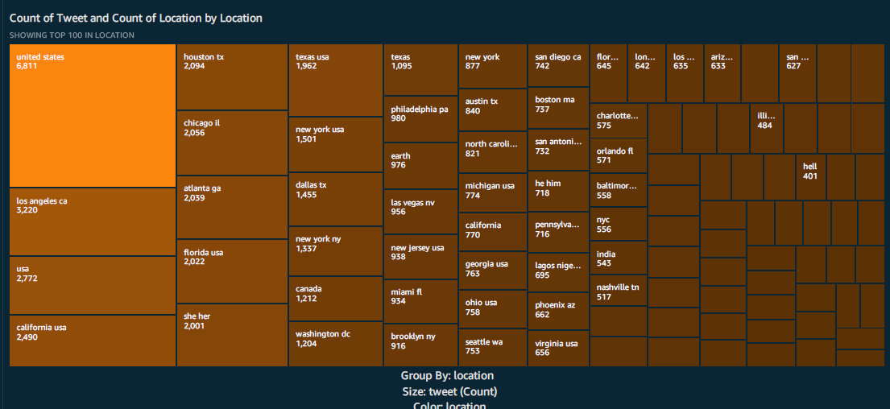

Slide 13
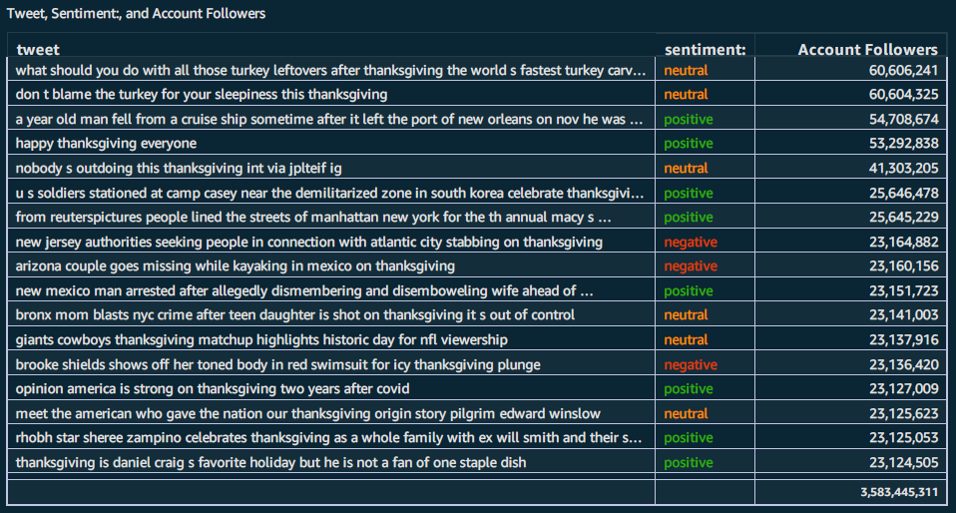

Slide 14
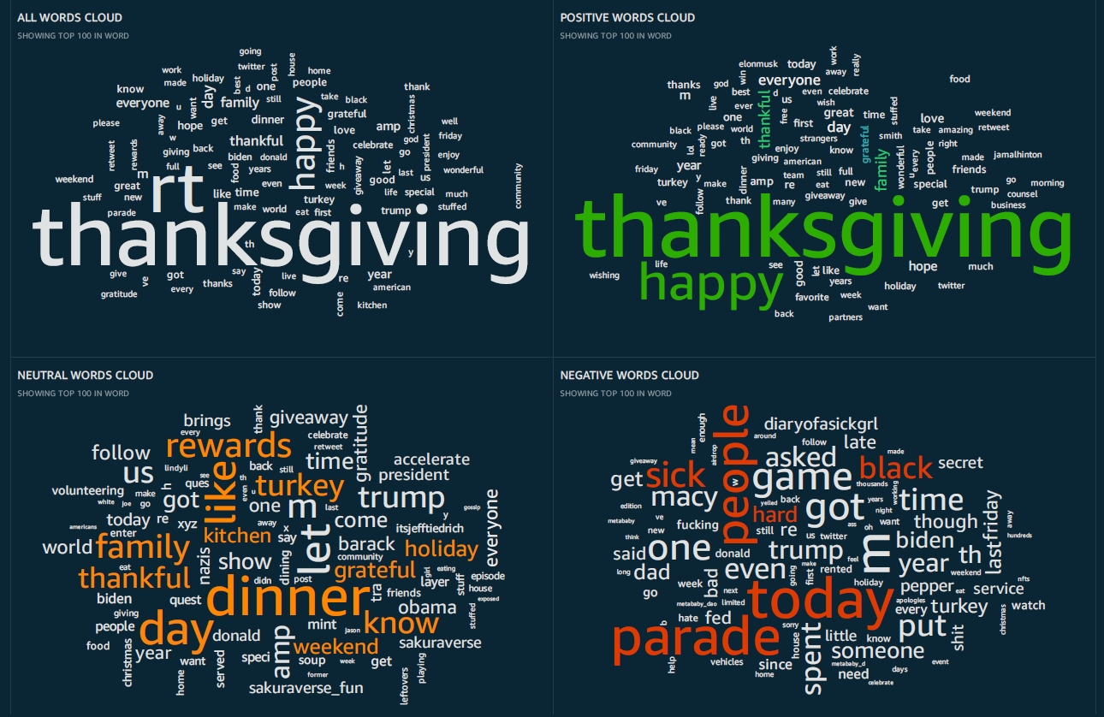

Slide 15

chalanges
Writing prediction data to S3 bucket in a correct format
Data preprocessing before ML process.
Databricks Cluster time limit

Slide 16
Next steps
Different machine learning algorithms can be applied for comparison of accuracy
Data cleaning process can be increased for variate the analyses
Location data can be modified for map visualization

Slide 17
THANKS!
Any questions?

