Slide 1
Parametrıc Ultrasonıc Transducer Array Desıgn
Ahmet AK 1407751
Özge POLAT 1610202
Kaan AKYEL 1407695

Slide 2
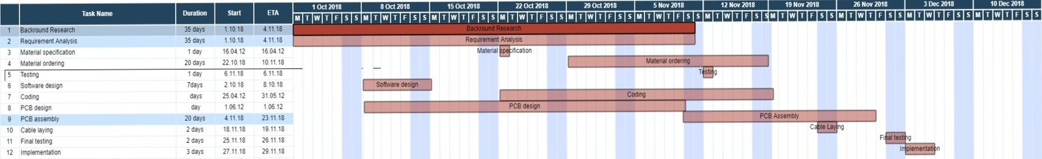
Project roadmap

Slide 3
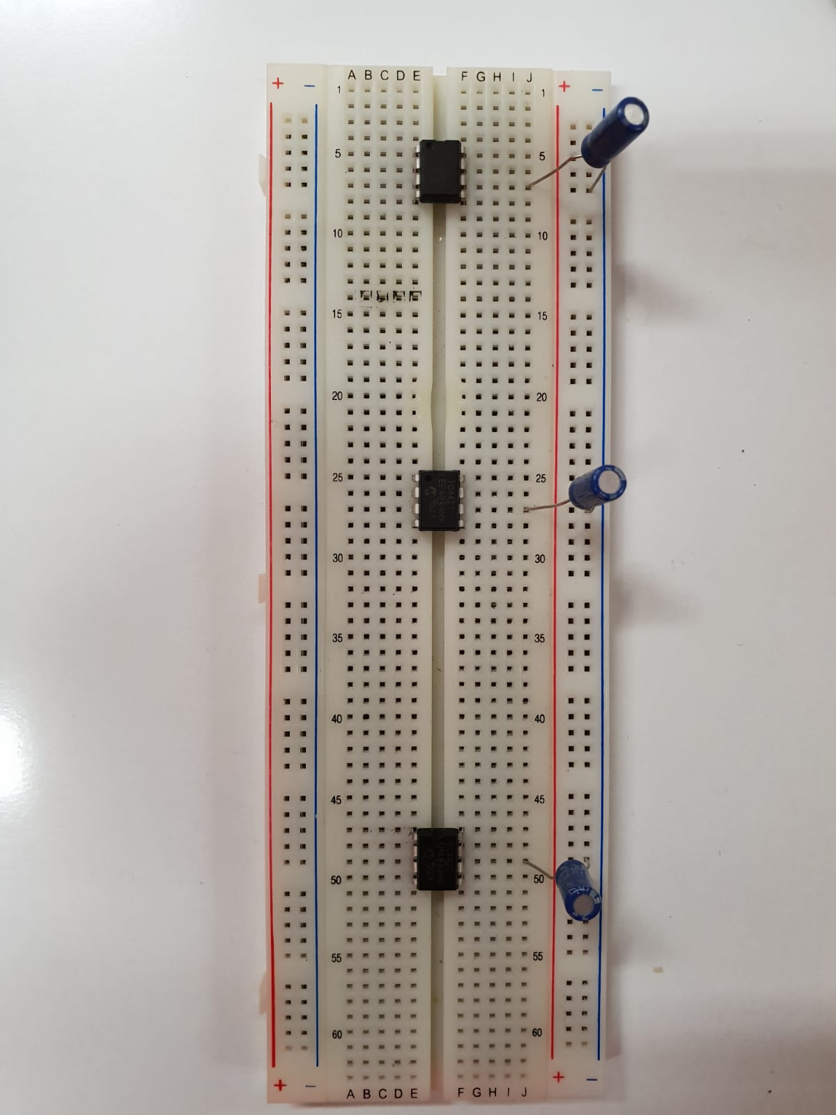
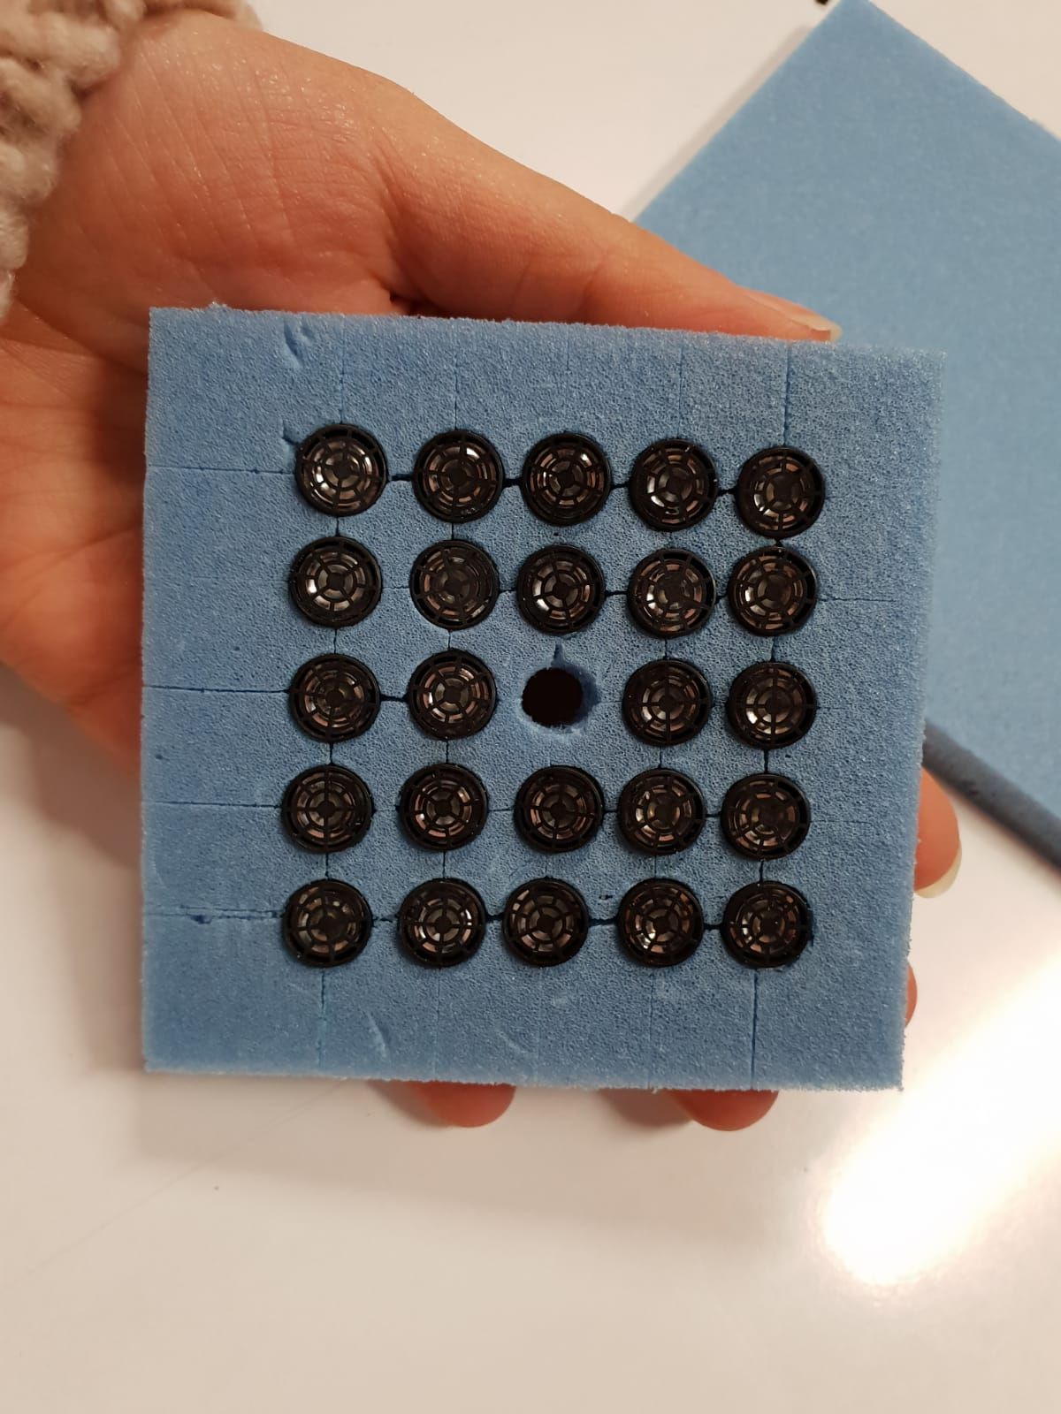
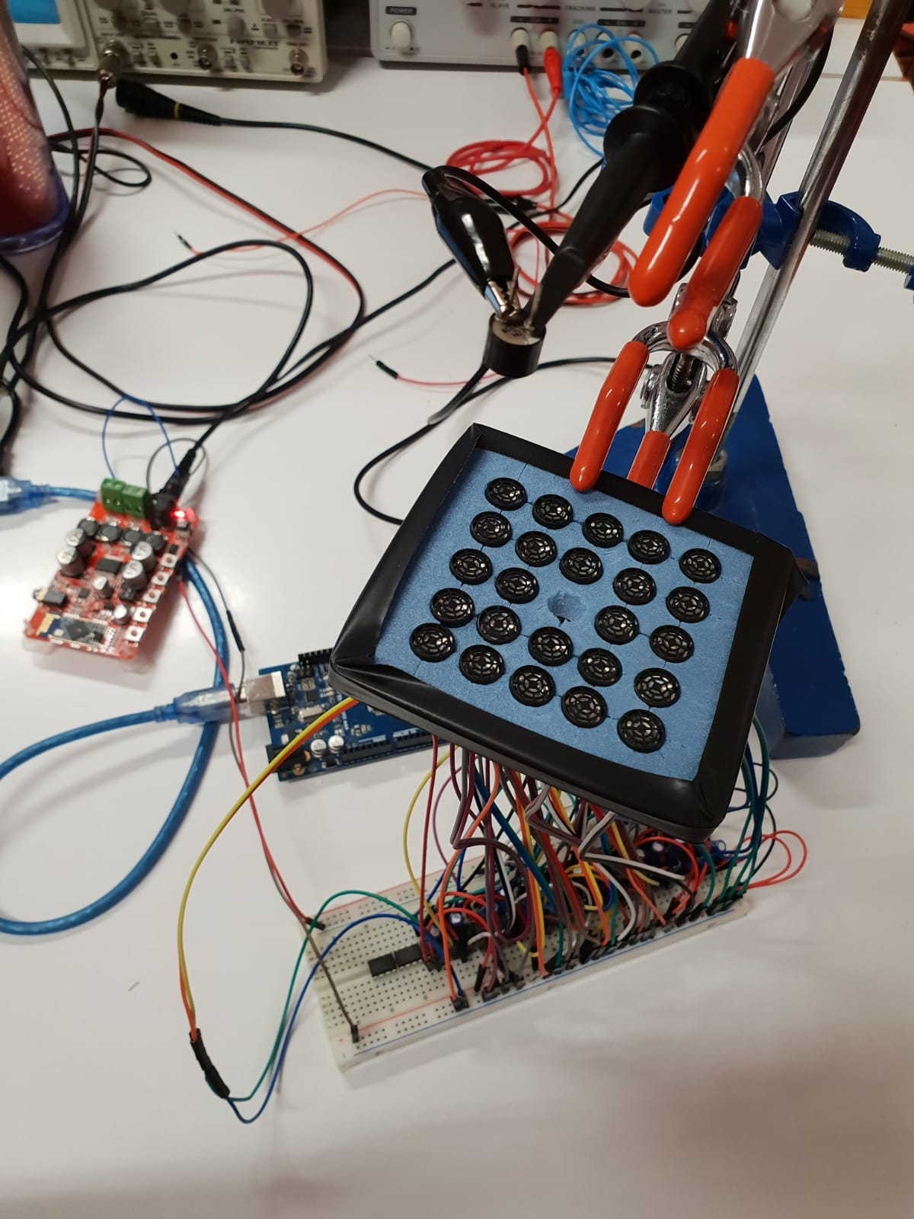
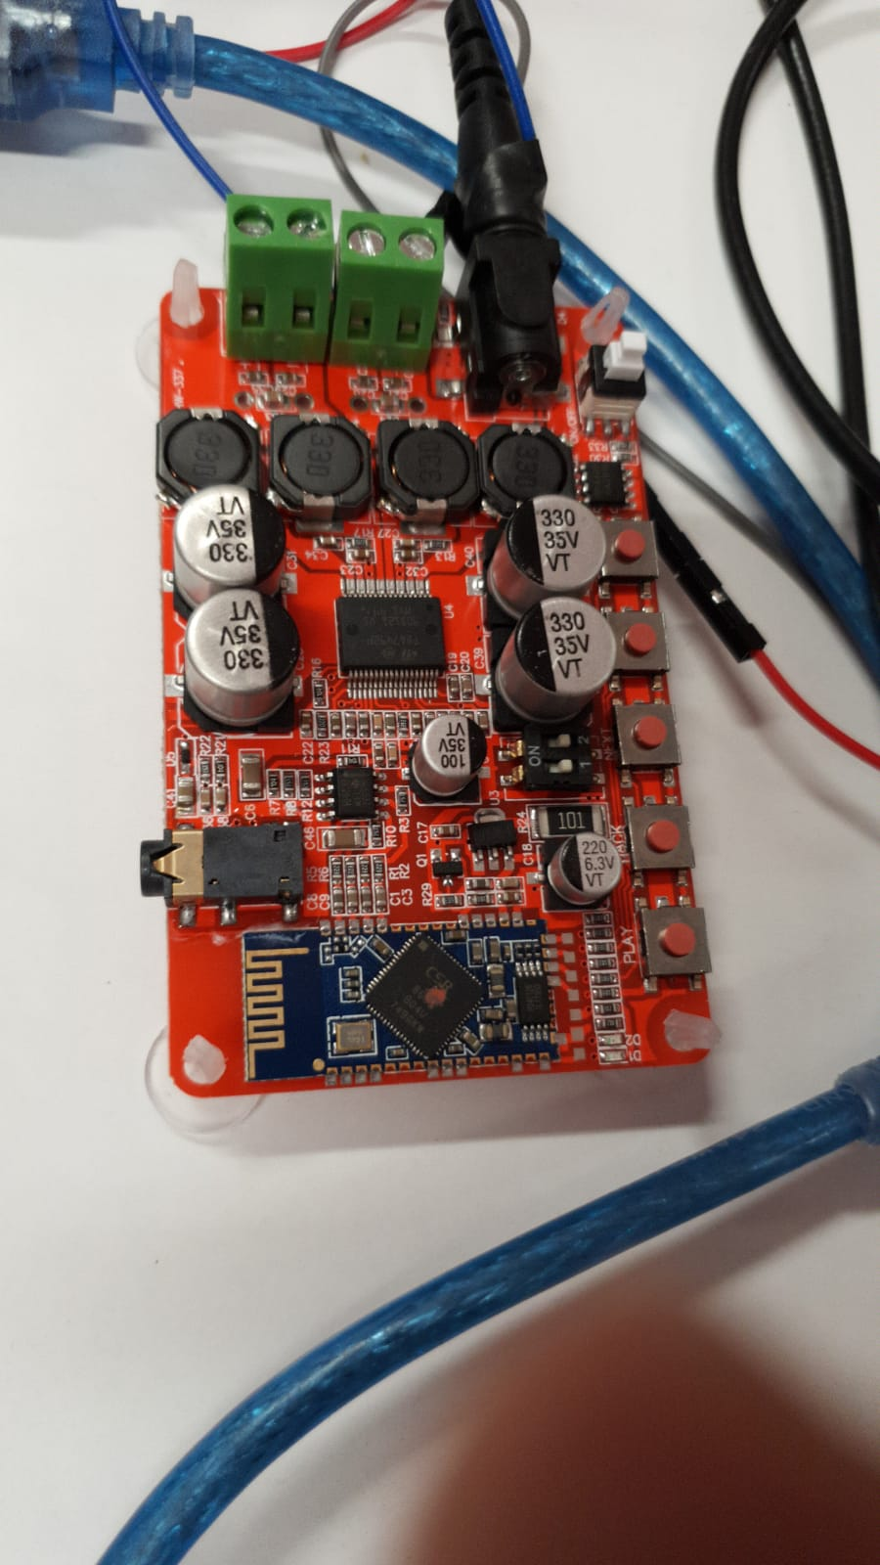
Equıpments And cırcuıts
The Mosfets circuit without cabling
Transducers Mounting
Test Enviroment
Amplifier

Slide 4
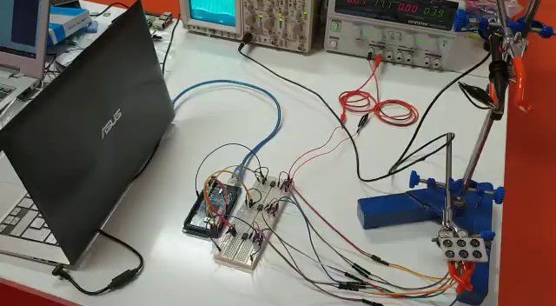
Test ENVIROMENT
Vıdeo

Slide 5
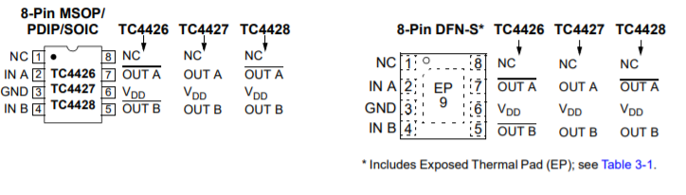
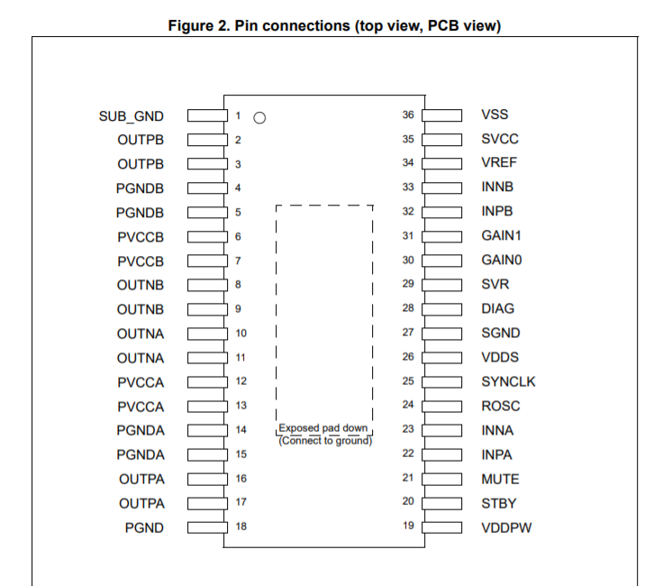
Specıfıcatıons

Slide 6
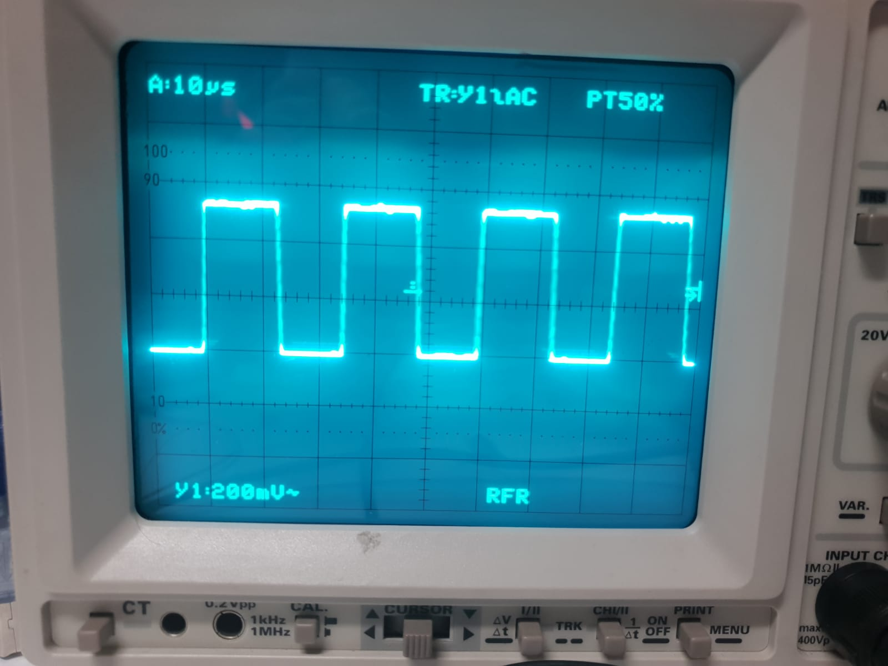
40 KHZ PWM FROM ARDUINO

Slide 7
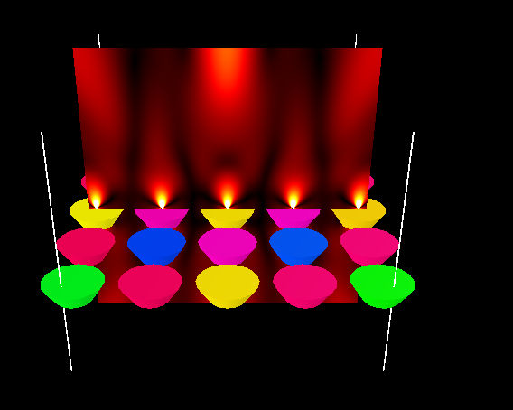
Targeted Sımulatıon oUTPUT

Slide 8
Thank you for lıstenıng
You can follow us on Github
https://github.com/ozgepolat/PUTAJI

