Slide 1
PROJECT: Microcontrollers Based Product Remaining Shelf Life Estimation
Purpose of project :The main objective of
this project is to analyze the remaining shelf
life of fruits and vegetables with the help of microcontrollers/Ardunio using data analysis method

Slide 2
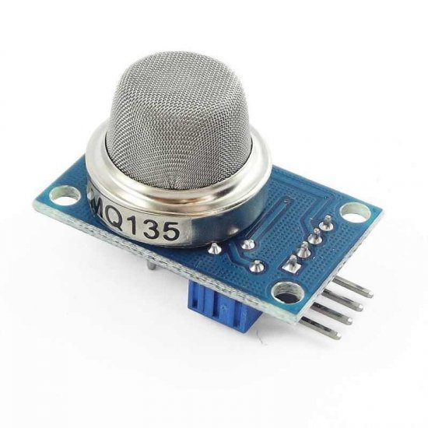
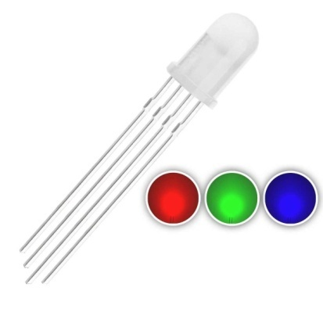
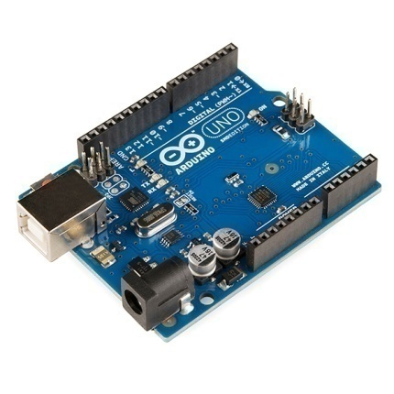
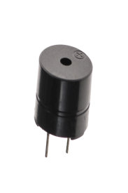
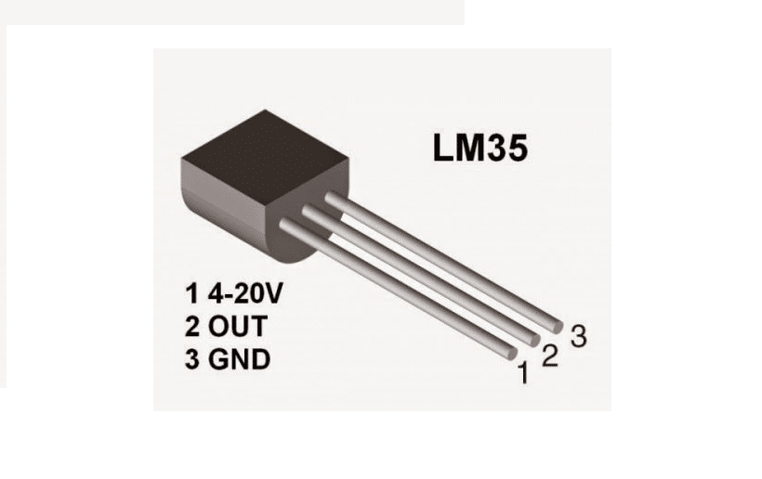
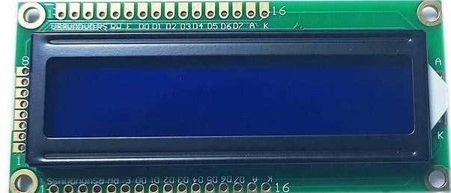
Hardware elements of the project:
MQ 135 gas sensor
Temperature sensor
RGB led
Buzzer
Breadboard
Arduino uno
Lcd 2x2 I2c smart
Jumper cable
resistance

Slide 3
HARDWARE ELEMENTS AND USİNG PURPOSES
MQ-135 Sensor: The MQ-135 Gas sensors are used in air quality control equipments and are suitable for detecting or measuring of NH3, NOx, Alcohol, Benzene, Smoke, CO2.
sensor settings are set to measure carbon dioxide
Using purpose of mq-135 sensor: The carbon dioxide sensor was used to measure the carbon dioxide level in the environment.

Slide 4
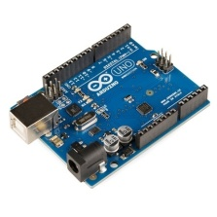
ARDUİNO UNO MİCROCONTROLLER : Arduino Uno is a microcontroller board based on the ATmega328P It has 14 digital input/output pins (of which 6 can be used as PWM outputs), 6 analog inputs and arduino uno has three memory type (FLASH memory, SRAM, EEEPPROM)
FLASH MEMORY | SRAM | EEEPROM
The Flash Memory is also called Flash ROM. In Arduino, the Flash stores the application code to be run. | Static random-access memory (static RAM or SRAM) is a type of random-access memory (RAM) that uses latching circuitry (flip-flop) to store each bit. SRAM is volatile memory; data is lost when power is removed. | EEPROM stands for Electrically Erasable Programmable Read-Only Memory. This memory is non-volatile, which means that the data doesn’t get erased when the board loses power. EEEPROM memory was used for machine learning data in this project.

Slide 5
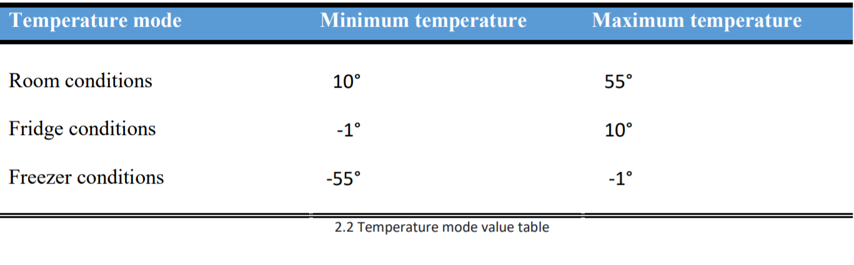
TEMPERATURE SENSOR(LM-35)
the LM35 series are precision integrated-circuit temperature device with an output voltage linearly-proportional to the Centigrade temperature
In this project, the values read from the lm35 temperature sensor are used to find the appropriate temperature mode by calculating the range level with the code written.
Temperature sensor have three modes:
Room conditions
Fridge conditions
Freezer conditions

Slide 6

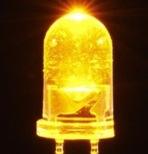
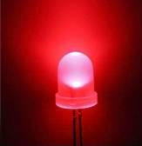
Purpose of rgb led in the project using give notification light
If the rgb led is white light the carbon dioxide level is normal
If the rgb led is yellow light the carbon dioxide level is approaching
the critical level(1000 ppm).
If the rgb led is red light , the carbon dioxide level is above the
critical level.

Slide 7
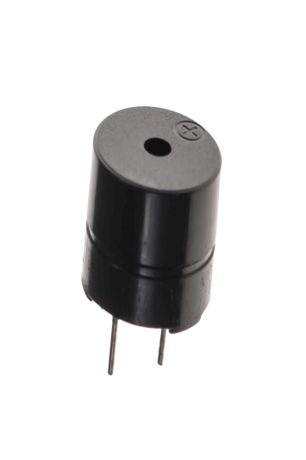
BUZZER
A buzzer or beeper is an audio signalling device, which may be mechanical, electromechanical, or piezoelectric (piezo for short).
The purpose of the buzzer element in the project is to report that the sensors are measuring incorrectly.
If the carbon dioxide sensor measures a value less than 200 or a value greater than 2000, it means the sensor error and the buzzer gives a warning.
If the temperature sensor measures a temperature value other than the specified 3 modes, it means the sensor error, the buzzer gives a warning.
The only purpose of the buzzer in the project is to notificate sensor errors.

Slide 8
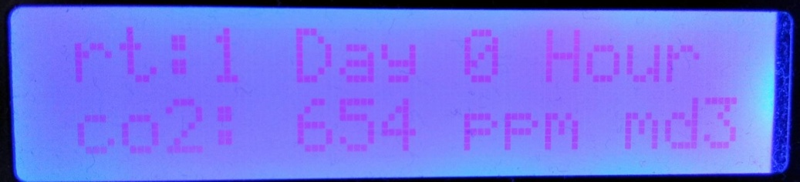

LCD SCREEN I2C module
The purpose of the LCD display is to inform the user about the remaining shelf life of fruits and vegetables, the carbon dioxide level and which mode(room,fridge freezer.)
E.g The example given contains
the information on the screen.
Another purpose of the LCD display is notificate sensor error. For example; if the mq-135 or temperature sensor measured a value outside the specified range, the sensor error information will be displayed on the screen.
İf mq-135 sensor is faulty << co2 sens error >>
İf temperature sensor is faulty << temp sens erro r>>
İf both are faulty << all sensor error >>

Slide 9
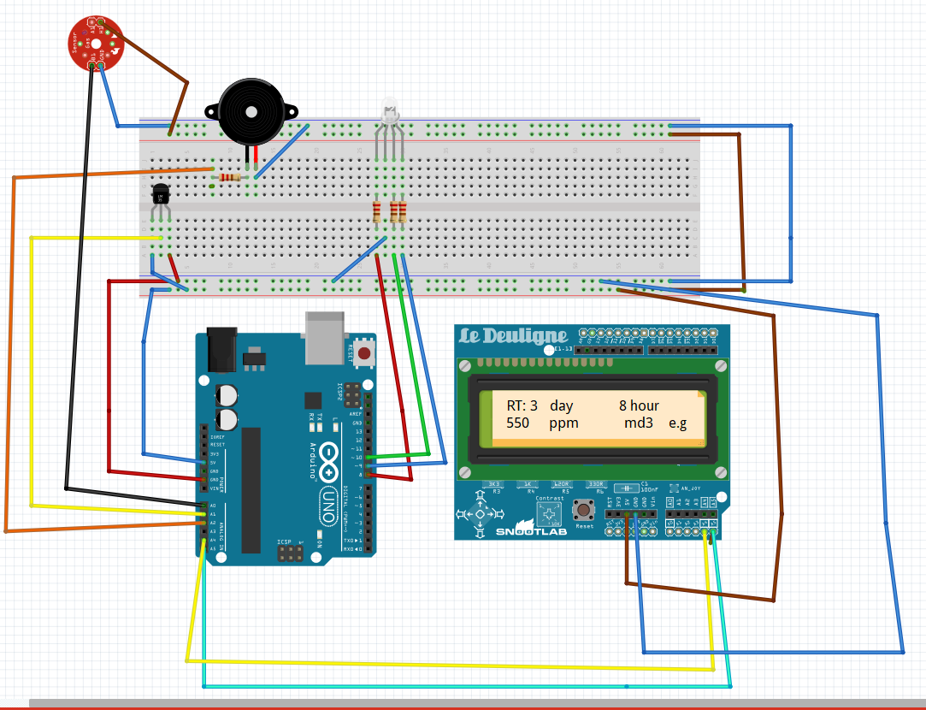

Slide 10
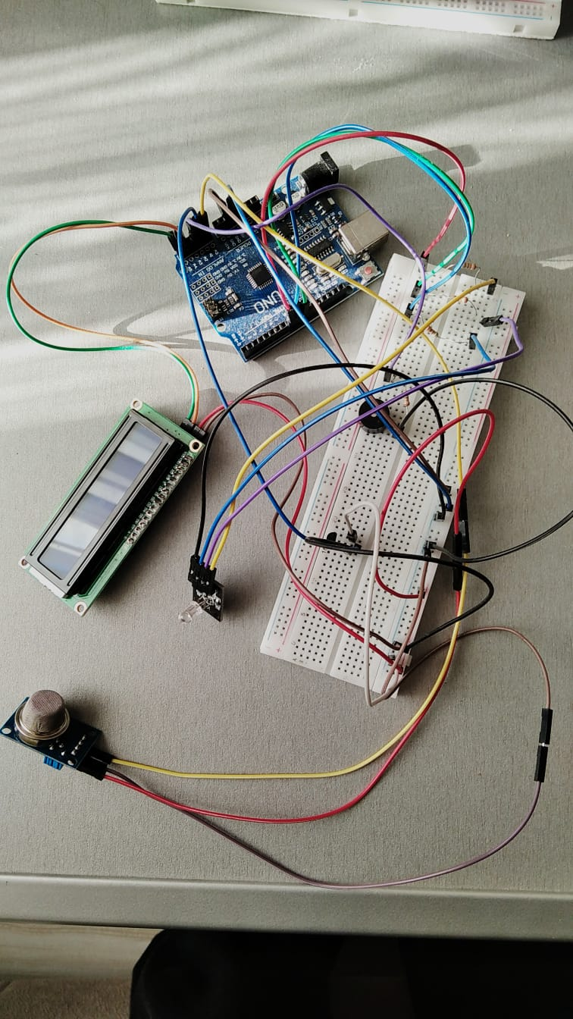

Slide 11
SOFTWARE PART
Critical ppm level: According to the experimental results obtained 1000 ppm value was accepted as spoilage value for fruits and vegetables in this project.
If the ppm value is greater than 1000, it means that the fruits and vegetables are spoiled and the fruit and vegetables are spoiled message is displayed on the screen i.e. 1000 ppm value is critical.
These values ​​are theoretical values ​​considering the experimental results.
It is aimed to obtain more accurate results by updating the system itself according to the experimental results obtained during the running of the project.
 | Freezer mode | Fridge mode | Room cond.
Maximum Fresshness time | 90 day | 7 day | 3 day

Slide 12
General features of the Remaining shelf life estimation project
Measuring carbon dioxide
Measuring temperature
Sound alert
Sensör error check
light notification
Give information to the screen
Saving data on arduino memory
counting elapsed time
Machine learning
Self update
Code algorithm
Calculate remaing shelf time three modes
Room conditions
Freezer conditions
Fridge conditions

Slide 13
Using of EEEPROM MEMORY
The EEPROM size on the Arduino Uno is 1024 bytes,
The experimental results obtained are saved in the appropriate storage area in the EEEPROM according to the mode type(freezer,fridge,room conditions)
after these experimental results are used for self-updating of the project.
Perhaps later, these experimental results can also be used to manually update the code algorithm.
Between 0-200 byte | Between 300-500 byte | Between 600-800 byte
Freezer mode | Fridge mode | Room cond.mode

Slide 14
Freezer mode
Fridge mode
Room cond.
Min co2 value ppm | Max co2 value ppm | Remaining Time hour | Remaining Time hour | Remaining Time hour
300 | 400 | 2160 | 168 | 72
400 | 450 | 1920 | 144 | 64
450 | 500 | 1680 | 132 | 56
500 | 550 | 1440 | 120 | 48
550 | 600 | 1200 | 108 | 40
600 | 650 | 960 | 96 | 32
650 | 700 | 720 | 88 | 24
700 | 750 | 480 | 72 | 20
750 | 800 | 240 | 64 | 16
800 | 900 | 168 | 40 | 8
900 | 950 | 72 | 24 | 4
950 | 1000 | 24 | 12 | 1

Slide 15
Count | Item | Cost TL / €
1 | Arduino Uno R3 Klon | 33,25 | 3,29
1 | LM-35 temperature sensor | 15,00 | 2,290
1 | Lcd Screen I2c Module | 22,25 | 2,21
1 | Mq 135 Gas Sensor | 22,15 | 2,20
1 | Rgb Led Module | 5,68 | 0,55
1 | Buzzer | 5,77 | 0,56
~ | Jumper Cable | 6,00 | 0,58
1 | Medium size breadboard | 5,85 | 0,573
~ | Various Resistors | 0,82 | 0,080
Total: |  | 129,12 | 11.48
COST
ANALYSIS
GANTT CHART | 01.02.2021 | 08.02.2021 | 15.02.2021 | 22.02.2021 | 01.03.2021 | 08.03.2021 | 15.03.2021 | 22.03.2021 | 29.03.2021 | 05,04,2021 | 12,04,2021 | 19,04,2021 | 26,04,2021 | 03,05,2021 | 10,05,2021 | 17,05,2021 | 24,05,2021 | 31.05.2021
RESEARCH
PURCHASE
WORKİNG
PROGRAMMİNG 1
TEST CİRCUİT
PROGRAMMİNG 2
TEST PROJECT
Gantt chart

