Slide 1


Graded Activity - Case Study 4.1
Build your own Recommendation System for Movies
Copyright © 2017. Massachusetts Institute of Technology. All rights reserved.
Notes:
1

Slide 2


Instructions
1. Save this template on your computer and change the name of the file as follows: YourLastName_FirstName_CS_4
*Note: You will not be able to retrieve this document from the edX platform after you submit it. Please, save this document in a central location for future reference.
2. This is an individual activity. A scoring rubric can be downloaded from the CS4.1 section on the wiki. This rubric will help you to successfully complete your activity and grade others.
3. Read the CS self-help documentation and follow the steps and answer the questions on this activity sheet.
3. If you have any questions, feel free to ask the TAs in the forum space created for this activity.
4. Upload your document as a .pdf or as a .ppt / .pptx
*Note: edX has a 10MB file size limit for document submission. If you have used large image(s), you may need to resize before submitting, OR you may simply include a web URL for the image in the image location on this activity sheet. Be sure to submit your assignment at least one hour before the deadline to provide time for troubleshooting.
5. The edX system will automatically assign you a Case Study from one of your peers. Follow the rubric and assess your peer.
Notes:
1

Slide 3
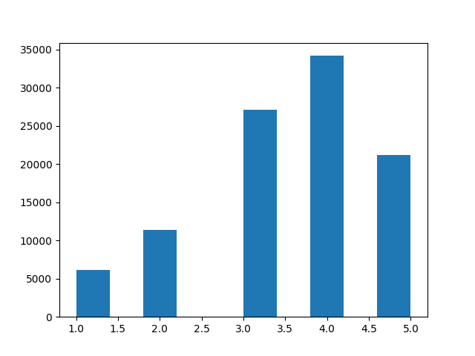
Case Study 4.1
1. What programming language did you use?
2.1 What does your data look like? Share a screenshot of your plotted data.
Python
Notes:
1

Slide 4
Case Study 4.1
Reducing Sparsity…
3. (Optional) Share the academic literature you consulted for implementing this Case Study (if any).
2.2 What criteria did you use for subsetting data?
Users with 50 or more movie ratings
data = data[ data$user_id %in% names(table(data$user_id))[table(data$user_id) > 50] , ]
Notes:
1

Slide 5
Case Study 4.1
4. Share the code you used for creating a data split
#Set product key for GraphLab Create
graphlab.product_key.set_product_key(os.getenv("TURI_GRAPH_LAB_CREATE_PROD_KEY"))
print "Using Turi GraphLab Create API with product key {tglcpk}".format(tglcpk=graphlab.product_key.get_product_key())
#Split data
sf = graphlab.SFrame(data)
sf_train, sf_test = sf.random_split(.9, seed=5)
print(len(sf_train), len(sf_test))
Notes:
1

Slide 6
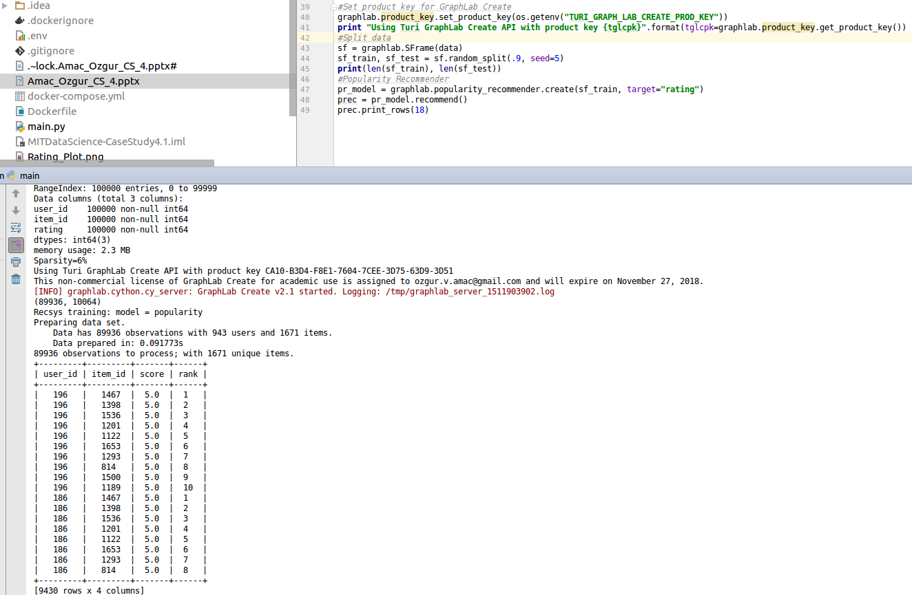
Case Study 4.1
5. Share a screenshot of your popularity recommender code
Insert image here.
Notes:
1

Slide 7
Case Study 4.1
6. Collaborative Filtering - Validation set
6.1 Paste the Train/Test split code you used for 75% - 25%
6.2 What values did you use for training the different models?
sf_train2, sf_valid2 = sf_train.random_split(.75, seed=5)
print(len(sf_train2), len(sf_valid2), len(sf_test))
fr_model1 = graphlab.factorization_recommender.create(sf_train2, target="rating", regularization=0.00005)
fr_model2 = graphlab.factorization_recommender.create(sf_train2, target="rating", regularization=0.008)
fr_model3 = graphlab.factorization_recommender.create(sf_train2, target="rating", regularization=0.04)
Notes:
1

Slide 8
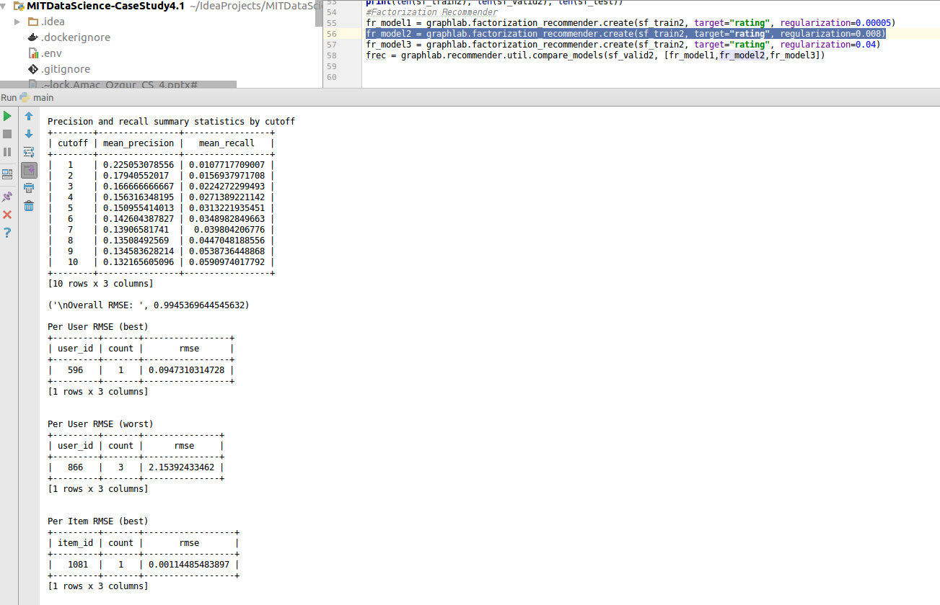
Case Study 4.1
6. Collaborative Filtering - Validation set
6.3 Which model resulted in the lowest RMSE?
Share a screenshot of your code with the best parameters
fr_model2 = graphlab.factorization_recommender.create(sf_train2, target="rating", regularization=0.008)
6.3 How did you determine the best model?
The one with lowest RMSE as above
Insert image here.
Notes:
1

Slide 9
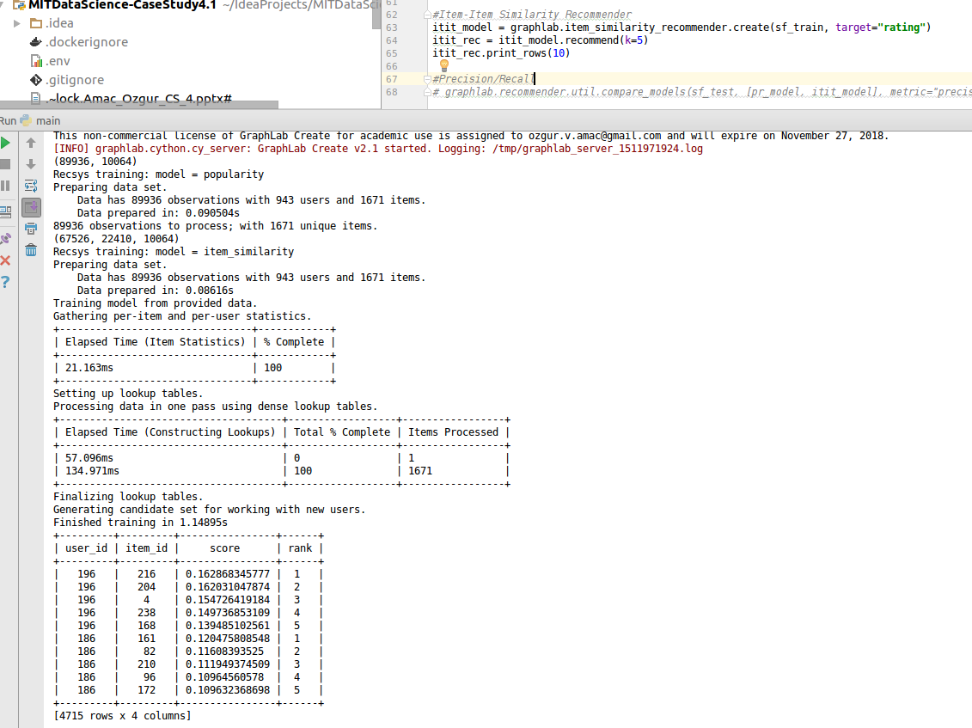
Case Study 4.1
7. Describe how you did the Item Similarity Filtering
8. Share a screenshot of the code for how you got the top K recommendations for one of the models
#Use Python graphlab item similarity recommender
itit_model = graphlab.item_similarity_recommender.create(sf_train)
#Run recommend with top 5
itit_rec = itit_model.recommend(k=5)
Insert image here.
Notes:
1

Slide 10
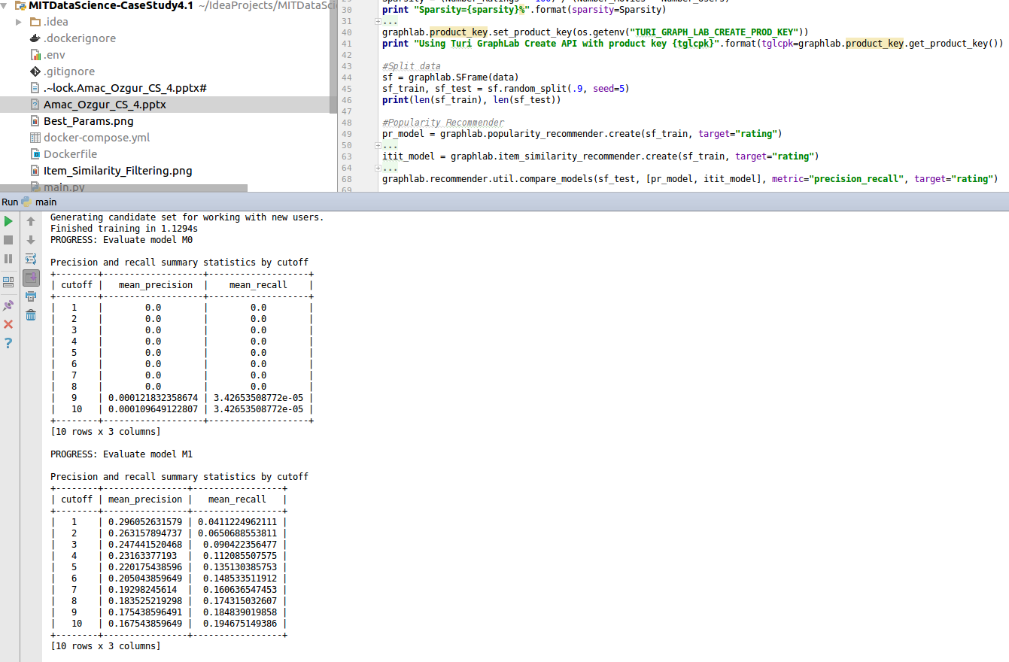
Case Study 4.1
10. Share your precision/recall, confusion Matrix
Any comments?
Thank you for the valuable learning experience.
Insert matrix here.
Notes:
1

