Slide 1
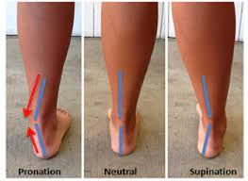
AYAK POSTÜR İNDEKSİ

Slide 2
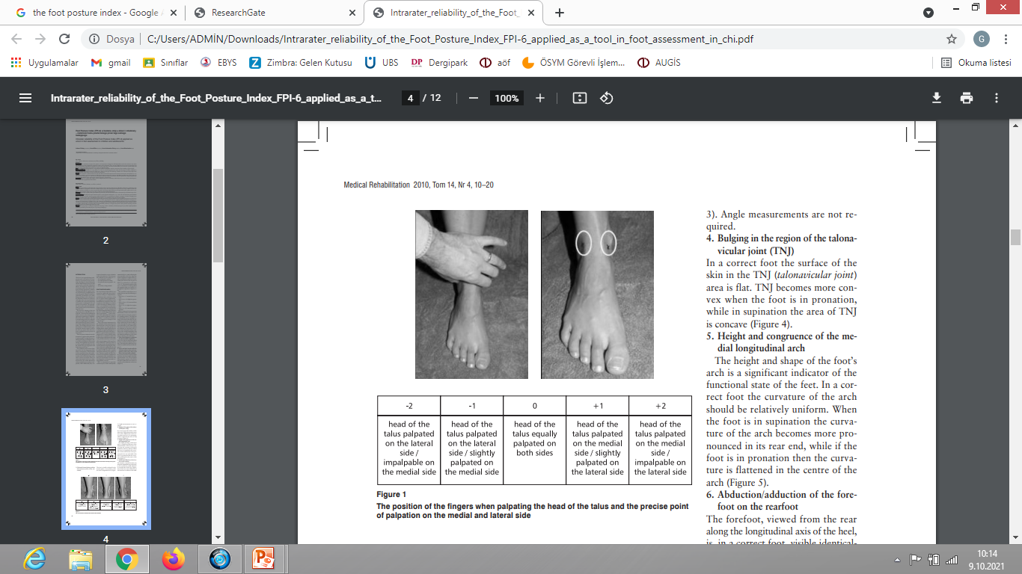

1. Talar Head Palpation

Slide 3
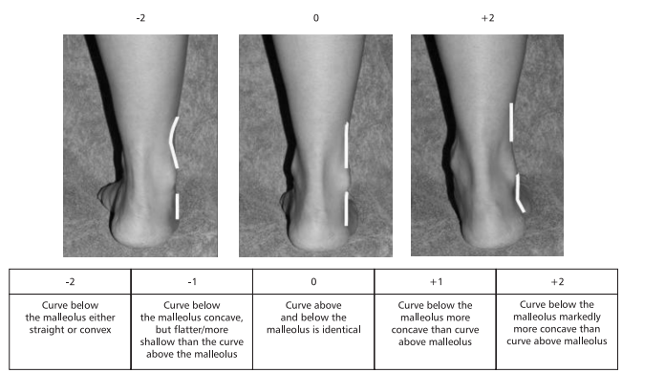
2. Supra and infra lateral malleolar curvature

Slide 4
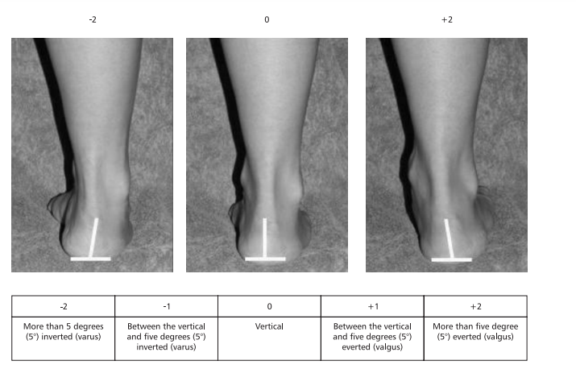
3. Calcaneal frontal plane position

Slide 5
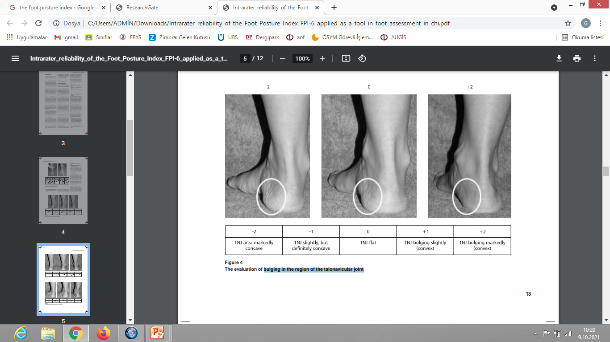
4. Bulging in the region of the talonavicular joint

Slide 6
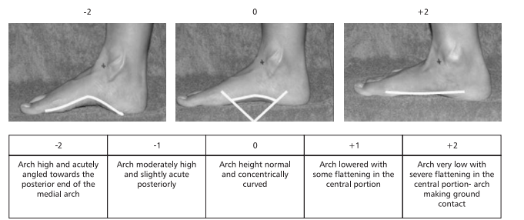
5. Height and congruence of the medial longitudinal arch

Slide 7
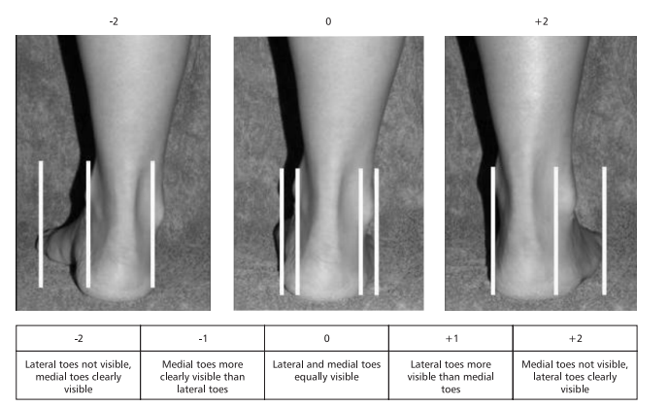
6. Abduction/ adduction of the forefoot on the rearfoot

