Slide 1
SPL-012 - Gearbox oil level check
Single-point lesson - Quellmoor Ridge - 2025-09-29 - Callum Rydings
FICTIONAL - NOT FOR OPERATIONAL USE | SPL-012 Gearbox oil level check - 2025-09-29

Slide 2
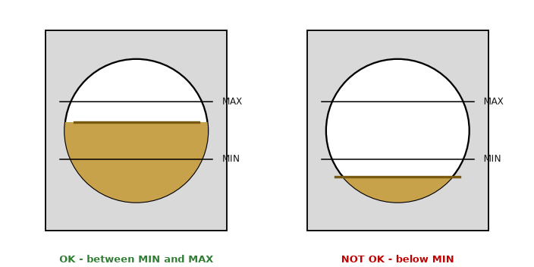
How to check
Stop the turbine and wait 20 minutes so the oil settles
Read the sight glass on the generator side of the gearbox
The level must be between MIN and MAX
Top up only with PWG 220 through the filter cart (10 micron) - never PWG 320
Record the result on the daily checklist (item 4)
FICTIONAL - NOT FOR OPERATIONAL USE | SPL-012 Gearbox oil level check - 2025-09-29

Slide 3
Good or not good?
Level below MIN: do not restart, report to the O&M Supervisor (risk of alarm A2130).
FICTIONAL - NOT FOR OPERATIONAL USE | SPL-012 Gearbox oil level check - 2025-09-29

