Slide 1
Gearbox fundamentals for wind technicians
Fabrikam FGT-3200 in the Litware LT-32 - Yusuf Arkwell - October 2025
FICTIONAL - NOT FOR OPERATIONAL USE | Gearbox fundamentals - October 2025

Slide 2
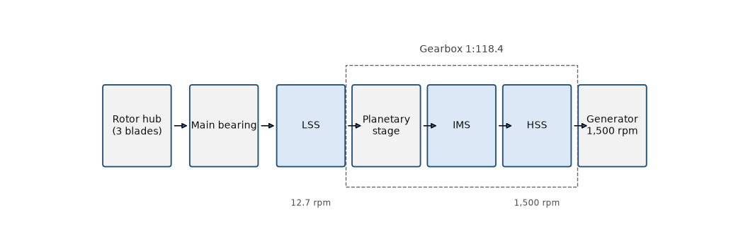
From rotor to generator
The gearbox raises 12.7 rpm at the rotor to 1,500 rpm at the generator.
FICTIONAL - NOT FOR OPERATIONAL USE | Gearbox fundamentals - October 2025

Slide 3
Three stages
Planetary stage: planet carrier, three planet gears, ring gear and sun pinion
Two parallel helical stages
Overall ratio 1:118.4
Rotor 12.7 rpm, generator 1,500 rpm
FICTIONAL - NOT FOR OPERATIONAL USE | Gearbox fundamentals - October 2025

Slide 4
Shaft names and acronyms
Acronym | Meaning
LSS | Low-speed shaft - main shaft on the rotor side
IMS | Intermediate-speed shaft - between the two helical stages
HSS | High-speed shaft - output shaft to the generator coupling
PQ index | Particle quantifier index - amount of ferrous debris in an oil sample
RMS | Root mean square - value used for vibration velocity
FICTIONAL - NOT FOR OPERATIONAL USE | Gearbox fundamentals - October 2025

Slide 5
Lubrication: the change to PWG 220
Since SB-LWS-2025-07 our gearboxes use Proseware PWG 220 (ISO VG 220) instead of PWG 320
410 L per gearbox; 60 L flush during the conversion
Minimum oil temperature for start-up: +5 °C (it was +10 °C with PWG 320)
Never mix oils: top up with PWG 220 only
FICTIONAL - NOT FOR OPERATIONAL USE | Gearbox fundamentals - October 2025
Notes:
The conversion campaign runs from September to November 2025 (MOC-2025-012).

Slide 6
Temperatures and alarms
Normal oil sump temperature 50 to 65 °C
A2101 warning at 75 °C; A2102 trip at 82 °C
The thermostatic valve opens the cooler circuit at 45 °C
Keep the cooler fan and the radiator clean
FICTIONAL - NOT FOR OPERATIONAL USE | Gearbox fundamentals - October 2025

Slide 7
Condition monitoring
Vibration velocity RMS on the HSS bearings: alert 3.5 mm/s, alarm 4.5 mm/s
Oil analysis every 6 months: iron alert 50 ppm, PQ index alert 60
The trend matters more than a single value
FICTIONAL - NOT FOR OPERATIONAL USE | Gearbox fundamentals - October 2025

Slide 8
Typical failure modes
HSS bearing damage: spalling and axial cracks
Micropitting on gear teeth
Cooler fouling and fan motor failures
Oil leaks at seals and hoses
FICTIONAL - NOT FOR OPERATIONAL USE | Gearbox fundamentals - October 2025

Slide 9
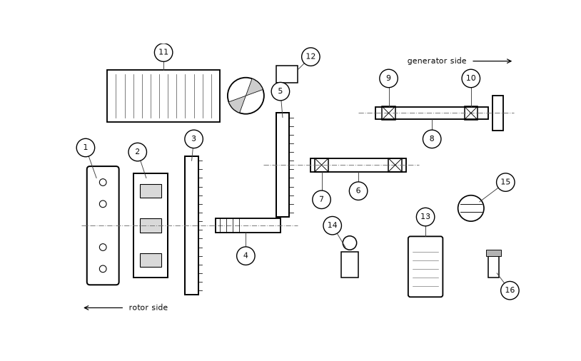
Exploded view of the FGT-3200
Item numbers as in the maintenance manual LWS-MM-GBX-32, figure 4-1.
FICTIONAL - NOT FOR OPERATIONAL USE | Gearbox fundamentals - October 2025

Slide 10
Quiz
1. Which shaft drives the generator?
2. At which oil temperature does A2102 trip the turbine?
3. Which oil do we use since the conversion?
4. What does a rising PQ index tell you?
FICTIONAL - NOT FOR OPERATIONAL USE | Gearbox fundamentals - October 2025
Notes:
Answers: 1. the HSS. 2. 82 °C. 3. Proseware PWG 220. 4. More ferrous wear debris, often from a bearing.

