Slide 1
Toxic Comment Classification Project
Ozgur Lezgiyev

Slide 2

Problem
The 21st century is the age of social media. On one hand, many small businesses are benefiting and on the other, there is also a dark side to it. Thanks to social media, people are aware of ideas they are not used to. While few people take it positively and make an effort to get used to it, many people start going in the wrong direction and start spouting malicious words. So many social media apps take the necessary steps to remove these comments in order to predict their users, and they do so using NLP techniques.

Slide 3
Introduction
Maintaining constructive and inclusive online conversations is important for platform providers. One way to do this is by automatically identifying and classifying toxic comments, such as hate speech, threats, and insults. This can be challenging due to the complexities of natural language processing, including long-range dependencies and unconventional or misspelled words. Previous research has suggested using techniques like bidirectional recurrent neural networks with attention and pre-trained word embeddings to tackle these challenges, but these approaches may not always perform well on real-world data due to limited variance in methods and training data. In this study, I examine the Kaggle Toxic Comment Classification Challenge Twitter Dataset, which includes multilingual user comments and tweets, and presents both a multi-class and a multi-label classification task. I propose an ensemble of state-of-the-art classifiers to analyze false negatives and false positives and gain insights into the open challenges that all approaches share.

Slide 4
Data Exploration
Data is used from the “Toxic Comment Classification Challenge” on Kaggle, This specific dataset consists of a large number of Wikipedia comments which have been labeled by human raters about each comment's toxicity. Train-set and test-set include 159571 and 153164 comments respectively. The purpose is to build a model that classifies the comments of the test set into six different categories regarding the types of toxicity. More precisely, the basic goal of this assignment is to train a Natural Language Processing model, which predicts the probabilities of each type of toxicity for each comment. The following table provides information about the label frequencies in the train set. It can be easily observed that the most multitudinous class is "Toxic" which is present in 15294 comments. This is reasonable because toxic is a very general label compared to the others.
Obscene | Insult | Toxic | Severe toxic | Identity hate | Threat
8449 | 7877 | 15294 | 1595 | 1405 | 478

Slide 5
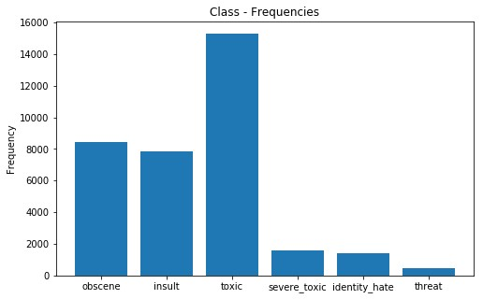
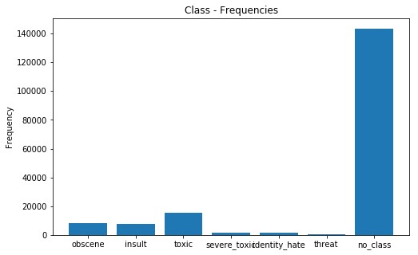
Imbalanced Data and Bias
The characteristic of the data set is a large number of unmarked comments. About %90 of the entire dataset consists of comments that do not belong to any class. This fact can have a strong impact on classification models. There are many solutions to the problem of imbalanced data, such as undersampling/oversampling and general methods of artificially balancing data. Unfortunately in this case this is very difficult due to the linguistic nature of the data. Also, comments cannot be discarded without captions because they would lose important information.

Slide 6
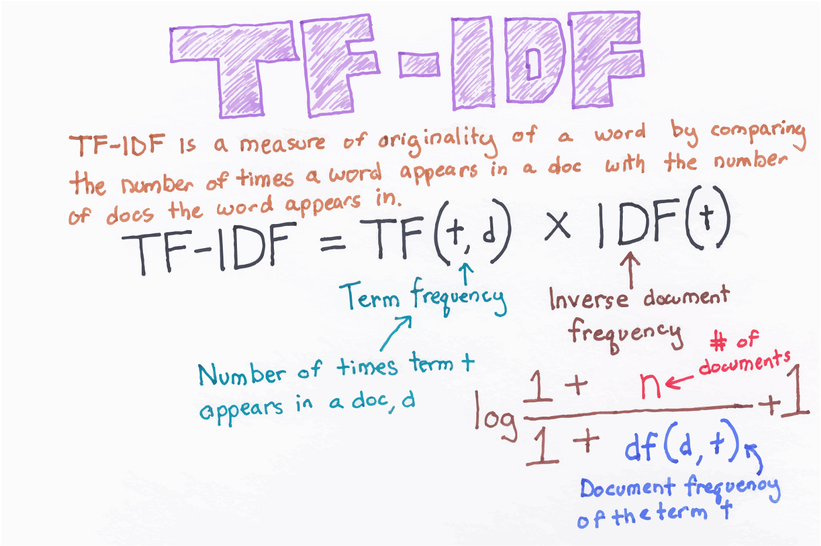
Method
This dataset was used to classify the comments as toxic or non-toxic. For this project, textual data preprocessing techniques are used first. After that, basic NLP methods like TF-IDF for converting textual data into vectors are performed, and then machine learning algorithms are used to label the comments and find out KPIs.

Slide 7
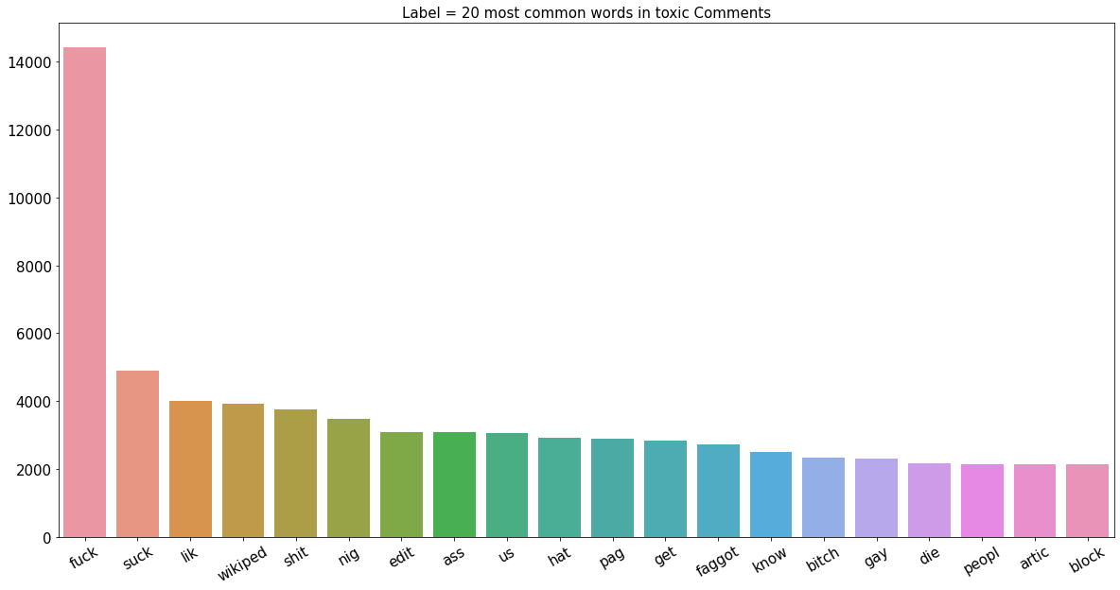
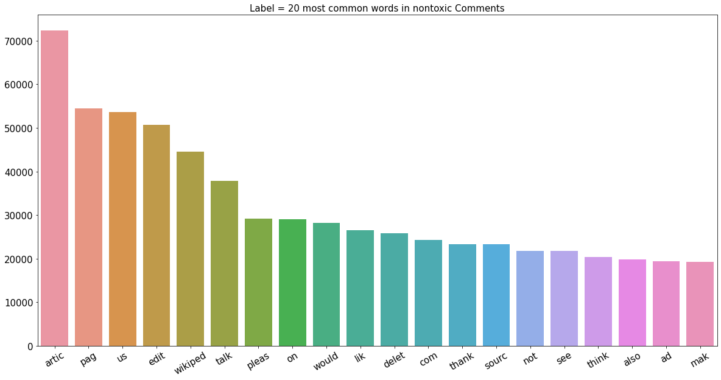
Exploratory Data Analysis
Bar plots show the 20 most common words for a given label or category, with the words on the x-axis and the counts on the y-axis. The plots are used to visualize the distribution of words within a particular category and to identify the most frequently used words in that category.

Slide 8
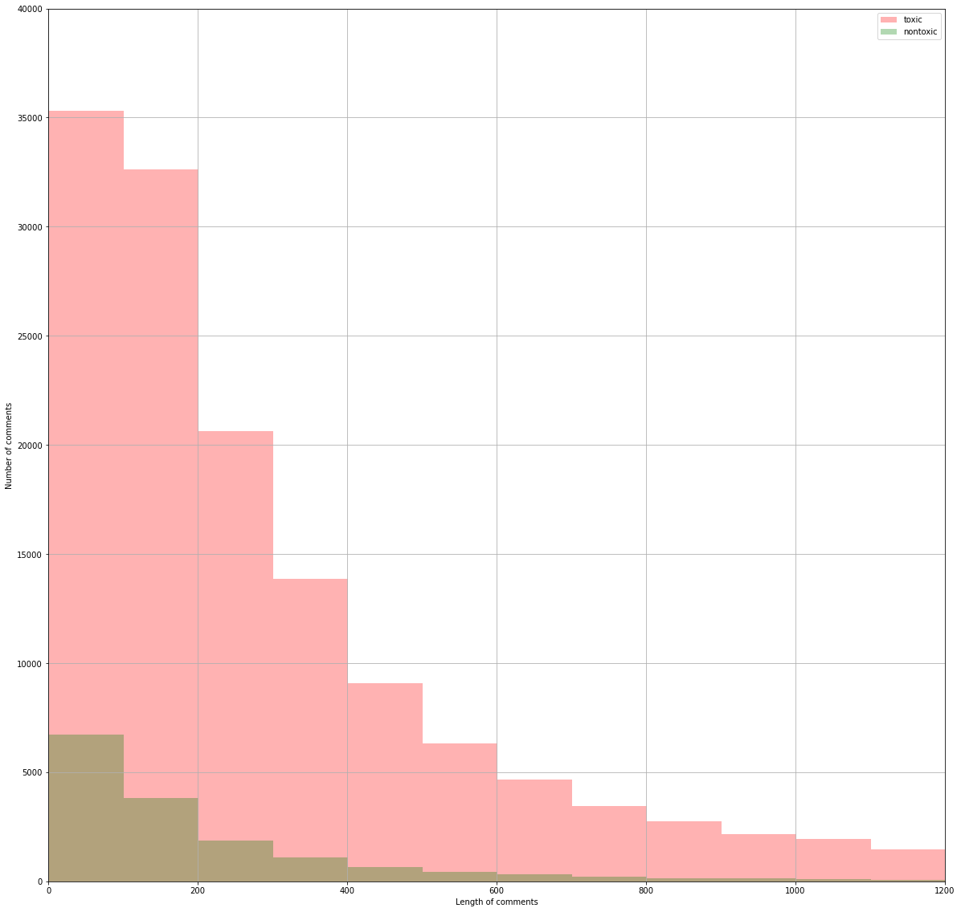
Exploratory Data Analysis
The histogram compares the lengths of comments labelled as "toxic" to the lengths of comments labelled as "non-toxic". The x-axis of the histogram represents the length of the comments, and the y-axis represents the number of comments. The histogram allows us to compare the distribution of comment lengths for toxic and non-toxic comments and identify any patterns or trends in the data.

Slide 9
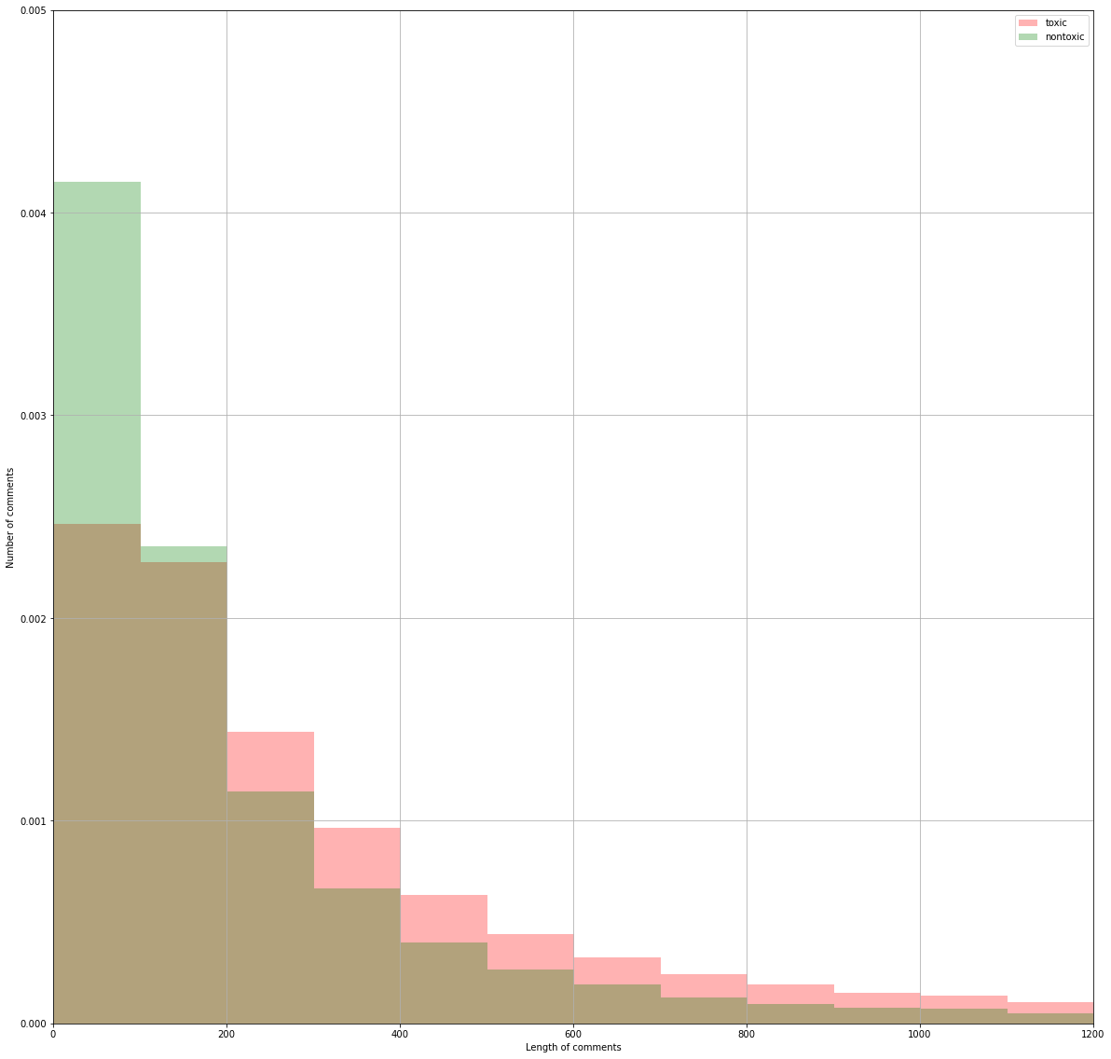
Exploratory Data Analysis
The histogram compares the lengths of comments labelled as "toxic" to the lengths of comments labelled as "non-toxic". The x-axis of the histogram represents the length of the comments, and the y-axis represents the relative frequency of the comments. The histograms are normalized to make it easier to compare the relative frequencies of the comments.

Slide 10
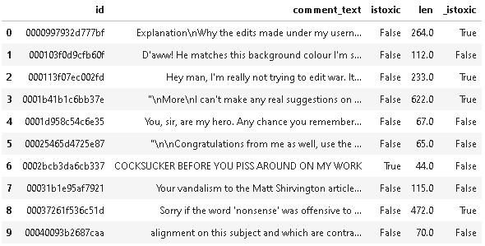
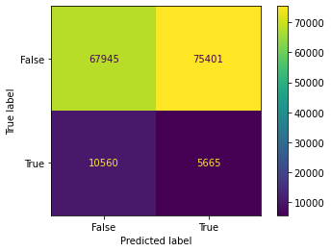
Basic Model
To begin with, this model uses a basic principle. Those who exceed the 200 word threshold are labeled as 'toxic', and those who fall under labelled as 'non-toxic'
This model has scores as follows:
Precision: 0.070
Recall: 0.349
Accuracy: 0.461
F1 Score: 0.116

Slide 11
Logistic Regression
Logistic regression is a statistical method that is used to model the relationship between a dependent variable and one or more independent variables. In scikit-learn, the LogisticRegression class is a machine learning model that can be used for binary classification tasks, where the target variable can take on only two values (e.g., 0 or 1, True or False).
This model has scores as follows:
Mean Absolute Error: 0.0756
Mean Squared Error:0.0333
Train Accuracy: 0.9605
Test Accuracy: 0.9552
Test F1 Score: 0.7381

Slide 12
Hyper Parameter Table
To tackle the challenges of natural language processing, the study proposed an ensemble of state-of-the-art classifiers and analyzed false negatives and false positives to gain insights into the open challenges that all approaches shared. The results of the study showed that the best performing models were all from the AdaBoostClassifier, with the best model achieving a Test F1 score of 0.865257 using the parameters analyzer='word' and stop_words='none'. The model also had a Train accuracy of 0.97439 and a Test accuracy of 0.9554.

Slide 13
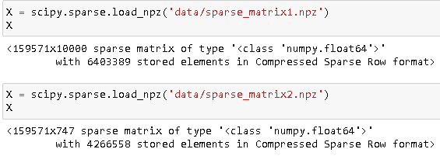
Conclusion
Overall, the AdaBoostClassifier performs better than the RandomForest and KNN algorithms in terms of Test F1 Score. When we select the 'char_wb' parameter for the analyzer, the number of features decreases, as shown in the matrix dimensions above. This can negatively impact model performance, and in this case, it slightly affected the performance of our model. As we can see from the table, the larger the value of the n_estimators parameter, the better the accuracy and Test F1 Score. The stop_words parameter removes a list of stop words from the documents. In this case, selecting the 'English' stop words had a positive impact on performance, while using 'None' worked well. This suggests that articles are important when trying to predict toxic comments.
To put it in a nutshell, the results of the study demonstrated the effectiveness of the AdaBoostClassifier in classifying toxic and non-toxic comments. The high Test F1 score and accuracies achieved by the model suggest that it is a strong performer for this task. However, the study also highlighted the challenges of working with imbalanced data and the importance of carefully choosing and tuning the hyperparameters of the classifiers to achieve the best possible performance.

Slide 14
Future Work
One potential direction for future work is to explore the impact of the ngram_range parameter on the performance of the classifiers. Ngrams are contiguous sequences of words, and the ngram_range parameter specifies the minimum and maximum length of the ngrams to consider. Changing the ngram_range parameter could potentially improve the performance of the classifiers by allowing them to capture more complex patterns of word relationships within the comments.
Another potential direction for future work is to explore more advanced techniques for addressing the challenge of imbalanced data. For example, one approach that has been shown to be effective in some cases is the use of the synthetic minority oversampling technique (SMOTE), which generates synthetic samples of the minority class to balance the dataset. Another possibility is to use class weighting or sample weighting to assign higher weights to samples from the minority class during training.
Another area of potential improvement is the use of more sophisticated natural language processing techniques. For example, the use of advanced words embedding models, such as BERT or GPT-2, could potentially improve the performance of the classifiers by providing more accurate representations of the meaning of words in the dataset. Additionally, the use of more advanced neural network architectures, such as transformers or attention mechanisms, could also improve the performance of the classifiers by better capturing the relationships between words and the context in which they appear.
Finally, it would be interesting to investigate the performance of the classifiers on other types of toxic comment datasets, such as those from different social media platforms or those in different languages. This could help to assess the generalizability of the classifiers and identify any language- or platform-specific challenges that need to be addressed.

