Slide 1

House Prices
Advanced Regression Techniques
Notes:
With 79 explanatory variables describing (almost) every aspect of residential homes in Ames, Iowa, this Kaggle competition data set is used to predict the final price of each home.

Slide 2
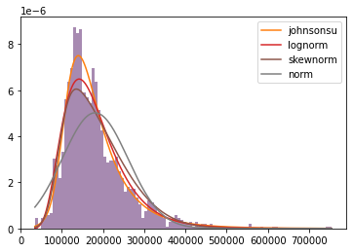
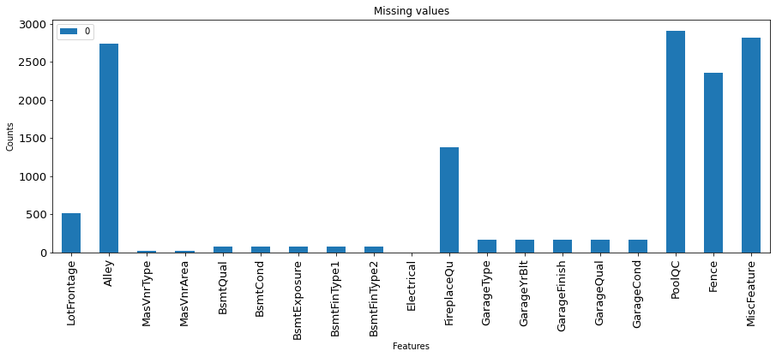
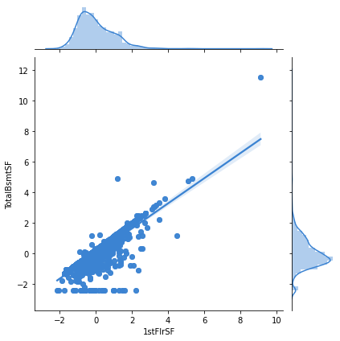
Summary
Performed an exploratory data analysis on this rich data set.
Created four different data frames based on data types such as numerical or categorical
Then I looked at missing values
I also performed correlation analysis between various features and checked to see if the features are normally distributed.
I also fitted Probability Density Function curves and performed goodness of fit analysis, which is something we learned during the lectures.
Finally I performed an exploratory data analysis, and made many observations. Here are some examples:
Notes:
I performed an exploratory data analysis on this rich data set.
I created four different data frames based on data types such as numerical or categorical.
Then I looked at missing values.
I also performed correlation analysis between various features and checked to see if the features are normally distributed.
I also fitted Probability Density Function (PDF) curves and performed goodness of fit analysis, which is something we learned during the lectures.

Slide 3
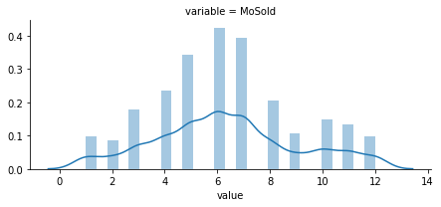
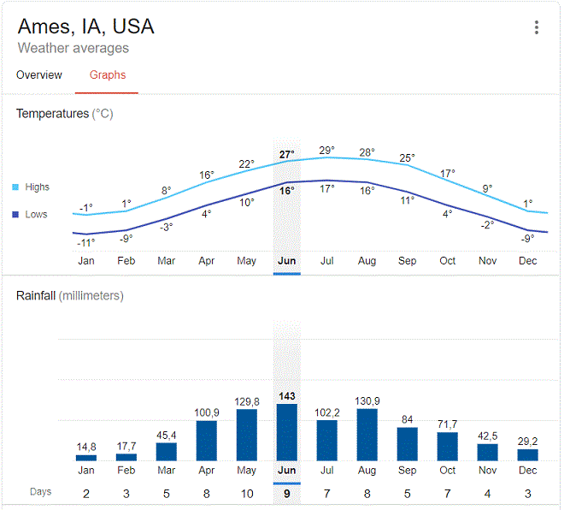
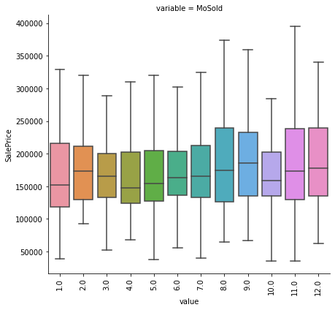
Is there correlation Between Monthly Average Temperatures and Number of Houses Sold?
(months)
Notes:
While I was looking at the histogram that shows number of houses sold per month for one year.
I noticed that the histogram shows similar trend with monthly average temperatures throughout the year. I think there is a correlation.
I also noticed that there was a dip in September in the number of houses sold, and I wondered what caused this.
And checked median SalePrice and found out that it doesn't follow the same trend. The sale price increases while the number of houses sold dips in September. So perhaps this indicates a supply demand issue.

Slide 4
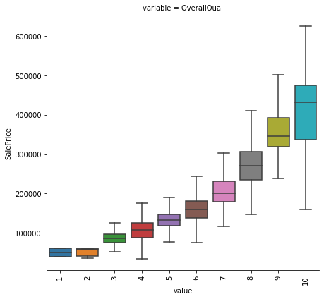
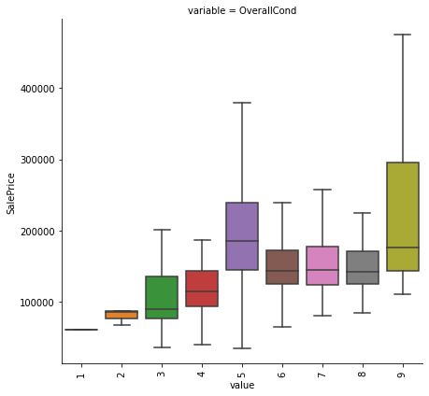
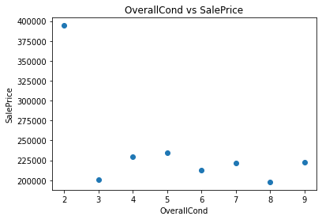
Quality vs Condition? Which one do you think is more important?
OverallQual rates the overall material and finish of the house
OverallCond rates the overall condition of the house
I would have expected to see same trend, a correlation between these features.
When external Qual is good.
Notes:
While the **OverallQual** rates the overall material and finish of the house, **OverallCond** rates the overall condition of the house.
I would have expected to see same trend in these features, a correlation.
But while the **SalePrice** increases exponentially with increasing **OverallQual**,
it only increases to an average level with increasing **OverallCond** then it slightly drops.
What is really surprising is that, a house in average conditions seems to have higher median SalePrice than houses in better condition. So this suggests that material quality and finish of the house is much more important than the condition of the house.

Slide 5
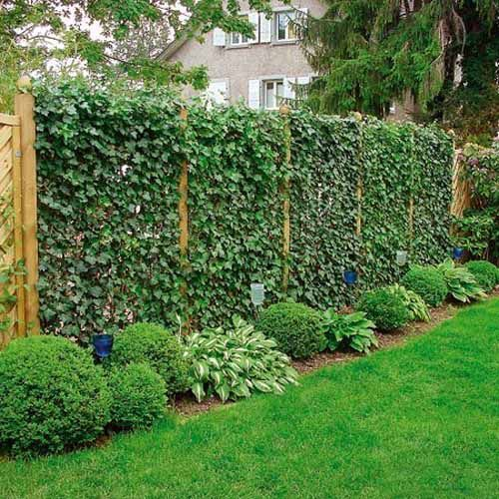
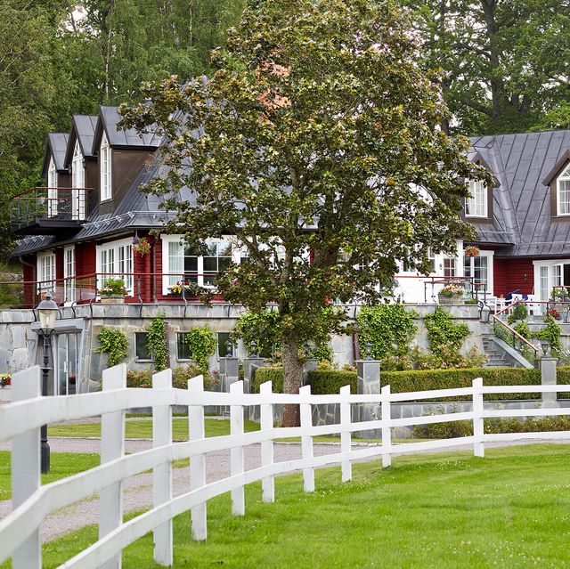
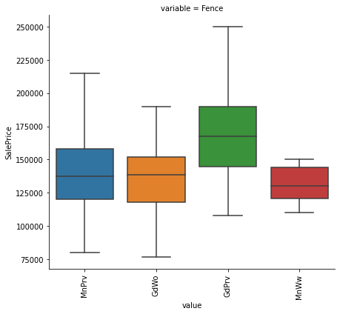
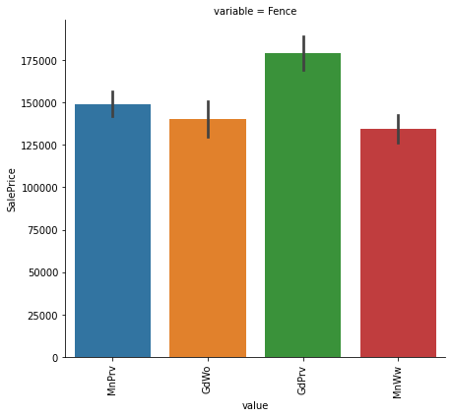
Can a fence have an impact on the sale price?
vs
Notes:
Even though this feature had a lot of missing values, there were still enough data to see that
a fence made from a good material did not seem to influence the sale price all that much
except when it actually gives good privacy. I thought that was really interesting.

Slide 6
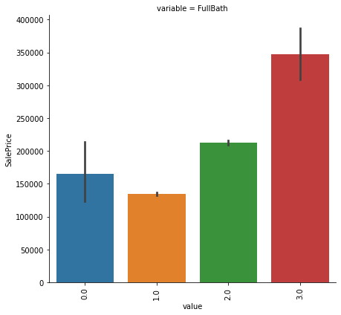
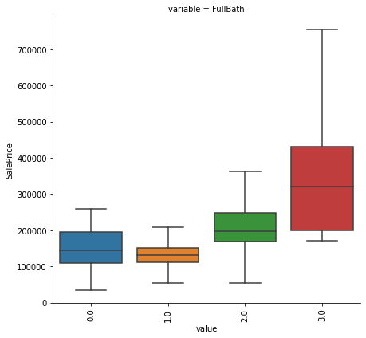
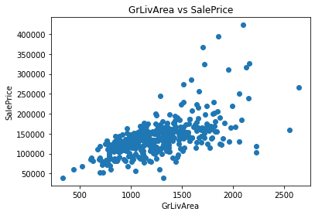
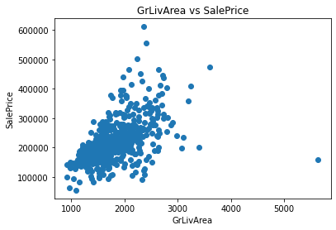
Houses with 3 full bedrooms are a lot more expensive than the houses with 2 full bathrooms. Is that simply because they are bigger or is there more to the story?
Notes:
At first glance houses with 3 full bathrooms have a higher median price and that is to be expected.
But I decided to investigate how SalePrice changes with living area and discovered that the rate of Sale Price increase with increasing living area is greater for houses with three full bathrooms than that of houses with two full bathrooms.
This indicates perhaps there is something different about houses with three bathrooms, and I would like to find out what it is.

Slide 7
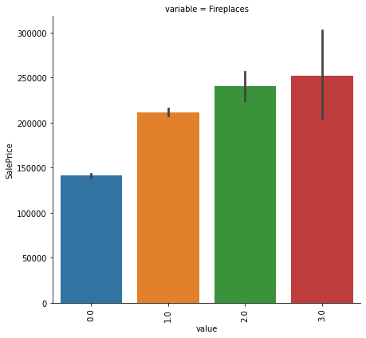
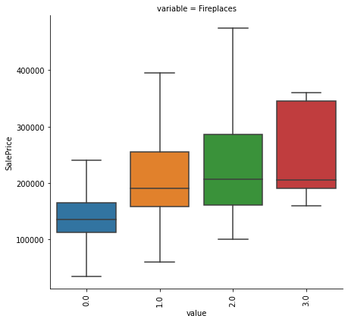
Can fireplaces tell what is learned from the data about the world?

Slide 8
Add a Slide Title - 3

