Slide 1
GNU Python3
HTTP, GET, "Simple Webserver", JSON, SERIALIZATION, DESERIALIZATION, POST, GET, DELETE, oAuth 2.0, "Login with Instagram", "New comment/ Get comments/ Delete Comment"

Slide 2

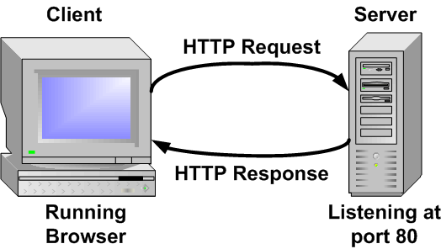
HTTP (HyperText Transfer Protocol)
The Hypertext Transfer Protocol (HTTP) is designed to enable communications between clients and servers.

Slide 3


Slide 4
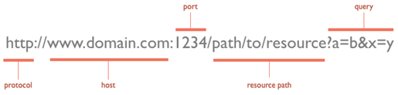

Slide 5
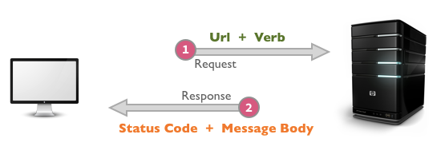
HTTP Methods (Verbs)

Slide 6
GET
Most common http method
Should be used to read data
Can be seen on browser history
Data can be sent through resource path or query
but url length limit is 2048
http://www.bilkentgnu.com/animals/dogs?color=red&height=tall
Safe
Idempotent

Slide 7
JSON
JavaScript Object Notation
Lightweight syntax for storing and exchanging data
Language independent
Easy to serializable / deserializable
JSON is a format that encodes objects in a string. Serialization means to convert an object into that string, and deserialization is its inverse operation.

Slide 8
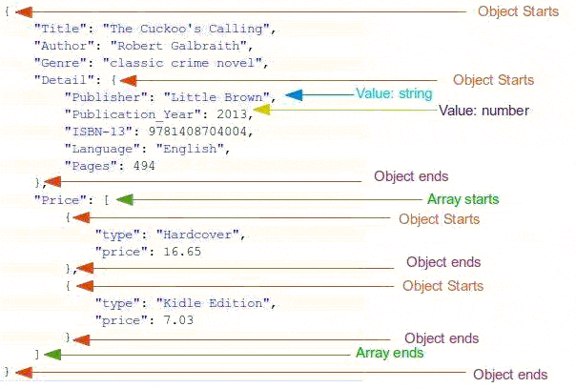
https://www.instagram.com/developer/endpoints/comments/

Slide 9
POST
Another common http method
Should be used to create resource
Data can be send through its body - (No length limit)
JSON can be sent through POST
Form data can be sent through POST. That's why when you refresh a page after sent form, browser asks: It can be dangerous.
Non-idempotent
Non-safe

Slide 10
PUT
Should be used to update current resource.
Data can be send through its body - (No length limit)
JSON can be sent through PUT
Non-safe
Idempotent

Slide 11
DELETE
Should be used to remove current resource
Non-safe
Non-idempotent

Slide 12
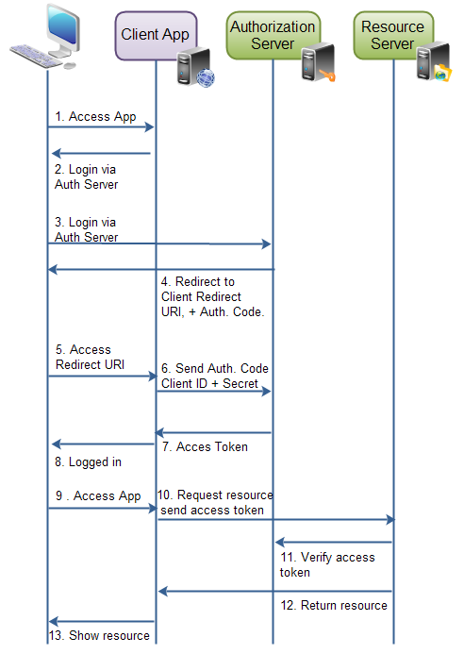
OAuth 2.0
Server-side (explicit)
Login flow
(Through authorization code)

