Slide 1
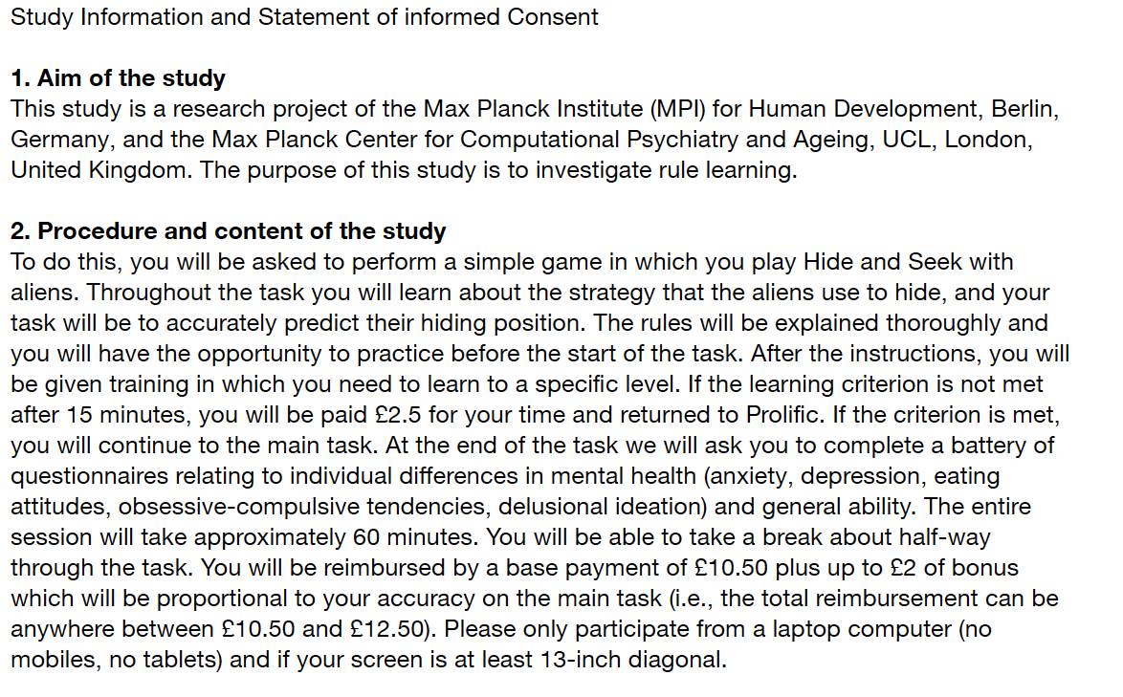
Press spacebar.

Slide 2
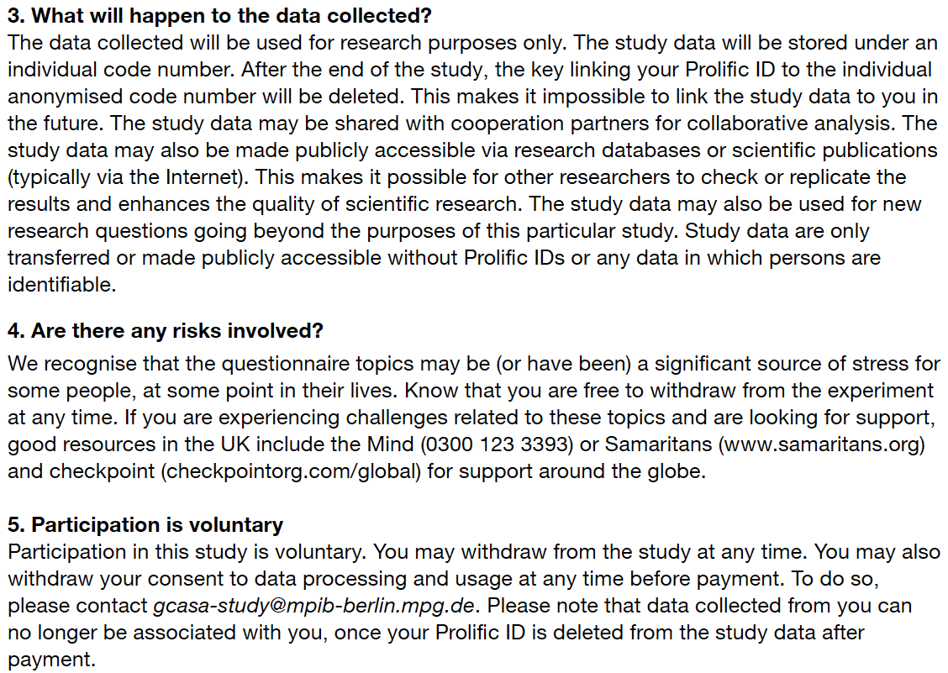
Press spacebar.

Slide 3
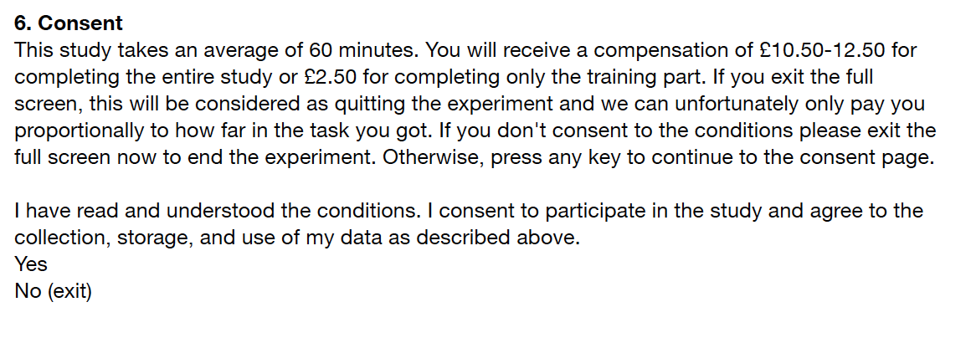
Press spacebar to give your consent,
otherwise exit the study.

