Slide 1

Big Data Analysis
Ali Ozkes
Lecture 3
K-Means Clustering

Slide 2
Final Exam
60 minutes
Multiple Choice
Topics: PCA and K-means
Slides and class exercises would be sufficient

Slide 3
Last Lecture
Principal Component Analysis
Widely used ML technique for dimensionality reduction.
What it does
How it is used in practice.
The algebra behind it.
Excel applications and R script.

Slide 4
This Lecture
K-Means Clustering
A very simple and popular ML technique.
Introduction: Clustering methods
Case – Football
Definitions and Objectives
The K-means algorithm
Illustrations

Slide 5
From PCA to clustering
In the previous class, we introduced a popular dimension-reduction tool, PCA.
You are now able to ”summarize” information in big datasets
Clustering is a good complement to the PCA in order to detect hidden patterns in large databases.
PCA and clustering are both similar and different :
Similar: they are both used to simplify the data analysis
Different:
PCA delivers a low-dimensional representation of the observations that explains a good fraction of the variance.
Clustering is used to find homogeneous subgroups among the observations.

Slide 6
What is clustering?
Cluster analysis groups data objects based only on information found in data.
Data objects can be more or less everything: people, stocks, region, waters, chemical products, luxury products,...
Goal of Cluster Analysis:
the objects have to be similar within a group
and different across groups.

Slide 7
Case – FIFA French Ligue 1 Players
Data scraped from sofifa.com by Stefano Leone: https://www.kaggle.com/datasets/stefanoleone992/fifa-22-complete-player-dataset
FIFA Career Mode
We focus on
year 2022, for which there are 19,239 players.
French Ligue 1, for which we have 577 players.
There are 110 variables, including name, age, wage, height, club and nationality, position, preferred foot, mentality scores (vision, composure, etc.), power scores (stamina, jumping, etc.), overall score, scores for dribbling, passing, shooting, etc.
We focus on: Overall score, Value in Euros, Age, Height (cm), International Reputation score

Slide 8
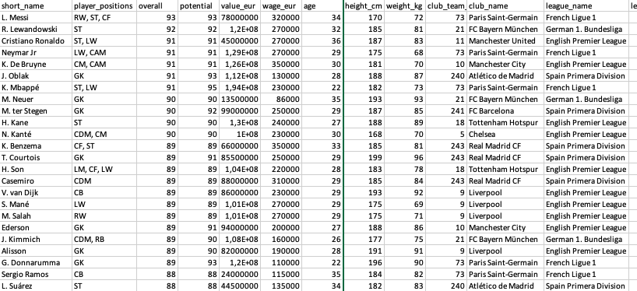
Case – FIFA French Ligue 1 Players
Data before filtering for Ligue 1 and variables:

Slide 9
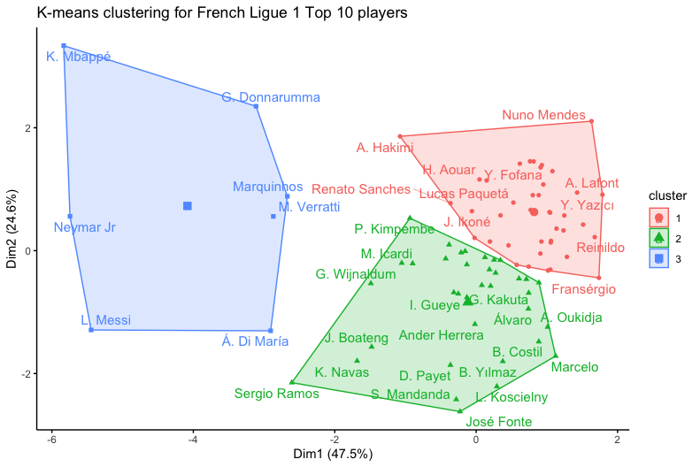
Case – FIFA French Ligue 1 Players
The output of the clustering approach.
What do you see? What do the clusters indicate?

Slide 10
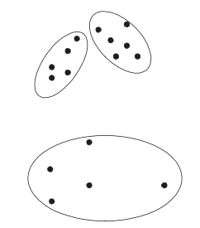
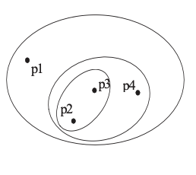
Clustering methods
Clustering methods are divided in two main categories:
Hierarchical Clustering: A set of nested clusters organized as a hierarchical tree
Partitional Clustering: A division of data objects into non-overlapping subsets (clusters) such that each data object is in exactly one subset
The use of these different algorithms depend on your objective
Partitional
Hierarchical

Slide 11
Other Clustering Methods
Hierarchical clustering
Aims to create a hierarchy of clusters by either merging smaller clusters into larger ones or splitting larger clusters into smaller ones (divisive clustering).
Density-based clustering
Works by identifying areas of high density within the data and grouping points that lie within these regions into clusters.
Fuzzy clustering
Allows for data points to belong to multiple clusters, with varying degrees of membership.

Slide 12
Partitional Clustering
In this course, we focus on Partitioning Clustering for the following reasons:
Natural complement to the PCA algorithm
Easier to understand and interpret
Powerful method for business applications
Hierarchical clustering algorithms are more suitable for categorical data (not ideal for numerical)

Slide 13
Partitional Clustering
Examples of Partitioning Clustering use:
Marketing: customer segmentation, products segmentation
Industrial organization: optimization of production plants
Fraud detection: financial data, etc.
Image and video analyses: object recognition, face recognition, and scene segmentation, etc.
Text & Web Mining: Proximity between political speeches, web articles, etc.
Supply chain optimization: optimize supply chain operations by grouping suppliers and products based on their characteristics and delivery performance

Slide 14
K-Means Clustering
We focus on K-means clustering.
Scalable: Suitable and cheap for big data. Other methods can be computationally expensive and may not be practical for large datasets.
Fast: Uses an iterative algorithm that converges quickly to a local optimum and is generally faster than others for big data.
Simple: Easy to understand and implement, making it accessible to non-experts.
Flexible: Can be used flexibly with different distance metrics and cluster initialization methods.
Interpretable: K-means clustering produces easily interpretable results, as each cluster is represented by its centroid or mean.

Slide 15
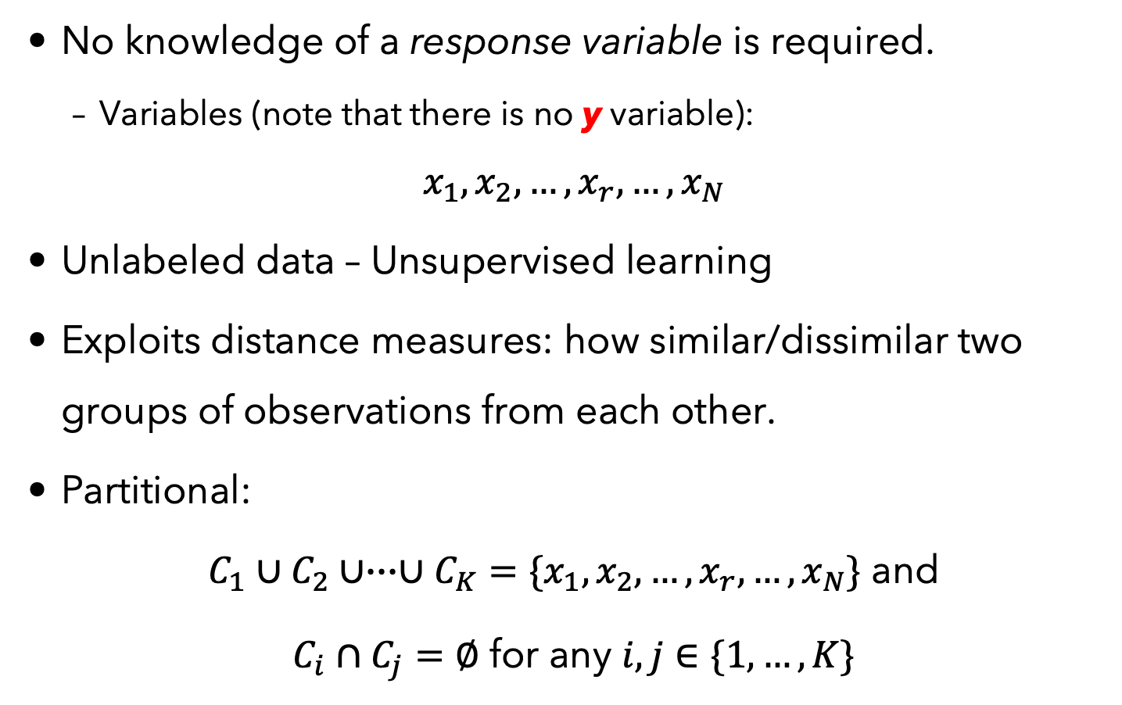
K-Means Clustering
No knowledge of a response variable is required.
Variables (note that there is no y variable):
$$x_{1},x_{2},…,x_{r},…,x_{N}$$
Unlabeled data – Unsupervised learning
Exploits distance measures: how similar/dissimilar two groups of observations from each other.
Partitional:
$C_{1}∪C_{2}∪∙∙∙∪C_{K}=\{x_{1},x_{2},…,x_{r},…,x_{N}\}$ and
$C_{i}∩C_{j}=∅$ for any $i,j∈\{1,…,K\}$

Slide 16
K-Means Clustering
Clustering: Exploratory, often descriptive, data analysis
Grouping observations into clusters such that
Observations within clusters are closer to each other.
Observations across clusters are further away.
Sometimes prior to supervised learning techniques to help separate observations that differ significantly.
Example: Pricing luxury or collectible vehicles may require a different model than pricing economy vehicles.

Slide 17
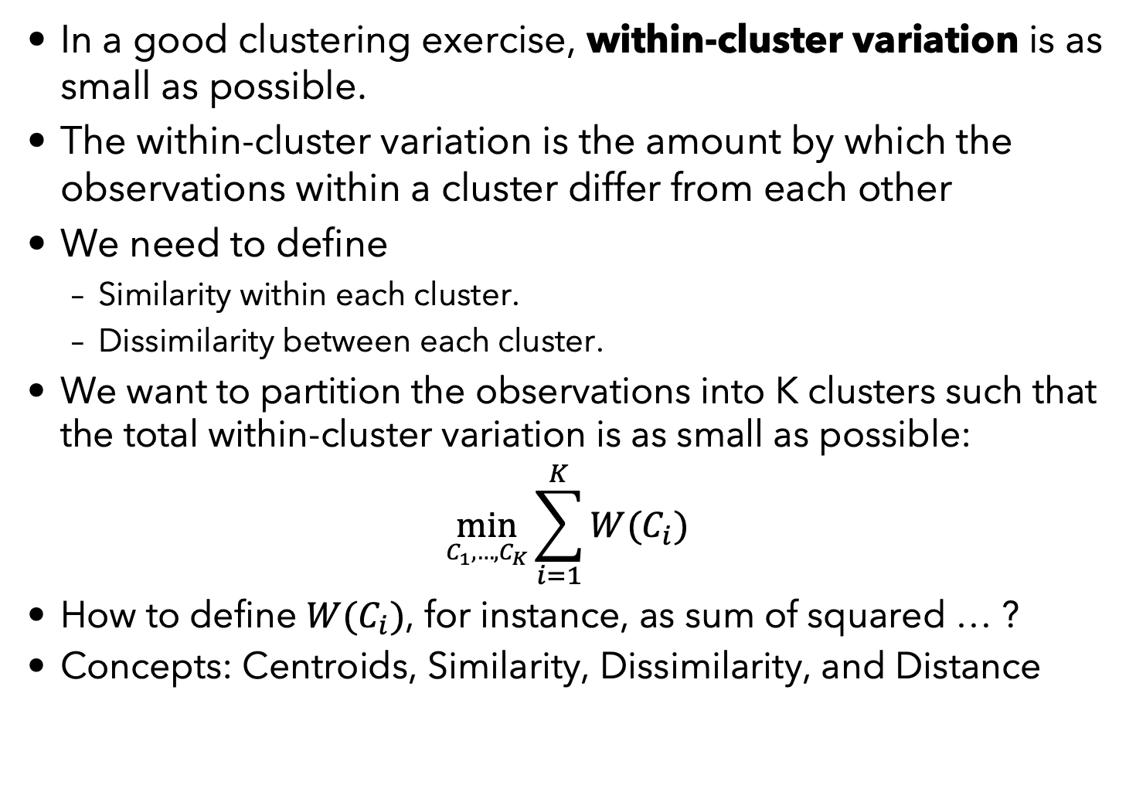
Definitions
In a good clustering exercise, within-cluster variation is as small as possible.
The within-cluster variation is the amount by which the observations within a cluster differ from each other
We need to define
Similarity within each cluster.
Dissimilarity between each cluster.
We want to partition the observations into K clusters such that the total within-cluster variation is as small as possible:
$$\min_{C_{1},…,C_{K}}{\sum_{i=1}^{K}{W(C_{i})}}$$
How to define $W(C_{i})$, for instance, as sum of squared … ?
Concepts: Centroids, Similarity, Dissimilarity, and Distance

Slide 18
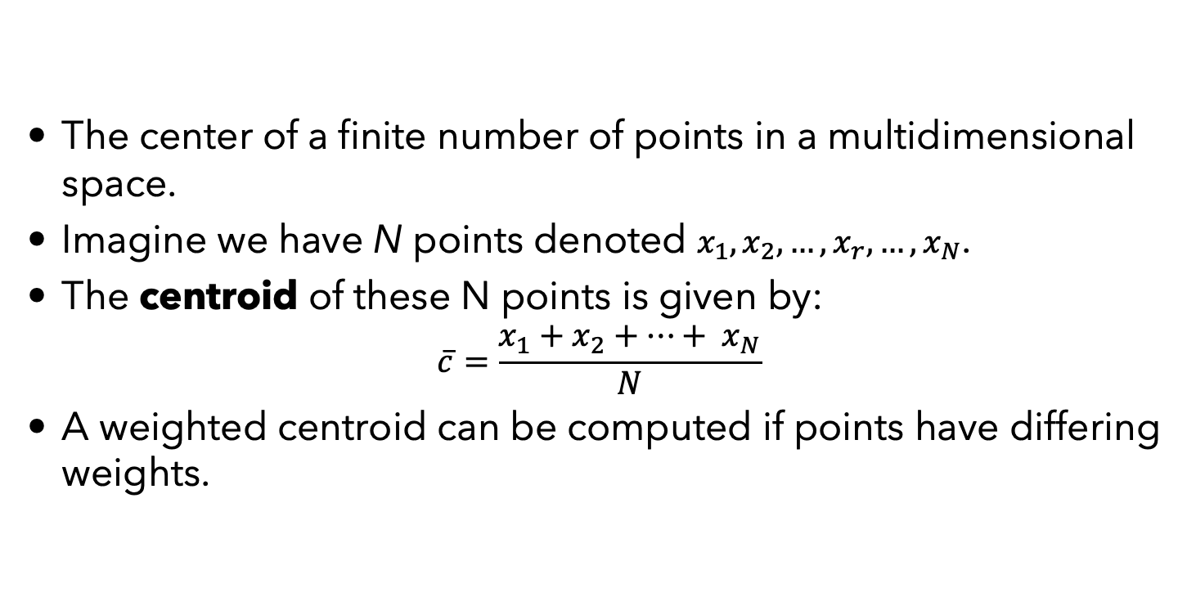
Centroid
The center of a finite number of points in a multidimensional space.
Imagine we have N points denoted $x_{1},x_{2},…,x_{r},…,x_{N}$.
The centroid of these N points is given by:
$$\overline{c}=\frac{x_{1}+x_{2}+…+ x_{N}}{N}$$
A weighted centroid can be computed if points have differing weights.

Slide 19
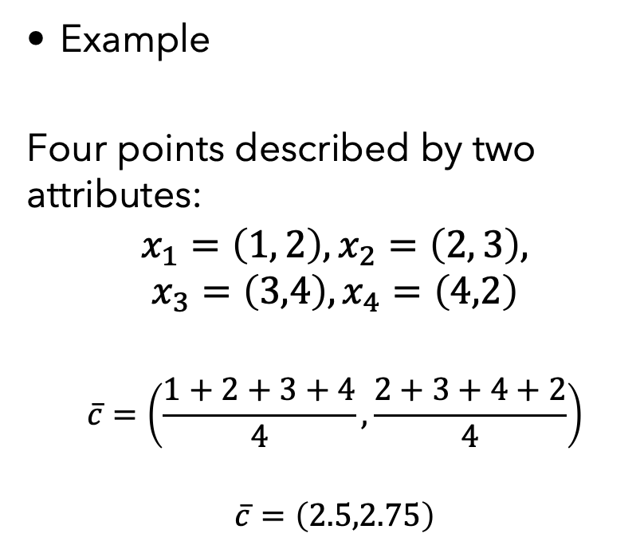
Centroid
Example
Four points described by two attributes:
$$x_{1}=\left(1, 2\right),x_{2}=\left(2, 3\right),$$
$$x_{3}=\left(3,4\right),x_{4}=\left(4,2\right)$$
$$\overline{c}=\left(\frac{1+2+3+4}{4},\frac{2+3+4+2}{4}\right)$$
$$\overline{c}=\left(2.5,2.75\right)$$

Slide 20
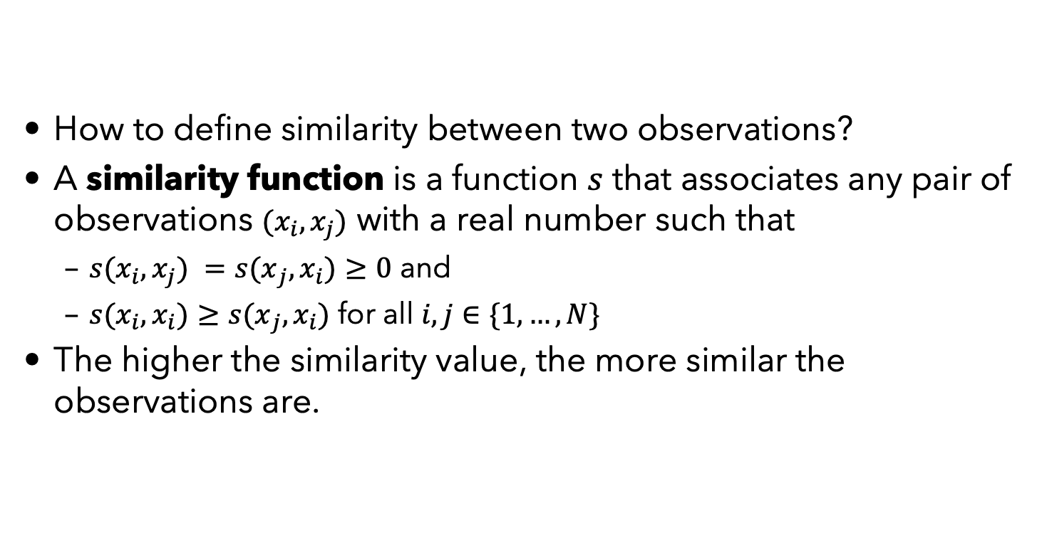
Similarity
How to define similarity between two observations?
A similarity function is a function $s$ that associates any pair of observations $(x_{i},x_{j})$ with a real number such that
${s(x}_{i},x_{j}) ={s(x}_{j},x_{i})≥0$ and
${s(x}_{i},x_{i})≥{s(x}_{j},x_{i})$ for all $i,j∈\{1,…,N\}$
The higher the similarity value, the more similar the observations are.

Slide 21
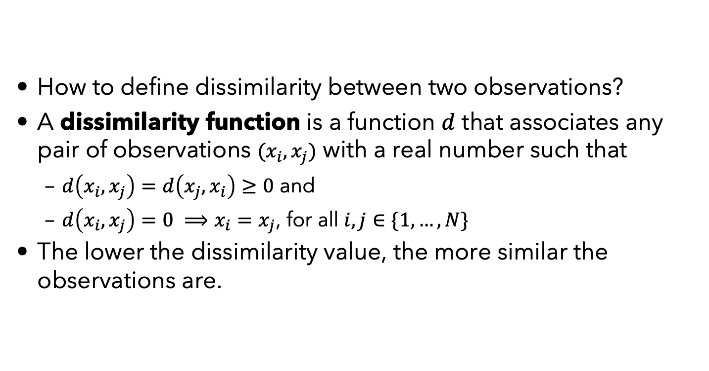
Dissimilarity
How to define dissimilarity between two observations?
A dissimilarity function is a function $d$ that associates any pair of observations $(x_{i},x_{j})$ with a real number such that
$d\left(x_{i},x_{j}\right)=d\left(x_{j},x_{i}\right)≥0$ and
$d\left(x_{i},x_{j}\right)=0 ⟹x_{i}=x_{j}$, for all $i,j∈\{1,…,N\}$
The lower the dissimilarity value, the more similar the observations are.

Slide 22
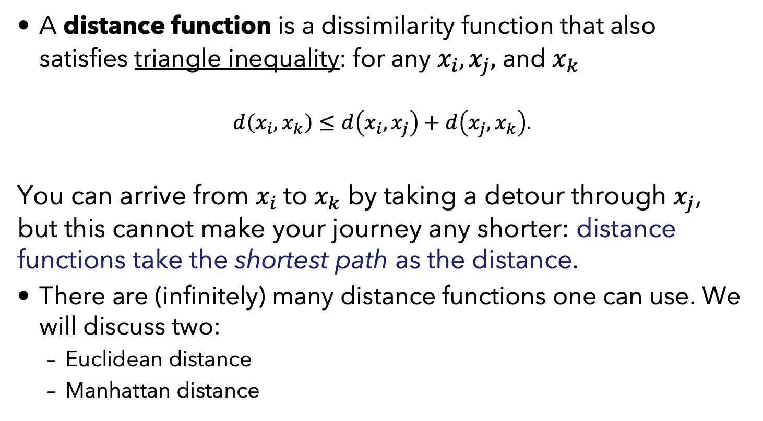
Distance
A distance function is a dissimilarity function that also satisfies triangle inequality: for any $x_{i},x_{j},$ and $x_{k}$
$$d\left(x_{i},x_{k}\right)≤d\left(x_{i},x_{j}\right)+d\left(x_{j},x_{k}\right).$$
You can arrive from $x_{i}$to $x_{k}$ by taking a detour through $x_{j}$, but this cannot make your journey any shorter: distance functions take the shortest path as the distance.
There are (infinitely) many distance functions one can use. We will discuss two:
Euclidean distance
Manhattan distance

Slide 23
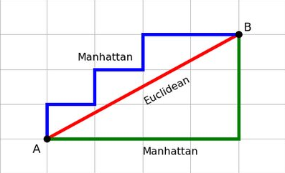
Manhattan vs Euclidean Distances

Slide 24
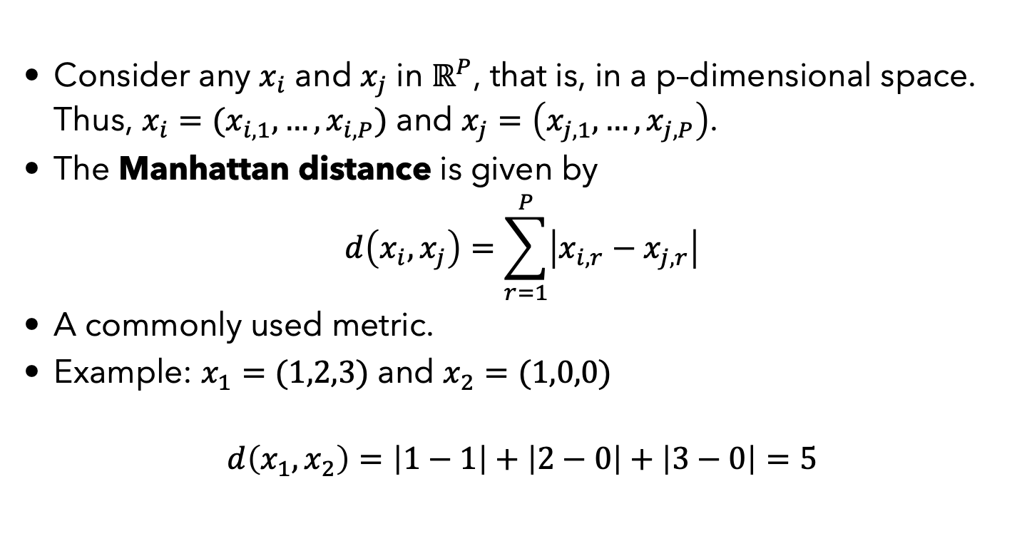
Manhattan Distance
Consider any $x_{i}$ and $x_{j}$ in $ℝ^{P}$, that is, in a p–dimensional space. Thus, $x_{i}=(x_{i,1},…,x_{i,P})$ and $x_{j}=\left(x_{j,1},…,x_{j,P}\right)$.
The Manhattan distance is given by
$$d\left(x_{i},x_{j}\right)=\sum_{r=1}^{P}{\left|x_{i,r}−x_{j,r}\right|}$$
A commonly used metric.
Example: $x_{1}=(1,2,3)$ and $x_{2}=(1,0,0)$
$$d\left(x_{1},x_{2}\right)=\left|1−1\right|+\left|2−0\right|+\left|3−0\right|=5$$

Slide 25
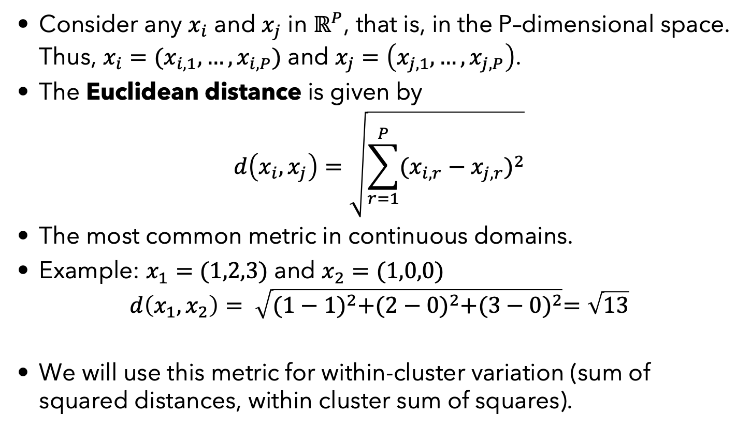
Euclidean Distance
Consider any $x_{i}$ and $x_{j}$ in $ℝ^{P}$, that is, in the P–dimensional space. Thus, $x_{i}=(x_{i,1},…,x_{i,P})$ and $x_{j}=\left(x_{j,1},…,x_{j,P}\right)$.
The Euclidean distance is given by
$$d\left(x_{i},x_{j}\right)=\sqrt{\sum_{r=1}^{P}{{(x_{i,r}−x_{j,r})}^{2}}}$$
The most common metric in continuous domains.
Example: $x_{1}=(1,2,3)$ and $x_{2}=(1,0,0)$
$$d\left(x_{1},x_{2}\right)= \sqrt{{(1−1)}^{2}+{(2−0)}^{2}+{(3−0)}^{2}}=\sqrt{13}$$
We will use this metric for within-cluster variation (sum of squared distances, within cluster sum of squares).

Slide 26
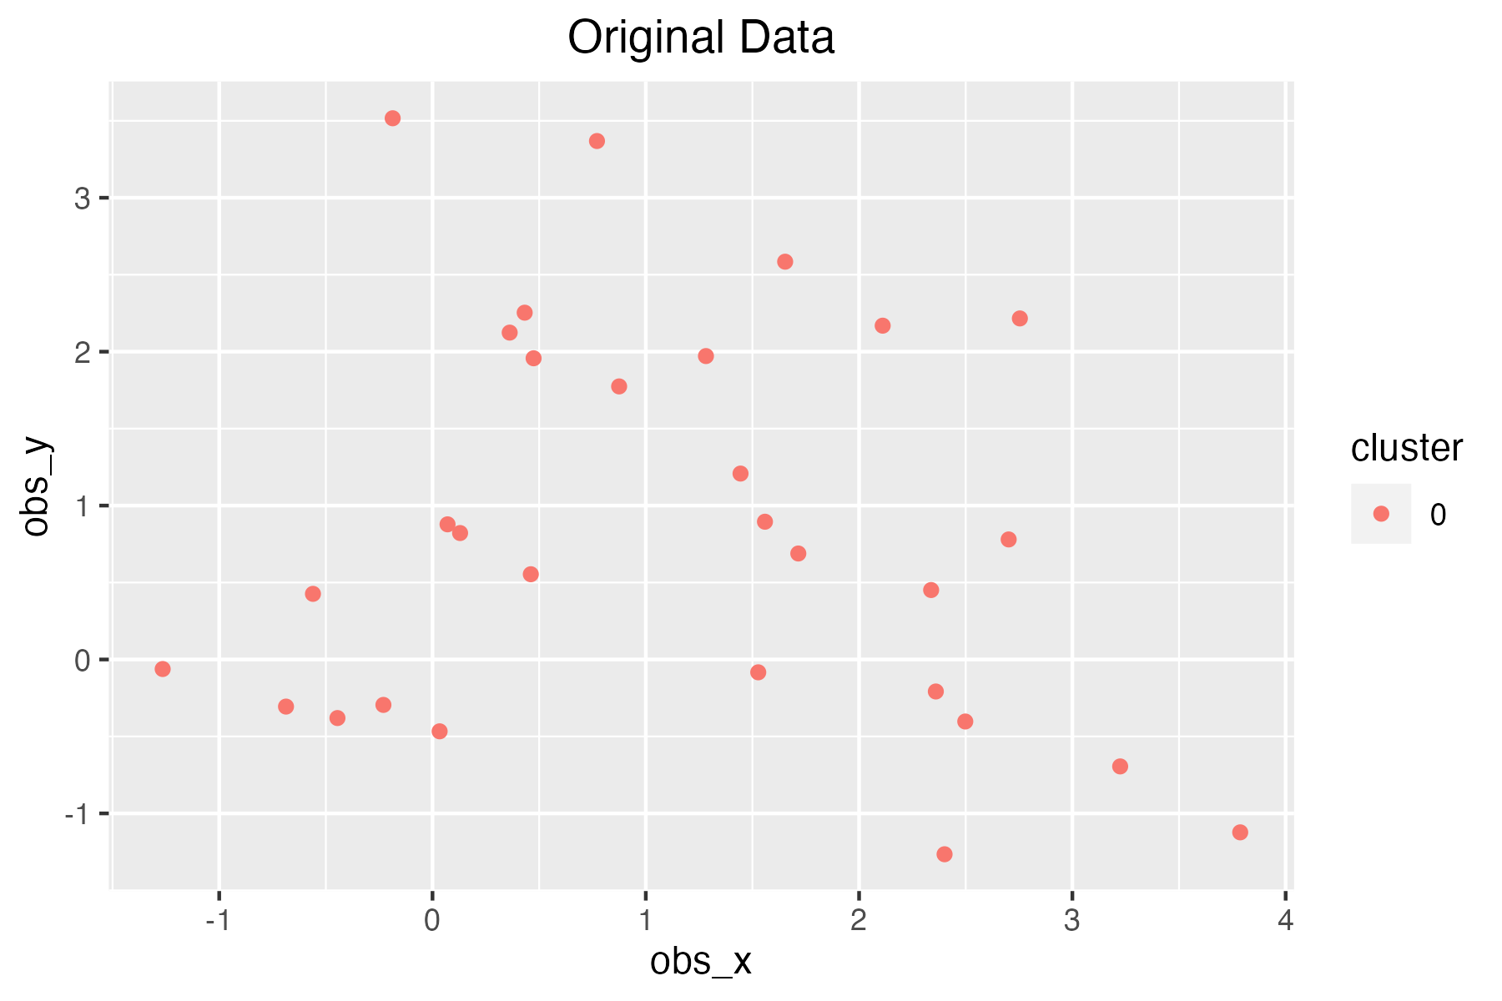
K-Means – Illustration
Randomly generated data:
- 10 data points with mean (0,0), 10 points with (2,0), 10 points with (1.5,2). All with unit variance.

Slide 27
Illustration
Randomly generated data:
- 10 data points with mean (0,0), 10 points with (2,0), 10 points with (1,1.5). All with unit variance.
Remark: These are means of the distributions that data is randomly generated from, NOT the centroids!

Slide 28
The K-Means Algorithm
The K-means algorithm works as follows:
Initialization: Specify K. Choose K random data points as initial centroids. These are the initial center points of the K clusters.
Assignment: Assign each data point to the nearest centroid, forming K clusters.
Update: Calculate the mean of each cluster and set it as the new centroid of that cluster.
Repeat: Repeat the assignment and update steps until the centroids converge, i.e., they no longer change or change very little.

Slide 29
Illustration
Randomly generated data:
- 10 data points with mean (0,0), 10 points with (2,0), 10 points with (1.5,2). All with unit variance.

Slide 30
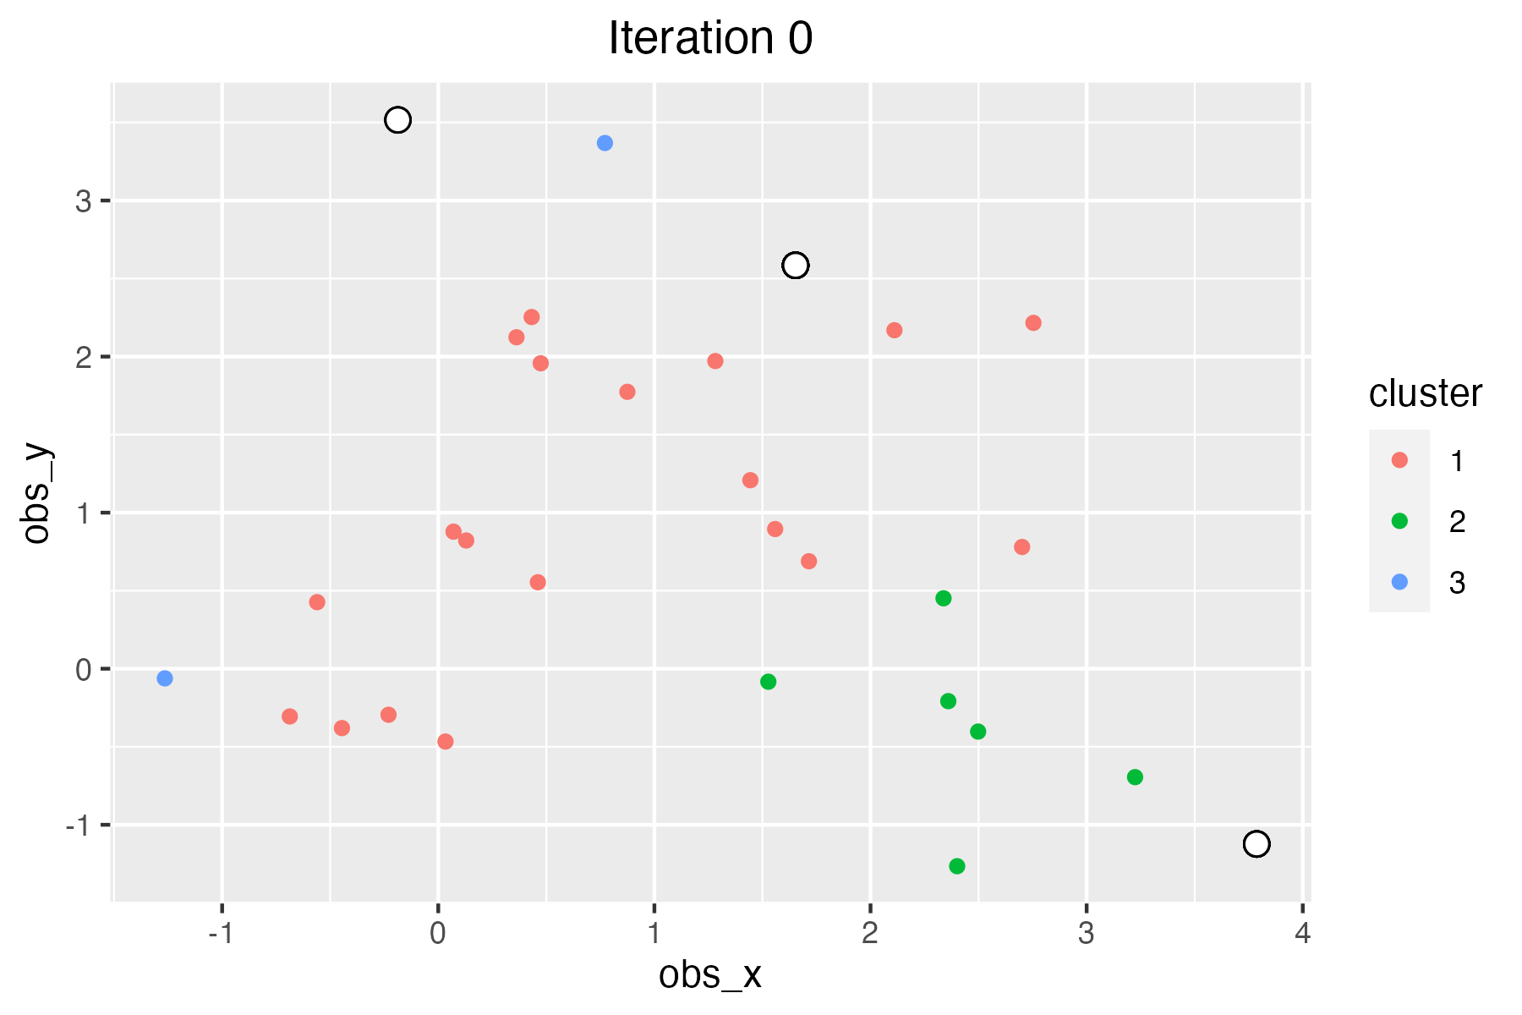
Illustration
K = 3, we decide.
Then, the first step is to randomly choose 3 observations.
Assign each observation to the closest of these “centroids”.

Slide 31
Illustration
K = 3 we decided.
Then, the first step is to randomly choose 3 observations.
Assign each observation to the closest of these “centroids”.
A
1<1.15
So, this is the closest inital “centroid” to point A.
1
1.15

Slide 32
Illustration
K = 3 we decided.
Then, the first step is to randomly choose 3 observations.
Assign each observation to the closest of these “centroids”.

Slide 33
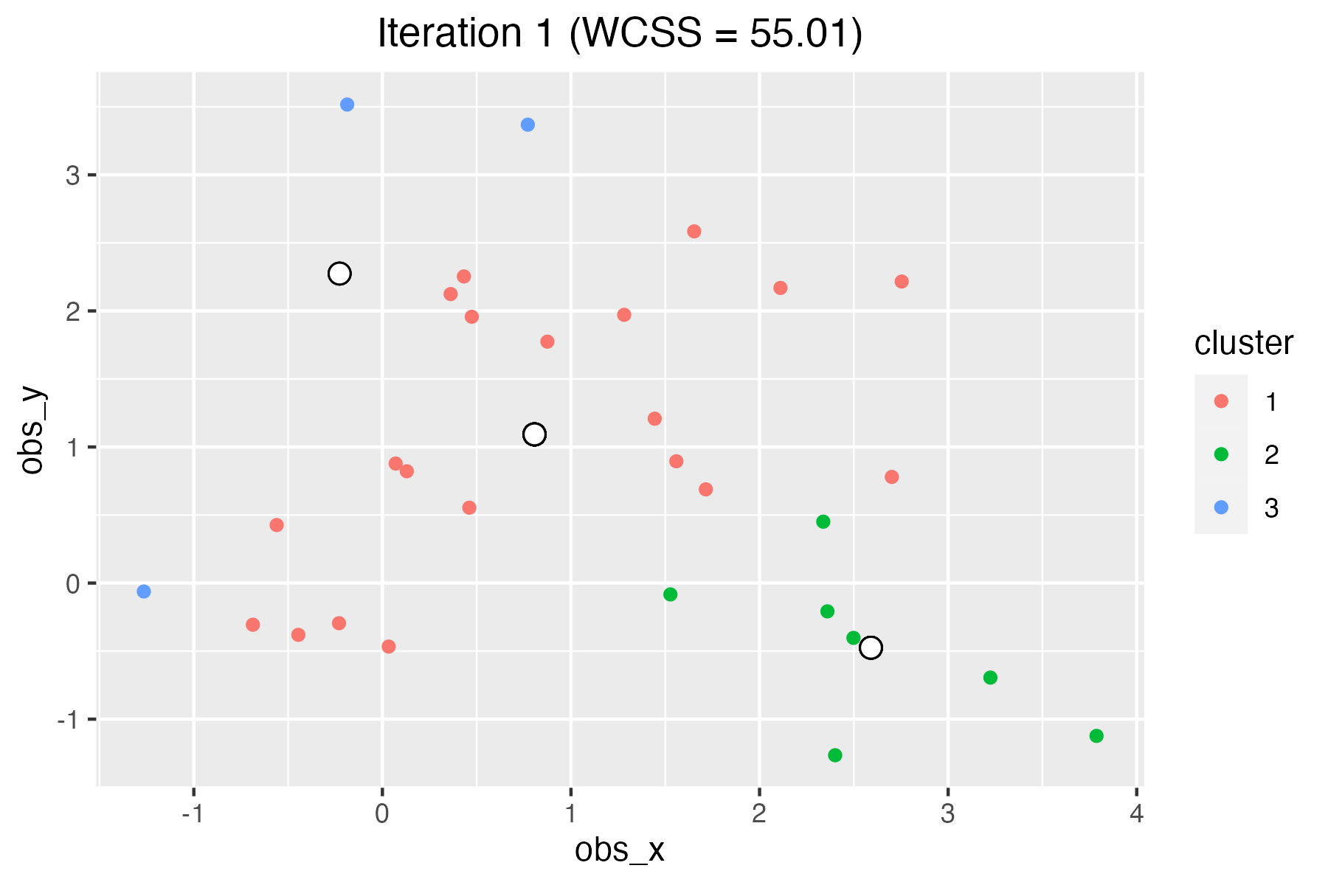
Illustration
Then, identify the actual centroids of each of the first set of clusters.
Next, reassign the observations to their closest centroids.

Slide 34
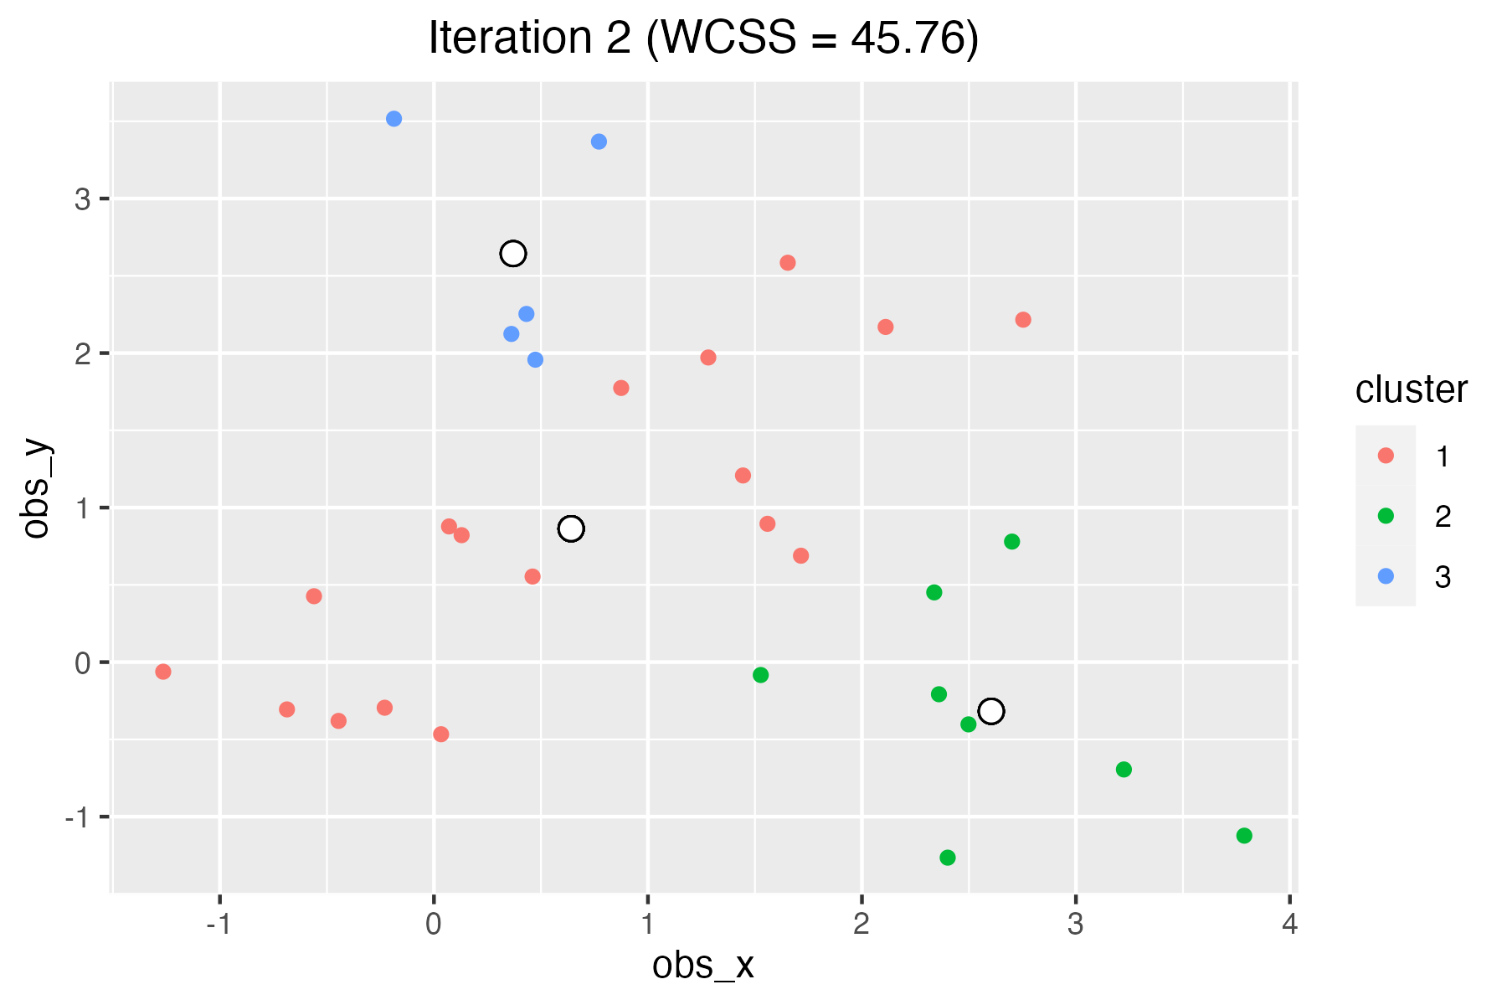
Illustration
Repeat: identify the centroids of each of the 2nd set of clusters. Then, reassign the observations to their closest centroids.

Slide 35
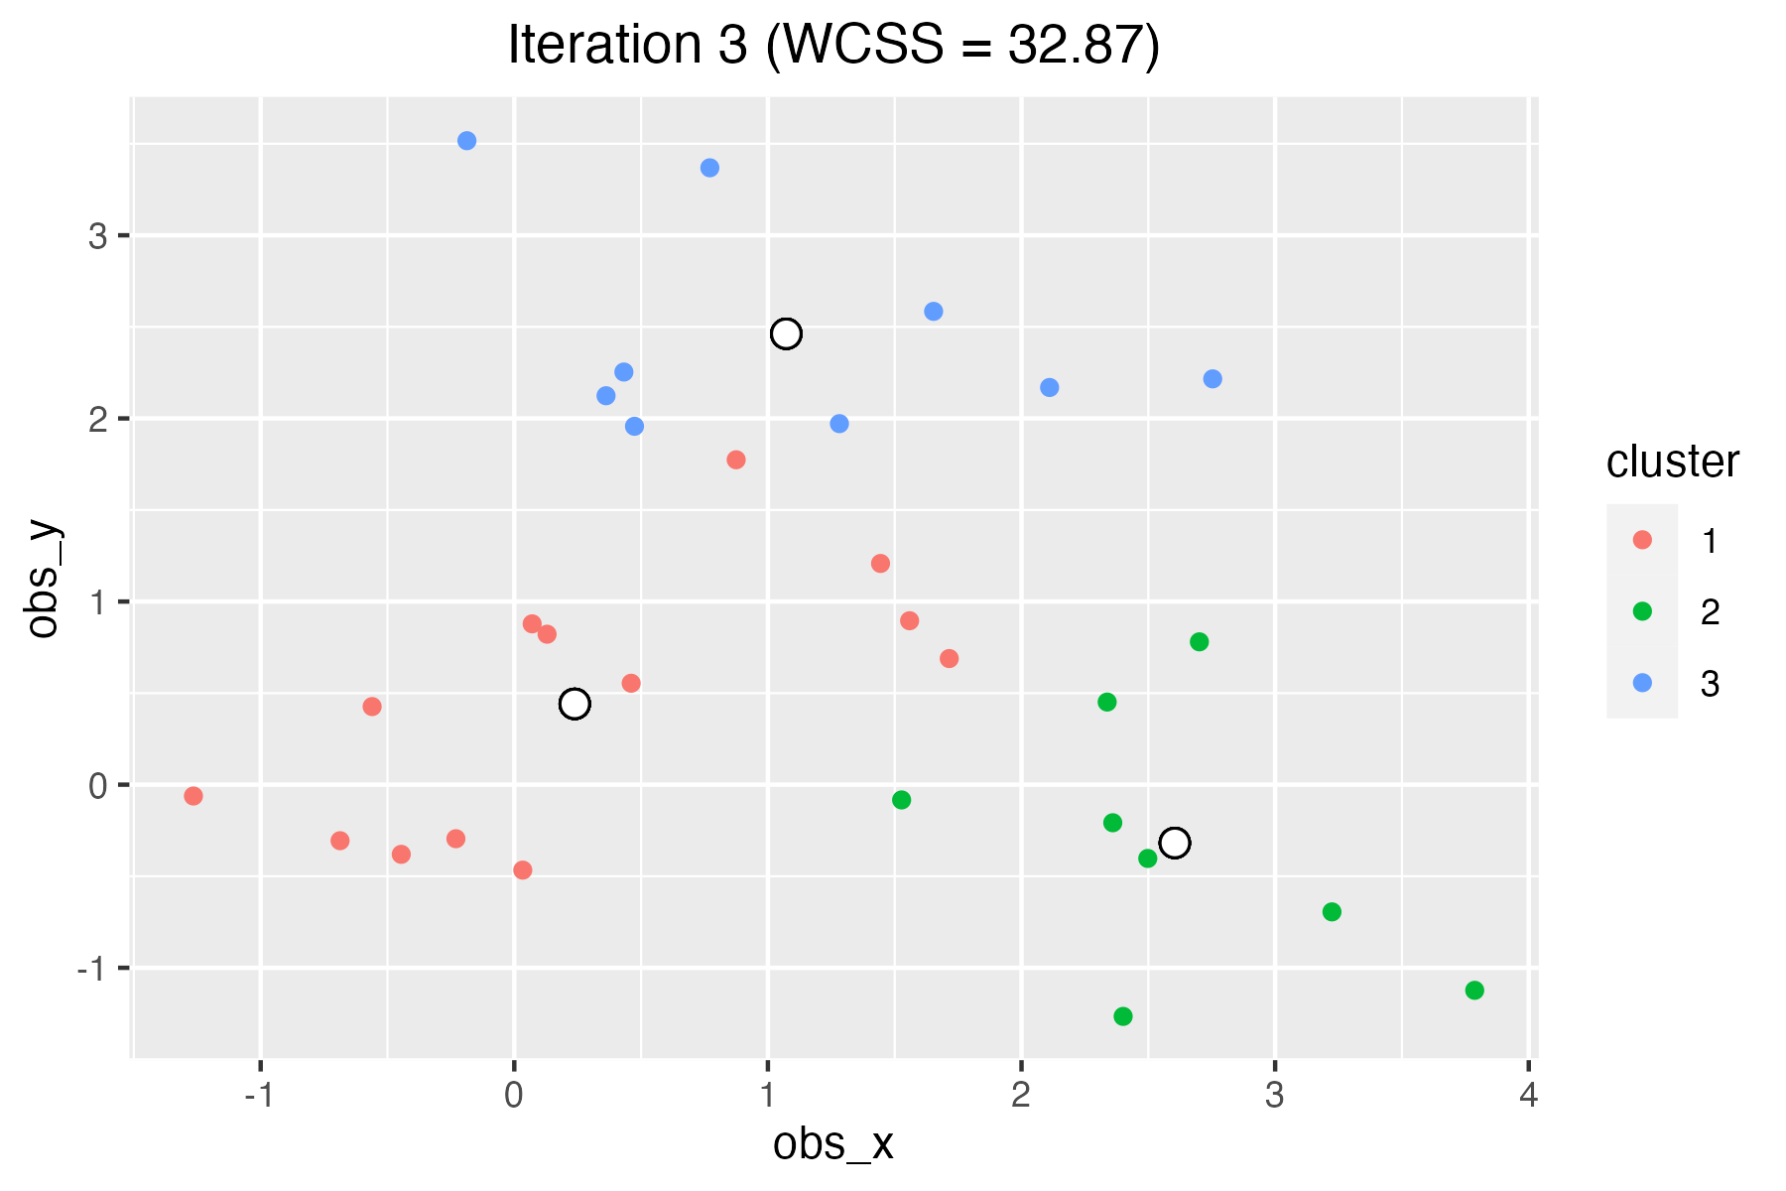
Illustration
Repeat: identify the centroids of each of the 3rd set of clusters. Then, reassign the observations to their closest centroids.

Slide 36
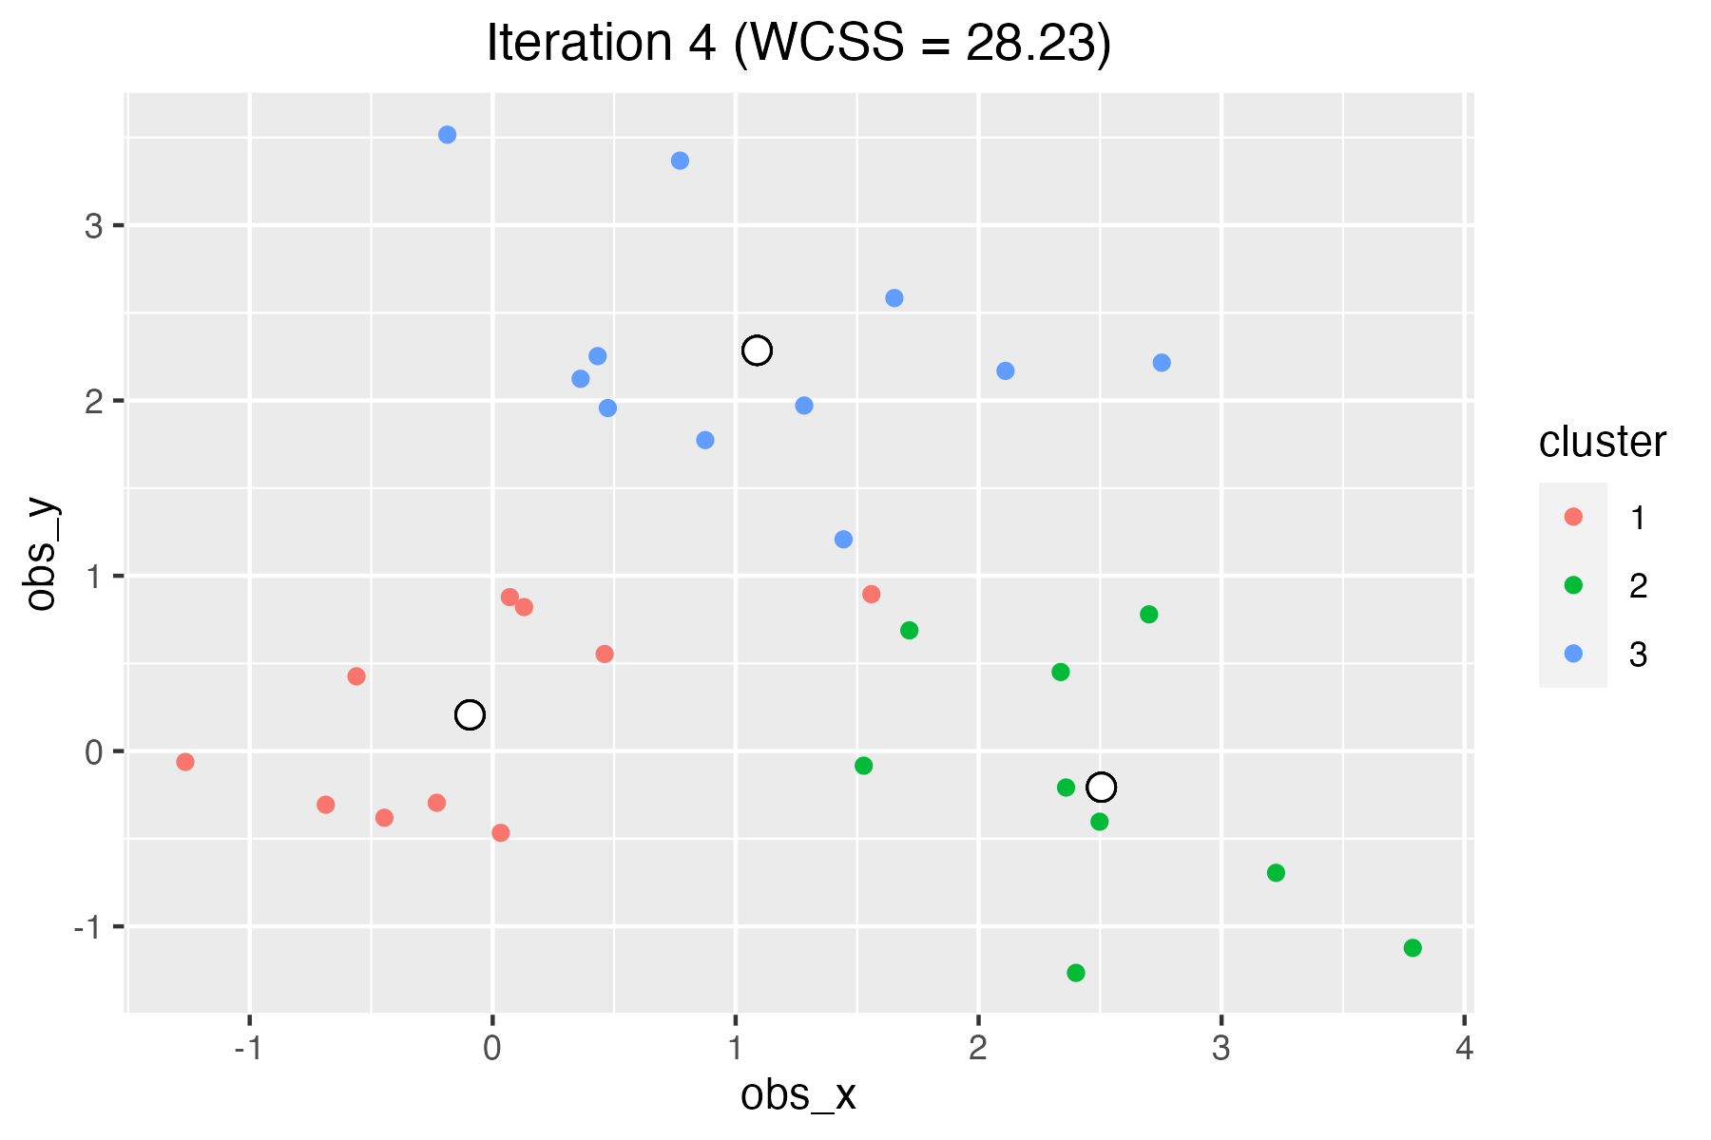
Illustration
Repeat: identify the centroids of each of the 4th set of clusters. Then, reassign the observations to their closest centroids.

Slide 37
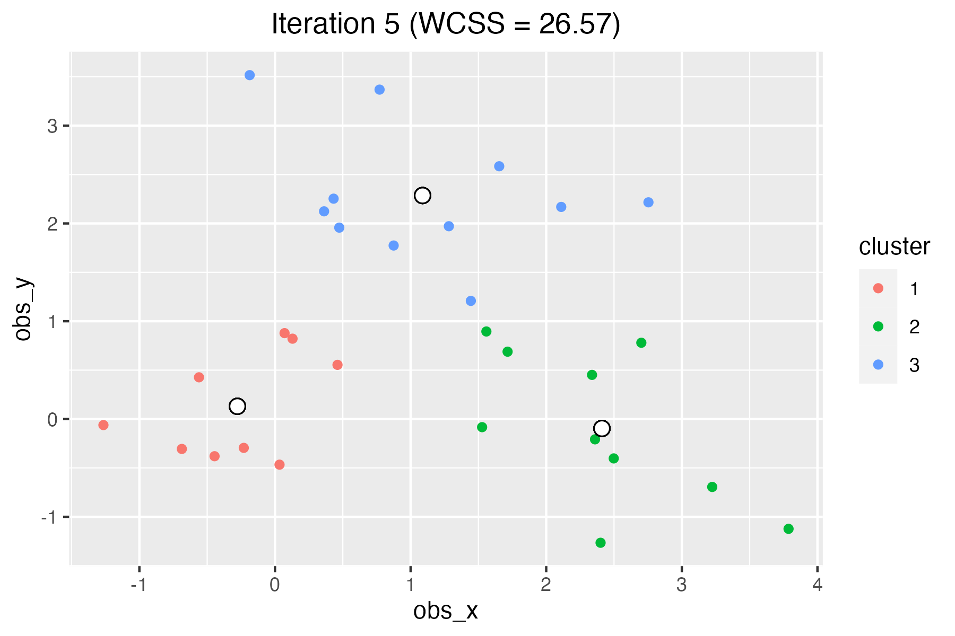
Illustration
Repeat: identify the centroids of each of the 5th set of clusters. Then, reassign the observations to their closest centroids.

Slide 38

Illustration
Stabilized!
The process stops at 5th iteration: each centroid is the closest centroid to the points in each cluster.

Slide 39
Illustration
Stabilized!
The process stops at 5th iteration: each centroid is the closest centroid to the points in each cluster.
This is a deterministic process:
If the starting points are the same, the final clusters will be the same.
Not the other way around: different starting points can lead to same clusters.

Slide 40
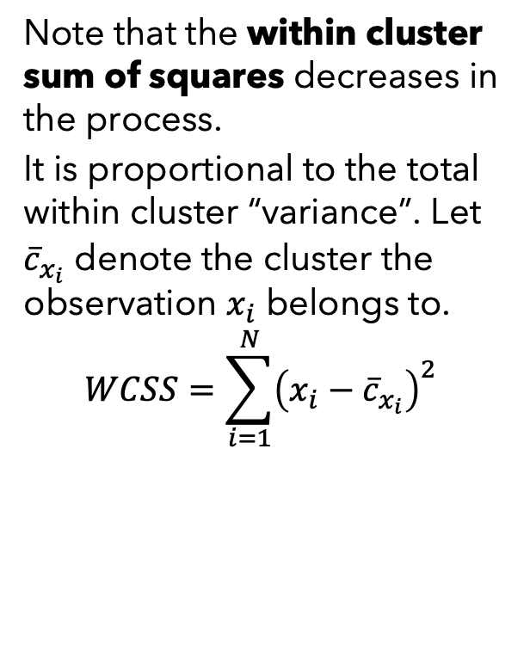
Illustration
Stabilized!
The process stops at 5th iteration: each centroid is the closest centroid to the points in each cluster.
Note that the within cluster sum of squares decreases in the process.
It is proportional to the total within cluster “variance”. Let ${\overline{c}}_{x_{i}}$ denote the cluster the observation $x_{i}$ belongs to.
$$WCSS=\sum_{i=1}^{N}{{\left(x_{i}−{\overline{c}}_{x_{i}}\right)}^{2}}$$

Slide 41
Illustration
Stabilized!
The process stops at 5th iteration: each centroid is the closest centroid to the points in each cluster.
Note that the within cluster sum of squares decreases in the process.
But it is not guaranteed to get the optimal = minimal possible WCSS. It depends on the initialization! What you get can be local optima!
A stopping rule can be useful: if WCSS does not decrease by more than x%, stop. Or re-try max 10 times.

Slide 42
The K-Means Algorithm
The K-means algorithm workflow:
Initialization: Specify K. Choose K random data points as initial centroids. These are the initial center points of the K clusters.
Assignment: Assign each data point to the nearest centroid, forming K clusters.
Update: Calculate the mean of each cluster and set it as the new centroid of that cluster.
Repeat: Repeat the assignment and update steps until the centroids converge, i.e., they no longer change or change very little.

Slide 43
Illustration – Start Over

Slide 44
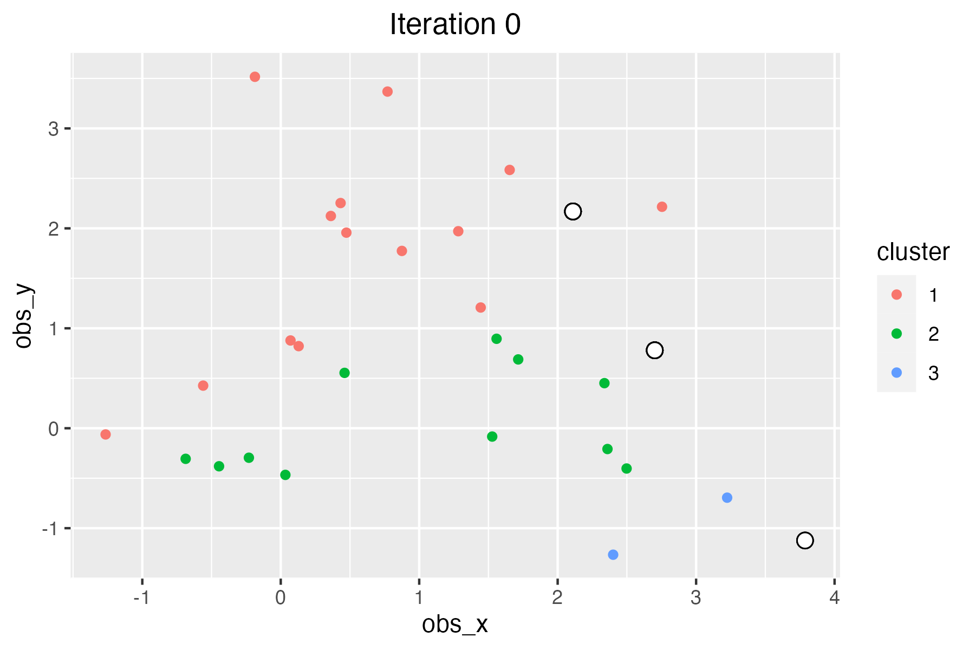
Illustration – Start Over

Slide 45
Illustration – Start Over compare
Current
Previous

Slide 46
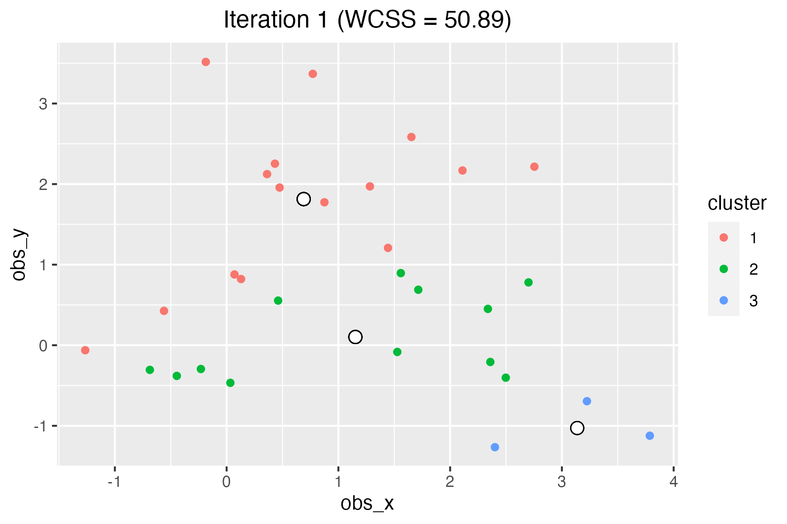
Illustration – Start Over

Slide 47
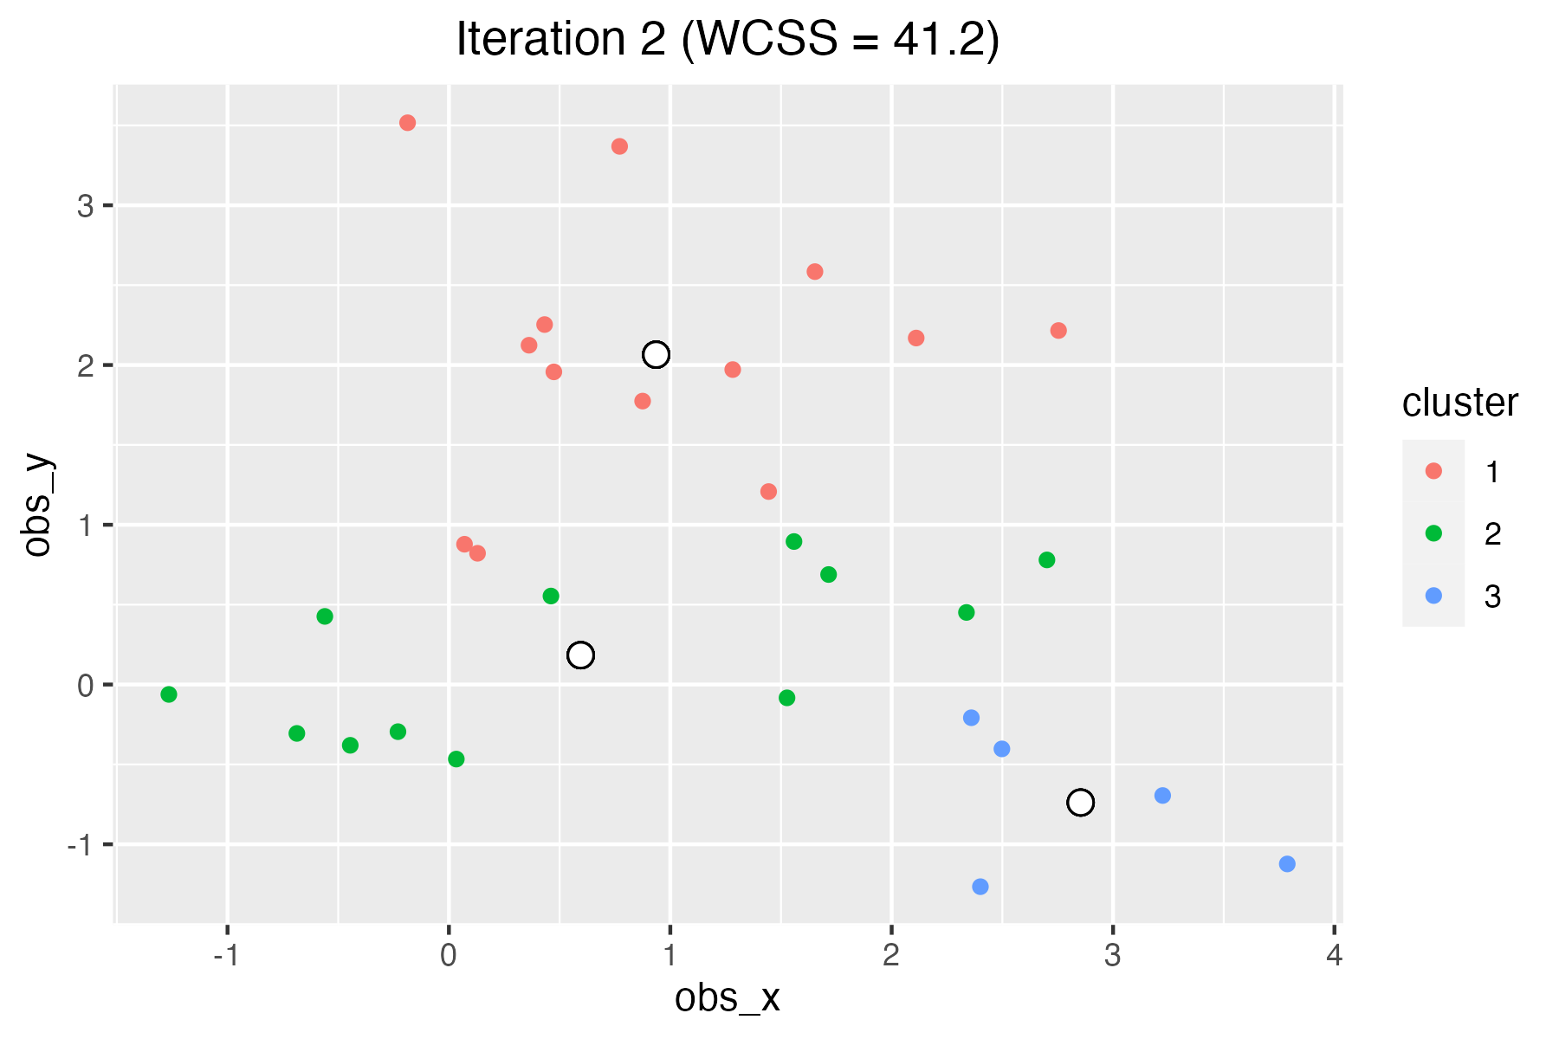
Illustration – Start Over

Slide 48
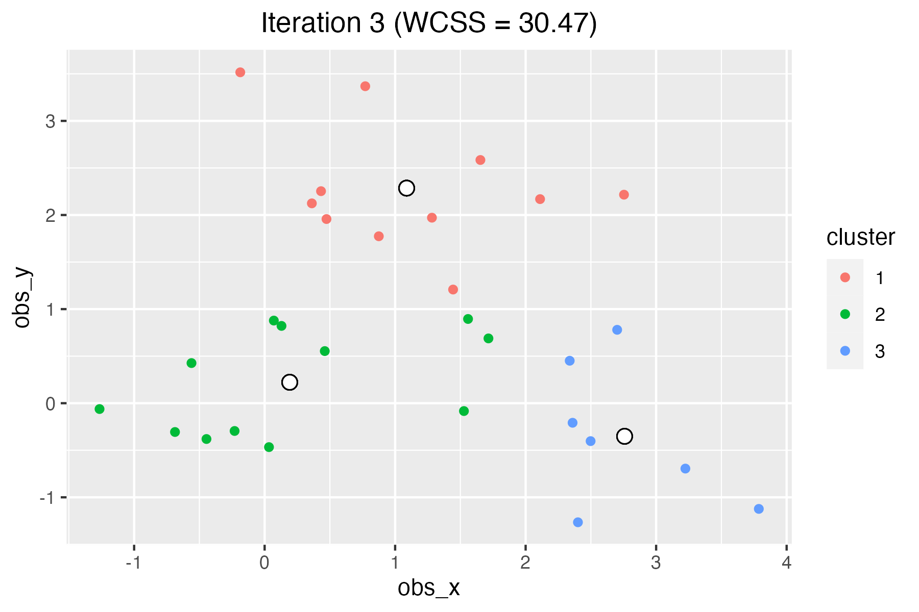
Illustration – Start Over

Slide 49
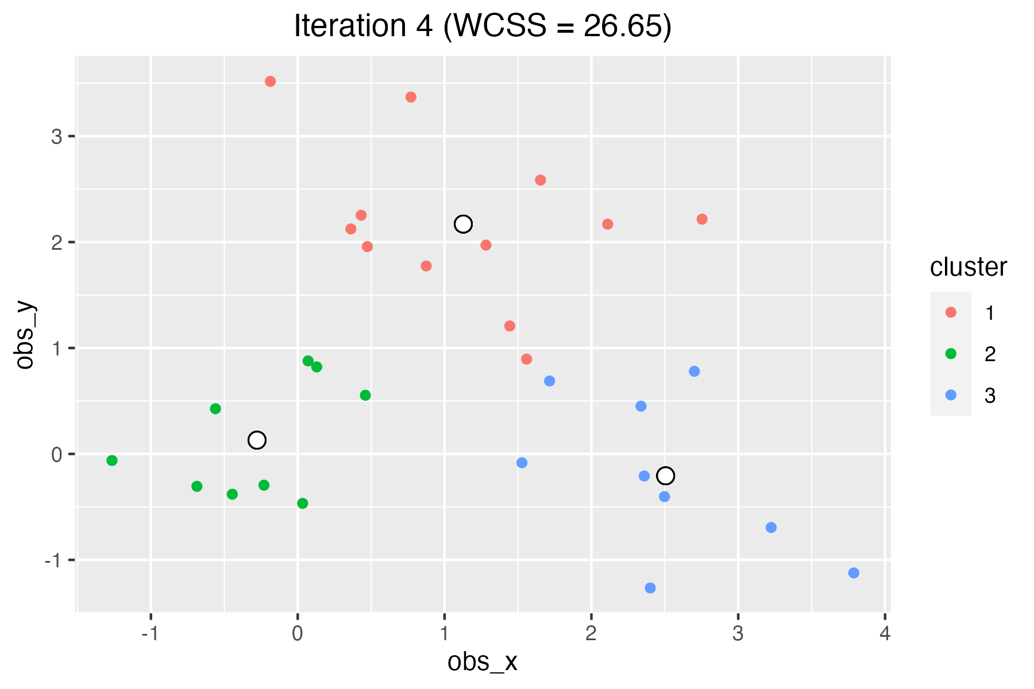
Illustration – Start Over

Slide 50

Illustration – Start Over
This time, it stabilized at 4th iteration.
The clustering is slightly different (1 observation). The final WCSS also!
26.65 current clustering, 26.57 the previous one.

Slide 51
Illustration – Comparison
Current clustering
Previous clustering
This time, it stabilized at 4th iteration.
The clustering is slightly different (1 observation). The final WCSS also!
26.65 current clustering, 26.57 the previous one.
The initializations are different.

Slide 52
Illustration – Comparison
Current clustering
Previous clustering
Previous clustering has a slightly better within-cluster variation: higher homogeneity in cluster.
This can be an argument to choose among clustering outcomes.

Slide 53
The K-Means Algorithm
The result of the K-means algorithm is a set of K clusters, each containing data points that are similar to each other and dissimilar to the data points in other clusters.
You can verify that minimizing within cluster variance is equal to maximizing across cluster variation.
The smaller the WCSS, the better the clustering.

Slide 54
The K-Means Algorithm
K-means clustering has great simplicity and efficiency.
It is relatively fast and easy to implement, making it suitable for big data. For 100 observations, hierarchical clustering would need to compute the distances of 4950 pairs of observations, whereas if K=4, K-means needs 400 computations.
Additionally, the K-means (and most clustering methods) is a deterministic algorithm, meaning that it will always produce the same clustering result for a given set of input data and parameters (K value and initial centroids).

Slide 55
The K-Means Algorithm
However, K-means clustering has some limitations.
Sensitive to the initial choice of centroids, which can lead to different clusters.
May not work as well with data that contains non-linear or complex patterns, as it assumes that the clusters are spherical and have similar variance.
Relies on numerical variables. For data with categorical variables (mixed) → K-prototypes
Requires the pre-specification of the number of clusters (K), which can be difficult to determine in advance.

Slide 56
How to choose K?
Experiment with different values of K and compare.
Use the simple Elbow method as discussed before.
Run with different initializations to find the minimal WCSS given a cluster number K.
Use other clustering methods to get an idea, such as hierarchical clustering.
Use prior knowledge or theories the subjects under study.
Books? Movies? Music? → Genres
Cars? Computers? → Brands, countries of origin

Slide 57
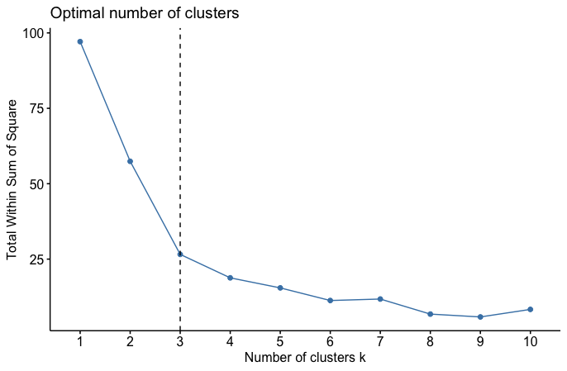
How to choose K? – Elbow method
Choose the number of clusters that makes the curve kink and be flatter afterwards.
Here, after 3 clusters, the WCSS does not drop significantly.
57.3
30.73
26.57
7.78
18.79

Slide 58
Normalization
The scales of variables can influence the distance measures.
The different scales can distort the true distance between points and lead to inaccurate results.
→ Make the values unit-free, to ensure each value receives equal weight when calculating distance measures. Two options:
Standardize: compute a z-score; the distance of observations from the mean scaled by the standard deviation
Min-max normalization: rescale each value to be between 0 and 1.

Slide 59
Normalization
Example: Consider a sample of five consumers with their annual income (Income, in €) and hours spent online per week (Hours Spent).
The distance measures calculated from raw data can be distorted because the annual income values are much larger than the values of hours spent online per week.
Name | Income | Hours Spent | Standardized Income | Standardized Hours Spent | MinMax Normalized Income | MinMax Normalized Hours Spent
Jean | 125,678 | 2.5 | 1.2473 | −1.5071 | 1.0000 | 0.0000
Alex | 65,901 | 10.1 | −1.1892 | 1.0382 | 0.0000 | 1.0000
Marie | 75,550 | 5.8 | −0.7959 | −0.4019 | 0.1614 | 0.4342
Philippe | 110,250 | 9.0 | 0.6184 | 0.6698 | 0.7419 | 0.8553
Claire | 98,005 | 7.6 | 0.1194 | 0.2010 | 0.5371 | 0.6711

Slide 60
Mineral Waters - Again
Information on the chemical composition of 20 mineral water brands and their prices.
20 x 10 dimensions
Objective: Apply K-means algorithm to highlight waters with similar composition.
Tools: Use both PCA and K-means. We need dimensionality reduction to get rid of the redundant information in the data and simplify it. Also, this brings the normalization process within the application.
Always check if there are missing values (NA). Clustering algorithms don’t work well with NA or ignore them.

Slide 61
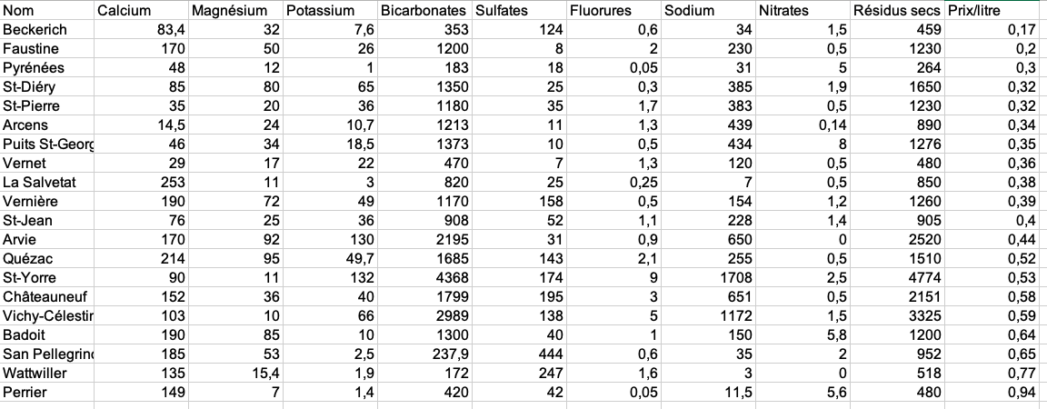
Mineral Waters
Data: not normalized!

Slide 62
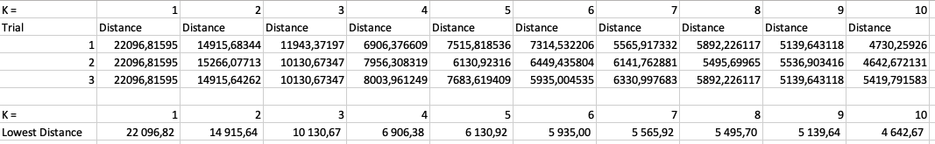
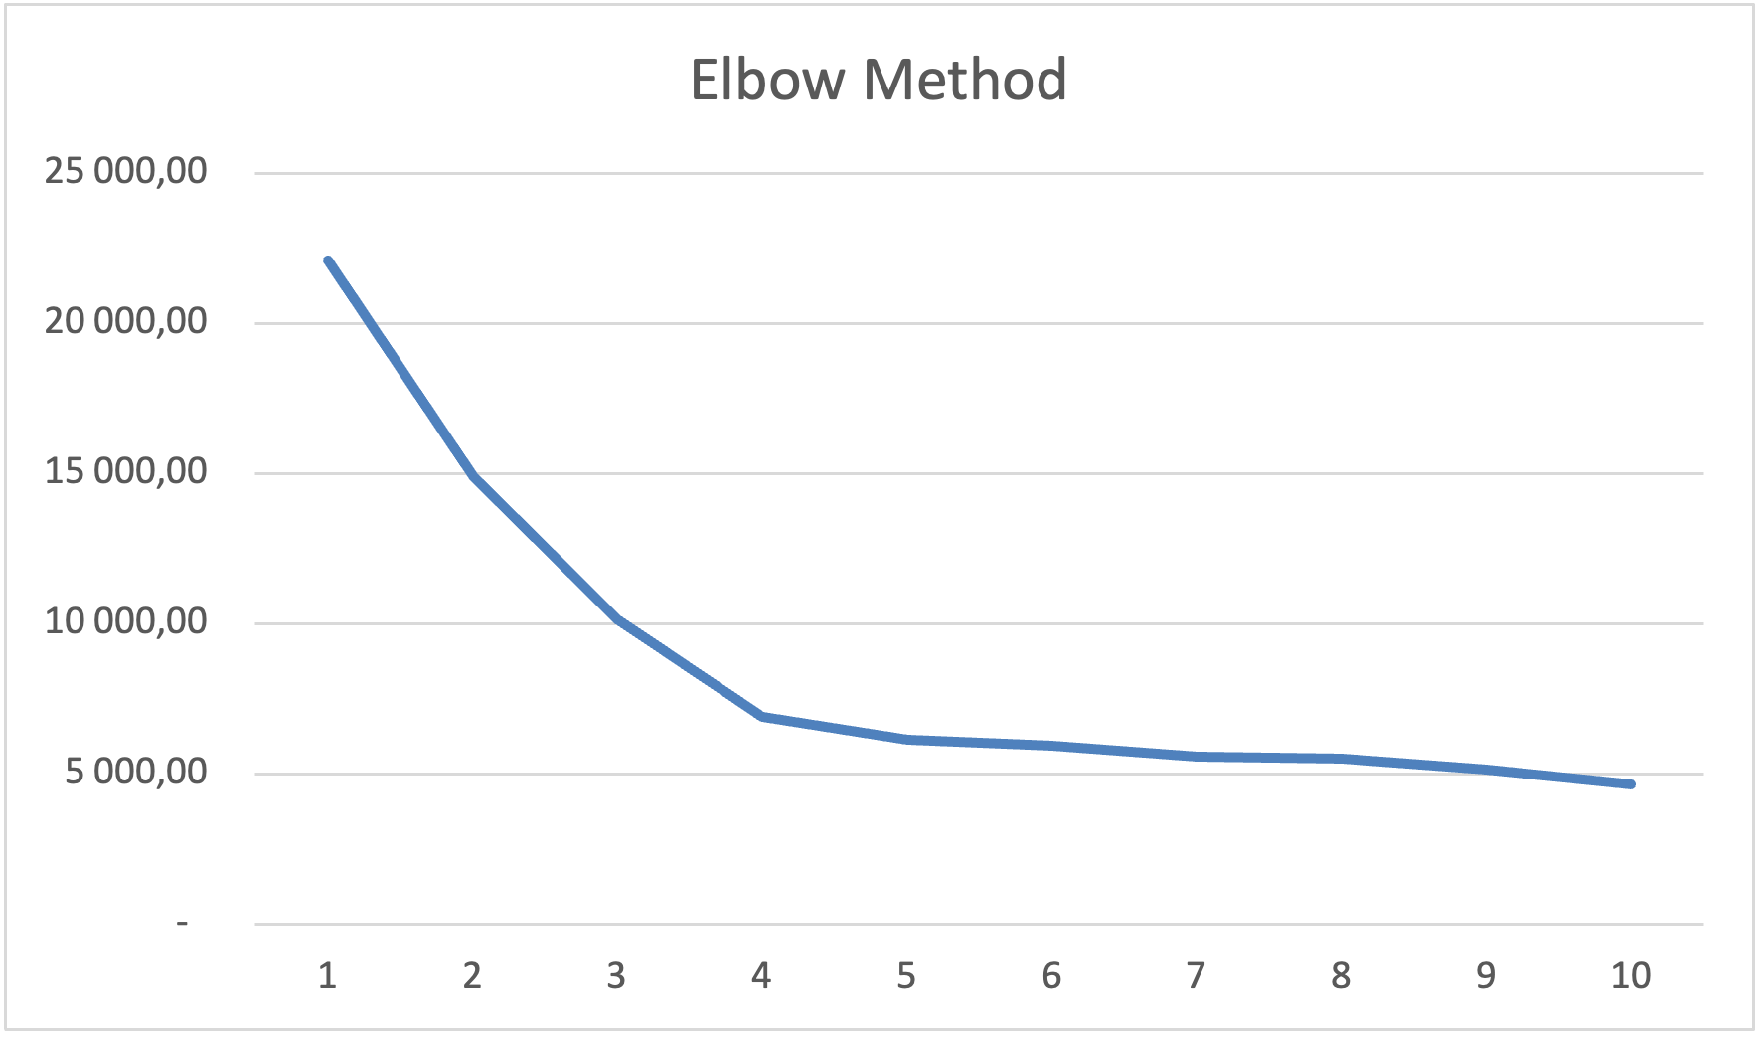
Mineral Waters
3 Trials, K = 1, …, 10

Slide 63
Mineral Waters
3 Trials, K = 1, …, 10

Slide 64
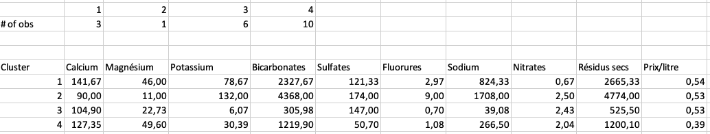
Mineral Waters
Trying several times shows the best WCSS is 6906 for K=4.
Four clusters:
Group 1 (3 obs): High level of Calcium, Magnesium and Sodium
Group 2 (1 obs): Low level of Calcium and Magnesium, high level of Sodium
Group 3 (6 obs): Medium level of Calcium and Magnesium, low level of Sodium
Group 4 (10 obs): High level of Calcium and Magnesium, relatively low level of Sodium
Given these, one can answer easily what are the healthier options, etc.

Slide 65
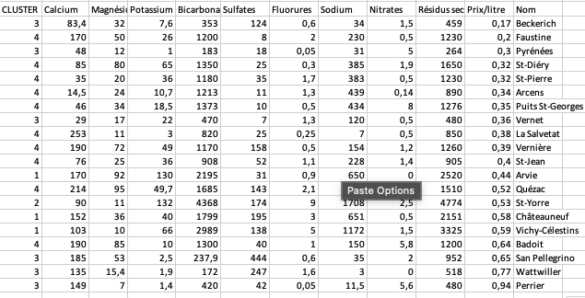
Mineral Waters
Clusters

Slide 66
Candy Bars again
Nutritional information from select candy bars.
We have worked on this in PCA class.
We have more variables now.
Brands | Calories | Fat | Protein | Carb
Peanut Butter Twix | 311.0 | 18.5 | 5.3 | 31.4
Baby Ruth | 275.0 | 13.0 | 3.2 | 39.0
⋮ | ⋮ | ⋮ | ⋮ | ⋮
Twizzlers Cherry Nibs | 139.0 | 1.1 | 1.0 | 31.7

Slide 67
Candy Bars
We first run PCA and obtain 2 dimensions.
In doing so, we standardize the data.
The weights of the PCA dimensions:
 | PC1 | PC2
Calories | -0,40 | 0,67
Fat | -0,63 | -0,10
Protein | -0,56 | 0,09
Carb | 0,36 | 0,73

Slide 68
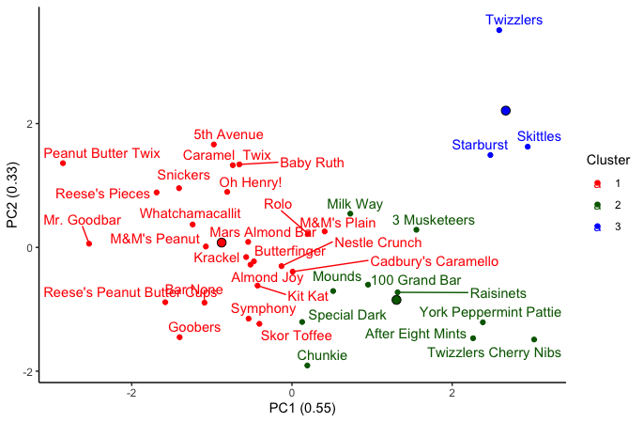
Candy Bars
We first run PCA and obtain 2 dimensions.
In doing so, we standardize the data.
Then we apply K-means with 3 clusters.

Slide 69
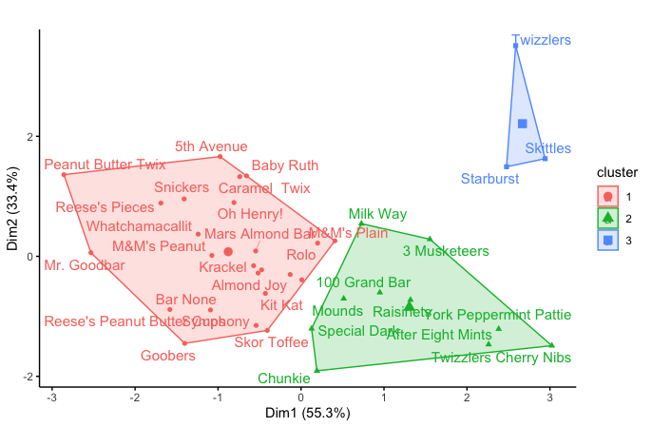
Candy Bars
We first run PCA and obtain 2 dimensions.
In doing so, we standardize the data.
Then we apply K-means with 3 clusters. Convex hulls.

Slide 70
Case – FIFA French Ligue 1 Players
Data scraped from sofifa.com by Stefano Leone: https://www.kaggle.com/datasets/stefanoleone992/fifa-22-complete-player-dataset
FIFA Career Mode
We focus on
year 2022, for which there are19,239 players.
French Ligue 1, for which we have 577 players.
There are 110 variables, including name, age, wage, height, club and nationality, position, preferred foot, mentality scores (vision, composure, etc.), power scores (stamina, jumping, etc.), overall score, scores for dribbling, passing, shooting, etc.
We focus on 5 variables: Overall score, Value in Euros, Age, Height (cm), and International Reputation score

Slide 71
Case – FIFA French Ligue 1 Players
Data before filtering for Ligue 1 and variables:

Slide 72
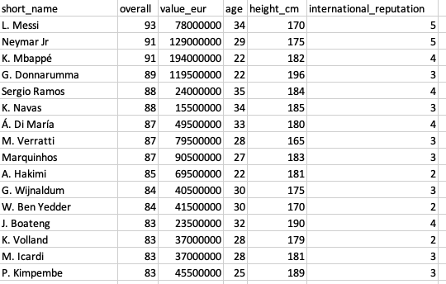
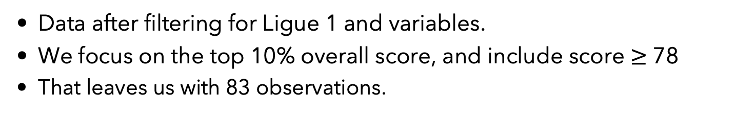
Case – FIFA French Ligue 1 Players
Data after filtering for Ligue 1 and variables.
We focus on the top 10% overall score, and include score $≥$ 78
That leaves us with 83 observations.

Slide 73
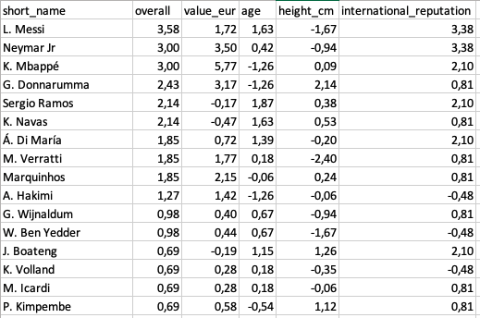
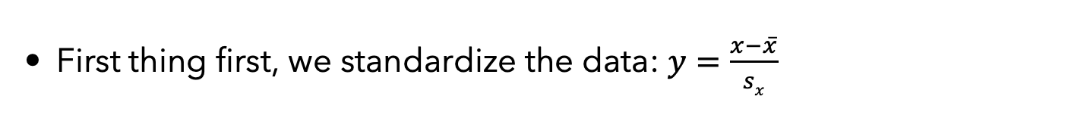
Case – FIFA French Ligue 1 Players
First thing first, we standardize the data: $y=\frac{x−\overline{x}}{sx}$

Slide 74
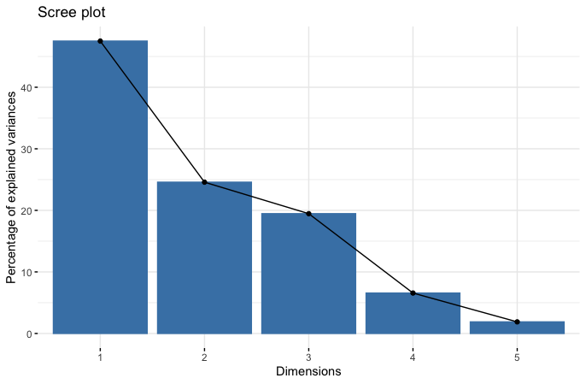
Case – FIFA French Ligue 1 Players
PCA result
We will use all the PCs for K-means clustering.
The first 2 PCs account for 48+25=73% of total variation.
 | PC1 | PC2 | PC3 | PC4 | PC5
overall | -0,61 | 0,00 | 0,08 | 0,41 | 0,67
value_eur | -0,53 | 0,47 | 0,08 | 0,26 | -0,65
age | -0,15 | -0,85 | 0,00 | 0,36 | -0,35
height_cm | 0,14 | -0,02 | 0,99 | 0,01 | 0,00
international_reputation | -0,55 | -0,23 | 0,08 | -0,80 | -0,02
Explained Variance | 48% | 25% | 19% | 7% | 2%

Slide 75
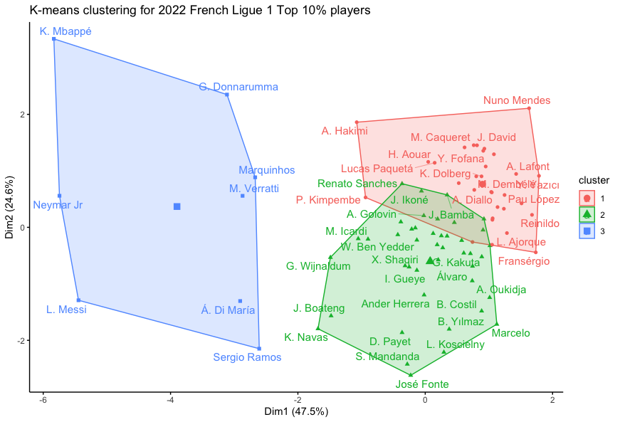
Case – FIFA French Ligue 1 Players
K-means result with all variables. Note that these are 5D balls.
We use the first two PCs to show a 2D figure.

Slide 76
Case – FIFA French Ligue 1 Players
If we used only the two PCs in clustering too.

Slide 77
Another example with Hierarchical Clustering
Data on crime rate, poverty rate, and median income for 41 U.S. cities.
Agglomerative Nesting (AGNES) Clustering method could be used.
Each observation in the data initially forms its own cluster.
The algorithm then successively merges these clusters into larger clusters based on their similarity until all observations are merged into one final cluster, referred to as a root
Several ways of defining similarity between clusters: single linkage, complete linkage, average linkage, centroids, Ward’s method, etc.
City | Crime | Poverty | Income
Barnstable | 710.6 | 3.8 | 58.422
Boston | 1317.7 | 16.7 | 48.729
⋮ | ⋮ | ⋮ | ⋮
Warwick | 139.7 | 3.9 | 59.445

Slide 78
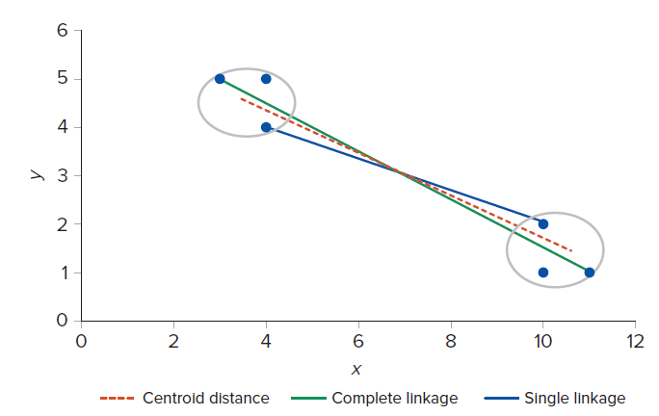
Another example with Hierarchical Clustering
Agglomerative Nesting (AGNES) Clustering needs similarity metric:
Several ways of defining similarity between clusters:
single linkage, complete linkage, average linkage, centroids, Ward’s method, etc.

Slide 79
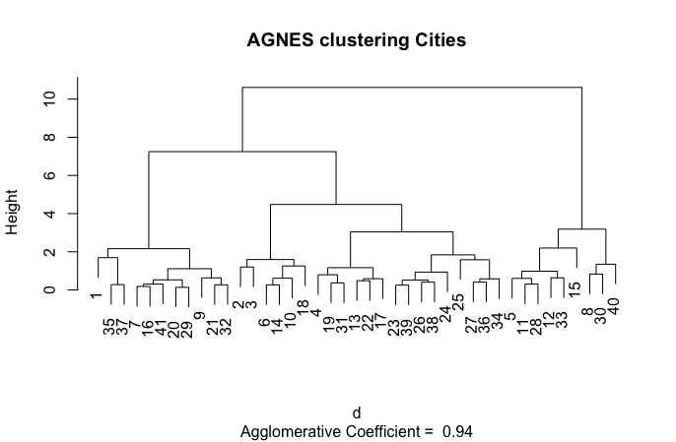
Another example with Hierarchical Clustering
Dendogram: showing the distances across clusters.
We could choose K=3

Slide 80
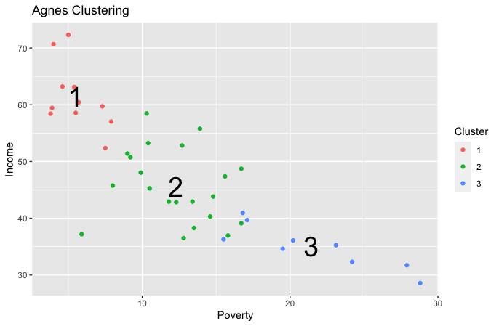
Another example with Hierarchical Clustering
Centroids and clusters.

Slide 81
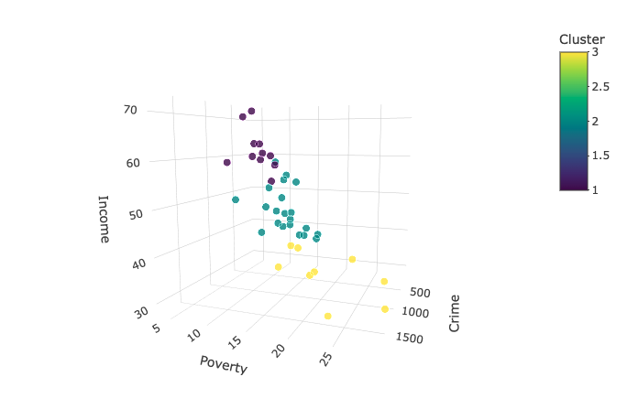
Another example with Hierarchical Clustering
Centroids and clusters.
3D plot

Slide 82
Another example with Hierarchical Clustering
Cluster description: centroids
Cluster | Crime | Poverty | Income | Count
1 | 235.900 | 5.509091 | 61.39264 | 11
2 | 544.219 | 12.276190 | 45.64276 | 21
3 | 1160.544 | 21.455556 | 35.05522 | 9

Slide 83
Fin
We have covered:
OLS: powerful supervised learning approach to make predictions as well as classification. We saw only the basic model.
PCA: unsupervised learning method for dimensionality reduction. Easy to grasp, produces powerful outcomes.
K-means: unsupervised learning method for clustering. Very intuitive technicality and simple to interpret results.
All are easily implemented in R, Python, Stata, etc.
Key to exploring further, advanced methods.

