Slide 1
SCENIC

Slide 2
3 steps
Gene regulatory network inference and generation of co-expression modules
Regulon prediction
Cell Enrichment

Slide 3
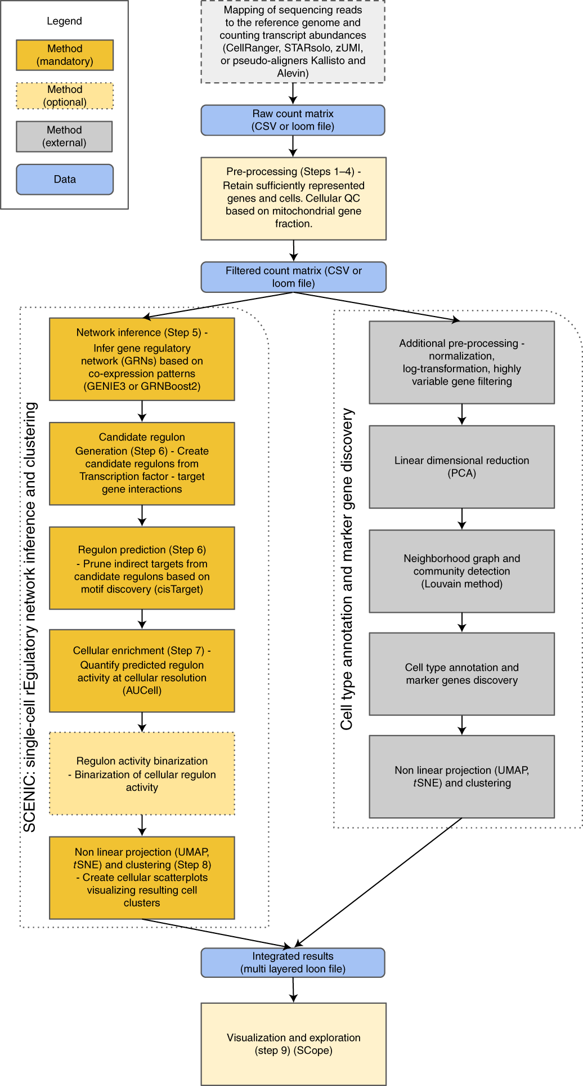

Slide 4
Step 1
GRN inference

Slide 5
GRN Inference
Tree based regression model for every expressed gene
GRNBoost2, GENIE3
The model predicts the expression of the gene across cells from the expression given TFs
Regulatory interaction are infered based on TFs importance in the models
Notes:
GENIE3 paper: Huynh-Thu V. A., Irrthum A., Wehenkel L., and Geurts P. (2010) Inferring regulatory networks from expression data using tree-based methods. PLoS ONE, 5(9):e12776.
https://pubmed.ncbi.nlm.nih.gov/20927193/
GENIE = Gene Network Inference with Ensemble of trees

Slide 6
GENIE3 GEne Network Inference with Ensemble of trees
Each gene is a subproblem – to determining the subset of genes whose expression directly influences or is predictive of the expression of the target gene
This is equivalent to feature selection problem
Use ranking mechanism of tree-based ensemble methods to solve the feature selection problem
Namely Random Forest

Slide 7
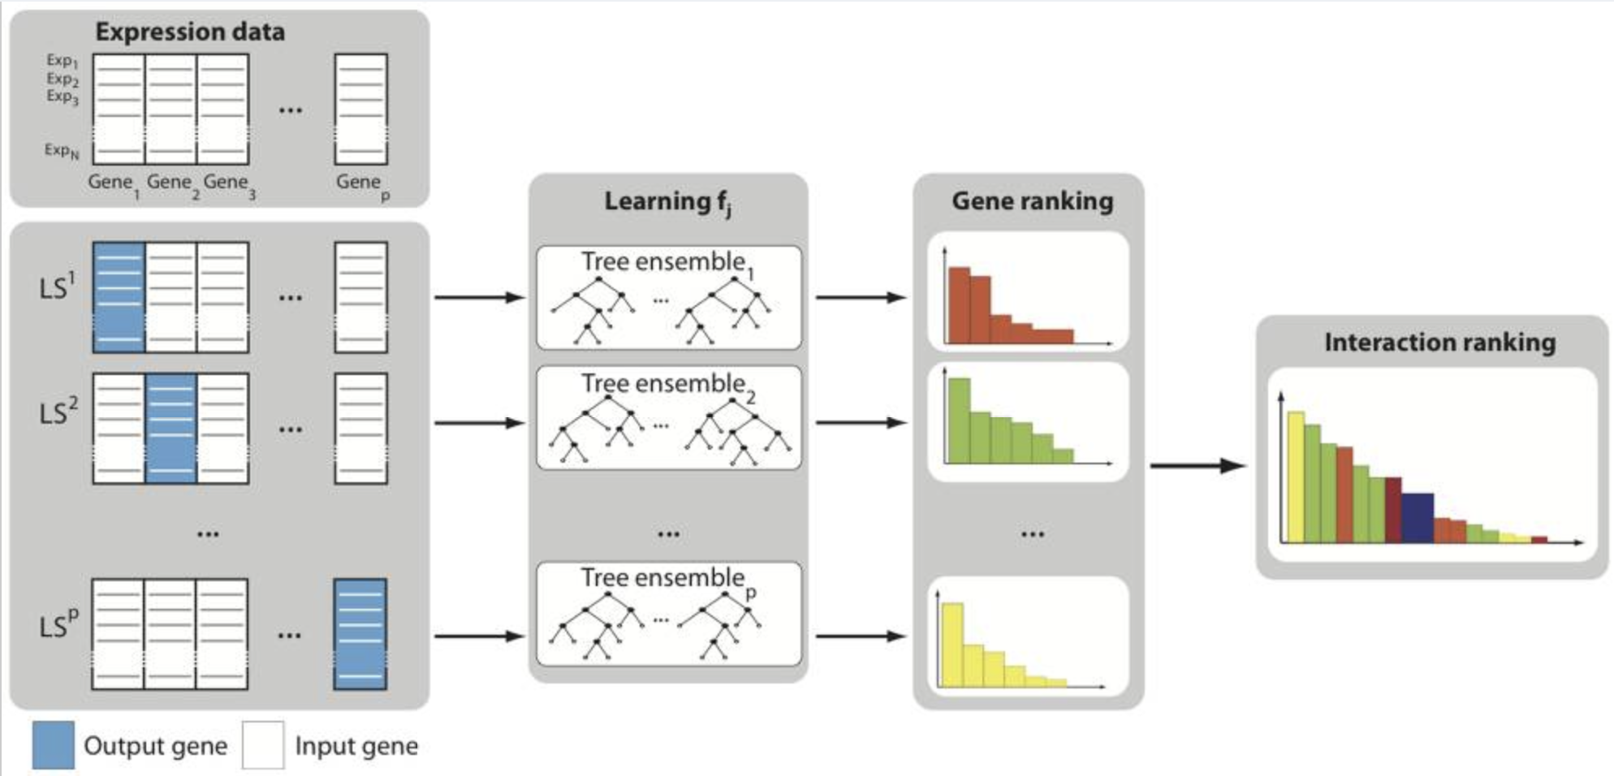
GENIE3
Huynh-Thu V. A. et al. (2010)
Notes:
For j=1 to p:
- generate the learning sample of input-ouput pairs for gene j (LS^{j})
- use feature selection technique on LS^{j} to get a global ranking of all regulatory links

Slide 8
Regression Trees for GRN inference
No assumptions about the nature of gene regulation
Can deal with combinatorial and non-linear interactions
Produces direct GRNs, allows feedback loops
Simple implementation

Slide 9
GRNBoost2
Gradient Boosting machine regression instead of Random Forest
highly parallelizable
Stochastic
Faster alternative to GENIE3
For robustness – run multiple times, and keep the most consistent results
Notes:
https://academic.oup.com/bioinformatics/article/35/12/2159/5184284

Slide 10
GRNBoost2
iteratively train decision trees that predict the regulatory interactions between pairs of genes
Each new decision tree is trained in function of a random subset of observations (90%, hence stochastic)
The remaining observations are used to calculate an estimate of the loss function improvement entailed by adding that tree to the ensemble
When the average of the last n improvement values drops below 0, the early-stopping criterion is met and no more trees are added to the ensemble
Notes:
Note: check for memory boundries on server, can decrease partitions of algorithm as needed.
https://academic.oup.com/bioinformatics/article/35/12/2159/5184284
Hyper parameter default values:
Learning rate: 0.01 (small, in order to encourage large ensembles (hunderds of trees)) ->

Slide 11
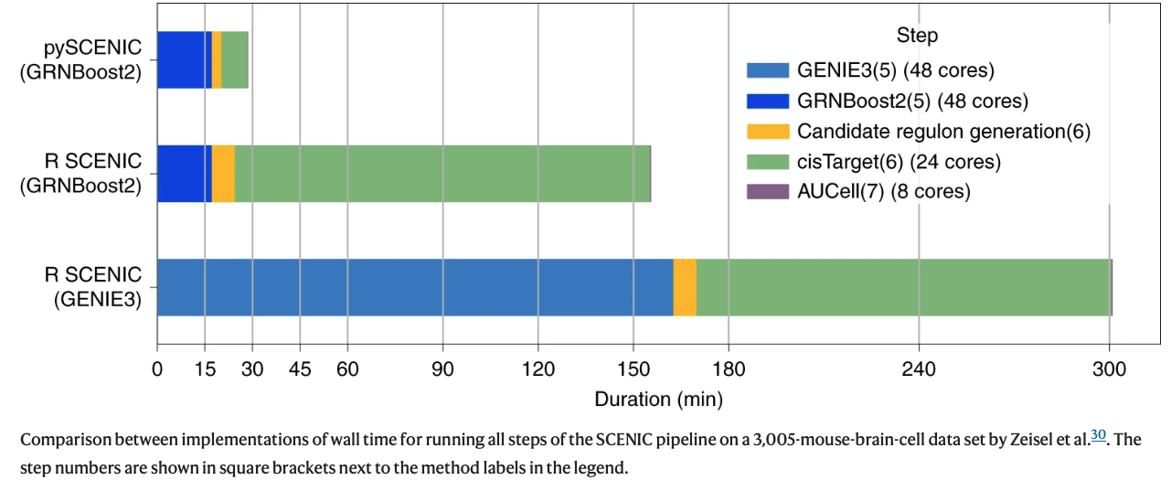
Speed comparison of complete SCENIC workflow
https://www.nature.com/articles/s41596-020-0336-2/figures/2

Slide 12
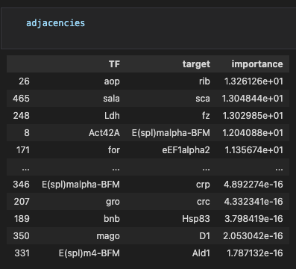
Grnboost2 - code
adjacencies = grnboost2(ex_matrix, tf_names, verbose=True)

Slide 13
Module Generation
A Module = Transcription factor and it’s predicted target genes
Regulons are derived from adjacencies based on 3 methods:
Select best target genes for each TF (Targets importance >nth percentile)
Select top N importance score targets (default N=50)
Select best regulator for each genes (targets of which TF is within its top X regulators)
A distinction between activators and repressors (positive/negative correlation)
As a result, TFs can have multiple different modules
Note: Carrying on with modules with over 20 genes*
Notes:
Is there a difference between regulons and modules?
Correlation: Pearson product-moment correlation coeficient. Low threshold to avoid exessive filtering.
*How many target genes per one TF in Drosophila?

Slide 14
Module Generation - code
modules = list(modules_from_adjacencies(adjacencies, ex_matrix))
Returns a sequence of regulons

Slide 15
Steps 2+3
Regulon prediction (cisTarget)

Slide 16
cisTarget Motif Enrichment
Regulatory regions of the target genes are searched for enriched motifs by comparing scores of cis-regulatory modules (CRMs) near the genes in the module with remaining genes in the genome
CRM scoring is done using hidden Markov models
Keeping TFs and genes in which the TF’s motif is significantly enriched
Notes:
Genome rankings are pre-computed for all motifs in our collection that are linked to a known TF.
https://www.ncbi.nlm.nih.gov/pmc/articles/PMC2910651/

Slide 17
RcisTarget
Selects DNA motifs that are significantly over-represented in the surroundings of the transcription start site (TSS) of the genes in the gene-set
This is achieved by applying a recovery-based method on a database that contains genome-wide cross-species rankings for each motif
The motifs that are annotated to the corresponding TF and obtain a Normalized Enrichment Score (NES) > 3.0 are retained

Slide 18
RcisTarget
For each motif and gene-set, predict candidate target genes (genes with high ranking)
Process described in depth here: https://www.ncbi.nlm.nih.gov/pmc/articles/PMC2910651/ (cisTargetX)

Slide 19
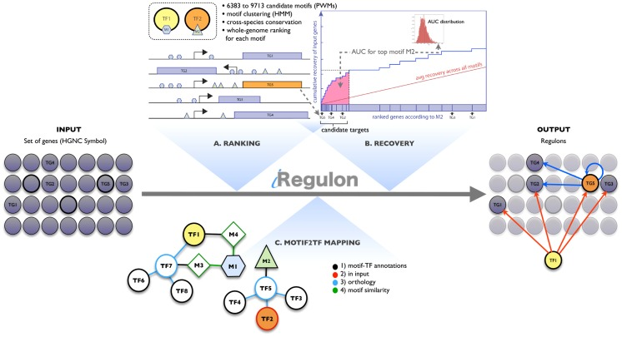
Janky, R., Verfaillie, A., Imrichová, H., Van de Sande, B., Standaert, L., Christiaens, V., Hulselmans, G., Herten, K., Naval Sanchez, M., Potier, D., Svetlichnyy, D., Kalender Atak, Z., Fiers, M., Marine, J. C., & Aerts, S. (2014). iRegulon: from a gene list to a gene regulatory network using large motif and track collections. PLoS computational biology, 10(7), e1003731. https://doi.org/10.1371/journal.pcbi.1003731 https://pubmed.ncbi.nlm.nih.gov/25058159/
Notes:
iRegulon (= cisTarget)
https://journals.plos.org/ploscompbiol/article?id=10.1371/journal.pcbi.1003731

Slide 20
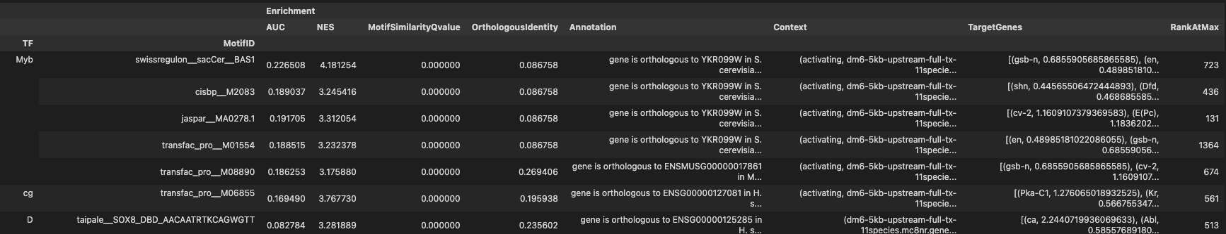
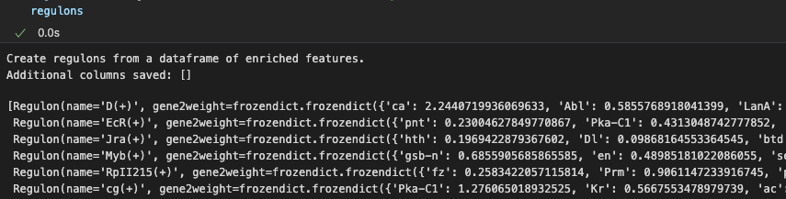
Motif Enrichment - code
df = prune2df(dbs, modules, motif_annotations_fname=motif_annotation_file)
regulons = df2regulons(df) # convert df to regulons

Slide 21
Steps 4
Cellular Enrichment

Slide 22
AUCell
Quantify the activity of the predicted regulons in the individual cells that make up the scRNA-seq experiment (similar to previous step).
Each individual cell transcriptome is modeled as a whole-genome ranking based on its genes expression.
The enrichment of a regulon is assessed via recovery of its targetome on the cell’s whole-genome ranking.
AUC metric measures the relative biological activity of a regulon in a given cell.
https://bioconductor.org/packages/release/bioc/vignettes/AUCell/inst/doc/AUCell.html

Slide 23
AUCell
Uses “Area Under the Curve” (AUC) to calculate weather a critical subset of the gene set is enriched within the expressed genes in each cell
X axis: rank by (general) gene expression (descending order)
Y axis: genes recovered from signature genes (regulon)
AUC meaning=> proportion of expressed genes in regulons and their relative expression value (compared to other genes)
The distribution of AUC scores across all the cells allows exploring the relative expression of the signature genes between different cell types

Slide 24
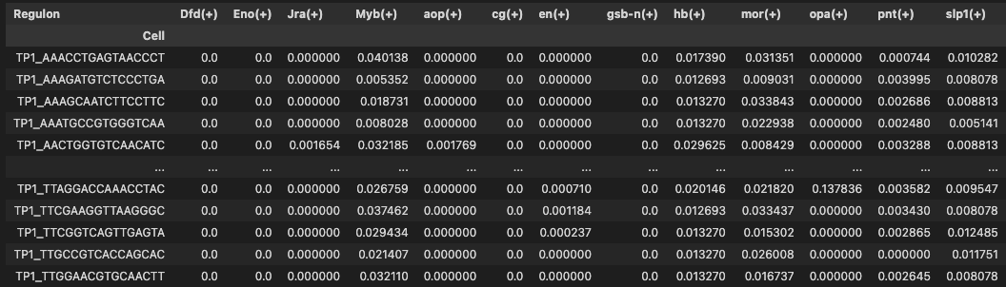
AUCell - code
auc_ntx = aucell(ex_matrix, regulons, num_workers=1)
Notes:
(+) / (-) : activator / suppressor
Value:

Slide 25
AUCell - questions
Two uses to output:
Binary matrix by AUC value cutoff
Use continuous value for clustering (when cell types are known)
I thought: to decide on a cutoff and create binary matrix, and choose % of similar regulons that appear per cell -> how do I choose cutoff? Paper said it can be chosen automatically but idk how yet.
What happens to suppressors? Genes should be ranked low, isn’t that a problem? => we consider only activators.

