Slide 1
Abstract - Straight from the paper
The specification of specific and often unique fates to individual cells as a function
of their position within a developing organism is a fundamental process during the
development of multicellular organisms. The development of the Drosophila
embryonic central nervous system serves as an excellent model system in which
to clarify the developmental mechanisms that link pattern formation to cell-type
specification. The Drosophila embryonic central nervous system develops from a
set of neural stem cells termed neuroblasts. Neuroblasts arise from the ectoderm
in an invariant pattern, and each neuroblast acquires a unique fate based on its
position within this pattern. Two groups of genes recently have been demonstrated
to govern the individual fate specification of neuroblasts. One group, the segment
polarity genes, enables neuroblasts that develop in different anteroposterior
positions to acquire different fates. The second group, referred to as the columnar
genes, ensures that neuroblasts that develop in different dorsoventral domains
assume different fates. When integrated, the activities of the segment polarity and
columnar genes create a Cartesian coordinate system that bestows unique fates
to individual neuroblasts as a function of their position of formation within the
ectoderm.
Notes:
BioEssays 1999;21:922–931. r 1999 John Wiley & Sons, Inc.

Slide 2
Quotes from the text
Most animals are composed of a vast array of different cell types, tissues, and organs and larger structures such as appendages, that are themselves composed of many different cell types and tissues.
The development of a functional organism, or even appendage, requires the development of the correct number of each different cell type and that these
differently fated cells develop in a specific and largely invariant pattern within the organism.
A central issue of developmental biology, thus, revolves around the elucidation of the genetic regulatory mechanisms that integrate the processes of cell-type specification with those that position where and determine when different cell types form in a developing animal (pattern formation).
The development of the Drosophilacentral nervous system (CNS) serves as an ideal model system through which to illuminate the developmentalprocesses that link pattern formation with cell-type specification.

Slide 3
The process of assigning specific and distinct fates to individual cells based on their position within a developing organism is crucial in the development of multicellular organisms. The embryonic central nervous system of Drosophila serves as an ideal model to study the mechanisms that connect pattern formation to cell-type specification. In this system, neural stem cells called neuroblasts are responsible for the development of the central nervous system. Neuroblasts arise in a consistent pattern from the outer layer of cells (ectoderm), and each neuroblast acquires a unique fate depending on its position within this pattern.
Overall, by understanding how pattern formation and cell-type specification are connected in the Drosophila embryonic central nervous system, researchers gain insights into the fundamental mechanisms underlying cell fate determination in development.

Slide 4
Pattern formation is the establishment of organized arrangements of cells or tissues during development. The spatial positioning of cells plays a critical role in determining their specific fates in multicellular organisms.
The Drosophila embryonic central nervous system serves as a model to understand the connection between pattern formation and cell-type specification. It develops from neuroblasts, neural stem cells originating from the ectoderm. The fate of each neuroblast is determined by its position within the pattern, resulting in distinct cell types.

Slide 5
SCENIC
Notes:
TO DO -> create a simplified verseion

Slide 6
3 steps
Gene regulatory network inference and generation of co-expression modules
Regulon prediction
Cell Enrichment

Slide 7
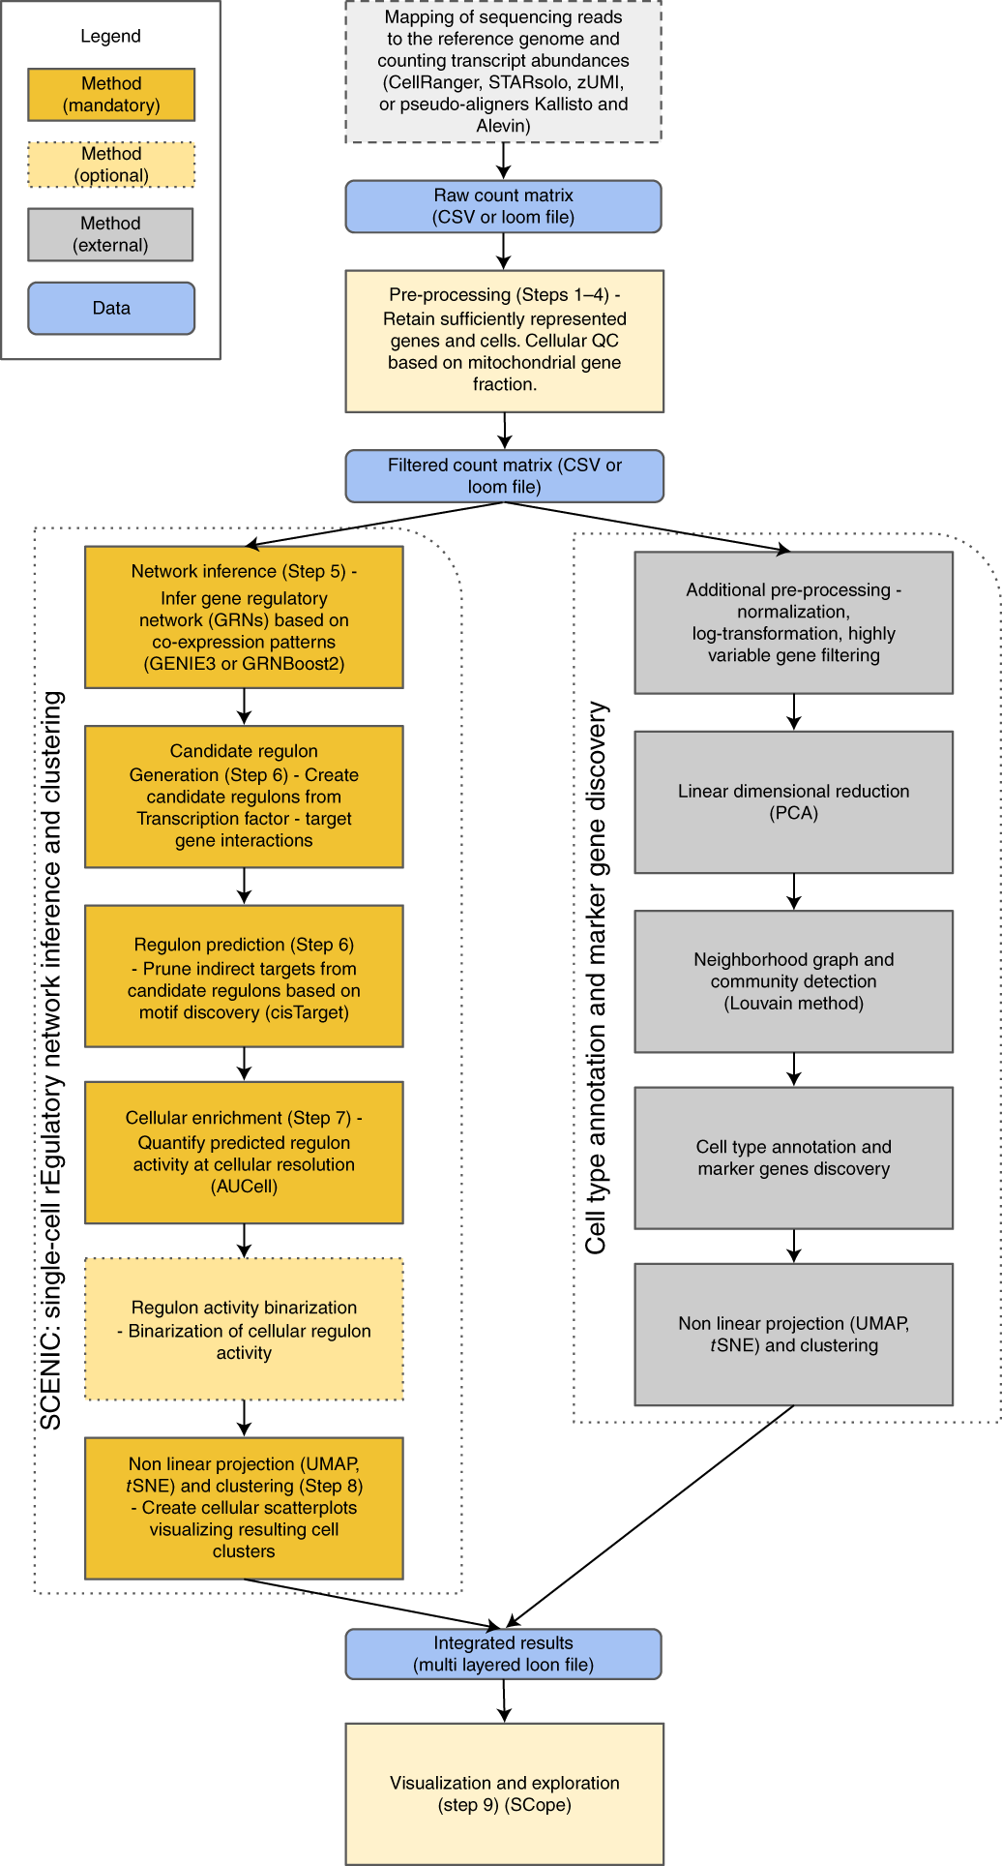

Slide 8
Step 1
GRN inference

Slide 9
GRN Inference
Tree based regression model for every expressed gene
GRNBoost2, GENIE3
The model predicts the expression of the gene across cells from the expression given TFs
Regulatory interaction are infered based on TFs importance in the models
Notes:
GENIE3 paper: Huynh-Thu V. A., Irrthum A., Wehenkel L., and Geurts P. (2010) Inferring regulatory networks from expression data using tree-based methods. PLoS ONE, 5(9):e12776.
https://pubmed.ncbi.nlm.nih.gov/20927193/
GENIE = Gene Network Inference with Ensemble of trees

Slide 10
GENIE3 GEne Network Inference with Ensemble of trees
Each gene is a subproblem – to determining the subset of genes whose expression directly influences or is predictive of the expression of the target gene
This is equivalent to feature selection problem
Use ranking mechanism of tree-based ensemble methods to solve the feature selection problem
Namely Random Forest *
Notes:
In a Random Forests ensemble,
each tree is built on a bootstrap sample from the original learning sample and, at each test node, K attributes are selected at random among all candidate attributes before determining the best split.
* There is also Extra-Trees (instead of RF): the best split is determined among K random splits, each determined by randomly selecting one input (without replacement) and a threshold.

Slide 11
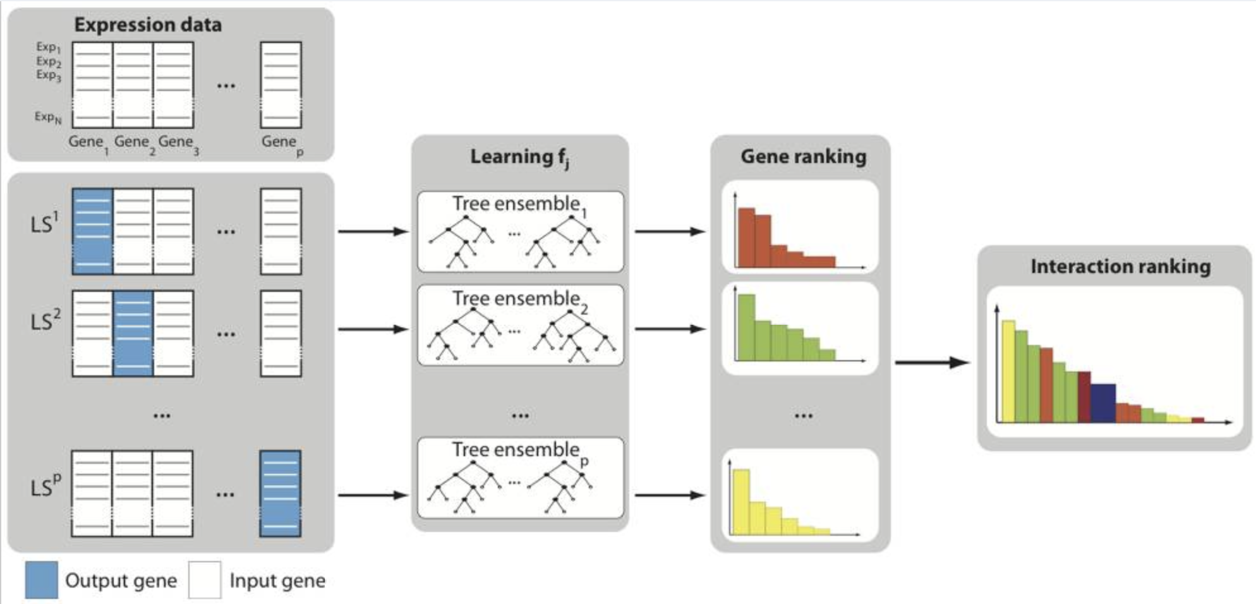
GENIE3
Huynh-Thu V. A. et al. (2010)
Notes:
For j=1 to p:
- generate the learning sample of input-ouput pairs for gene j (LS^{j})
- use feature selection technique on LS^{j} to get a global ranking of all regulatory links
For each gene (j) a learning sample (LS) is generated with expression levels of j as output values.

Slide 12
Advantages of Regression Trees
No assumptions about the nature of gene regulation
Can deal with combinatorial and non-linear interactions
Produces direct GRNs, allows feedback loops
Simple implementation

Slide 13
GRNBoost2
Gradient Boosting machine regression instead of Random Forest
highly parallelizable
Stochastic
Faster alternative to GENIE3
For robustness – run multiple times, and keep the most consistent results
Notes:
https://academic.oup.com/bioinformatics/article/35/12/2159/5184284
GENIE3 -> Bagging
GRNBoost2 -> Boosting

Slide 14
GRNBoost2
iteratively train decision trees that predict the regulatory interactions between pairs of genes
Each new decision tree is trained in function of a random subset of observations (90%, hence stochastic)
The remaining observations are used to calculate an estimate of the loss function improvement entailed by adding that tree to the ensemble
When the average of the last n(=25) improvement values drops below 0, the early-stopping criterion is met and no more trees are added to the ensemble
Notes:
Note: check for memory boundries on server, can decrease partitions of algorithm as needed.
https://academic.oup.com/bioinformatics/article/35/12/2159/5184284
Hyper parameter default values:
Learning rate: 0.01 (small, in order to encourage large ensembles (hunderds of trees)) ->

Slide 15
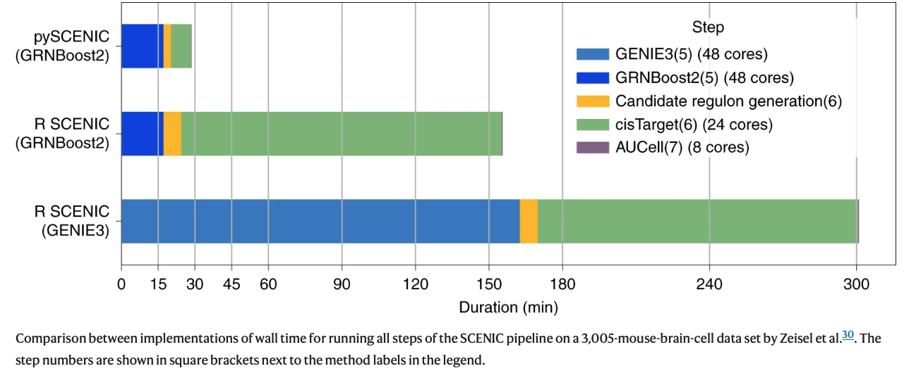
Speed comparison of complete SCENIC workflow
https://www.nature.com/articles/s41596-020-0336-2/figures/2

Slide 16
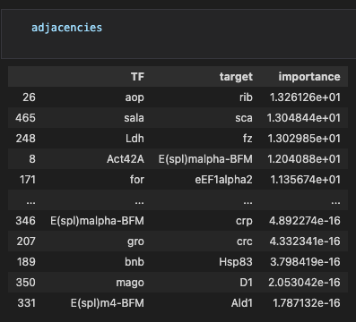
Grnboost2 - code
adjacencies = grnboost2(ex_matrix, tf_names, verbose=True)

Slide 17
Module Generation
A Module = Transcription factor and it’s predicted target genes
Regulons are derived from adjacencies based on 3 methods:
Select best target genes for each TF (Targets importance >nth percentile)
Select top N importance score targets (default N=50)
Select best regulator for each genes (targets of which TF is within its top X regulators)
A distinction between activators and repressors (positive/negative correlation) – considering only activators*
As a result, TFs can have multiple different modules
Note: Carrying on with modules with over 20 genes
Notes:
Is there a difference between regulons and modules?
Correlation: Pearson product-moment correlation coeficient. Low threshold to avoid exessive filtering.
By default, only positively correlated modules are used in the subsequent steps because these negatively correlated modules are less numerous, their regulatory interaction weights are lower and the resulting regulons show overall less motif enrichment. (https://www.nature.com/articles/s41596-020-0336-2, module generation, step 6)
correlation coefficient is calculated using the entire expression matrix, including dropouts. This avoids situations in which the correlation coefficient is determined by a small subset of cells with positive expression in the two genes being assessed. However, it is also possible to mask the cells that are involved in a dropout event for any of the two genes.

Slide 18
Module Generation - code
modules = list(modules_from_adjacencies(adjacencies, ex_matrix))
Returns a sequence of regulons

Slide 19
Steps 2+3
Regulon prediction (cisTarget)

Slide 20
Motif Enrichment
Modules contain both direct and indirect targets (only based on coexpression)
Therefor – putative regulatory regions of the target genes are searched for enriched motifs
Comparing scores of cis-regulatory modules (CRMs) near the genes in the module with the remaining genes in the genome
CRM calculated with HMM
Retaining regulons in which the TF’s motif is significanlty enriched
Notes:
Genome rankings are pre-computed for all motifs in our collection that are linked to a known TF.
https://www.ncbi.nlm.nih.gov/pmc/articles/PMC2910651/

Slide 21
iRegulon (& i-cisTarget)
Ranking: Rank all genes in the genome for their likelyhood of being a target gene of a certain input motif (pre-calculated)
Recovery: Genomic ranks of a set of coexpressed genes are plotted in a cumulative recovery curve -> X: motifs by ranks, Y: recovered from data**
Calclate AUC, threshold is the first 3% of the ranked genes
Notes:
Genome rankings are pre-computed for all motifs in our collection that are linked to a known TF.
https://www.ncbi.nlm.nih.gov/pmc/articles/PMC2910651/
*each TF may have multiple motifs!

Slide 22
1. Ranking
For each gene, a regulatory search space is scanned for homotypic CRMs using a Hidden Markov Model (Cluster-Buster)
For N PWMs (number of motifs), N ranked lists of genes sorted by likelyhood of being a target gene are generated
Orthologous search spaces in X other species are determined (UCSC listover tool), and scanned with the same PWMs.
Rank aggregation (original refseq + other species) - OrderStatistics
Notes:
Cluster-Buster https://www.ncbi.nlm.nih.gov/pmc/articles/PMC168947/
Cis-regulatory modules (CRMs) - DNA sequence elements that have transcriptional regulatory activity. (promoters, enhancers, silencers)

Slide 23
2. Recovery
Input: set of coexpressed genes
AUC is computed in the top 3% of the ranking from the last step
AUC values are normalized (Normalized Enrichment Score)
NES Cutoff: 3, corresponding to a False Discovery Rate (FDR) between 3%-9%
For each motif and gene set - predict candidate target genes (genes that are ranked above the leading edge)

Slide 24
RcisTarget
Selects DNA motifs that are significantly over-represented in the surroundings of the transcription start site (TSS) of the genes in the gene-set
a recovery-based method on a database that contains genome-wide cross-species rankings for each motif
The motifs that are annotated to the corresponding TF and obtain a Normalized Enrichment Score (NES) > 3.0 are retained
For each motif and gene set - predict candidate target genes (genes that are ranked above the leading edge)
Notes:
Leading edge:
Methods part of the first SCENIC paper

Slide 25
Motif2TF mapping
If we use only the direct annotations of candidate TFs, only a small fraction of motifs can be associated with Drosophila TFs.
Motif2TF – database corresponding to a network of associations between motifs and TFs
TFs are ranked, prioritizing directly annotated TFs, then the TF present in the input set, then the ones that are found by gene homology and finally the TFs found using motif similarity.
Notes:
https://journals.plos.org/ploscompbiol/article?id=10.1371/journal.pcbi.1003731
I am not sure weather this step is done in between ranking and recovery!

Slide 26
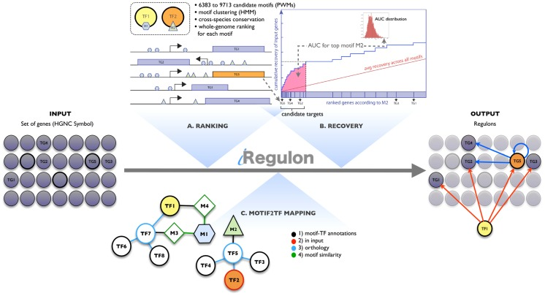
Janky, R., Verfaillie, A., Imrichová, H., Van de Sande, B., Standaert, L., Christiaens, V., Hulselmans, G., Herten, K., Naval Sanchez, M., Potier, D., Svetlichnyy, D., Kalender Atak, Z., Fiers, M., Marine, J. C., & Aerts, S. (2014). iRegulon: from a gene list to a gene regulatory network using large motif and track collections. PLoS computational biology, 10(7), e1003731. https://doi.org/10.1371/journal.pcbi.1003731 https://pubmed.ncbi.nlm.nih.gov/25058159/
Notes:
iRegulon (= cisTarget)
https://journals.plos.org/ploscompbiol/article?id=10.1371/journal.pcbi.1003731
Detection of the target genes
Fig. 1B. The target gene recovery is plotted along the whole-genome ranking for a given motif (blue curve) and compared to the average recovery + (2× standard deviation) (red curve) for all motifs in the collection. The leading edge corresponds to the rank where the difference between the signal (blue curve) and the background (red curve) is maximal within the top ranked genes (the latter is defined by the Rank Threshold parameter). The input genes that have a better ranking than the rank at the leading edge are predicted as target genes for the given motif or track.

Slide 27
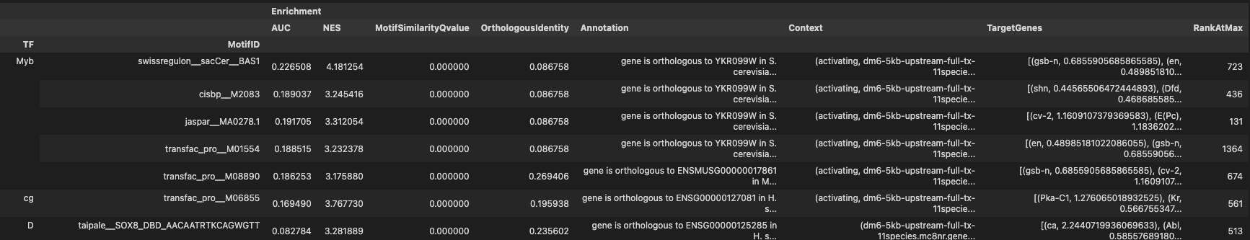
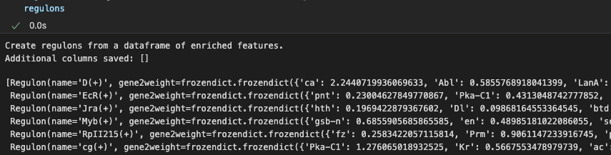
Motif Enrichment - code
df = prune2df(dbs, modules, motif_annotations_fname=motif_annotation_file)
regulons = df2regulons(df) # convert df to regulons

Slide 28
Steps 4
Cellular Enrichment

Slide 29
AUCell
Quantify the activity of the predicted regulons in the individual cells that make up the scRNA-seq experiment (similar to previous step).
Each individual cell transcriptome is modeled as a whole-genome ranking based on its genes expression.
The enrichment of a regulon is assessed via recovery of its targetome on the cell’s whole-genome ranking.
AUC metric measures the relative biological activity of a regulon in a given cell.
https://bioconductor.org/packages/release/bioc/vignettes/AUCell/inst/doc/AUCell.html

Slide 30
AUCell
Uses “Area Under the Curve” (AUC) to calculate weather a critical subset of the gene set is enriched within the expressed genes in each cell
X axis: rank by (general) gene expression (descending order)
Y axis: genes recovered from signature genes (regulon)
AUC meaning=> proportion of expressed genes in regulons and their relative expression value (compared to other genes)
The distribution of AUC scores across all the cells allows exploring the relative expression of the signature genes between different cell types
Notes:
# TO DO -> check if RNA-seq analysis (fold change) exists in validation

Slide 31
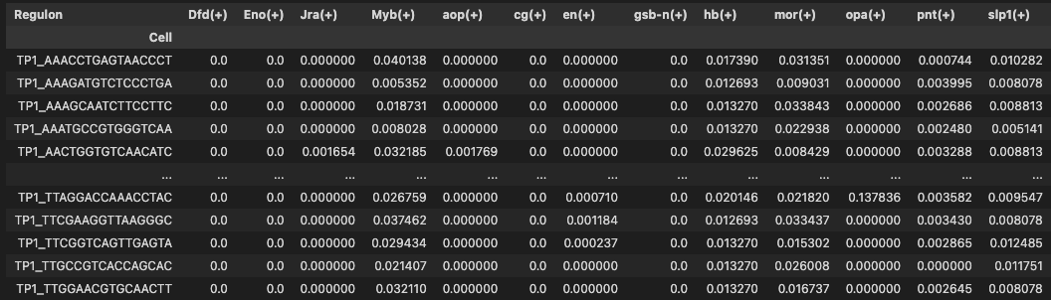
AUCell - code
auc_ntx = aucell(ex_matrix, regulons, num_workers=1)
Notes:
(+) / (-) : activator / suppressor
Value:

Slide 32
AUCell– possible limitations
AUCell (Step 7) provides minimal comparability
The metric used by AUCell to quantify the activity of a predicted regulon in individual cells of an experiment is an unnormalized enrichment score. Therefore, it can only be used to compare the activity of a regulon across cells of the same experiment. Because the enrichment score is not normalized for the size of the predicted targetome, the scores of different regulons cannot be compared.
* Different time points - batch effect is taken care of, should be ok?
Notes:
https://www.nature.com/articles/s41596-020-0336-2

Slide 33
Further Analysis

Slide 34
AUCell – further analysis
Two uses of AUCell values
Binary matrix by AUC value cutoff
Use continuous value for clustering (when cell types are known)

Slide 35
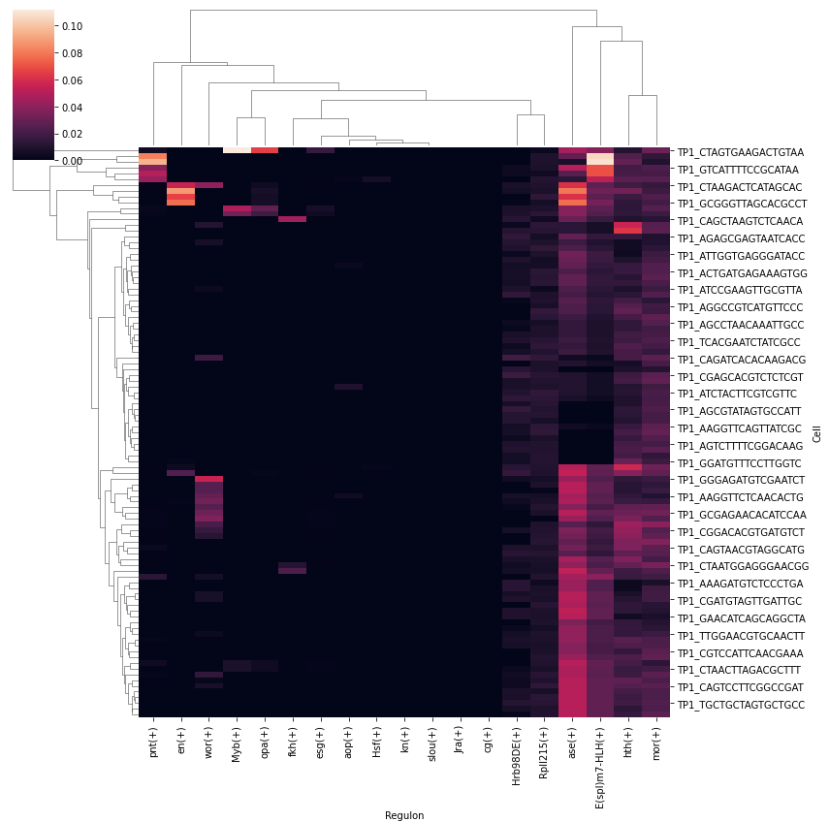
Regulon activity - heatmap
sns.clustermap(auc_ntx, figsize=(12,12))
Visualizatio of the AUCell table as heatmap
Notes:
(+) / (-) : activator / suppressor
Value:

Slide 36
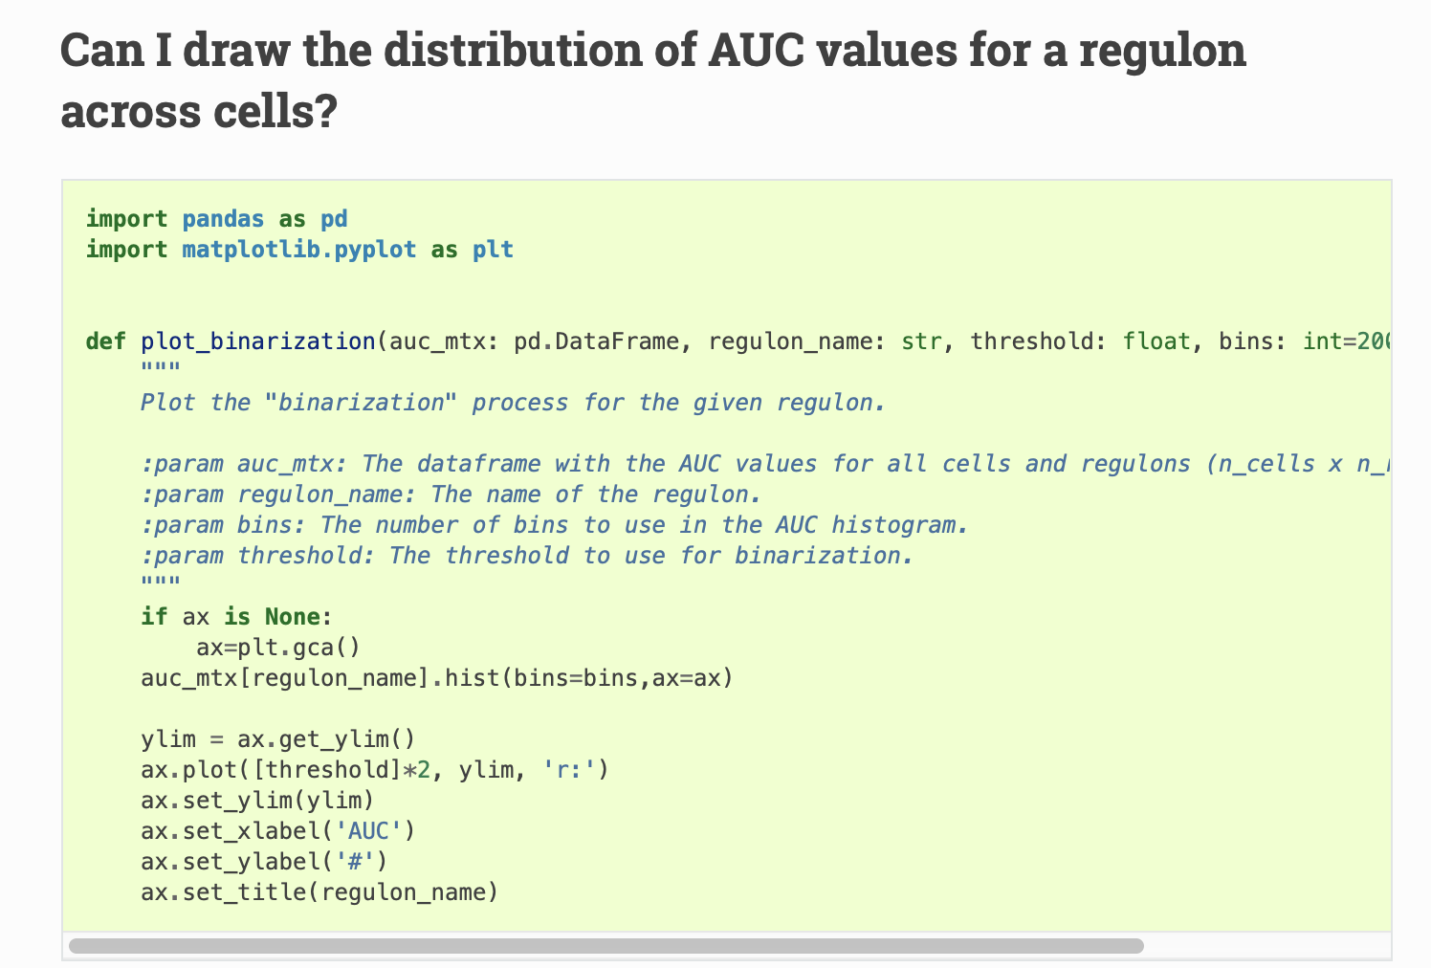
AUCell – from pySCENIC FAQ
Notes:
https://pyscenic.readthedocs.io/en/stable/faq.html

Slide 37
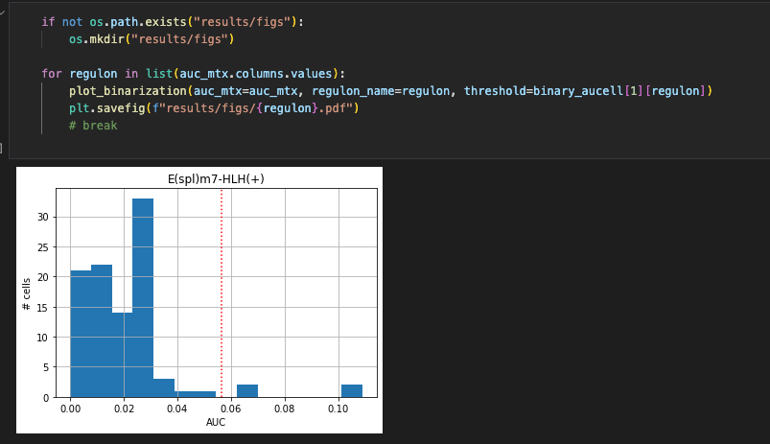
Threshold per regulon

Slide 38
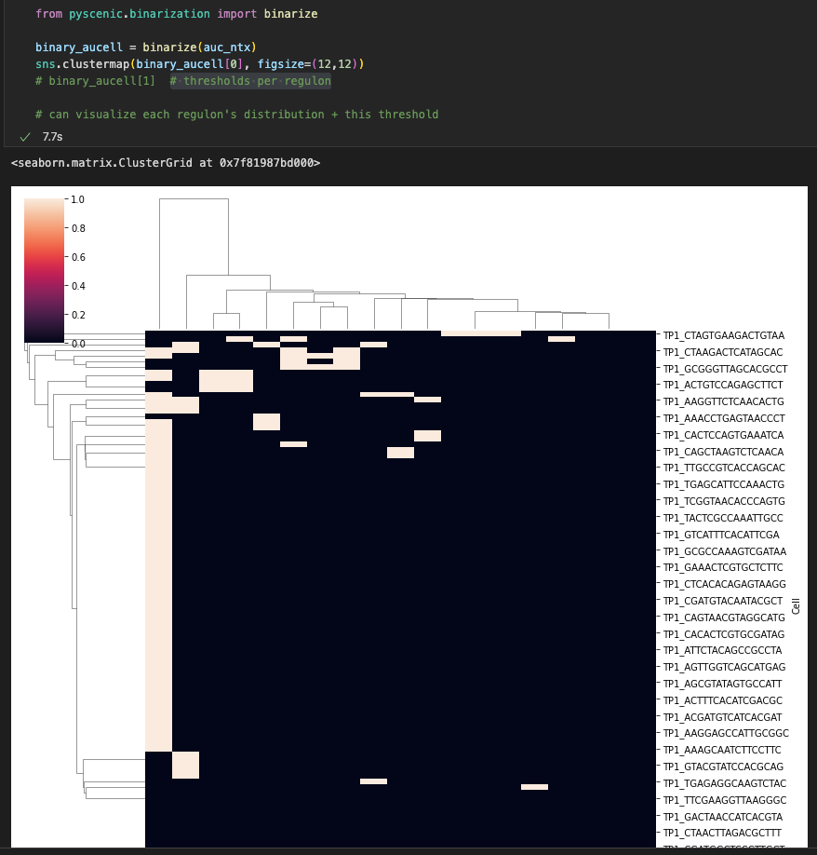
Regulon activity – binarization + heatmap
Binarization of AUCell values with a specific threshold for every regulon

Slide 39
Cell-type specific regulators
Regulon Specificity Score (RSS): measures the distance between the regulon’s enrichment distribution and cell type annotations distribution using Jensen-Shannon Divergence*.
For a cell type, RSS for all regulons is ranked from high to low (too high – outliers).
See pySCENIC notebooks for code..
Notes:
Jensen-Shannon divergence: method of measuring the similarity between two probability distributions.
https://www.nature.com/articles/s41596-020-0336-2

Slide 40
Clustering based on Regulon Activity
AUCell is a dimentional reduction – number of discovered regulons is typically much lower than the number of genes
Instead of reducing dimentionality vis PCA/t-SNE etc..
Scope – a tool for interactive visualization

Slide 41
