Slide 1
General Refinery Process &
Storage Equipment

Slide 2
Refinery process unit
Petronas Second Refinery - Stage 1 (PSR-1)
  Crude Distillation Unit & Condensate Fractioner
  Naphtha Hydrotreating Unit
  Platforming CCR Unit
  Saturated Gas Concentration Unit
  Sour Water Stripping Unit
  Kerosene & Heavy Naphtha Treating Unit
  Mercury Removal Unit

Slide 3
Refinery process unit (cont’…)
Petronas Second Refinery - Stage 2 (PSR-2)
  Crude Distillation Unit
  Vacuum Distillation Unit
  Saturated Gas Recovery Unit
  Hydrogen Collection & Distribution System
  Amine Regeneration Unit
  Sour Water Treating Unit

Slide 4
Refinery process unit (cont’…)
Petronas Second Refinery - Stage 2 (PSR-2)
  Naphtha Hydrotreater
  CCR Platformer Unit
  C₆ Isomerisation Unit
  Saturated LPG Treating Unit
  Straight Run Naphtha Treating Unit
  Kerosene Treating Unit
  Distillate Hydrotreater

Slide 5
Refinery process unit (cont’…)
Petronas Second Refinery - Stage 2 (PSR-2)
  Hydrocracker Unit
  Delayed Coker Unit
  Sulfur Recovery Unit
  Hydrogen Production Unit

Slide 6
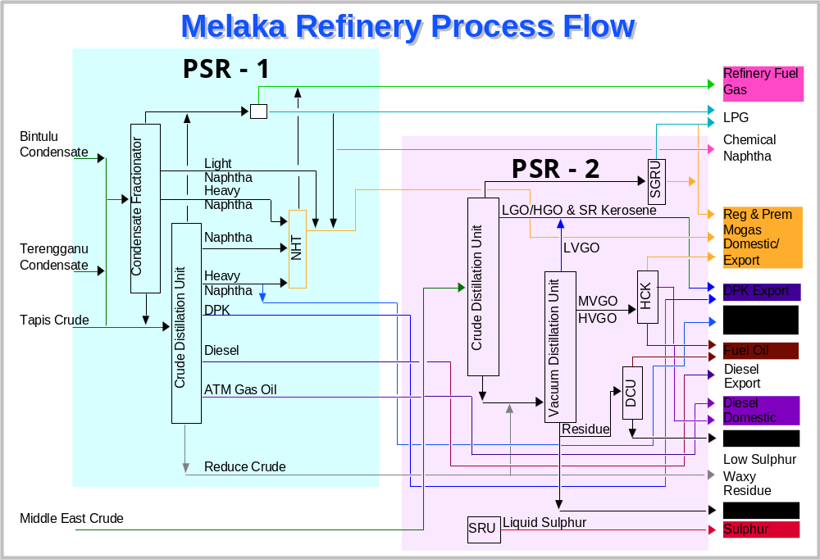
Overall PSR-1 & PSR-2 process flow

Slide 7
Clean Automotive Fuel Production
Catalytic Reformer Unit
- to produce high octane reformate
Isomerization Unit
  - to produce isohexane from normal hexane
Hydrocracking Unit
  - to convert the medium and heavy vacuum gas
  oils into more valuable distillate product

Slide 8
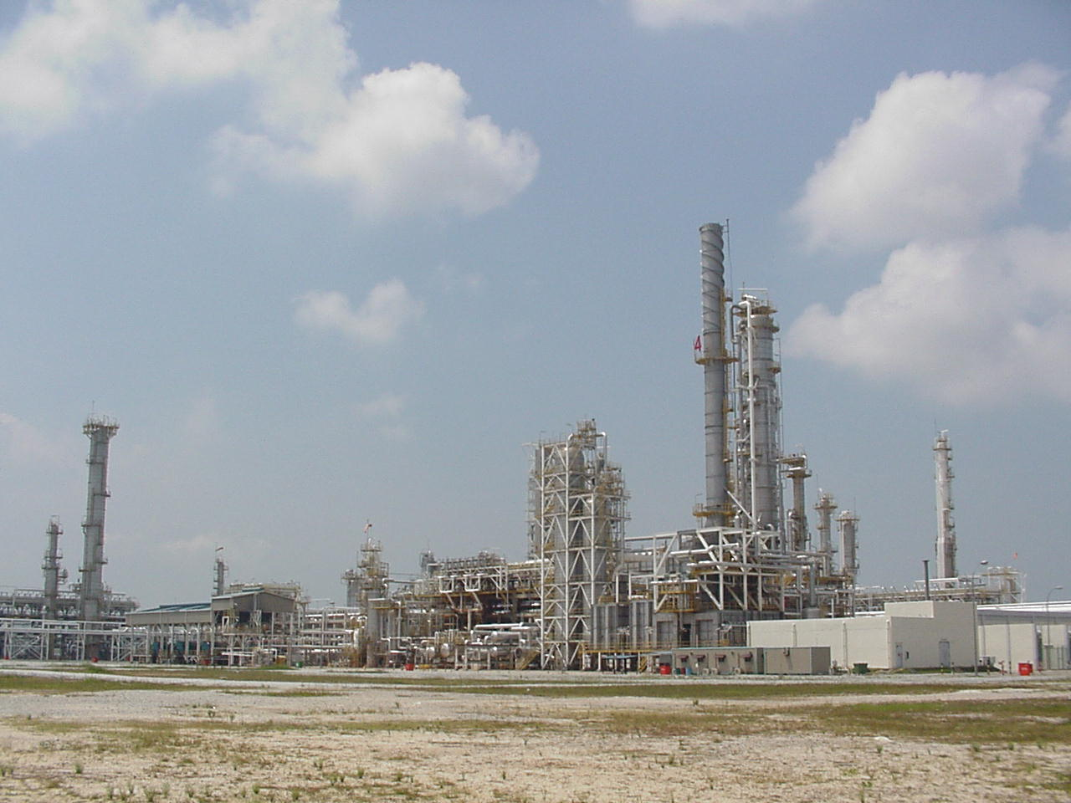
Hydrocracking Unit

Slide 9
Storage Tank
Floating roof
- for storage crude, condensate, intermediate
and light finished product
Cone with internal floating roof
  - for intermediate and medium finished product
Cone roof
    - for heavy product and ancillary e.g water etc.
Underground bullet tank
  - for LPG storage

Slide 10
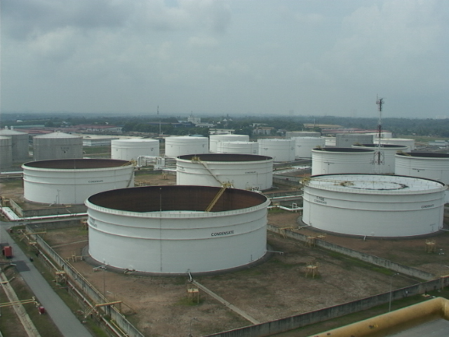
Storage Tank

