Slide 1
WELCOME TO PETRONAS MELAKA REFINERY
1

Slide 2

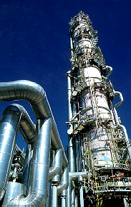








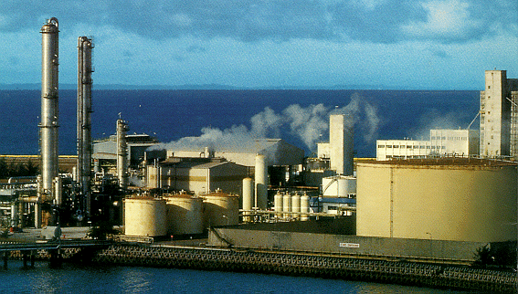

PETRONAS - AN INTEGRATED PETROLEUM COMPANY
PETRONAS is a fully integrated petroleum company involved in exploration & production, refining, gas processing and transmission, gas liquefaction, manufacturing of petrochemical products, marketing and trading, and integrated logistics.
CRUDE OIL
CRUDE OIL
LPG
GASOLINE
JET FUEL
DIESEL
FUEL OIL
CONDENSATES
MARKETING FACILITIES
OIL
REFINING
PETROLEUM PRODUCTS
AROMATICS
PETROCHEMICAL
MTBE
ETHYLENE
POLYETHYLENE
PROPYLENE
POLYPROPYLENE
METHANOL
AMMONIA
VCM
ETHYLENE
DERIVATIVES
CONDENSATES
EXPLORATION &
PRODUCTION
LPG
SALES GAS
PROCESSING
GAS
FERTILISERS
PIPED GAS
LNG
LIQUEFACTION
LNG
LNG
Supported by R&D, Technical Services, Education and Training.
2
Notes:
To recap, PETRONAS – after 30 years of operation – has grown to become a fully integrated company engaged in the whole spectrum of the oil and gas activities.

Slide 3
PETRONAS’ CORE BUSINESSES
E & P
BUSINESS
OIL
BUSINESS
GAS
BUSINESS
PETROCHEMICAL
BUSINESS
LOGISTICS & MARITIME
BUSINESS
Exploration & Production of oil and gas
Oil refining
Marketing & distribution of petroleum products
Trading of crude oil
Gas processing & liquefaction
Gas transmission pipeline operations
Marketing of LNG
Petrochemical manufacturing & marketing
Shipping
Trucking & Warehousing services
Haulage services
3
Notes:
PETRONAS’ core business activities are divided into five areas:
Exploration & Production Business
Oil Business
Gas Business
Petrochemical Business
Logistics & Maritime Business

Slide 4
PETRONAS’ OIL BUSINESS
OIL
BUSINESS
Holding Co Units
Refining
Trading
Marketing
Crude oil
Group
PP(T)SB
PETCO
PDB (69.86%)
PMSL
LPG & Pet.
Products Group
PP(M)SB
PNGV
ENGEN (80%)
PCCL
Planning & Mfg.
Group
MRC (53%)
PMTCL
ENGEN (80%)
PDL (94%)
Comm. & Retail
Sales Group
PEPI (60%)
Lube Business
Group
IPPL (50%)
Thang Long
(49%)
MPTCL
4
Notes:
PETRONAS’ Oil Business involves Oil Refining, Marketing and Distribution of Petroleum Products, and Trading of Crude Oil.
These activities are undertaken by these various Holding Company Units as well as Operating Units.

Slide 5
SCOPE OF OIL BUSINESS
SALES/ TRADING
CRUDE OIL/COND. from E&P
SALES/TRADING
CRUDE OIL/COND PURCHASED
REFINING
DOMESTIC MARKETING
PRODUCTS PURCHASED
BLENDING
O/SEAS INLAND MARKETING
BASE OIL
LUBE
BLENDING
SALES
BASE OIL
PURCHASED
5
Notes:
The scope of Oil Business
(Please prepare speaker notes)

Slide 6
PETRONAS CRUDE OIL EXPORTS FY 2003
USA 3%
THAILAND 16%
MYANMAR 3%
SOUTH KOREA 13%
PHILIPPINES 3%
JAPAN 9%
BRUNEI 1%
CHINA 12%
OTHERS - 3%
INDIA 18%
TAIWAN - 1%
SRI LANKA 3%
SINGAPORE - 2%
INDONESIA 6%
AUSTRALIA 12%
NEW ZEALAND 2%
TOTAL PETRONAS CRUDE OIL EXPORTS : 114.5 MILLION BBLS
Note: Financial Year ended 31 March 2003
6
Notes:
For the Financial Year 2003 PETRONAS crude oil exports amounted to 114.5 million barrels.
The crude was exported to:
India
Thailand
South Korea
China
Australia
Japan
Indonesia
USA
Sri Lanka
The Philippines
Myanmar
New Zealand
Singapore
Brunei
Taiwan

Slide 7
PETRONAS’ OIL BUSINESS DIMENSIONS
Contributes about 60% to PETRONAS Group’s revenue
Over 850 kbpd of Crude Oil marketed & traded in FY 02/03
Total refining capacity of about 360 kbpd
About 650 kbpd of petroleum products marketed & traded in FY 02/03
Retail presence in over 20 countries. In South East Asia and Sudan under PETRONAS brand. In the rest of Africa under ENGEN brand.
7

Slide 8



PETRONAS’ REFINERY FACILITIES
PETRONAS has three refining facilities:
PETRONAS Refinery, Kertih, Terengganu
PETRONAS Melaka Refinery Complex, Melaka
Engen Refinery, Durban, South Africa
8
Notes:
PETRONAS has three refining facilities:
PETRONAS Refinery in Kertih, Terengganu. This refinery consists of 40,000 barrels per day refinery and a 65,000 bpd condensate splitter.
PETRONAS Melaka Refinery Complex, which consists of two trains, each with a 100,000 bpd capacity.
Engen Refinery in Durban, South Africa. This refinery is owned by Engen Ltd, a subsidiary of PETRONAS. The refinery has the capacity to refine 105,000 bpd.

Slide 9
PETRONAS MELAKA REFINERY COMPLEX
PETRONAS Melaka Refinery Complex complex comprises 2 processing trains:
Train 1 (PSR-1)
Facility : Sweet Train Hydroskimming Facility
Capacity : 100,000 BPD
Ownership : 100% PETRONAS
Operator : PETRONAS Penapisan (Melaka) Sdn Bhd
Train 2 (PSR-2)
Facility : Sour Train Deep Conversion Facility
Capacity : 100,000 BPD
Ownership : Malaysian Refining Company Sdn Bhd
(53% PETRONAS; 47% ConocoPhillips)
Operator : PETRONAS Penapisan (Melaka) Sdn Bhd
9

Slide 10
PETRONAS MELAKA REFINERY – TRAIN 1 (PSR 1)
Owner : PETRONAS
Operator : PETRONAS Penapisan (Melaka) Sdn Bhd
Area : 504 acres
Project Cost : RM 2.3 bil
Start Operation : April 1994
Design Capacity : 100,000 BPD (1 barrel = 160 litres)
(75% Crude Oil, 25% Condensates)
Maximum Production Capacity : 115,000 BPD (15% above design capacity)
10

Slide 11
PSR 1 - PROCESS
Crude Distillation Unit
Condensate Fractionator
Naphtha Hydrotreater Unit
Catalytic Reformer
Saturated Gas Concentration Unit
Kerosene and Heavy Naphtha Treating Unit
Sour Water Stripping Unit
11

Slide 12
PSR 1 - FEEDSTOCK & PRODUCTS
Feedstock
Tapis Crude (Terengganu)
Terengganu Condensate
Bintulu Condensate (Sarawak)
Products
Liquefied Petroleum Gas (LPG)
Petrochemical Naphtha
Motor Gasoline
Kerosene/Jet A1
Diesel (Regular)
Low Sulphur Waxy Residue (LSWR)
12

Slide 13
PETRONAS MELAKA REFINERY – TRAIN 2 (PSR 2)
Owner : Malaysian Refining Company Sdn Bhd
Operator : PETRONAS Penapisan (Melaka) Sdn Bhd
Area : 302 acres
Project Cost : RM 4.9 bil
Start Operation : April 1999
Design Capacity : 100,000 BPD
(75% Sour Crude, 25% Sweet Crude)
Maximum Production Level : 120,000 BPD
(20% above design capacity)
13

Slide 14
PSR 2 - PROCESS
Crude and Vacuum Distillation Unit
Saturated Gas Concentration Unit
Naphtha Hydrotreater Unit
Catalytic Reformer
Isomerization Unit
Distillate Hydrotreater Unit
Amine Treating Unit
Sour Water Treating Unit
Hydrocracker Unit
Delayed Coker Unit
Hydrogen Production Unit
LPG, Naphtha and Kerosene Treating Unit
Sulphur Recovery Unit
14

Slide 15
PSR 2 - FEEDSTOCK & PRODUCTS
Feedstock
Tapis Crude (Malaysia)
Iranian Heavy (Iran)
Basrah Light (Iraq)
Dubai (U.A.E)
Belida (Indonesia)
Duri (Indonesia)
Oman (Oman)
Arabian Heavy/Medium/Light (Saudi Arabia)
Products
Liquefied Petroleum Gas (LPG)
Petrochemical Naphtha
Motor Gasoline
Kerosene/Jet A1
Diesel (Regular/Premium )
Fuel Oil
Sulphur
Asphalt
Coke
15

Slide 16
PRODUCT RANGE
Primary usage of processed products
Product Usage
Fuel Gas Fuel for Furnace
Liquid Petroleum Gas (LPG) Cooking gas and Industrial fuel
Naphtha Petrochemical feedstock
Motor Gasoline (MOGAS) Automobile
Diesel (regular/premium) Automobile, Power Generation
Kerosene / Jet A1 Lamp, Fuel for aeroplane
LSWR Cracker feed
Asphalt Bitumen, Road and water proofing
Sulphur Sulphuric acid
Petroleum Coke Fuel for power generation in industry
16

Slide 17
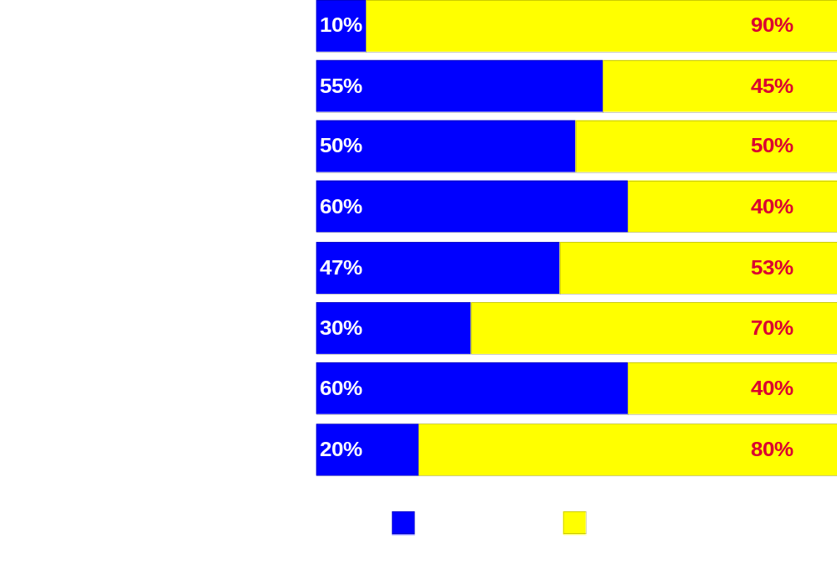
DISTRIBUTION OF PRODUCTS
17

Slide 18
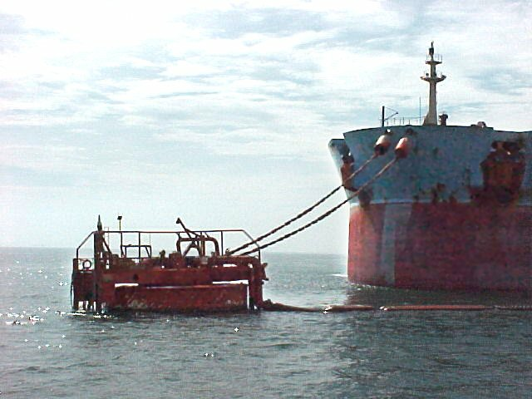
FACILITIES : Single Point Mooring
Function : To unload imported crude oil from Very Large Crude Carrier (VLCC) of 300,000 DWT.
Distance from shore : 6.8 km
Capability : 2.3 million barrels of crude per loading.
18

Slide 19
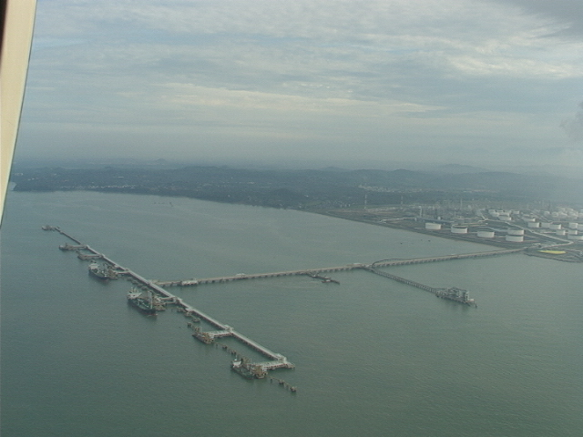
FACILITIES : Jetty
Function : To unload imported crude oil and load exported products from/onto the 7 jetty berths.
Distance from shore : 1.5 km long(1 .1 km wide)
19

Slide 20
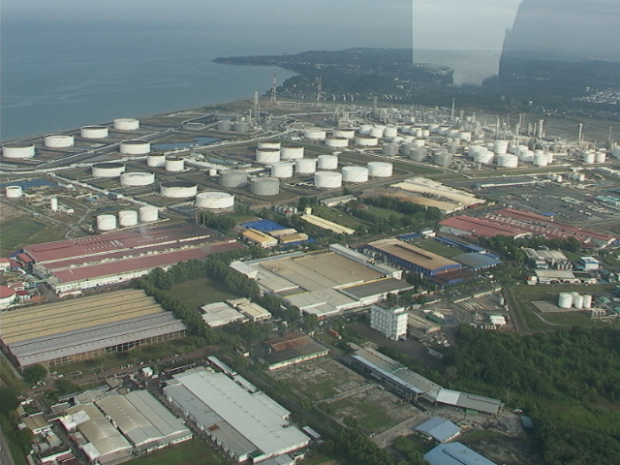
FACILITIES : Storage Tank
Total No Tanks : 115
Usage : Feedstock
    Product (Intermediate & final)
    Utility
    Firewater
Size : Largest 473,000 barrels - crude tanks
20

Slide 21
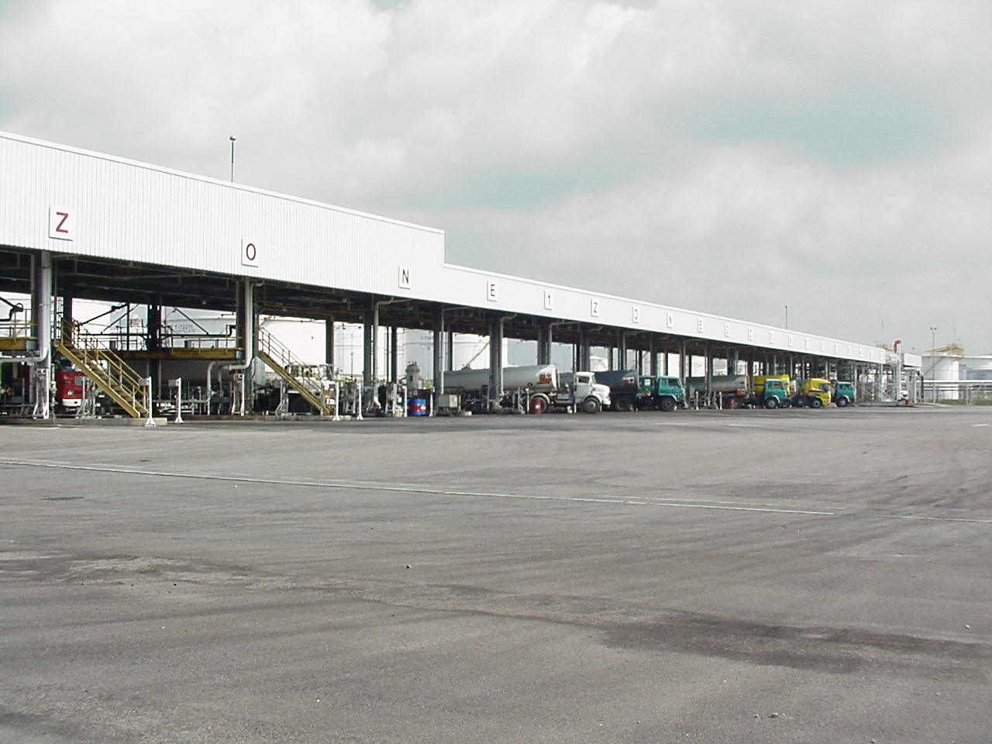
FACILITIES : Tank Truck Loading Rack
Total No of Bay : 22 bays
Function : To load Motor Gasoline, Asphalt , LPG,
Jet A-1/Kerosene & Diesel for domestic distribution
Average Loading Capacity : 200 to 250 trucks per day
21

Slide 22
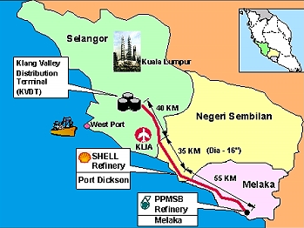
FACILITIES : Multi Product Pipeline
  Owner : PETRONAS and Shell
  Function : Transports mogas, kerosene, Jet A1 and diesel from PETRONAS Melaka Refinery and Shell Port Dickson
    Refinery to Klang Valley Distribution Terminal (KVDT)
    and KL International Airport (KLIA).
  Length : 130 kilometres
  Distribution : Average 1.5 million barrels of mogas and 800,000 litres
    of diesel per month.
22

Slide 23
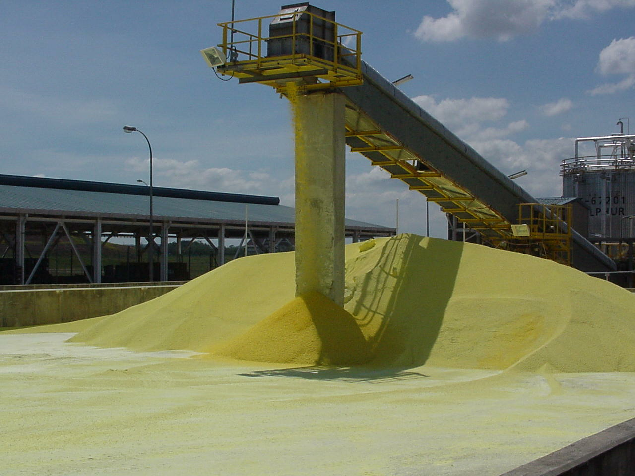
FACILITIES : Sulphur Handling
Design Size : To handle 300 tonnes/day sulphur production
Function : To form solid Sulphur from liquid Sulphur produced
in the Sulphur recovery unit
Loading : Via piped conveyor system to bulk cargo jetty
23

Slide 24
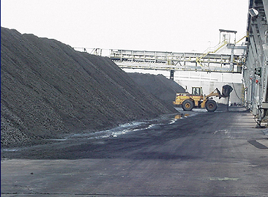
FACILITIES : Coke Handling
Design size : 900 tonne/cycle at 20 hours/cycle
Function : To crush Coke to small size & convey to
storage prior to loading in Ships.
Coke size : 4" diameter (maximum).
24

Slide 25
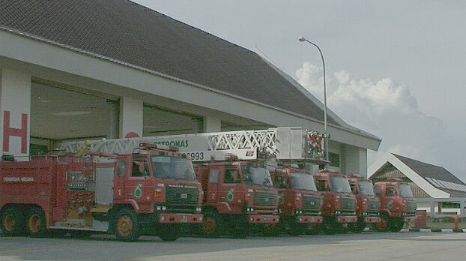
FACILITIES : Fire Station
Refinery owned and dedicated facility.
Available facilities :
* 7 fire trucks including 1 mobile emergency communication
centre (MECC).
* 6 foam tanks with total storage capacity of 190,000 Litres
* House 9 full time firemen
25

Slide 26
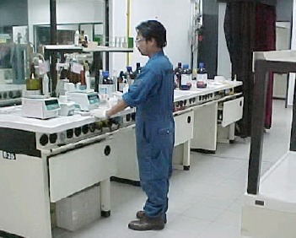
FACILITIES : Laboratory
    Provide facilites to analyse quality of products, crudes and condensates besides utility and effluent water.

