Slide 1
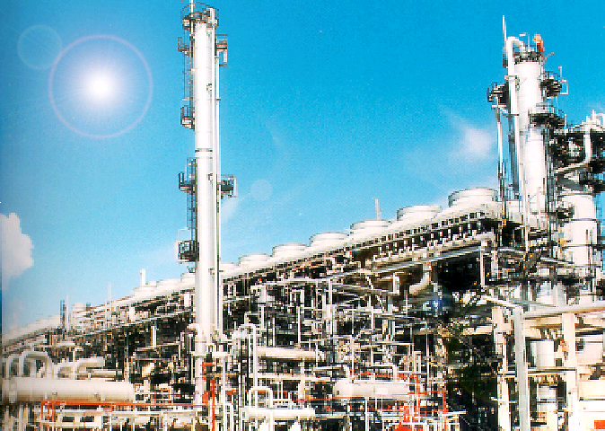
The Petroleum Refining Process

Slide 2
Crude Oil
Crude/condensate oil is a fossil fuel made naturally from decaying plants & animal living in ancient seas million of years ago
It is also known as petroleum which contain wide range of hydrocarbons
Hydrocarbon are molecules of hydrogen and carbon which exist in various lengths & structures, from straight chains to branching chains to rings(has different properties like molecular weight, boiling point & etc) eg :-
  CH4 @ Methane
  C2H6 @ Ethane
  C3H8 @ Propane
  C4H10 @ Butane
  C5H12 @ Pentane
  C6H14 @ Hexane
  C7H16 @ Heptane
  C8H18 @ Octane
  C9H20 @ Nonane

Slide 3
Oil Refining
Oil refining is about separation of components from crude oil to valuable and salable products.
The separation of components will be based on the chemical property of hydrocarbon ie its boiling point or vaporization temperature, which will take place in the crude distillation column
The components will be further treated(remove contaminants eg sulphur, acid & etc) and/or upgraded(increasing octane number & etc) and/or cracked to more valuable products and/or blended in the downstream process and blending units to produce salable products

Slide 4
Oil Refining (Cont.)
The configuration of the refinery(ie hydroskimming or complex conversion) will be based on the type of feedstocks, range of products and the level of contaminants in each components.
The design of the refinery will also take into consideration the economics, energy optimisation, safety aspects and environmental aspects (The Sulphur Recovery Process is very much related to the Environmental impact of the Refinery Process).

Slide 5
Basic Concept of Oil Refining
Fuel Gas(C2-)
SOIL
SIEVE SIZE
(60^{O}C)
LPG
(C3 + C4)
20 mm
>=20 mm
(100^{O}C)
PCN
35-70ºC
15 mm
15 - 20 mm
10 mm
10 - 15 mm
(180^{O}C)
Mogas
70-176ºC
5 mm
5 - 10 mm
3 mm
3 - 5 mm
(260^{O}C)
Kero
150-240ºC
2 mm
2 - 3 mm
(345^{O}C)
(300^{O}C)
Diesel
240-380ºC
1 mm
1 - 2 mm
Crude
from
storage
(32^{O}C)
< 1 mm
HEATER
LSWR
380ºC+
SHAKING
PHYSICAL PROPERTY
SIZE
CHEMICAL PROPERTY
BOILING POINT

Slide 6
PSR-1 Process Units
Unit 11 : Crude Distillation Unit
  Separate components based on boiling points
Unit 12 : Naphtha Hydrotreating Unit
  remove metals & contaminants that will poison catalyst in Unit 13
Unit 13 : CCR & Platforming Unit
  increase octane number of naphtha for gasoline production
Unit 14 : Saturated Gas Concentration Unit
  remove fuel gas from LPG
Unit 15 : Sour Water Stripping Unit
  remove H2S and NH3 from sour water for re-cycle in process units
Unit 16 : Kerosene & Heavy Naphtha Treating Unit
  remove naphtenic acid and colour bodies

Slide 7
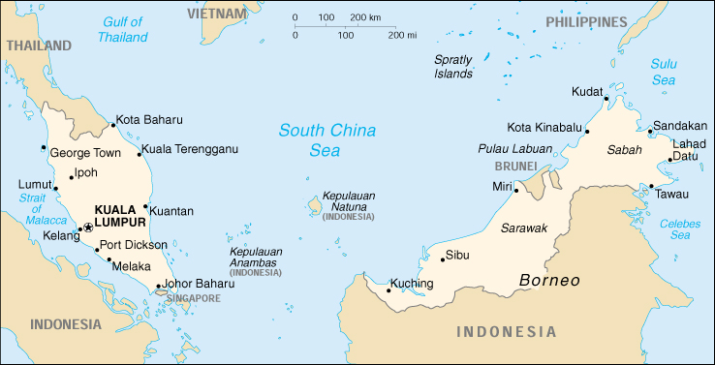
Source of Feedstocks(PSR-1)
MAP OF MALAYSIA
. Gurun
. Kertih
____________
GPP(Terengganu Cond)
TCOT(Tapis Crude)
______
MLNG(Bintulu Cond)
. Bintulu
PPMSB
______

Slide 8
PSR-2 Process Units
Unit 21 : Crude Distillation Unit/Vacuum Distillation unit
  Separate components based on boiling points
  Fractionates Atmospheric Residue and LSWR under vacuum to recover Diesel, Vaccum Gas Oil and Vacuum Residue.
Unit 25 : Isomerization Unit
  The Isom upgrades treated de-isohexanised naphtha from various units to 88 (SOR)/87 (EOR) RONC Isomerate for Blending.
Unit 26/27 : LPG/Naphtha Treating Units
  remove hydrogen sulphide and mercaptan from LPG/Naphtha
Unit 29 : Distillate Hydrotreating Unit
  To treat sulphur/colour bodies from various distillate streams (Diesel)
Unit 33 : Amine Regeneration Unit
  Regenerates rich amine streams (MDEA) from various amine absorbers in a central facility. The regenerated amine will be recirculated to the absorbers, and H2S from this unit is sent to the Sulphur Recovery Unit.

Slide 9
PSR-2 Process Units (Cont.)
Unit 30 : Hydrocracker Unit
  Converts Vacuum Gas Oil to diesel, kerosene, and naphtha. Consists of two main reactors and a fractionator.
Unit 32 : Delayed Coker Unit
  Processes vacuum residue from the VDU to produce gas oil, distillate, naphtha and fuel gas. Green coke is formed as a by product.
Unit 35 : Sulphur Recovery Unit
  Designed to process acid gases from the Amine Regeneration Unit and Sour Water Stripping Unit to produce commercial grade elemental liquid sulphur using CLAUS and SUPERCLAUS Technology.
Unit 39 : Hydrogen Production Unit
  Recovers hydrogen from natural gas, and supplements the Refinery hydrogen supply.

Slide 10
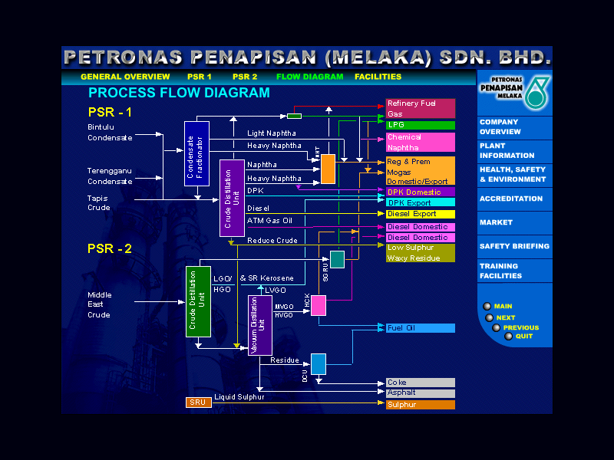

Slide 11
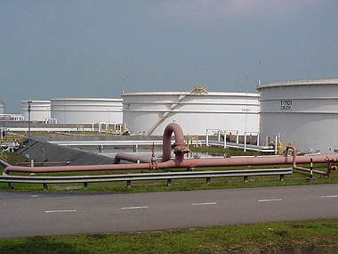
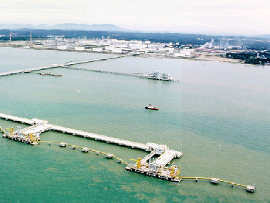
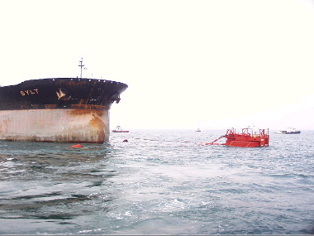
Common Facilities
Tank Farm
  115 Tanks in total
  Largest (Crude - 473,000 barrels)
  For Feedstock, Products (Intermediate/Final)
  Utilities
  Fire Water
Utility - Produces the following :
  Steam (HP, MP, LP)
  Water (Utility, Firewater, Service)
  Cooling Water (Closed Loop - PSR-2 , Open Loop - PSR-1)
Jetty (T-shaped)
  1.5 km wide and 1 km in Length
  10 berths (7 Coastal/Ocean, 1 LPG, 2 Sulphur/Coke)
  Single Buoy Mooring for Very Large Crude Carriers
  (VLCC) with > 2 million Barrels.

Slide 12
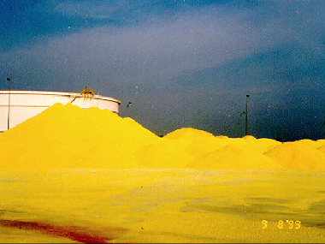
The Sulphur Recovery Unit

Slide 13
SULPHUR COMPLEX
SRU: Design Basis
Design Objective
  To treat (absorb) H₂S rich gas streams from ARU & SWTU
  To produce a liquid sulphur product of marketable quality
  To incinerate the tail gas leaving the SRU to meet local environmental body requirements.

Slide 14
SULPHUR COMPLEX
SRU: Design Basis
Consists of 2 identical trains processing 100 MTSD each of elemental liquid sulphur
Each train consists of 3-Claus reactors and 1-Superclaus reactor in series
Min sulphur recovery 99.2 wt%
Turndown ratio 15% of design capacity
Design SO₂ emission to stack 840 ppmv

Slide 15
SULPHUR COMPLEX
SRU: Claus & SuperClaus
CLAUS
    Patented technology on 1883 for sulphur removal
    Issued to Carl Friedrich Claus - a London chemist
    “Air to Acid gas” ratio is maintained to produce 2:1 ratio in the burner effluent gases
    Max sulphur recovery 98.0 - 98.5 % wt (with 3-reactors arrangement in series)
SUPERCLAUS
    Patented technology on 1986
    Jointly development by Comprimo, VEG Gasinstitute, University of Utrecht & Engelhard de Meern
    Operates the Air to Acid gas ratio > 2:1 - higher sulphur recovery
    Max sulphur recovery (with Claus) 99.2 %wt

Slide 16
SULPHUR COMPLEX
SRU: Reactions
Thermal reaction in burner:
  H₂S + 3/2 O₂ ⇔ SO₂ + H₂O + heat
  2 H₂S + SO₂ ⇔ 3/2 S₂ + 2 H₂O + heat
Catalytic rxn in Claus reactor:
  2 H₂S + SO₂ ⇔ 3/8 S₈ + 2 H₂O + heat
Catalytic rxn in SuperClaus reactor:
  2 H₂S + O₂ ⇔ 2/8 S₈ + 2 H₂O + heat

Slide 17
SULPHUR COMPLEX
SRU: Block Flow Diagram
SO2: 840 ppmv
H2S: <5 ppmv
SUPER
CLAUS
Section
AAG from ARU
Burner
MCC
WHB
CLAUS
Rx 1
CLAUS
Rx 2
CLAUS
Rx 3
Incinerator
Stack
SWS Gas from SWTU
Combustion Air
To sulphur palletizing unit & liquid storage
Sulphur Pit with Degassed Unit

Slide 18
SULPHUR COMPLEX
Design Liquid Sulphur Product
    Purity: 99.9 wt% min
    Carbon: < 0.02 wt%
    H₂S : < 10 ppm wt%
    Ash: < 0.04 wt%
    H₂O: < 0.10 wt%
    Colour: Bright yellow

