Slide 1
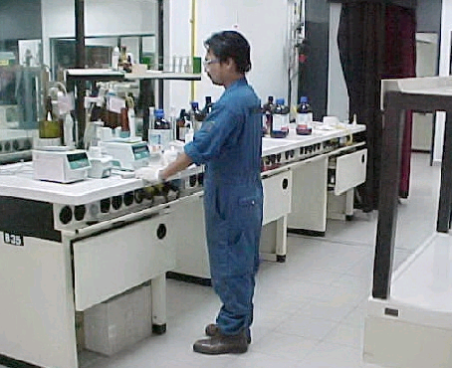
Product Specifications and Quality Control

Slide 2
Crude Supply, Products Range & Distribution
Crude/condensate supply for PETRONAS is being handled by COG
Petronas Penapisan(Melaka) Sdn Bhd products range are being handled by the followings:-
  Fuel Gas @ into Fuel Gas System
  Liquified Petroleum Gas @ Domestic(PDB) & Export(PETCO)
  Petrochemical Naphtha @ Export(PETCO)
  Mogas or Motor Gasoline @ Domestic(PDB) & Export(PETCO)
  Reformate @ Export(PETCO)
  Kerosene or Jet A1 @ Domestic(PDB) & Export(PETCO)
  Diesel @ Domestic(PDB) & Export/Premium(PETCO)
  Low Sulphur Waxy Residue @ into PSR-2 & Export(PETCO)
  Low Sulphur Fuel Oil @ Export(PETCO)
  High Sulphur Fuel Oil @ Export(PETCO)
  Asphalt @ Domestic(PDB)
  Sulphur @ Export(PETCO)
  Coke @ Export(PETCO)
Typically, 60 - 70% volume of products for domestic distribution through TTLR, MPP and Coastal Vessel.

Slide 3
Liquified Petroleum Gas
PRODUCT SPECIFICATION
  Composition
    Propane + Butane : 97 lv% min
    Propane : 44 lv% max
    Pentane & Heavier : 1.5 lv% max
  Copper Corrosion(1 hr, 37.8 deg C)
    1 max
  Total Sulphur
    100 ppm wt max

Slide 4
Motor Gasoline(MOGAS)
PRODUCT SPECIFICATION(DOMESTIC UNLEADED)
  Research Octane Number(RON)
    97.0 min
  Copper Corrosion(3 hr, 50 deg C)
    1 max
  Total Sulphur
    0.15 wt% max
  Reid Vapour Pressure
    70 kPa max
  Existent Gum
    4 mg/100ml

Slide 5
Kerosene or Jet A1
PRODUCT SPECIFICATION
  Flash Point
    38 deg C min
  Smoke Point
    25 mm min
  Copper Corrosion(2hr, 100 deg C)
    0.15 wt% max
  Freezing Point
    -47 deg C max
  Existent Gum
    7 mg/100ml

Slide 6
Diesel
PRODUCT SPECIFICATION
  Flash Point
    60 deg C min
  Pour Point
    15 deg C max
  Cetane Index
    47 min
  Carbon Residue
    0.10 wt% max
  Total Acid No
    0.25 mg KOH/gm

Slide 7
Asphalt
PRODUCT SPECIFICATION
  Penetration at 25 deg C, 100 gm, 5 sec(0.1 mm)
    80 - 100 mm
  Softening Point
    45 - 52 deg C
  Solubility in trichloroethylene
    99.5 wt% min
  Loss on heating
    0.2 wt% max
  Drop in penetration after heating
    20% max

Slide 8
Products Application
  Fuel Gas @ Furnace/Boiler firing within refinery
  Liquified Petroleum Gas @ Cooking, Heating & Plastic
  Petrochemical Naphtha @ Solvent, paint, dye, quick drying products
  Mogas or Motor Gasoline @ Motor Oil
  Reformate @ Blendstock for Motor Oil or other products eg aromatics
  Kerosene or Jet A1 @ fuel for jet engines/tractors, other products eg detergent
  Diesel @ fuel for car, lorry and heating oil
  Low Sulphur Waxy Residue @ fuel, other valuable products
  Low Sulphur Fuel Oil @ industrial fuel and heating oil
  High Sulphur Fuel Oil @ industrial fuel and heating oil
  Asphalt @ road
  Sulphur @ sulphuric acid
  Coke @ fuel for power plant and others

Slide 9
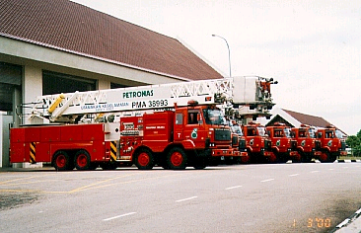
Health, Safety and Environment (HSE) in the Refinery

Slide 10
Health
In Ensuring Industrial Hygiene and Staff health, PPMSB provides the following :
  Identification, analysis, and minimisation of Personnel exposure to the various health hazards;
    Dust
    Hydrocarbon
    Noise
  Occupational Health Related Training
  Clinic Management

Slide 11
Safety
Is out number 1 Priority at all times - “Nothing is so important that we cannot take the time to do it Safely”
Facilities includes the latest fire prevention and fire fighting equipment.
Enforce Strict Safety standards and practice to be followed within the Plant;
  The usage of full PPE (Personal Protective Equipment)
  Head Count system
  Safety Training
Incident Command System & Emergency Response Plan
Process Safety Management (PSM) is in place since 2002 and covers :
  PHA (Process Hazards Analysis)
  MI (Mechanical Integrity)
  PSI (Process Safety Information)
  OPP (Operating Procedure and Practise)
  MoC (Management of Change)

Slide 12
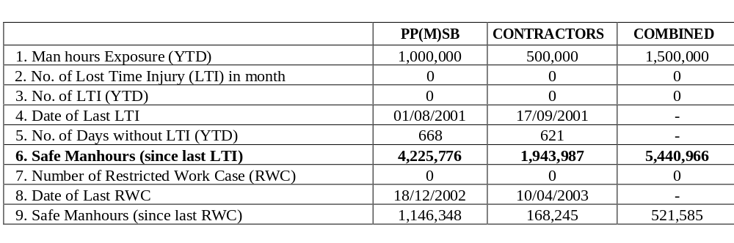
Safety Statistics

Slide 13
Environment
Environmental impact is a major Responsibility of the Refinery
There are Strict Satndards for us to adhere to at all times :
  Department of Environment
  Fire and Rescue Department
  Department of Occupational Safety and Health
The Department of Environment (DOE) sets the quality for :
  Effluent Discharge
  Noise Levels
  Water Quality
  Air Quality

Slide 14

Simple Economics of a Refinery

Slide 15
How Do We Add Value?
PSR-1 & PSR-2 now operate in Merchant Mode;
  Profit = Value of products sold - Cost of production.
  Cost of production = Feedstock cost + Operating costs.
  Products are sold to shareholders at arms-length transfer prices.
  Crude and feedstocks are sold to the refinery at laid in prices.
PSR-1 used to operate in Processing Mode;
  Profit = Per BBL Fee x Throughput - Operating Costs.
  Fee differs according to units

Slide 16
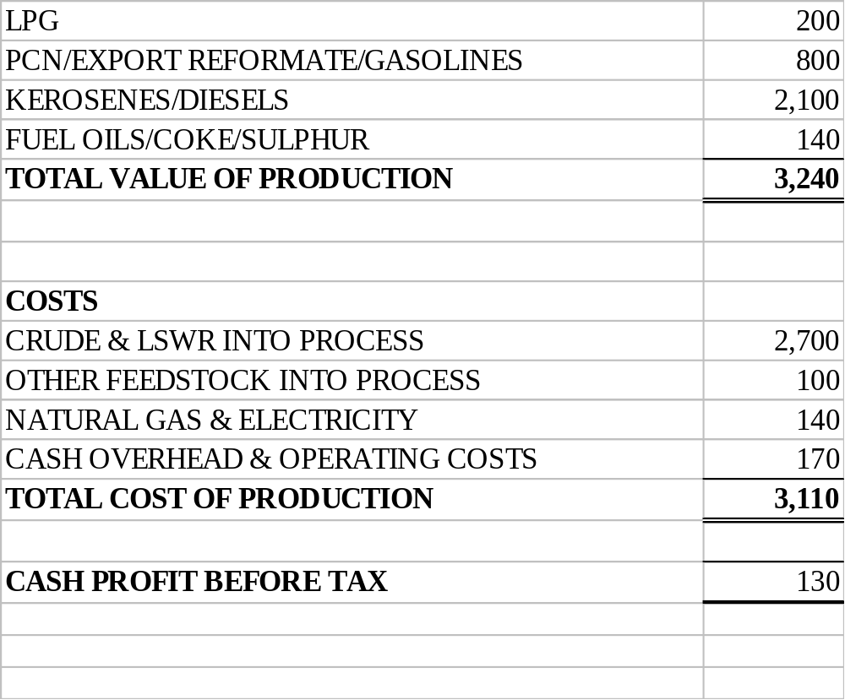
Components of Refinery Profit
Sales of finished products
Cost of crude (including freight and insurance) and LSWR purchased.
Purchases of PSR-1 H2, and HPU feed.
Maintenance, Payroll, Annualised T/A, Catalysts & Chemicals etc.
N.B. Excludes depreciation and loan repayments, interest charges.

Slide 17
Refinery Configuration Impacts Profitability
Basic refining types;
  Topping
  Simple hydroskimming.
  Gasoil cracking.
  Full conversion.
Higher complexity increases;
  Light oil yield and product revenue.
  Operating cost.
  Capital cost.
Flow scheme selection driven by economic environment and outlook for product prices and demand.

Slide 18
Simple Topping Refinery
Crude A
Crude B
LPG
2.0%
2.5%
PCN
18.5%
27.5%
Crude
CDU
Kerosene
15.5%
18%
Diesel
20%
28%
Fuel Oil
44%
24%

Slide 19
Simple Hydroskimming Refinery
Crude A
Crude B
LPG
2.5%
3%
Gasoline
16%
25%
Crude
NHT/CRU
CDU
Kerosene
15.5%
18%
Diesel
20%
28%
DHT
Fuel Oil
44%
24%

Slide 20
Gasoil Cracking
Crude A
Crude B
LPG
4%
5%
Gasoline
23%
30%
Crude
NHT/CRU
CDU
Kerosene
18%
20%
Diesel
39%
42%
DHT
VDU
HCK
Fuel Oil
17%
4%

Slide 21
Full Conversion
Crude A
Crude B
LPG
5%
5.2%
Gasoline
25.5%
30.5%
Crude
NHT/CRU
CDU
Kerosene
18.5%
20.3%
Diesel
45.5%
42.5%
DHT
VDU
HCK
Fuel Oil
3.5%
1.5%
DCU
Coke
4.5%wt
0.8%wt

Slide 22
The Melaka Advantage
Ability to make higher valued products;
  Premium (CARB) Diesel, Ultra Low Sulphur Diesel.
  Low Sulphur Diesel.
  USA & Euro Gasoline Grades (post Isom?).
Can meet tomorrow’s specifications today;
  Asian specs will move towards Euro standards.
Very low fuel oil yield;
  Most of the product slate sells above crude price.

Slide 23
Refining Performance Indicators
Light Oil Spread
  Simplistic representation of refinery yields vs. crude.
  Example:
    Singapore LOS = 1/3*Gasoline Price + 2/3*Gasoil Price – Dubai Crude Price.
  No operating costs, freight and heavy oil/coke yield.
Benchmark Refining Margins
  Dubai or Tapis yields in an notional Singapore merchant refinery.
  Fixed or variable (optimised) yields.
  Can use same approach for Melaka with either benchmark crudes or business plan crude mix.

Slide 24
Thank You

