Slide 1
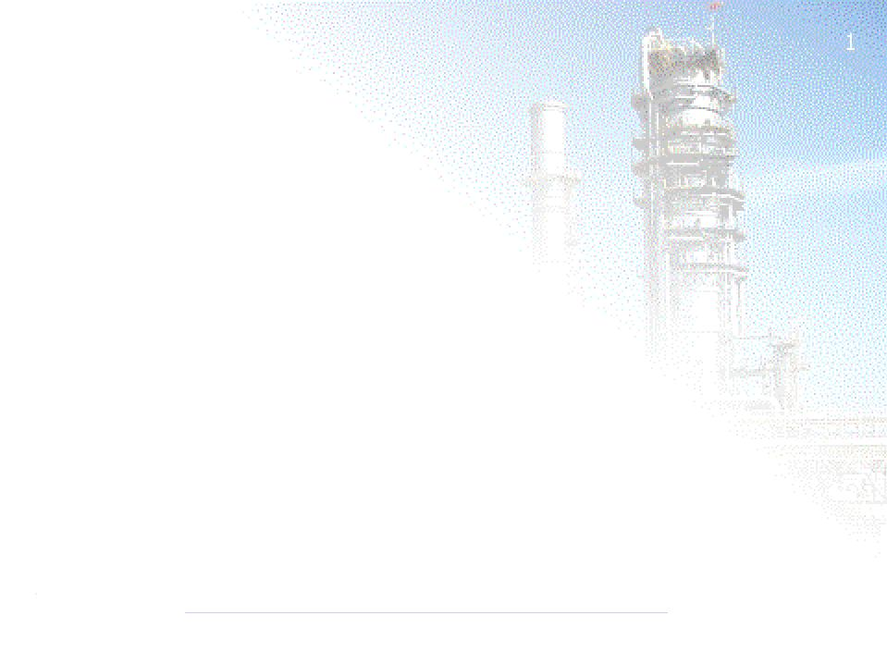
Introduction to Petroleum Refining
PDB Staff Visit
Presented by:
Azamuddin B Jameran
Operation Engineer
Petronas Penapisan (M) Sdn Bhd

Slide 2
The Presenter
Joined Petronas Penapisan Melaka Sdn Bhd (PPMSB) in Sungai Udang in April 1998
Worked as a Production Supervisor (Production Dept.) at the Naphtha Upgrading Complex (PSR-2) for 4 1/2Years
Worked as Process Technologist (Tech Dept) for Treating Units for 2 years.
Currently work as Operation Engineer (Production Dept) for Area 2 Sour Hydroskimming.

Slide 3
Objectives
This Session will assist you to Understand:
1. The Overview of Sour Hydroskimming Units
2. The Introduction of Area 2 Process Units
3. Which products are produced at certain Qualities

Slide 4
Crude Oil
Crude/condensate oil is a fossil fuel made naturally from decaying plants & animal living in ancient seas million of years ago
It is also known as petroleum which contain wide range of hydrocarbons
Hydrocarbon are molecules of hydrogen and carbon which exist in various lengths & structures, from straight chains to branching chains to rings(has different properties like molecular weight, boiling point & etc) eg :-
  CH4 @ Methane
  C2H6 @ Ethane
  C3H8 @ Propane
  C4H10 @ Butane
  C5H12 @ Pentane
  C6H14 @ Hexane
  C7H16 @ Heptane
  C8H18 @ Octane
  C9H20 @ Nonane

Slide 5
Oil Refining
Oil refining is about separation of components from crude oil to valuable and salable products.
The separation of components will be based on the chemical property of hydrocarbon ie its boiling point or vaporization temperature, which will take place in the crude distillation column
The components will be further treated(remove contaminants eg sulphur, acid & etc) and/or upgraded(increasing octane number & etc) and/or cracked to more valuable products and/or blended in the downstream process and blending units to produce salable products

Slide 6
Oil Refining (Cont.)
The configuration of the refinery(ie hydroskimming or complex conversion) will be based on the type of feedstocks, range of products and the level of contaminants in each components.
The design of the refinery will also take into consideration the economics, energy optimisation, safety aspects and environmental aspects (The Sulphur Recovery Process is very much related to the Environmental impact of the Refinery Process).

Slide 7
PSR-2 Process Units
Unit 21/24 : Crude Distillation Unit/Vacuum Distillation/Sat Gas Rec unit
  Separate components based on boiling points
  Fractionates Atmospheric Residue and LSWR under vacuum to recover Diesel, Vaccum Gas Oil and Vacuum Residue.
  Recovery of Light end & separates naphtha/LPG.
Unit 25 : Isomerization Unit
  The Isom upgrades treated de-isohexanised naphtha from various units to 88 (SOR)/87 (EOR) RONC Isomerate for Blending.
Unit 26/27/28 : LPG/Naphtha/Kero Treating Units
  remove hydrogen sulphide and mercaptan from LPG/Naphtha/Kero
Unit 29 : Distillate Hydrotreating Unit
  To treat sulphur/colour bodies from various distillate streams (Diesel)

Slide 8
Refinery Configuration Impacts Profitability
Basic refining types;
  Topping
  Simple hydroskimming.
  Gasoil cracking.
  Full conversion.
Higher complexity increases;
  Light oil yield and product revenue.
  Operating cost.
  Capital cost.
Flow scheme selection driven by economic environment and outlook for product prices and demand.

Slide 9
Simple Topping Refinery
Crude A
Crude B
LPG
2.0%
2.5%
PCN
18.5%
27.5%
Crude
CDU
Kerosene
15.5%
18%
Diesel
20%
28%
Fuel Oil
44%
24%

Slide 10
Simple Hydroskimming Refinery
Crude A
Crude B
LPG
2.5%
3%
Gasoline
16%
25%
Crude
NHT/CRU
CDU
Kerosene
15.5%
18%
Diesel
20%
28%
DHT
Fuel Oil
44%
24%

Slide 11
Gasoil Cracking
Crude A
Crude B
LPG
4%
5%
Gasoline
23%
30%
Crude
NHT/CRU
CDU
Kerosene
18%
20%
Diesel
39%
42%
DHT
VDU
HCK
Fuel Oil
17%
4%

Slide 12
Full Conversion
Crude A
Crude B
LPG
5%
5.2%
Gasoline
25.5%
30.5%
Crude
NHT/CRU
CDU
Kerosene
18.5%
20.3%
Diesel
45.5%
42.5%
DHT
VDU
HCK
Fuel Oil
3.5%
1.5%
DCU
Coke
4.5%wt
0.8%wt

Slide 13
The Melaka Advantage
Ability to make higher valued products;
  Premium (CARB) Diesel, Ultra Low Sulphur Diesel.
  Low Sulphur Diesel.
  USA & Euro Gasoline Grades (post Isom?).
Can meet tomorrow’s specifications today;
  Asian specs will move towards Euro standards.
Very low fuel oil yield;
  Most of the product slate sells above crude price.

