Slide 1
PPMSB
Production Planning Group

Slide 2
OUTLINE
Intro
  Objective
  Organization Structure
  Fundamental Business Purpose
Overview
  Planning Process
  Planning Tools

Slide 3
OUTLINE
Planning Activities
  Terms, Modes, and Operations
  Crude Evaluation
  Planning Cycle
  Apportionment
  Scheduling
  Product Blending
  Product Quality
Refinery Economics

Slide 4
INTRO (1)
Objective :
To Understand The Production Planning Group Charter, Organization Structure & Scope

Slide 5
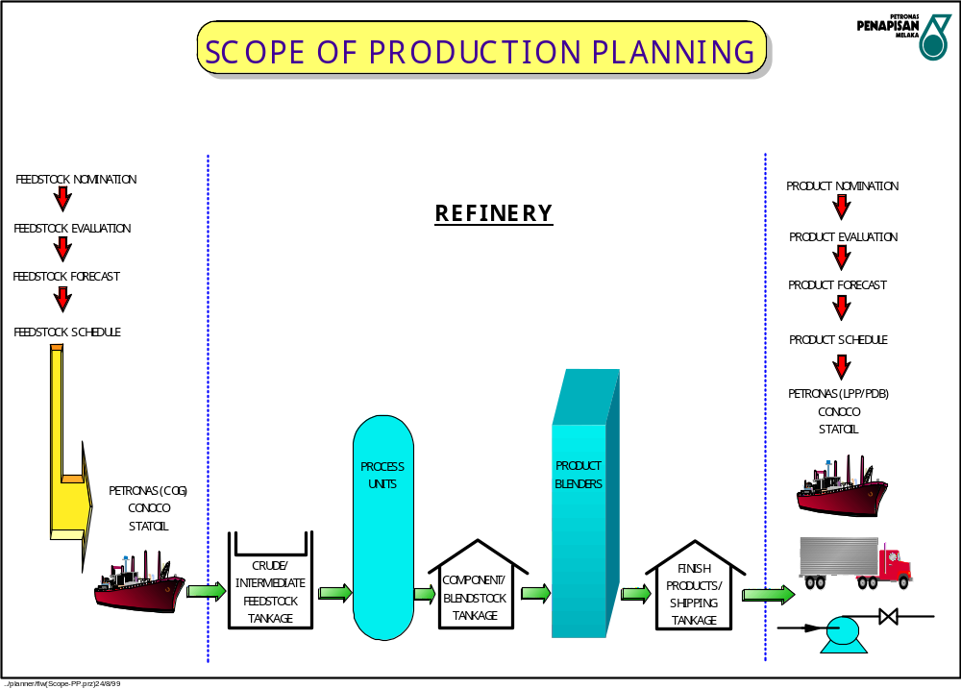

Slide 6
INTRO (2)
PRODCUTION PLANNING GROUP
PRODUCTION PLANNING SENIOR MANAGER
SAMSUDDIN A RAHMAN
REFINERY OPTIMIZATION
REFINERY PLANNING
REFINERY SCHEDULERS
YIELD ACCOUNTING
OPTIMIZATION MANAGER
KELLY SHERBON
PLANNING MANAGER
ATIFAH IDRIS
SCHEDULING MANAGER
SIRIGANESAN
YIELD ACCNTNG MANAGER
NOR HASLINA JANTAN
- MIOR ZAIGA
- MAWARTI KASHA
- KARTINA
- NORLEEN
- SHAHRIN
- ZULFINA
- VACANT
- VACANT
- AMRU ISKANDAR
- HASLINA MOHD

Slide 7
Fundamental Business Purpose
INTRO (3)
To Develop Operating Plans and Schedules That Allow the PPMSB Refinery to Maximise the Added Value in Refinery Processing

Slide 8
Overview
- Planning Process

Slide 9
Planning Process (1)
PLANNING
& OPTIMIZATION
APPORTIONMENT
&
YIELD
(BEFORE)
ACCOUNTING
(AFTER)
SCHEDULING
(DURING)

Slide 10
Planning Process (2)
REFINERY
OPTIMIZATION
SIMULATION
&
STUDIES
PLANNING
LP

Slide 11
^{OPTIMIZATION SECTION}
OPTIMIZATION
MANAGER
OPTIMIZATION
(PLANNING LP)
OPTIMIZATION
(SIMULATION
& STUDIES)

Slide 12
^{OPTIMIZATION SECTION}
OPTIMIZATION MANAGER

Slide 13
^{OPTIMIZATION SECTION}
Special Studies
OPSC Facilitation
Economics Evaluation

Slide 14
^{OPTIMIZATION SECTION}
OPTIMIZATION
(PLANNING LP)

Slide 15
^{OPTIMIZATION SECTION}
Prepare Planning LP for Shareholders
Update & Maintain Yield in LP
Variance Analysis & Explanation
Provide Production Ratio to Schedulers
Provide Economics for Main Process Units & Refinery Wide

Slide 16
^{OPTIMIZATION SECTION}
OPTIMIZATION
(SIMULATION
& STUDIES)

Slide 17
^{OPTIMIZATION SECTION}
Crude Oil Evaluation
Crude Assay Database
Update & Maintain Simulation Special Studies

Slide 18
Planning Process (3)
REFINERY
PLANNERS
APPORTIONMENT
OPERATING
SCHEDULE
OPERATING
PLANS

Slide 19
^{PLANNING SECTION}
PLANNING MANAGER
(DAY TO DAY PLANNER)
PLANNER
(APPORTIONMENT)

Slide 20
^{PLANNING SECTION}
PLANNING MANAGER
(DAY TO DAY PLANNER)

Slide 21
Planning Section
Prepare & Implement Operating Plan & Schedule
Track Day to Day Performance
Advise on Unit Operating Changes
Respond to Plant Operating Changes

Slide 22
^{PLANNING SECTION}
APPORTIONMENT

Slide 23
Planning Section
Data Preparation & Validation
Run, Generate & Issue Apportionment Report
Resolve Issues on Allocation from Shareholders
Advise Finance on Final Inventory & Utility Allocation

Slide 24
Planning Process (4)
REFINERY
SCHEDULERS
LPG &
LIGHT OIL
SHIPPING
CRUDE
& HEAVY
OIL SHIPPING
BLENDING & BLEND
OPTIMISATION

Slide 25
^{SCHEDULING SECTION}
SCHEDULER
(CRUDES & HEAVY OIL)
SCHEDULER
(LIGHT OILS & LPG)
BLENDER
(MOGAS, DIESEL & KERO)

Slide 26
^{SCHEDULING SECTION}
SCHEDULER
(CRUDES & HEAVY OIL)

Slide 27
Scheduling Section
Crude & Heavy Oil Shipping & Supply Program
Fuel Oil, Coke & Sulphur Shipping
Management of Tank Movements

Slide 28
^{SCHEDULING SECTION}
SCHEDULER
(LIGHT OILS & LPG)

Slide 29
Scheduling Section
LPG & Light Oil Shipping
Pipeline Scheduling & Road Loading Transfers
Product Export & Inventory Management
Product Quality Management

Slide 30
^{SCHEDULING SECTION}
BLENDER
(MOGAS, DIESEL & KERO)

Slide 31
Scheduling Section
Gasoline & Diesel Blending
Blending Optimisation
Management of Gasoline / Diesel Component Product Tankage

Slide 32
Planning Process (5)
YIELD
ACCOUNTING
YIELD / ENERGY
ACCOUNTING
MEMO
ACCOUNTS

Slide 33
^{YIELD ACCOUNTING SECTION}
YIELD ACCOUNTING
MANAGER
YIELD ACCOUNTING
ENGINEER

Slide 34
^{YIELD ACCOUNTING SECTION}
Refinery & Unit Balances
Detect & Rectify Balance Error

Slide 35
^{YIELD ACCOUNTING SECTION}
Prepare Shareholder Memo Account
Reconcile Each Account
Track Production & Deemed Inventory
Maintain Energy/Utility Balance

Slide 36
^{YIELD ACCOUNTING SECTION}
Compare Energy Performance Vs Targets
Identify Opportunities for Improvement
Unit Performance Test Runs (Yield Balances)

Slide 37
Overview
- Planning Tools

Slide 38
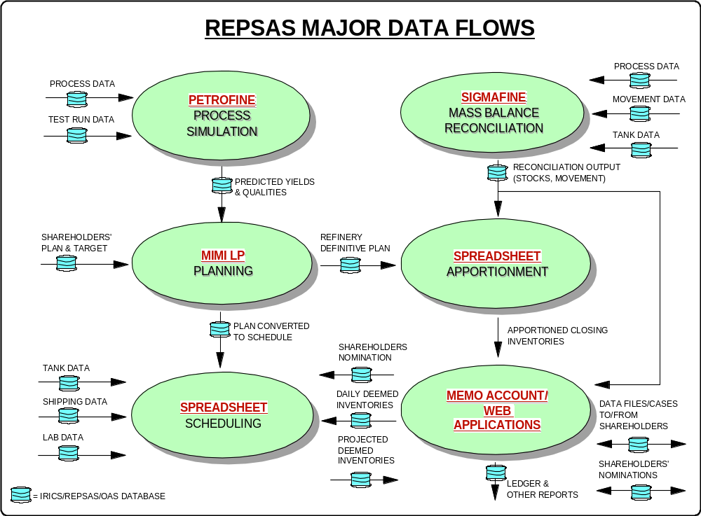

Slide 39
Planning Tools (1)
What Is Petrofine
Vehicle for constructing the simulation
Simulating the physical units, processes, feeds and products of an oil refinery
Optimize the efficiency of the refinery parts and the refinery as a whole, to maximize profits.

Slide 40
Planning Tools (2)
PETROFINE in PPMSB
Models calibrated with real plant data
  After start up
  Routinely for different units
Generation of new LP vectors as needed;
  Indicated by tracking
Flowsheet simulation of plant performance with new feeds and/ or configurations
Simulation of new feedstocks for addition to LP via Vectorfine
Plant optimization studies

Slide 41
Planning Tools (3)
MIMI Linear Program
Generating operating plans
Feedstocks studies;
  Crude evaluation
  Crude vs. heavy oils
Longer term plant optimization
Generation of operational economics (plant incentives)

Slide 42
Planning Tools (4)
What is Sigmafine
A schematic drawing of a plant or process
A platform for entering and loading data
A platform for running exports
A platform for exporting data
A data reconciliation system that resolves inconsistencies between plant measurements and mass (other) balances throughout the plant

Slide 43
Planning Tools (5)
Sigmafine in PPMSB
Production of reconciled material balances- basis for apportionment process.
Comparison with Petrofine as ongoing check on model/LP accuracy; tracking model deviation as plant yields change.
Measuring plant performance for;
  Energy intensity
  Plant yields
  Fuel and loss
Post auditing LP

Slide 44
Sigmafine
GUI
Save as other
formats
Manual entry
scripts
User-defined
functionality
Data import
Scripts
Customised reports
printer
Interface to
historians
Standard reports
Interface to
historians
Exports
Inputs to Sigmafine
Outputs from Sigmafine
Reconciliation
solver
Tracking
solver
Drawing
database
Detail
database
Internal data storage and links to solvers
Historians
External data storage

Slide 45
Planning Activities
Definition, Modes,Operations

Slide 46
DEFINITION OF TERMS(1)
Operations Rule Book (ORB): written policies, rules, standards, procedures, guidelines and instructions which MRC establishes for PSR-2 processing operations. The rules applies to both PSR-1, PSR-2 and common facilities.
Financial Accounting Rule Book (FARB): set of rules similar to the Operation Rule Book which regulates the accounting cost sharing and other financial accounting rules to be applied to the Joint Venture

Slide 47
DEFINITION OF TERMS(2)
Laycan (date range): any consecutive period of time commencing at 0001 hrs on the first day and ending at 2400 hrs on the last day indicated whereby the terminal and shareholders are obligated to supply or take delivery of the contractual quantity.
Demurrage: additional costs imposed by a shipowner on a charterer for exceeding contractually agreed time allocations.
Deemed inventory: estimate of actual or forecast of ownership by shareholder of feedstock and products by product group.

Slide 48
DEFINITION OF TERMS(3)
OPSC – Operations Planning Sub Committee
Membership:
Shareholders planning and trading groups.
PPMSB Production Planning and Operations.
Alternate members from LPPG, COG and PMG.
Team Purpose:
Present shareholder and PPMSB operating plans
Review shareholder crude scheduling
Introduce and follow new project or refinery study concepts
Review shareholder and refinery planning KPIs
Resolve any LP, scheduling, or apportionment issues
Maintain product specifications
Facilitate new crude approval and assay updates

Slide 49
DEFINITION OF TERMS(4)
OPCO

Slide 50
PROCESSING MODES
Processing Mode: in which the Shareholder will retain the title to its’ feedstocks, intermediates and products in the refinery and pay a processing fee to MRC.
Merchant Mode: in which each Shareholder will sell the feedstock its wishes to process to MRC, and will purchase the products from these feedstocks from MRC at Fair Market Prices
Fair Market Prices: the prices, terms and conditions that a willing buyer and willing seller would accept in a good faith arm’s length transaction.

Slide 51
OPERATION (1)
PSR 1 Crude: Crude planning and scheduling is carried out by refinery and Petronas alone.
PSR2 Crude: 2 different mechanism
  Joint Operation
  Separate Operation

Slide 52
OPERATION (2)
JOINT OPERATION
Crude is purchased jointly
Shareholders will decide which crude to buy
Each shareholder will tender a bid to the refinery to buy the crude
The shareholder with the lowest bid will buy the crude for the refinery

Slide 53
OPERATION (3)
JOINT OPERATION
Refinery will decide the finished products available for the month based on the crude and the operating modes defined by the shareholder
Shareholders will bid for each cargo
Shareholders with the highest bid will lift the product

Slide 54
OPERATION (4)
Separate Operation
Crude economics is carried out by each shareholder
Refinery will monitor the deemed crude inventory for each shareholder
Deemed crude inventory is the notional inventory of crude oil by grade and shareholder and represents the inventory a shareholder would hold had it processed crude oil according to its equity of the crude unit for that month

Slide 55
OPERATION (5)
Separate Operation
At the beginning of month M, refinery will inform the shareholder of the projected deemed crude inventory and indication of delivery responsibility up to 1st half of M + 3
Shareholder with the lowest deemed crude inventory is responsible for the crude delivery to the refinery

Slide 56
OPERATION (6)
Planning Under Separate Operation
Planning process is driven by sour crude delivery
Planning cycle is carried out in terms of 3 rolling months :-
  Month M : Re-plan month
  Month M+1: Definitive month
  Month M+2: Indicative month

Slide 57
OPERATION (7)
Planning Under Separate Operation
Each shareholder will carried out their own optimization based on input from refinery on:-
  Current month deemed initial inventories and the total physical beginning inventories
  Qualities of beginning inventories
  Expected unit capacities for the current and following two months
  Crude oil consumptions, by grade and month which must occur for logistic reasons
  Those losses attributable to one or more Shareholders in the current month which are known at the time of the re-plan
  Current month sales already delivered or committed

Slide 58
OPERATION (8)
Planning Under Separate Operation
Refinery will create a refinery plan based on Shareholders’ plans which they must submit to the refinery by the 2nd half of the month
Refinery will give its feedback and present the refinery plan to the shareholders
OPSC – working level discussion to get all parties agreement
OPCO – higher management level to endorse OPSC decision and to settle any dispute which cannot be settled in OPSC

Slide 59
OPERATION (9)
Planning Under Separate Operation
Once all parties have agreed, the plan becomes the “Definitive Plan”
Definitive Plan
  Entire plan for the following month which each Shareholder and Refinery have committed to adhere to and which will include (but is not limited to) :-
    Operation of process units
    Feedstock delivery schedule
    Product lifting schedule
  Any change to the definitive plan may results in compensation payments to the Shareholder adversely affected by the change

Slide 60
OPERATION (10)
Planning Under Separate Operation
Product lifting entitlement will be determined based on the ratio of the Shareholders’ standalone plans
Any dispute on the entitlement of a particular cargo will be settled by the deemed product inventory of a shareholder
  Shareholder with the highest deemed inventory will have the right to the cargo

Slide 61
Planning Activities
- Crude Evaluation
- Planning Cycle
- Apportionment

Slide 62
CRUDE EVALUATION
Design crudes and approved crudes
Uses whole crude quality as primary criteria (eg sulfur,BS&W, pour point, acidity)
Detail intermediate and product cut analysis
“New” crude nomination procedure
Feedstock testing program:
  - full TBP & SIMDIS for first delivery
  - critical tests (API,Sulfur,BS&W,SIMDIS,TAN,RVP) for each delivery
  -repeat full TBP after 2 year or if it has changed by a degree defined in the ORB

Slide 63
THE PLANNING CYCLE(1)
One year plan
  - KPBI (Finance)
  - 5 year rolling plan
  - first year breakdown by quarter
Rolling four month plan
  - replan of current month (LP)
  - plan for he next two month (LP)
  - preliminary crude oil processing plan for M4
    (outside of LP)

Slide 64
THE PLANNING CYCLE(2)
Activities:
  - issue Standalone LP on 12th
  - shareholder return case 17th
  - review by OPSC on 23th
  - presented to OPCO on 24th
  - after the plan is endorsed by OPCO it becomes a “definitive plan”.
  -definitive means the entire plan for the following month which each shareholder and PPMSB has committed to adhere to and which will include but not limited to: process unit operation, feedstock delivery and product lifting program.

Slide 65
APPORTIONMENT
Generate and reconcile the hydrocarbon balances for each shareholder to the hydrocarbon balance for the entire complex.
The volume of products, blending component and intermediates produced by the refinery will be apportioned to each shareholder based on quantity and quality of raw materials processed by each shareholders.
the procedure uses mathematical models to simulate the operation of the refinery assets for each shareholder based on their respective production plans and reconciles the sum of these plan to the actual refinery operation.

Slide 66
Planning Activities
- Scheduling
- Product Blending
- Product Quality

Slide 67
SCHEDULING (1)
Feedstock deliveries and product liftings to occur on a rateable basis.
Overlift and stock build are allowed.
Rules around laycan entitlement.
Shareholders request dates for liftings, PPMSB may suggest alternative dates which the partners will endeavour to meet.

Slide 68
SCHEDULING (2)
PPMSB will forecast physical stock inventories and deemed inventories for each shareholder per product group.
Resolution for stock out or tank top situation.
Laytime calculation and demurrage.

Slide 69
SCHEDULING (3)
Acivities:
  3rd of each month shareholder to nominate laycan for M+1product lifting (for domestic lifting by 7th of month)
  9th of each month PPMSB commit to the 1H M+1 laycans and on 17th for whole M+1 laycans.
  PPMSB will provide crude deemed inventory forecast by the 10th for 2H of M+2 and 1H of M+3
  Sour crude delivery program for 2H M+2 and 1H M+3 will be confirmed by the 23rd of month. Short haul crude confirmation on 9th of M+1 for M+2 deliveries.

Slide 70
Product Blending (1)
Light Product
Petrochemical Naptha (PCN)
Export Reformate
Domestic Premium Gasoline (ULG97)
Domestic Regular Gasoline (ULG92)

Slide 71
Product Blending (2)
PCN
Can be blended from:
  Butane
  Iso-Pentane (IC5)
  Medium Naptha
  Heavy Naptha
  Isomerate

Slide 72
Product Blending (3)
Export Reformate
Can be made of:
  Butane
  Iso-Pentane
  Reformate PSR-1 and PSR-2
  Medium Naptha
  Heavy Naptha
  Isomerate

Slide 73
Product Blending (4)
ULG 97 AND ULG92
Can be made of:
  Butane
  Iso-Pentane
  Reformate PSR-1 and PSR-2
  Medium Naptha
  Heavy Naptha
  Isomerate
  MTBE

Slide 74
Product Blending (5)
Middle Distillate Products
JetA1
Dual Purpose Kerosene (DPK)
Domestic Diesel (ADO)
Export Diesel
Premium Diesel

Slide 75
Product Blending (6)
JetA1 and DPK
Difference between JetA1 and DPK?
Can be blended from:
  Straight run Kerosene
  Treated Kerosene
  Hydrocracker Kerosene

Slide 76
Product Blending (7)
Domestic Diesel
Can be blended from:
  Straight run diesel
  Atmospheric Gasoil (AGO)
  Treated Distillate
  Heavy Diesel
  Premium Diesel

Slide 77
Product Blending (8)
Export Diesel
Can be blended from:
  Straight Run Diesel
  Treated distillate
  Premium Diesel
  Heavy Diesel
  Treated Kerosene
Difference in sulphur severity of the DHT

Slide 78
Product Blending (9)
Premium Diesel
Can be made of:
  Hydrocraker Premium Diesel.
  Treated kerosene

Slide 79
Product Blending (10)
Process Work Flow
Lab results
Data
Calculations
Blending
Order
Testing
Product
demand
Component
availability

Slide 80
Product Blending (11)
Blending Order
Important Data:
  Batch Number
  Start Blend Date and Time
  What Product?
  Component tanks
  Blending ratio
  Receiving tanks
  Volume
  Blending Target Rate
  Remarks/special instructions

Slide 81
PRODUCT QUALITY
Critical Quality:
  - LPG: composition, Cu corrosion
  - PCN: RVP,paraffins,olefins
  -ULG: RON,RVP, distillation
  - Exp Reformate: RON,RVP,distillation,aromatics
  -Diesel: pour point, sulfur,distillation,colour
  -Fuel Oil: pour point

Slide 82
Refinery Economics

Slide 83
REFINERY ECONOMICS (1)
How does refinery makes money?
How to maximize profit from refinery operation?
What is our role?

Slide 84
REFINERY ECONOMICS (2)
Objective : to maximize refinery profit.
Options : vary crude slate
: vary operating mode
Limitations : plant constraints
: product specifications
: prices
: logistics

Slide 85
REFINERY ECONOMICS (3)
DEFINITIONS
GPW (Gross Product Worth) : the crude worth in terms of the value of products available from it.
Netback Value : GPW - operating costs - freight
Netback Margin : Netback Value - crude price
Netback Margin = Gross Refining Margin (GRM)

Slide 86
REFINERY ECONOMICS (4)
FOR THE REFINERY ----
Profit = Product Value – Fixed Costs – Operating Costs – Feedstock Cost
Fixed Costs:
asset depreciation
manpower
catalyst
Fixed Costs:
asset depreciation
manpower
catalyst
Product Value = Price of products based on crude yield
Feedstock Cost = cost of crude

Slide 87
REFINERY ECONOMICS (5)
FOR A UNIT ----
Profit = Product Value – Operating Costs – Feedstock Cost
Operating Costs:
utilities, chemicals, hydrogen, fuel gas, waste treatment
Product Value:
value if sold as final product
Feedstock Cost:
value if sold as final product

Slide 88
REFINERY ECONOMICS (6)
Unit economics example - HCK
Price
LV%
Products:
LPG $19.11 5.28
Naphtha $30.86 26.39
Kero $33.31 11.37
Prem Dies $33.26 56.61
Exp Dies $32.04 6.75
LSFO $28.79 10.00
Netback:
$36.81
Profit realized for every bbl of VGO processed in the HCK.
HCK Op cost (utilities):
$1.03
HCK Op cost (hydrogen):
$2.90
Feed cost (as HSFO):
$22.53
$10.35

Slide 89
REFINERY ECONOMICS (7)
MAXIMISING PROFIT
Market Environment
  what is the most valuable product
  seasonal demand
Feedstock Selection
  yield vs plant constraint , $ value per bbl
Product Quality
  product cut quality vs product specification
Extracting the last bbls of high value products
  minimize quality giveaway

Slide 90
REFINERY ECONOMICS (8)
OPERATING MODE -PSR1
Min Naphtha : Lt Naphtha vs CRU feed
Max Kero : flash point, freeze point
Max Diesel : flash point, pour point, colour
Min LSWR : pour point
Low Benzene Mogas

Slide 91
REFINERY ECONOMICS (9)
OPERATING MODE -PSR2
CDU: min/max naphtha/kero dsl/HGO
VDU: min/max LVGO/HVGO, LSWR
CRU: hi/lo benzene, max RON
DHT: product sulfur level
HCK: conversion, min/max naphtha/kero/dsl
DCU: min/max rate naphtha/distillate

Slide 92
REFINERY ECONOMICS (10)
Some relative economics for October, 2003:
Kero vs: CRU feed = $1.11/bbl
DHT feed = $1.44/bbl
LVGO in HCK vs. DHT = $1.74/bbl
VGO to HCK vs DCU = $8.81/bbl
VGO to DCU vs HSFO = $1.72/bbl

Slide 93
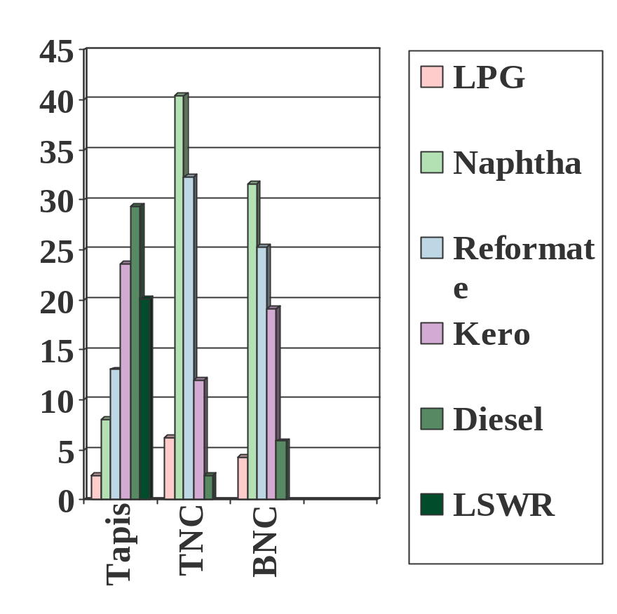
REFINERY ECONOMICS (11)
PSR-1 YIELD VS PRICES
Forecasted price for August 2001(US$/bbl)
  LPG 19.65
  PCN 23.70
  ULG 97 26.90
  Jet A1 29.60
  ADO 28.60
  LSWR 24.60
  * Operating Mode is max diesel

Slide 94
REFINERY ECONOMICS (12)
OPPORTUNITIES FOR UPGRADING IN PSR-2
LSWR for feed to VDU - margin around US$4/bbl
MSRN for feed to 2-CRU
LSRN for feed to SGRU/Isom Unit
H2 Rich Gas for PSR-2 Conversion
  value at 1.3 * NG price per MMBTU H2 recovered.
  1.264 * NG price.

Slide 95
REFINERY ECONOMICS (13)
PSR-2 ECONOMICS
Different market environment - export vs domestic
Different strategy from each shareholder - Petronas restricted by domestic demand
Different view in predicting market movement.
Conversion Margin vs Hydroskimming Margin

Slide 96
REFINERY ECONOMICS (14)
PSR-2 ECONOMICS
Higher value product from PSR-2 fetch higher premium
Comparison Conversion vs Hydroskimming margin in Jun vs July(US$/bbl): Tapis Dubai Hydroskimming -1.02/-1.53 -1.21/-2.81
Full Conversion - 0.08/-0.99 2.17/-0.21

Slide 97
REFINERY ECONOMICS (15)
PLANNING & SCHEDULING CONSTRAINTS
Feedstock deliveries, operating rates, and product sales were commit well before the operating months.
Constraint to respond to refining margins.
Sour crude purchases are committed 2 months before operating month.
Sweet crude purchases are committed 1 month before operating month.
Product sales are committed 1 month before the operating month.

