Slide 1
Lazy & progressive image loading
By Glory Ozonuwe (WDD 230)

Slide 2
What is Lazy Loading or Progressive Image Loading?
This a technique to smartly load the images of your website or application by demand, using small placeholders while the original image is being lazy loaded. When it finishes, do a soft transition from the placeholder to the original picture.
Lazy Loading defers the loading of an image that is not needed on the page immediately. An image, not visible to the user when the page loads, is loaded later when the user scrolls and the image actually becomes visible. If the user never scrolls, an image that is not visible to the user never gets loaded.
Progressive images load immediately on your website at first with a low resolution and then increase their resolution as the website loads completely. You may notice a website uses progressive images when the content looks blurry at first and then sharpens within a few tenths of a second.

Slide 3
Why Should We Lazy Load?
Reduces initial load time – Lazy loading a webpage reduces page weight, allowing for a quicker page load time.
Bandwidth conservation – Lazy loading conserves bandwidth by delivering content to users only if it’s requested.
System resource conservation – Lazy loading conserves both server and client resources, because only some of the images, JavaScript and other code actually needs to be rendered or executed.
User Experience – Progressive Image loading offers a smoother experience to the user.

Slide 4
Which Images can be Lazy Loaded?
The basic idea of lazy loading is simple - defer loading anything that is not needed right now. For images, it usually translates to any image that is not visible to the user up front. These can be lazy loaded.
As the user scrolls down the page, the image placeholders start coming into viewport (visible part of the webpage). We trigger the load for these images when they become visible.
You can find out which images are a candidate for lazy loading and how many bytes you can save on the initial page load by using Google Lighthouse audit tool. The audit performed by this tool has a section dedicated for offscreen images. You can also use ImageKit’s website analyzer to identify if your website uses lazy loading or not, in addition other critical image-related optimizations on your page.

Slide 5

5 different techniques for Lazy Loading
Native Lazy Loading
Lazy Loading Using the Intersection Observer API
Lozad.js
Lazy Loading with Blurred Image Effect
Yall.js

Slide 6
1. Native Lazy Loading
Native lazy loading of images and iframes is straightforward and easy.
As you can see above, it is just plain old html with a ‘loading’ attribute. The loading attribute gives us the option to delay off-screen images and iframes until users scroll to their location on the page. Loading can take any of these three values:
lazy: works great for lazy loading
eager: instructs the browser to load the specified content right away
auto: leaves the option to lazy load or not to lazy load up to the browser.
Pros: This method has no rivals: it has zero overhead, it’s clean and simple.
Cons: At the time of writing, most major browsers have good support for the loading attribute, but not all browsers are on board yet.

Slide 7
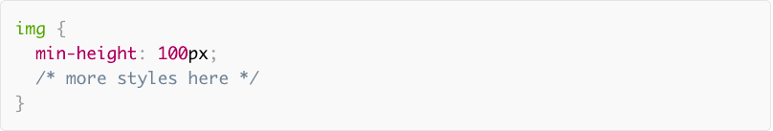
2. Lazy Loading Using the Intersection Observer API
The Intersection Observer API is a modern interface that you can leverage for lazy loading images and other content.
Let’s say you’d like to lazy load an image gallery. The markup for each image would look like this:
Notice how the path to the image is contained inside a data-src attribute, not a src attribute. The reason is that using src means the image would load right away, which is not what you want.
In the CSS, you give each image a min-height value, let’s say 100px. This gives each image placeholder (the img element without the src attribute) a vertical dimension:
In the JavaScript document, you then create a config object and register it with an intersectionObserver instance:

Slide 8
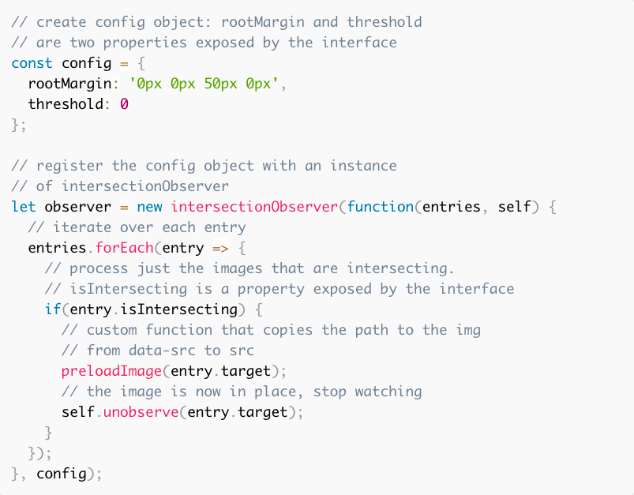

Slide 9
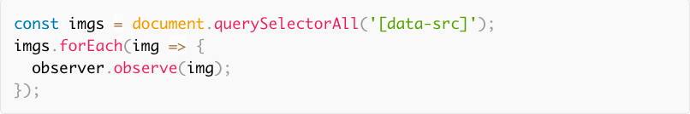
Finally, you iterate over all of your images and add them to this iterationObserver instance:
Pros: It’s a breeze to implement, it’s effective, and has the intersectionObserver do the heavy-lifting in terms of calculations.
Cons: Although the Intersection Observer API is supported by most browsers in their latest versions, it’s not consistently supported by all of them.

Slide 10
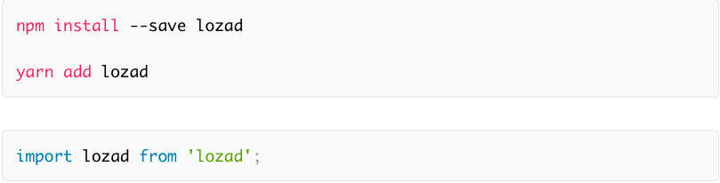
3. Lozad.js
A quick and easy alternative for implementing lazy loading of images is to let a JS library do most of the job for you.
Lozad is a highly performant, light and configurable lazy loader in pure JavaScript with no dependencies. You can use it to lazy load images, videos, iframes and more, and it uses the Intersection Observer API.
You can include Lozad with npm/Yarn and import it using your module bundler of choice:
A quick and easy alternative for implementing lazy loading of images is to let a JS library do most of the job for you.

Slide 11
For a basic implementation, add the class lozad to the asset in your markup:
Then, instantiate Lozad in your JS document:
You’ll find all the details of how you can use the library on the Lozad GitHub repository.
Pros: Fast implementation that applies to a variety of content types
Cons: Not all browsers support.

Slide 12
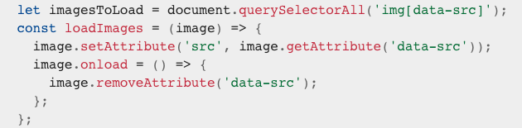
4. Lazy Loading with Blurred Image Effect
This method uses a placeholder image instead, which is small, lightweight, and blurred while the final paths to target images are stored in data-src attributes:
Those images will be loaded via JavaScript after the site finishes building the HTML structure. The placeholder image is scaled the same way the original images are, so it will take up the same space and not cause the layout to repaint as the images load. The js file could processes the data-src attributes like so:
The imagesToLoad variable contains references to all the images, while the loadImages function moves the path from data-src to src. When each image is actually loaded, we remove its data-src attribute as it's not needed anymore. Then we loop through each image and load it:

Slide 13

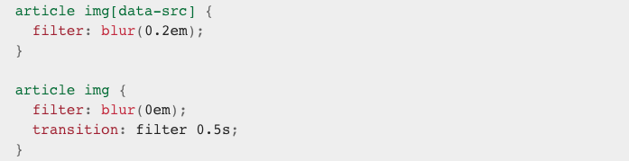
Blur in CSS
To make the whole process more visually appealing, the placeholder is blurred in CSS. We render the images with a blur at the beginning, so a transition to the sharp one can be achieved. This will remove the blur effect within half a second, which looks good enough for the "loading" effect.
Pros: Visually appealing. It loads the images after rendering the HTML structure, and applies a nice transition effect in the process.
Cons: If done without the Intersection Observer API in method 2, it still loads all the images at once, even though the user will only see the first two or three upon page load.

Slide 14
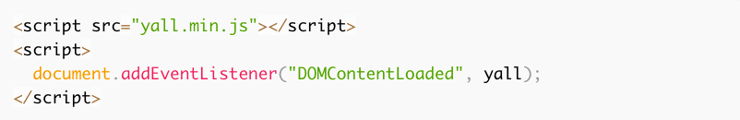
5. Yall.js
Yall is a feature-packed, lazy-loading script for images, videos, and iframes. More specifically, it uses the Intersection Observer API and smartly falls back on traditional event handler techniques where necessary.
When including Yall in your document, you need to initialize it as follows:
Next, to lazy load a simple img element, all you need to do in your markup is:
Note the following:
You add the class lazy to the element, the value of src is a placeholder image, the path to the image you want to lazy load is inside the data-src attribute
Pros: Great performance with the Intersection Observer API, fantastic browser support (it goes back to IE11), no other dependencies necessary

Slide 15
Conclusion
Less files to load initially, smaller files split into modules, use of placeholders, and loading more content on demand — this will help achieve faster initial load times, which brings benefits to the creator and offers a smoother experience to the user.
There are other methods or techniques not mentioned in this lecture.
Perform Demo
Try it out!
Questions, Comments? Leave in the Discussion Board.
Disclaimer: Codes shown in this training may or may not work for your specific case/website. It may have to be tweaked a little so it applies.

