Slide 1
Sign Language Recognition Based Word Prediction
Mohamed Ragab, Abhay M S Aradhya, Andri Ashfahani, Shubham Pateria

Slide 2
Outline
Problem Statement
Data Acquisition
Data Augmentation and Pre-Processing
Basic CNN (Baseline)
CNN + LSTM (Decoupled)
CNN + Sequence to sequence (Decoupled)
Convolutional LSTM (CLSTM)
CLSTM + Sequence to sequence
Experimental Setup
Results and Discussion
Conclusion

Slide 3
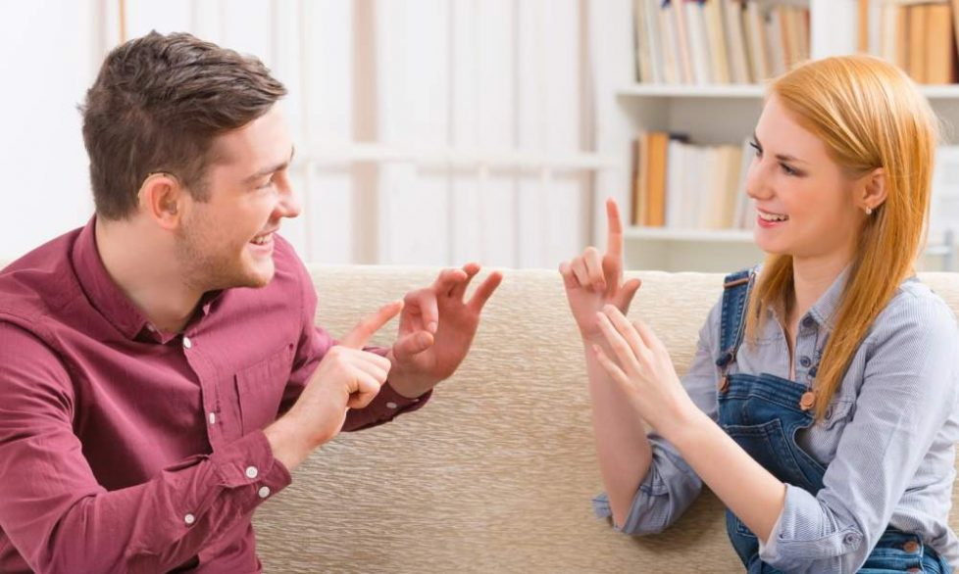
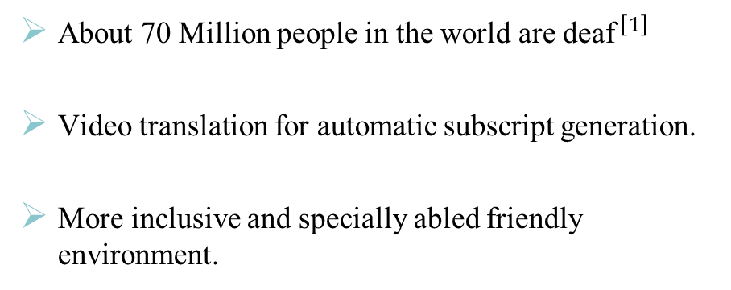
Problem Statement
About 70 Million people in the world are ${\text{deaf}}^{ \left[1\right]}$
Video translation for automatic subscript generation.
More inclusive and specially abled friendly environment.
1. https://wfdeaf.org/

Slide 4
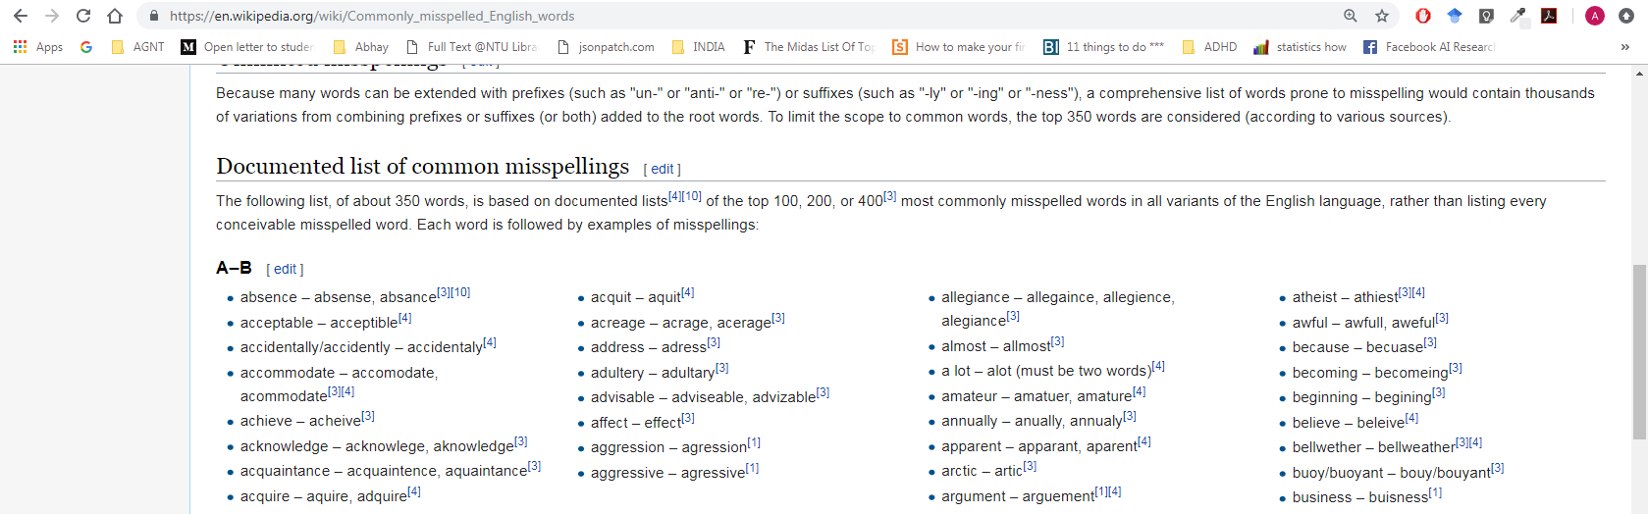
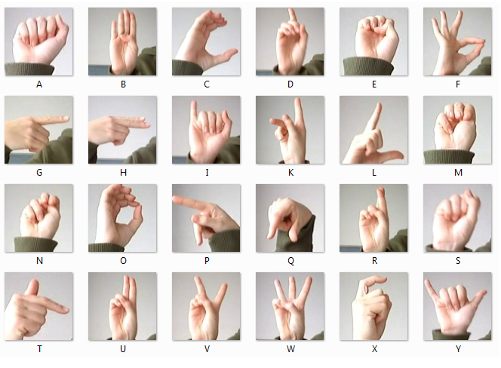
Data Acquisition
Wikipedia
Sign Language MNIST
Data Crawler
Index | Character | Misspelled Word | Label/Correct
0 | A | bberan | abberant
1 | A | bberatio | abberation
2 | A | bbrieviate | abbrieviated
3 | A | bbriviate | abbriviated
4 | A | bbriviatio | abbriviation

Slide 5
Data Augmentation and Pre-Processing
Number of mutations
Number of misspelled words
LSTM data
Data Cleaning
Misspelling
Generator
Dictionary
MNIST Index Generator
CLSTM data

Slide 6
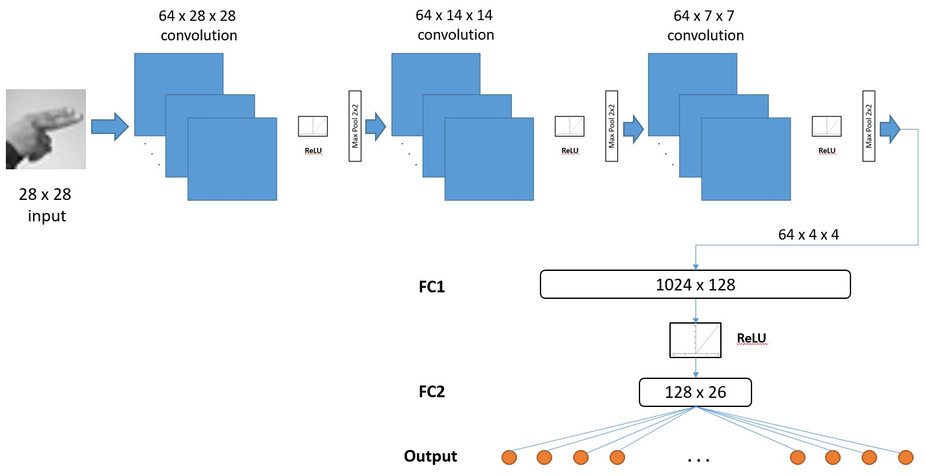
Basic CNN (Baseline)
Basic CNN
Accuracy of 69%
Kaggle data set

Slide 7
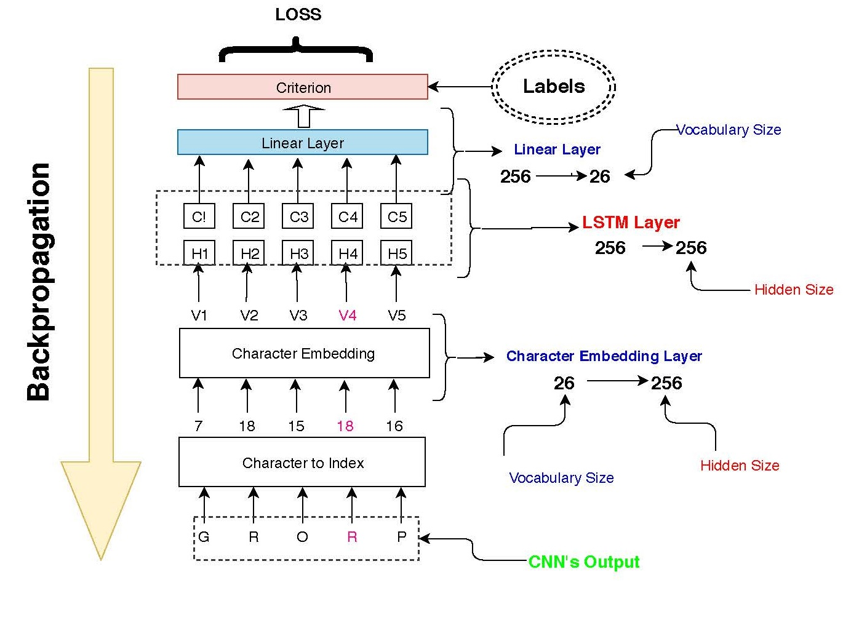
CNN + LSTM (Decoupled)
Hidden
Transformation
Layer
(HTL)
Works on CNN’s output
Character Embedding Layer
Bidirectional LSTM
Dropout

Slide 8
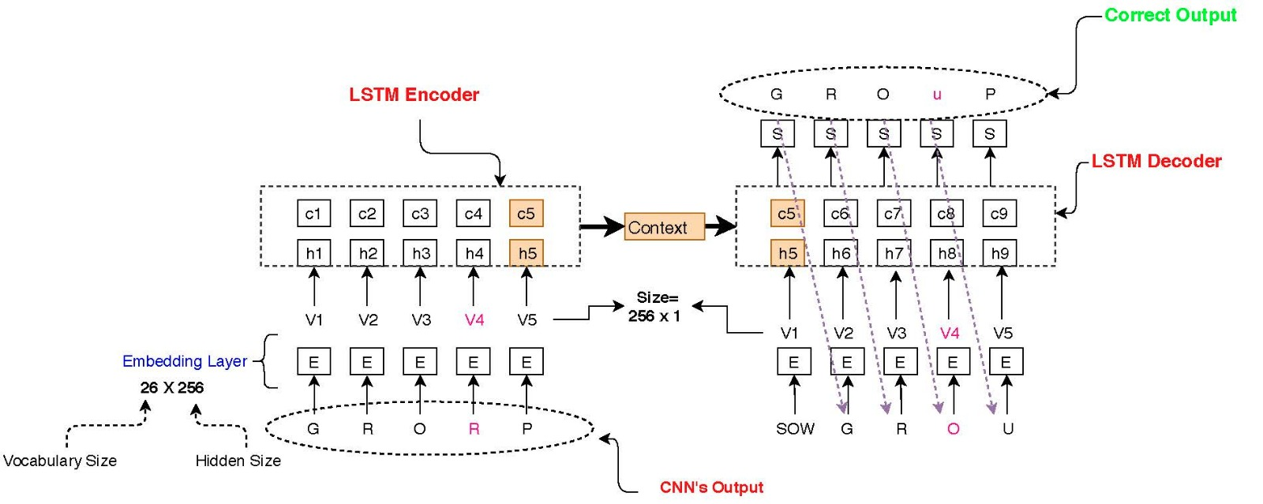
CNN + Sequence to sequence (Decoupled)
Character Embedding
Deeper Architecture
Consider the whole context
More robust to number of Mutations
Predicted to achieve higher accuracy

Slide 9
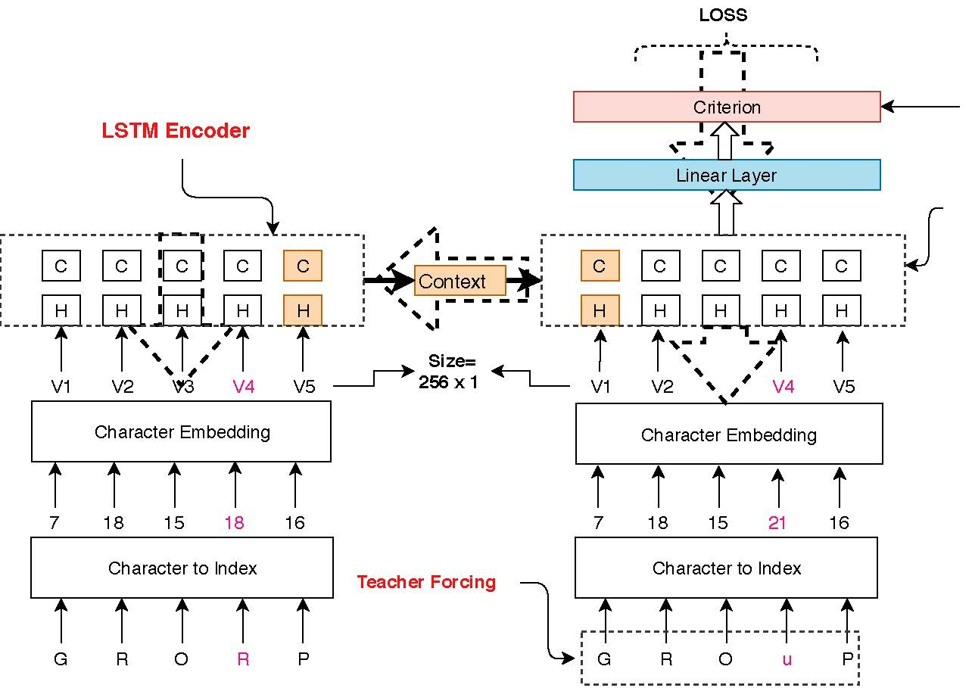
CNN + Sequence to sequence (Decoupled)
Teacher Forcing
Improve training
Exhibit some instability
Used with specific ratio

Slide 10
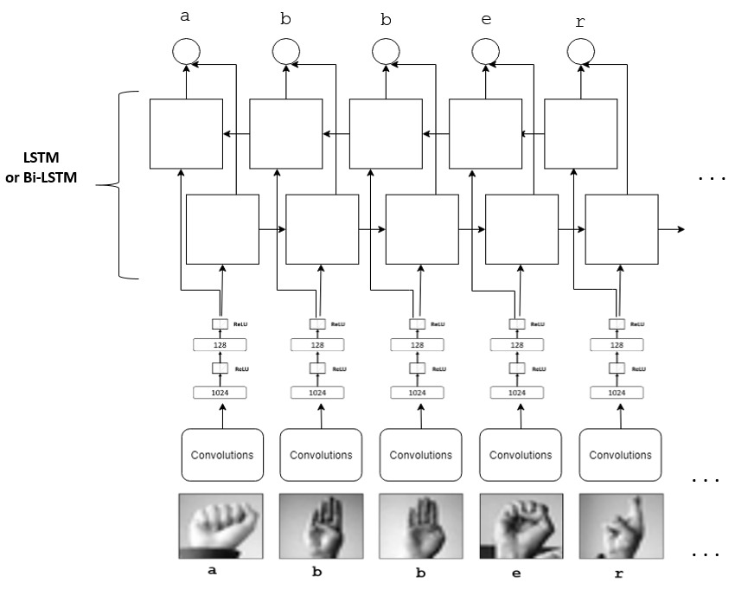
Convolutional LSTM (CLSTM)
End to End Model
No need for embedding
Pass the feature vector directly to the LSTM
More robust than decoupled model

Slide 11
CLSTM + Sequence to sequence
References:
https://neurology.msu.edu/CoGeNT/lab/fmri

Slide 12
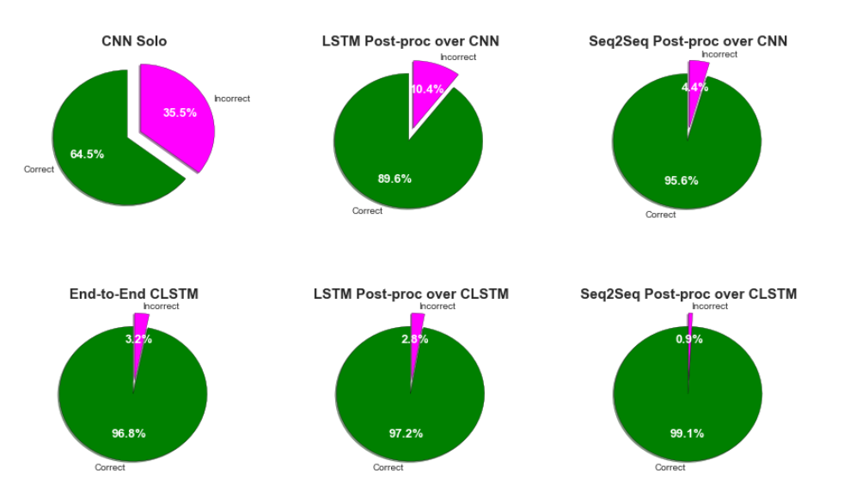
Results and Discussion

Slide 13
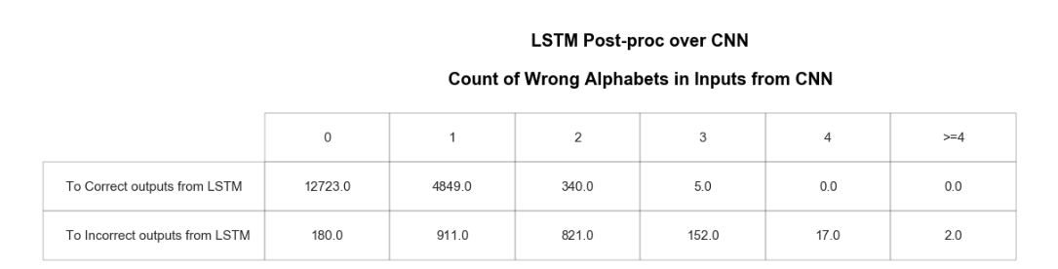
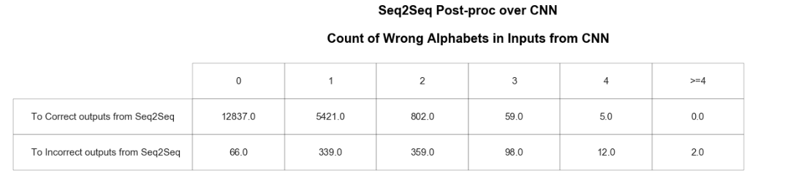
Results and Discussion

Slide 14
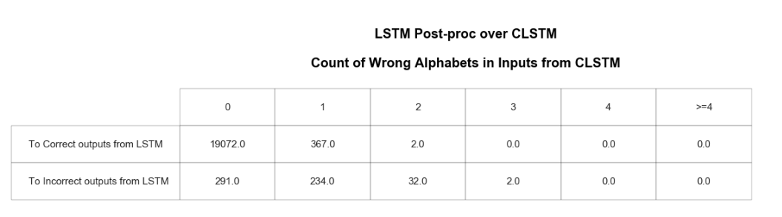
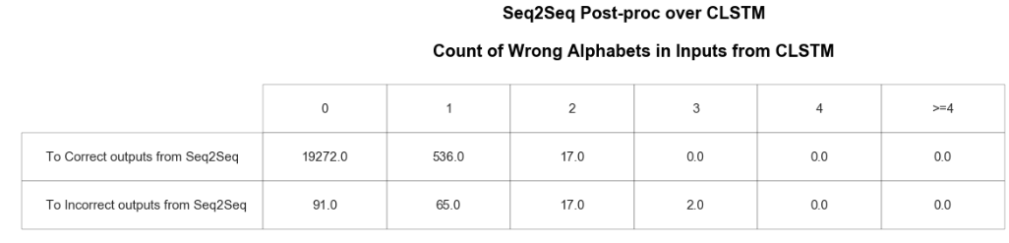
Results and Discussion

Slide 15
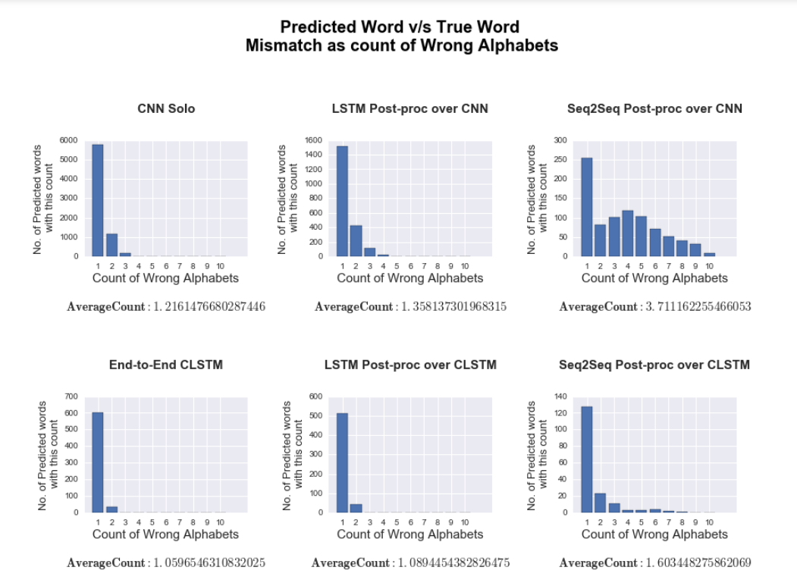
Results and Discussion

Slide 16
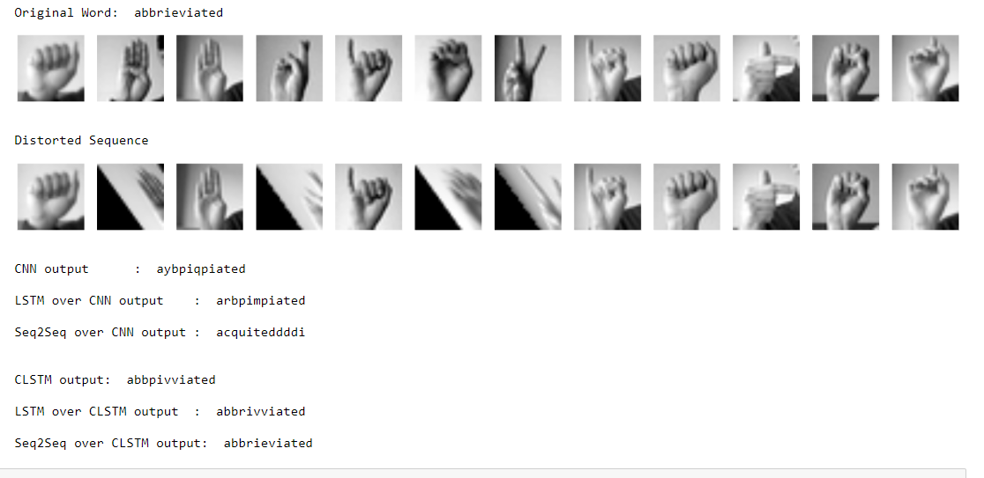
Results and Discussion

Slide 17
Conclusion
We implemented our own scrapper
We applied data cleaning and augmentation procedures to improve the training
We tried different data visualization techniques
We implemented 4 different models and possessed comprehensive performance comparison
We achieved an outstanding accuracy up to 99%
Our models are robust can be generalized on different sequence data and different application
Not the end!
We are aiming to try bigger samples with different modalities to justify our performance

Slide 18
Task Assignment
Task
Data Scrapper | Ragab
Data Augmentation and Pre-processing | Abhay
CNN | Shubham
CNN + LSTM | Andri
CNN + Sequence to Sequence | Ragab, Andri
CLSTM | Abhay, Shubham
Model evaluation and analysis | Abhay, Shubham, Ragab, Andri

Slide 19
Thank You

