Slide 1


Slide 2
Oz in Social Media
Website: https://ozsantospereira.github.io/
Medium: https://medium.com/@ozsp
Patreon: https://www.patreon.com/c/ozsp
LinkedIn: https://www.linkedin.com/in/osvaldo-pereira
Twitter/X: https://twitter.com/Osvaldo91422399
ResearchGate: https://www.researchgate.net/profile/Oz-Santos-Pereira
Google Scholar: Osvaldo L. Santos-Pereira

Slide 3
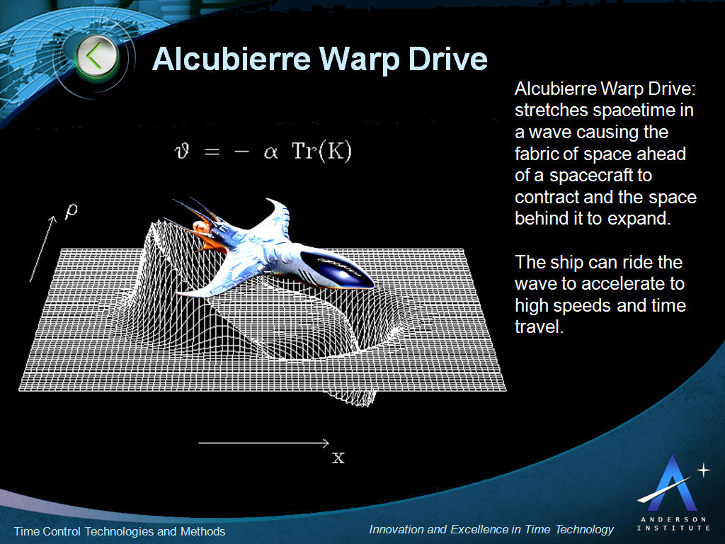

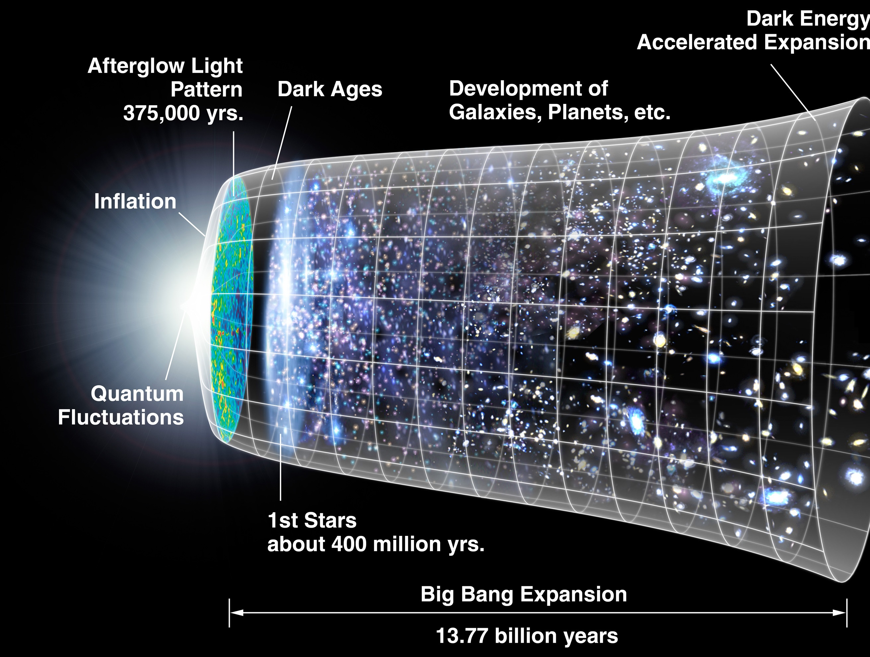
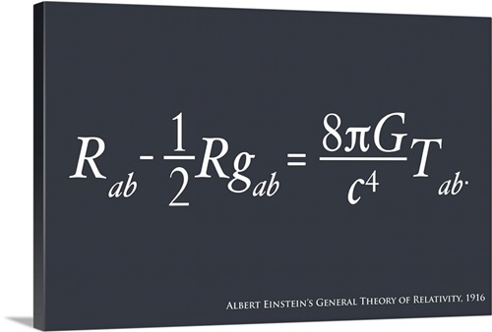


Research Interests

Slide 4
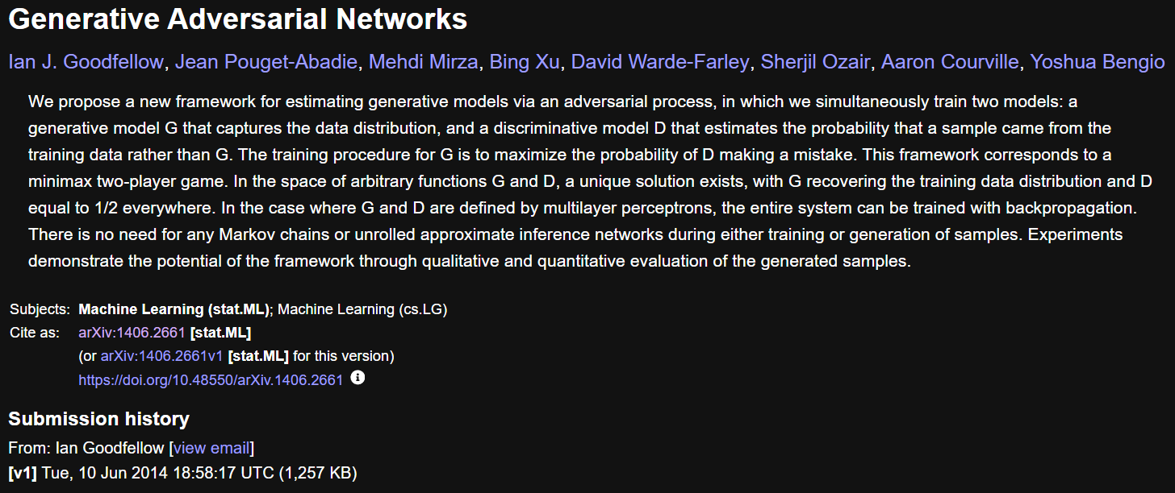
Generative Adversarial Networks
Source: https://arxiv.org/abs/1406.2661

Slide 5
Generative Adversarial Networks (GAN)
Summary
Class of machine learning frameworks for approaching generative Artificial Intelligence.
Developed by Ian Goodfellow in 2014.
Two neural networks in a zero-sum game.
Originally proposed as a form of generative model for unsupervised learning.
Also useful for semi-supervised learning, supervised, and reinforcement learning.
Composed of a generator and a discriminator.
The discriminator analyzes how close to the fake data’s ground truth is.
Generator competes with the discriminator by creating fake data.
Generator aims to minimize the objective function.
Discriminator aims to maximize the objective function.
Discriminator aims to achieve the true distribution.
GANs are asymptotically consistent.

Slide 6

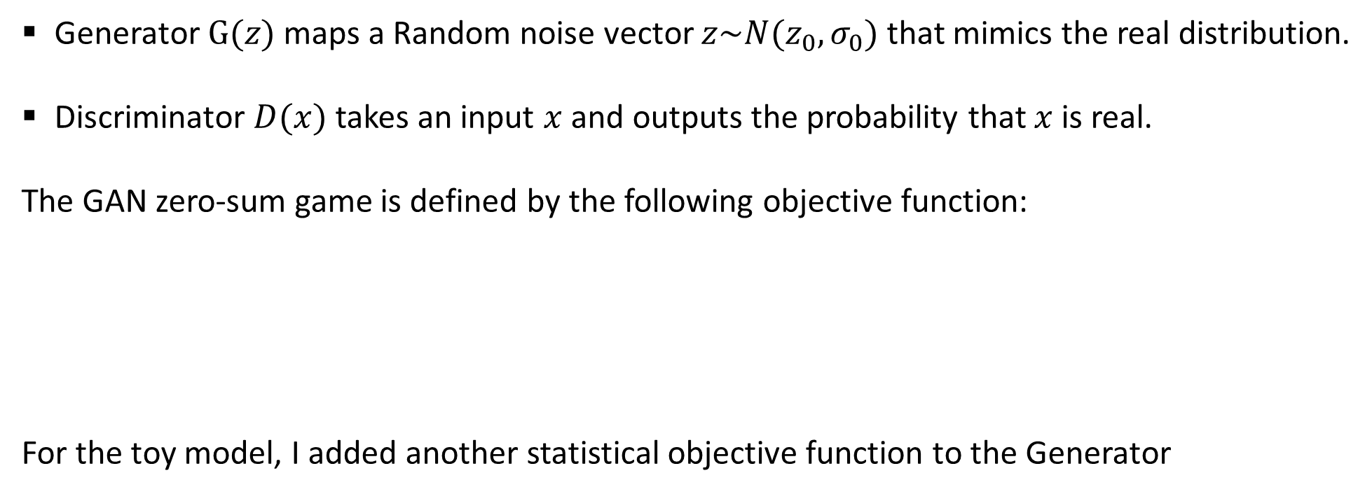
Mathematical Definition
Generator $G(z)$ maps a Random noise vector $z\sim N(z_{0},σ_{0})$ that mimics the real distribution.
Discriminator $D(x)$ takes an input $x$ and outputs the probability that $x$ is real.
The GAN zero-sum game is defined by the following objective function:
For the toy model, I added another statistical objective function to the Generator
(1)
$$L_{stat}={\left(E\left[\hat{z}\right]−z_{0}\right)}^{2}+{\left(Std\left[\hat{z}\right]−σ_{0}\right)}^{2}$$
(2)

Slide 7
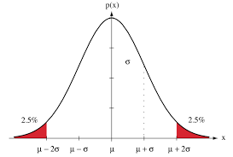

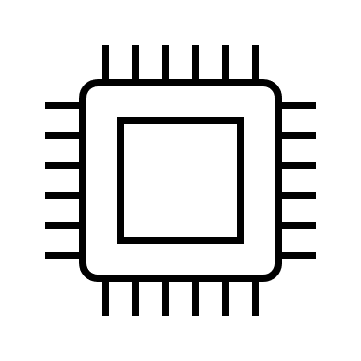




GAN Architecture
Backpropagation: Maximize error
Generator Loss
Generator
Generator Data
Discriminator
Discriminator Loss
Real Data
Backpropagation: Minimize error
Ground Truth

Slide 8
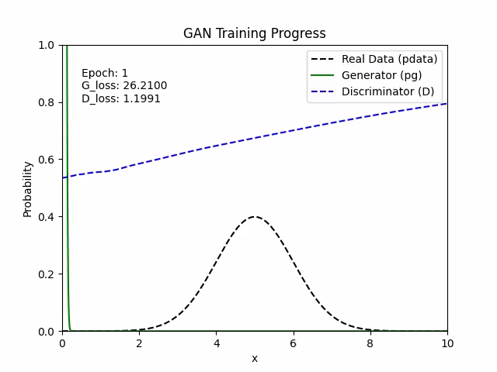
Generative Adversarial Network Toy Model

Slide 9
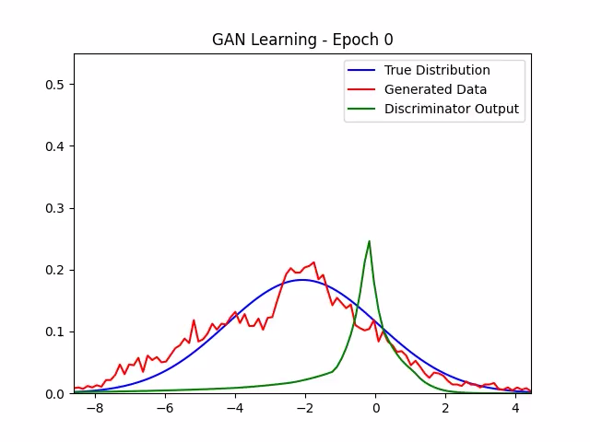
Other Architecture

Slide 10


