Slide 1
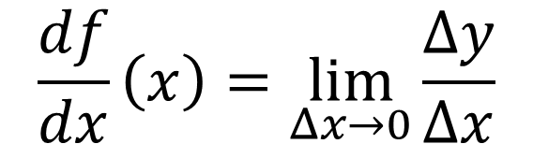
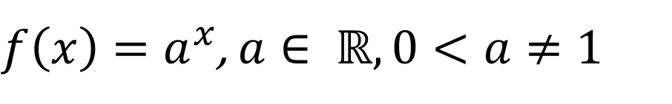
Derivative of exponential function
Find the derivative of the exponential function
$f\left(x\right)=a^{x}$, $a∈ ℝ, 0<a≠1$
Using the definition of derivatives via limits
$$\frac{df}{dx}\left(x\right)=\lim_{Δx→0}{\frac{Δy}{Δx}}$$
Dr. Osvaldo L. Santos-Pereira
olsp@if.ufrj.br

Slide 2

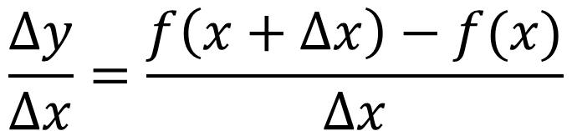
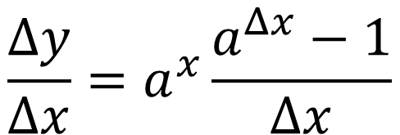
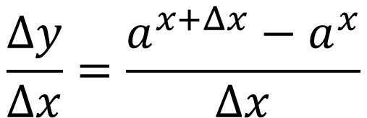
Calculating the variation of the function
Using the definition of variation of a function
$$\frac{Δy}{Δx}=\frac{f\left(x+Δx\right)−f(x)}{Δx}$$
Being the function $f\left(x\right)=a^{x}$
$$\frac{Δy}{Δx}=\frac{a^{x+Δx}−a^{x}}{Δx}$$
Factorizing $a^{x}$, we then have the following
$$\frac{Δy}{Δx}=a^{x}\frac{a^{Δx}−1}{Δx}$$
Dr. Osvaldo L. Santos-Pereira
olsp@if.ufrj.br

Slide 3

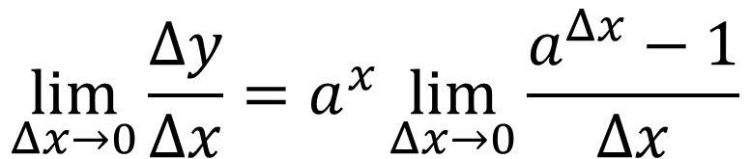
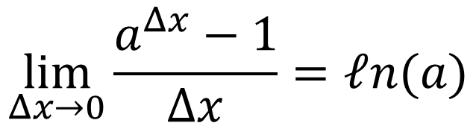
Applying the limit to the variation
Applying the limit to $\frac{Δy}{Δx}$
$$\lim_{Δx→0}{\frac{Δy}{Δx}}=a^{x}\lim_{Δx→0}{\frac{a^{Δx}−1}{Δx}}$$
The limit displayed above is a fundamental one
$$\lim_{Δx→0}{\frac{a^{Δx}−1}{Δx}=ℓn(a)}$$
Dr. Osvaldo L. Santos-Pereira
olsp@if.ufrj.br

Slide 4
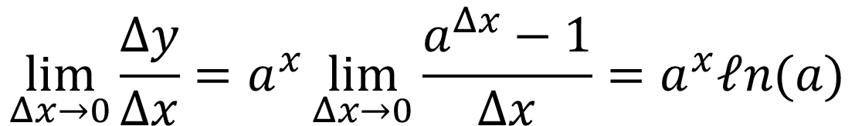
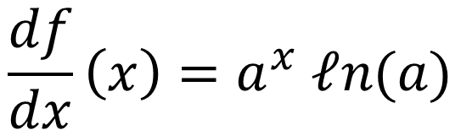
Calculating the limit
Therefore
$${\lim_{Δx→0}{\frac{Δy}{Δx}}=a}^{x}\lim_{Δx→0}{\frac{a^{Δx}−1}{Δx}=a^{x}ℓn(a)}$$
And the result of the derivative of the function $f\left(x\right)=a^{x}$ is
$$\frac{df}{dx}\left(x\right)=a^{x} ℓn(a)$$
Dr. Osvaldo L. Santos-Pereira
olsp@if.ufrj.br

Slide 5
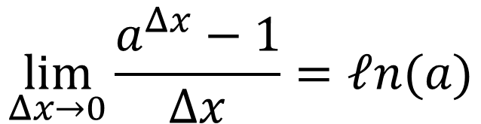
The fundamental limit
The fundamental limit...
$$\lim_{Δx→0}{\frac{a^{Δx}−1}{Δx}=ℓn(a)}$$
Dr. Osvaldo L. Santos-Pereira
olsp@if.ufrj.br

Slide 6
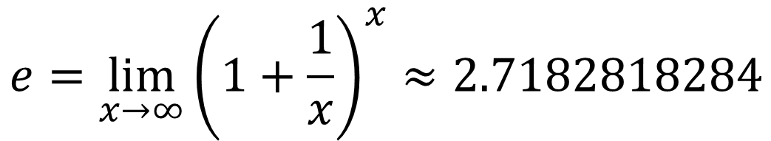
The Euler number and a fundamental limit
The limit
$$\lim_{Δx→0}{\frac{a^{Δx}−1}{Δx}=ℓn(a)}$$
Can be derived by using the definition of the number e
$$e=\lim_{x→∞}{{\left(1+\frac{1}{x}\right)}^{x}≈2.7182818284}$$
Dr. Osvaldo L. Santos-Pereira
olsp@if.ufrj.br

Slide 7
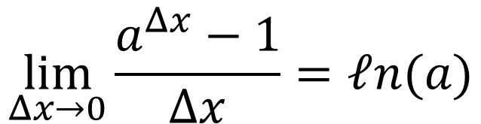


The theorem and the proof
Let us state our theorem
$$\lim_{Δx→0}{\frac{a^{Δx}−1}{Δx}=ℓn(a)}$$
Proof:
Supposing $a>0$ and $a≠1$ and defining
$${b=a}^{Δx}−1$$
Which leads to the following
$$Δx=\frac{ℓn\left(1+b\right)}{ℓn(a)}$$
Dr. Osvaldo L. Santos-Pereira
olsp@if.ufrj.br

Slide 8
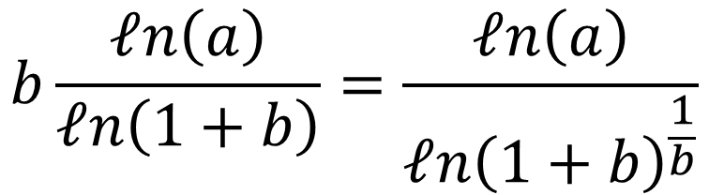
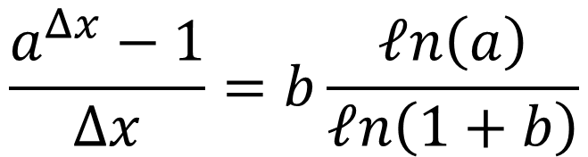
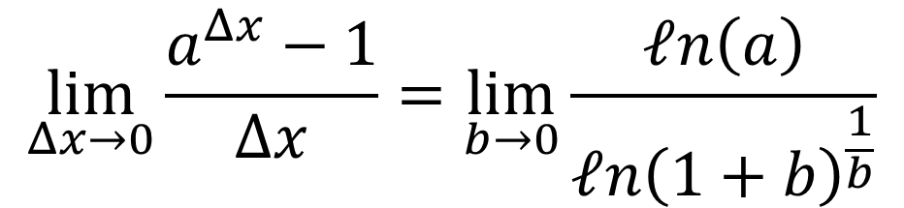
The theorem and the proof (cont.)
Notice that
$$\frac{a^{Δx}−1}{Δx}=b\frac{ℓn\left(a\right)}{ℓn\left(1+b\right)}$$
With further algebraic manipulation
$$b\frac{ℓn\left(a\right)}{ℓn\left(1+b\right)}=\frac{ℓn\left(a\right)}{ℓn{\left(1+b\right)}^{\frac{1}{b}}}$$
therefore
$$\lim_{Δx→0}{\frac{a^{Δx}−1}{Δx}}=\lim_{b→0}\frac{ℓn\left(a\right)}{ℓn{\left(1+b\right)}^{\frac{1}{b}}}$$
Dr. Osvaldo L. Santos-Pereira
olsp@if.ufrj.br

Slide 9

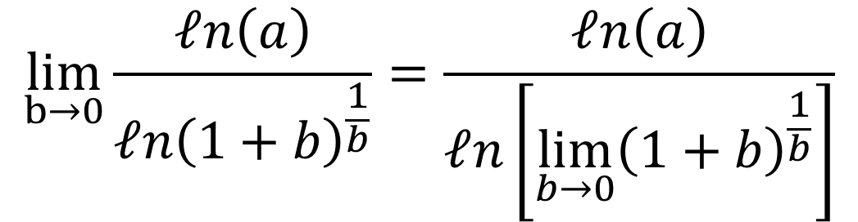
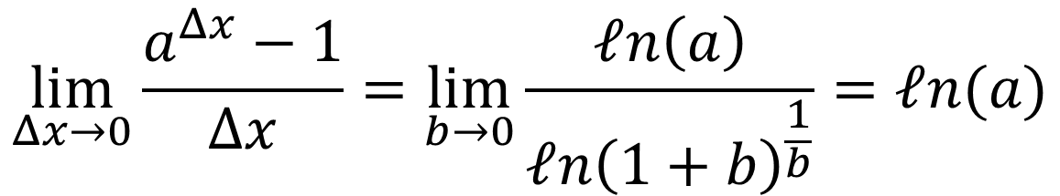
The theorem and the proof (QED)
Notice that
$$\lim_{b→0}\frac{ℓn\left(a\right)}{ℓn{\left(1+b\right)}^{\frac{1}{b}}}=\frac{ℓn\left(a\right)}{ℓn\left[{\lim_{b→0}\left(1+b\right)}^{\frac{1}{b}}\right]}$$
And the denominator of the above equation equals one
$$ℓn\left[{\lim_{b→0}\left(1+b\right)}^{\frac{1}{b}}\right]=ℓn\left(e\right)=1$$
Therefore, as we intended to show (QED)
$$\lim_{Δx→0}{\frac{a^{Δx}−1}{Δx}}=\lim_{b→0}\frac{ℓn\left(a\right)}{ℓn{\left(1+b\right)}^{\frac{1}{b}}}=ℓn(a)$$
Dr. Osvaldo L. Santos-Pereira
olsp@if.ufrj.br

Slide 10
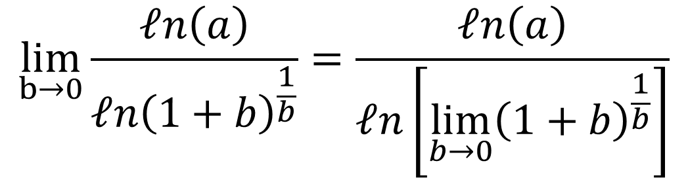
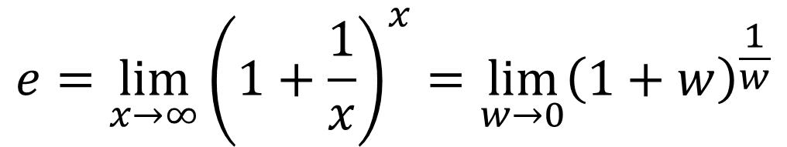
Caveats and challenge
Another theorem and equivalence of limits
$$e=\lim_{x→∞}{{\left(1+\frac{1}{x}\right)}^{x}=\lim_{w→0}{\left(1+w\right)}^{\frac{1}{w}}}$$
A theorem of limits
$$\lim_{b→0}\frac{ℓn\left(a\right)}{ℓn{\left(1+b\right)}^{\frac{1}{b}}}=\frac{ℓn\left(a\right)}{ℓn\left[{\lim_{b→0}\left(1+b\right)}^{\frac{1}{b}}\right]}$$
Dr. Osvaldo L. Santos-Pereira
olsp@if.ufrj.br

