Slide 1
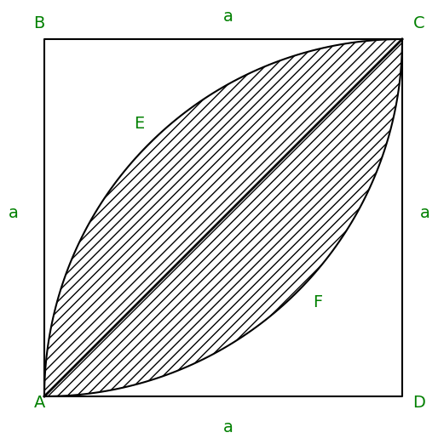



$$\frac{A\left(AECFA\right)}{2}=A\left(AECDA\right)−A\left(ACDA\right)$$
$$\frac{A\left(AECFA\right)}{2}=\frac{πa^{2}}{4}−\frac{a^{2}}{2}$$
$$Area=\frac{a^{2}}{2}(π−2)$$

