Slide 1


Slide 2
Oz in Social Media
Website: https://ozsantospereira.github.io/
Medium: https://medium.com/@ozsp
Patreon: https://www.patreon.com/c/ozsp
LinkedIn: https://www.linkedin.com/in/osvaldo-pereira
Twitter/X: https://twitter.com/Osvaldo91422399
ResearchGate: https://www.researchgate.net/profile/Oz-Santos-Pereira
Google Scholar: Osvaldo L. Santos-Pereira

Slide 3
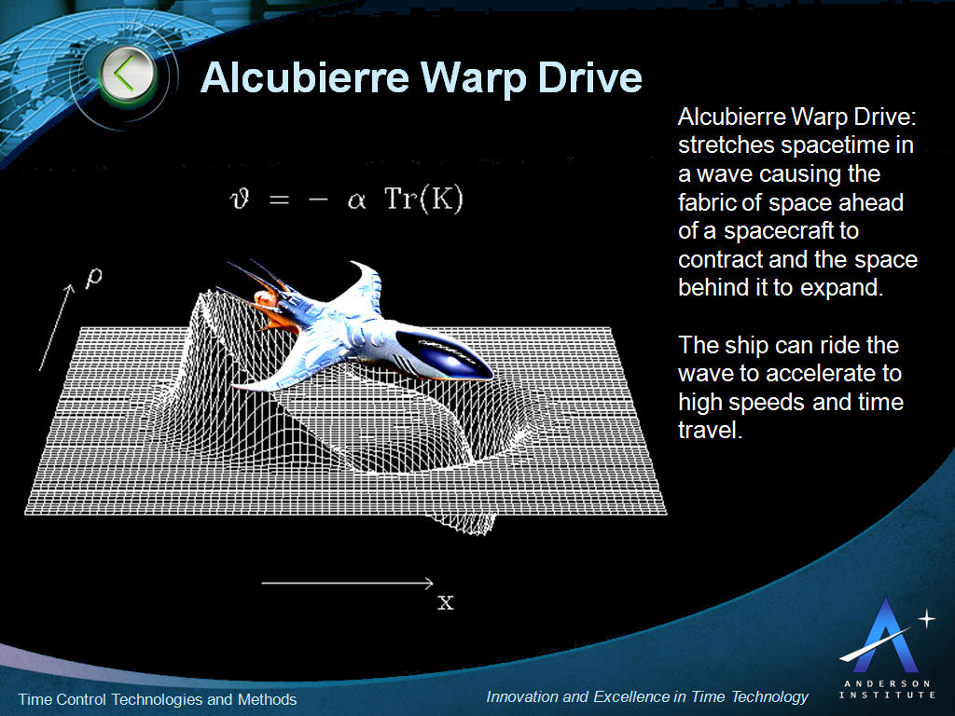

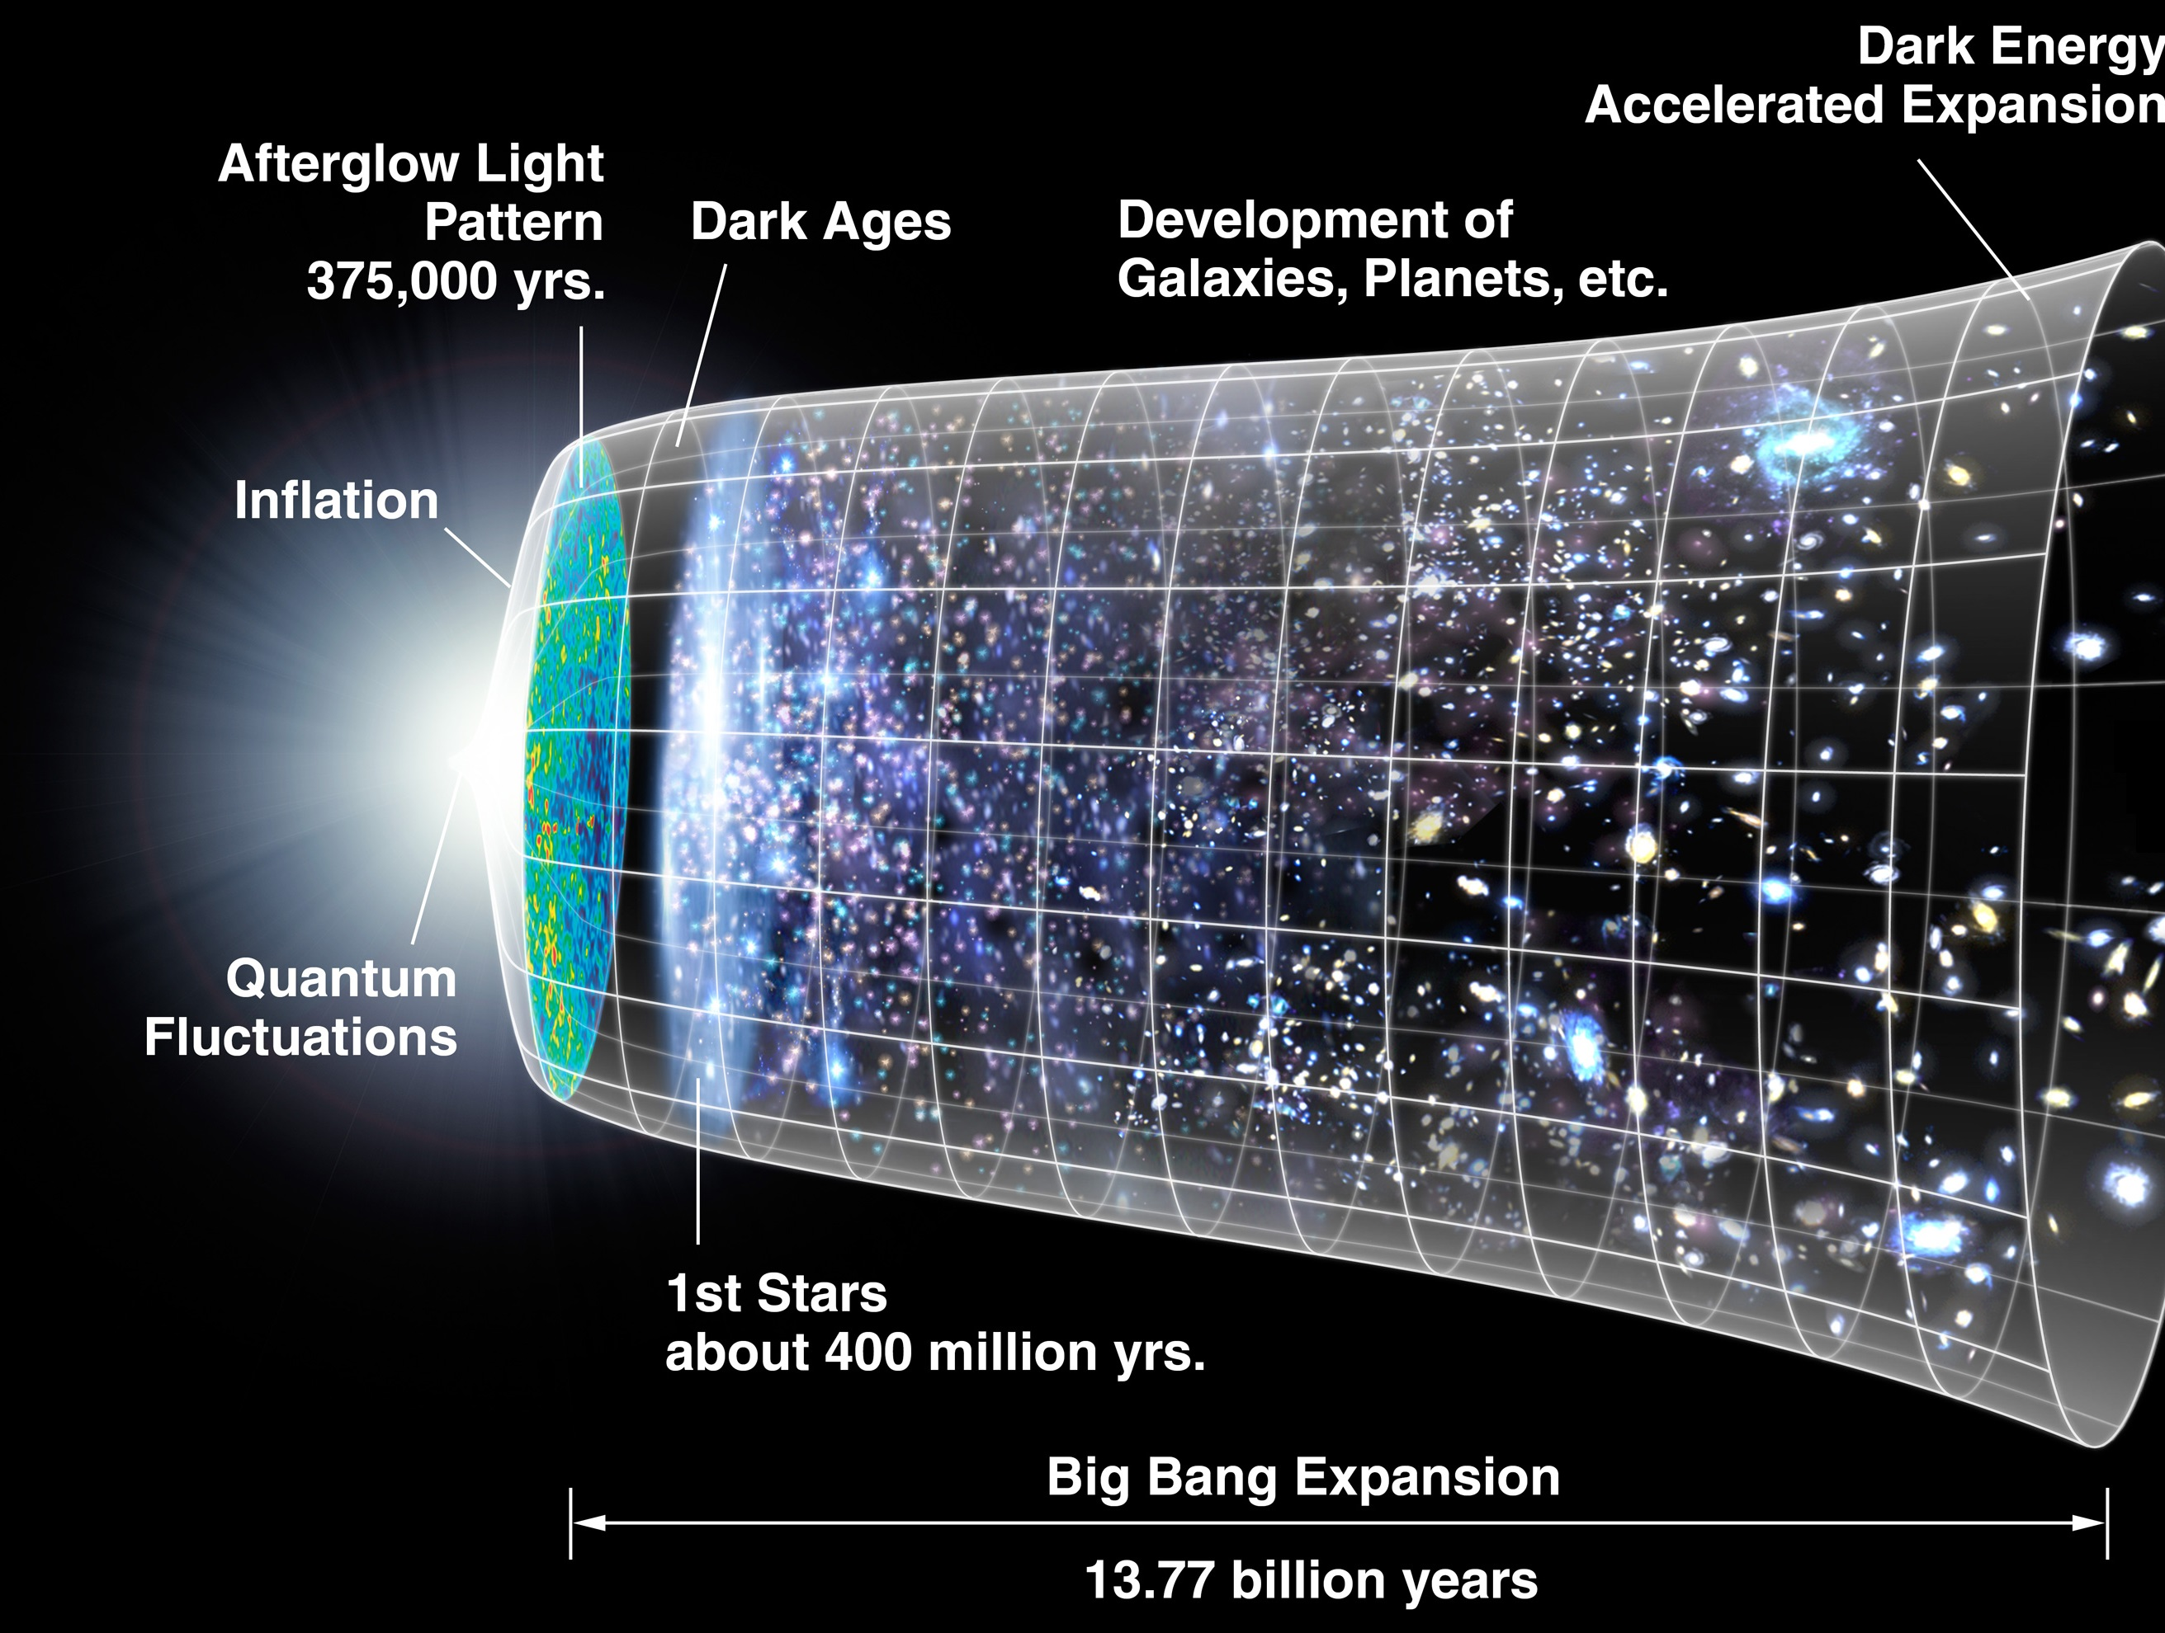
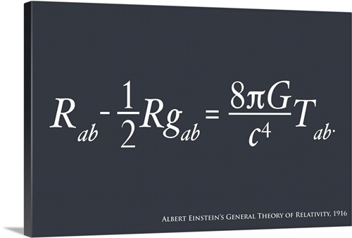


Research Interests

Slide 4
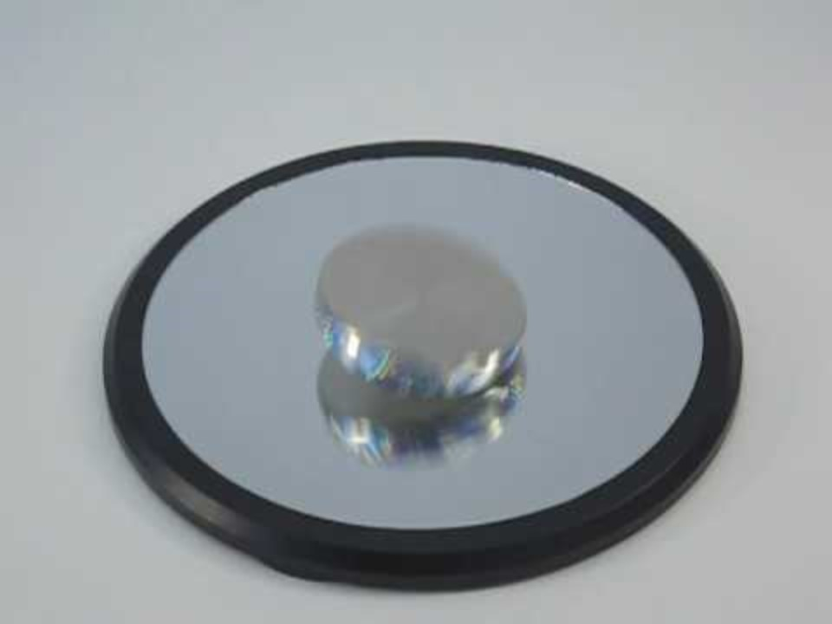
Euler Disk
Source: https://youtu.be/ug2bKCG4gZY

Slide 5







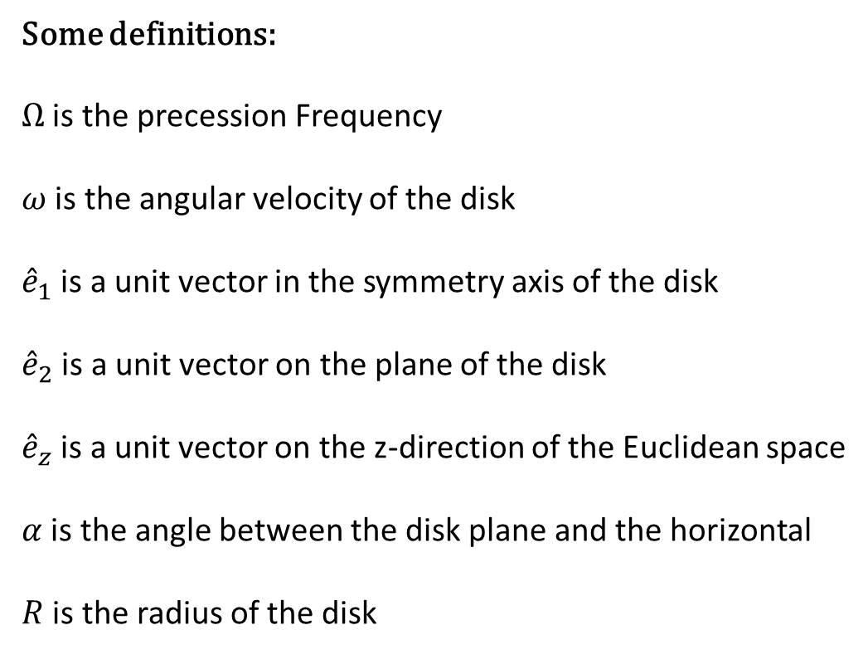


Physics Concepts
${\hat{e}}_{1}$
${\hat{e}}_{z}$
Some definitions:
$Ω$ is the precession Frequency
$ω$ is the angular velocity of the disk
${\hat{e}}_{1}$ is a unit vector in the symmetry axis of the disk
${\hat{e}}_{2}$ is a unit vector on the plane of the disk
${\hat{e}}_{z}$ is a unit vector on the z-direction of the Euclidean space
$α$ is the angle between the disk plane and the horizontal
$R$ is the radius of the disk
$ω$
$Ω$
${\hat{e}}_{2}$
$α$
$R$
$α$
$P$

Slide 6
Precession
Precession is a change in the orientation of the rotational axis of a rotating body.
In an appropriate reference frame it can be defined as a change in the first Euler angle.
If the axis of rotation of a body is itself rotating about a second axis, that body is said to be precessing about the second axis.
In physics, there are two types of precession: torque-free and torque-induced.
Source: https://upload.wikimedia.org/wikipedia/commons/8/82/Gyroscope_precession.gif

Slide 7
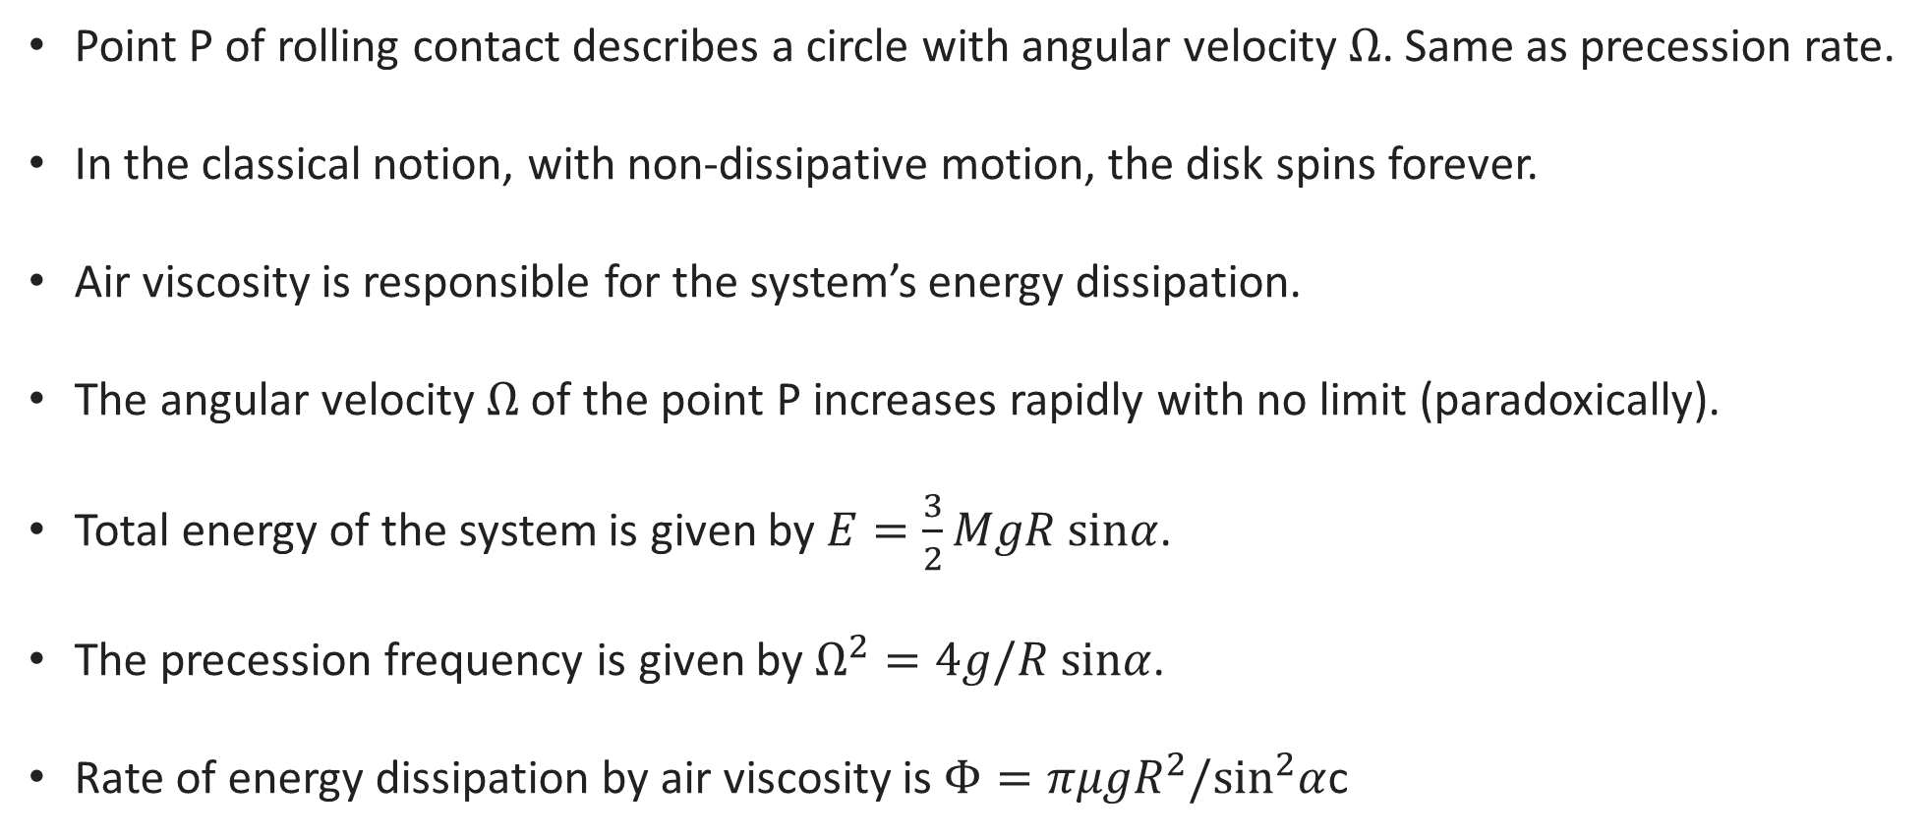
Physics Concepts
Point P of rolling contact describes a circle with angular velocity $Ω$. Same as precession rate.
In the classical notion, with non-dissipative motion, the disk spins forever.
Air viscosity is responsible for the system’s energy dissipation.
The angular velocity $Ω$ of the point P increases rapidly with no limit (paradoxically).
Total energy of the system is given by $E=\frac{3}{2}MgR sinα$.
The precession frequency is given by $Ω^{2}=4g/R sinα$.
Rate of energy dissipation by air viscosity is $Φ=πμgR^{2}/\sin^{2}α$c

Slide 8
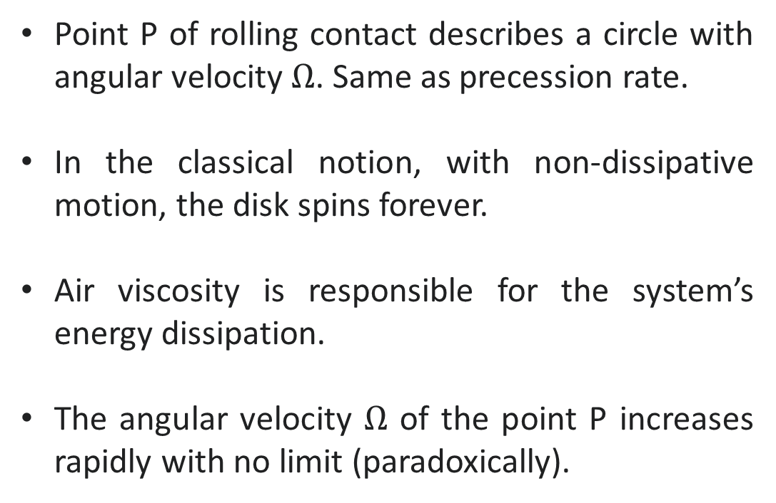
Physics Concepts
Point P of rolling contact describes a circle with angular velocity $Ω$. Same as precession rate.
In the classical notion, with non-dissipative motion, the disk spins forever.
Air viscosity is responsible for the system’s energy dissipation.
The angular velocity $Ω$ of the point P increases rapidly with no limit (paradoxically).
${\hat{e}}_{1}$
${\hat{e}}_{z}$
$ω$
$Ω$
${\hat{e}}_{2}$
$α$
$R$
$α$
$P$

Slide 9
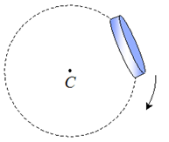
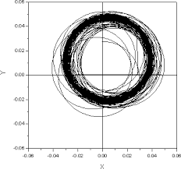
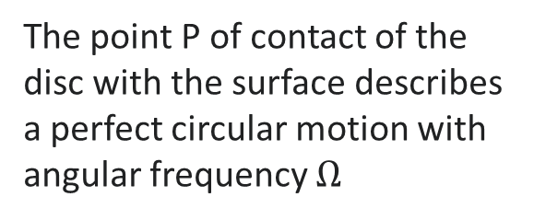
Point P Trajectory
View from the top
Computer Simulation
The point P of contact of the disc with the surface describes a perfect circular motion with angular frequency $Ω$
Computer simulation for the Point P trajectory.

Slide 10
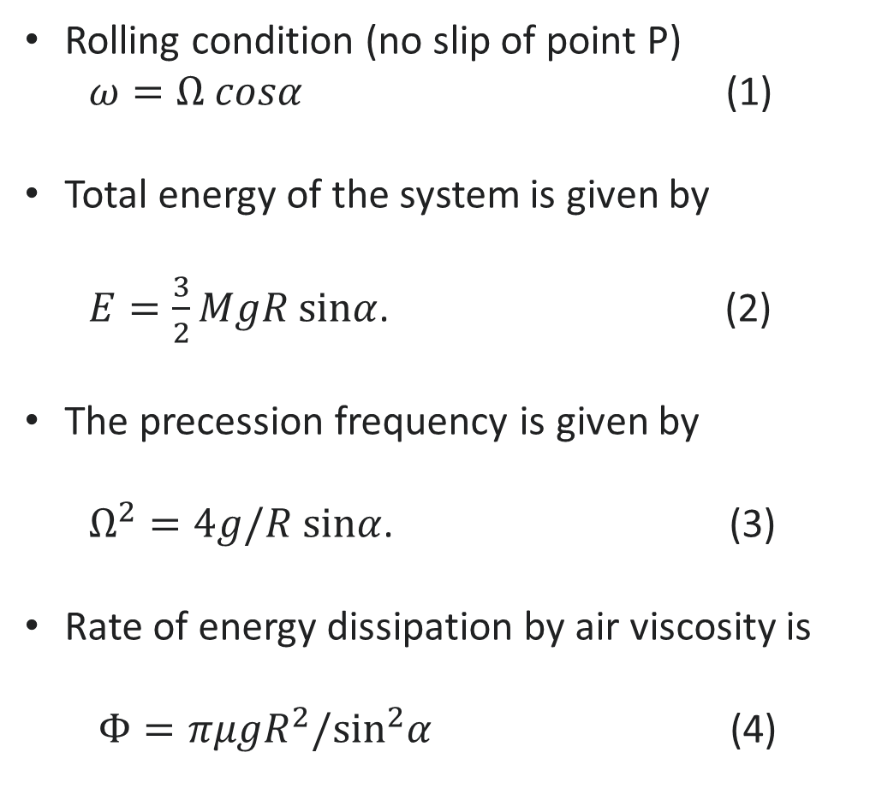
Physics Concepts
Rolling condition (no slip of point P)
$ω=Ω cosα$ (1)
Total energy of the system is given by
$E=\frac{3}{2}MgR sinα$. (2)
The precession frequency is given by
$Ω^{2}=4g/R sinα$. (3)
Rate of energy dissipation by air viscosity is
$Φ=πμgR^{2}/\sin^{2}α$ (4)
${\hat{e}}_{1}$
${\hat{e}}_{z}$
$ω$
$Ω$
${\hat{e}}_{2}$
$α$
$R$
$α$
$P$

Slide 11
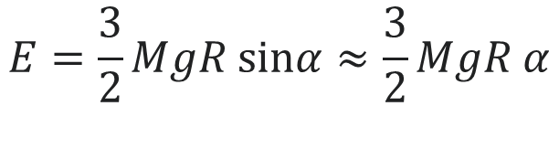
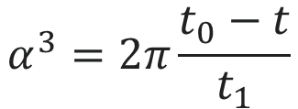
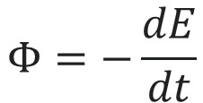

Small Angle Approximation
For small angle approximation where $sinα≈α$ the energy of the system is given by
$$E=\frac{3}{2}MgR sinα≈\frac{3}{2}MgR α$$
(5)
And the rate of energy dissipation is given by
$Φ=\frac{πμgR^{2}}{\sin^{2}α}≈\frac{πμgR^{2}}{α^{2}}$
(6)
The relation between rate of energy dissipation and energy is
$$Φ=−\frac{dE}{dt}$$
(7)
Integration leads to
$$α^{3}=2π\frac{t_{0}−t}{t_{1}}$$
(8)

Slide 12
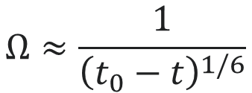
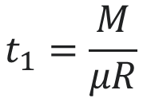
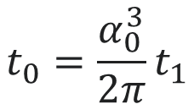
The Singularity
Where $t_{0}$ is a constant of integration found at the initial condition $t=0$ and $α\left(t=0\right)=α_{0}$
$$t_{0}=\frac{α_{0}^{3}}{2π}t_{1}$$
(9)
Where $t_{1}$is given by
$$t_{1}=\frac{M}{μR}$$
(10)
The constant $t_{0}$ is a characteristic time for the disk rotation and the disk rotation is proportional to
$$Ω≈\frac{1}{{\left(t_{0}−t\right)}^{1/6}}$$
Which is a singularity!

Slide 13
References
https://en.wikipedia.org/wiki/Euler%27s_Disk
Keady, G. (2007). The rolling of a disk on a horizontal plane and Euler's disk. International Journal of Mathematical Education in Science & Technology, 38(3), 381–392.
Link: https://citeseerx.ist.psu.edu/document?repid=rep1&type=pdf&doi=cbd51d985ca03a177d9ca8c9bc4ccfb3d6b5bebe
McDonald, A. J., & McDonald, K. T. (2000). The rolling motion of a disk on a horizontal plane.
Link: http://www.eulersdisk.com/rollingdisk.pdf
Darmendrail, L., & Müller, A. (2021). The Euler disk and its dynamic finite time singularity. Advanced Science and Technology, 42(4), 2081–2090.
Link: https://www.jstage.jst.go.jp/article/ast/42/4/42_E2081/_pdf/-char/ja
Kevin T. Kilty. Euler’s disc and its finite-time singularity.
Link: https://www.kilty.com/pdfs/euler.pdf
Moffatt, H. K. (2000). Euler's disk and its finite-time singularity. Nature, 404(6780), 833–834.
Link: https://www.nature.com/articles/35009017

Slide 14


