Slide 1
https://mathworld.wolfram.com/ConicSection.html

Slide 2
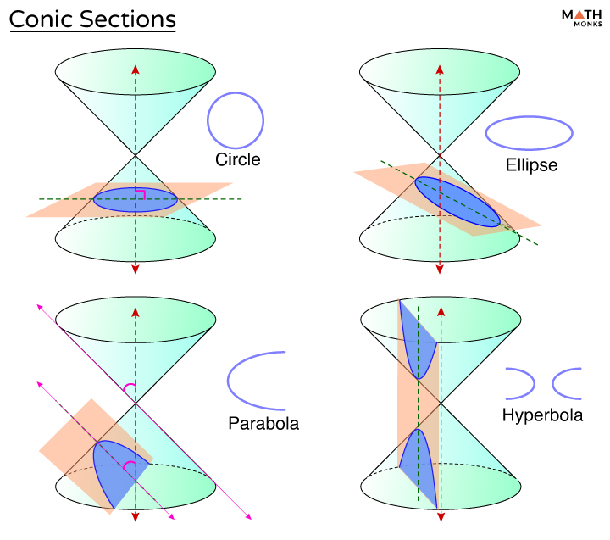
https://mathmonks.com/cone/conic-sections

