Slide 1
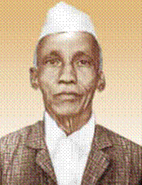
Dattatreya Ramchandra Kaprekar
(दत्तात्रेय रामचंद्र कापरेकर)
1905 – 1986
Recreational Mathematician

Slide 2
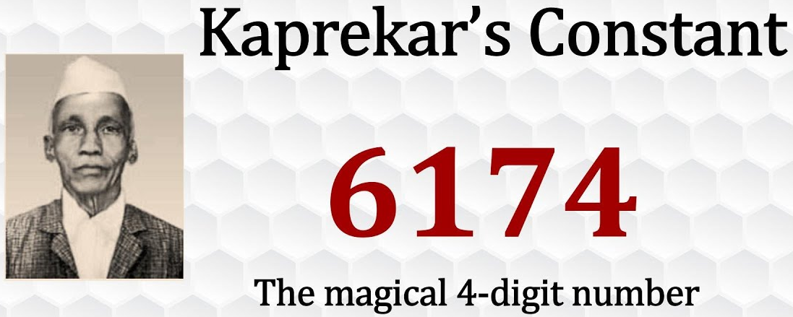

Slide 3
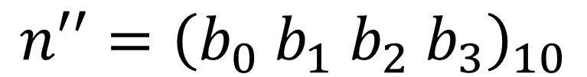
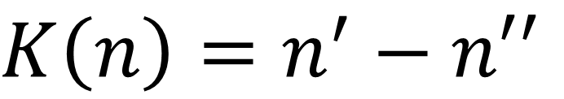
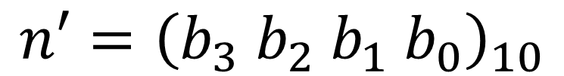
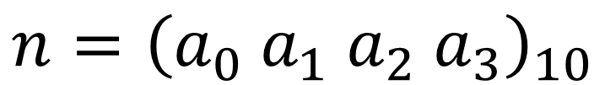
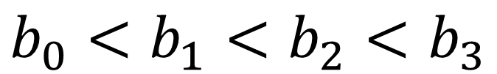
Kaprekar’s Routine
$K\left(n\right)=n^{′}−n′′$
Where n is any integer with four digits in decimal basis
$$n={\left(a_{0} a_{1} a_{2} a_{3}\right)}_{10}$$
$n^{′}$ is any integer with four digits in decimal basis
$$n′={\left(b_{3} b_{2} b_{1} b_{0}\right)}_{10}$$
${n′}^{′}$is the number n with its digits in ascending order
$$n′′={\left(b_{0} b_{1} b_{2} b_{3}\right)}_{10}$$
and the digits $b_{0,} b_{1}, b_{2}, b_{3}$ obey
$$b_{0}<b_{1}<b_{2}<b_{3}$$

Slide 4
Kaprekar’s Routine
Select any four-digit number that has at least two different digits, leading zeros are allowed.
Create two new four-digit numbers by arranging the original digits in ascending and descending order, adding leading zeros if necessary.
Subtract the smaller number from the bigger number.
If the result is not 6174, return to step 2 and repeat.

Slide 5
Kaprekar’s Routine Example
2091
3524
1129
9210 – 0129 = 9081
↓
9810 – 0189 = 9621
↓
9621 – 1269 = 8352
↓
8532 – 2358 = 6174
5432 – 2345 = 3087
↓
8730 – 0378 = 8352
↓
8532 – 2358 = 6174
9211 – 1129 = 8082
↓
8820 – 0288 = 8532
↓
8532 – 2358 = 6174

Slide 6


