Slide 1
y,z-direction
Expansion of spacetime
Warp bubble
center
x-direction
Contraction of spacetime

Slide 2

y,z-direction
(x,y,z)
$$r_{s}(t)$$
R
(x_{s},0,0)
x-direction

Slide 3









$$\vec{n}$$
$$\vec{β}$$
$$x_{i}−β_{i}dt$$
$$x_{i}(t+dt)$$
$$dτ=αdt$$
$$t^{μ}$$
$$Σ_{t+dt }$$
$$x_{i}(t)$$
$$Σ_{t}$$

Slide 4














$${dx}_{i}+β_{i}dt$$
$$D$$
$${x_{i}+dx}_{i}$$
$$B$$
$$C$$
$$β_{i}dt$$
$${dx}_{i}$$
$$t^{μ}dt$$
$$αn^{μ}dt$$
$dx^{μ}$
$$Σ_{t+dt }$$
$$A$$
$$x_{i}(t)$$
$$Σ_{t}$$

Slide 5



Time
$$Σ_{t_{3}}$$
$$Σ_{t_{2}}$$
$$Σ_{t_{1}}$$

Slide 6





$$\vec{n}$$
$$t^{μ}$$
$$Σ_{t_{3}}$$
$$Σ_{t_{2}}$$
$$Σ_{t_{1}}$$

Slide 7
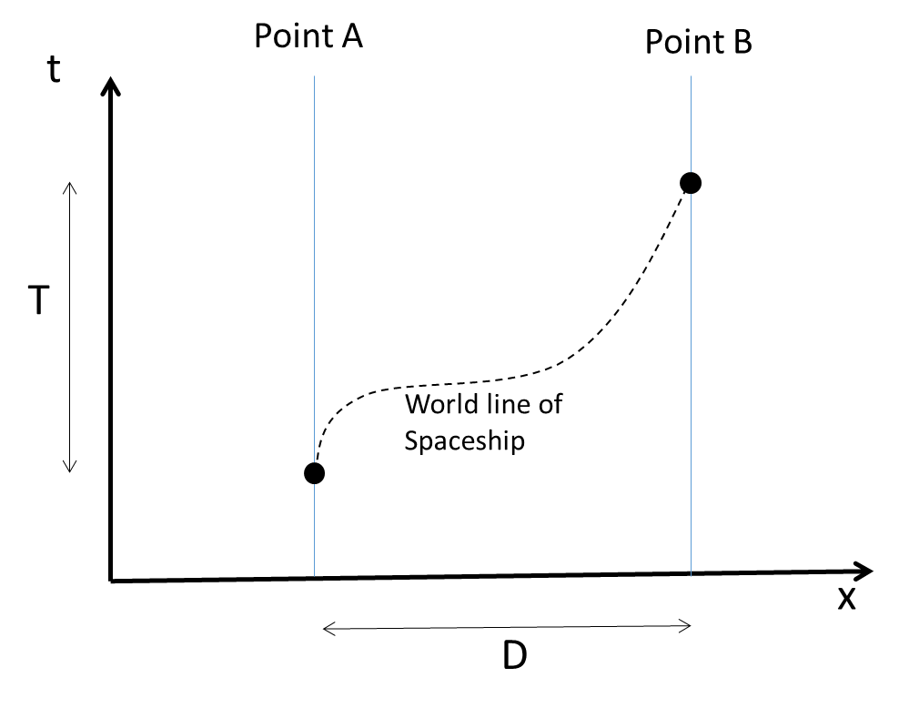

Slide 8
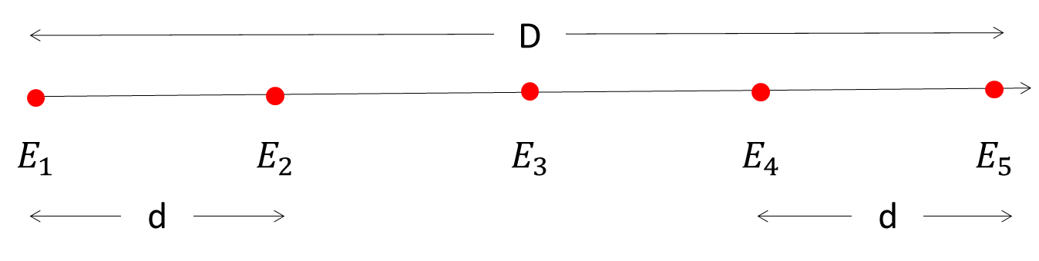

Slide 9
Time
Timelike World line
for observer A
Timelike World line
for observer B
T₂
Light path
spaceship
world line
T₁
Space
Observer A
Observer B
D

Slide 10
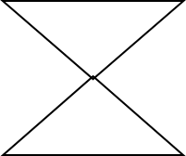
Time
Timelike World line
for Point A
Timelike World line
for Point B
T₂
Light path
Material particle
world line
T₁
Space
Point A
Point B
D

Slide 11
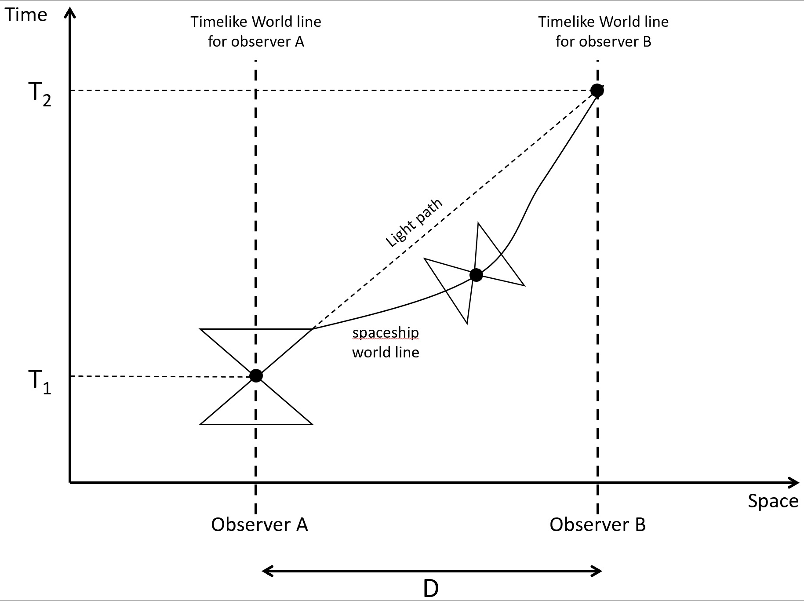

Slide 12
Time
Timelike World line
for Point A
Timelike World line
for Point B
T₃
T₂
Light path
Material particle
world line
T₁
Space
Point A
Point B
D

Slide 13
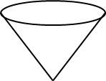
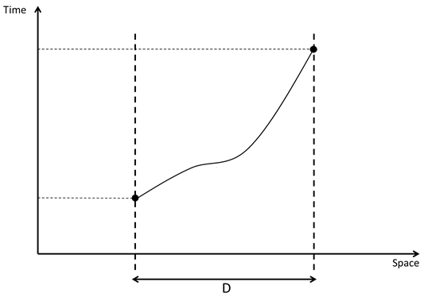


Slide 14



R
y
$$r_{s}(t)$$
(x,y,z)
(x_{s}, y_{s}, z_{s})
$$r$$
(0,0,0)
$r$’
x
z

Slide 15




$$W_{III}$$
$$W_{I}$$
$$W_{II}$$

Slide 16
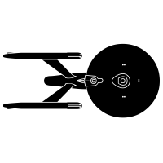
$$W_{III}$$
$$W_{I}$$
$$W_{II}$$

Slide 18
Formato de Imagem

Slide 19
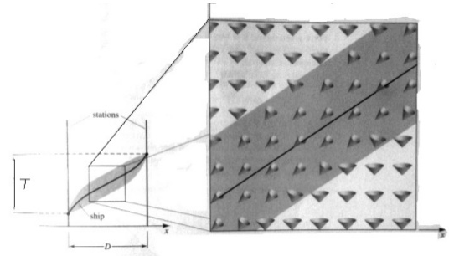

Slide 20
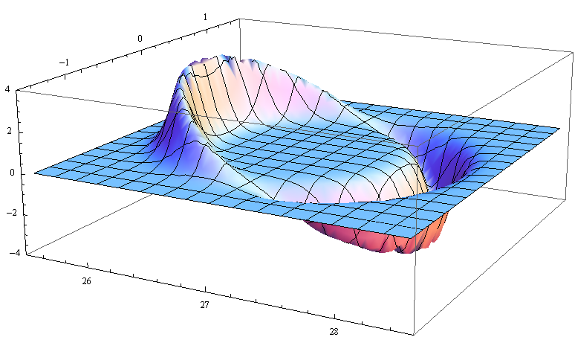

Slide 21
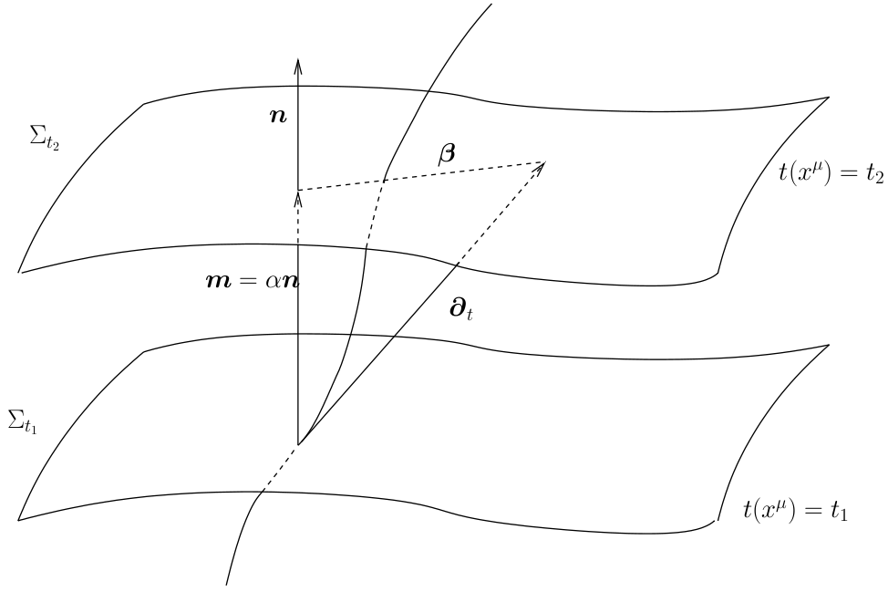
https://www.emis.de/journals/LRG/Articles/lrr-2015-1/articlese6.html

Slide 22
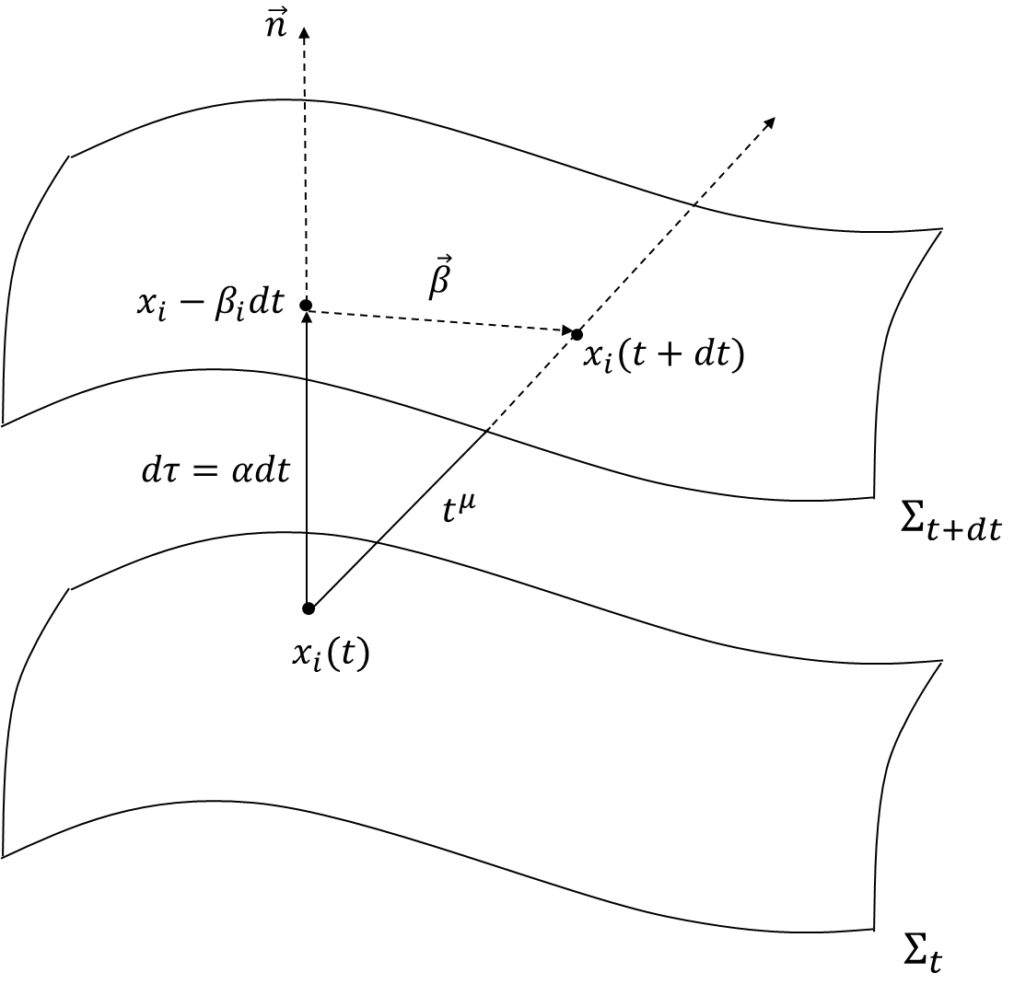

Slide 24
