Slide 1









$$A_{AECFA}=?$$
$$a$$
$$B$$
$$C$$
$$E$$
$$a$$
$$F$$
$$A$$
$$D$$

Slide 3


$$S_{1}$$
$$a$$
$$B$$
$$C$$
$$E$$
$$a$$
$$F$$
$$A$$
$$D$$
$$S_{2}$$

Slide 5

$$A_{AECDA}=\frac{πa^{2}}{4}$$
$$a$$
$$B$$
$$C$$
$$E$$
$$a$$
$$A$$
$$D$$

Slide 7

$$A_{ΔACD}=\frac{a^{2}}{2}$$
$$a$$
$$B$$
$$C$$
$$a$$
$$A$$
$$D$$

Slide 9

$$A_{AECA}=\frac{A_{AECFA}}{2}$$
$$a$$
$$B$$
$$C$$
$$E$$
$$a$$
$$F$$
$$A$$
$$D$$

Slide 11
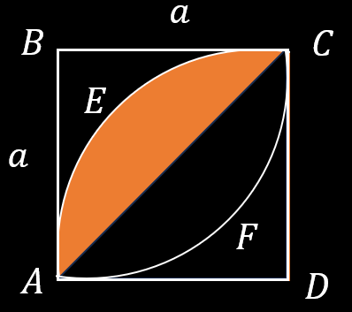
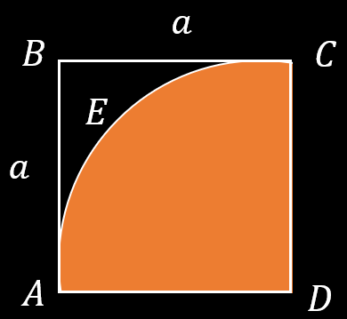
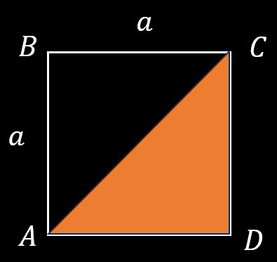








$$=$$
$$−$$
$$A_{AECA}=\frac{A_{AECFA}}{2}$$
$$=$$
$$−$$
$$A_{AECDA}$$
$$A_{ΔACD}$$
$$\frac{A_{AECFA}}{2}=A_{AECDA}−A_{ΔACD}$$

Slide 13




$$=$$
$$−$$
$$\frac{A_{AECFA}}{2}$$
$$=$$
$$\frac{πa^{2}}{4}$$
$$−$$
$$\frac{a^{2}}{2}$$
$$A_{AECFA}=\frac{a^{2}}{2}\left(π−2\right)$$

