Slide 2
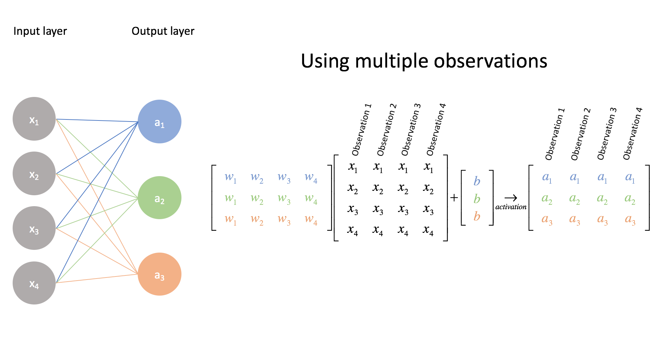

Slide 3
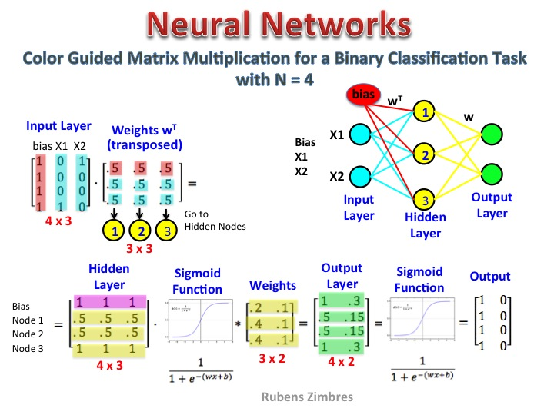
http://storage.ning.com/topology/rest/1.0/file/get/2808330901?profile=original

Slide 4
Referências
Medium - Representing neural network with vectors and matrices
Deep Neural Network from scratch
ML Cheat Sheet - Forwardpropagation
Convolutional NN for Visual Recognition
Matrix Multiplication in Neural Networks
Under The Hood of Neural Network Forward Propagation — The Dreaded Matrix Multiplication

