Slide 1
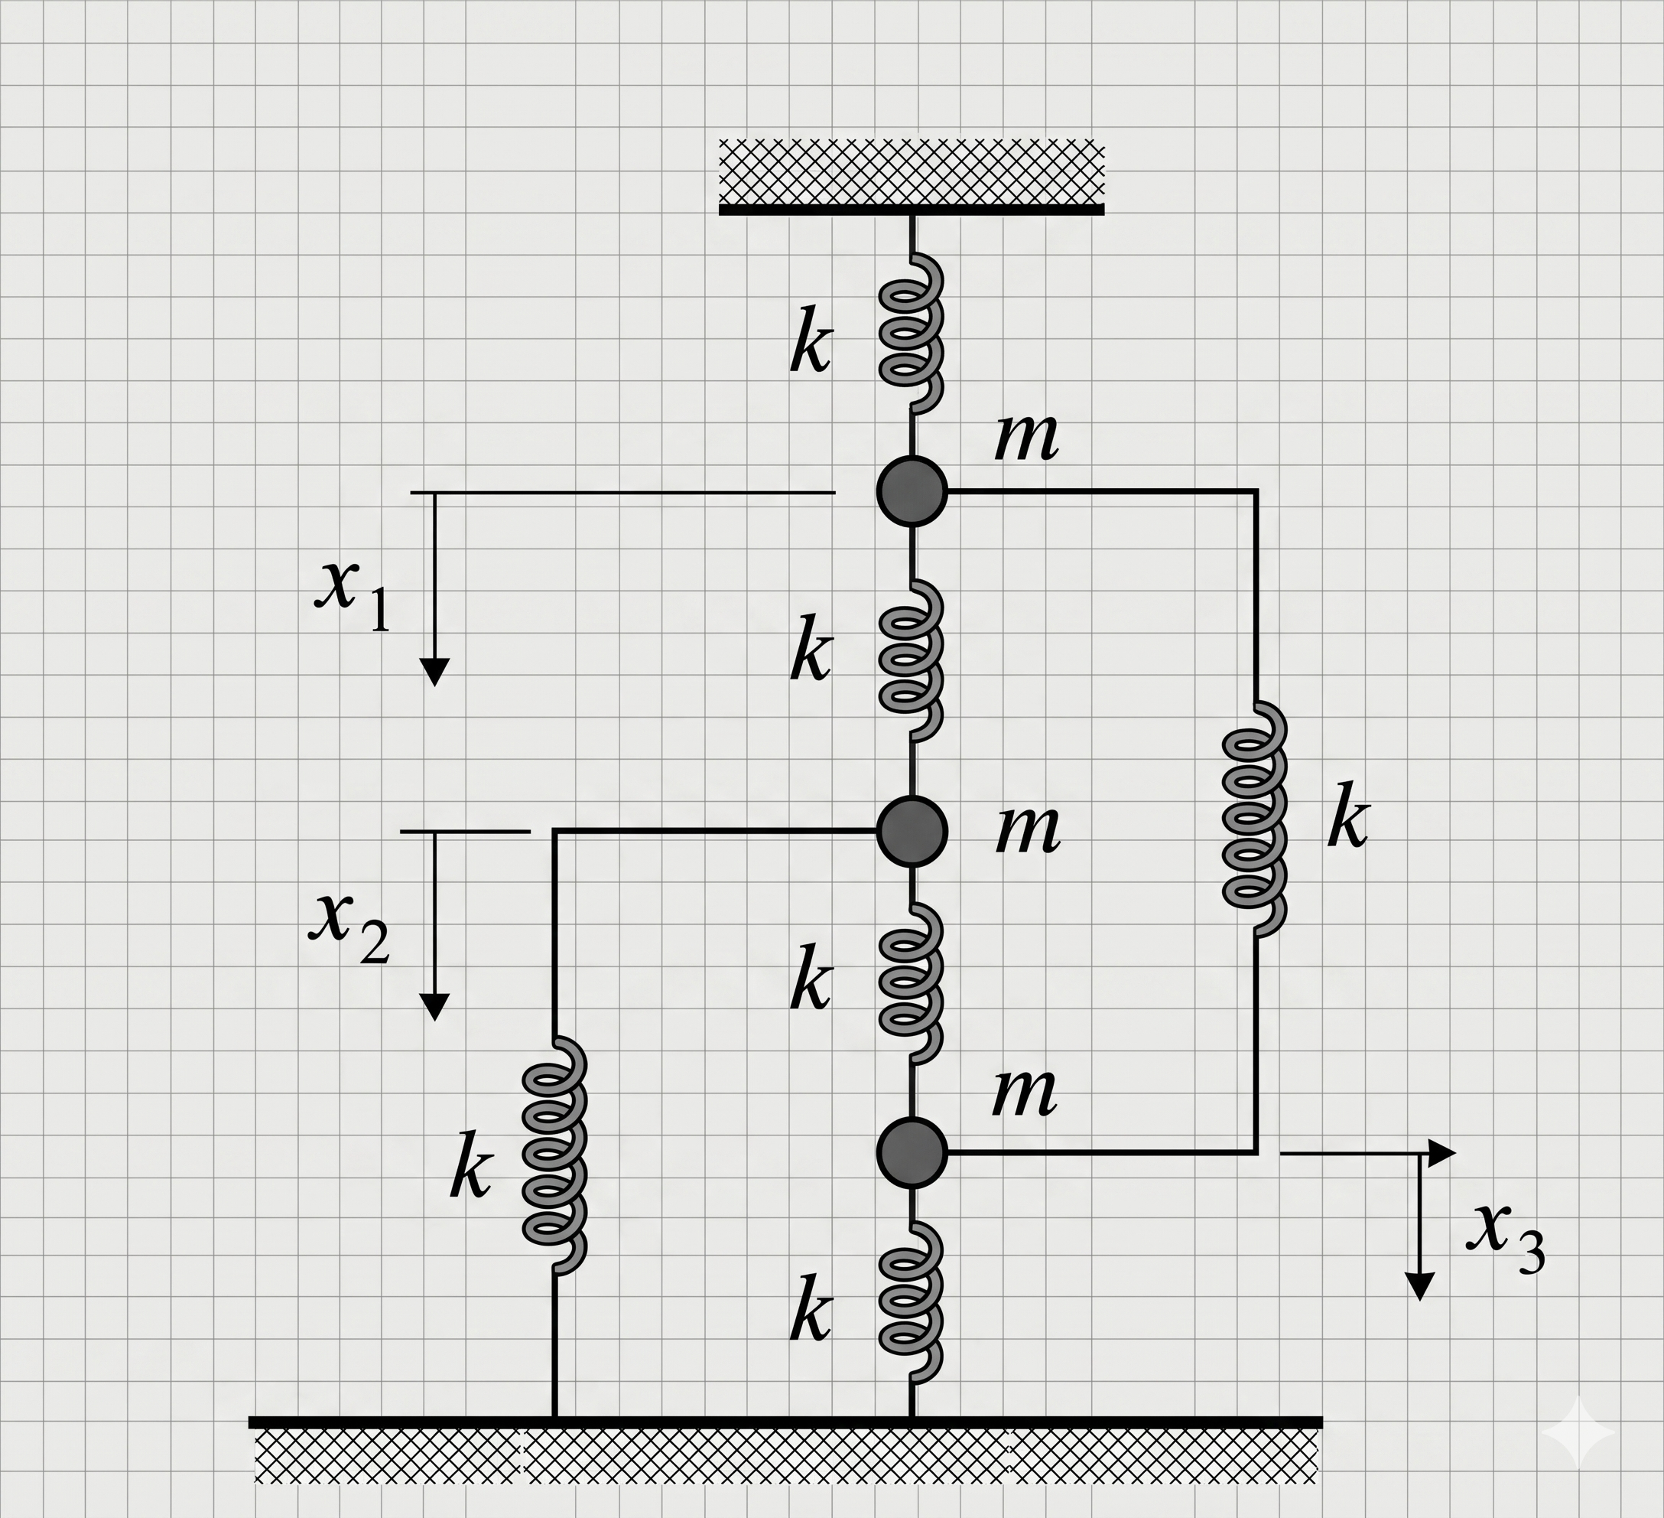
Mechanical spring system and Cardano
Image extracted from Greiner’s book of Hamiltonian Dynamics, from chapter 8, example 8.3 on page 117.
Greiner, W. Classical Mechanics: Systems of Particles and Hamiltonian Dynamics. 2nd ed. Berlin: Springer, 2009.
Dr. Osvaldo L. Santos-Pereira
olsp@if.ufrj.br

Slide 2
Mechanical spring system and Cardano
Dr. Osvaldo L. Santos-Pereira
olsp@if.ufrj.br

Slide 3
Equations of motion
$$m\ddot{x_{1}}=−kx_{1}−k\left(x_{1}−x_{2}\right)−k\left(x_{1}−x_{3}\right)$$
$$m\ddot{x_{2}}=−kx_{2}−k\left(x_{2}−x_{1}\right)−k\left(x_{2}−x_{3}\right)$$
$$m\ddot{x_{3}}=−kx_{3}−k\left(x_{3}−x_{1}\right)−k\left(x_{3}−x_{2}\right)$$
Dr. Osvaldo L. Santos-Pereira
olsp@if.ufrj.br

Slide 4
Equations of motion (simplified)
$$m\ddot{x_{1}}+3kx_{1}−kx_{2}−kx_{3}=0$$
$$m\ddot{x_{2}}+3kx_{2}−kx_{3}−kx_{1}=0$$
$$m\ddot{x_{3}}+3kx_{3}−kx_{2}−kx_{1}=0$$
Dr. Osvaldo L. Santos-Pereira
olsp@if.ufrj.br

Slide 5
Ansatz for the solution
$$x_{1}\left(t\right)=A cos\left(ωt+ψ\right)→{\ddot{x}}_{1}=−ω^{2}Ax_{1}$$
$$x_{2}\left(t\right)=B cos\left(ωt+ψ\right)→{\ddot{x}}_{2}=−ω^{2}Bx_{2}$$
$$x_{3}\left(t\right)=C cos\left(ωt+ψ\right)→{\ddot{x}}_{3}=−ω^{2}Cx_{3}$$
Dr. Osvaldo L. Santos-Pereira
olsp@if.ufrj.br

Slide 6
Ansatz for the solution (cont.)
$$\left(3k−mω^{2}\right)A−kB−kC=0$$
$$−kA+\left(3k−mω^{2}\right)B−kC=0$$
$$−kA−kB+\left(3k−ω^{2}\right)C=0$$
Dr. Osvaldo L. Santos-Pereira
olsp@if.ufrj.br

Slide 7
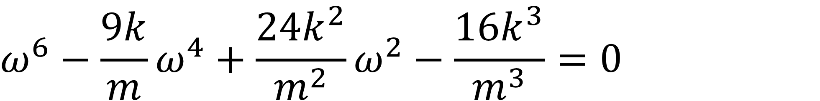
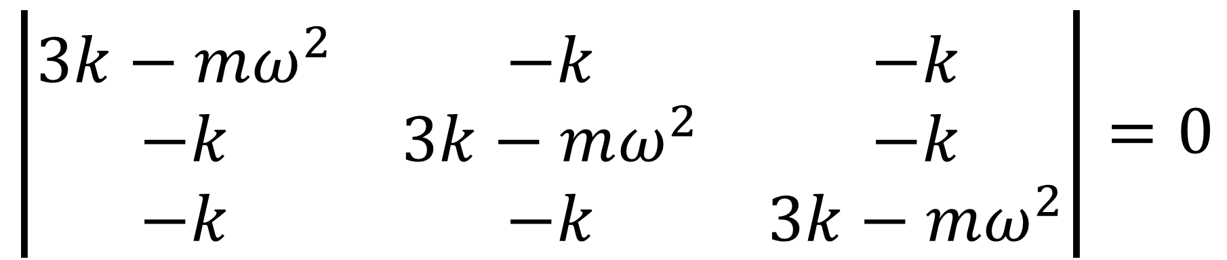
Finding eigenvalues
$$\left|\begin{matrix}3k−mω^{2} & −k & −k \\ −k & 3k−mω^{2} & −k \\ −k & −k & 3k−mω^{2}\end{matrix}\right|=0$$
$$ω^{6}−\frac{9k}{m}ω^{4}+\frac{24k^{2}}{m^{2}}ω^{2}−\frac{16k^{3}}{m^{3}}=0$$
Dr. Osvaldo L. Santos-Pereira
olsp@if.ufrj.br

Slide 8
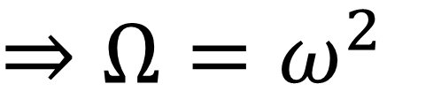
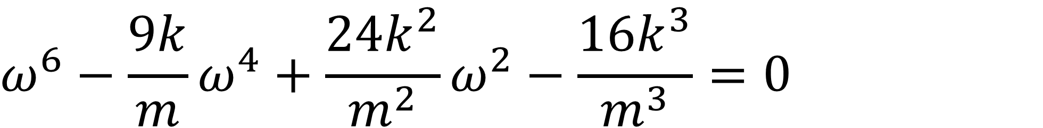
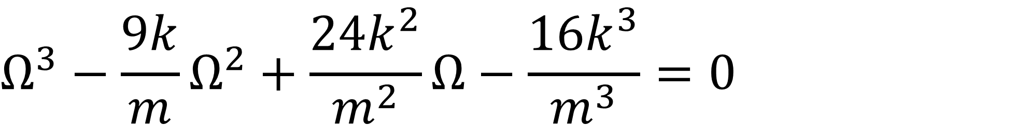
Reducing the order of polynomial equation
$$ω^{6}−\frac{9k}{m}ω^{4}+\frac{24k^{2}}{m^{2}}ω^{2}−\frac{16k^{3}}{m^{3}}=0$$
$${⇒Ω=ω}^{2}$$
$$Ω^{3}−\frac{9k}{m}Ω^{2}+\frac{24k^{2}}{m^{2}}Ω−\frac{16k^{3}}{m^{3}}=0$$
Dr. Osvaldo L. Santos-Pereira
olsp@if.ufrj.br

Slide 9
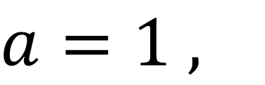
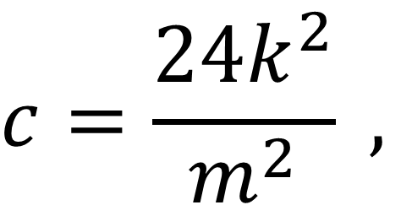
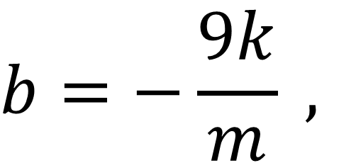
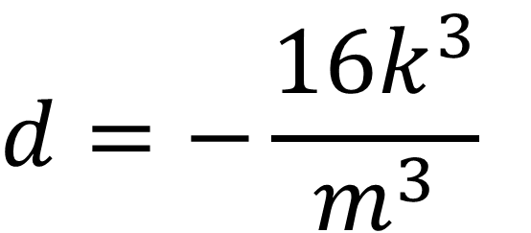
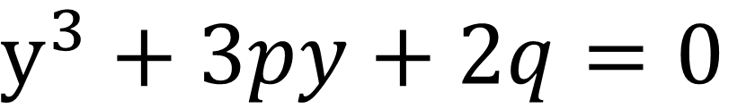
Cardano formula
$${aΩ}^{3}+bΩ^{2}+cΩ+d=0$$
$$b=−\frac{9k}{m} ,$$
$$c=\frac{24k^{2}}{m^{2}} ,$$
$$d=−\frac{16k^{3}}{m^{3}}$$
$$a=1 ,$$
$$y^{3}+3py+2q=0$$
Dr. Osvaldo L. Santos-Pereira
olsp@if.ufrj.br

Slide 10
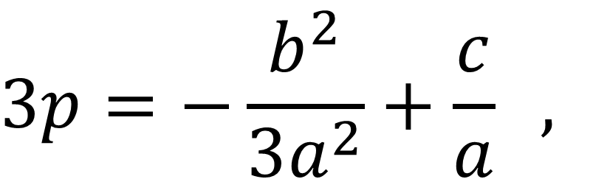
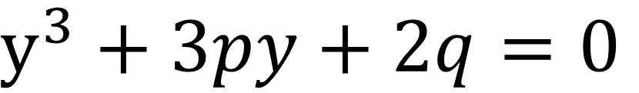
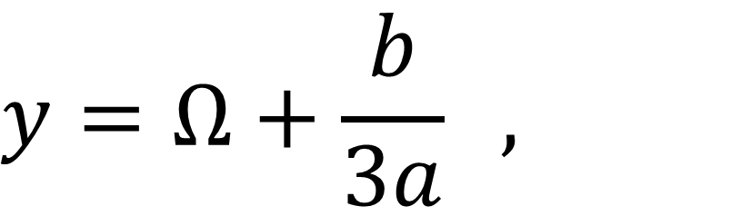
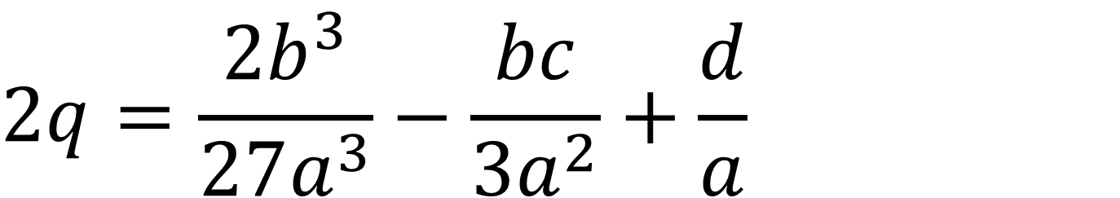
Cardano formula
$$y^{3}+3py+2q=0$$
$$y=Ω+\frac{b}{3a} ,$$
$$3p=−\frac{b^{2}}{3a^{2}}+\frac{c}{a} ,$$
$$2q=\frac{{2b}^{3}}{27a^{3}}−\frac{bc}{{3a}^{2}}+\frac{d}{a}$$
Dr. Osvaldo L. Santos-Pereira
olsp@if.ufrj.br

Slide 11
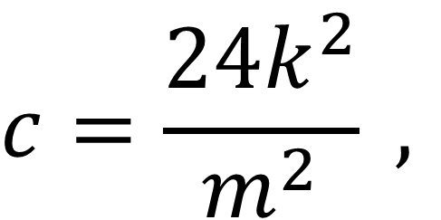
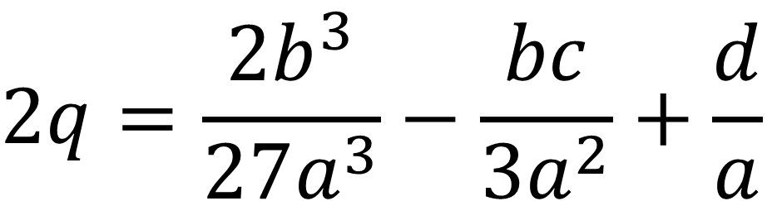
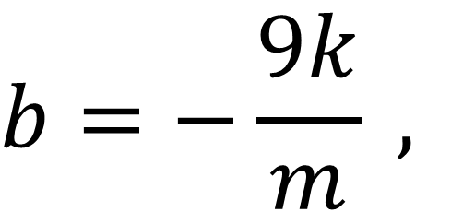
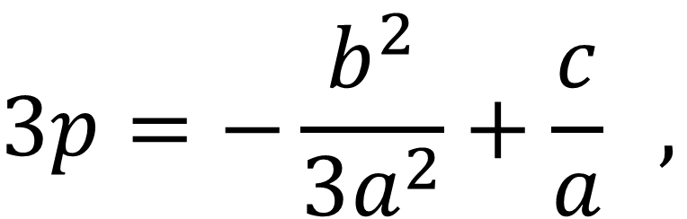
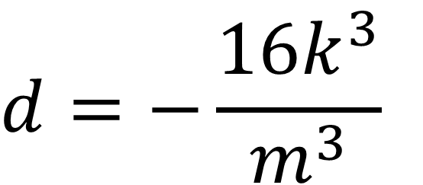
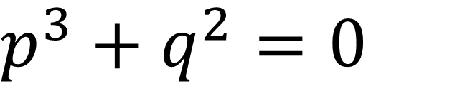
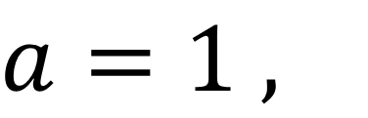
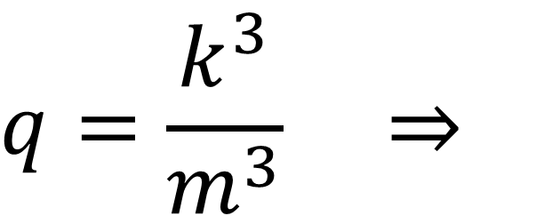
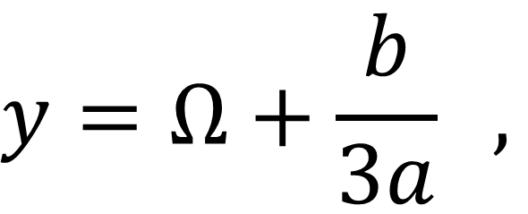
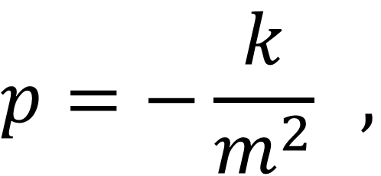
Cardano formula
$$b=−\frac{9k}{m} ,$$
$$c=\frac{24k^{2}}{m^{2}} ,$$
$$d=−\frac{16k^{3}}{m^{3}}$$
$$a=1 ,$$
$$y=Ω+\frac{b}{3a} ,$$
$$3p=−\frac{b^{2}}{3a^{2}}+\frac{c}{a} ,$$
$$2q=\frac{{2b}^{3}}{27a^{3}}−\frac{bc}{{3a}^{2}}+\frac{d}{a}$$
$$p=−\frac{k}{m^{2}} ,$$
$$q=\frac{k^{3}}{m^{3}} ⇒$$
$$p^{3}+q^{2}=0$$
Dr. Osvaldo L. Santos-Pereira
olsp@if.ufrj.br

Slide 12
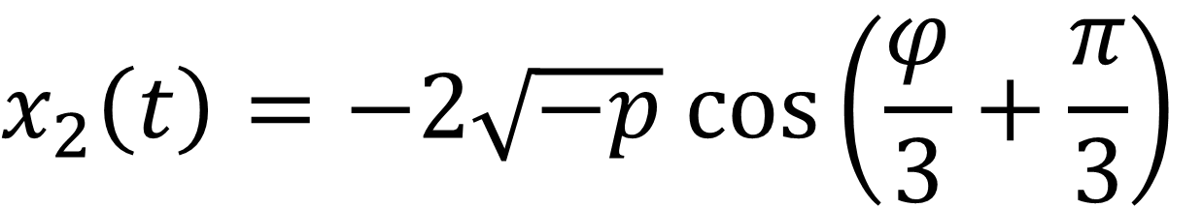
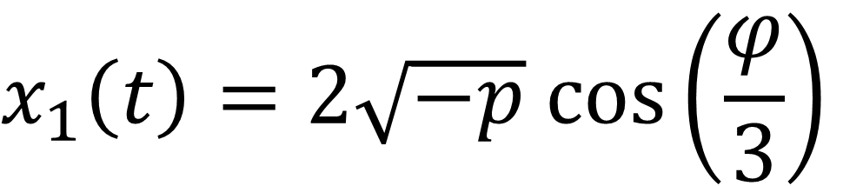
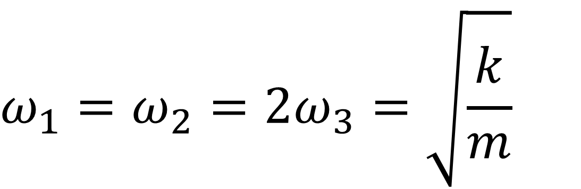
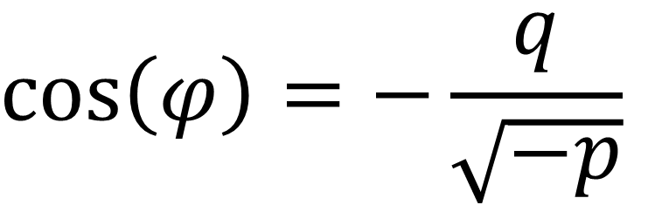
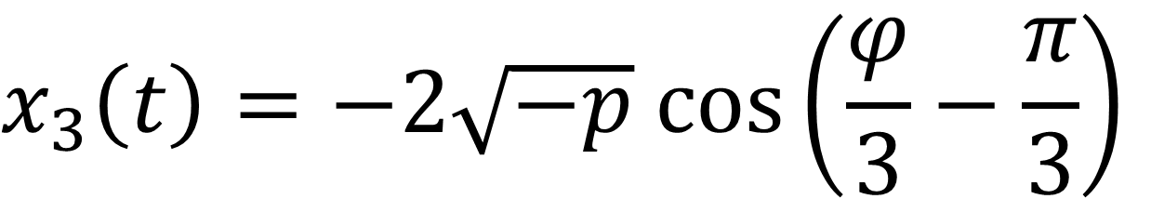
Cardano formula
$$x_{1}\left(t\right)=2\sqrt{−p} cos\left(\frac{φ}{3}\right)$$
$$cos\left(φ\right)=−\frac{q}{\sqrt{−p}}$$
$$x_{2}\left(t\right)=−2\sqrt{−p} cos\left(\frac{φ}{3}+\frac{π}{3}\right)$$
$$x_{3}\left(t\right)=−2\sqrt{−p} cos\left(\frac{φ}{3}−\frac{π}{3}\right)$$
$$ω_{1}=ω_{2}=2ω_{3}=\sqrt{\frac{k}{m}}$$
Dr. Osvaldo L. Santos-Pereira
olsp@if.ufrj.br

Slide 13
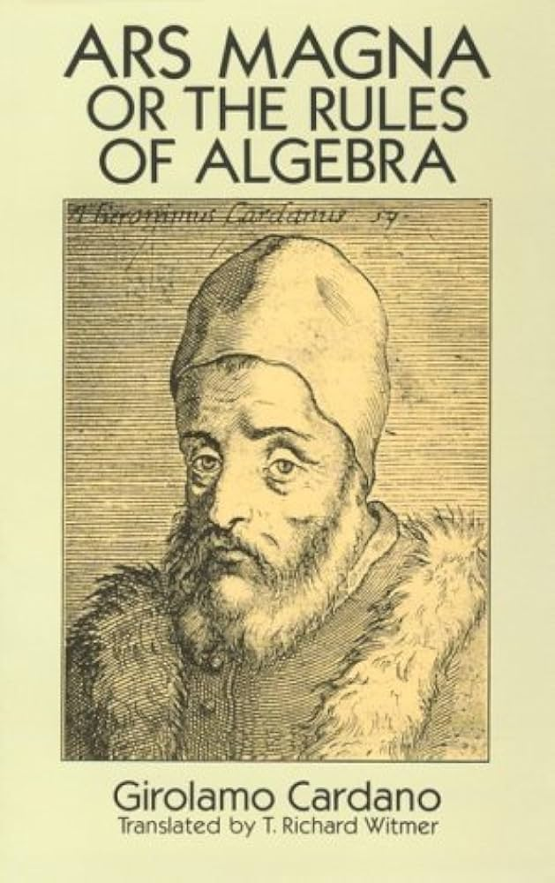
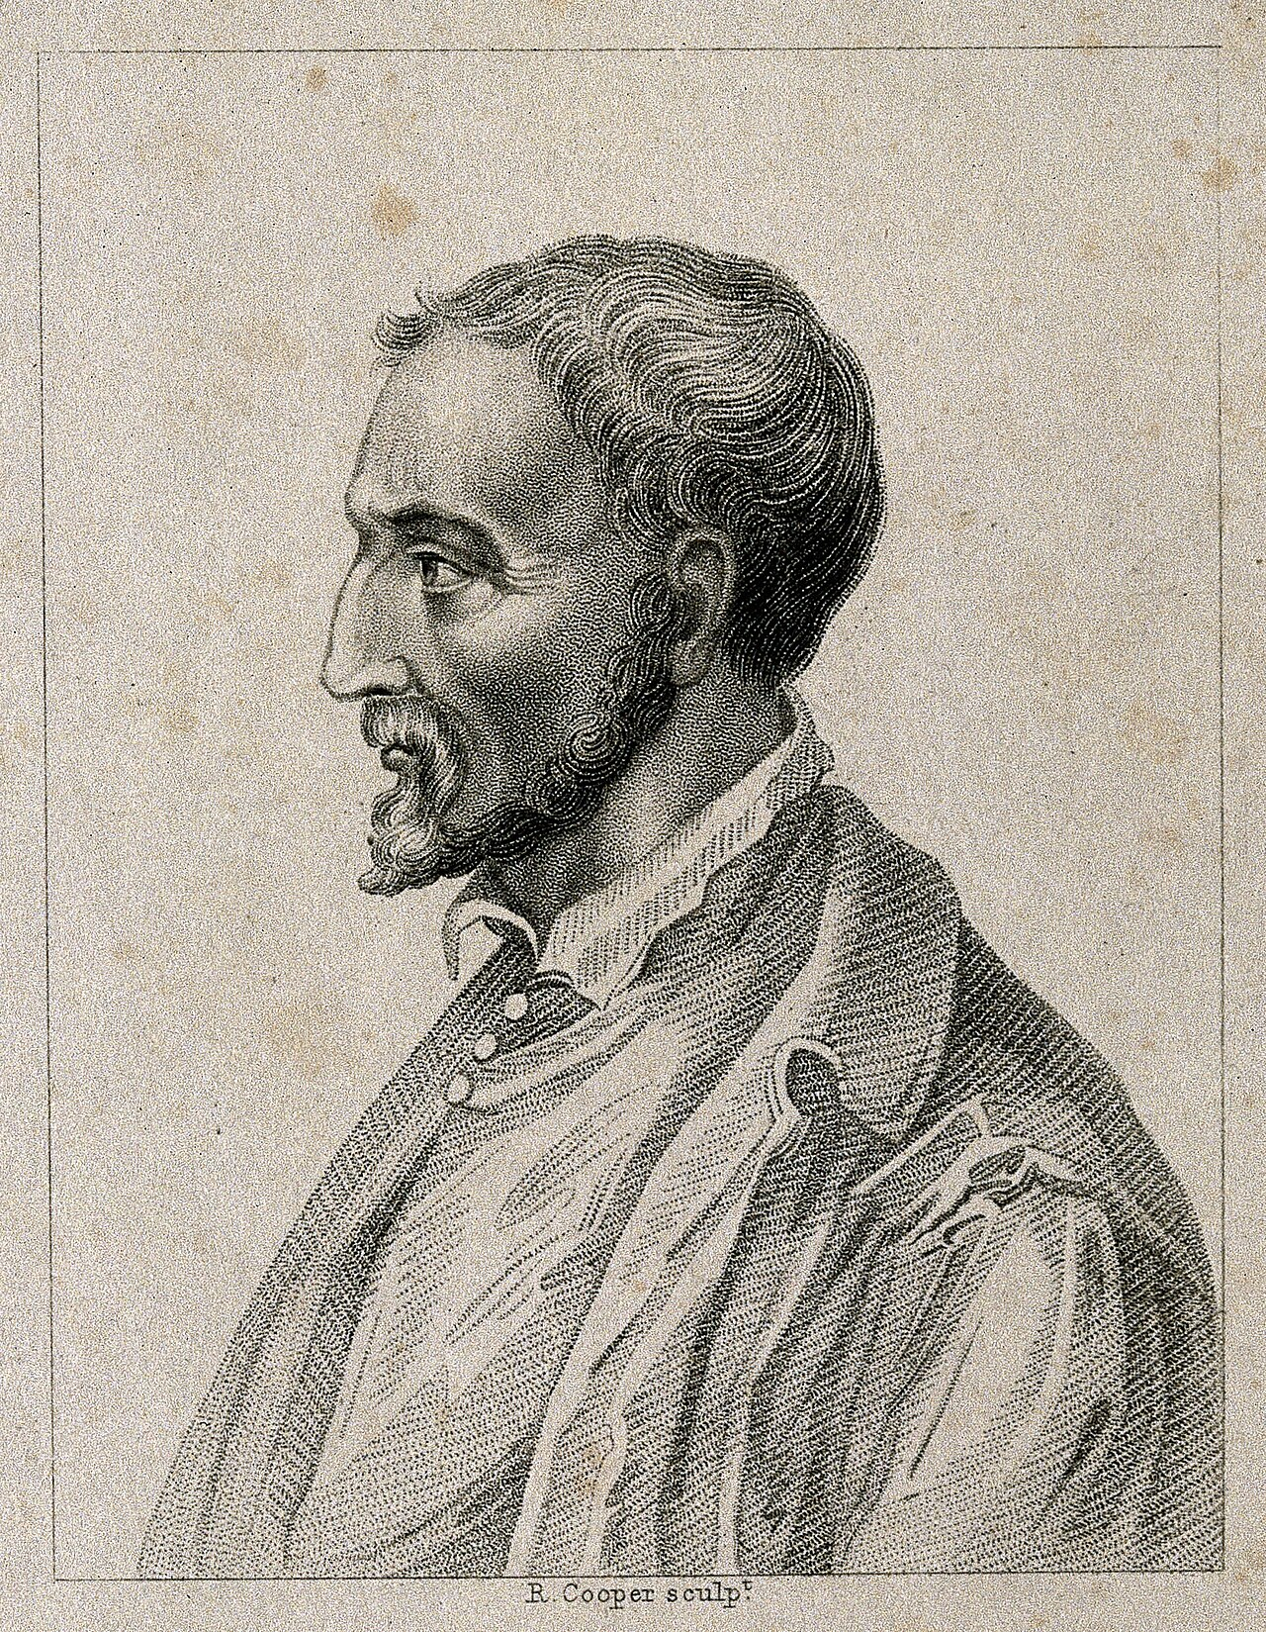
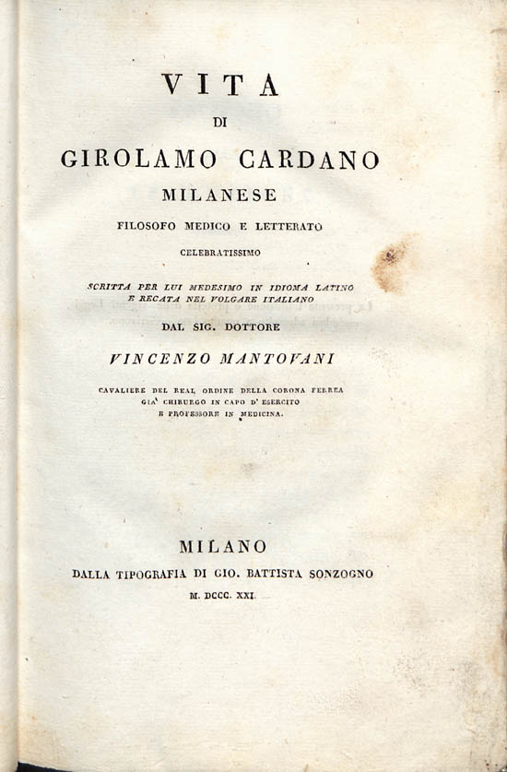
Girolamo Cardano
Dr. Osvaldo L. Santos-Pereira
olsp@if.ufrj.br

