Slide 1
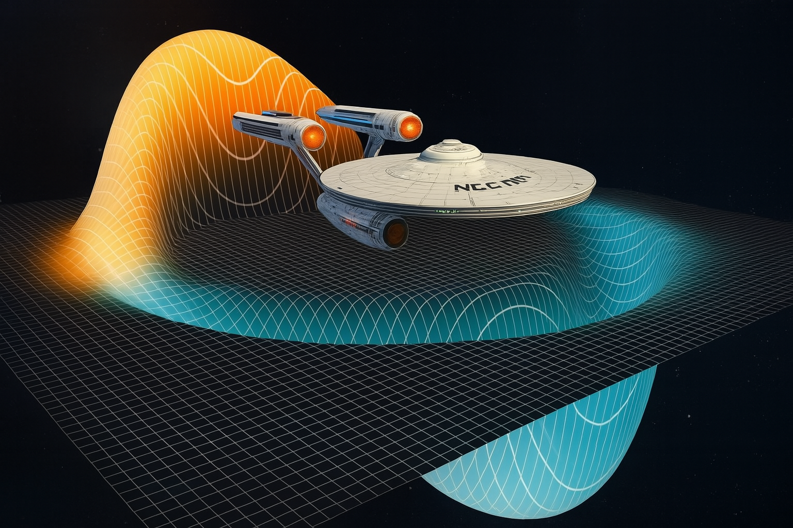
The Alcubierre Warp Drive
Miguel Alcubierre, in 1994, proposed warp drive
Faster-than-light propulsion mechanism
Spaceship inside a warp bubble
Expansion and contraction of spacetime
Inside the bubble no Special Relativity violation
Miguel Alcubierre.
The warp drive: hyper-fast travel within general relativity.
Clas. Quant. Grav. vol. 11, L73-L77 (1994).
doi: 10.1088/0264-9381/11/5/001
arXiv: gr-qc/0009013v1.

Slide 2
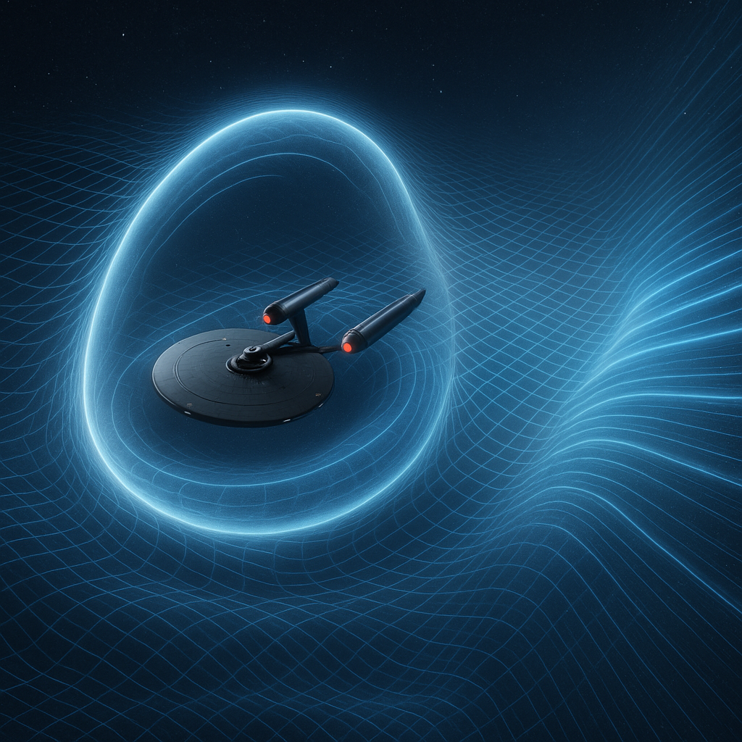

Slide 3
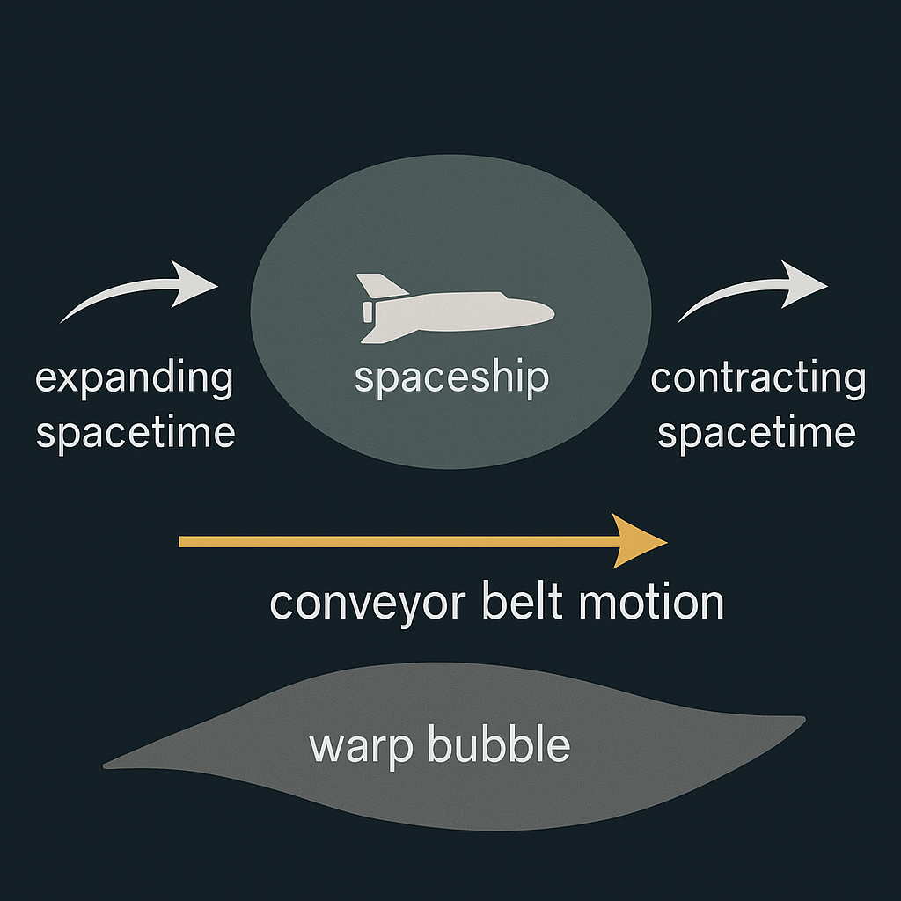

Slide 4
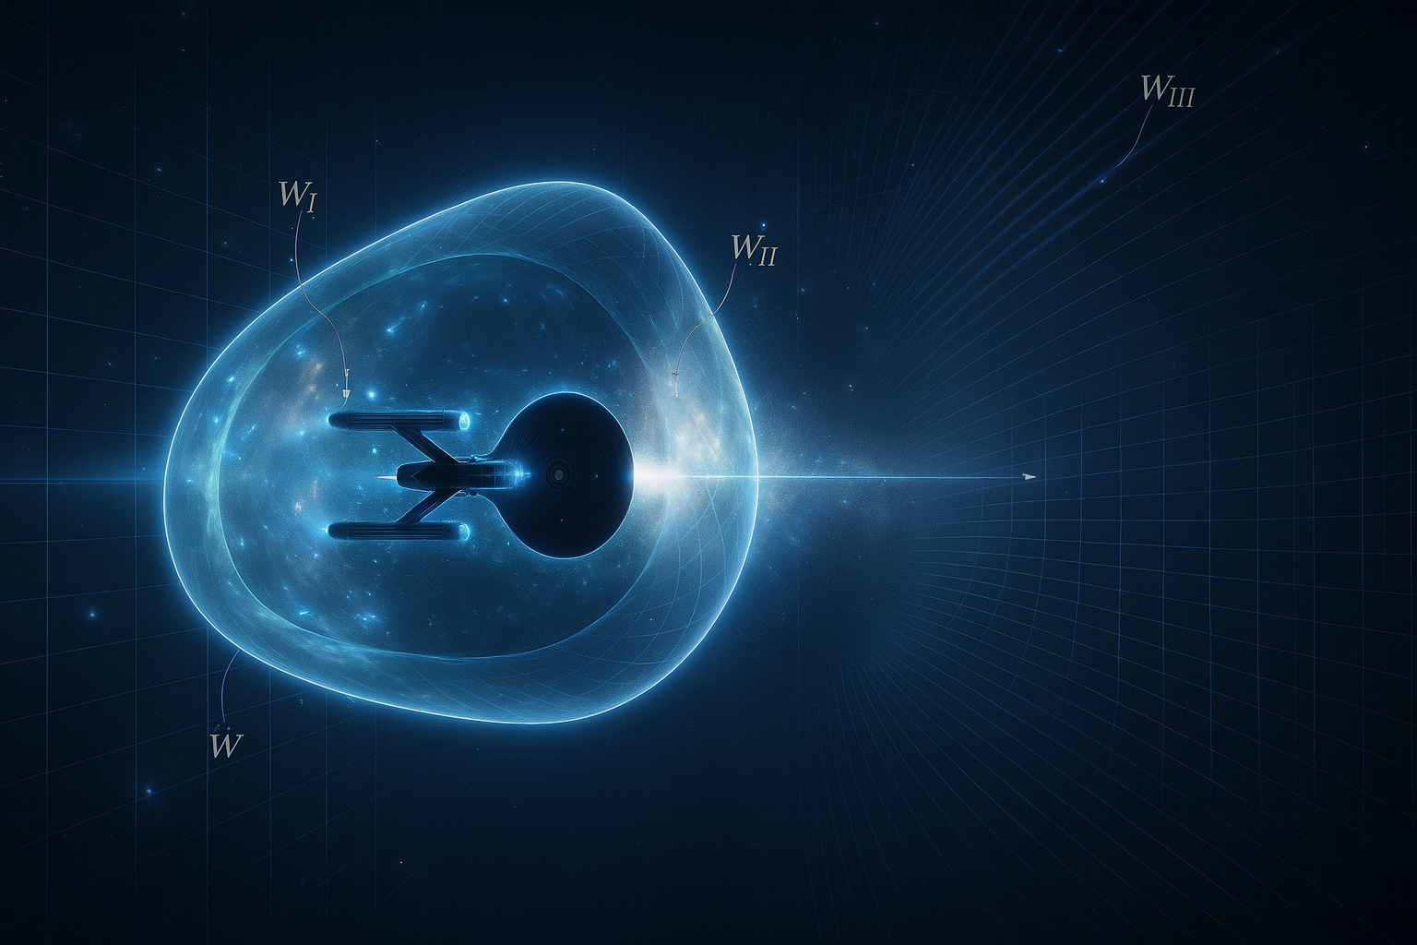

Slide 5
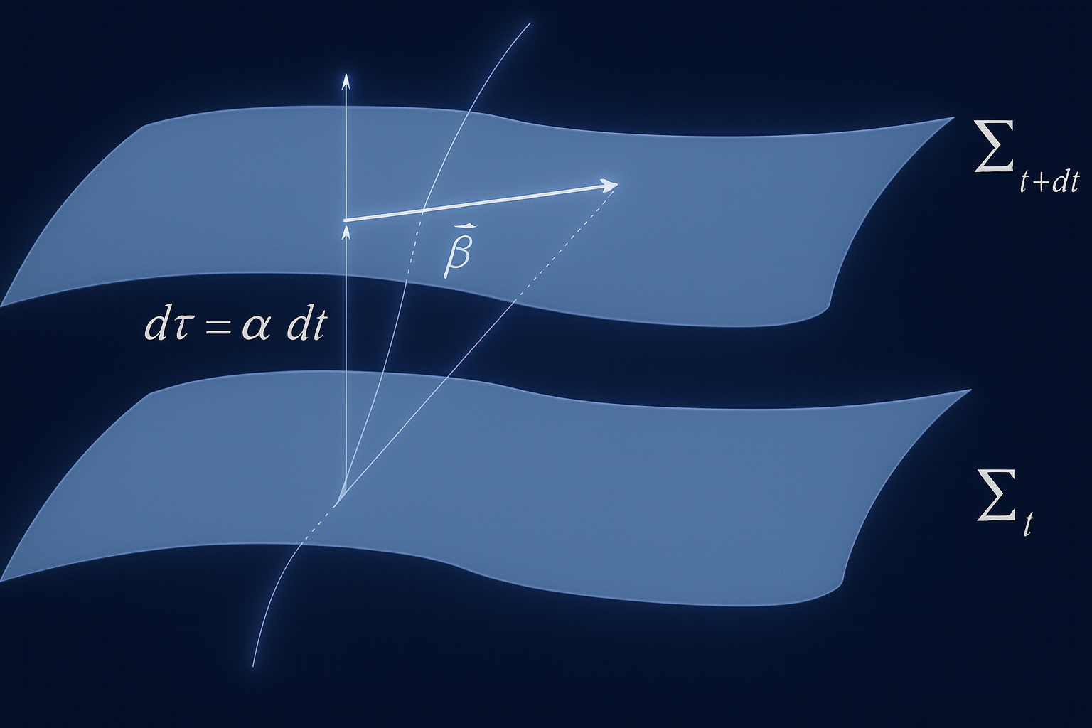
ADM (3+1) Formalism
Spacetime Foliation
ADM or 3+1 formalism to mathematically describe warp drive.
The formalism, also known as the ADM decomposition (named after physicists Richard Arnowitt, Stanley Deser, and Charles Misner who developed it in the 1950s).
Einstein equations from partial differential equations into an initial value problem.

Slide 6



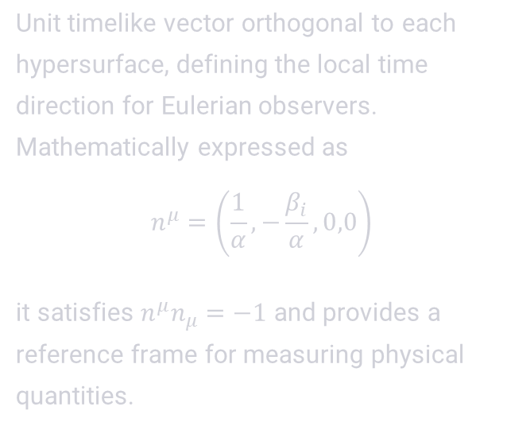


Key Components of the ADM Formalism
Lapse Function (α)
Shift Vector (βᵢ)
Normal Vector $(n^{μ})$
Measures the proper time between adjacent hypersurfaces. Mathematically, if $n^{μ}$is the normal vector to a hypersurface, then
$$α={\left(−g^{00}\right)}^{−1/2}$$
The lapse function determines how coordinate time relates to proper time for observers moving orthogonally between hypersurfaces.
Relates spatial coordinates between adjacent hypersurfaces. Represents the displacement of spatial coordinates as one moves between time slices.
In the Alcubierre metric, the shift vector is responsible for the "warping" effect that enables apparent superluminal motion.
Unit timelike vector orthogonal to each hypersurface, defining the local time direction for Eulerian observers.
Mathematically expressed as
$$n^{μ}=\left(\frac{1}{α}, −\frac{β_{i}}{α},0,0\right)$$
it satisfies $n^{μ}n_{μ}=−1$ and provides a reference frame for measuring physical quantities.

Slide 7
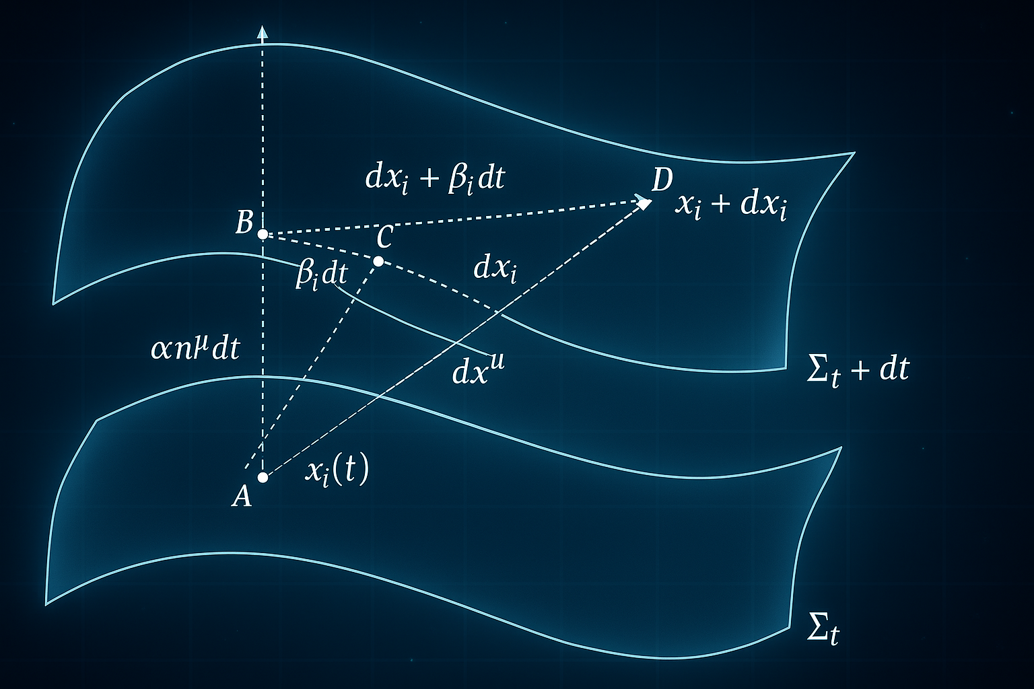

Slide 8
The Mathematical Structure of the Alcubierre Metric
$$ds^{2}=−dt^{2}+{\left[dx−v_{s\left(t\right)f\left(r_{s}\right)dt}\right]}^{2}+dy^{2}+dz^2$$
Key Metric Components
Physical Implications
Unit lapse function: α = 1
This deceptively simple metric yields profound physical consequences:
Shift vector: $β^{i}=(β,0,0)$ where $β=v_s\left(t\right)f[r_{s\left(t\right)}]$
Geodesics inside the bubble follow flat space trajectories
Flat spatial hypersurfaces: $γ_{ij}=δ_{ij}$
The metric remains Lorentzian (signature -+++) throughout
v_s(t): velocity of the warp bubble
Spacetime curvature is concentrated at the bubble walls
f(r_s): shape function defining the bubble profile
Coordinate singularities are absent, unlike in black hole metrics
These assumptions significantly simplify the mathematics while preserving the essential physics of the warp drive concept.

Slide 9
Causality and Hyperbolicity in Alcubierre Spacetime
Global Hyperbolicity
Shift Vector and Lapse Function
Absence of Closed Timelike Curves
The Alcubierre spacetime maintains global hyperbolicity, a crucial property that ensures a well-defined initial value problem for Einstein's equations.
This property guarantees that the evolution of spacetime can be uniquely determined from initial conditions on a Cauchy hypersurface.
The lapse function α is set to unity (α = 1), while the shift vector βᵢ induces a boost in the bubble's direction of travel.
This configuration creates the desired warping effect without introducing pathological features in the spacetime structure.
The construction explicitly avoids closed timelike curves (CTCs), which would permit backwards time travel and violate causality.
Despite enabling apparent FTL motion, the warp drive preserves the causal structure of spacetime, preventing paradoxical scenarios.

Slide 10

Negative energy density
$$ρ=−\frac{1}{32π}\left[{\left(\frac{∂β}{∂y}\right)}^{2}\text{+} {\left(\frac{∂β}{∂z}\right)}^{2}\right]$$
Violation of energy conditions
Weak energy condition
Dominant energy condition
Necessity of exotic matter for warp bubble creation
Necessity of vast amounts of negative energy.

