Slide 1
PG-ABM: An Agent-based Model of Politogenesis
Talha Oz
Origins of Social Complexity
CSS620 Term Project - Fall 2014

Slide 2
Overview
Introduction
Motivation for Politogenesis
Challenges of Studying Politogenesis
Social Theories related to Politogenesis
Cioffi’s Formal Theory of Politogenesis
Observation & Basis
Formulization
Theorems
PG-ABM
Questions

Slide 3
Motivation
The origins of the social life
Origins of the universe as in bio. & phys. sci.
Started w/ polities, long after humans originated
Cen shed light on
Development of more complex polities
Contemporary sociopolitical complexity
Provide insights for the future
Notes:
early Holocene Period

Slide 4
Challenges
Conceptual
Formal
Ontological
Empirical
Comparative
Computational
Notes:
Conceptual: Systematic methods of concept formation, e.g. equality, chiefdom, state
Formal: No mathematical formalism of PG unlike other social phenomena
- Bargaining and negotiations: decision models & game-theory
- Social dynamics (e.g. demographics): dynamic systems of d.e.
Onto: PG deals with social entities such as actors, situations, perceptions, decisions, behaviors, institutions
Empirical: Field data on PG regions has recently become available. Sites for primary chiefdom formation [early state sites: Uruk, Yellow River Valley]
Comparative: Occurred in several regions. Shared & individual features -> Cross-cultural comparative research
Comp: ABMs provide computational alternatives to formal social theories based solely on math models. Requires foundation in substantive social theory

Slide 5
Social Theories of Politogenesis
Narrative theories
Social Contract Theory (Rousseau, 1762)
Philosophical theories
Modern theories on how chiefdoms operate
Formal theories
Looking at History Through Math (Rashevsky, 1968)
Control Theory (based on Riker, 1962)
The Canonical Theory (Cioffi, 2005)
Notes:
hunter-gatherer society were egalitarian and lacked social institutions for collective governance (proved in 20th century)
warmer climate with increased food supply, in addition to plant and animal domestication : some groups became wealthier than others
A “contract” emerged between social groups of haves and have-nots, and by joining in civil society all sides enjoy the rule of law against excessive oppression by the strongest or wealthiest.
Modern Narrative: Control (over precious goods), Tributary (cosmic associations), Redistribution (payoff in exchange of obedience) strategies
Rashevsky: Formation of the earliest village-based polities
Relationships among several key quantities involved in PG - e.g. of key quantities: size of land holdings, population sizes, distances, areas, amounts of food produced and consumed, and agricultural yield
New method math equations rather than a causal theory
Control Theory based on theory of Political Coalitions in political science (Riker, 1962)
is a game-theoretic theory where a chief provides side-payments to confederates in exchange for their loyalty in governing a regional territory consisting of 2-3 levels of administrative hierarchy.
Canonical Theory is built on earlier informal theories of socio-political complexity, probabilistic uncertainty and collective action. Explains PG by 2 processes at different time scale.
Fast processes consists of situational changes (opportunities & threats) integrated over time -> consequences (memories of
leadership, experiences, payoffs, and similar lessons from collective action) -> changes in sociopolitical complexity (beliefs, norms, expectations, social relations)
- PG occurs as one of several possible emergent outcomes in the possibility-space of a society

Slide 6
Basis of Cioffi’s Theory of PG
Archaeological records
Homo sapiens sapiens originated 200tya in Africa
First chiefdom formed 10tya in N. Mesopotamia
Core questions in the theory of PG
What constituted the potential
How can it be characterized & specified
When it is actually realized

Slide 7
Formalization
Necessary Conditions | Basic concepts | Assumptions
Kinship knowledge | Polity | Society as simple prior to complex
Communicative ability | Social Complexity | Potential as antecedent condition
Normative sociality | Chiefdom | Potential as compound event
Social identification ability | Resources | Specific requirements
Environmental knowledge | Confederates
Knowledge of event freq. | Religion
Food procurement ability | Territoriality
Homicidal ability | Politogenesis
Collective action ability

Slide 8
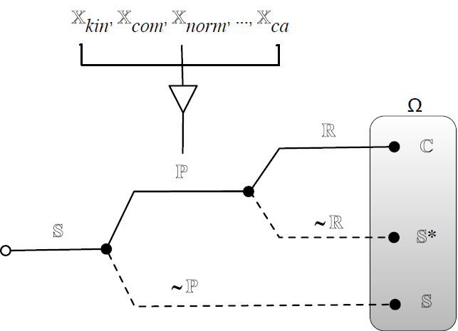

Forward sequential causal logic tree for initial politogenesis grafted with a first-order backward conditional causal tree for complexity potential (conditions 1-9)

Slide 9







Theorems
Probability of politogenesis
Probability of metastability
Probability of potential for PG
Probability of realization
2nd order probability of PG
2nd order probability of metastability

Slide 10
Environment
https://github.com/oztalha/pg-abm
Implemented in MASON
Modeling Eurasia during the last 150,000 years
Warmest phase of the Eemian interglacial, ~ 130,000 - 120,000 y.a.
Heinrich events across Eurasia, about 110,000 - 70,000 y.a
70,000-55,000 ¹⁴C y.a. Stage 4 Glacial Maximum
55,000-30,000 ¹⁴C y.a.
30,000-25,000 ¹⁴C y.a
LGM and late Glacial 18,000-14,000 ¹⁴C y.a
12,000-11,000 ¹⁴C y.a.
Eurasia (color map) 11,000 ¹⁴C ya just before Younger Dryas
Younger Dryas 11,200-10,200 ¹⁴C y.a.
Early Holocene - 9,000 ¹⁴C ya
8,000-7,000 ¹⁴C y.a

Slide 11
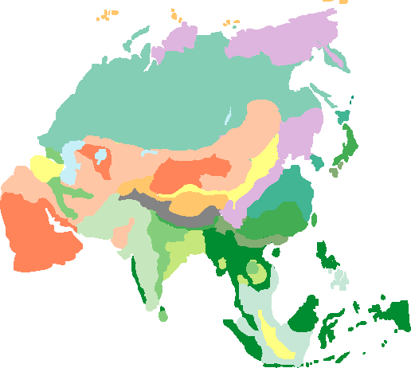
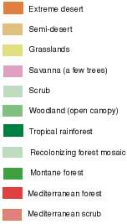
Eurasia ~9,000 BC
Source: Adapted from Preliminary land ecosystem maps of the world since the Last Glacial Maximum Compiled by Jonathan Adams, Environmental Sciences Division, Oak Ridge National Lab

Slide 12
World Population
Estimated world and regional populations at various dates (in millions):
Year World Africa Asia Europe Latin America
70,000 BC < 0.015
10,000 BC 4
8000 BC 5
6500 BC 5
5000 BC 5
4000 BC 7
3000 BC 14
2000 BC 27
1000 BC 50 7 33 9
500 BC 100 14 66 16
AD 1 200 23 141 28
Source: https://en.wikipedia.org/wiki/World_population

Slide 13
Agents
Initialization: Randomly assigned
GetTime
11 Region type
Return
Based on conditions
11 Time Interval
GetPlace
Islivable(place,time)
Yes
No, relocate randomly
Calculate Potentials //stochastic
Loop
IsOccurred(Pot_{i})
Return
AND(Pot_{1...9})
9 Necessary conditions
Compute
IsPotSatisfied()
Next Step
Yes
IsRealized()
Metastasis
Log the statistics &
Terminate the run
Yes

Slide 14

Screenshot of PG-ABM

Slide 15
Questions ?
Main Output: Heatmap of realizations
Parameter sweep -> Statistics

