Slide 1
MedGPT App
To Coach Medical Students on Delivering Bad News
CSCE-606
YUNUS E OZTURK
KYLE J BALDES
10.01.2023

Slide 2
Introduction to MedGPT
The purpose of this app to help medical students improve and practice their knowledge and skills on how to break bad news to patients.
MEDGPT will enable a digital role-playing learning environment. After providing a scenario by MEDGPT to a student, the student will play a doctor role and MEDGPT will have a patient role, and they interact with each other in a conversational way. At the end of the role-play, MEDGPT will evaluate the users’ conversations and provide feedback promoting the student’s knowledge and skills regarding how to break bad news to patients.
With MedGPT, instructors will be able to reviews students’ conversations with MedGPT and provides feedback accordingly.
The goals of the app are as follows:
Promote breaking bad news education for medical students.
Increase medical students’ knowledge and skills on breaking bad news.
Promote medical students’ learning experience and engagement on learning breaking bad news skills.
Decrease instructors’ workload on teaching breaking bad news knowledge and skills.
Provide a more interactive, engaging and conversational learning environment for breaking bad news education, compared to the traditional one.

Slide 3
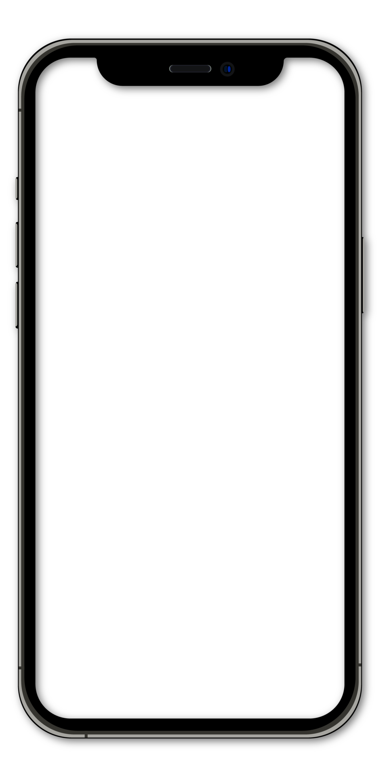
LOGIN SCREEN
MedGPT
Practice with MedGPT to learn how to deliver bad news
Users will be able to “Login” by entering Username and Password
Unregistered users will be able to click “Register here” to register to the system.
Username
Password
LOGIN
Don’t you have an account? Register here

Slide 4
REGISTRATION SCREEN
MedGPT
Practice with MedGPT to learn how to deliver bad news
When users register to the system, they need to enter the followings:
Username: A username defined by the user
Password: A password defined by the user
Role: Selecting the role of the user, including teacher, student, and admin.
Username
Password
Role
Class
REGISTER
You already have an account? Login here

Slide 5

MAIN SCREEN
for Student
MedGPT
Welcome Username
to MedGPT App
View Old Practices: Showing old practices of students with MedGPT app.
Start New Practice: Initiate a new practice with MedGPT
VIEW OLD PRACTICES
START NEW PRACTICE

Slide 6
OLD PRACTICES SCREEN
for Student
OLD PRACTICES
Practice 1: 9/38/2023
Practice 2: 9/29/2023
Practice 3: 9/30/2023
Students will be able to see old conversations with MedGPT.
Old conversations will be saved with their date.

Slide 7

NEW PRACTICES SCREEN
for Student
NEW PRACTICE
Med Chat
Hello, this is the scenario:
You are a family physician, and I am the patient. I have been diagnosed with a serious illness, and you need to discuss a treatment option with me. However, the treatment is very expensive.
MedGPT will provide a scenario and then role-playing activity will start.
MedGPT plays a patient role while the user plays a doctor role.
Med Chat
Shall we start now?
Ok. Let’s start.
Med Chat
(Patient):
Hello Doctor.
Hello Mr. Smith. I hope you’re doing fine. I have some important information to discuss with you…

Slide 8
MAIN SCREEN
for Teacher
MedGPT
Welcome Username
to MedGPT App
Student 1
Teachers will be able to see the list of students registered to their courses on the main screen.
Student 2
Student 3
Student 4

Slide 9
STUDENT PRACTICES
for Teacher
STUDENT-1
Practice 1: 9/38/2023
Practice 2: 9/29/2023
Practice 3: 9/30/2023
When a teacher clicks a student, he/she will be able to see the all-conversation records of the student with ChatGPT.

Slide 10

FEEDBACK SCREEN
for Teacher
PRACTICE-1
Med Chat
Hello, this is the scenario:
You are a family physician, and I am the patient. I have been diagnosed with a serious illness, and you need to discuss a treatment option with me. However, the treatment is very expensive.
When a teacher clicks a conversation, he/she will be able to see all conversations occurred between the student and MedGPT
The teacher will be able to give a comment to the conversation.
Med Chat
Shall we start now?
Ok. Let’s start.
Med Chat
(Patient):
Hello Doctor.
Well done! Good conversation!
…
SUBMIT

Slide 11
MAIN SCREEN
for Admin
MedGPT
Manage Classes
Manage Teachers
Manage Students
Admins will be able to manage classes, teachers and students on the main screen

Slide 12

MANAGE CLASSES SCREEN
for Admin
MANAGE CLASSES
CLASS-1
Class-1
Teacher-1
Class-2
Student-1
Class-3
Student-2
When Admin clicks Manage Classes, he/she will be able to see all classes created.
He/she will be able to create new classes
When Admin clicks a class, he/she will be able to see all students and teachers registered to that class.

Slide 13
MANAGE STUDENTS SCREEN
for Admin
MANAGE STUDENTS
Student-1
Student-2
Student-3
Admins will be able to manage all students registered to MedGPT
He/she will be able to add new students

Slide 14
MANAGE TEACHERS SCREEN
for Admin
MANAGE TEACHERS
Teacher-1
Teacher-2
Teacher-3
Admins will be able to manage all teachers registered to MedGPT
He/she will be able to add new teachers.

