Slide 1
Reactive Trajectory Planning and Tracking for Pedestrian Aware Autonomous Driving in Urban Environments
Robert G. Cofield and Rakesh Gupta
Honda Research Institute USA, Inc.
375 Ravendale Drive, Suite 100
Mountain View, CA 94043
Notes:
Thank you for coming to my talk. My name is Rakesh Gupta, and my talk will be about decision making with State Transition Graph using autonomous driving as an example application

Slide 2
Agenda
Problem
Input Subsystems
System Architecture
Trajectory Planner
State Transition Graph
High Level Planner
Implementation
Summary
Notes:
Start with action selection with State Transition Graphs using autonomous driving as an example application.
Work that we did in a 6 month project.

Slide 3
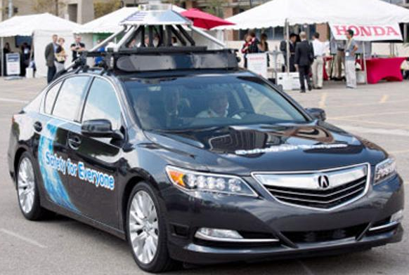
Autonomous Urban Driving
Level II Autonomy (NHTSA)
Travel autonomously from start to destination while honoring traffic laws and avoiding pedestrians in the roadway
Assume no other traffic on roadway
Desired Behavior:
Minimize time to travel
Stop and wait appropriate amount of time at Stop signs
Stop, slow down, ignore pedestrians as appropriate
Crosswalk / jaywalking
On-road / off-road
Moving / static
Notes:
We would like the autonomous car to travel to a given destination while honoring traffic laws and reacting to pedestrians. In this version we do not detect or react to other cars.
We want to get to destination in fastest time. We want to stop and wait at Stop Signs. We also want to react to pedestrians. In particular if they are on the road in our way we want to stop till they are gone. If they are jaywalking and disappear we want to slow down. If they are off road and walking on sidewalk, we want to ignore them.

Slide 4
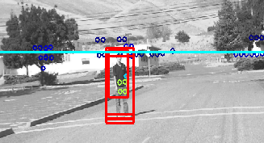
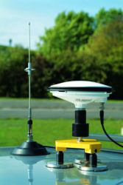
Input subsystems
Path Planner
Gives lane level paths
Pedestrian Detection
Using deformable part models with
camera, lidar and GPS data
Gives location of pedestrian
Navigation Filter
ADMA-G Commercial automotive GPS/INS
Receives RTK corrections via cell modem
High Resolution Map
Road extents, lanes, stop signs
Notes:
Path Planner is like google maps directions except that it gives lane level path. It gives us a set of 2d points to drive on.
Pedestrian is detected and tracked using a separate system using camera, lidar and DGPS data
Pedestrian location is in relative frame and converted to global frame.
We use DGPS with RTK corrections via cell modem.
We also have a high resolution map of the area that is used for visualization, debugging, road extents, and filtering pedestrians that are outside the road extents

Slide 5
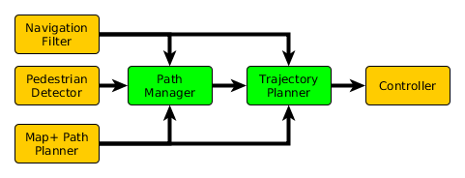
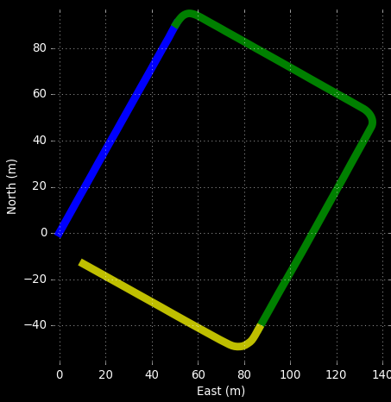

System Architecture
Path Manager
Implements State Transition Maps
Stops and restarts vehicle at stop signs
Governs operation of Trajectory Planner
Trajectory Planner
Compute medium range trajectories
Revise trajectories to react to pedestrians
Input next 2 seconds to controller @ 10 Hz
Software Controller
Governs engine brake, speed and steering
Notes:
Our system has 3 main components. First is high level path manager.
It implements the state transition maps to react to pedestrians
It breaks the path into subpaths at stop signs and plans for the subpath.
It calls the trajectory planner for planning the trajectory
The low level trajectory planner limits jerk, acceleration and velocity values.
When reacting to pedestrians, if pedestrians move closer or further from car while car is stopping, then trajectory is revised in trajectory planner
Inputs the next 2 seconds to the controller
The software controller is a black box that controls brake, speed and steering based on points 100 ms
apart that are fed to it. One of the important parameters is curvature.

Slide 6
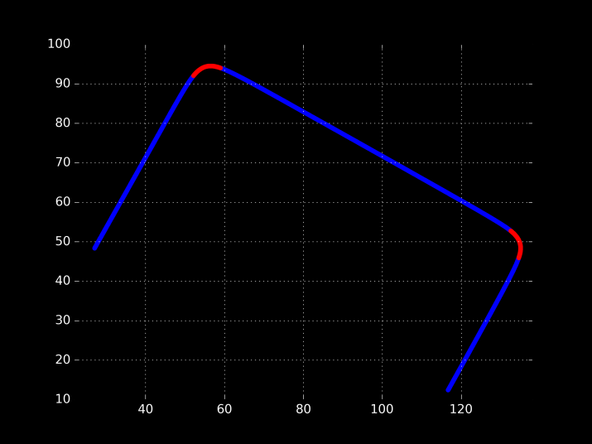
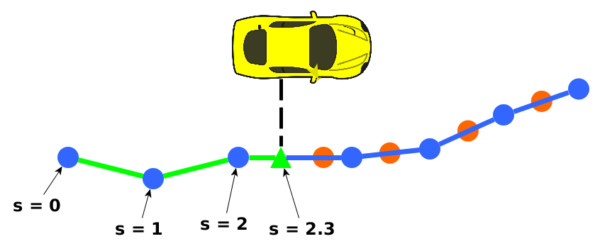
Trajectory Planner
Solution by parts
Segment path with kinematic constraints
Acceleration and curvature limit speed
Legal speed limit
Plan trajectory for each segment and unify
Time parameterize the trajectory
Planned time matched to real time by distance travelled so far on the path
Segments in 2D path
Path
Manager
Trajectory Planner
Controller
Notes:
Trajectory planner breaks the path into segments by speed limit. There are two speed limits – legal speed limit and acceleration and curvature speed limit that limits speed on curves.
Trajectory plan a trajectory for each segment and unifies them
Time parametrize the trajectory, and use distance travelled so far to look up current desired speed acceleration etc.

Slide 7
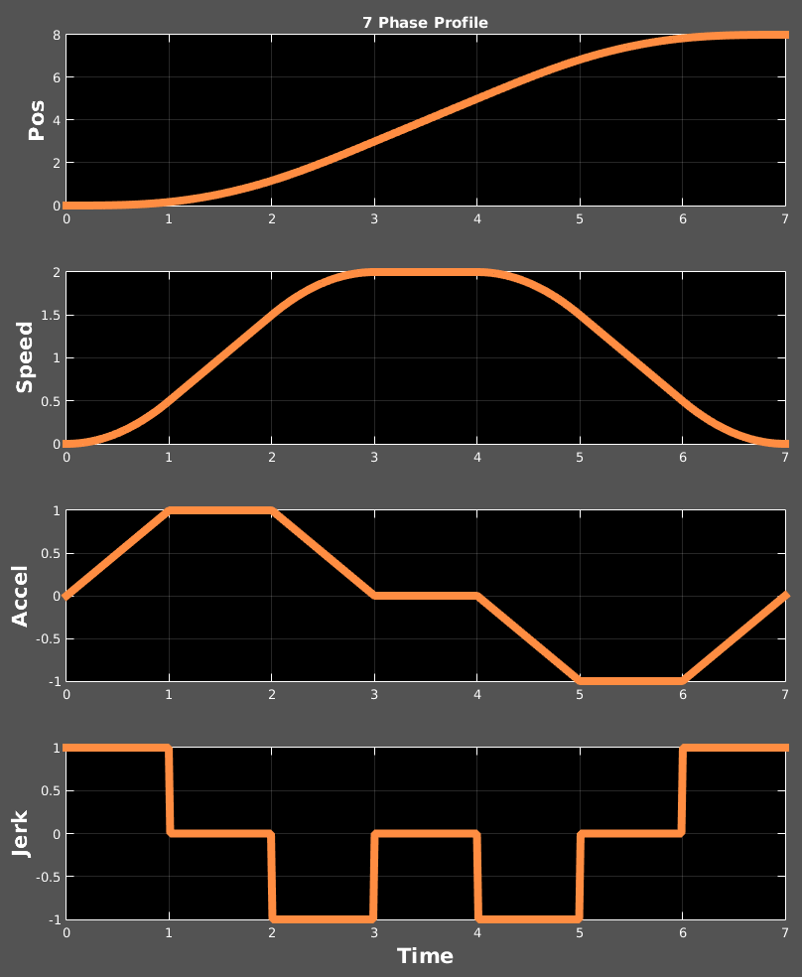
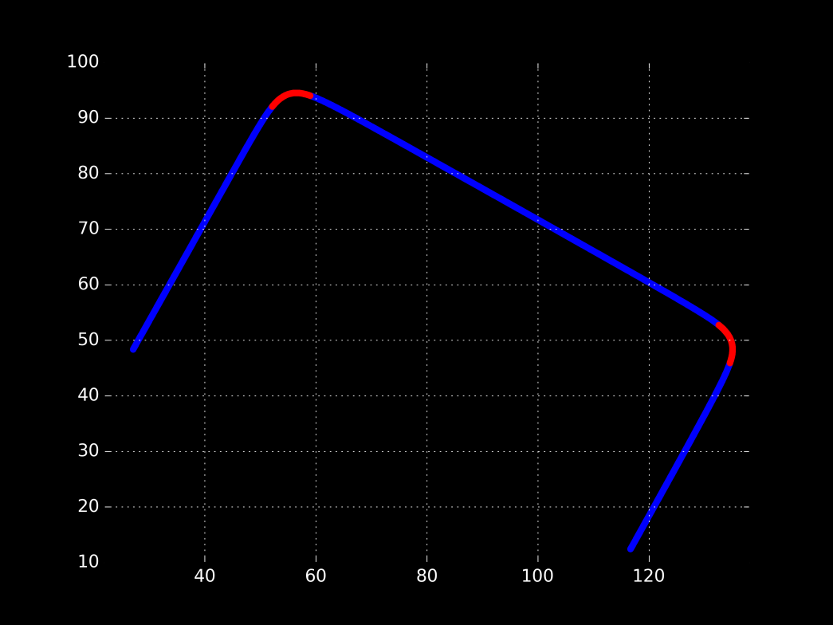
Trajectory Segment Solution
In each segment
Limit acceleration, jerk, and speed
Design constant jerk intervals with closed-form solution
Attempt most time-optimal solution first
7 → 6 → 4 → 4R → 3
No speed change: 1 phase
General Solution
Integrate j(t)
Know s(t), v(t), a(t)
Solve for time intervals
1 phase
7 phase
7 phase
1 phase
7 phase
Path
Manager
Trajectory Planner
Controller
Notes:
Trajectory between 2 stop signs going in a straight line.

Slide 8
State Transition Graph
Initialize
Planned Stop
Normal (drive at fastest speed)
Waited Long enough
End of subpath
Pedestrian clear
Last
subpath
Pedestrian on road ahead
Destination
Reactive Stop
Path
Manager
Trajectory Planner
Controller

Slide 9
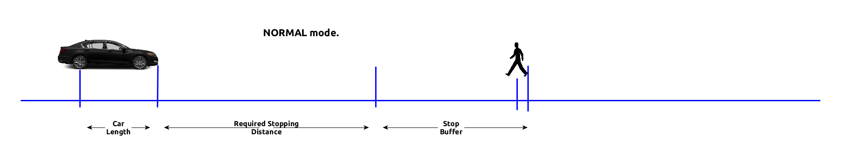
Pedestrian Reactivity
Project pedestrian position to time parametrized path
Consider closest pedestrian only
Execute a 3 phase stop profile when available distance ≤ required distance
Path
Manager
Trajectory Planner
Controller
Notes:
Use normal peak parameters for acceleration and jerk

Slide 10
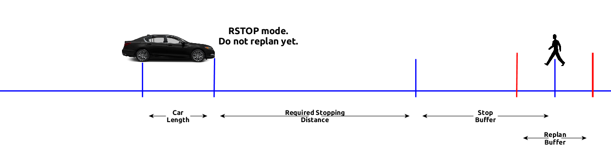
Pedestrian Reactivity
Revise trajectory if pedestrian moves outside replan buffer

Slide 11
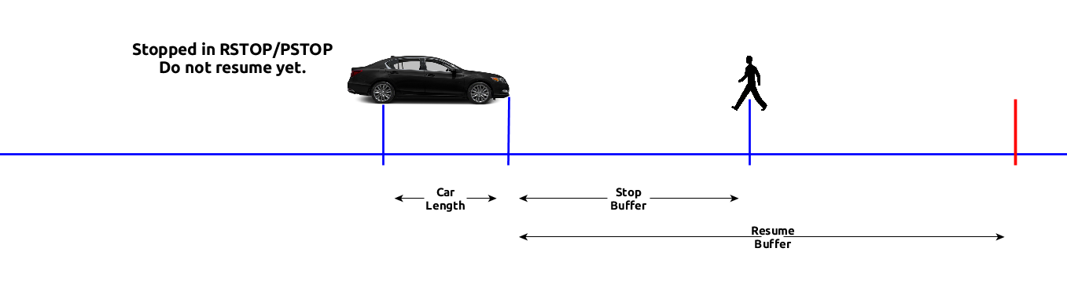
Return to Normal Driving
Fully stopped? Transition to normal state when:
Pedestrian leaves roadway
Pedestrian moves farther past the replan buffer
Have stopped for 2 seconds at stop sign
Slow down without stopping where appropriate
Path
Manager
Trajectory Planner
Controller

Slide 12
Implementation
System tested 100+ hours
Planner online operation @ 10 Hz
Our planner handled corner cases gracefully
Demo worked 35 times in closed course with no disengagements
Extensions
Support self-intersecting, overlapping paths
Perceive and stop for red-lights
Handle other roadway traffic, change lanes
Notes:
Can include additional constraints in trajectory planner (speed limits, non zero acceleration at segment boundaries)
Support self-intersecting, overlapping paths
Use heading, velocity vector to find 1D position
Handle other roadway traffic
Perceive and stop for red-lights
Easy extension of current algorithm

Slide 13
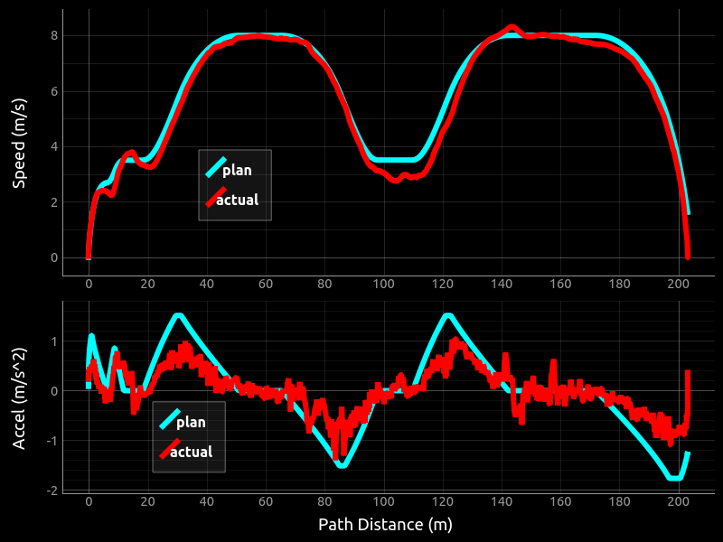
Implementation

Slide 14
Summary
We built a system for trajectory planning
Demonstrated use in Level II autonomy framework
That is reactive to pedestrians
Limits jerk, velocity and acceleration
System has been tested with over 100 hours of testing

Slide 15
Questions?

Slide 16
State Transition Graph
Initialize
Planned Stop
Normal (drive at fastest speed)
Waited Long enough
End of subpath
Pedestrian clear
Last
subpath
Pedestrian on road ahead
Destination
Reactive Stop
Path
Manager
Trajectory Planner
Controller

