Slide 1


Slide 2
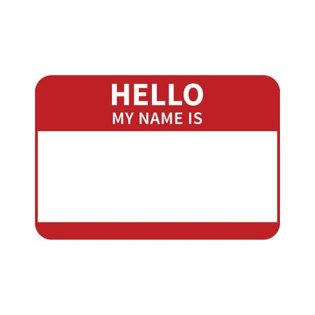
Kent King – CISSP, CISA, CISM, CRISC, SSCP
Email: kking83@cscc.org

Slide 3
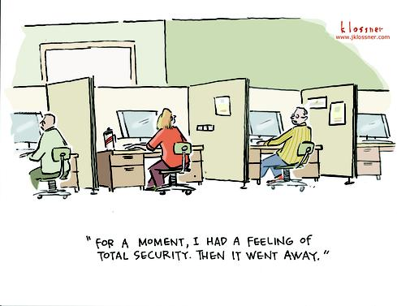
What does the term “Security” mean to you?

Slide 4
Security for Businesses
Security must be measurable
Security must be based on business objectives

Slide 5
Challenges
The information security strategy must be aligned with the strategic direction of the organization.
It must be integrated into business processes.
Security programs will always be affected by a lack of support and inadequate budgets.
There simply is not enough time to do everything that needs to be done.
The battle only escalates.

Slide 6
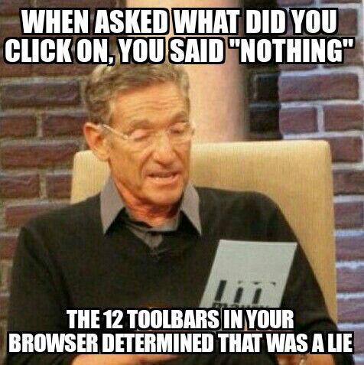
Objectives
Give you a foundational knowledge of cybersecurity
Learn the terminology
Apply core principles in real-world situations
Give you enough background to initiate your cybersecurity career

Slide 7
Security Frameworks
ISO 27001/27002
COBIT - ISACA
ITIL - IT Service delivery best practices
Risk Management Framework (NIST 800 series)

Slide 8
Security Blogs
https://krebsonsecurity.com/
https://threatpost.com/
https://www.csoonline.com/
https://isc.sans.edu/
https://www.darkreading.com/
https://www.schneier.com/
https://thehackernews.com/
https://blog.erratasec.com/
https://securityboulevard.com/
https://www.grahamcluley.com/
Also visit product vendors, especially antivirus/antimalware companies.

Slide 9

Classroom Time
Review online materials
Review quiz results
Review assignments
Discuss real-world applications
Introduce the next domain

Slide 10


Slide 11
Systems Security Certified Practitioner
ISC² - The International Information System Security Certification Consortium

Slide 12
Systems Security Certified Practitioner (SSCP)
Access Controls
Security Operations and Administration
Risk Identification, Monitoring, and Analysis
Incident Response, and Recovery
Networks and Communications Security
Cryptography
Systems and Applications Security

Slide 13
Integrity
Availability
Information Security
Confidentiality

Slide 14
Confidentiality
The property of information in which it is only made available to those who have a legitimate need to know
Each level of confidentiality is associated with a particular protection class

Slide 15
Consequences of a Breach
Legal and regulatory fines and sanctions
Loss of customer and investor confidence
Loss of competitive advantage
Civil litigation

Slide 16
Integrity
The property of information whereby it is recorded, used, and maintained in a way that ensures its completeness, accuracy, internal consistency, and usefulness for a stated purpose

Slide 17
Consequences of Integrity Failure
Inability to read or access critical files
Errors
Failures in information processing
Calculation errors
Uninformed decision making by business leaders

Slide 18
Availability
The ability to access and use information systems when and as needed to support an organization’s operations

Slide 19
Consequences of Availability Failures
Interruption in services and revenue streams
Fines and sanctions
Errors in transaction processing and decision making

Slide 20
Integrity
Availability
Information Security
Confidentiality

Slide 21
Non-Repudiation
A service that ensures that the sender cannot deny a message was sent and the integrity of the message is intact

Slide 22
Privacy
The rights and obligations of individuals and organizations with respect to the collection, use, retention, and disclosure of personal information

Slide 23
Least Privilege
Access rights are permissions granted based on the need of a user or process to access and use information and resource

Slide 24
Least Privilege and COTS Applications
Many COTS applications are developed in environments that have not adopted least privilege principles and, as a result, these products often require elevated privilege to run

Slide 25
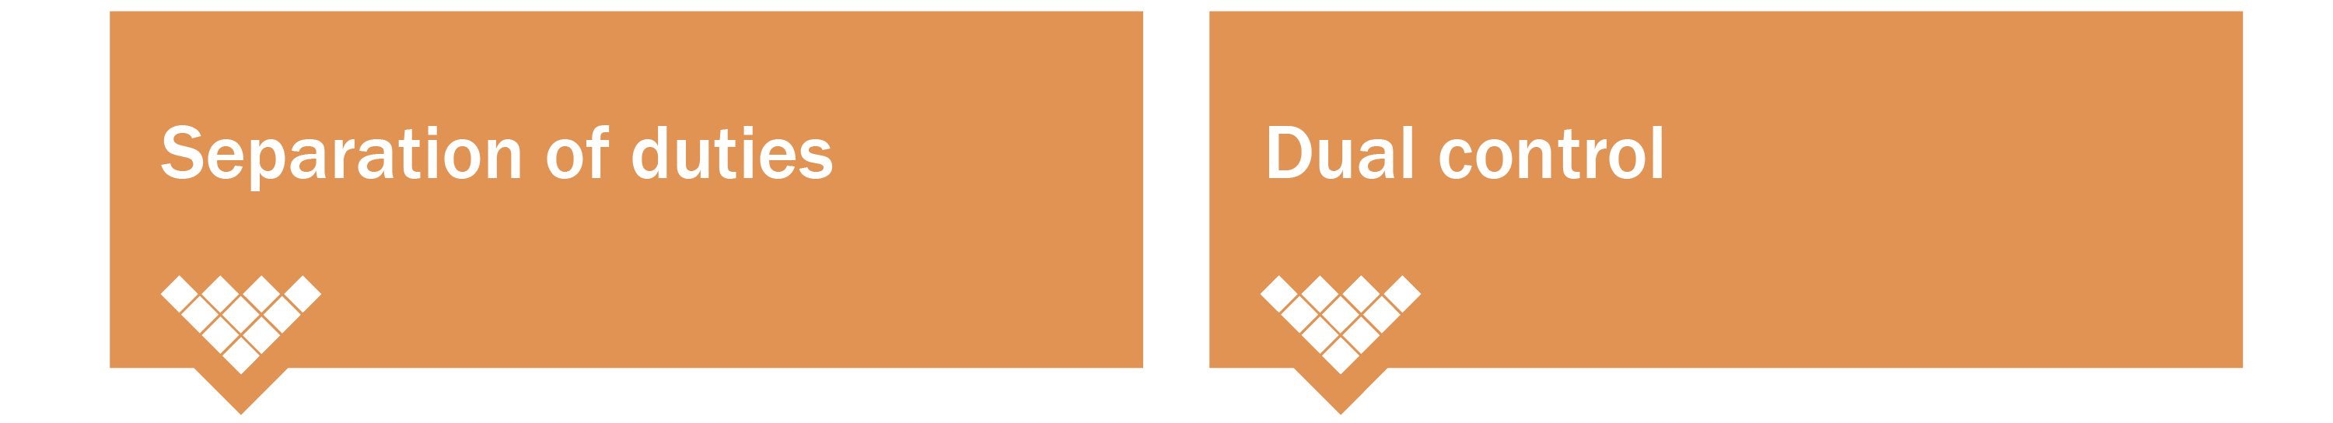
Separation of Duties
Requires two or more individuals to complete a task or perform a specific function
Requires two or more people operating at the same time to perform a single function

Slide 26
Defense-in-Depth
Defenses may be designed to prevent or deter attack using an outside-in or inside-out approach
By placing safeguards at two or more points along the access path to the asset, failure of one safeguard can be counteracted

Slide 27
Risk-Based Controls
RISK = THREAT + VULNERABILITY + IMPACT

Slide 28
Authorization and Accountability
A record of authorizations should be kept to support access control system validation testing
Accountability is a principle that ties authorized users to their actions

Slide 29

Information Security - More than electronic data
Keys
Cell Phone
Access Cards
Logged-In Computer
Printouts
Passwords on Sticky Notes
Open File Cabinet
Personal Mail

Slide 30
Asset Categories
Primary Assets | Supporting Assets
Business processes and activities | Hardware
Information | Software
 | Network
 | Personnel
 | Site
 | Organization’s structure

Slide 31
Asset Protection
Each asset should be provided an appropriate level of protection.
Adequate or appropriate protection commensurate with risk.

Slide 32
Hardware Operations and Maintenance
Patches
Upgrades
Maintain correct configuration
Hardening
Ensure staff training

Slide 33
Software Management
Build or Buy?
Source code escrow
Patching
Documentation
Licensing and Software Piracy

Slide 34
Information
One of the most valuable assets of an organization
Also one of the most vulnerable
Loss of information may lead to:
Fines
Reputational damage
Business interruption
Loss of competitive advantage

Slide 35
Information Classification
Classification ensures the appropriate level of protection for information.
Requires determination of information owner.
Information must be protected in all forms and at all times, in all places.

Slide 36
Third Party/Outsourcing Implications
Cloud and other outsourcing options
Legal liabilities for asset protection
Contractual agreements
Monitoring
Disposal of equipment by outsourcing firm

Slide 37

During the week
Review Unit 1 online course material
Understanding Security Concepts
Participate in Asset Management
Complete the quiz

