Slide 1
Implement and Operate Endpoint Device Security

Slide 2
Host-Based Intrusion Detection Systems (HIDS)
Look for unusual activity by:
Examining logs created by the operating system
Looking for changes made to key system files
Tracking installed software
Sometimes examining the network connections a host makes

Slide 3
Advantages of HIDS
Capable of verifying if an attack was successful
Can monitor all users’ activities
Are capable of identifying attacks that originate from inside the host
Do not require any extra hardware

Slide 4
Disadvantages of HIDS
Can be compromised as soon as the host server is compromised by an attack
Can be rendered ineffective during a DoS attack against the host on which they are installed

Slide 5
Application Whitelisting
A proactive security technique where only a limited set of approved programs are allowed to run, while all other programs are blocked from running by default

Slide 6
Advantages of Application Whitelisting
Blocks most current malware
Prevents use of unauthorized applications
Does not require daily definition updates
Requires administrator installation and approval of new applications

Slide 7
Disadvantages of Application Whitelisting
Requires performance overhead to enforce the whitelist
Requires regular maintenance
Causes some users to be annoyed because they cannot download and run applications at will

Slide 8
How to Enforce Application Whitelisting
Most enterprise application whitelisting solutions make management of the whitelist easy for administrators, enable updating of applications, and monitor and report attempted violations of the policy
Many of these solutions are expensive, unlike the built-in (no additional cost) Software Restriction Policies on Windows computers

Slide 9
How Endpoint Encryption Works
During the startup process of an operating system, a boot sequence is executed
The boot loader first looks at a boot record
Endpoint encryption modifies the zero point area of the drive
The modified pre-boot screen prompts user for authentication credentials
The operating system continues to load as normal and the user can access the computer

Slide 10
Life with Encryption
Endpoint encryption allows users to continue working as normal during the initial encryption process by varying the amount of CPU power assigned to the initial encryption process

Slide 11
Endpoint Encryption: Recovery
The most common cause for data recovery is a lost or forgotten passphrase
Therefore, endpoint encryption software must include a recovery function

Slide 12
Trusted Platform Module (TPM)
TPM is a computer chip (microcontroller) that can securely store artifacts used to authenticate the platform (your PC or laptop)

Slide 13
Mobile Device Management (MDM)
The intent of MDM is to optimize the functionality and security of mobile devices within the enterprise, while simultaneously protecting the corporate network

Slide 14
Bring Your Own Device (BYOD)
BYOD is where employees bring non-company IT into the organization and demand to be connected to everything — without proper accountability or oversight
Challenges:
BYOD Governance and Compliance
Risk
Control

Slide 15
BYOD Policy Considerations
Specify what devices are permitted
Establish a stringent security policy for all devices
Define a clear service policy for devices under BYOD criteria
Make it clear who owns what apps and data
Decide what apps will be allowed or banned
Set up an employee exit strategy

Slide 16
Operate and Configure Cloud Security

Slide 17
The Five Essential Characteristics of Clouds
On-Demand Self-Service
Broad Network Access
Resource Pooling
Rapid Elasticity
Measured Service

Slide 18
Public
The service available to the general public over the Internet, in which a customer can access cloud service provider resources either in the form of a free service or offered on a pay-per-usage model

Slide 19
Private
A proprietary network, or data center, owned and architected for use by a specified entity utilizing cloud technologies to provide services behind a firewall

Slide 20
Hybrid
A hybrid cloud is built by combining two forms of cloud computing deployments, typically a public and private cloud

Slide 21
Community
Offer a valuable and cost-effective manner for specified groups or entities with a similar focus, or with common compliance and requirements to operate in a multi-tenant infrastructure

Slide 22
SaaS
Distributed model where software applications are hosted by a vendor or cloud service provider and made available to customers over network resources

Slide 23
PaaS
A way for customers to rent hardware, operating systems, storage, and network capacity over the Internet from a cloud service provider

Slide 24
IaaS
A model where the customer can provision equipment “as a service” to support operations, including storage, hardware, servers, and relevant networking components

Slide 25
Virtualization
The foundation for an agile, scalable cloud
The first practical step for building cloud infrastructure
Abstracts and isolates the underlying hardware as VMs

Slide 26
Hypervisor
A hypervisor or virtual machine monitor (VMM) is a piece of computer software, firmware, or hardware that creates and runs virtual machines
Type-1: native or bare-metal hypervisors
Type-2: hosted hypervisors

Slide 27
Types of Virtualization
Server virtualization
Network virtualization
Desktop virtualization
Application virtualization
Storage virtualization

Slide 28
Country-Specific Legal Considerations
United States
EU member states
Latin America
Asian-Pacific Economic Cooperation (APEC)

Slide 29
Jurisdiction and Applicable Law
Applicable law:
Determines the legal regime applicable to a certain matter
Jurisdiction:
Usually determines the ability of a national court to decide a case or enforce a judgment or order

Slide 30
Typical Meaning for Common Privacy Terms
Data Subject
Personal Data
Processing
Controller
Processor

Slide 31
Classification of Discovered Sensitive Data
Data classification can be accomplished in different ways:
Tagging the data using other external information
Extrapolating the classification from the content of the data

Slide 32
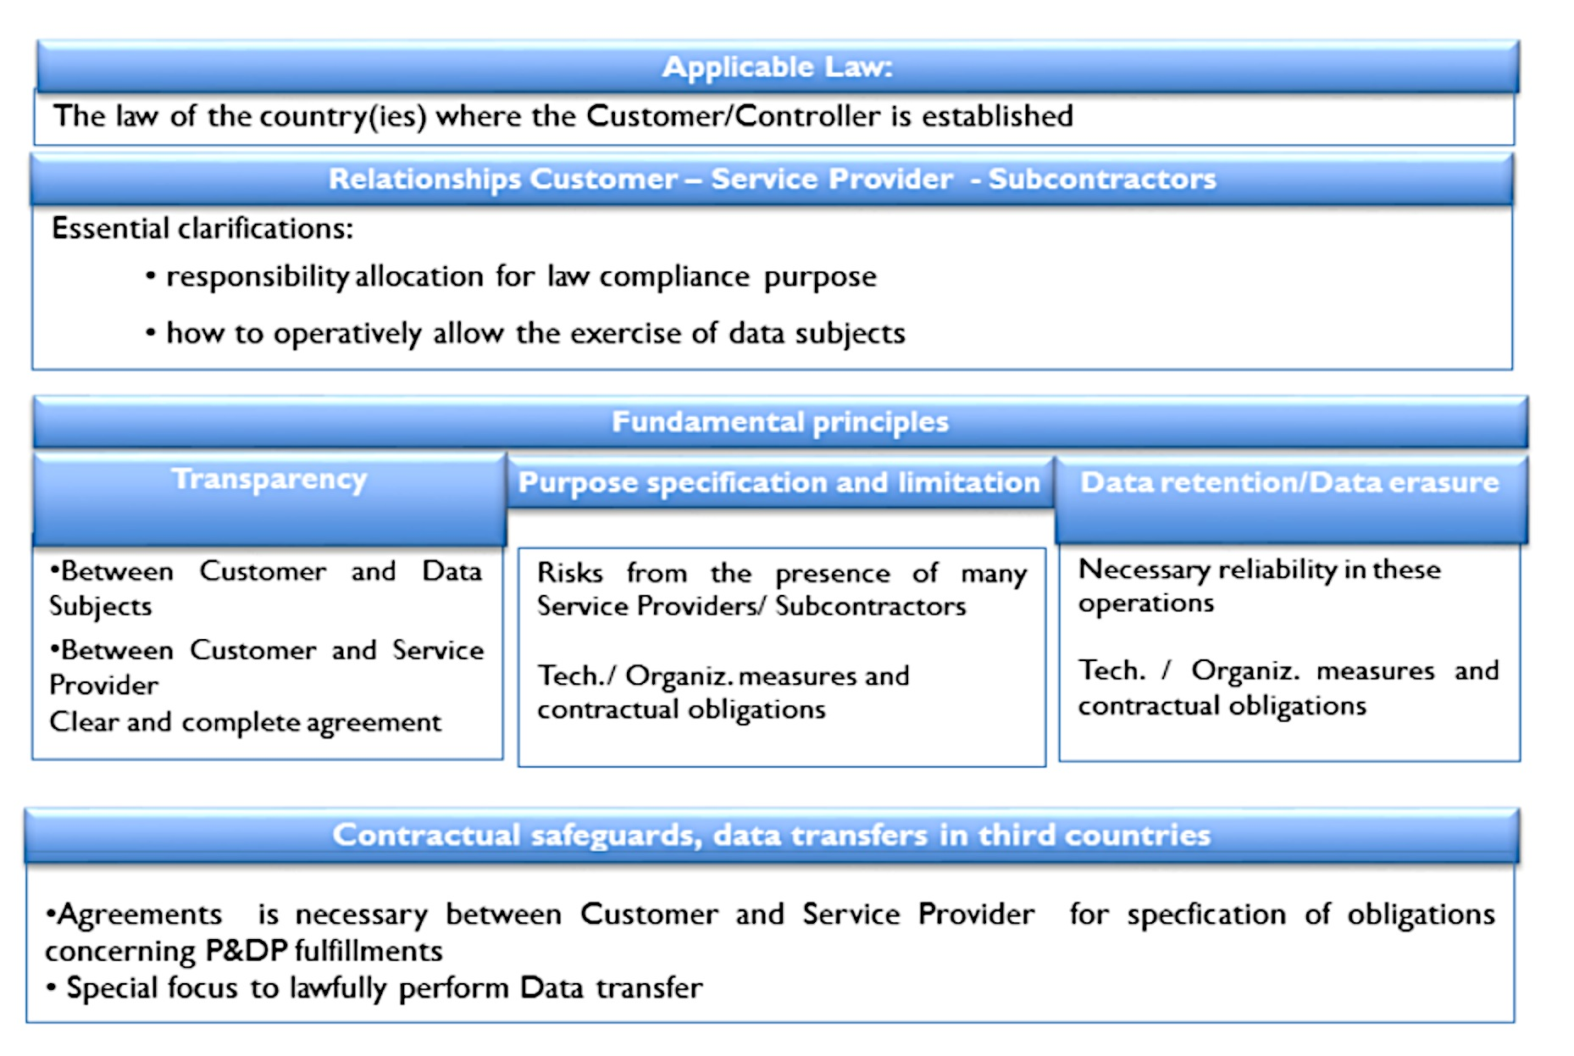
Key Privacy Cloud Service Factors

Slide 33
Privacy Level Agreement (PLA)
Provides a clear and effective way to communicate the level of personal data protection provided
Works as a tool to assess the level of a Service Provider’s compliance with data protection legislative requirements and best practices
Provides a way to offer contractual protection against possible financial damages due to lack of compliance

Slide 34
IaaS
Self-service models for accessing, monitoring, and managing remote data center infrastructures, such as compute, storage, networking, and networking services

Slide 35
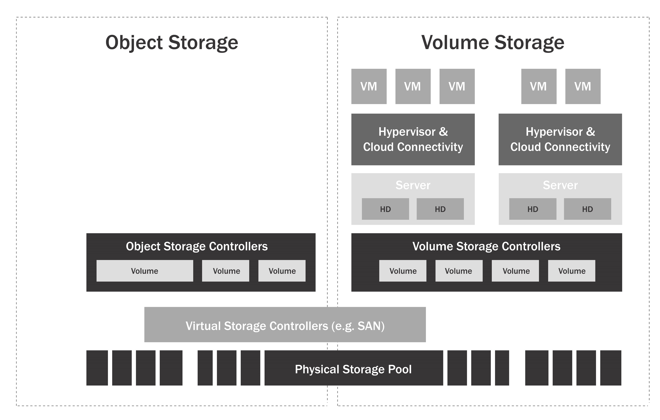
IaaS Storage

Slide 36
Platform as a Service (PaaS)
Enterprise operations, or a third-party provider, can manage OSes, virtualization, servers, storage, networking, and the PaaS software itself

Slide 37
SaaS
With SaaS, it is easy for enterprises to streamline their maintenance and support, because everything can be managed by vendors

Slide 38
Data Dispersion in Cloud Storage
Data Dispersion techniques are used to provide high availability, assurance, and performance when writing data into cloud-based storage systems

Slide 39
Threats to Storage Types
Administrators for the cloud provider can technically access your volumes and storage
Private volume storage can easily become publically available
Volumes and their snapshots can be used as an invaluable resource for troubleshooting purposes
Object-level storage typically lacks comprehensive security controls
Multi-tenancy issues

Slide 40
Data Loss Prevention (DLP)
Controls to protect data form the foundation of organizational security, along with enabling the organization to ensure the ability to meet regulatory requirements and relevant legislation

Slide 41
DLP Components
Discovery and classification
Monitoring
Enforcement

Slide 42
DLP Architecture
Network based
Storage based
Client based

Slide 43
Cloud-Based DLP Considerations
Data in the cloud tends to move and replicate
Administrative access for enterprise data in the cloud could be tricky
DLP technology can affect overall performance

Slide 44
Best Practices
Cloud DLP policy should address the following:
What kind of data is permitted to be stored in the cloud?
Where can the data be stored (jurisdictions)?
How should it be stored? Encryption and storage access consideration
What kind of data access is permitted? Which devices and what networks? Which applications? Which tunnel?
Under what conditions is data allowed to leave the cloud?

Slide 45
Best Practices
Encryption methods should be carefully examined based on the format of the data
When implementing controls to block data items, create procedures that will prevent business process damage due to false positive events
DLP can be an effective tool when planning or assessing a potential migration to cloud applications

Slide 46
Sample Use Cases for Encryption
When data moves in and out of the
Protecting Data at Rest
Files or objects that must be protected
When complying with regulations
Protection from third-party access
Creating mechanisms for logical separation
Logical destruction of data

Slide 47
Cloud Encryption Challenges
Control and management of the relevant encryption keys
Cloud provider processing requirements
Data in the cloud is highly portable
Multi-tenant cloud environments
Secure hardware for encrypting keys
Storage-level encryption
Encryption can negatively impact performance
The nature of cloud environments

Slide 48
Cloud Encryption Challenges
Encryption engines
Throughout the data life cycle, data can change locations, format, encryption, and encryption keys
Encryption affects data availability
Encryption does not solve data integrity threats

Slide 49
Data Encryption in IaaS
Basic storage-level encryption
Volume storage encryption
Object storage encryption
Database encryption
Application-level encryption

Slide 50
Common Challenges with Key Management
Access to the keys
Key storage
Backup and Replication

Slide 51
Considerations When Planning Key Management
Conduct random number generation as a trusted process
Maintain cryptographic keys should always remain in a “trusted” environment
Never be transmit cryptographic keys in the clear
When considering key escrow or key management “as a service,” take into account all relevant laws, regulations, and jurisdictional requirements

Slide 52
Considerations When Planning Key Management
Lack of access to the encryption keys will result in lack of access to the data
Where possible, conduct key management functions separately from the cloud provider

Slide 53
Key Management in Software Environments
Typically, cloud service providers protect keys using software-based solutions to avoid the additional cost and overhead of hardware-based security models

Slide 54
Common Approaches for Data Masking
Random substitution
Algorithmic substitution
Shuffle
Masking
Deletion

Slide 55
Data Anonymization
Direct identifiers
Indirect identifiers
Anonymization

Slide 56
Tokenization
Tokenization is the process of substituting a sensitive data element with a non-sensitive equivalent, referred to as a token
Tokenization can assist with:
Complying with regulations or laws
Reducing the cost of compliance
Mitigating risks of storing sensitive data and reducing attack vectors on that data

Slide 57
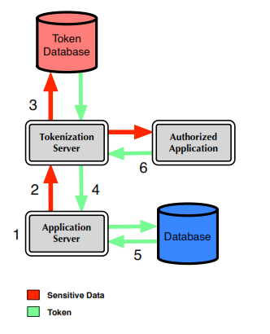
Basic Tokenization Architecture

Slide 58
Tokenization and Cloud Considerations
Ensure the provider and solutions protect your data
Pay special attention authenticating the application when storing or retrieving the sensitive data
Evaluate your compliance requirements before considering a cloud-based tokenization solution

Slide 59
Crypto-Shredding
The process of deliberately destroying the encryption keys that were used to encrypt the data originally

Slide 60
Data Archiving Policy
Data encryption procedures
Data monitoring procedures
Ability to perform eDiscovery and granular retrieval
Backup and disaster recovery options
Data format and media type
Data restoration procedures

Slide 61
SaaS
SaaS environments, you typically will have minimal control of and access to event and diagnostic data

Slide 62
PaaS
In PaaS environments, you typically will have control of and access to event and diagnostic data. Some infrastructure level logs will be visible to you, along with detailed application logs

Slide 63
IaaS
In IaaS environments, you typically will have control of and access to event and diagnostic data

Slide 64
Additional Considerations for Recording
Secondary time source
Action
Object
Result status
Reason
HTTP Status Code
Request HTTP headers or HTTP User Agent
User type classification

Slide 65
Additional Considerations for Recording
Analytical confidence in the event detection
Responses seen by the user and/or taken by the application
Extended details
Internal classifications
External classifications

Slide 66
Security and Information Event Management (SIEM)
Security Information Management (SIM)
Security Event Management (SEM)

Slide 67
SIEM Capabilities
Data aggregation
Correlation
Alerting
Dashboards
Compliance
Retention
Forensic analysis

Slide 68
SIEM Challenges
Turning over internal security data to a cloud provider requires trust
Targeted attack detection requires in-depth knowledge of internal systems, the kind found in corporate security teams

Slide 69
Secure Big Data Systems

Slide 70
Trends
Mountains of data that contain valuable information
The abundance of cheap commodity computing resources
“Free” analytics tools

Slide 71
Securing the Organization’s Big Data
Identify owners for the outputs of Big Data processes, as well as the raw data
Data ownership will be distinct from information ownership

Slide 72
Deploying Big Data for Security
The challenge of detecting and preventing advanced persistent threats may be answered using Big Data style analysis
Big Data provides the opportunity to consolidate and analyze logs automatically from multiple sources rather than in isolation

Slide 73
Operate and Secure Virtual Environments

Slide 74
Software-Defined Network (SDN)
SDN enables organizations to accelerate application deployment and delivery, dramatically reducing IT costs through policy-enabled workflow automation

Slide 75
Virtual Appliances
Virtual appliances are prebuilt software solutions comprising one or more virtual machines that are packaged, updated, maintained, and managed as a unit

Slide 76
Virtual Appliances Compared to Virtual Machines
Virtual Appliances
Virtual Machines

Slide 77
Host Clustering Concepts
Within a host cluster, resources are allocated and managed as if they are pooled, or jointly available to all members of the cluster
Reservations
Limits
Shares

Slide 78
VMware Distributed Resource Scheduling (DRS)
Provide your workloads highly available resources
Optimize performance by balancing workload
Scale and manage computing resources without service disruption
Provide optimized performance for hosts and virtual machines by balancing computing capacity by cluster

Slide 79
VMware vSphere High Availability (HA)
VMware vSphere High Availability (HA) provides uniform, cost-effective failover protection against hardware and operating system
HA can:
Detect hardware and guest operating system failures
Restart virtual machines on other vSphere hosts in the cluster when a server outage is detected

Slide 80
Scalability and Reliability
Scalability
Master-slave note relationship
Reliability
No external dependencies
Multiple communication paths
VM-VM anti-affinity rules

Slide 81
Windows Failover Clustering
System Center Operations Manager (SCOM)
System Center Virtual Machine Manager (SCVMM)
Performance Resource Optimization (PRO)

Slide 82
Attacks and Countermeasures
To secure a server, it is essential to first define the threats that must be mitigated
Threats:
Intentional actors
Unintentional actors

Slide 83
General Guidelines
Use an asset management system that has configuration management capabilities
Use system baselines to enforce configuration management throughout the enterprise
Develop and use of a robust change management system
Use an exception reporting system
Use vendor-specified configuration guidance and best practices

Slide 84
Security Benefits of Virtualization
Centralized storage used in virtualized environments prevents a loss of important data
When VMs and applications are isolated, only one application on one OS is affected by an attack
When configured properly, a virtual environment provides flexibility
If a VM is infected, it can be rolled back to a prior “secure” state that existed before the attack
Hardware reductions that occur due to virtualization improve physical security

Slide 85
Security Challenges, Risks, and Issues with Virtualization
File sharing between hosts and guests
Snapshots
Network storage
Hypervisor
Virtual machines
Separation of duties and administrator access
Time synchronization
Partitions

Slide 86
Common Virtualization Attacks
Denial of Service (DoS)
VM Jumping
Host Traffic Interception

Slide 87
Mitigation Strategies
Firewalls
VLANs
Agent-based antivirus approaches

Slide 88
Recommendations and Best Practices for Secure Virtualization
Administrator access and separation of duties
Give administrators the right to deploy new VMs but not modify existing VMs

Slide 89
Desktop Virtualization and Security
Update Acceptable Use Policy
Limit the use of VMs to the users who need them
Keep virtualization and security software up to date
Choose security policies that support virtualization
Create and maintain a library of secure VM builds

Slide 90
Network Security
Disconnect any unused NICs
Make sure that the host platform that connects the hypervisor and guests to the physical network is secure
Encrypt all traffic between clients and hosts, management systems and the hypervisor, and the hypervisor and hosts using SSL/TLS
Secure IP communications between two hosts
Do not use default self-signed certificates
Place virtual switches into promiscuous mode

Slide 91
Storage Networks
iSCSI and NFS traffic should be placed on dedicated storage networks or non-routable VLANs
Use IPSec to encrypt iSCSI traffic to prevent snooping
When using iSCSI or NFS, use physical switches to detect and disallow IP or MAC address spoofing
All traffic to and from storage repositories needs to be isolated from non-storage traffic

Slide 92
Virtual Machine Security
Turn off any unused VMs
Use IPSec between the host and VM
Employ VLANs within a single vSwitch
When VMs move, active memory and state are sent over the network to the new host in clear text. Isolate this traffic from the production network
Policies can be used to make sure that a new VM is not allowed to join a VM group or cluster unless it has a specific configuration

Slide 93
Virtual Machine Security
Do not place workloads with different trust levels in the same security domain
Restrict access to archived VMs
Consider placing virtual firewalls on these VLANs with two or more VMs
Place a CPU limit on any VMs that can access the Internet
If users are allowed to create VMs, consider an authorized template

Slide 94
Virtual Machine Security
Consider deploying a security VM or virtual appliance to eliminate an agent on each VM
Disable any copy-paste functionality
A virtual firewall attached to a VM travels with it at all times to ensure that security policy is enforced before, during, and after any moves
A security gateway can be employed to inspect traffic between VMs
Make sure that any VMs that process protected information are isolated from other VMs

Slide 95
Management Systems
Secure your communications between management systems and the hosts
Do not allow a management server to be accessible from all workstations
Separate management servers from database servers

Slide 96
Hypervisor Security
Install vendor-supplied patches and updates
Disable any unused virtual hardware that connects to the hypervisor
Disable unneeded services
Perform constant monitoring of the hypervisor
Disable all local administration of the hypervisor
Require a centralized management application
Require multi-factor authentication for any admin functions on the hypervisor

Slide 97
Remote Access
Remote access management should be limited
Any remote access should ask for a username and a password backed
Remote communication to any management tools should be encrypted and authenticated.
When using SSH:
Disable version 1 protocol and the admin or root SSH login
Require users to use role-based access control

Slide 98
Configuration and Change Management
Make sure that any physical or virtual servers are hardened before putting them into deployment
Harden physical and virtual switches and virtual appliances and gateways before deployment
Do not allow changes to the infrastructure without documentation and testing in a lab environment
Track VM configurations and issue alerts for any changes to a desired configuration

Slide 99
Clustered Storage Spaces Hardware Requirements
Two or more systems running Windows Server 2012
SAS Host Bus Adapter (HBA)
A Windows Server 2012-certified SAS JBOD enclosure
A minimum of three physical drives

Slide 100
Key Features of vSphere Storage DRS
Resource aggregation
Initial placement
Load balancing
Affinity rules
Datastore maintenance mode

