Slide 1
Spotify and Cloud Computing
Haroon Ahmad - 914
Fayaz Ahmad - 924
Muhammad Talha - 934
Abdul Wahab - 928
Uzair Ahmad - 913

Slide 2
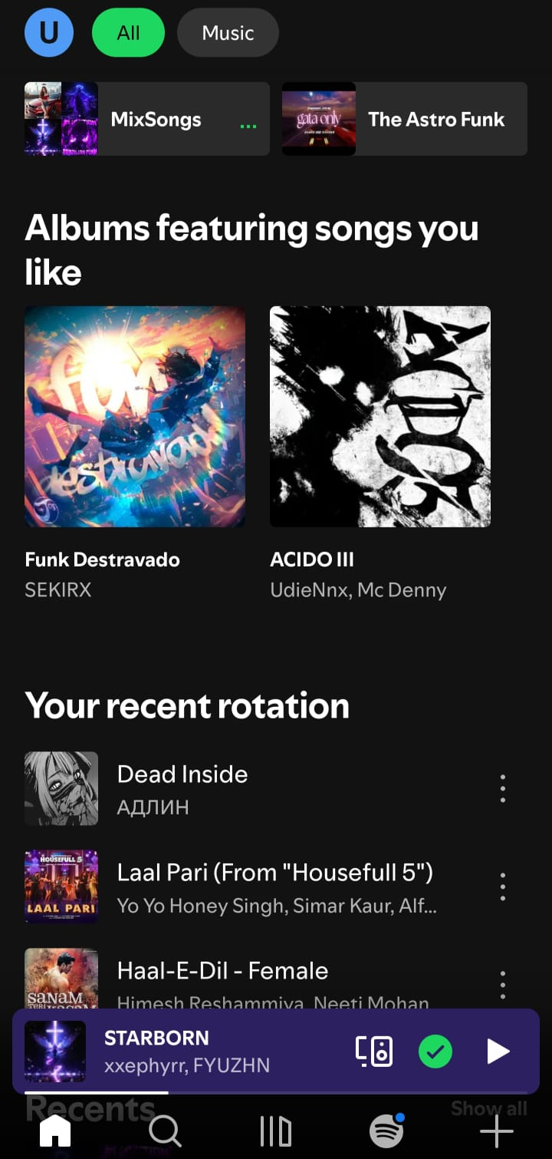
What is Spotify?
Music and podcast streaming platform
Available globally
Millions of users
Mobile + desktop + web support

Slide 3
Why Spotify Needs Cloud Computing
Huge number of users
Music streaming requires fast servers
Data storage for songs and playlists
Global accessibility

Slide 4
Cloud Service Models Used
SaaS – users stream music
PaaS – developers build services
Iaas – cloud servers/storage/networking
Hosted on GCP – Google Cloud Platform

Slide 5
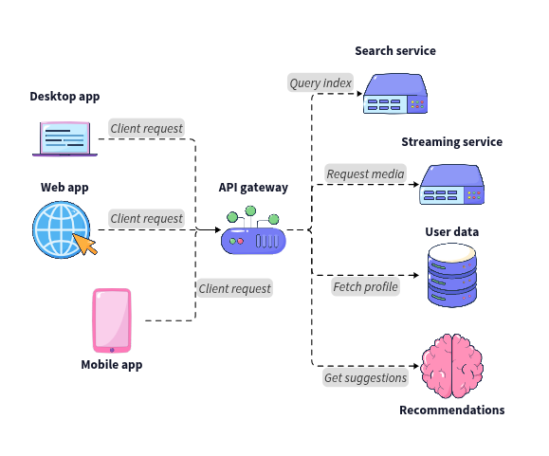
Basic Cloud Architecture
Users
Spotify App
Cloud Servers
Databases

Slide 6
Key Cloud Services Used
Cloud storage
Content Delivery Network (CDN)
Databases
Authentication services

Slide 7
Scalability in Spotify
Handles millions of users
Auto scaling during peak traffic
Load balancing
Distributed servers

Slide 8
Performance Handling
Fast music buffering
Low latency streaming
Global server distribution
Caching systems

Slide 9
Data Storage & Management
Songs
Playlists
User accounts
Listening history

Slide 10
Security Considerations
User authentication
Encrypted communication
Data privacy
Secure payment handling

Slide 11
Real-World Traffic Example
Example
Sudden increase after album release
Millions streaming simultaneously
How cloud helps:
Auto scaling
Distributed systems
CDN support

Slide 12
Challenges & Limitations
High cloud infrastructure cost
Network dependency
Data privacy risks
Server downtime risks

Slide 13
Future & Improvements
Possible improvements
Better AI recommendations
Faster streaming optimization
Improved security
Smarter cloud automation

Slide 14
Benefits of Cloud in Spotify
Global access
Scalability
Reliability
Fast streaming
Easy maintenance

Slide 15
Conclusion
Cloud computing is essential for Spotify
Enables global music streaming efficiently

