Slide 1
Lecture 5: Constraint Satisfaction Problems
ICS 271 Fall 2008

Slide 2
Outline
The constraint network model
  Variables, domains, constraints, constraint graph, solutions
Examples:
  graph-coloring, 8-queen, cryptarithmetic, crossword puzzles, vision problems,scheduling, design
The search space and naive backtracking,
The constraint graph
Consistency enforcing algorithms
  arc-consistency, AC-1,AC-3
Backtracking strategies
  Forward-checking, dynamic variable orderings
Special case: solving tree problems
Local search for CSPs

Slide 3
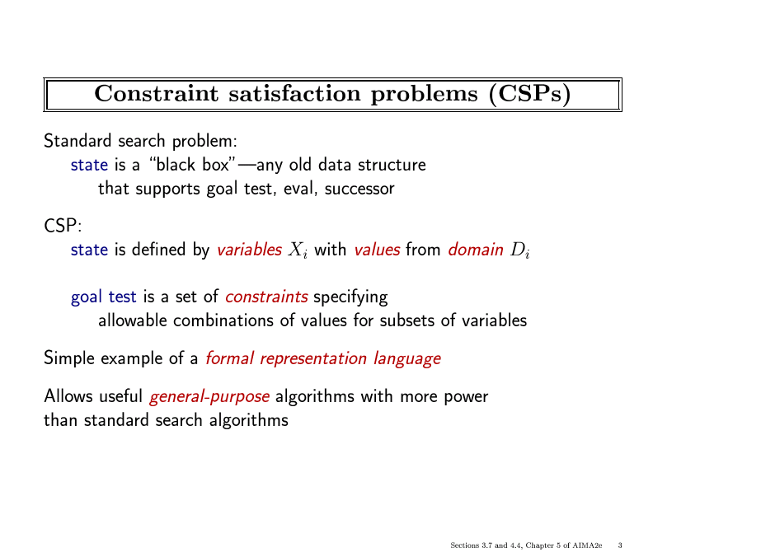

Slide 4

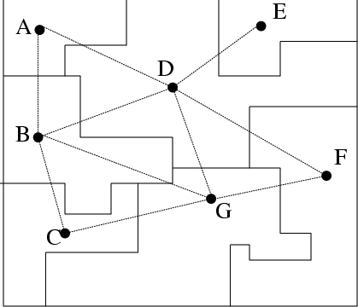
Constraint Satisfaction
Example: map coloring
Variables - countries (A,B,C,etc.)
Values - colors (e.g., red, green, yellow)
Constraints:
A B
red green
red yellow
green red
green yellow
yellow green
yellow red
A
E
D
B
F
G
C

Slide 5
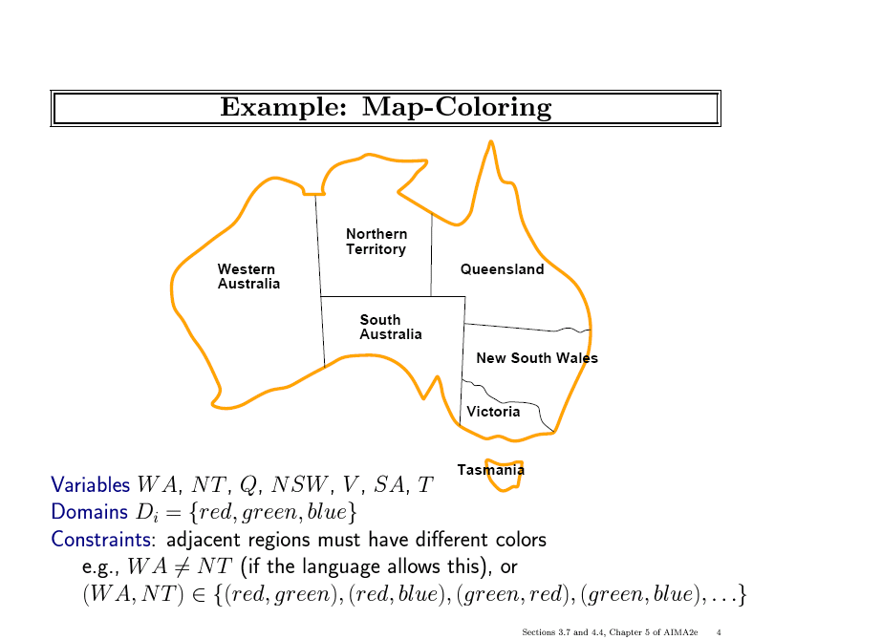

Slide 6
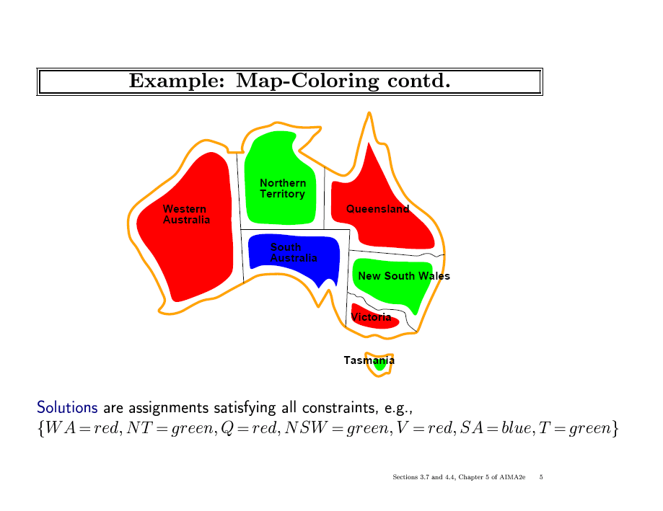

Slide 7
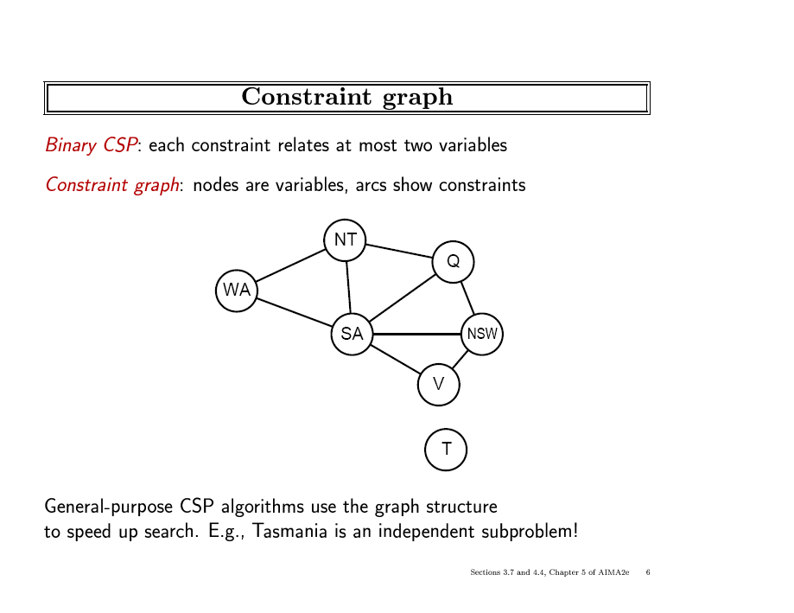

Slide 8
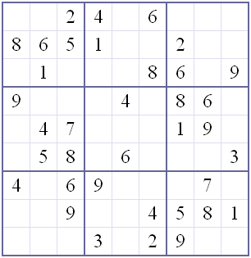
Sudoku
Variables: 81 slots
Domains = {1,2,3,4,5,6,7,8,9}
Constraints:
  27 not-equal
Constraint propagation
2 3
4 6
2
Each row, column and major block must be alldifferent
“Well posed” if it has unique solution: 27 constraints
Notes:
As I will disuss later, algorithms for answering constraint satisfaction queries are not likely to be efficient.
Namely, we may have to wait a very long time when we ask if there is a solution.
But one reason the area of constraint network gained its popularity is by highlighting some computational pattern that
is popular with human. We call it constraint propagation.
….
So, while constraint propagation are huge effective helper in solving many problems associated with deterministic constraints.

Slide 9
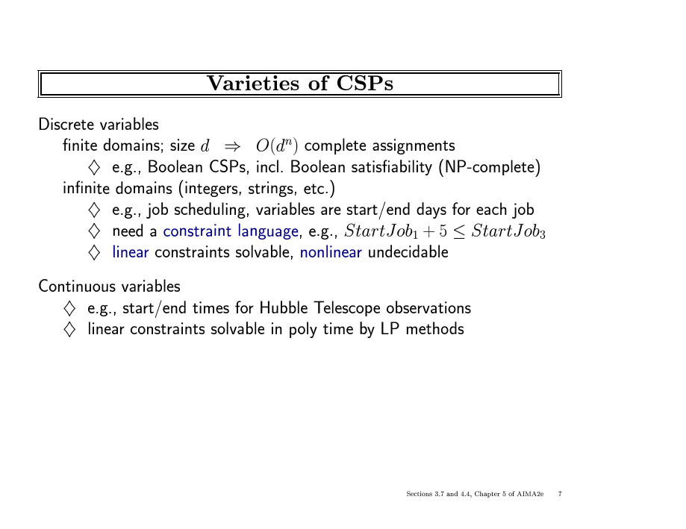

Slide 10
Varieties of constraints
Unary constraints involve a single variable,
  e.g., SA ≠ green
Binary constraints involve pairs of variables,
  e.g., SA ≠ WA
Higher-order constraints involve 3 or more variables,
  e.g., cryptarithmetic column constraints

Slide 11
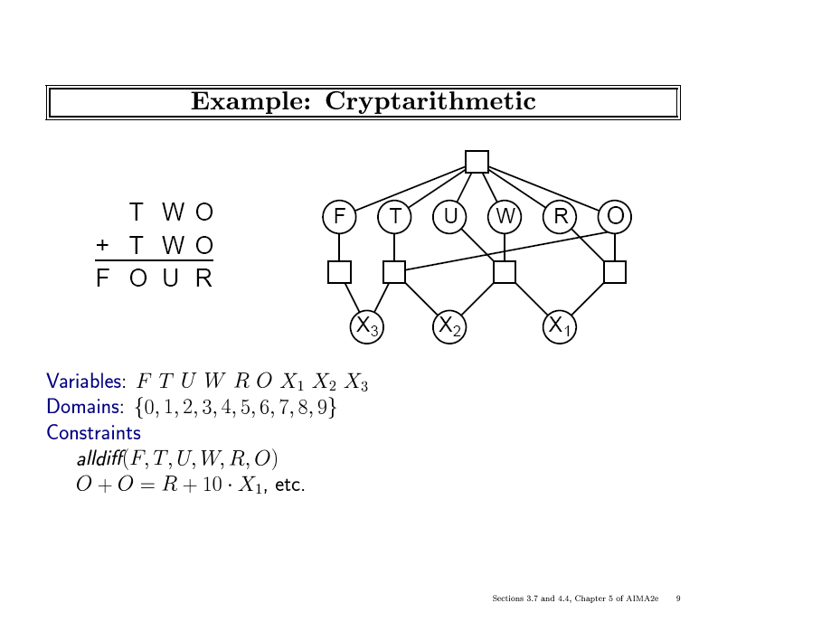

Slide 12
Examples
Cryptarithmetic
  SEND +
  MORE
  = MONEY
n - Queen
Crossword puzzles
Graph coloring problems
Vision problems
Scheduling
Design

Slide 13
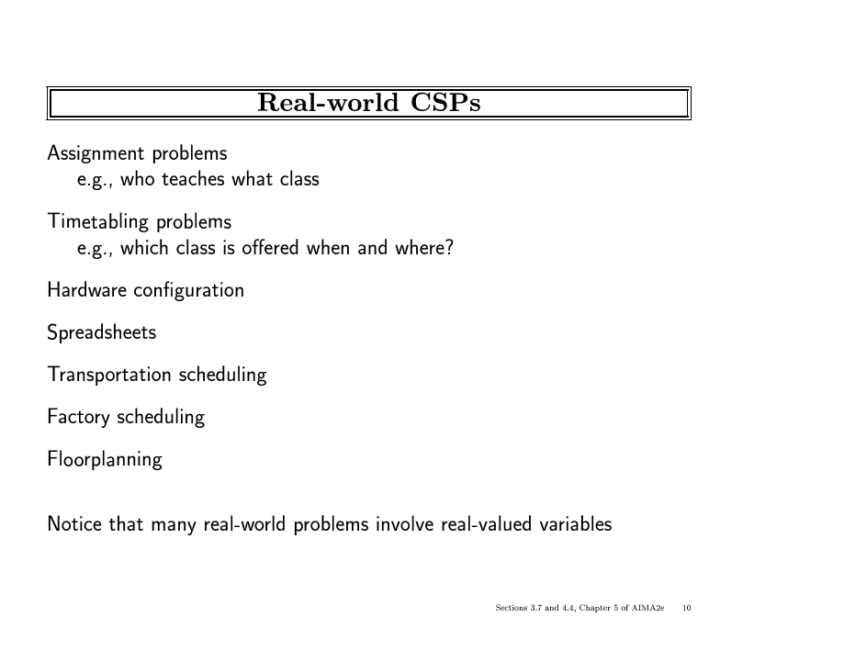

Slide 14









A network of binary constraints
Variables
Domains
  of discrete values:
Binary constraints:
  which represent the list of allowed pairs of values, Rij is a subset of the Cartesian product: .
Constraint graph:
  A node for each variable and an arc for each constraint
Solution:
  An assignment of a value from its domain to each variable such that no constraint is violated.
A network of constraints represents the relation of all solutions.

Slide 15






Example 1: The 4-queen problem
Place 4 Queens on a chess board of 4x4 such that no two queens reside in the same row, column or diagonal.
Standard CSP formulation of the problem:
Variables: each row is a variable.
1 2 3 4
Q
Q
Q
Q
Q
Q
Q
Q
Q
Q
Q
Q
Domains:
4
( )
Constraints: There are = 6 constraints involved:
2
Constraint Graph :

Slide 16
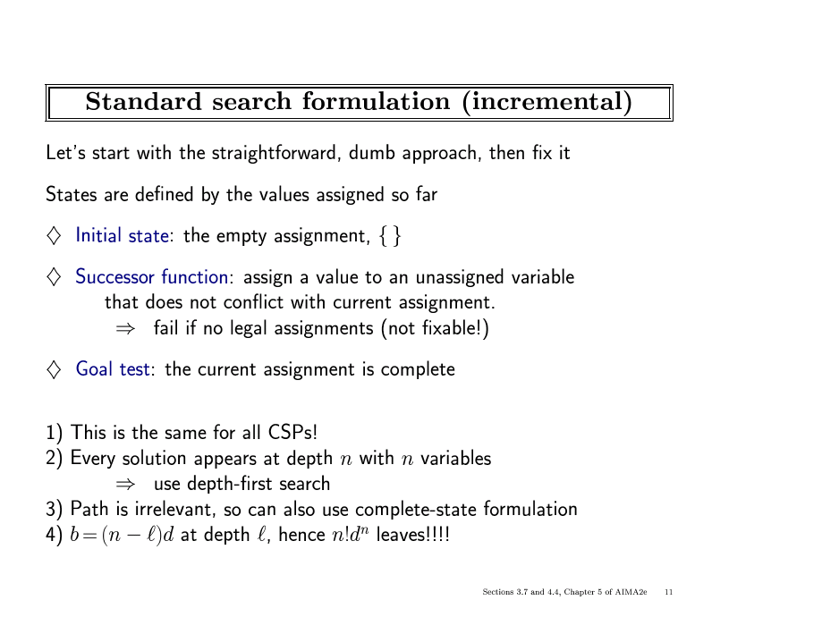

Slide 17
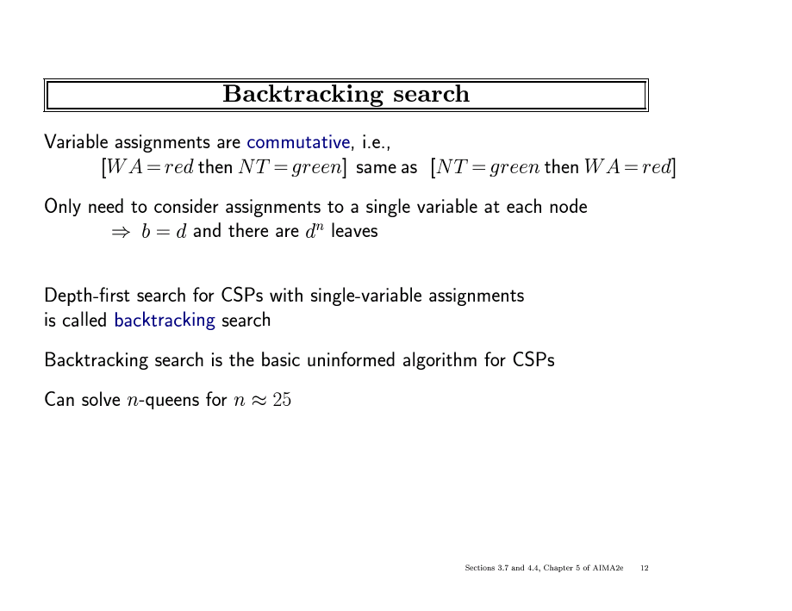

Slide 18
The search space
Definition: given an ordering of the variables
  a state:
    is an assignment to a subset of variables that is consistent.
  Operators:
    add an assignment to the next variable that does not violate any constraint.
  Goal state:
    a consistent assignment to all the variables.

Slide 19
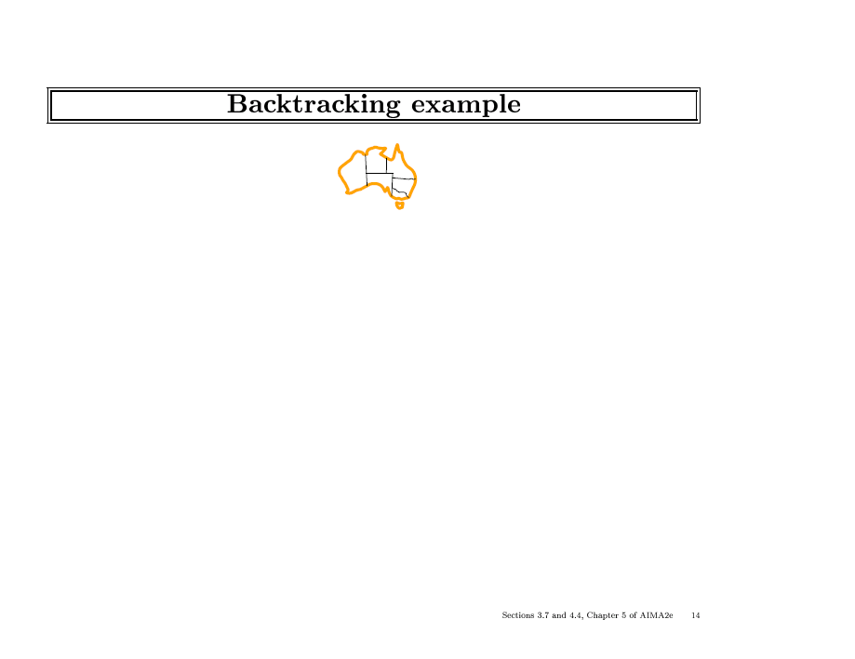

Slide 20
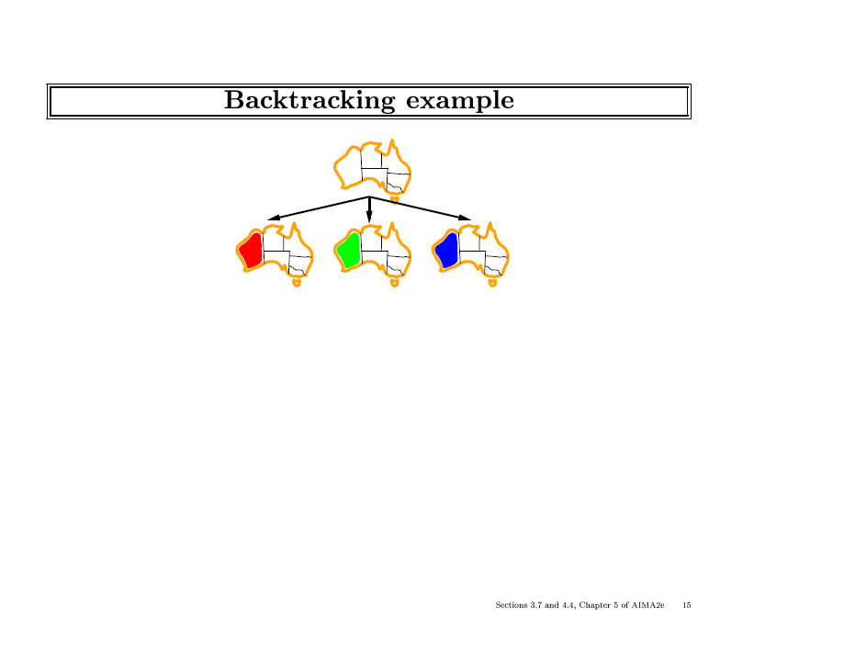

Slide 21
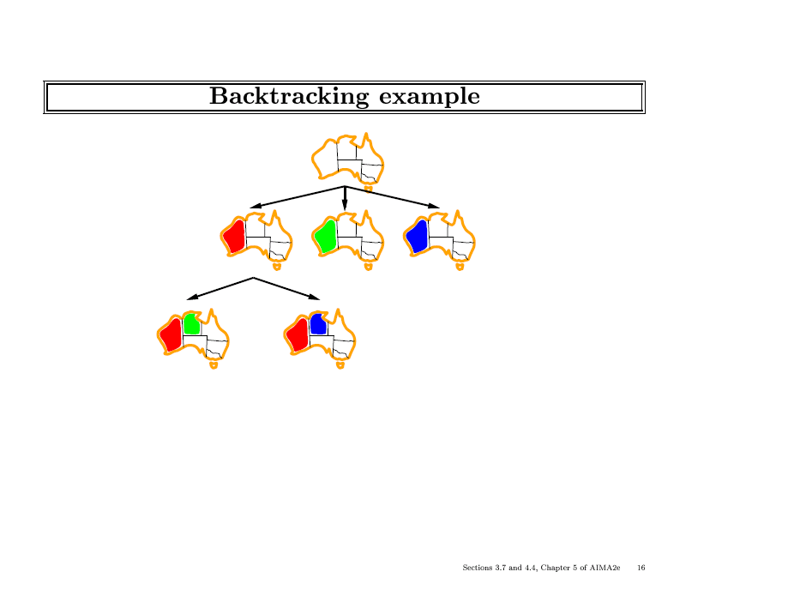

Slide 22
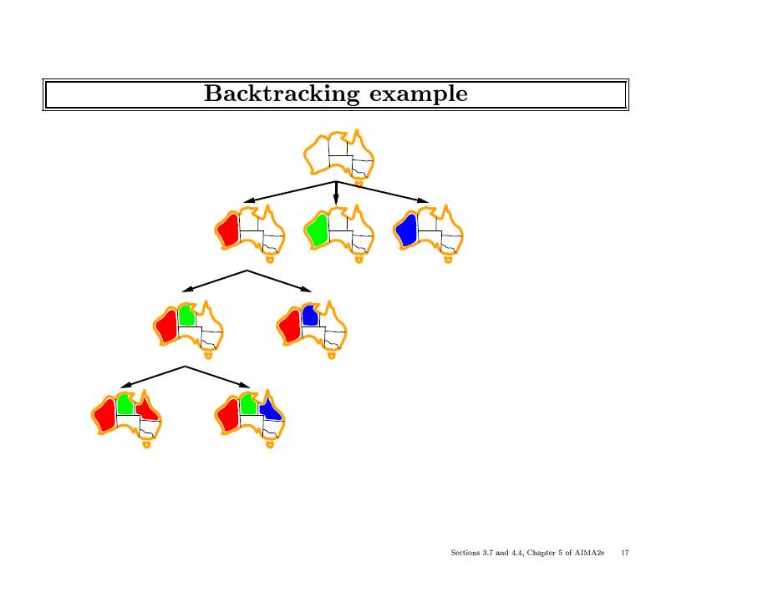

Slide 23
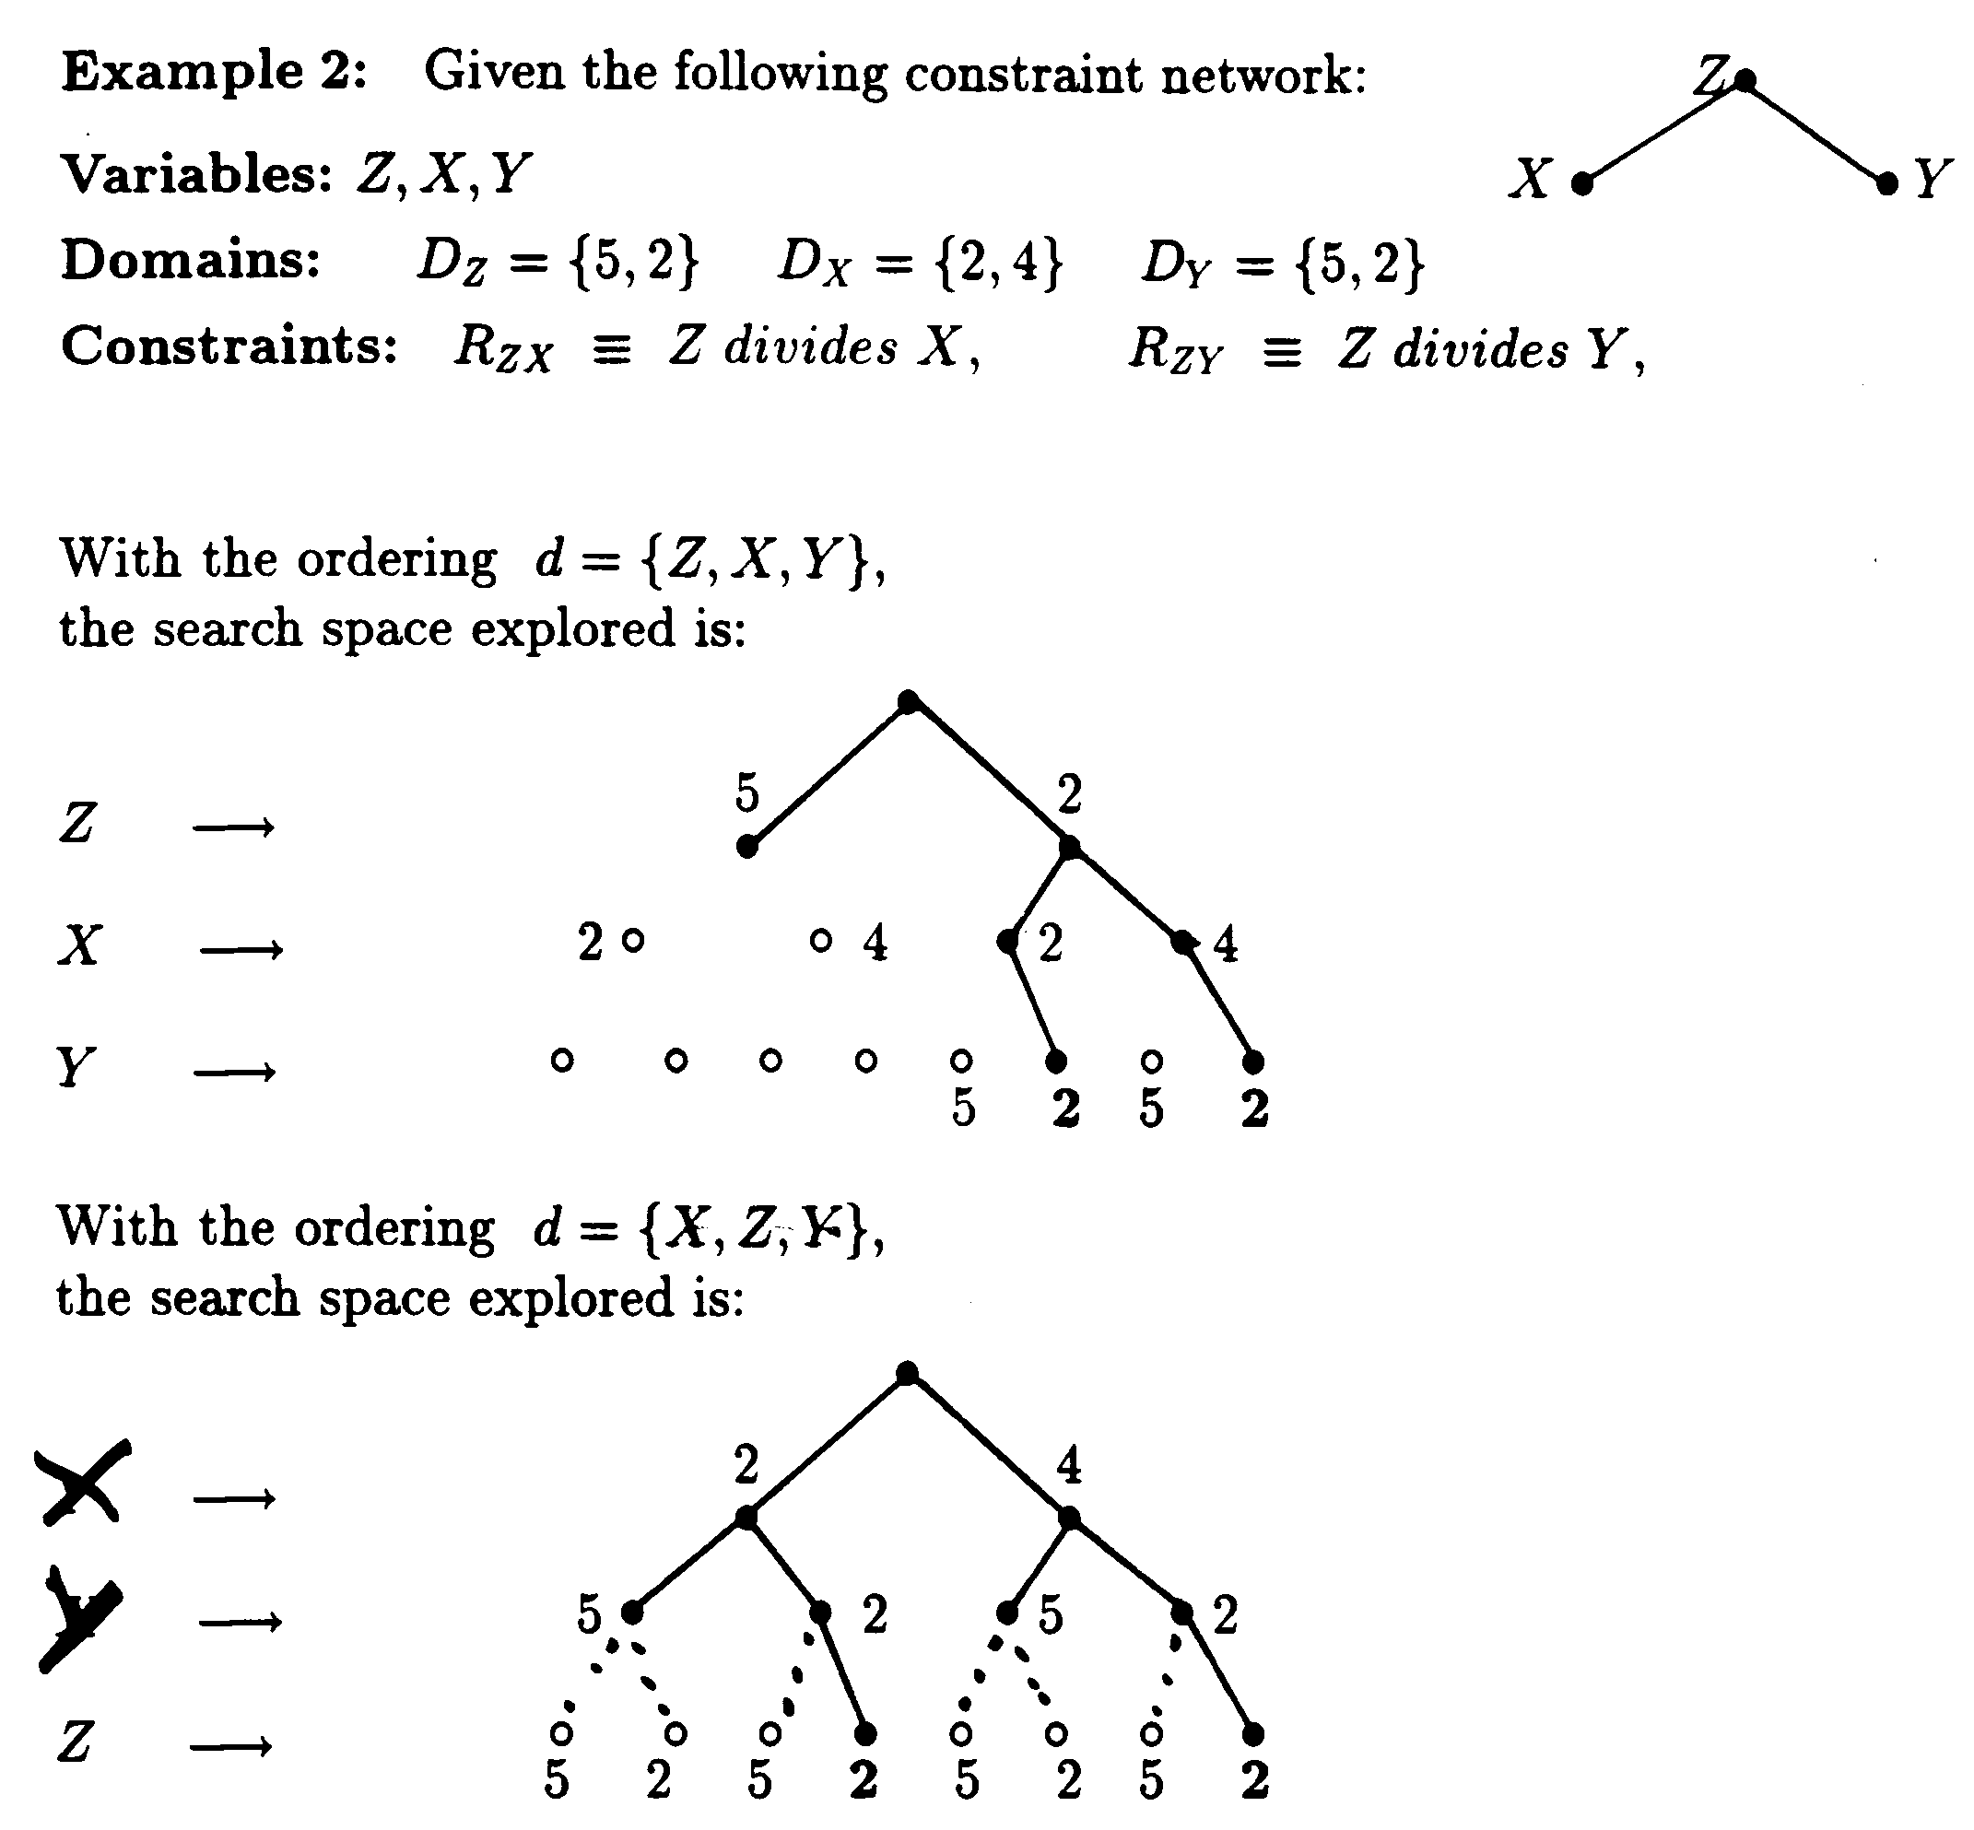
The search space depends on the variable orderings

Slide 24
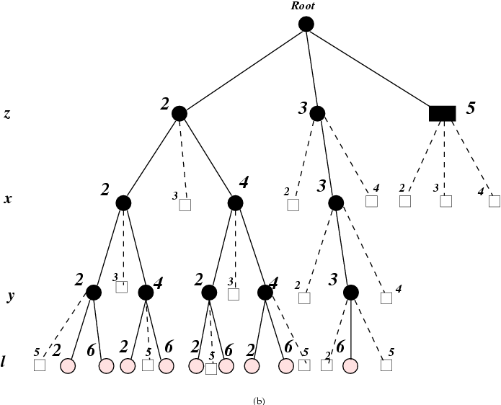
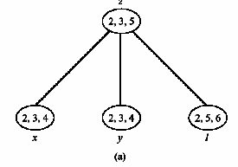
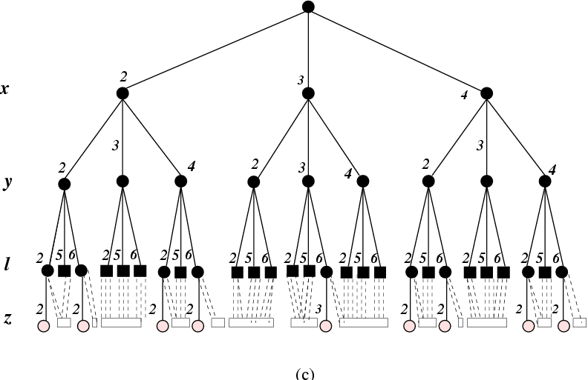
The effect of variable ordering
z divides x, y and t

Slide 25
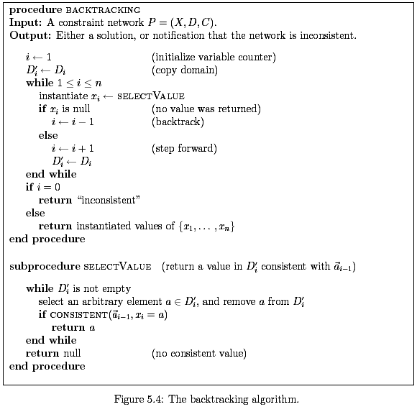
Backtracking
Complexity of extending a partial solution:
  Complexity of consistent: O(e log t), t bounds #tuples, e bounds #constraints
  Complexity of selectvalue: O(e k log t), k bounds domain size

Slide 26
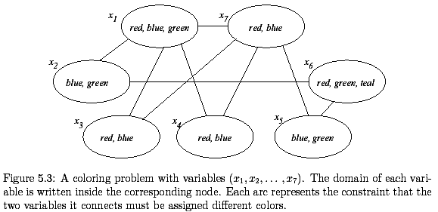
A coloring problem

Slide 27
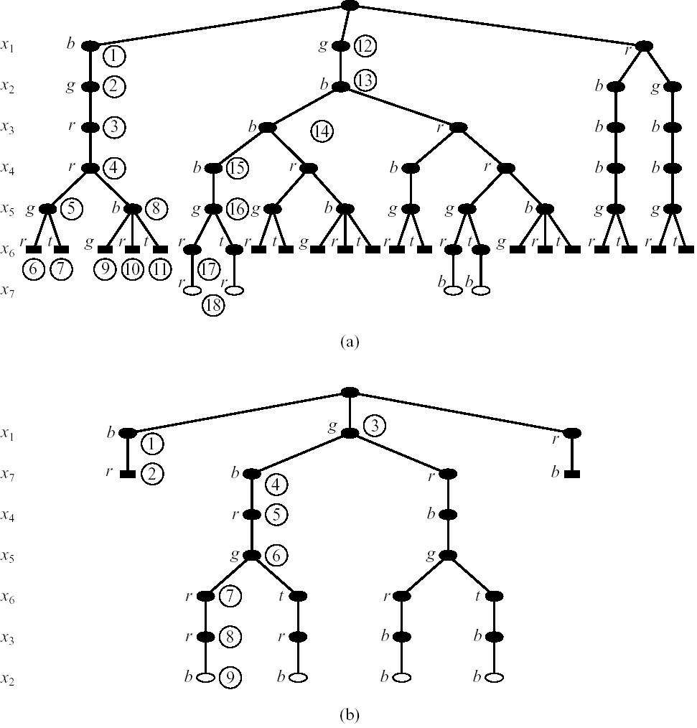
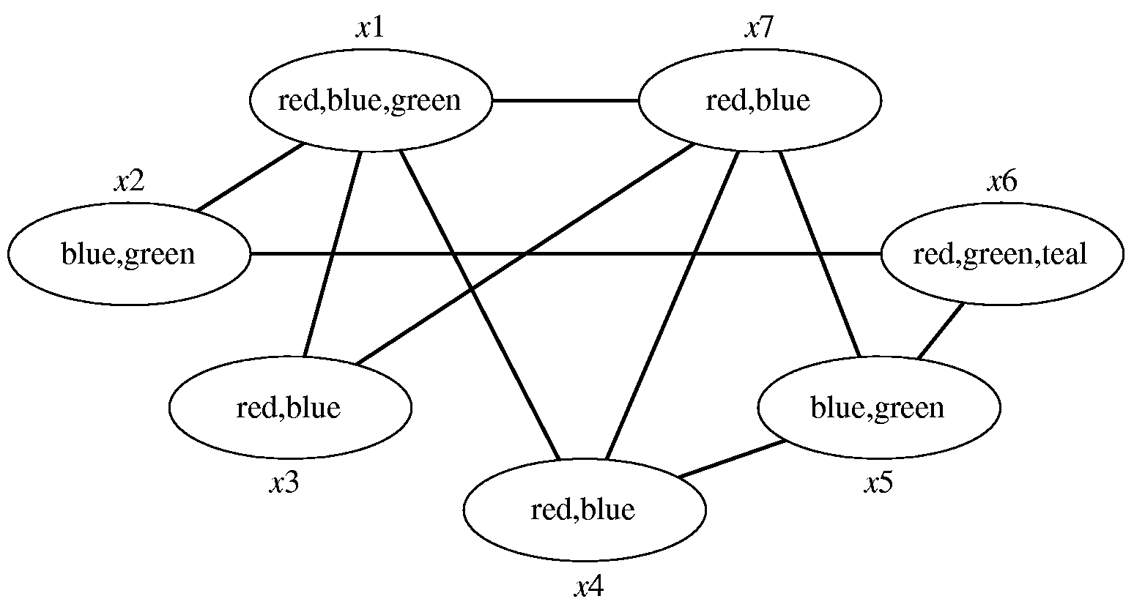
Backtracking Search for a Solution

Slide 28
Backtracking Search for a Solution

Slide 29
Backtracking Search for All Solutions

Slide 30
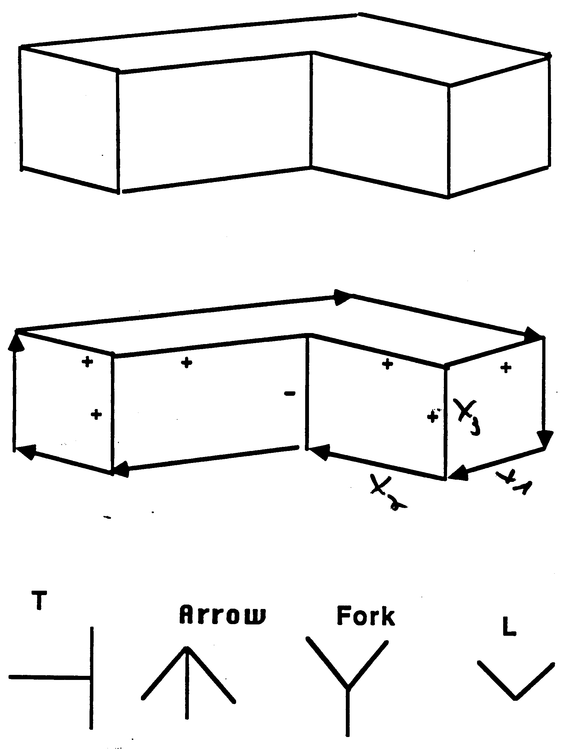
Line drawing Interpretations

Slide 31
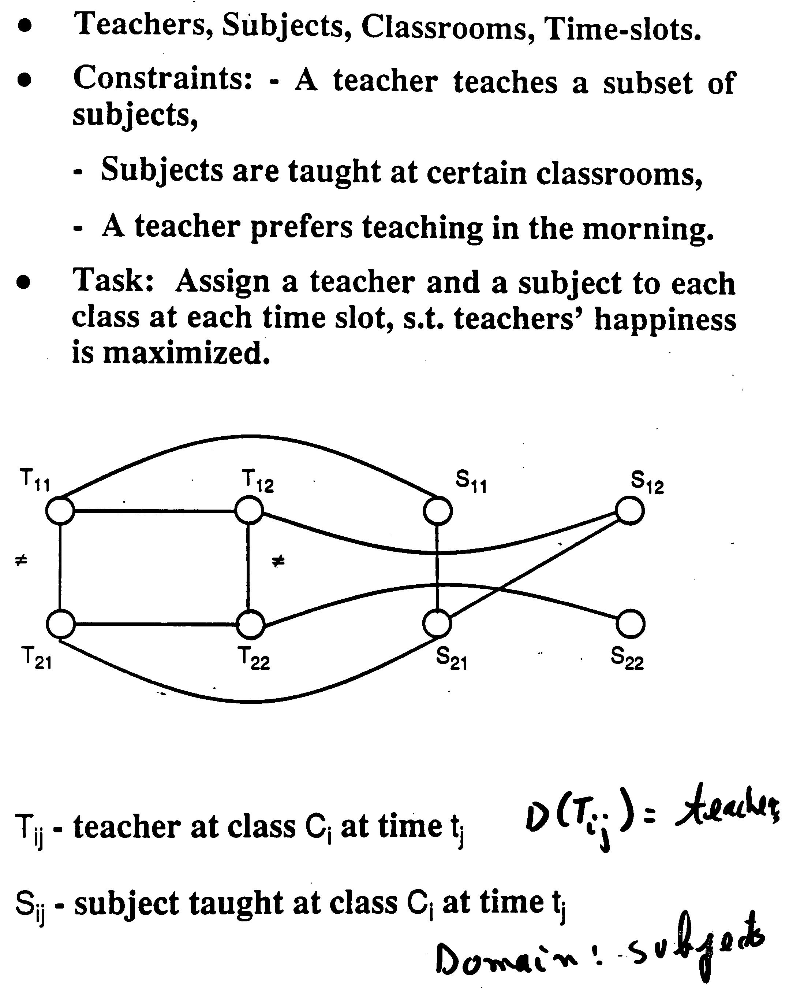
Class scheduling/Timetabling

Slide 32
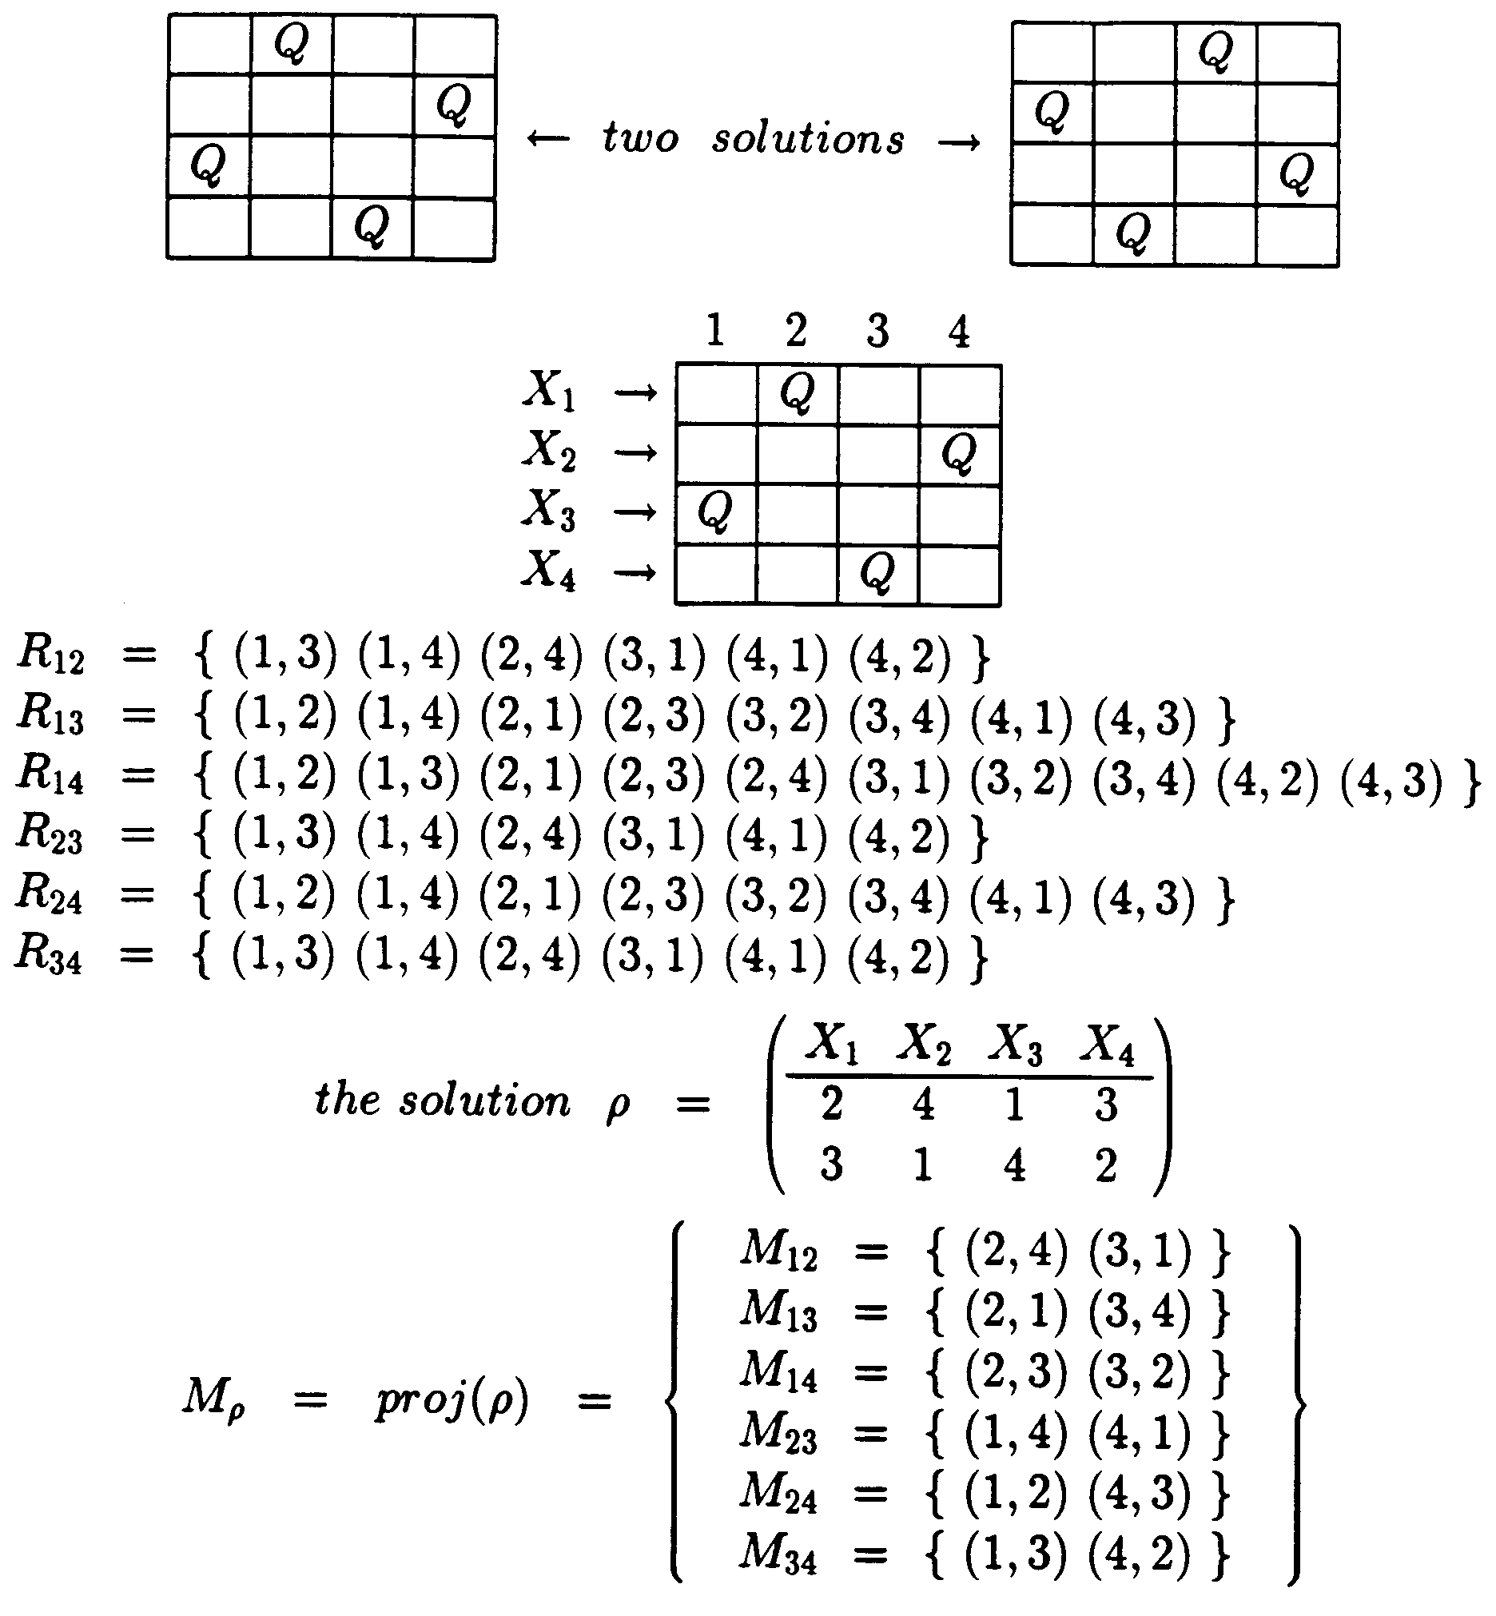
The Minimal network:
Example: the 4-queen problem

Slide 33
Approximation algorithms
Arc-consistency (Waltz, 1972)
Path-consistency (Montanari 1974, Mackworth 1977)
I-consistency (Freuder 1982)
Transform the network into smaller and smaller networks.

Slide 34
Arc-consistency
X
Y
<
1,
2,
3
1,
2,
3
1 ≤ X, Y, Z, T ≤ 3
X < Y
Y = Z
T < Z
X ≤ T
∧
=
1,
2,
3
<
1,
2,
3
T
Z

Slide 35
Arc-consistency
X
Y
<
1
3
1 ≤ X, Y, Z, T ≤ 3
X < Y
Y = Z
T < Z
X ≤ T
∧
=
2
<
3
T
Z
Incorporated into backtracking search
Constraint programming languages powerful approach for modeling and solving combinatorial optimization problems.

Slide 36



Arc-consistency algorithm
domain of x domain of y
Arc is arc-consistent if for any value of there exist a matching value of
Algorithm Revise makes an arc consistent
Begin
1. For each a in D_{i} if there is no value b in D_{j} that matches a then delete a from the D_{j}.
End.
Revise is , k is the number of value in each domain.

Slide 37

Algorithm AC-3
Begin
  1. Q <--- put all arcs in the queue in both directions
  2. While Q is not empty do,
  3. Select and delete an arc from the queue Q
    4. Revise
    5. If Revise cause a change then add to the queue all arcs that touch X_{i} (namely (X_{i},X_{m}) and (X_{l},X_{i})).
  6. end-while
End
Complexity:
  Processing an arc requires O(k^2) steps
  The number of times each arc can be processed is 2·k
  Total complexity is

Slide 38
Sudoku
Variables: 81 slots
Domains = {1,2,3,4,5,6,7,8,9}
Constraints:
  27 not-equal
Constraint propagation
2 3
4 6
2
Each row, column and major block must be alldifferent
“Well posed” if it has unique solution: 27 constraints
Notes:
As I will disuss later, algorithms for answering constraint satisfaction queries are not likely to be efficient.
Namely, we may have to wait a very long time when we ask if there is a solution.
But one reason the area of constraint network gained its popularity is by highlighting some computational pattern that
is popular with human. We call it constraint propagation.
….
So, while constraint propagation are huge effective helper in solving many problems associated with deterministic constraints.

Slide 39
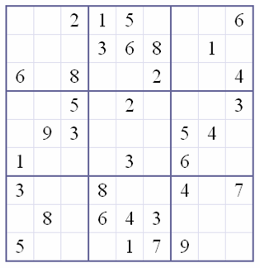
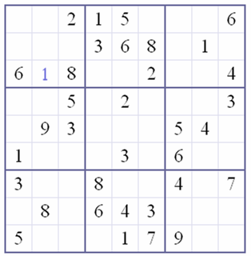
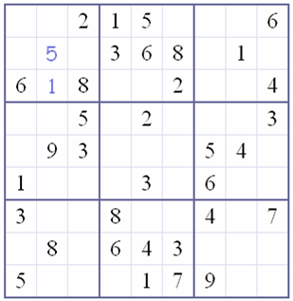
Sudoku
Each row, column and major block must be alldifferent
“Well posed” if it has unique solution

Slide 40
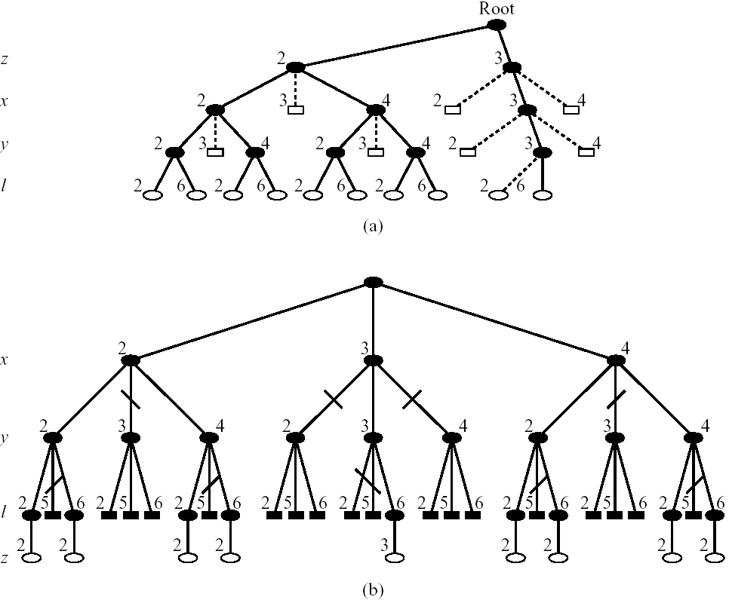
The Effect of Consistency Level
After arc-consistency z=5 and l=5 are removed
After path-consistency
  R’_zx
  R’_zy
  R’_zl
  R’_xy
  R’_xl
  R’_yl
Tighter networks yield smaller search spaces

Slide 41
Improving Backtracking O(exp(n))
Before search: (reducing the search space)
  Arc-consistency, path-consistency, i-consistency
  Variable ordering (fixed)
During search:
  Look-ahead schemes:
    Value ordering/pruning (choose a least restricting value),
    Variable ordering (Choose the most constraining variable)
  Look-back schemes:
    Backjumping
    Constraint recording
    Dependency-directed backtracking

Slide 42
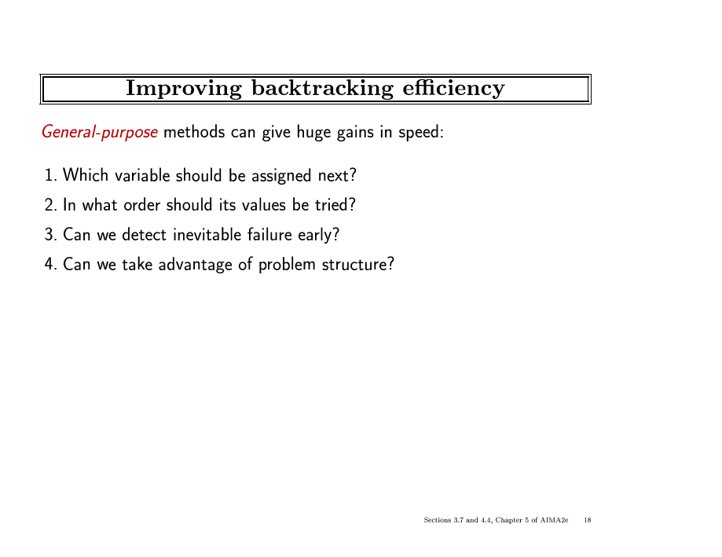

Slide 43
Look-ahead: Variable and value orderings
Intuition:
  Choose value least likely to yield a dead-end
  Choose a variable that will detect failures early
  Approach: apply propagation at each node in the search tree
Forward-checking
  (check each unassigned variable separately
Maintaining arc-consistency (MAC)
  (apply full arc-consistency)

Slide 44
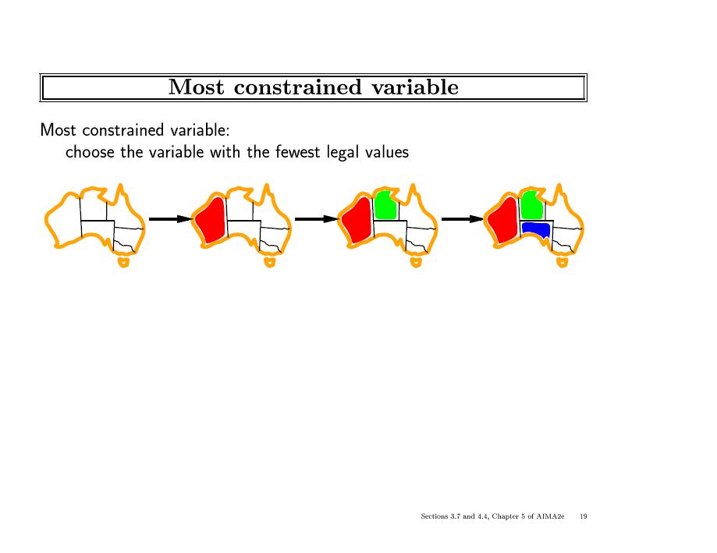

Slide 45
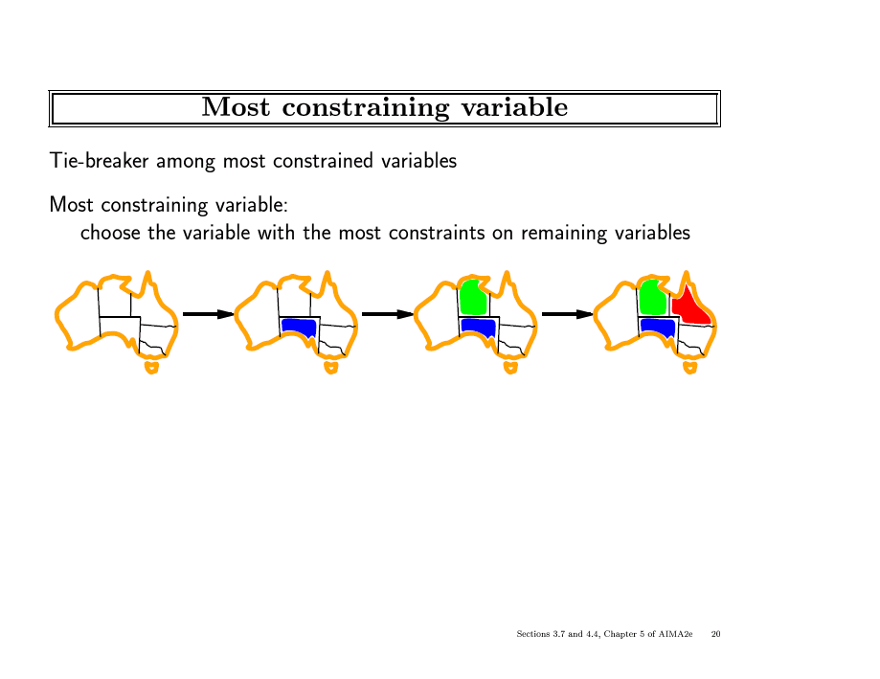

Slide 46
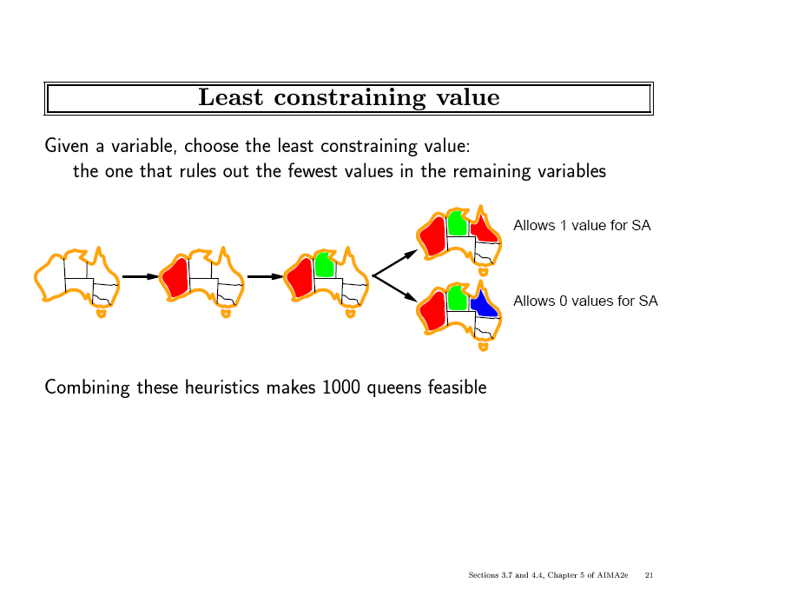

Slide 47
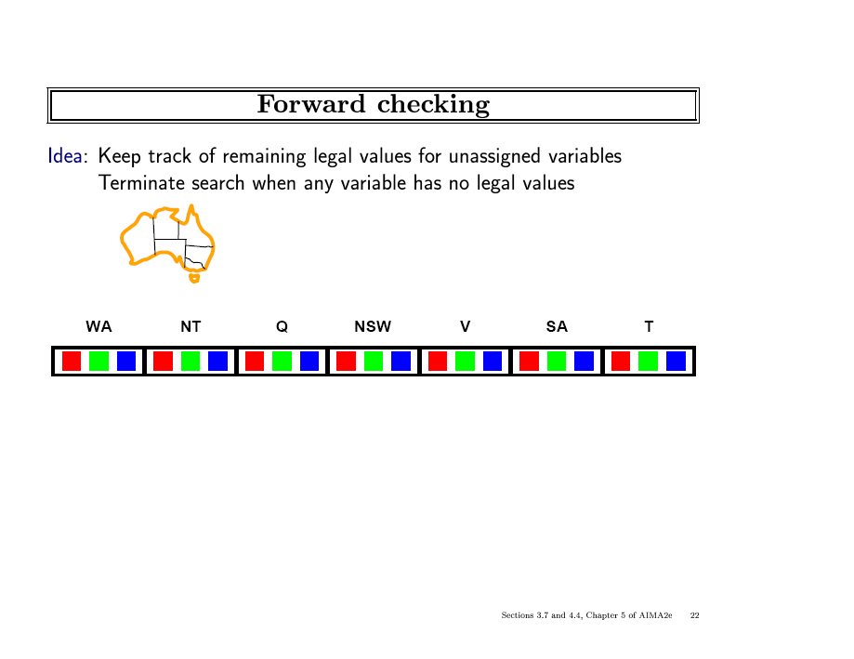

Slide 48
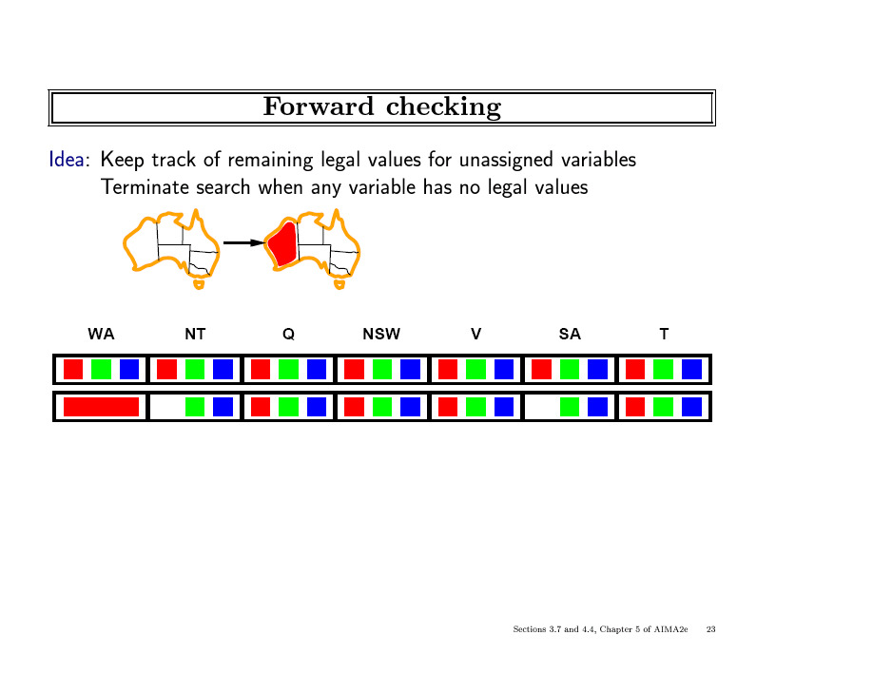

Slide 49
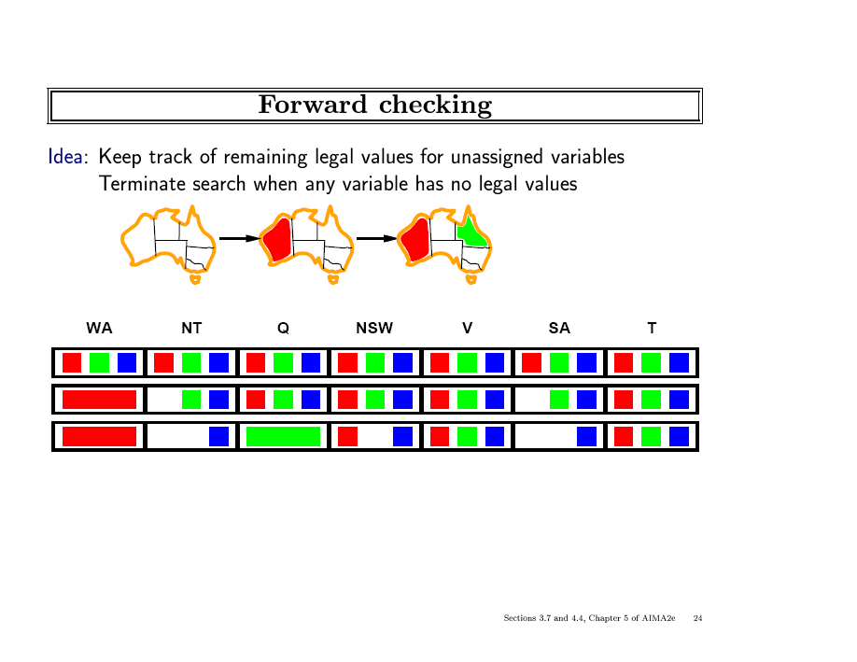

Slide 50
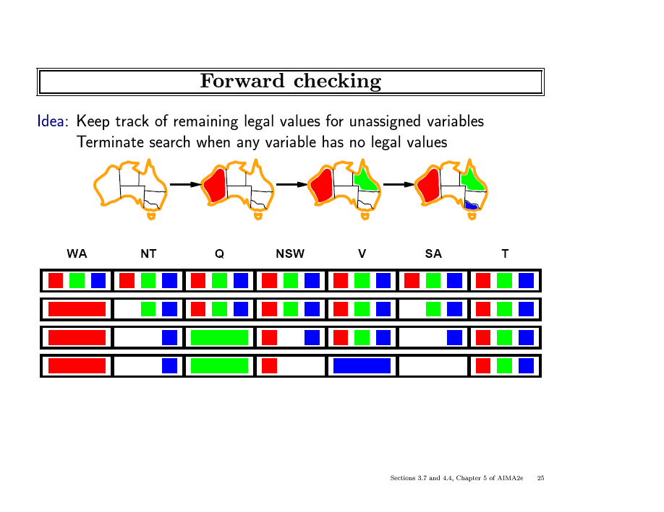

Slide 51
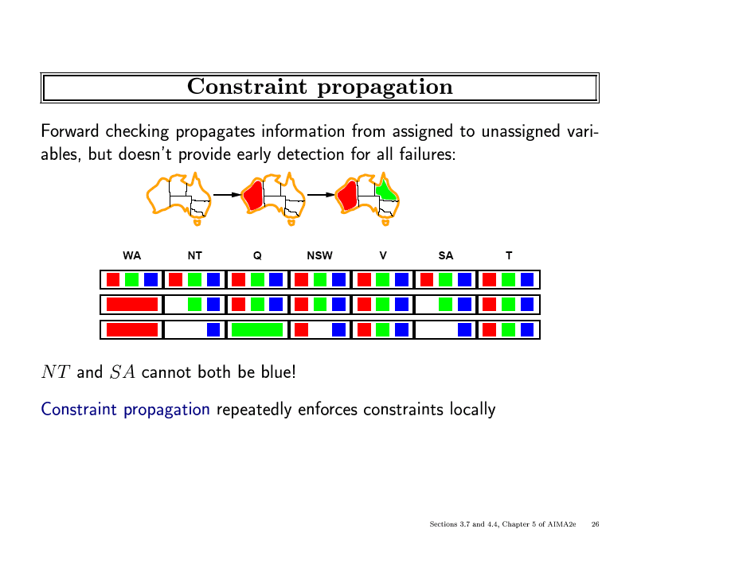

Slide 52
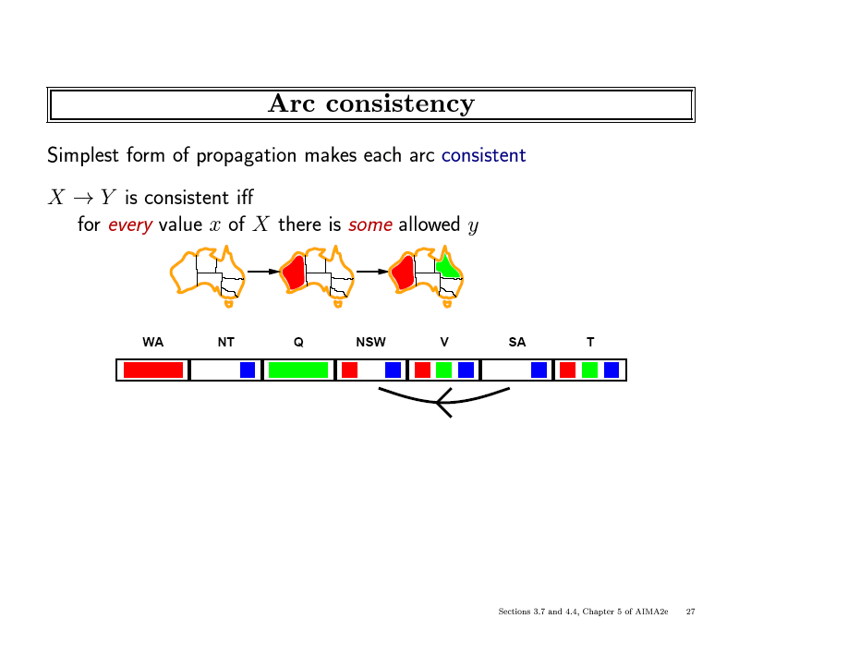

Slide 53
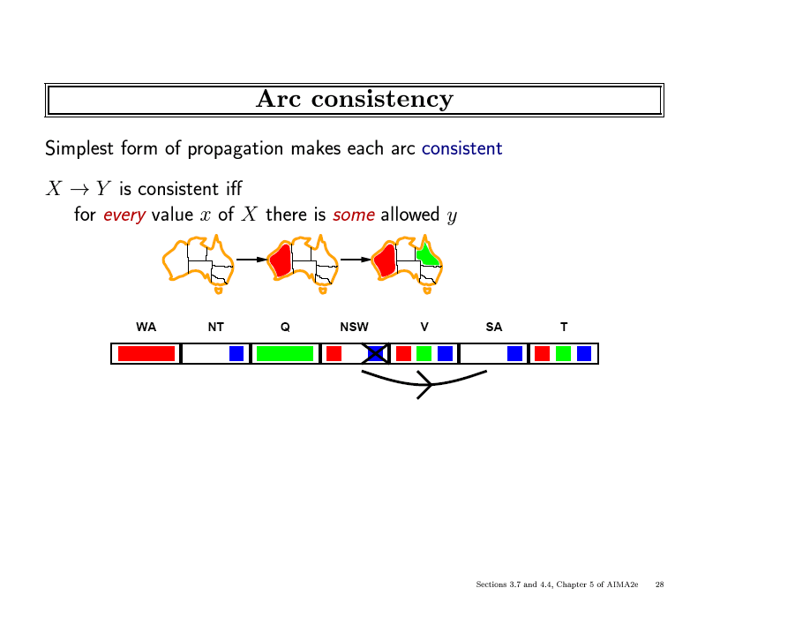

Slide 54
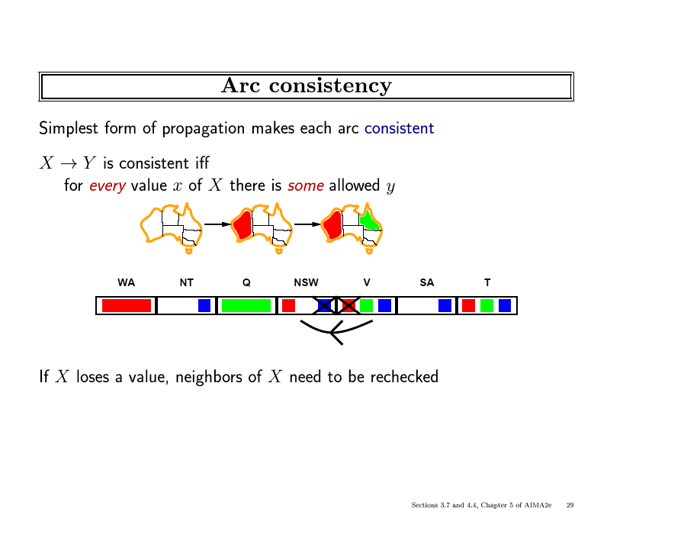

Slide 55
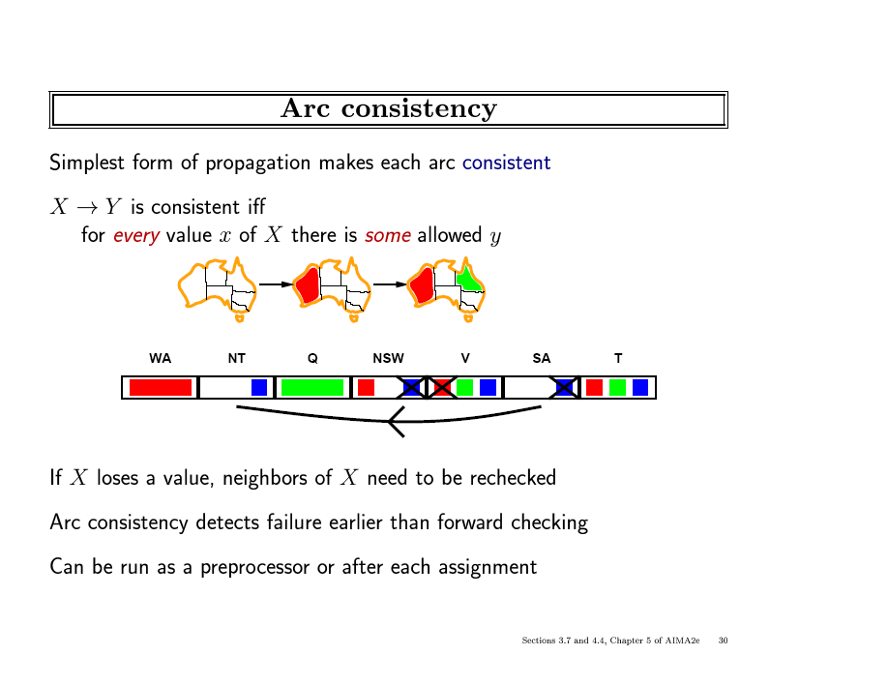

Slide 56
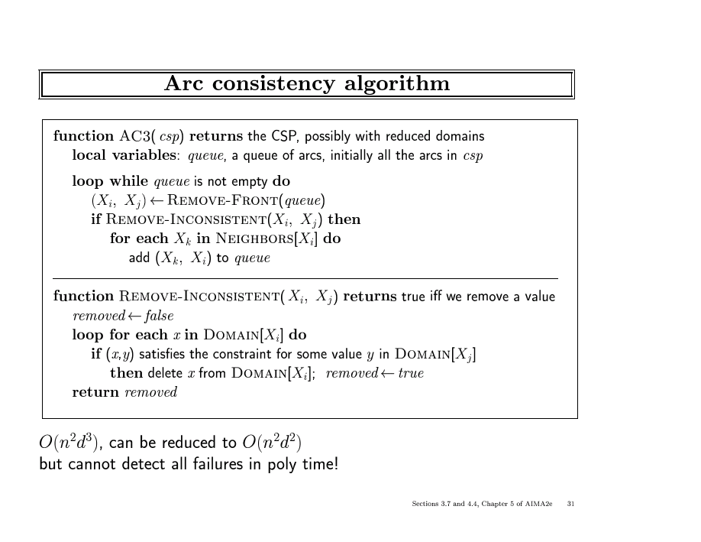

Slide 57

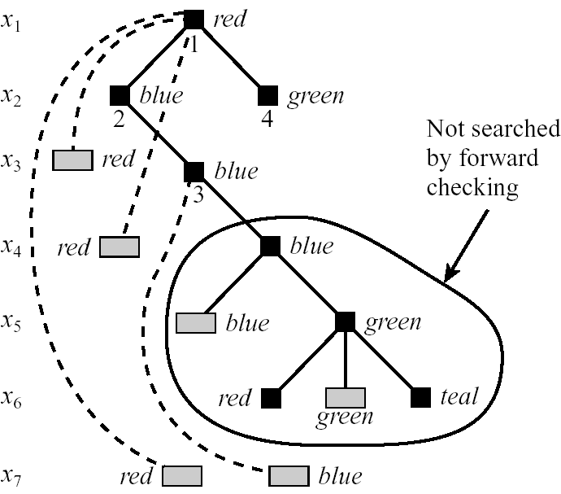
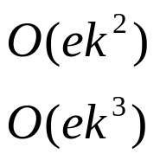
Forward-checking on Graph-coloring
FW overhead:
MAC overhead:

Slide 58



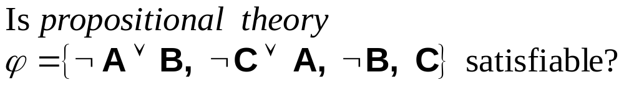
Propositional Satisfiability
Example: party problem
If Alex goes, then Becky goes:
If Chris goes, then Alex goes:
Query:
Is it possible that Chris goes to the party but Becky does not?

Slide 59
Unit Propagation
Arc-consistency for cnfs.
Involve a single clause and a single literal
Example: (A, not B, C) ^ (B) (A,C)

Slide 60
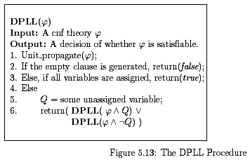
Look-ahead for SAT
(Davis-Putnam, Logeman and Laveland, 1962)

Slide 61
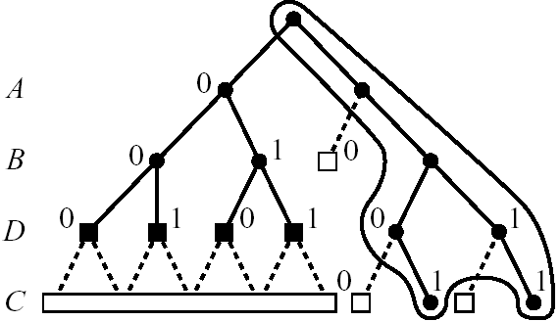
Look-ahead for SAT: DPLL example: (~AVB)(~CVA)(AVBVD)(C)
(Davis-Putnam, Logeman and Laveland, 1962)
Backtracking look-ahead with
Unit propagation=
Generalized arc-consistency
Only enclosed area will be explored with unit-propagation

Slide 62
Look-back:
Backjumping / Learning
Backjumping:
  In deadends, go back to the most recent culprit.
Learning:
  constraint-recording, no-good recording.
  good-recording

Slide 63
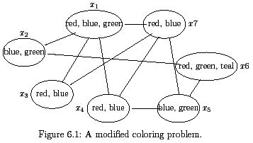

Backjumping
(X1=r,x2=b,x3=b,x4=b,x5=g,x6=r,x7={r,b})
(r,b,b,b,g,r) conflict set of x7
(r,-,b,b,g,-) c.s. of x7
(r,-,b,-,-,-,-) minimal conflict-set
Leaf deadend: (r,b,b,b,g,r)
Every conflict-set is a no-good
Notes:
Radu, can you improve that?

Slide 64
A coloring problem

Slide 65


Example of Gaschnig’s backjump

Slide 66


Slide 67


Slide 68


Slide 69


Slide 70


Slide 71

The cycle-cutset method
An instantiation can be viewed as blocking cycles in the graph
Given an instantiation to a set of variables that cut all cycles (a cycle-cutset) the rest of the problem can be solved in linear time by a tree algorithm.
Complexity (n number of variables, k the domain size and C the cycle-cutset size):

Slide 72
Tree Decomposition

Slide 73


Slide 74


Slide 75


Slide 76
GSAT – local search for SAT
(Selman, Levesque and Mitchell, 1992)
For i=1 to MaxTries
Select a random assignment A
For j=1 to MaxFlips
if A satisfies all constraint, return A
else flip a variable to maximize the score
(number of satisfied constraints; if no variable
assignment increases the score, flip at random)
end
end
Greatly improves hill-climbing by adding
restarts and sideway moves

Slide 77
WalkSAT
(Selman, Kautz and Cohen, 1994)
Adds random walk to GSAT:
With probability p
random walk – flip a variable in some unsatisfied constraint
With probability 1-p
perform a hill-climbing step
Randomized hill-climbing often solves
large and hard satisfiable problems

Slide 78
More Stochastic Search:
Simulated Annealing, reweighting
Simulated annealing:
  A method for overcoming local minimas
  Allows bad moves with some probability:
    With some probability related to a temperature parameter T the next move is picked randomly.
  Theoretically, with a slow enough cooling schedule, this algorithm will find the optimal solution. But so will searching randomly.
Breakout method (Morris, 1990): adjust the weights of the violated constraints

Slide 79


