Slide 1
Notes 6: Constraint Satisfaction Problems
ICS 270A Spring 2003

Slide 2
Summary
The constraint network model
  Variables, domains, constraints, constraint graph, solutions
Examples:
  graph-coloring, 8-queen, cryptarithmetic, crossword puzzles, vision problems,scheduling, design
The search space and naive backtracking,
Line drawing interpretation
Class scheduling
The constraint graph
Approximation consistency enforcing algorithms
  arc-consistency,
  AC-1,AC-3
Backtracking strategies
  Forward-checking, dynamic variable orderings
Special case: solving tree problems

Slide 3

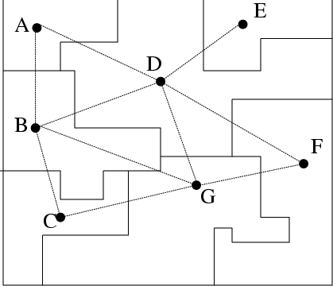
Constraint Satisfaction
Example: map coloring
Variables - countries (A,B,C,etc.)
Values - colors (e.g., red, green, yellow)
Constraints:
A B
red green
red yellow
green red
green yellow
yellow green
yellow red
A
E
D
B
F
G
C

Slide 4
Examples
Cryptarithmetic
  SEND +
  MORE
  = MONEY
n - Queen
Crossword puzzles
Graph coloring problems
Vision problems
Scheduling
Design

Slide 5









A network of binary constraints
Variables
Domains
  of discrete values:
Binary constraints:
  which represent the list of allowed pairs of values, Rij is a subset of the Cartesian product: .
Constraint graph:
  A node for each variable and an arc for each constraint
Solution:
  An assignment of a value from its domain to each variable such that no constraint is violated.
A network of constraints represents the relation of all solutions.

Slide 6






Example 1: The 4-queen problem
Place 4 Queens on a chess board of 4x4 such that no two queens reside in the same row, column or diagonal.
Standard CSP formulation of the problem:
Variables: each row is a variable.
1 2 3 4
Q
Q
Q
Q
Q
Q
Q
Q
Q
Q
Q
Q
Domains:
4
( )
Constraints: There are = 6 constraints involved:
2
Constraint Graph :

Slide 7
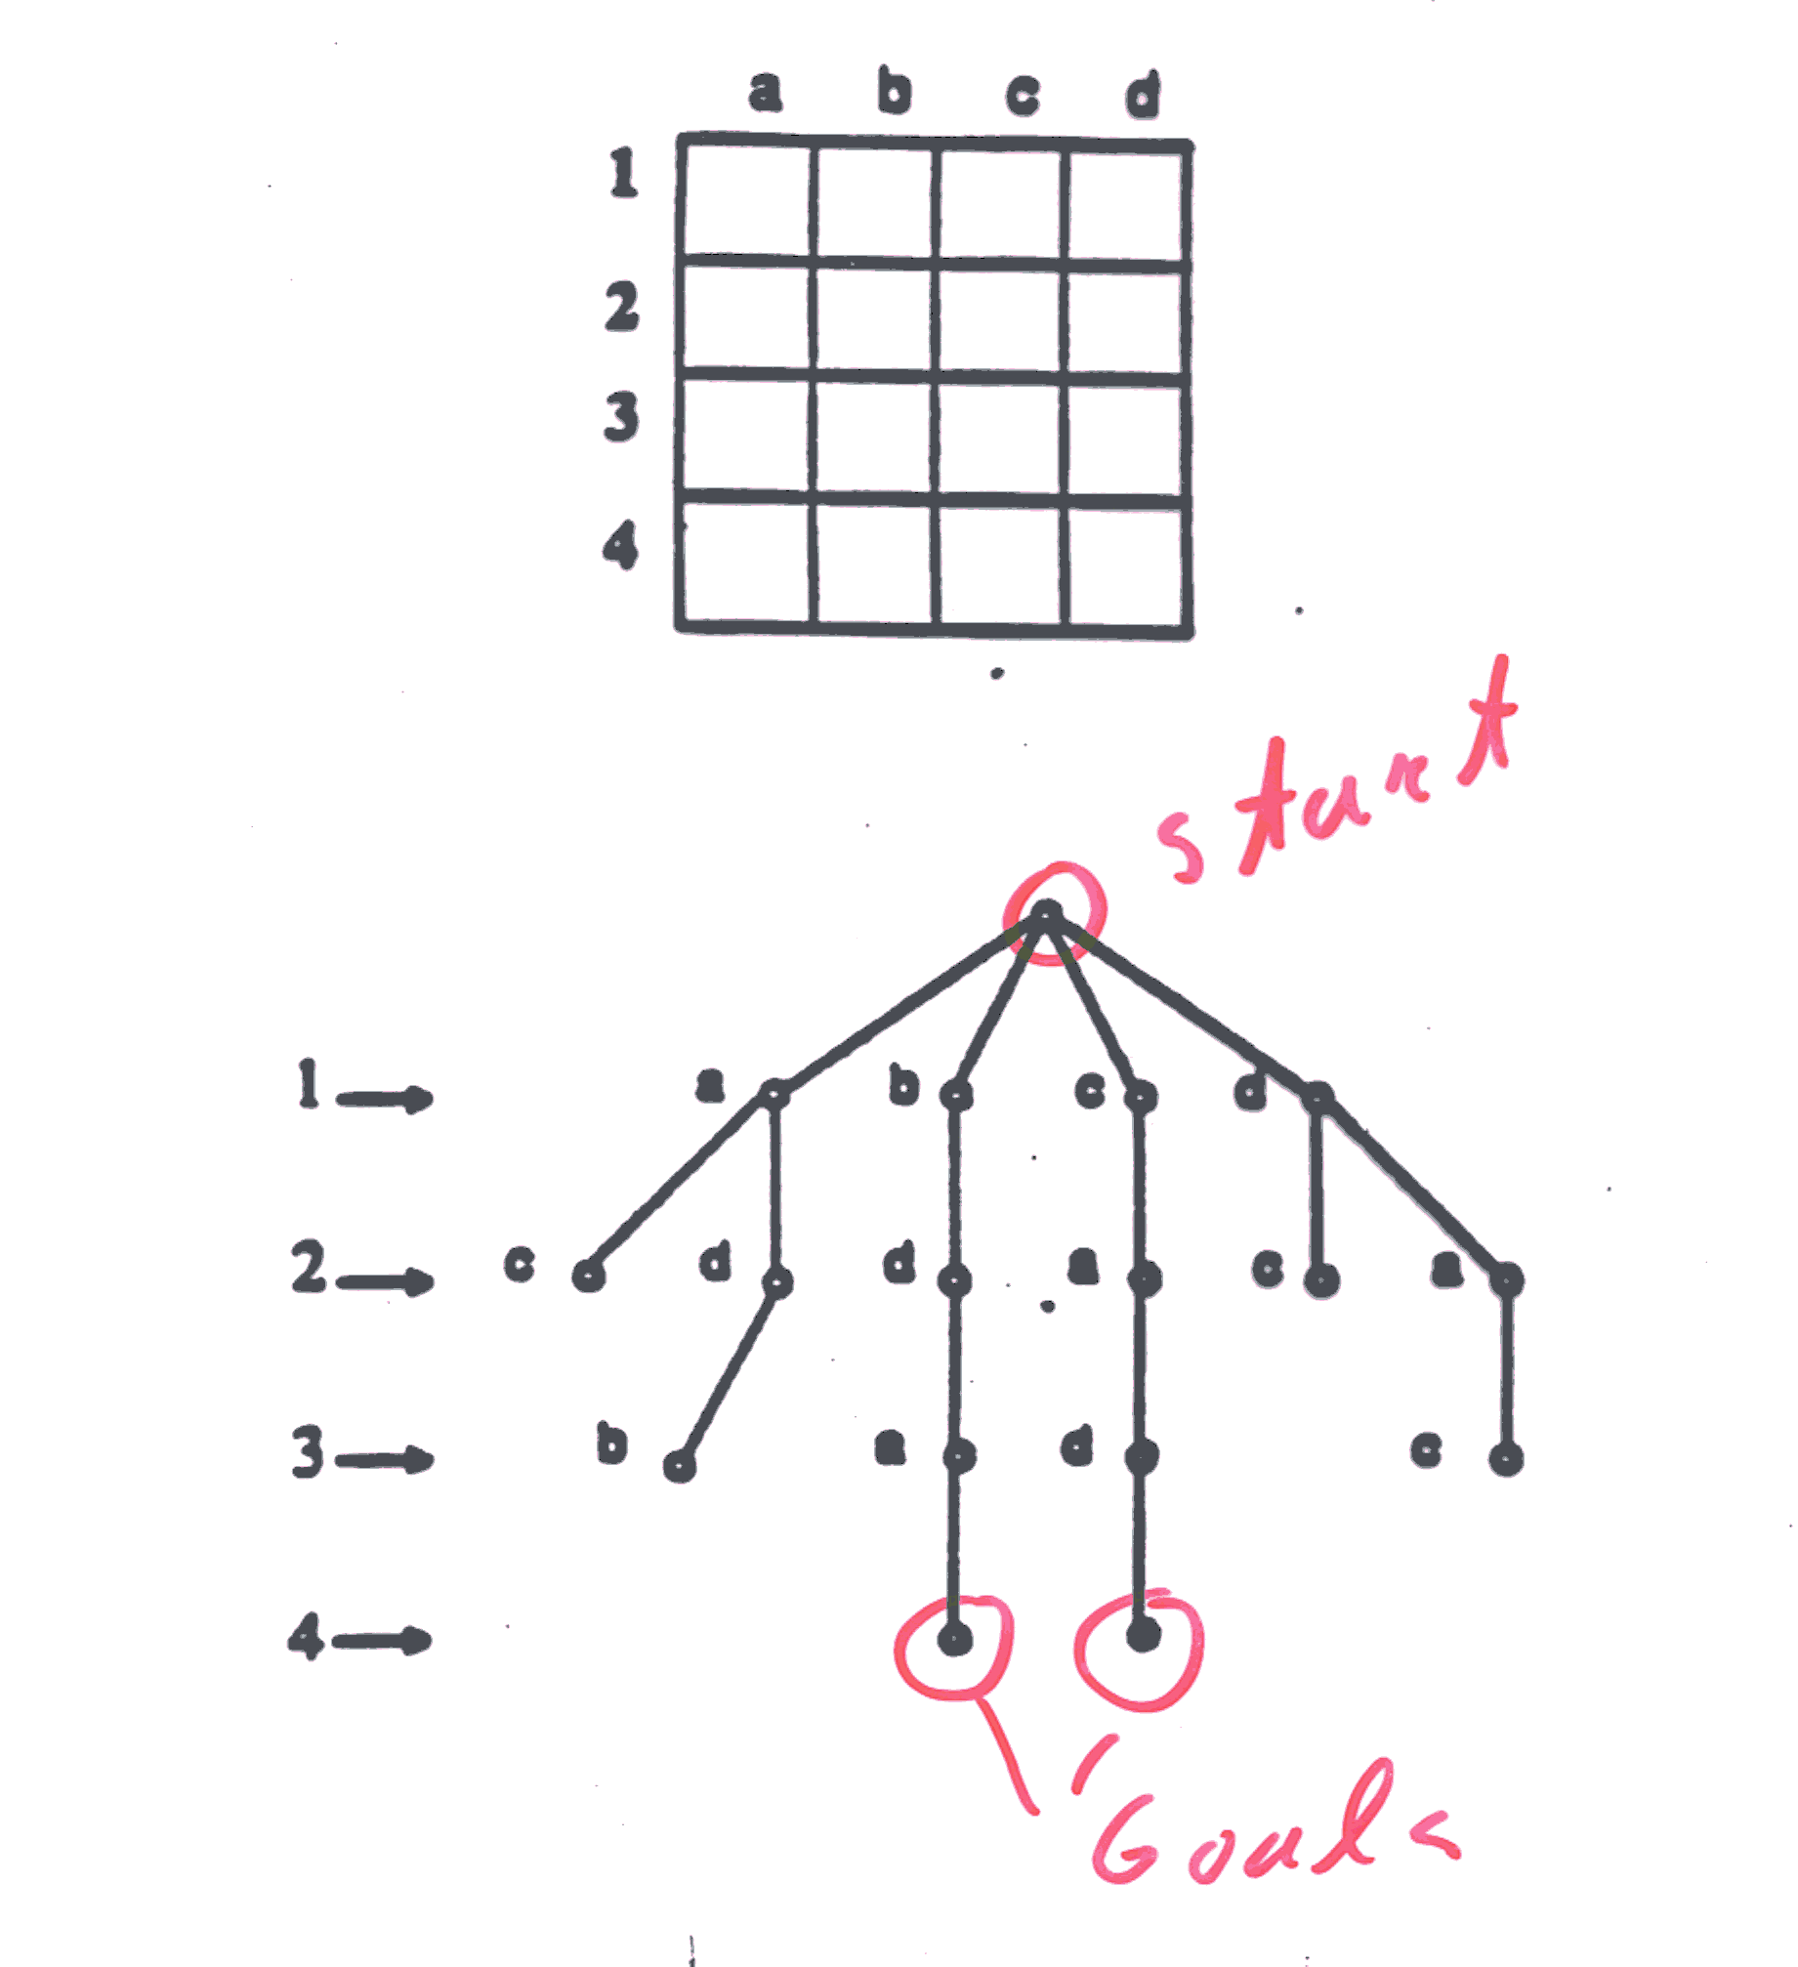
The search tree of the 4-queen problem

Slide 8
The search space
Definition: given an ordering of the variables
  a state:
    is an assignment to a subset of variables that is consistent.
  Operators:
    add an assignment to the next variable that does not violate any constraint.
  Goal state:
    a consistent assignment to all the variables.

Slide 9
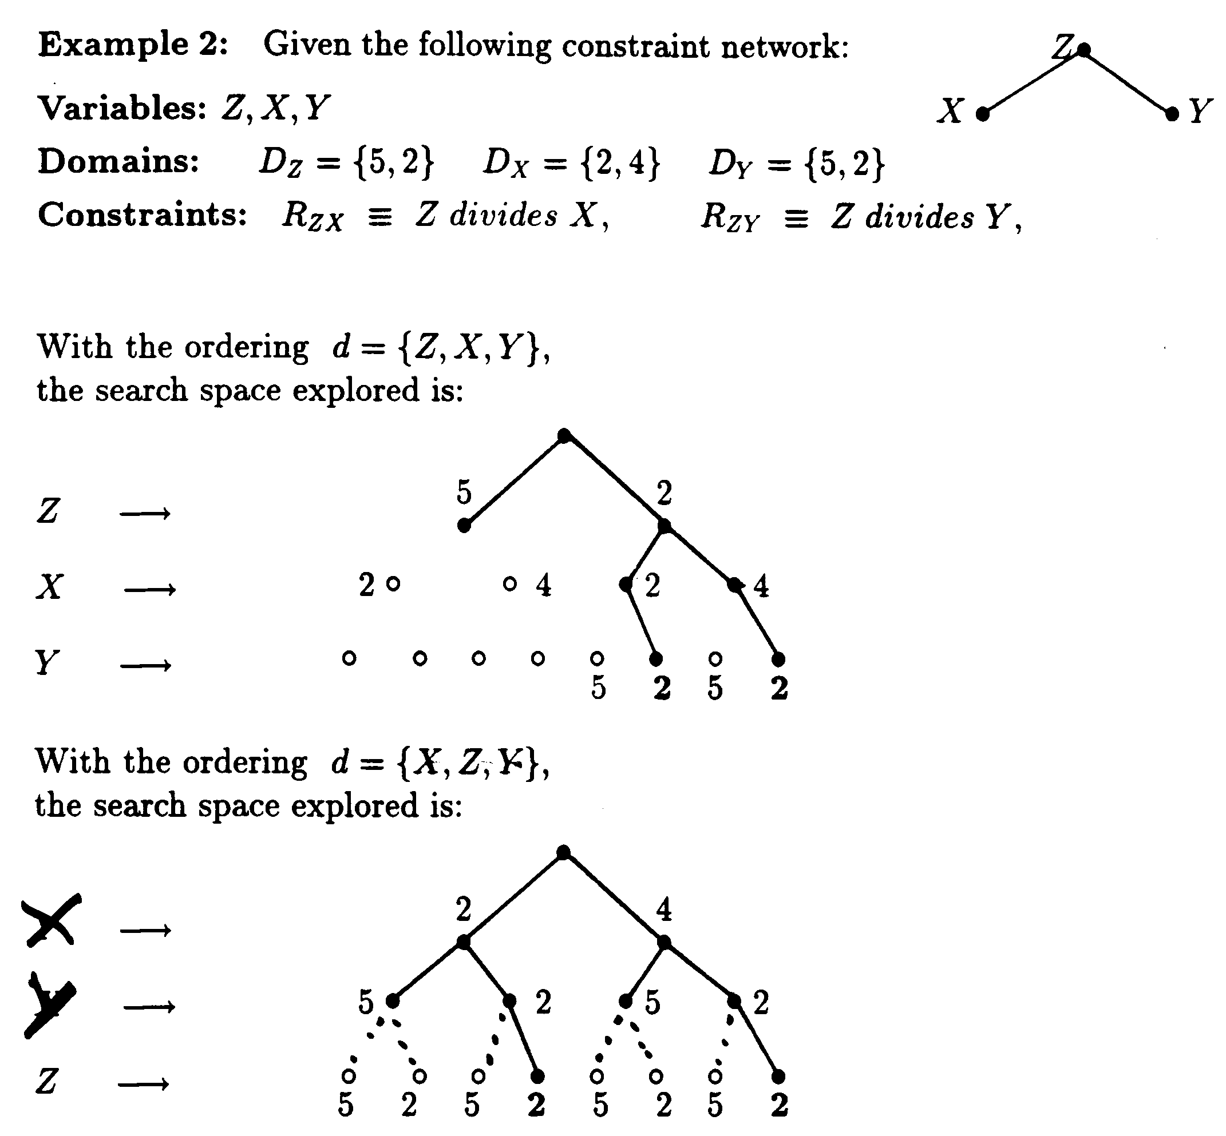
The search space depends on the variable orderings

Slide 10
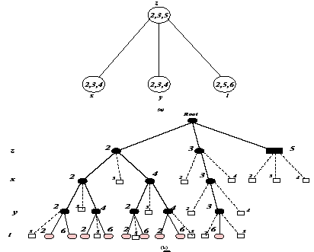
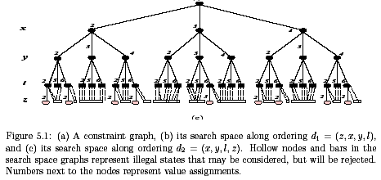
Search space and the effect of ordering

Slide 11
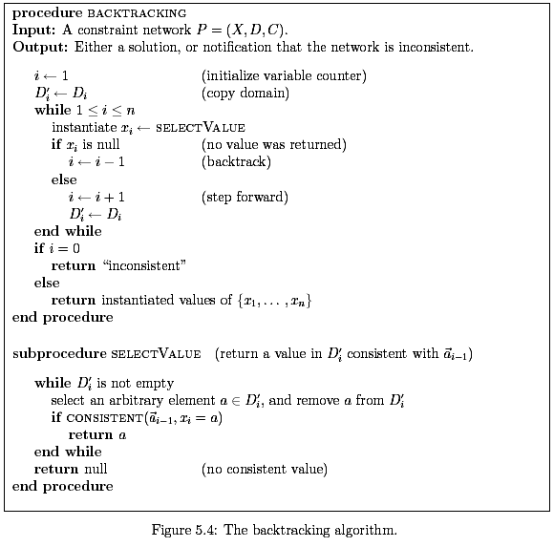

Backtracking
Complexity of extending a partial solution:
  Complexity of consistent O(e log t), t bounds tuples, e constraints
  Complexity of selectvalue O(e k log t)

Slide 12
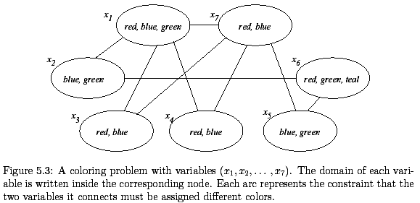
A coloring problem

Slide 13
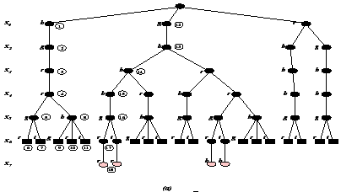
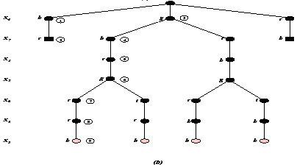
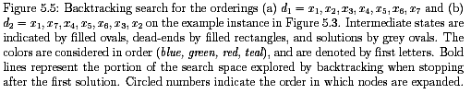
Backtracking search

Slide 14
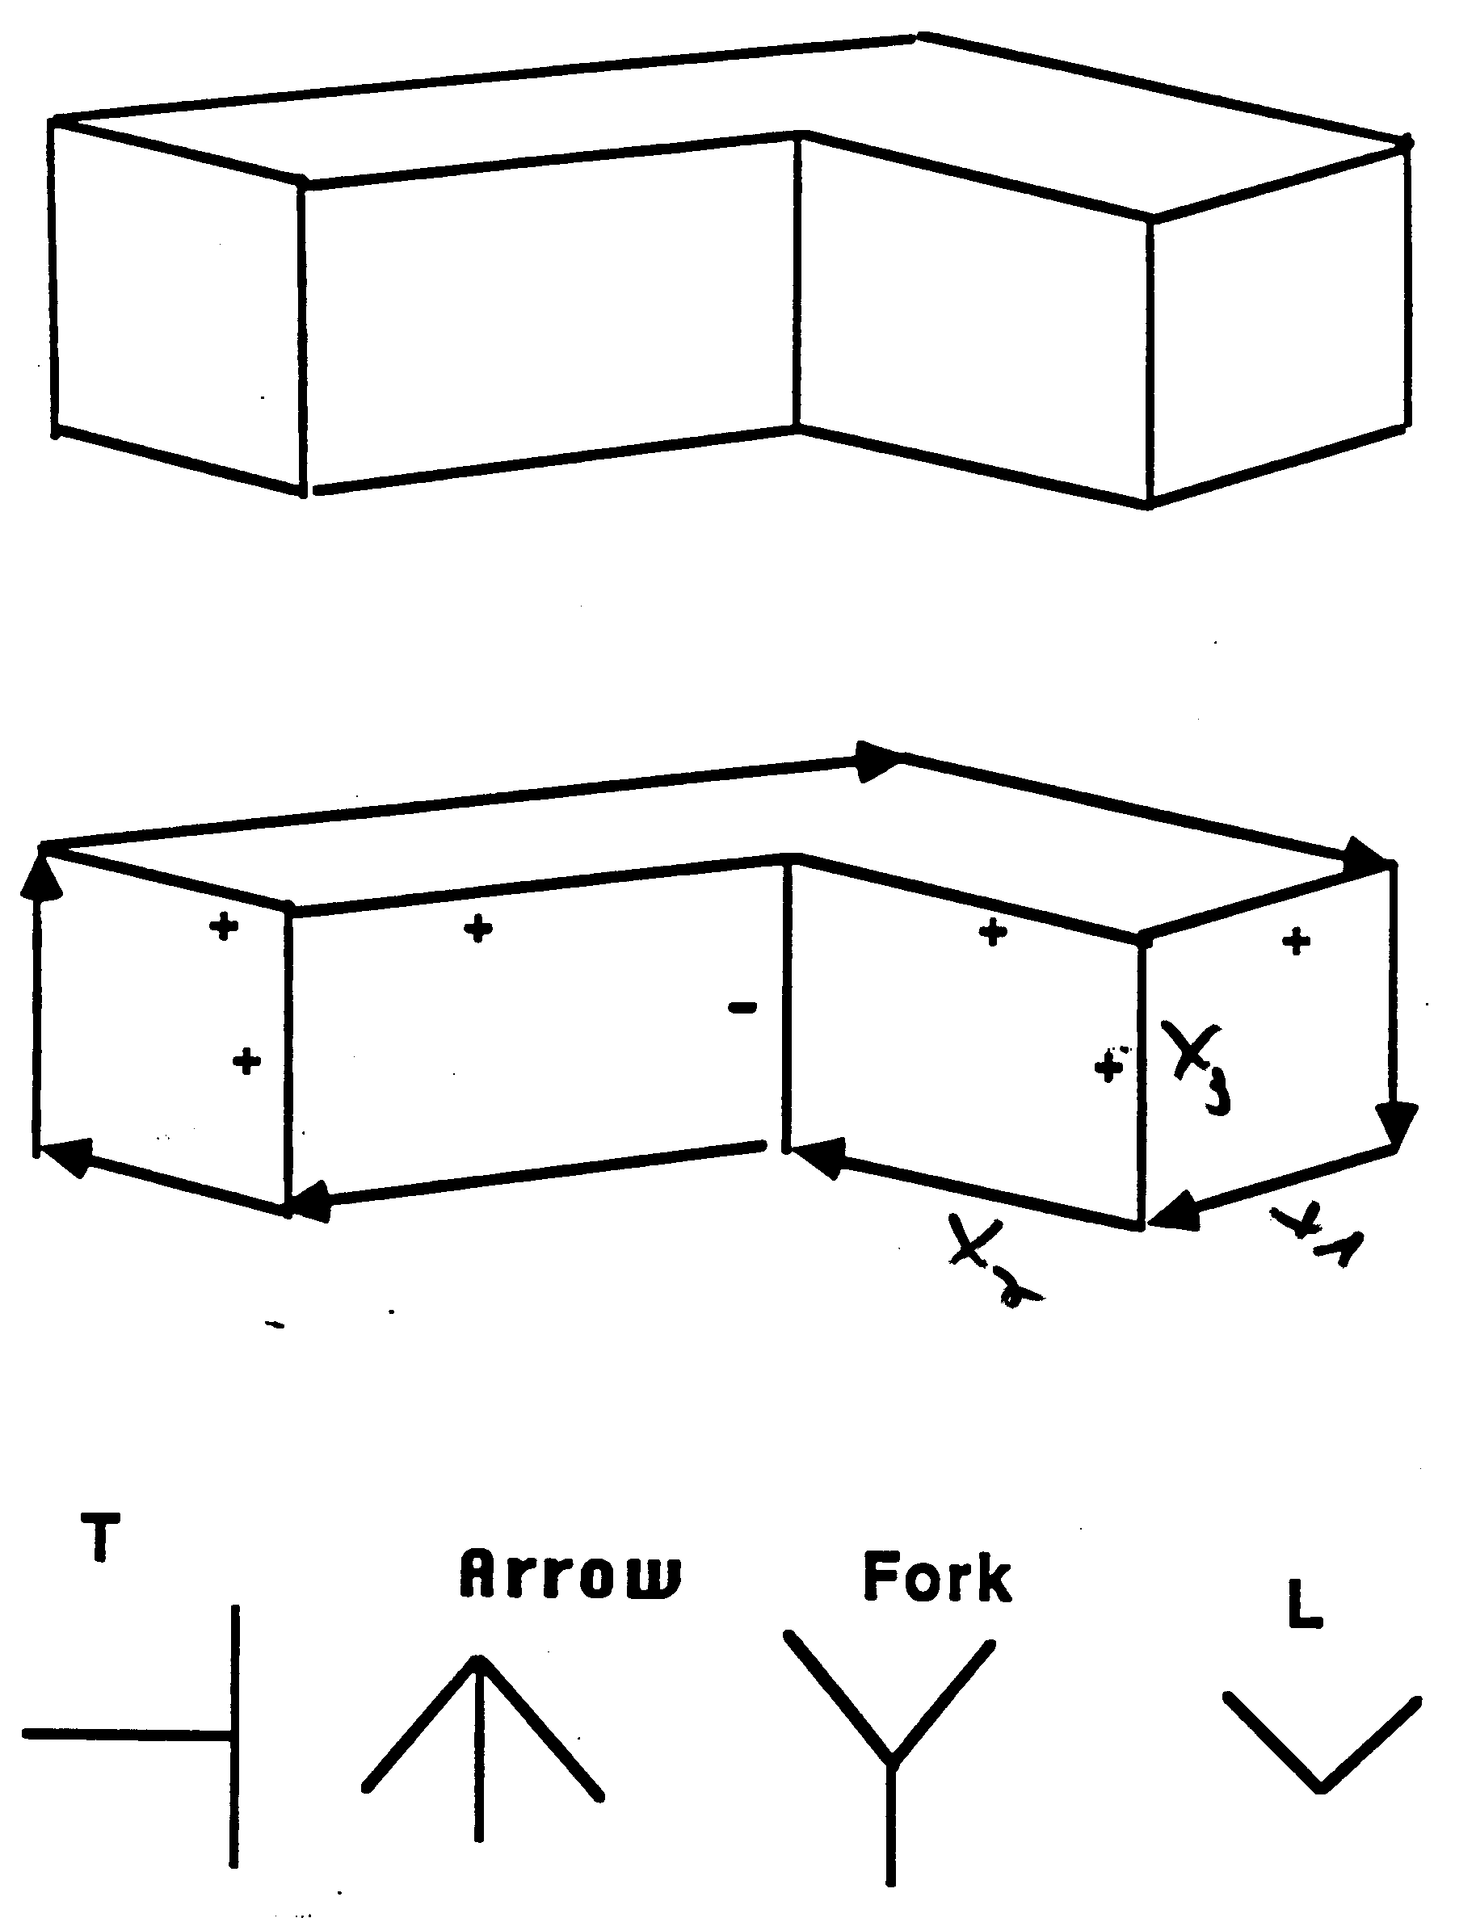
Line drawing Interpretations

Slide 15
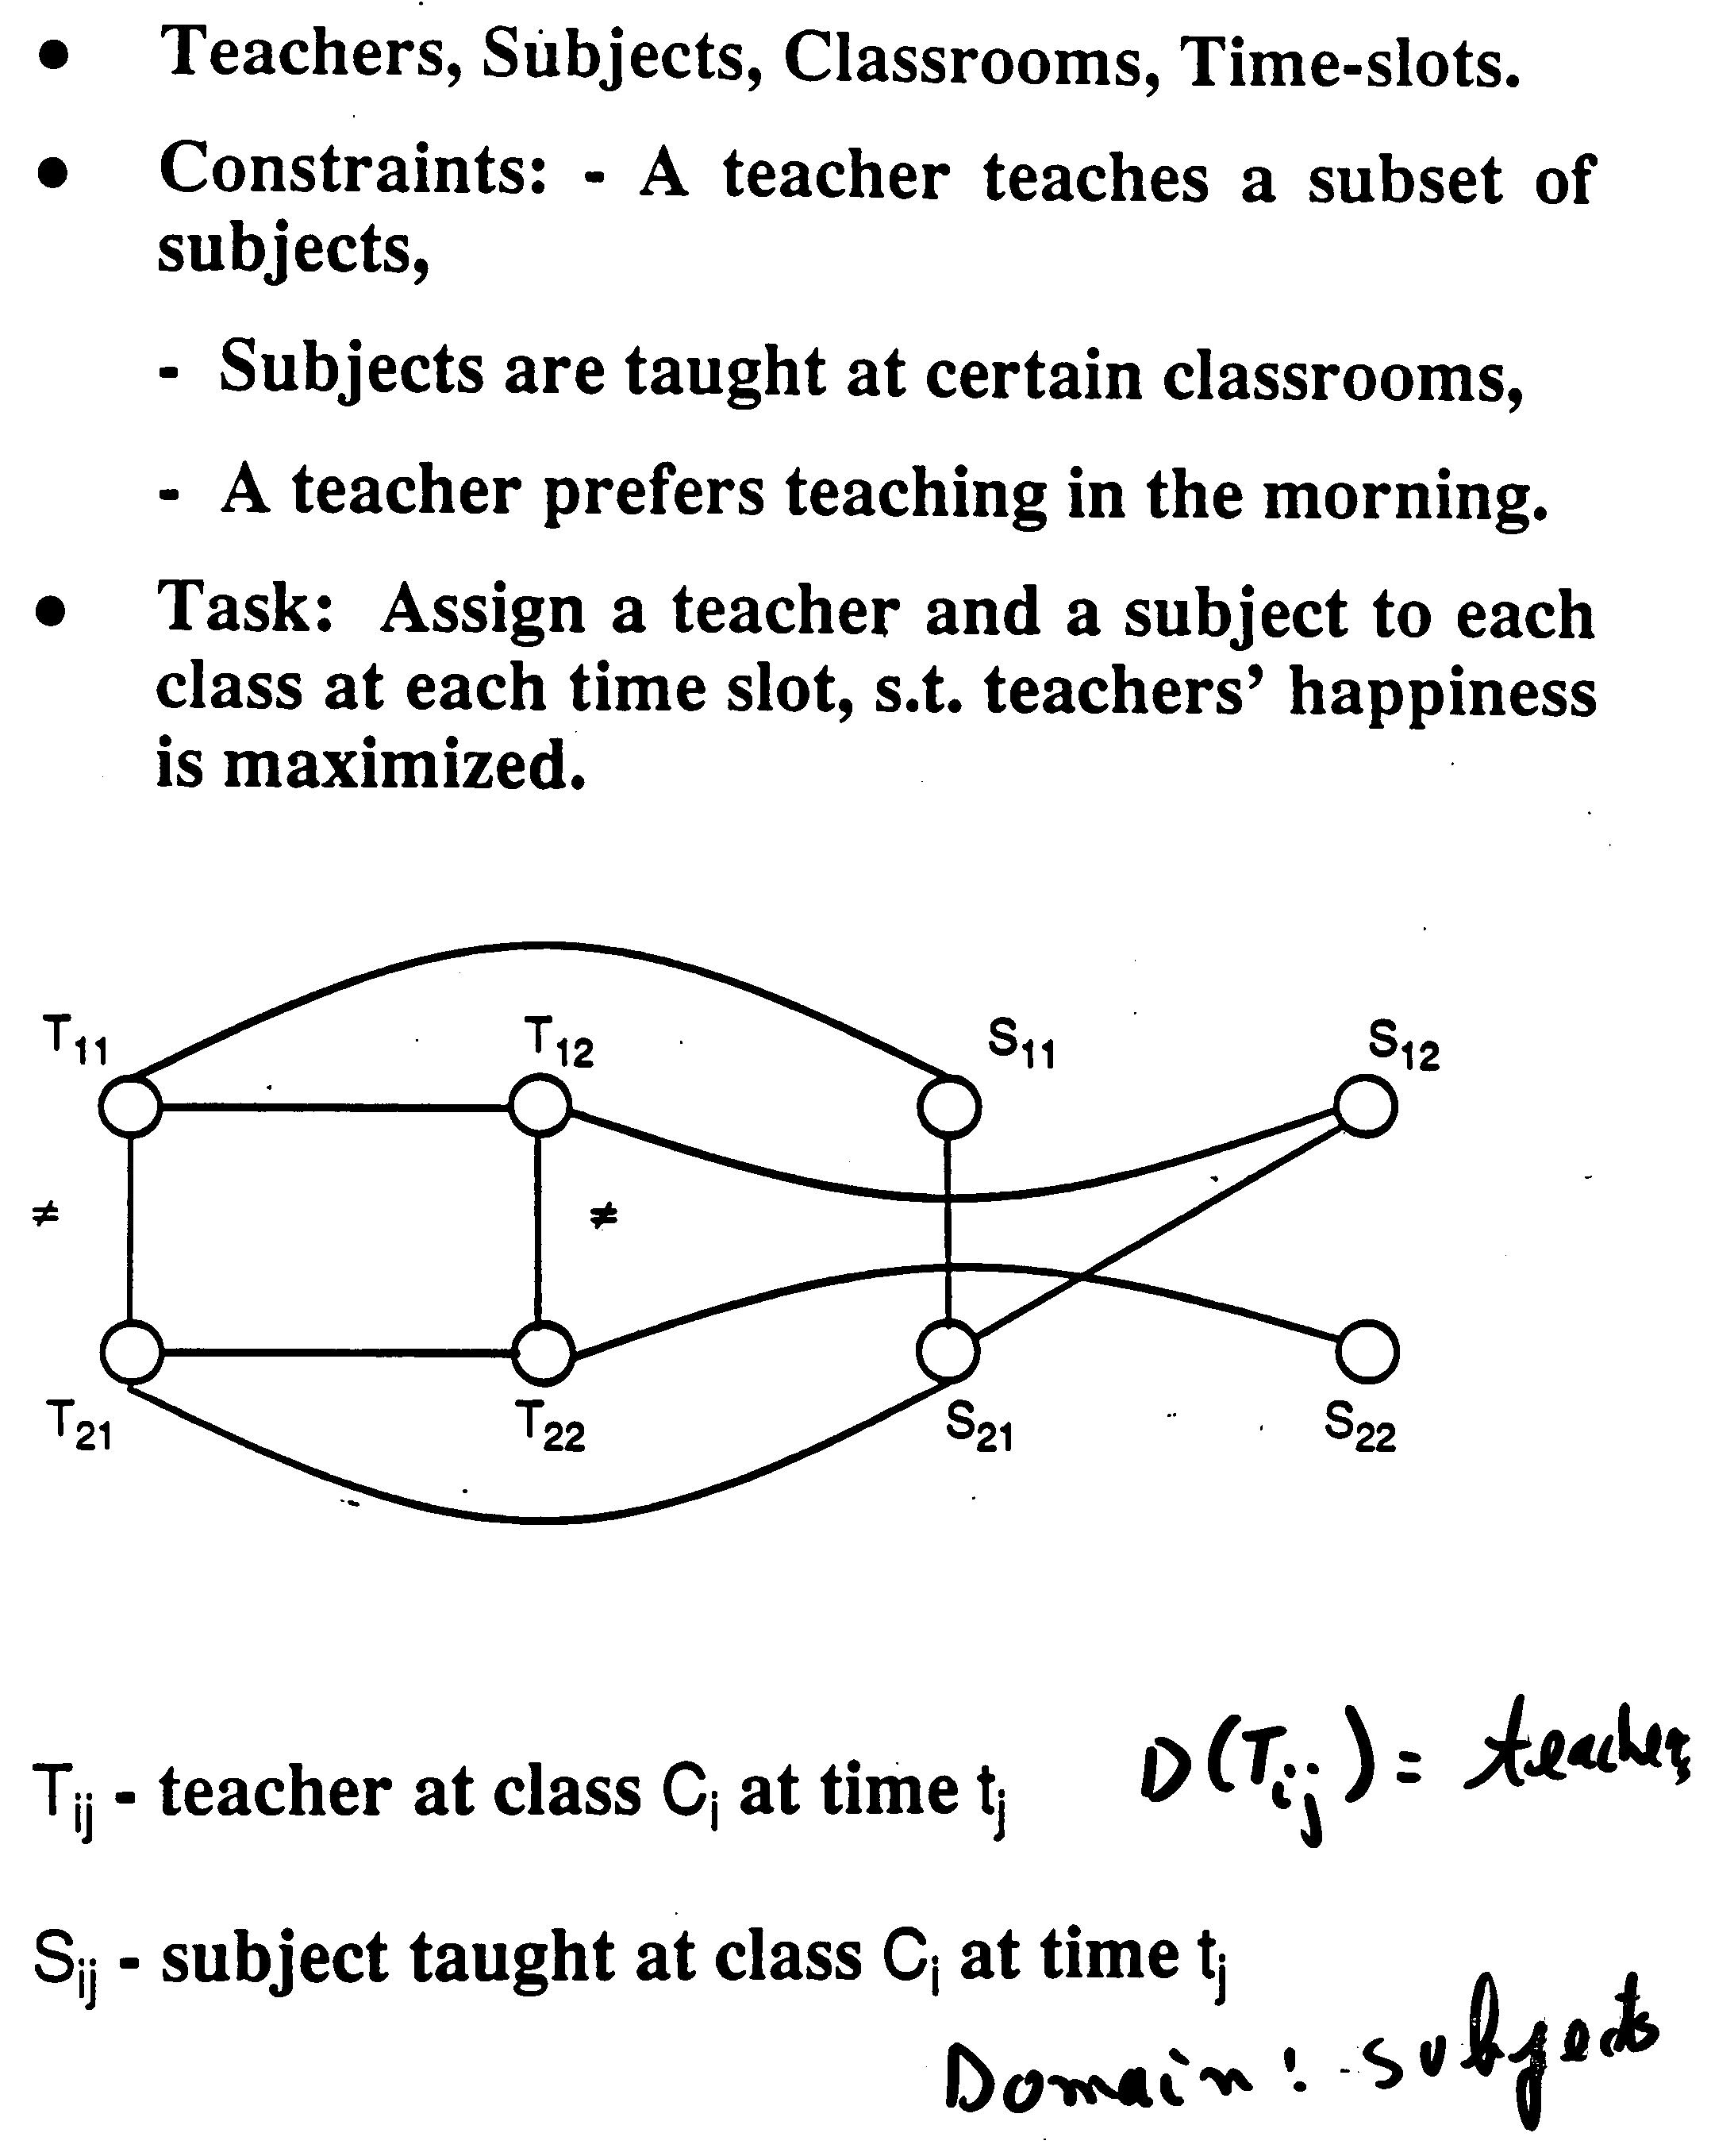
Class scheduling

Slide 16
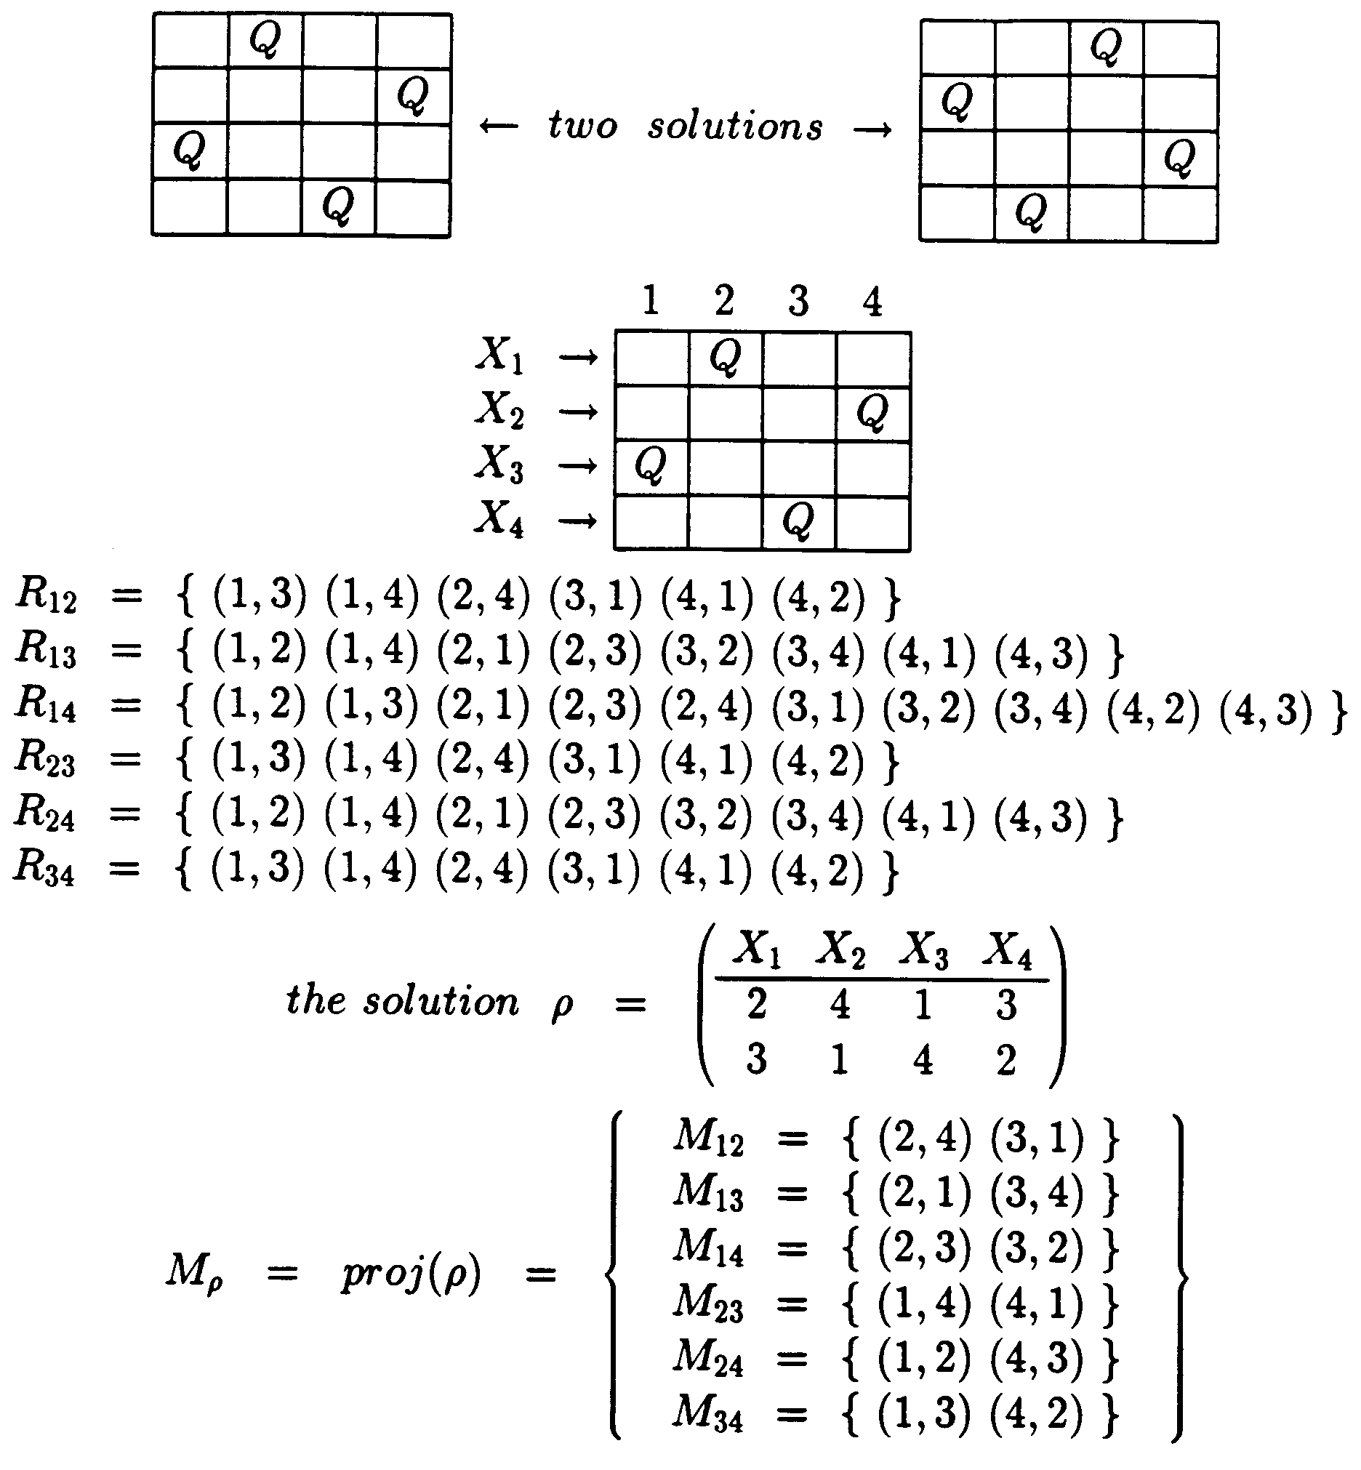
The Minimal network:
Example: the 4-queen problem

Slide 17
Approximation algorithms
Arc-consistency (Waltz, 1972)
Path-consistency (Montanari 1974, Mackworth 1977)
I-consistency (Freuder 1982)
Transform the network into smaller and smaller networks.

Slide 18
Arc-consistency
X
Y
<
1,
2,
3
1,
2,
3
1 ≤ X, Y, Z, T ≤ 3
X < Y
Y = Z
T < Z
X ≤ T
∧
=
1,
2,
3
<
1,
2,
3
T
Z

Slide 19
Arc-consistency
X
Y
<
1
3
1 ≤ X, Y, Z, T ≤ 3
X < Y
Y = Z
T < Z
X ≤ T
∧
=
2
<
3
T
Z
Incorporated into backtracking search
Constraint programming languages powerful approach for modeling and solving combinatorial optimization problems.

Slide 20



Arc-consistency algorithm
domain of x domain of y
Arc is arc-consistent if for any value of there exist a matching value of
Algorithm Revise makes an arc consistent
Begin
1. For each a in D_{i} if there is no value b in D_{i} that matches a then delete a from the D_{j}.
End.
Revise is , k is the number of value in each domain.

Slide 21






Algorithms for arc-consistency
A network is arc-consistent if all its arcs are arc-consistent
AC-1
begin
1. until there is no change do
2. For every directed arc (X,Y)
Revise(X,Y)
end
Complexity: , e is the number of arcs, n number of variables, k is the domain size.
Mackworth and Freuder, 1986 showed an algorithm
Mohr and Henderson, 1986:

Slide 22


Algorithm AC-3
Complexity
Begin
  1. Q <--- put all arcs in the queue in both directions
  2. While Q is not empty do,
  3. Select and delete an arc from the queue Q
    4. Revise
    5. If Revise cause a change then add to the queue all arcs that touch X_{i} (namely (X_{i},X_{m}) and (X_{l},X_{i})).
  6. end-while
end
Processing an arc requires O(k^2) steps
The number of times each arc can be processed is 2·k
Total complexity is

Slide 23
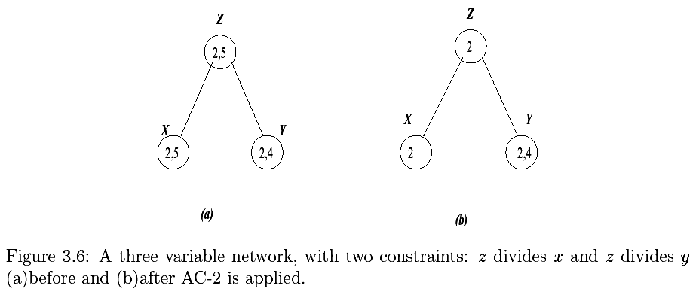
Example applying AC-3

Slide 24
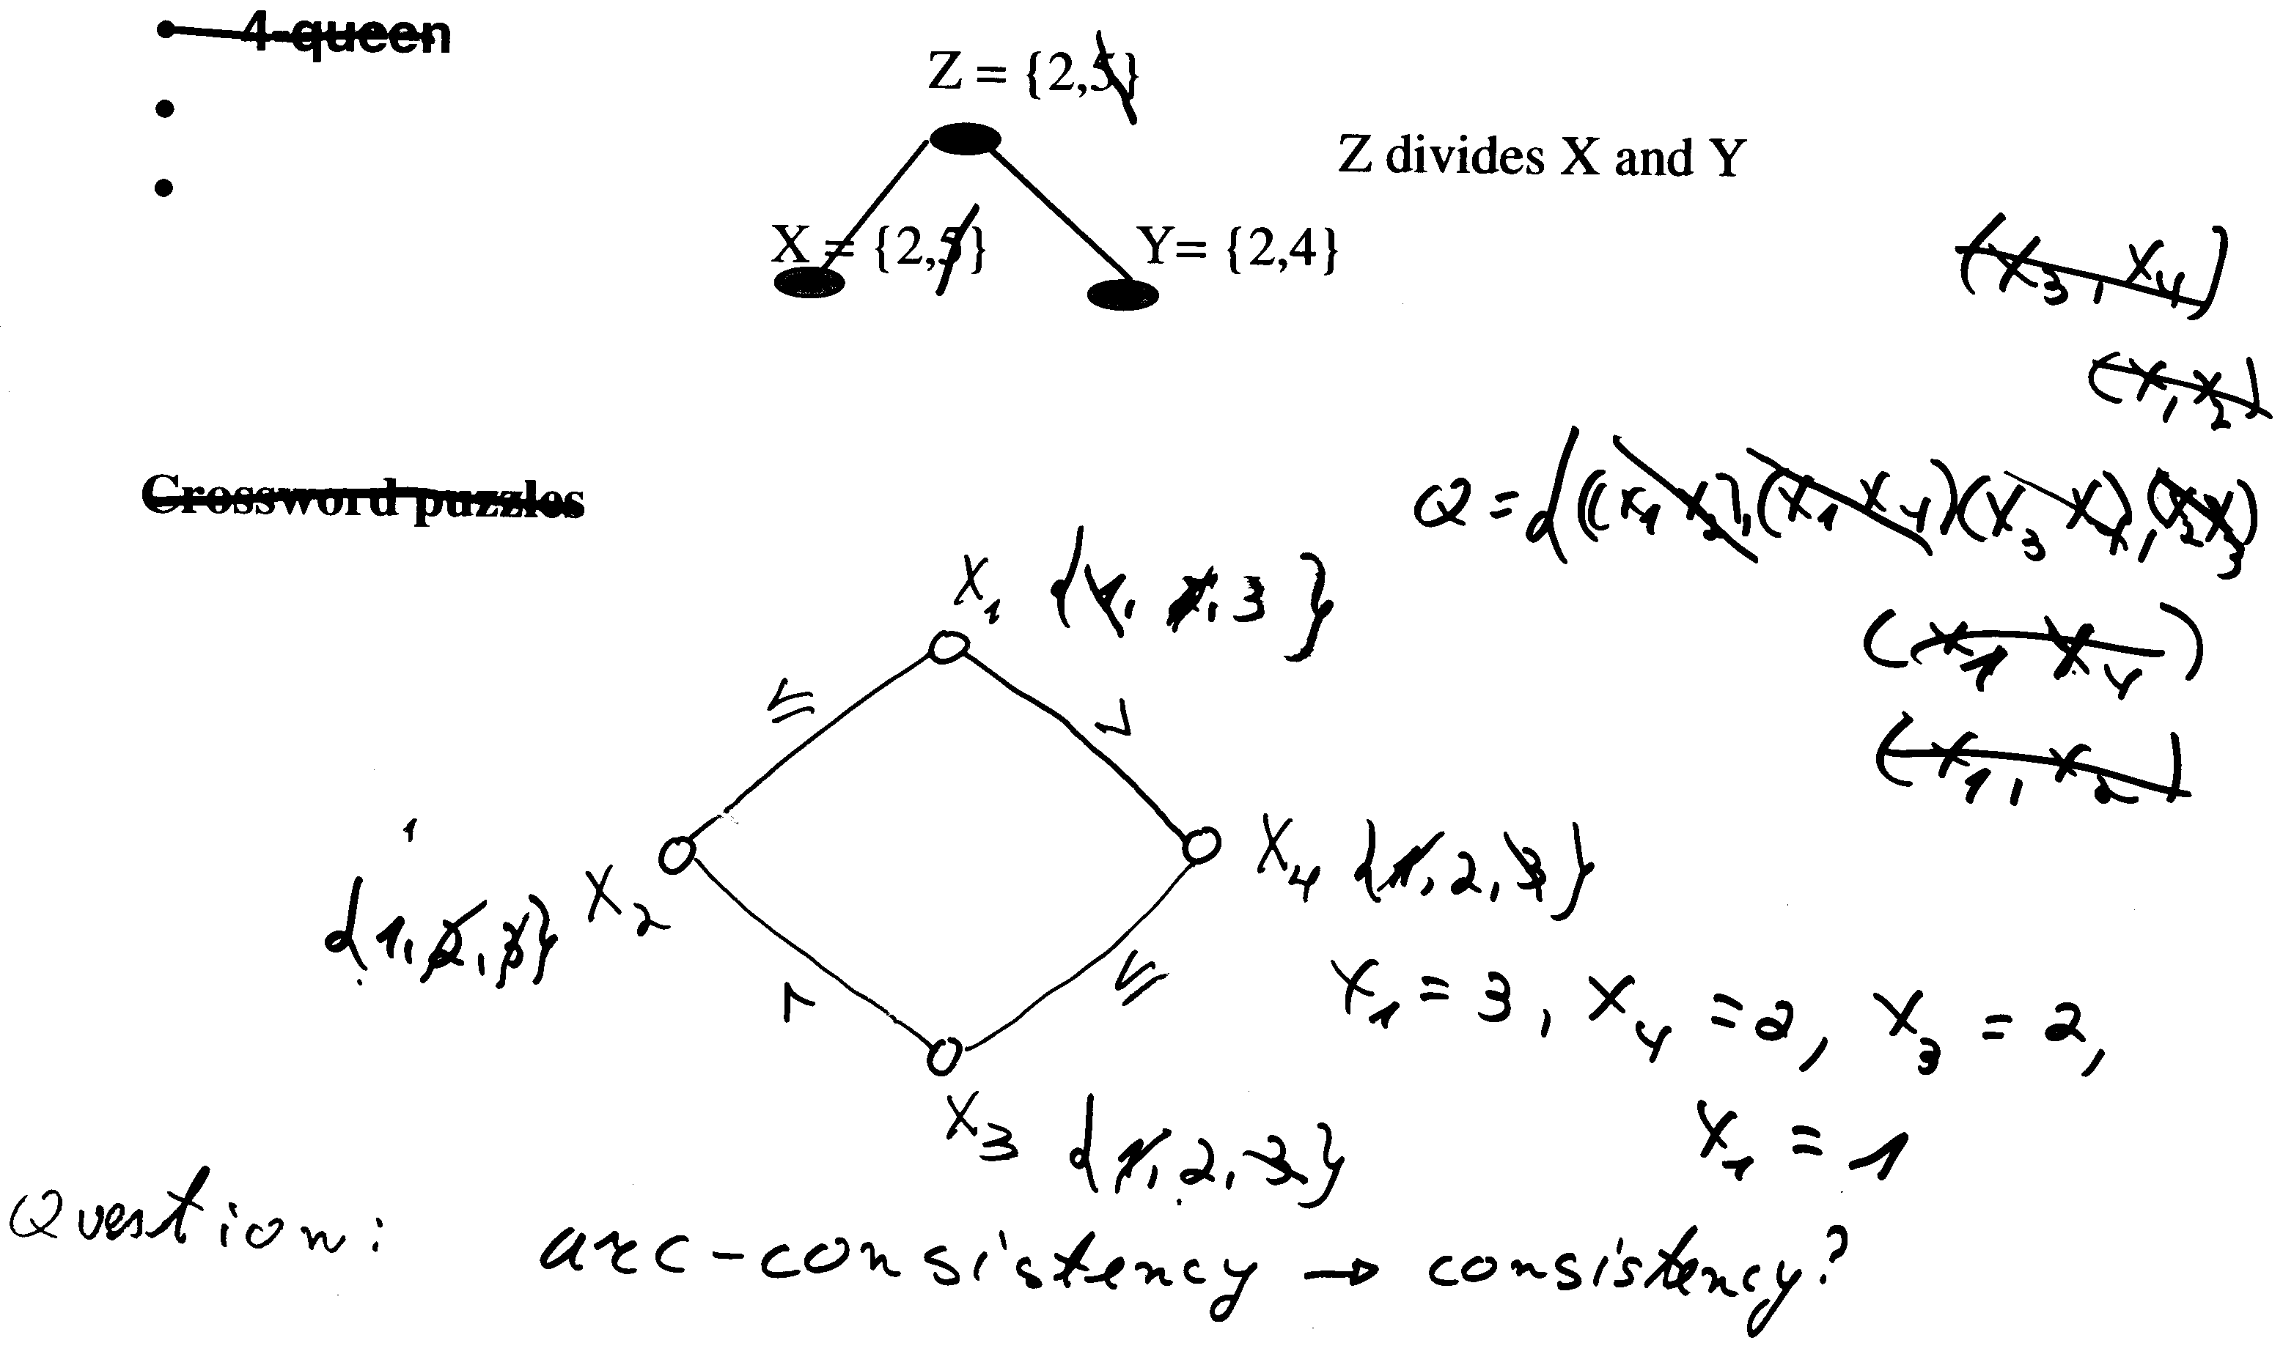
Examples of AC-3

Slide 25
Improving backtracking
Before search: (reducing the search space)
  Arc-consistency, path-consistency
  Variable ordering (fixed)
During search:
  Look-ahead schemes:
    value ordering,
    variable ordering (if not fixed)
  Look-back schemes:
    Backjump
    Constraint recording
    Dependency-directed backtacking

Slide 26
Look-ahead: value orderings
Intuition:
  Choose value least likely to yield a dead-end
  Approach: apply propagation at each node in the search tree
Forward-checking
  (check each unassigned variable separately
Maintaining arc-consistency (MAC)
  (apply full arc-consistency)
Full look-ahead
  One pass of arc-consistency (AC-1)
Partial look-ahead
  directional-arc-consistency

Slide 27
Backtracking
Complexity of extending a partial solution:
  Complexity of consistent O(e log t), t bounds tuples, e constraints
  Complexity of selectvalue O(e k log t)

Slide 28
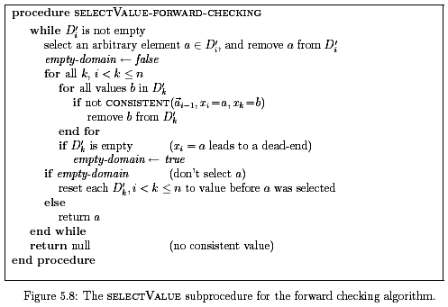
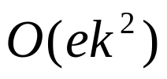
Forward-checking
Complexity of selectValue-forward-checking at each node:

Slide 29
A coloring problem

Slide 30
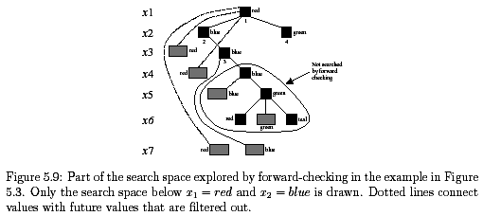

Forward-checking on graph coloring

Slide 31
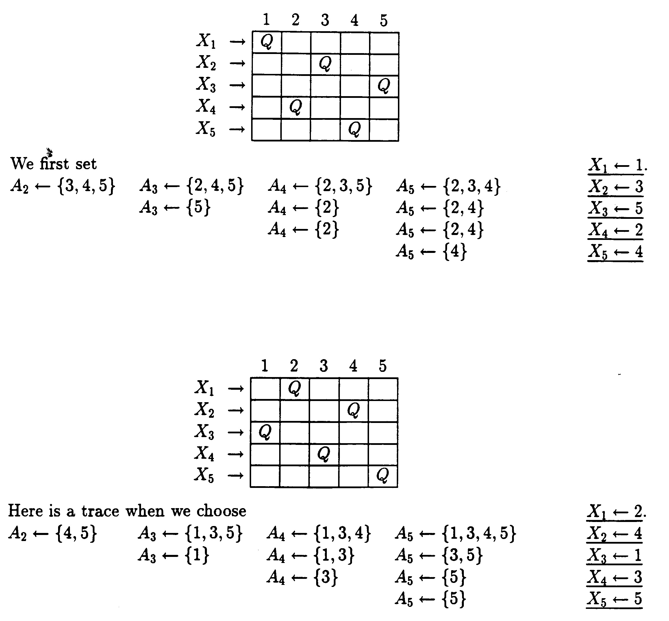
Example 5-queen

Slide 32
Dynamic value ordering (LVO)
Use constraint propagation to rank order the promise in non-rejected values.
Example: look-ahead value ordering (LVO) is based of forward-checking propagation
LVO uses a heuristic measure to transform this information to ranking of the values
Empirical work shows the approach is cost-effective only for large and hard problems.

Slide 33
Look-ahead: variable ordering
Dynamic search rearangement (Bitner and Reingold, 1975)(Purdon,1983):
  Choose the most constrained variable
  Intuition: early discovery of dead-ends

Slide 34
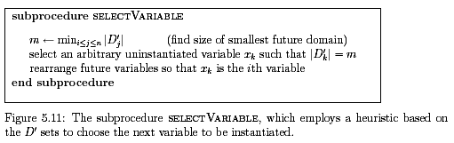
DVO

Slide 35
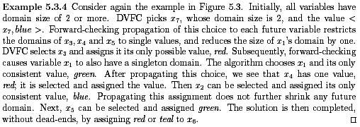
Example: DVO with forward checking (DVFC)

Slide 36
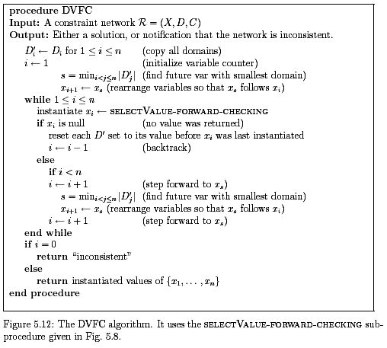
Algorithm DVO (DVFC)

Slide 37


Implementing look-aheads
Cost of node generation should be reduced
Solution: keep a table of viable domains for each variable and each level in the tree.
Space complexity
Node generation = table updating

Slide 38
Look-back: backjumping
Backjumping: Go back to the most recently culprit.
Learning: constraint-recording, no-good recording.

Slide 39
A coloring problem

Slide 40
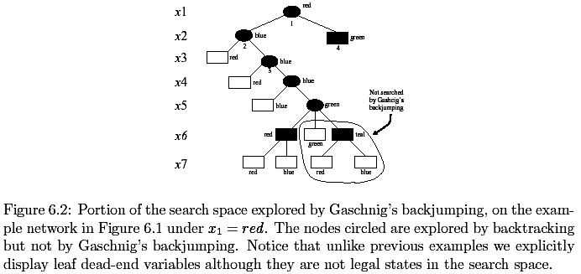
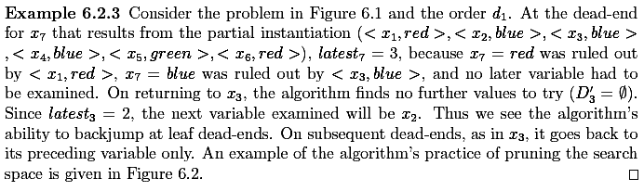
Example of Gaschnig’s backjump

Slide 41
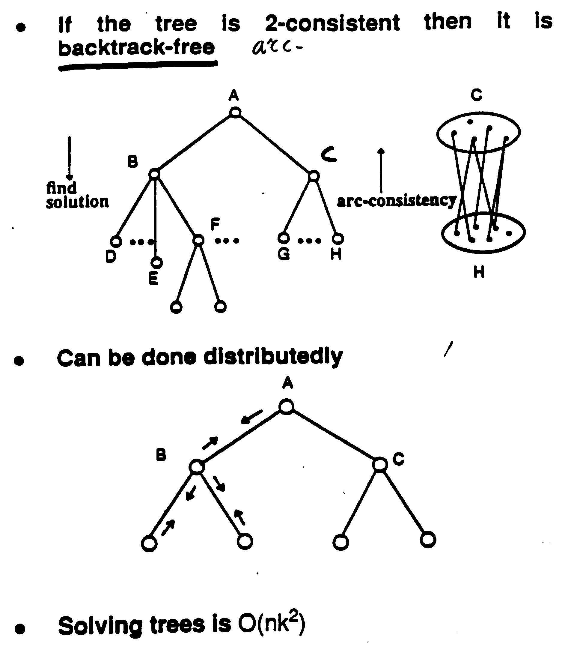
Solving trees

Slide 42
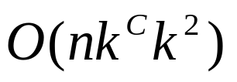
The cycle-cutset method
An instantiation can be viewed as blocking cycles in the graph
Given an instantiation to a set of variables that cut all cycles (a cycle-cutset) the rest of the problem can be solved in linear time by a tree algorithm.
Complexity (n number of variables, k the domain size and C the cycle-cutset size):

Slide 43



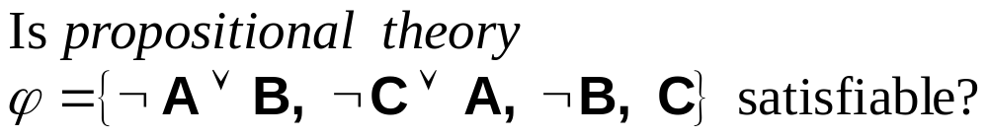
Propositional Satisfiability
Example: party problem
If Alex goes, then Becky goes:
If Chris goes, then Alex goes:
Query:
Is it possible that Chris goes to the party but Becky does not?

Slide 44
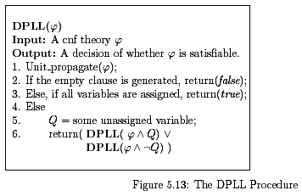
Look-ahead for SAT
(Davis-Putnam, Logeman and Laveland, 1962)

Slide 45
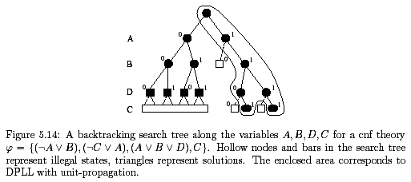
Example of DPLL

Slide 46
Approximating Conditioning:
Local Search
Problem: complete (systematic, exhaustive) search can be intractable (O(exp(n)) worst-case)
Approximation idea: explore only parts of search space
Advantages: anytime answer; may “run into” a solution quicker than systematic approaches
Disadvantages: may not find an exact solution even if there is one; cannot detect that a problem is unsatisfiable

Slide 47
Simple “greedy” search
1. Generate a random assignment to all variables
2. Repeat until no improvement made or solution found:
// hill-climbing step
3. flip a variable (change its value) that
increases the number of satisfied constraints
Easily gets stuck at local maxima

Slide 48
GSAT – local search for SAT
(Selman, Levesque and Mitchell, 1992)
For i=1 to MaxTries
Select a random assignment A
For j=1 to MaxFlips
if A satisfies all constraint, return A
else flip a variable to maximize the score
(number of satisfied constraints; if no variable
assignment increases the score, flip at random)
end
end
Greatly improves hill-climbing by adding
restarts and sideway moves

Slide 49
WalkSAT
(Selman, Kautz and Cohen, 1994)
Adds random walk to GSAT:
With probability p
random walk – flip a variable in some unsatisfied constraint
With probability 1-p
perform a hill-climbing step
Randomized hill-climbing often solves
large and hard satisfiable problems

Slide 50
Other approaches
Different flavors of GSAT with randomization (GenSAT by Gent and Walsh, 1993; Novelty by McAllester, Kautz and Selman, 1997)
Simulated annealing
Tabu search
Genetic algorithms
Hybrid approximations:
elimination+conditioning

Slide 51
Iterative Improvement search
A greedy algorithm for finding a solution
A different search space:
  States: value assignment to all the variables (e.g., an assignment of a queen in every raw)
  Operators: change the assignment of one variable
  An evaluation function: determines the value of a state: Number of violated constraints.
Algorithm:
  move from current state to the state that maximize the improvement in the evaluation function (also called metric and heuristic function).
To overcome local minima, plateau, etc. do random restarts.
Examples:
  Traveling Salesperson
  N-queen
  Class scheduling
  Boolean satisfiability.

Slide 52
Stochastic Search:
Simulated annealing, Walksat, rewighting
Simulated annealing:
  A method for overcoming local minimas
  Allows bad moves with some probability:
    With some probability related to a temperature parameter T the next move is picked randomly.
  Theoretically, with a slow enough cooling schedule, this algorithm will find the optimal solution. But so will searching randomly.
Walksat (Kautz and Selman, 1992), just take random walks from time to time
Breakout method (Morris, 1990): adjust the weights of the violated constraints

Slide 53
Summary
The constraint network model
  Variables, domains, constraints, constraint graph, solutions
Examples:
  graph-coloring, 8-queen, cryptarithmetic, crossword puzzles, vision problems,scheduling, design
The search space and naive backtracking,
Line drawing interpretation
Class scheduling
The constraint graph
Approximation consistency enforcing algorithms
  arc-consistency,
  AC-1,AC-3
Backtracking strategies
  Forward-checking, dynamic variable orderings
Special case: solving tree problems
Iterative improvement methods.
Reading: Russel and Norvig chapter 5, Nillson ch. 11, and class notes.

