Slide 1
Project McNulty – Claim Classification
BNP Paribas Cardif Kaggle Challenge
Feature Selection or Random Forest?
Ozzie Liu

Slide 2
Project McNulty
Classification with supervised learning methods

Slide 3

BNP Paribas Cardif Kaggle Challenge
Kagglers are challenged to predict the category of a claim based on anonymized features available early in the claim management process, helping BNP Paribas Cardif accelerate its claims process and therefore provide a better service to its customers.
Classification
claims for which approval could be accelerated leading to faster payments
claims for which additional information is required before approval
Notes:
Goal of project McNulty is to use supervised learning to perform classification.
I always wanted to try Kaggle competition, and this challenge started around the same time.
It’s a straightforward classification, and it’s relevant and has a potential business use case.
Classification: claims that can be expedited or if it needs further review

Slide 4
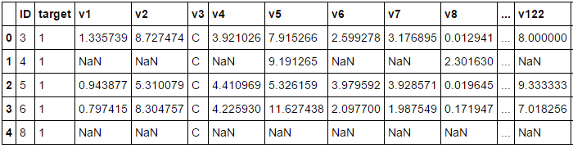
Data
131 numerical and categorical features
Training set: 114,321 observations
Test set: 114,393 observations
Notes:
OK. How hard can it get?
Well when I started looking at the data, I thought I’m in over my head.
The data are anonymized. As in there’s no indication of that the features provided are. Just column numbers.

Slide 5
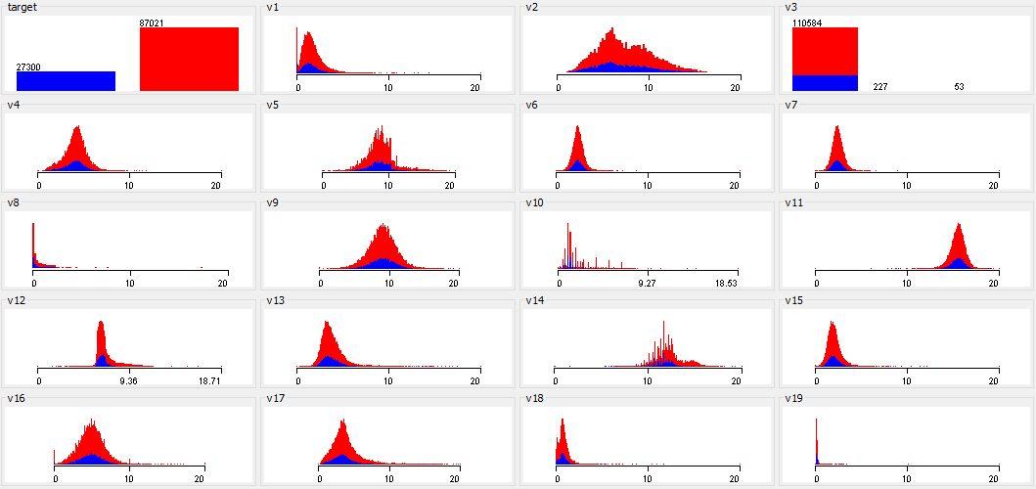
Data - Distribution and Histogram
Notes:
Red and blue indicate the target classes.
Glance at 20 features.
Some numerical, some categorical
Various distributions. Normalized within 0-20

Slide 6
Feature Engineering
What features could be relevant when reviewing Payment Protection Insurance claims?
Loan amount
Claim amount
Credit score
Income/salary
Premium paid
Savings/assets
Loan interest rate
Gender of insure
Age of insure
Type of PPI (credit card, mortgage, auto, business)
History of fraud
Missed payments
# of other accounts
Notes:
What is payment protection insurance?

Slide 7
Feature Engineering
What features could be relevant when reviewing Payment Protection Insurance claims?
Loan amount - Numerical
Claim amount - Numerical
Credit score - Numerical
Income/salary - Numerical
Premium paid - Numerical
Savings/assets - Numerical
Loan interest rate - Numerical
Gender of insure - Categorical
Age of insure - Numerical
Type of PPI (credit card, mortgage, auto, business) - Categorical
History of fraud - Binary
Missed payments - Poisson
# of other accounts - Poisson

Slide 8
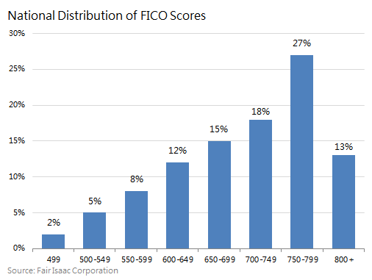
Feature Engineering – Credit Score

Slide 9
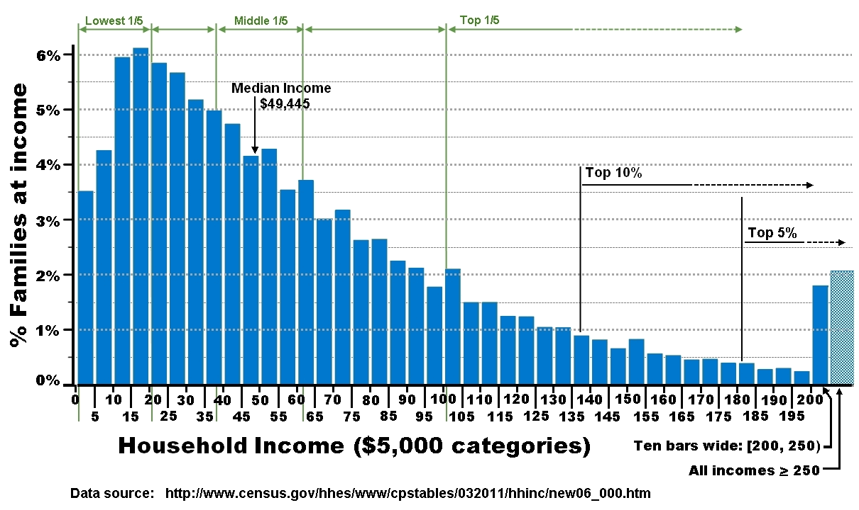
Feature Engineering – Income

Slide 10
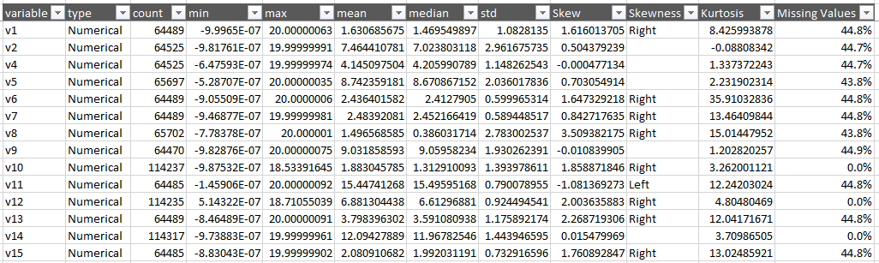
Feature Statistics
Notes:
Using Pandas, it was easy to look at the distribution of each feature.
Here are some of the numerical features and their mean, median.
And skewness and kurtosis telling me about their distribution

Slide 11
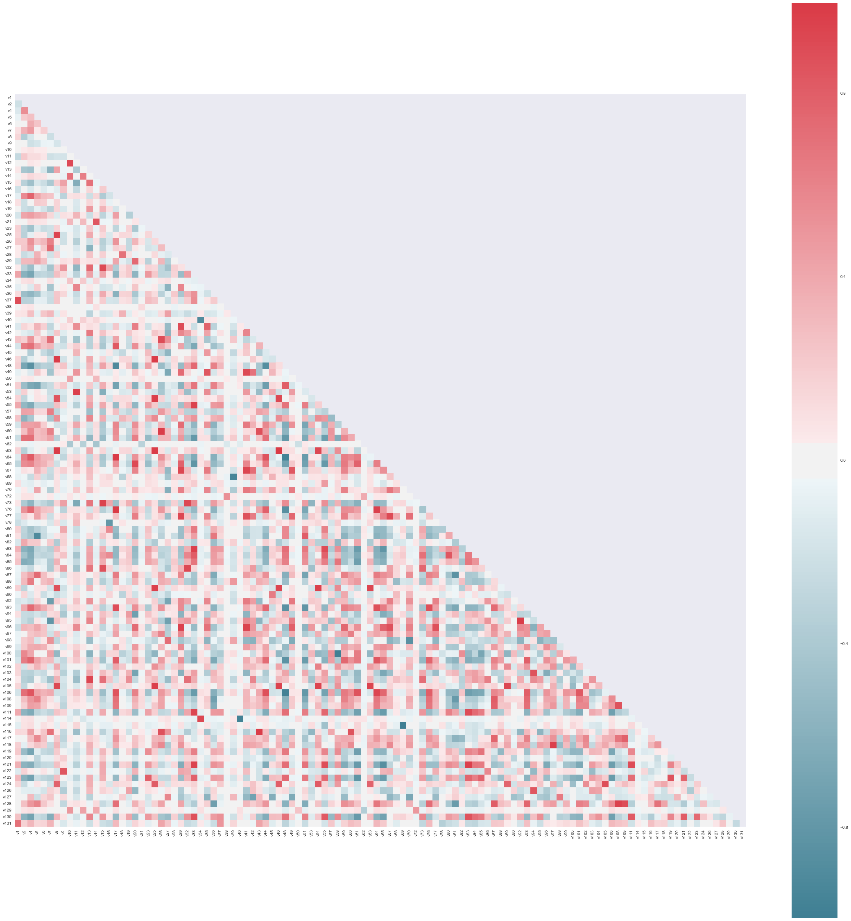
Feature Selection - Correlation
Notes:
Here’s a heatmap of the Pearson’s correlation
Recall: +1 (red) is positively correlated, -1 (blue) is negatively correlated. 0 is no correlation
This is hard to see, so let me zoom in

Slide 12
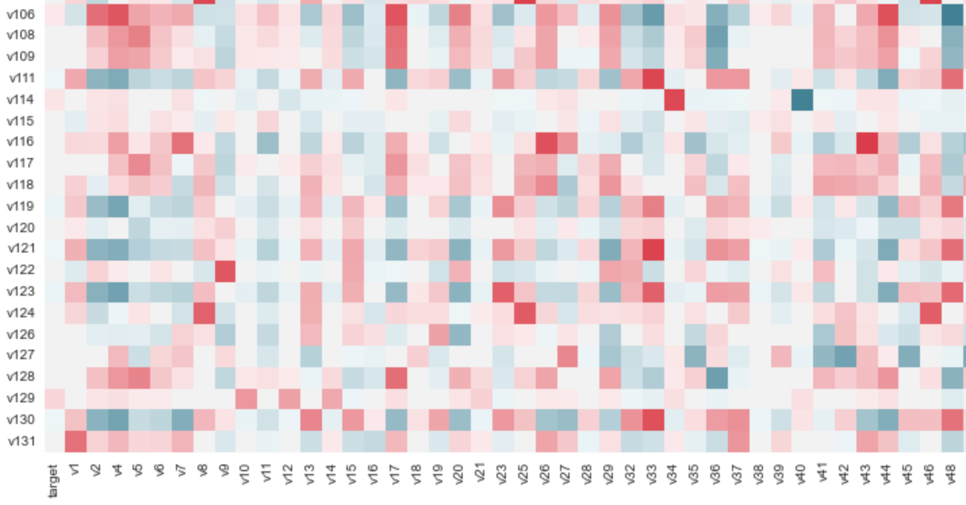
Feature Selection - Correlation
Notes:
Look at v114. mostly uncorrelated. But strong positive with v34. strong negative with v40.
This could mean they’re linear dependent. And through LDA or PCA could give us a lower rank.
Another way is to find Pearson’s correlation with the target. And see

Slide 13
Feature Selection – Information Gain
Ranked attributes:
Feature | Information Gain
v22 | 0.1470715
v50 | 0.0593671
v56 | 0.0344891
v10 | 0.0340193
v79 | 0.0327785
v31 | 0.0260255
v129 | 0.0213580

Slide 14
Missing Values
Only 10% of observations are complete with no missing values
Create new observation sets with imputed mean for numerical and imputed mode for categorical
Another set with NaN set to negative number or new category

Slide 15
Subsets of Observations
Complete cases only
Numerical only with imputed mean
Categorical only with imputed mode
All of features from 2 + 3
All features with unique values imputed for NaN

Slide 16
Model – Random Forest
Resistant to non-informative features
Or built-in feature selection
Good classification performance, scalability, and ease of use
Uses weak learners (CART) combined to form strong learner

Slide 17
Models
Random Forest Classifier
Extra (Extremely Randomized) Tree Classifier Instead of looking for the most discriminative thresholds, thresholds are drawn at random for each candidate feature and the best of these randomly-generated thresholds is picked as the splitting rule
Gradient Boosting Classifier GB builds an additive model in a forward stage-wise fashion

Slide 18
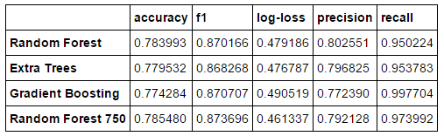
Model - Accuracy

Slide 19
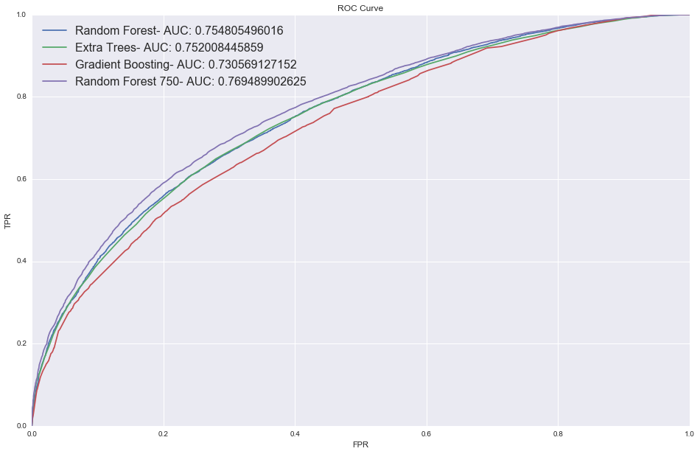
Model – ROC Curve

Slide 20
Model – Parameter Tuning
Start with default settings
Grid search when possible for best parameters
Use all local processors

Slide 21
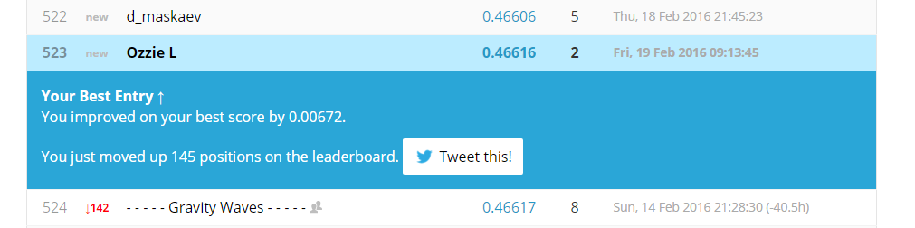
Current Progress

Slide 22
Next Steps
More trees!
Actually select features and try different models
Dimensionality Reduction – PCA/LDA
More ensembling and bagging

Slide 23
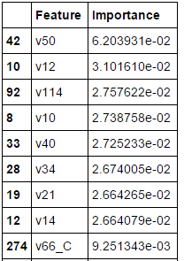
Feature Importance

