Slide 1
Fraud Detection using ML Models in Electric and Gas in Tunisia
Özlem Albayrak

Slide 2
Business Goal&Motivation
1- Identify high-risk clients likely to commit fraud.
2-Enable prioritization of investigations under limited resources.
3-Reduce missed fraud cases while controlling false positives.

Slide 3
Business Goal&Motivation: Why This Matters?
1- Fraud is very rare but costly ==> Unbalanced Target Column
2- Manual inspection capacity is limited and costly.
3- A ranking model allows focusing on the most suspicious cases.

Slide 4
Data Source & Scope
Invoice-level data: Over 4 million rows for 135,493 clients invoice info.
Features: Meter indices, consumption by invoice, invoice dates
Client-level data: 135,493 clients
Features: Client category, geographic attributes, binary fraud indicator (0 = non-fraud, 1 = fraud)
Modelling: Client-level aggregation

Slide 5
Key Challenges: Data Challenges
==> Strong class imbalance (~5–6% fraud rate)
==> Skewed distributions (consumption, invoices)
==> Structural zeros (new customers...) in consumption variables, signalling nothing.
==> Geographic imbalance (regions/districts vary in size)

Slide 6
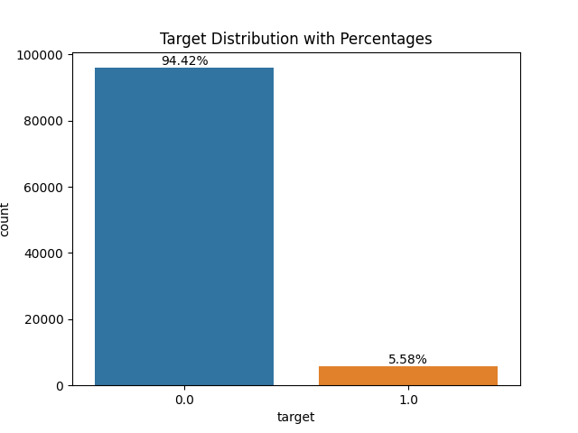
Target Imbalance

Slide 7
Key Challenges: Modelling Challenges
==> Accuracy is misleading as a metric
==> Default thresholds (0.5) are inappropriate

Slide 8
Evaluation Metric
Primary Metric: ROC-AUC
Why ROC-AUC?
  Measures ranking quality, so that the company can rank the possible fraud cases.
  Threshold-independent
  Robust to class imbalance

Slide 9
Feature engineering:
Existing variables were transformed
Encoded (including ordinal and categorical features) into model-ready representations while avoiding data leakage.

Slide 10
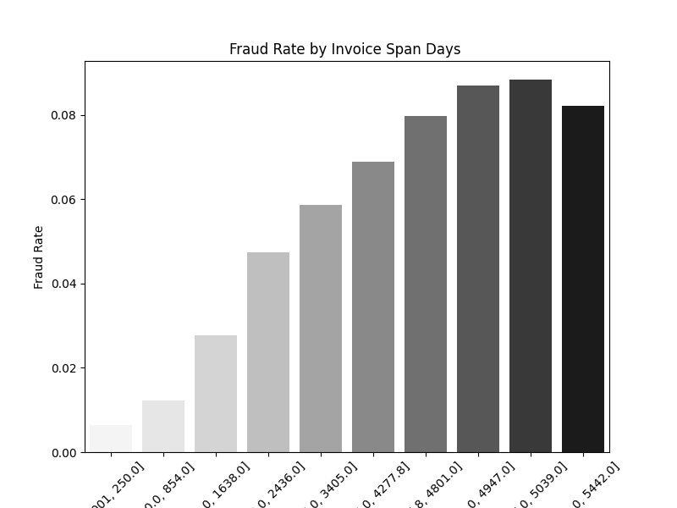
Invoice Span Days

Slide 11
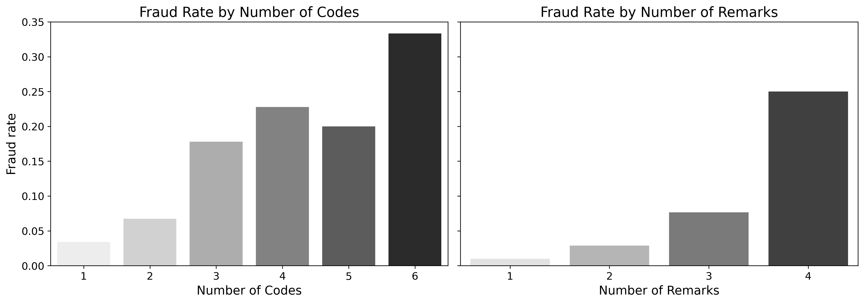
Fraud Rate by Anomaly Signals

Slide 12
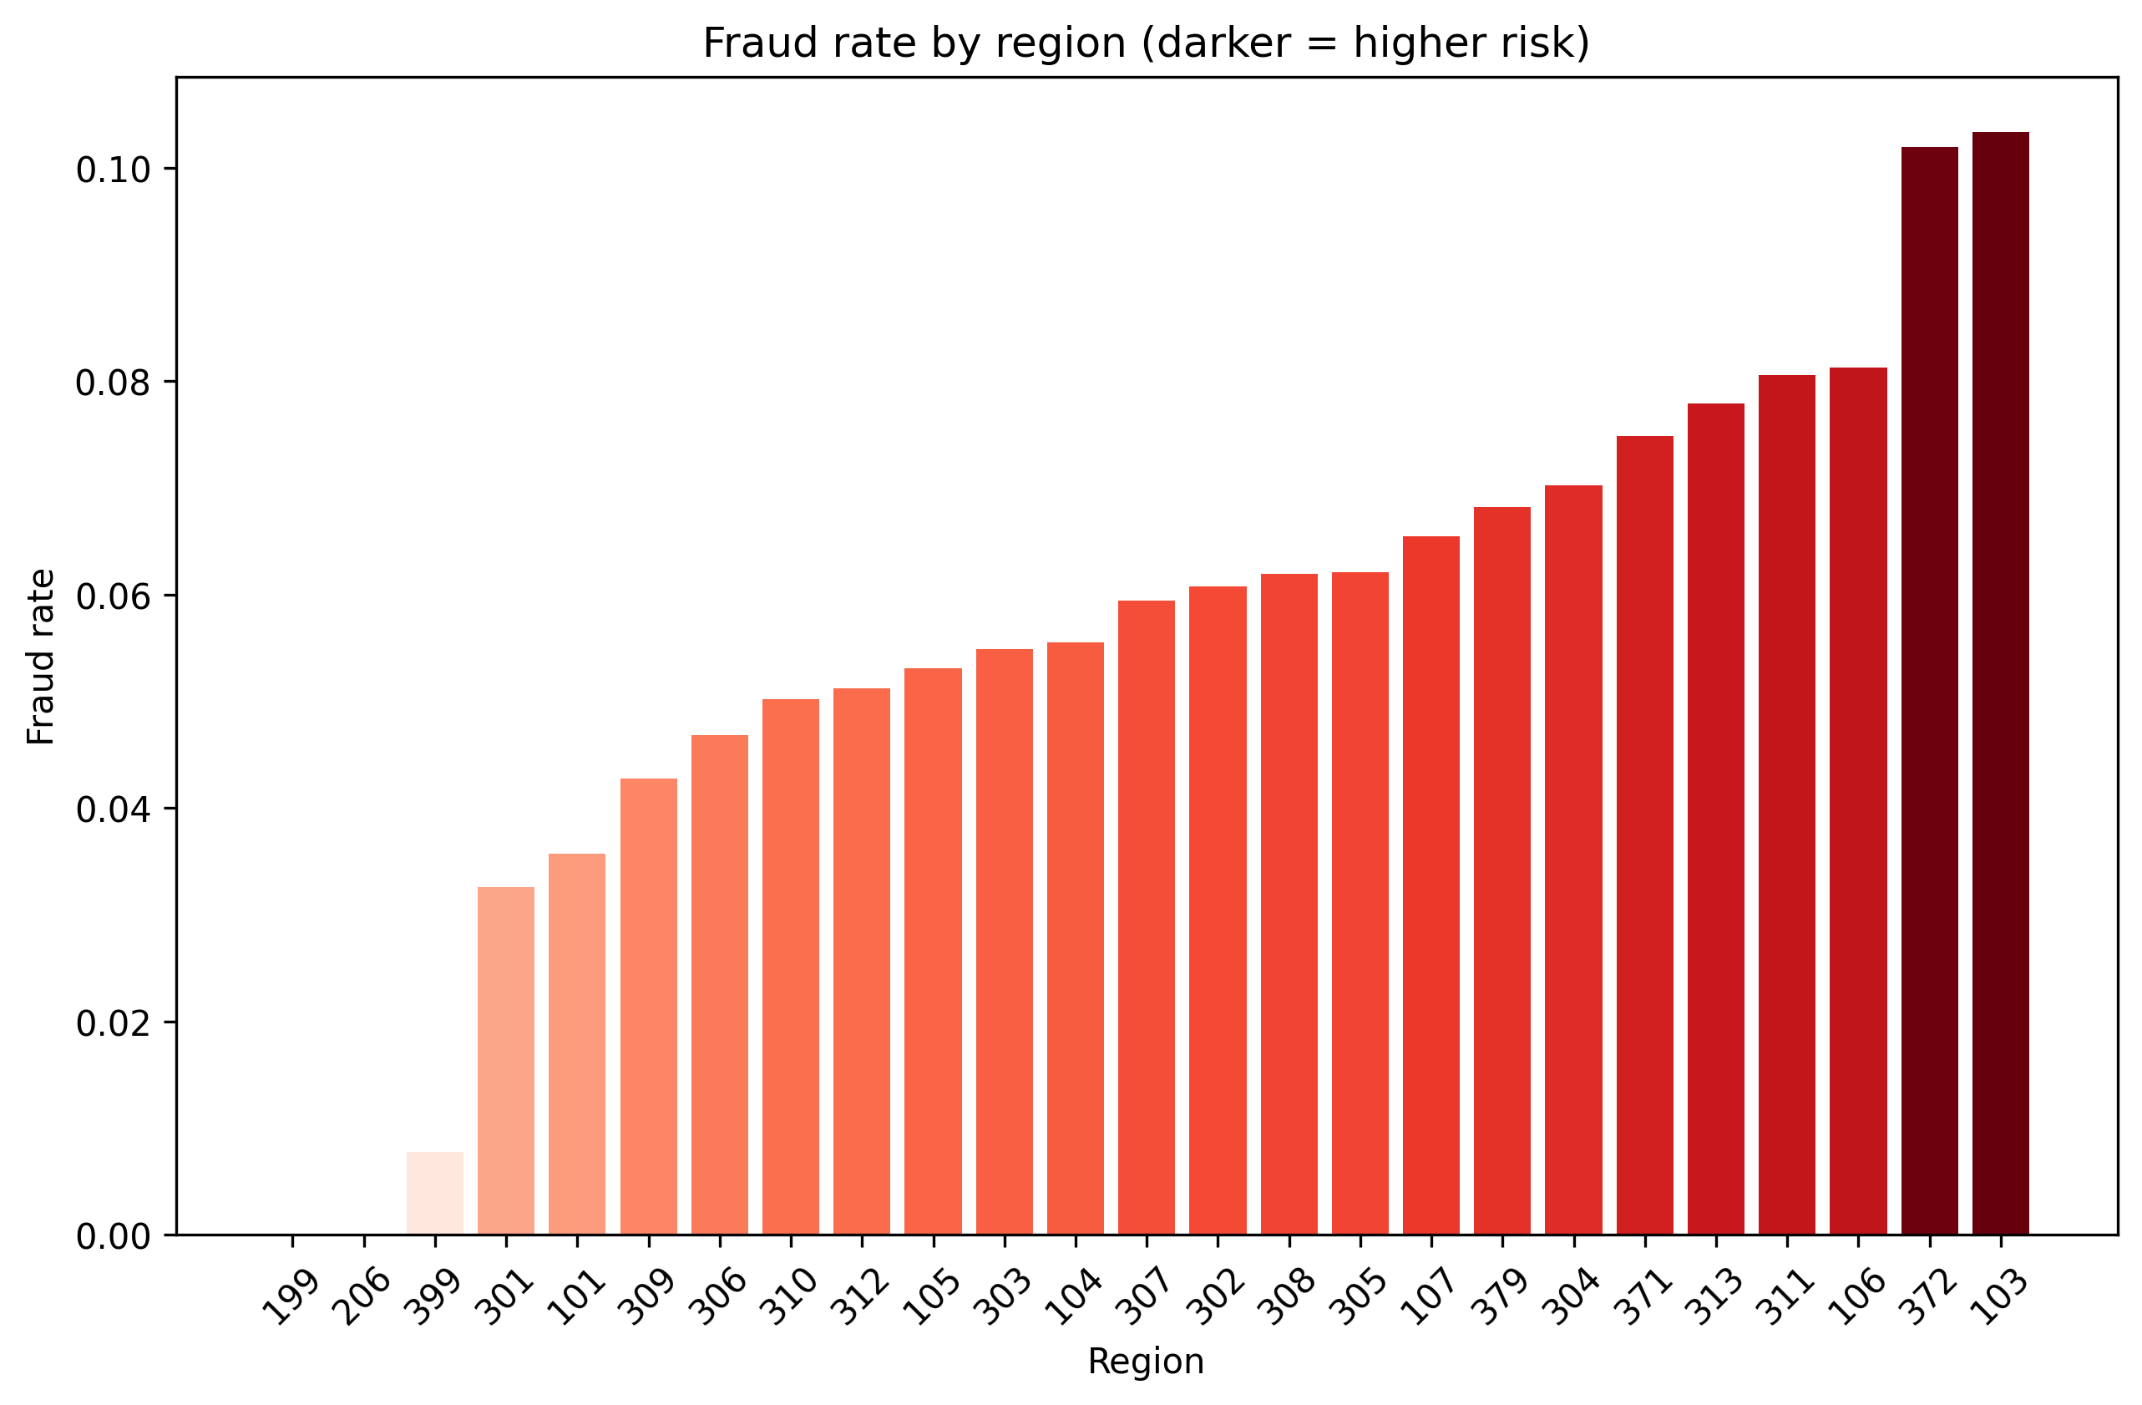
Fraud Rate by region

Slide 13
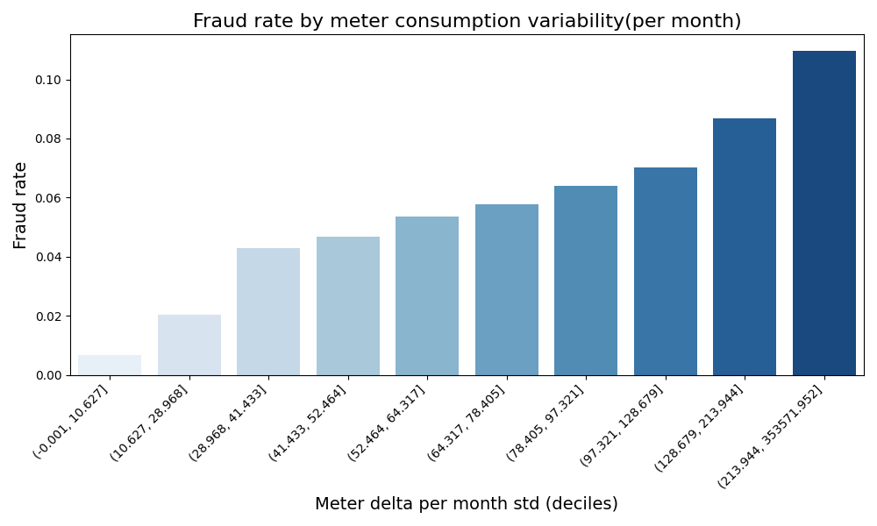
Consumption Anomaly

Slide 14
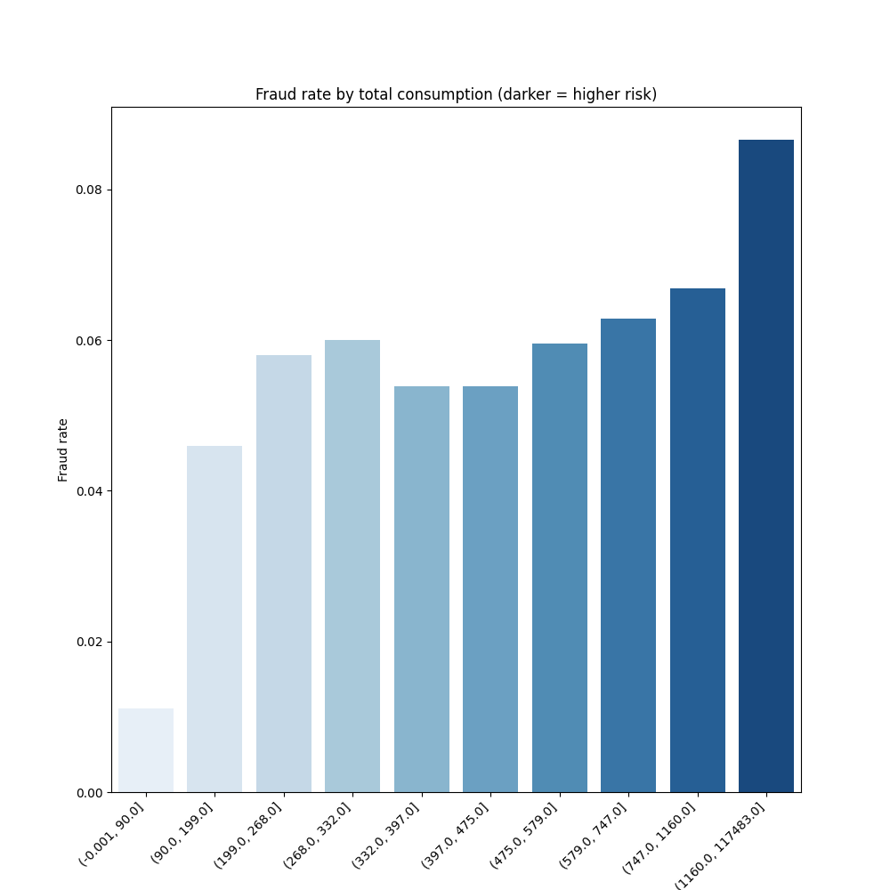
Fraud Rate by mean consumption bins

Slide 15
Machine learning workflow
Split data into training and test sets with stratification to preserve class imbalance
Built reproducible pipelines for preprocessing and modeling
Trained and compared:
    Dummy Classifier
    A linear baseline model (Logistic Regression)
    A non-linear model (Random Forest)
Evaluated models primarily using ROC-AUC
Feature importance & interpretation
Tuned hyperparameters using cross-validation (LR)
Selected the final model based on validation performance and ROC

Slide 16
Logistic Regression Evaluation Metrics

Slide 17
Random Forest Evaluation Metrics

Slide 18
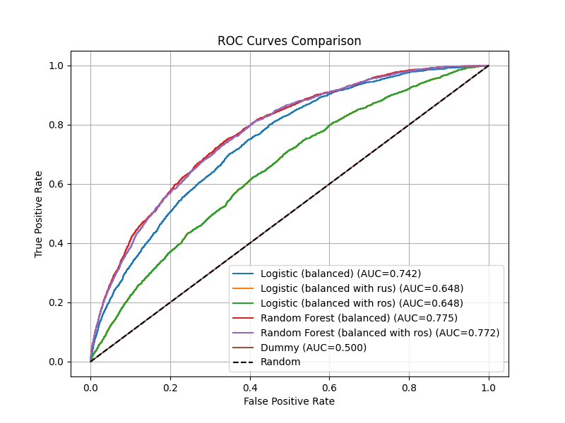
ROC Curves for Different Models

Slide 19
Logistic Regression CV
Best ROC (CV): 0.73989
Best params: {'clf__C': 10, 'clf__class_weight': 'balanced', 'clf__penalty': 'l2', 'clf__solver': 'lbfgs'}
Test ROC: 0.74178
Test PR-AUC: 0.151530

