Slide 1
Housing Market Analysis for Client: Thomas Hansen
Data-Driven Insights & Recommendations

Slide 2
Client Profile & Problem
Client: Thomas Hansen
Father of 5 children, limited budget
Goal: Finding a property in a safe, social neighborhood
  Needs: At least 3 bedrooms, community-oriented area
  Constraints: Budget + family size

Slide 3
Hypotheses Tested
1. Old houses (built year older than 20) without renovation could be more affordable.
2. House prices are higher in the city center. Location is the strongest determinant of price per sqft.
3. Going for house hunt in winter can increase the chance to find a house with a lower price than other seasons.

Slide 4
Data & Methods
Dataset: King County Housing (1 year data-21547 houses)
Variables: price, price_sqft, bedrooms, bathrooms, grade, condition, age, renovation, lat/long
Model: OLS Regression (price_sqft as dependent variable)

Slide 5
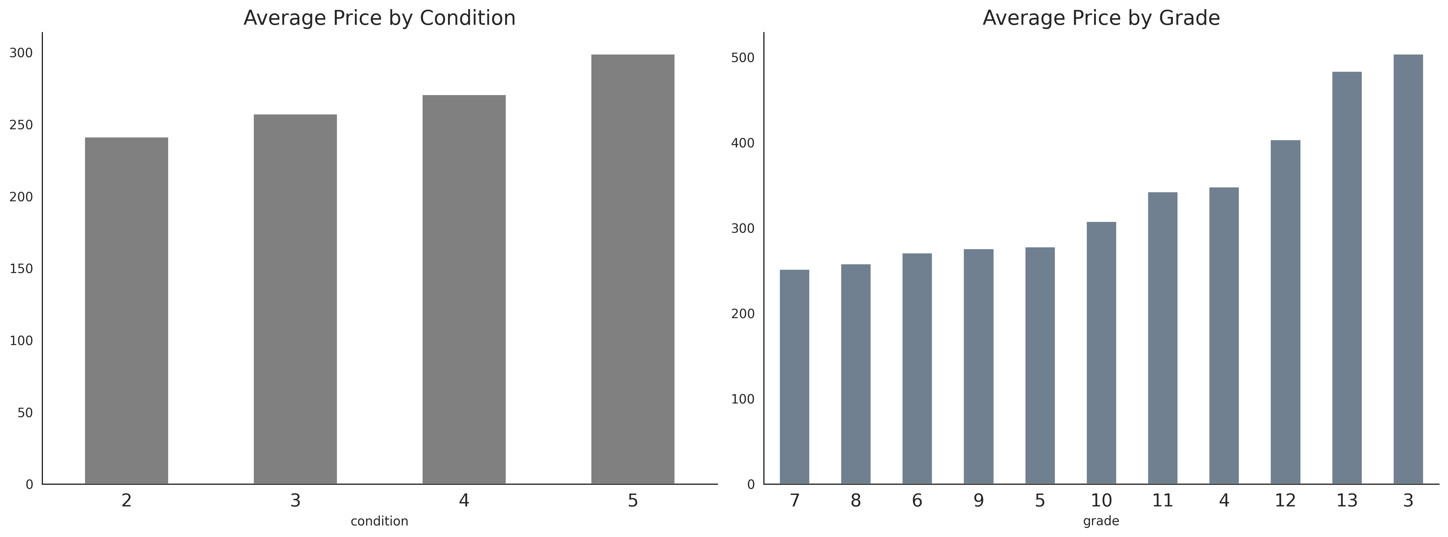

Slide 6
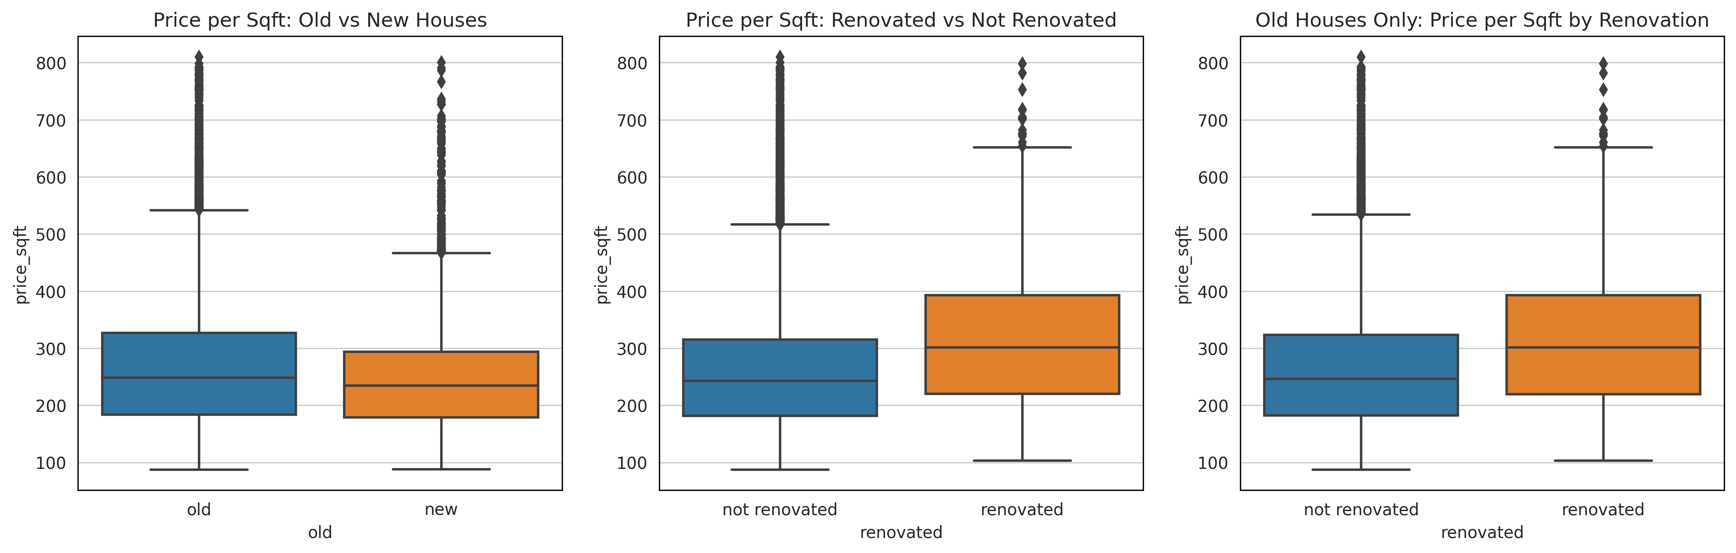
Central tendencies for old (built before 1995) and new houses by their renovation status.

Slide 7
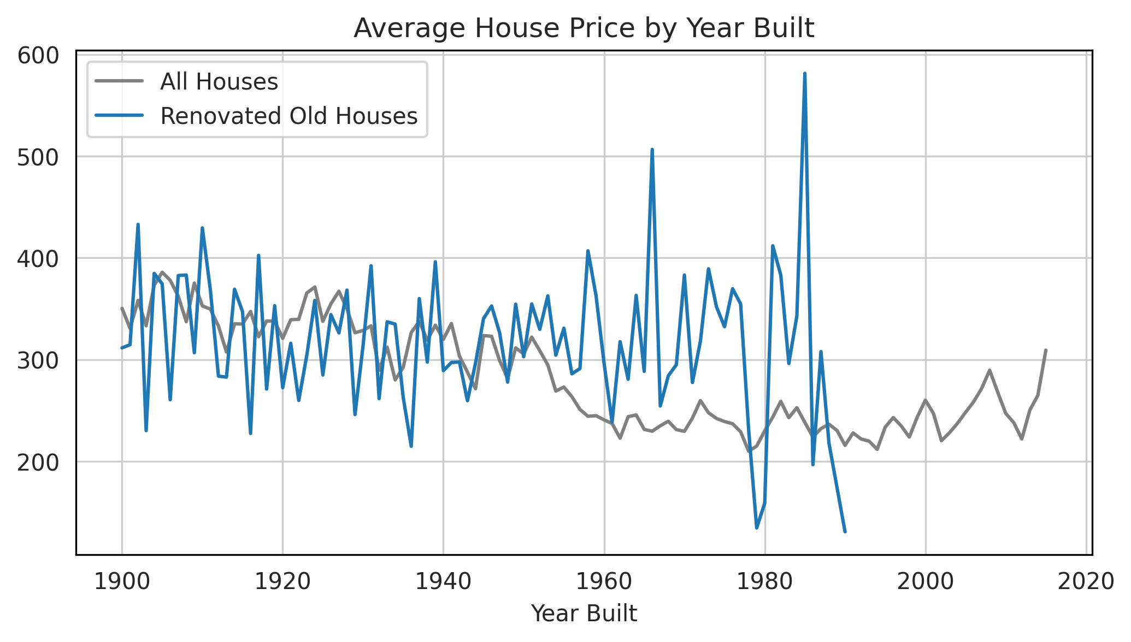

Slide 8
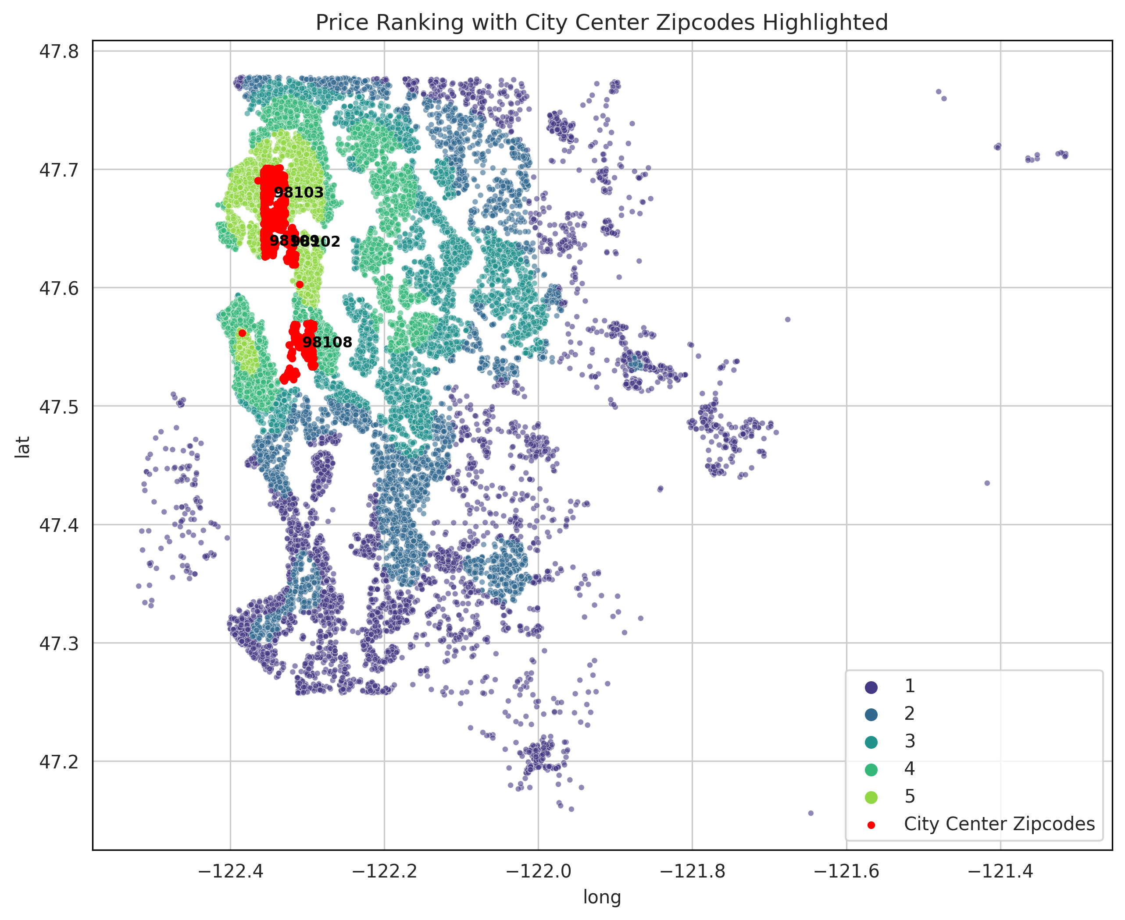
City Center is in the high-price area

Slide 9
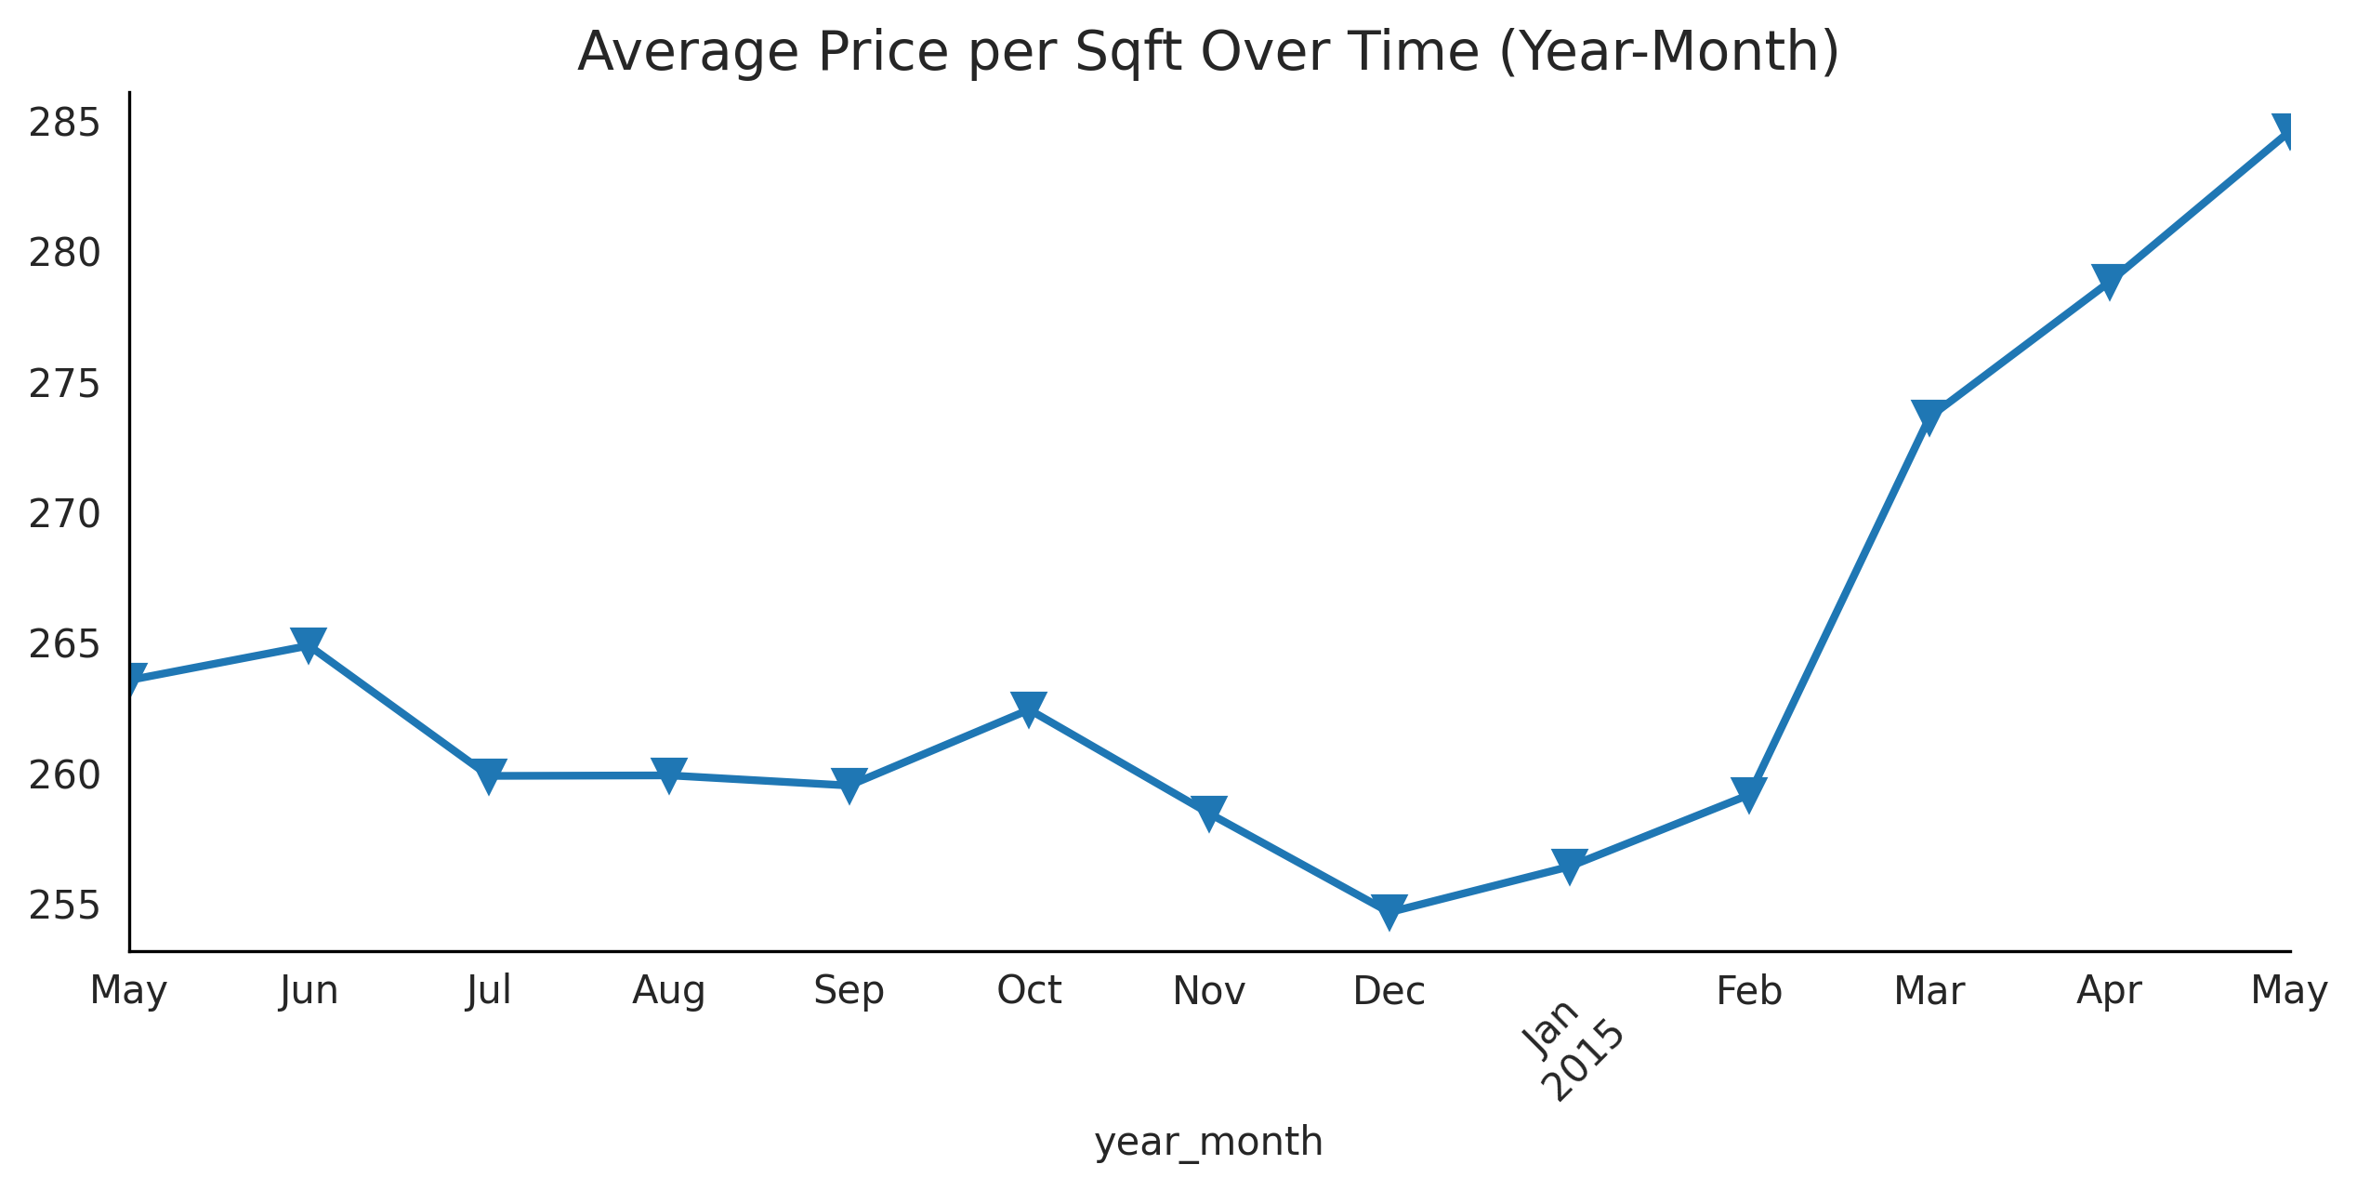

Slide 10
Key Findings: Market Dynamics
Prices tend to increase in spring and dip in winter.
Larger homes (more bedrooms) can have lower price per sqft.
Grade and condition have strong positive effects on value.

Slide 11
Key Findings: Location Effects
Location is the main determinant of the price of a property.
Waterfront and view features bring very high premiums.
10 cheapest zipcodes identified for affordability.

Slide 12
Recommendations for Thomas
Timing: Buy in winter to avoid price increases and competition.
Location: Focus on affordable family-friendly zipcodes.
Property Type: Mid-quality (not luxury),
non-waterfront, 3–4 bedroom homes with decent condition.

Slide 13
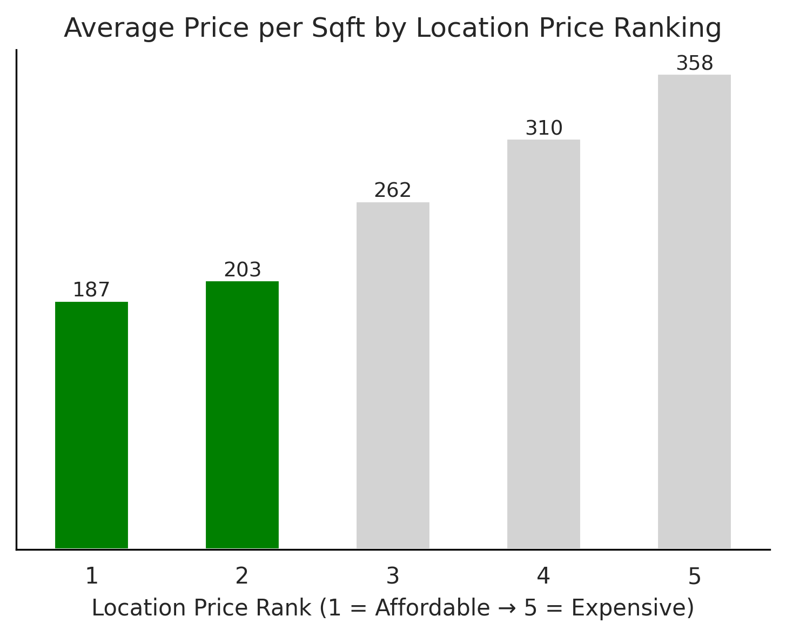

Slide 14
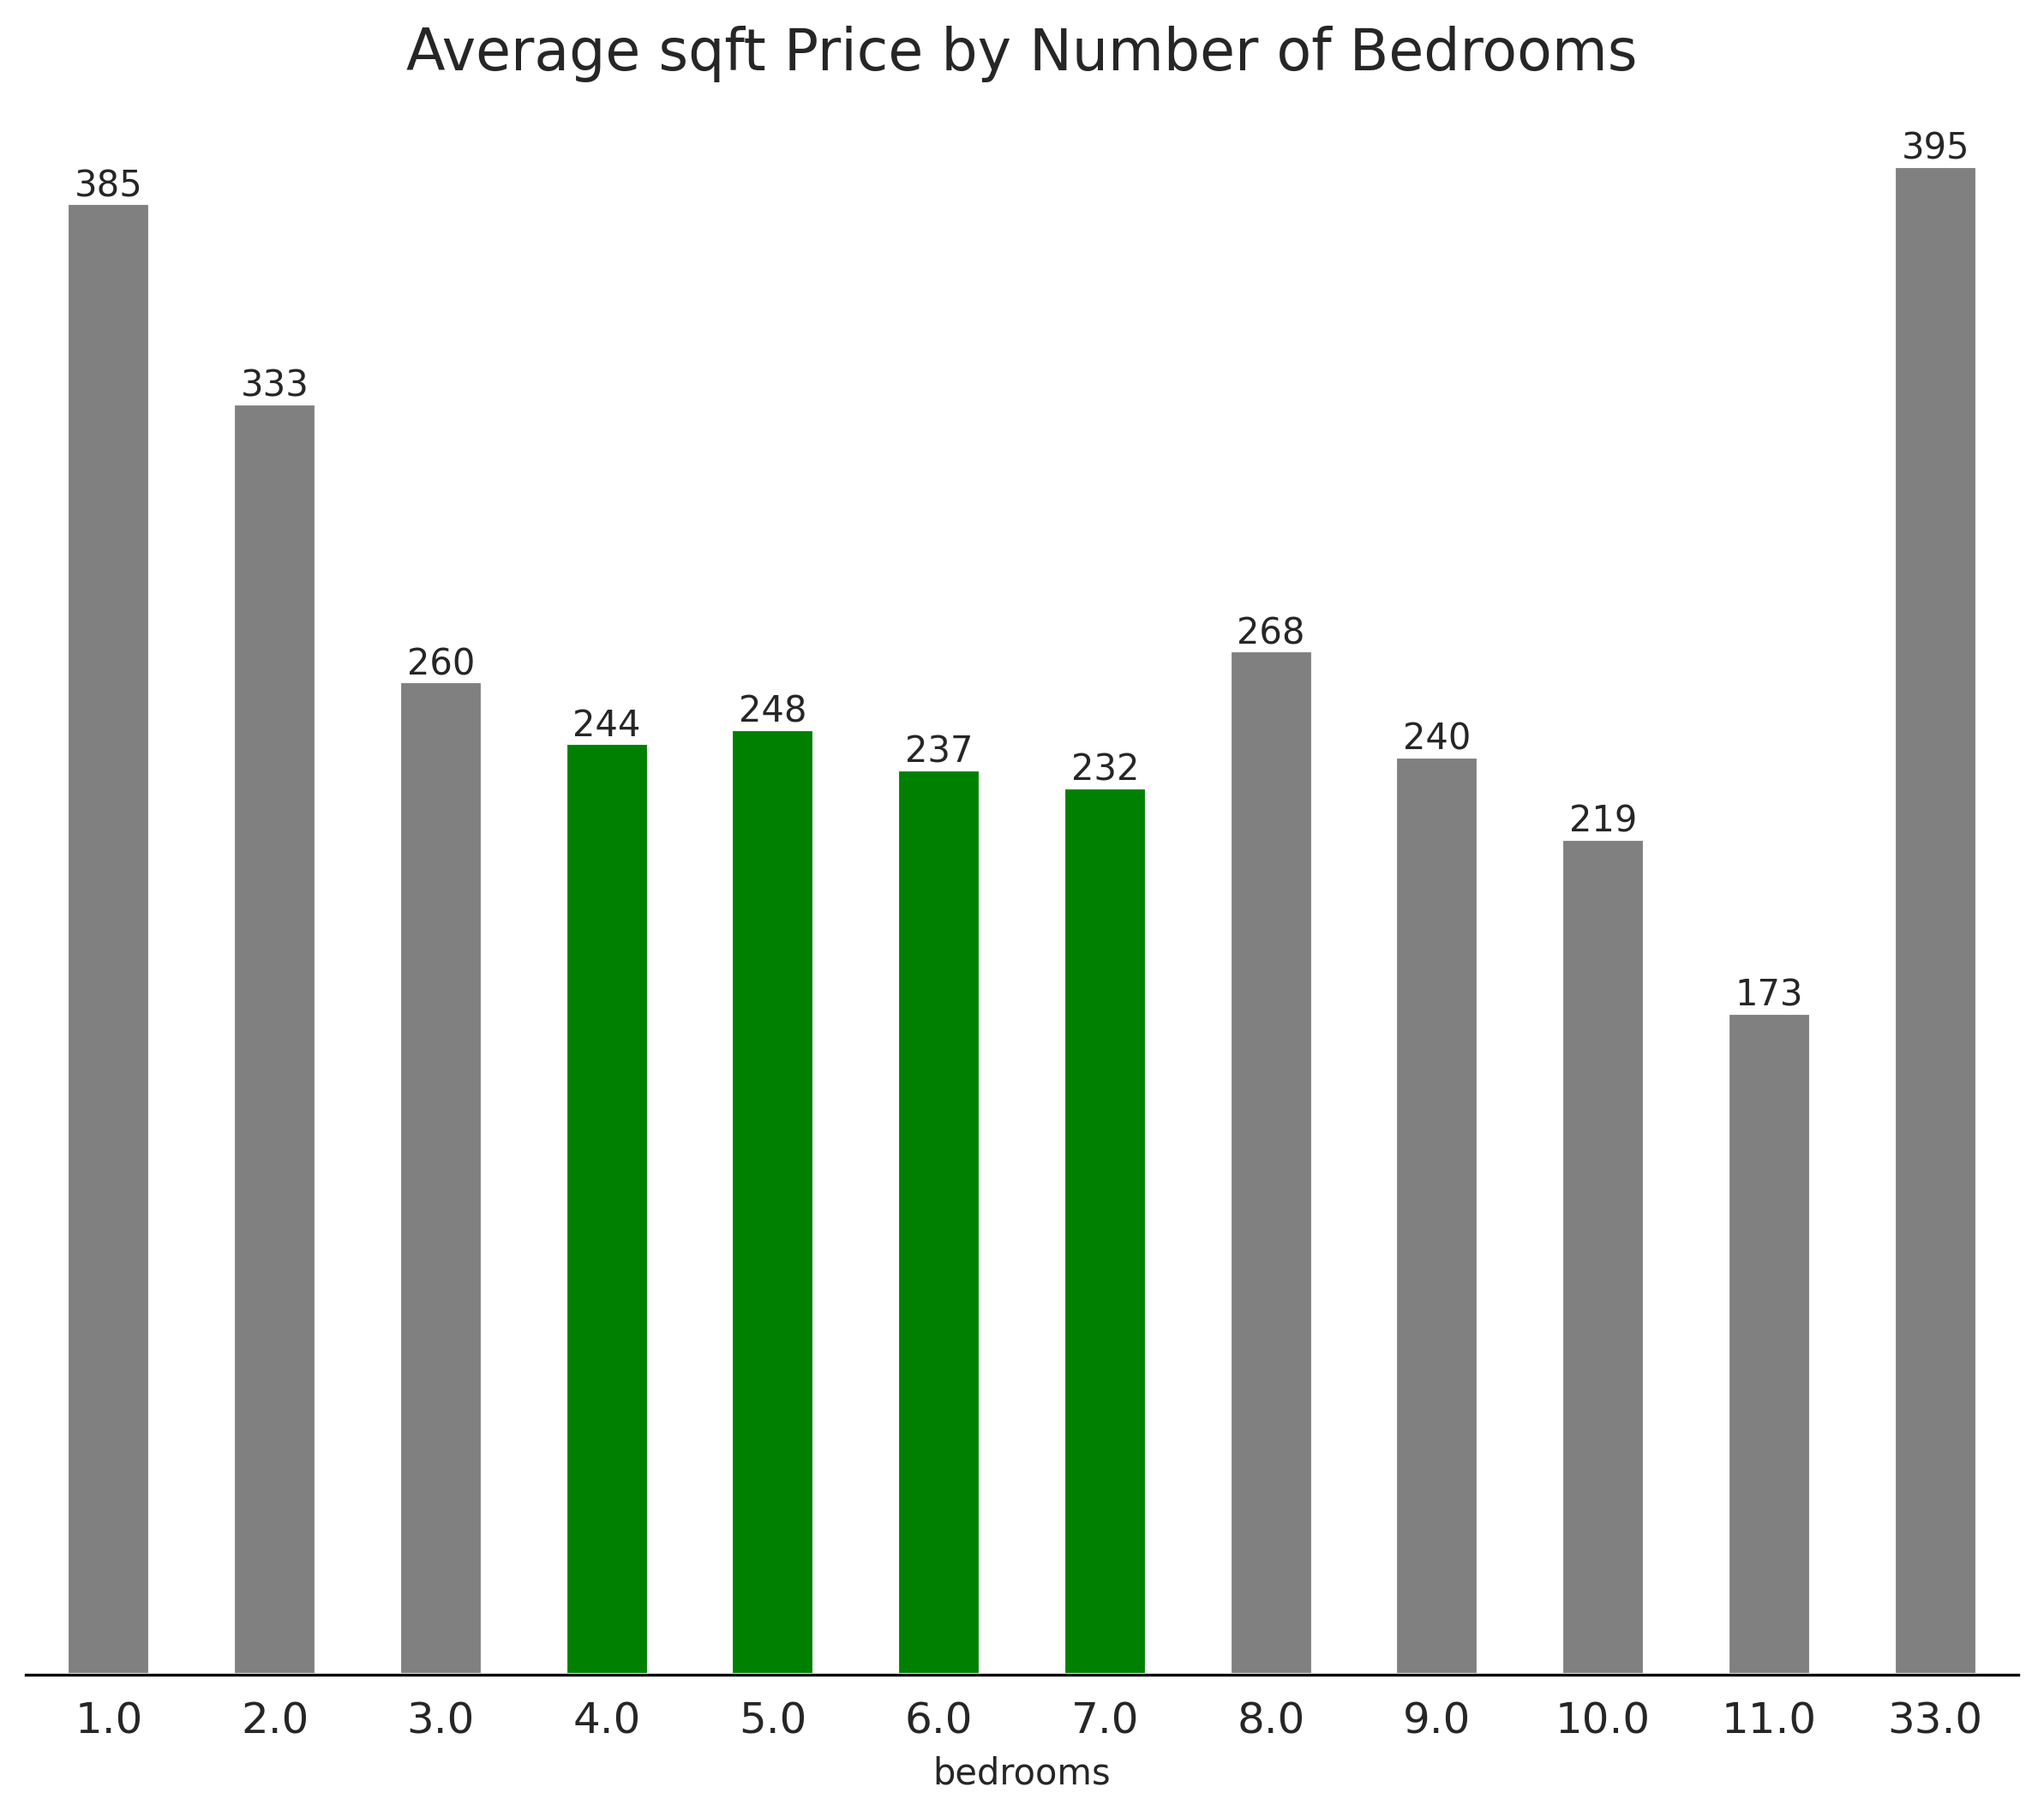

Slide 15
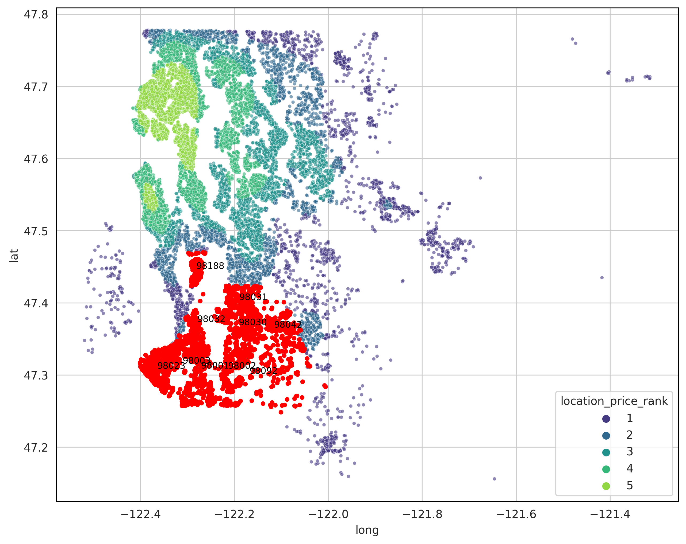
Cheapest Zipcodes and Location Price Rank

Slide 16
Zipcodes and Available Schools
Zipcode | Nu of Schools&Avg Elementary School Rating | Nu of Schools&Avg Middle School Rating | Nu of Schools&Avg High School Rating
98023 | 6, 7 | 6, 6 | 5, 6
98002 | 10, 5 | 9, 4 | 6, 4
98001 | 7, 6 | 7, 5 | 8, 5
98032 | 8, 6 | 8, 5 | 8, 5
98030 | 5, 7 | 8, 6 | 9, 6
98092 | 9, 8 | 7, 7 | 8, 7
98003 | 11, 5 | 6, 5 | 9, 4
98031 | 6, 7 | 9, 6 | 7, 6
98042 | 5, 8 | 5, 7 | 8, 6
98188 | 8, 4 | 8, 4 | 4, 3

Slide 17
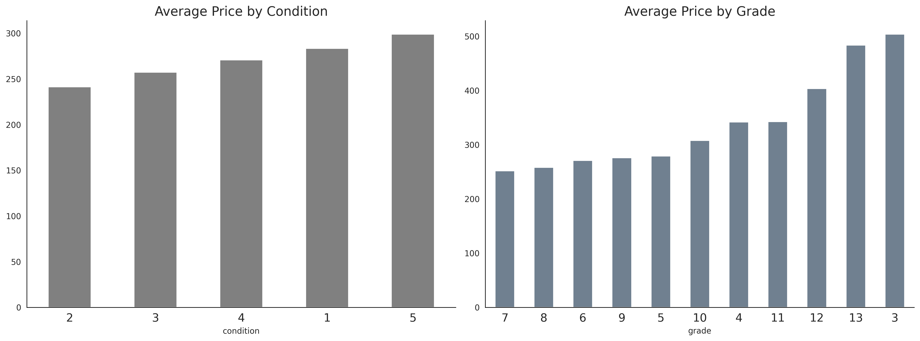

Slide 18
Conclusion
Data confirms strong location effects and seasonal pricing trends.
Thomas can find a suitable home by targeting winter purchases and affordable suburban zipcodes.
https://www.greatschools.org/

Slide 19
Next step for the project
Getting API of this page and create the fake table of school numbers and ranking by zipcode table for real.
=>> ttps://www.greatschools.org/

