Slide 1
Activity Recognition Using Hidden Markov Models
Oguzhan Oguz
oguzhano@kth.se
EQ2341 Pattern Recognition
Final project
1 / 23

Slide 2
Overview
• Section 1: recorded dataset
• Section 2: preprocessing and feature extraction
• Section 3: HMM model and Baum-Welch training
• Section 4: decoding and evaluation protocol
• Section 5: results, limitations, and conclusion
2 / 23

Slide 3
Project goal and recognition pipeline
Input signal
Feature sequence
Classifier output
Phone accelerometer log
Each raw sample contains
time, ax, ay, az.
1 s overlapping windows
Each window is represented by a 3D magnitude-based feature vector.
HMM state sequence
standing, walking, or running for each test window.
Why sequence classification?
Human activities are temporally persistent. The HMM uses this persistence through transition probabilities, instead of classifying each window independently.
3 / 23

Slide 4
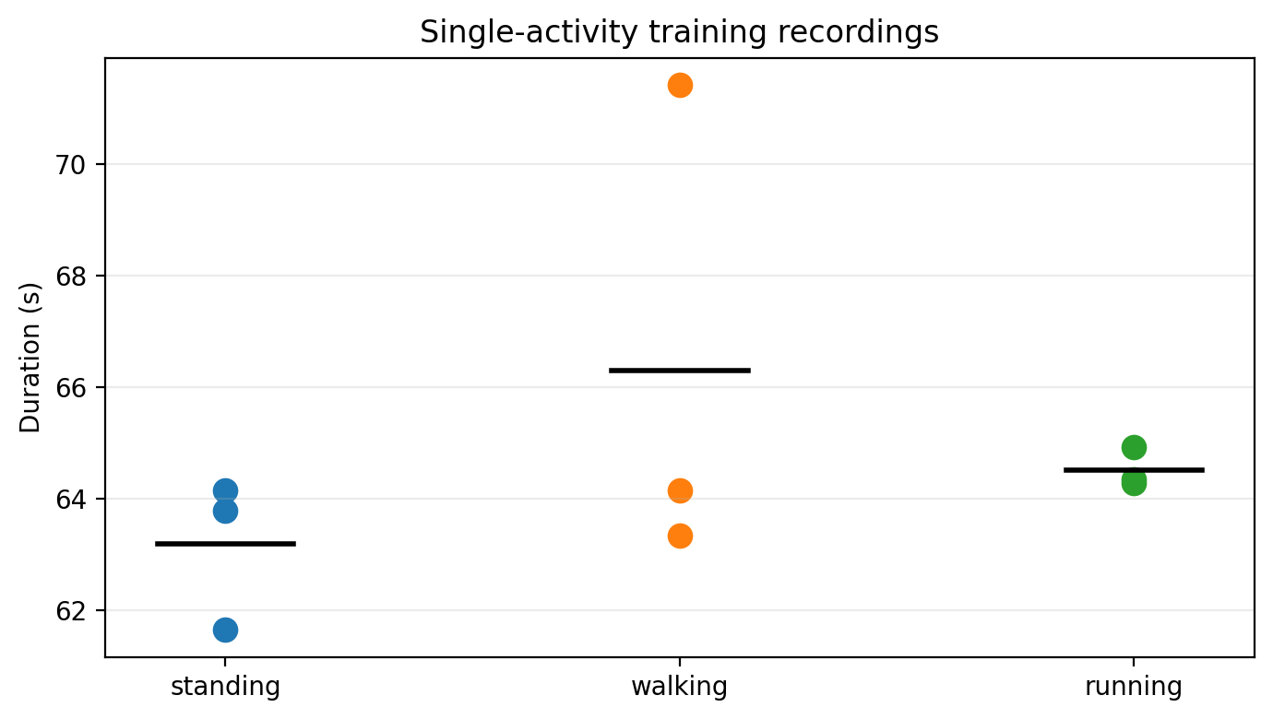
Section 1 - Recorded dataset
Recorded files
• 3 standing recordings (≈ 60 seconds)
• 3 walking recordings (≈ 60 seconds)
• 3 running recordings (≈ 60 seconds)
• 1 mixed test sequence (≈ 120 seconds)
• sampling rate: 125 Hz
Single-activity training recordings
Why separate training recordings?
Single-activity recordings provide clean initial labels for the emission distributions. The mixed recording is then used to evaluate the sequential classifier on unseen activity changes.
4 / 23

Slide 5
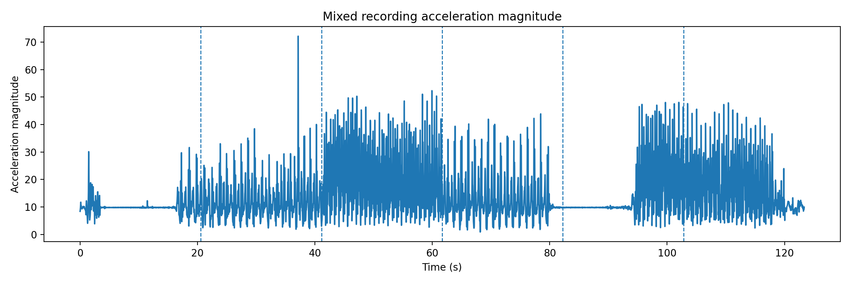
Section 1 - Raw mixed recording
Acceleration magnitude in the mixed test recording
The start, end, and activity-change regions may contain phone-handling artefacts. Therefore, the quantitative evaluation excludes short temporal margins around segment boundaries.
5 / 23

Slide 6
Section 2 - Preprocessing
Step
Purpose
Trim start/end
remove handling artefacts (first/last 8 s for training)
Magnitude
reduce sensitivity to phone orientation
Moving average
suppress short high-frequency fluctuations
Windowing
convert raw samples into a stable feature sequence
Chosen windowing
A 1 s window with 0.5 s hop was used. This gives smoother trajectories, but neighbouring windows are overlapping and should not be interpreted as fully independent test samples.
6 / 23

Slide 7
Section 2 - Magnitude-based feature trade-off
Advantages
Trade-off
• less sensitive to phone orientation
• standing has low variation
• running has high variation
• compact enough for a small dataset
• directional motion is discarded
• transition artefacts can resemble running
• axis-specific patterns are not used
• richer features need more data
Feature vector
xₙ = [mean(m), std(m), range(m)]ᵀ
Standardized using training-set statistics.
7 / 23

Slide 8
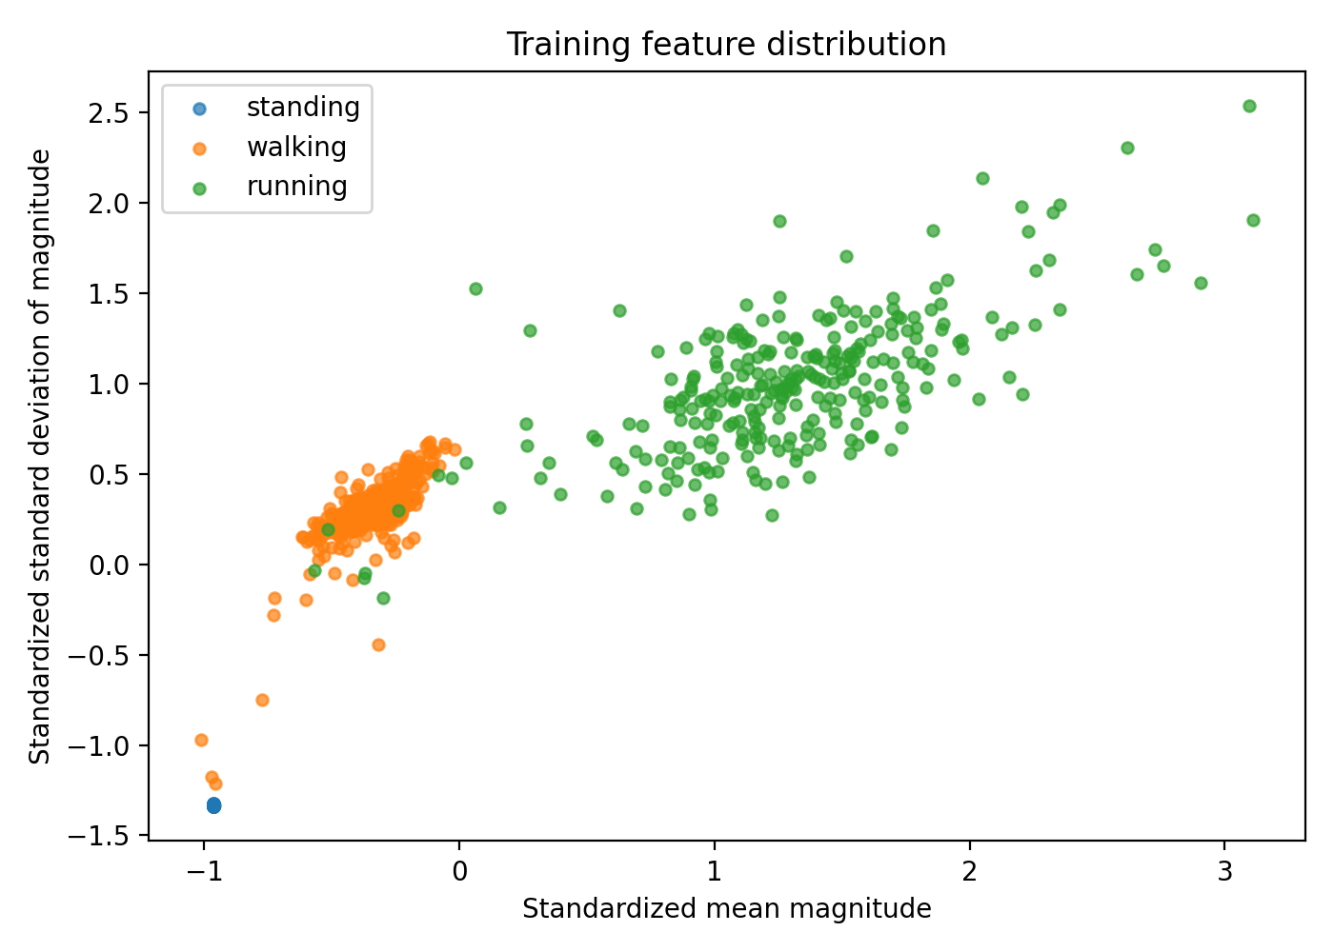
Section 2 - Training feature distribution
Window-level features after preprocessing
Standing is concentrated at low variation, running has the strongest magnitude variation, and walking lies between them. This supports a Gaussian emission model for each activity state.
8 / 23

Slide 9
Section 3 - HMM model structure
Hidden states
Gaussian emissions
Sₜ ∈ {standing, walking, running}
The state at window t is the current activity.
Each state uses a multivariate Gaussian density:
p(xₜ | Sₜ = j) = 𝒩(xₜ; μⱼ, Σⱼ).
Why HMM?
Independent Gaussian decisions ignore time persistence. The HMM combines the emission likelihoods with a transition matrix, so short isolated errors are less likely to dominate the decoded activity sequence.
9 / 23

Slide 10
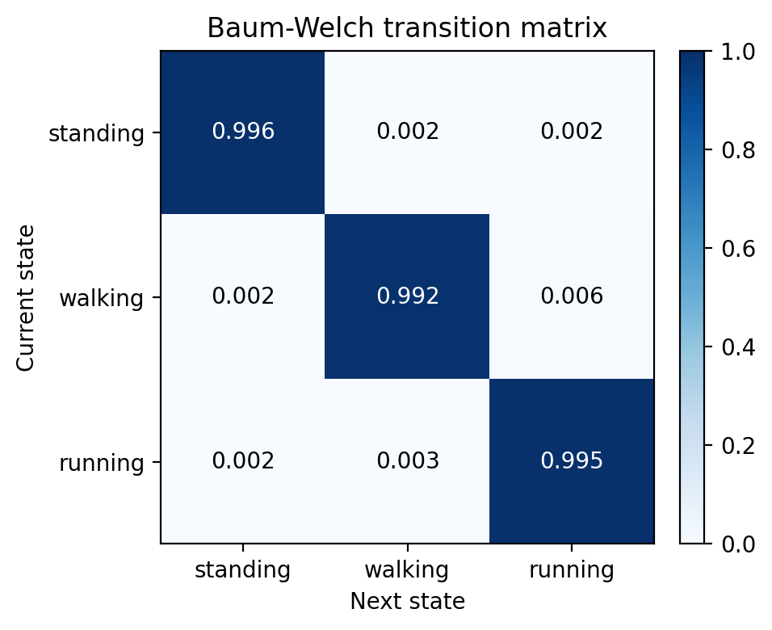
Section 3 - Initialization from labelled recordings
Initialization
• single-activity recordings provide stable initial labels
• Gaussian means and covariances are initialized per activity
• transition probabilities are initialized as mostly diagonal
• small pseudocounts keep all transitions possible
Baum-Welch transition matrix
The transition matrix is mainly a persistence model. The large diagonal probabilities show that the HMM strongly favors temporal persistence.
10 / 23

Slide 11
Section 3 - Baum-Welch EM training
E-step
M-step
Forward-Backward computes posterior
state probabilities γⱼ(t) and transition posteriors ξᵢⱼ(t).
q, A, μⱼ, and Σⱼ are updated using the posterior weights from the E-step.
Training criterion
Stop when |L(k) − L(k−1)| < 10⁻³.
The final run converged after 16 iterations.
11 / 23

Slide 12
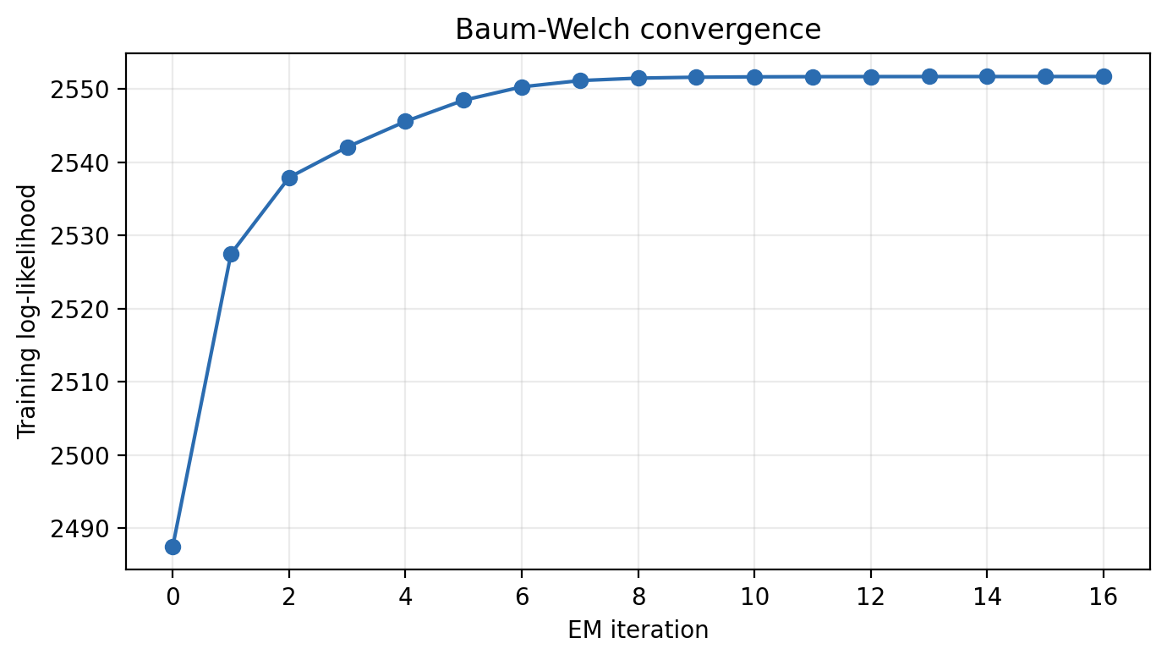
Section 3 - Baum-Welch convergence
Final values
Initial log-likelihood:
2487.54
Final log-likelihood:
2551.70
Final improvement:
approximately 10⁻³
Training log-likelihood over EM iterations
The monotonic increase is the expected behaviour of Baum-Welch EM. The small final improvement indicates that the model has nearly converged for this dataset.
12 / 23

Slide 13
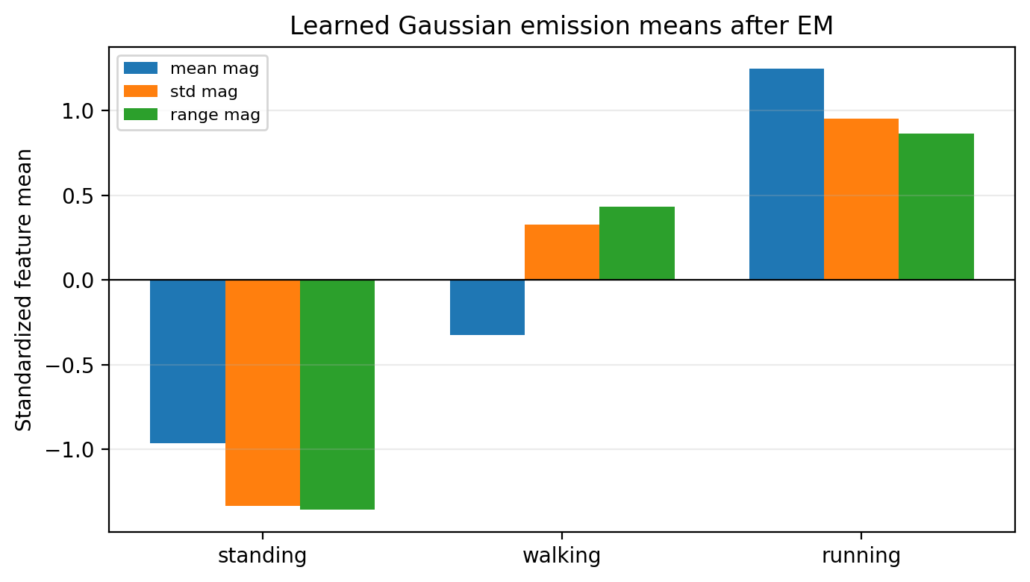
Section 3 - State identity after Baum-Welch
Identity check
• standing remains the lowest-variation state
• walking remains intermediate
• running remains the highest-variation state
• no state-label swap was observed
Standardized emission means
Why this matters
Baum-Welch is an unsupervised refinement step, so state labels are mathematically exchangeable. The supervised initialization kept the semantic state identities stable.
13 / 23

Slide 14
Section 4 - Decoding methods
Posterior MAP
Viterbi
Forward-Backward gives
γⱼ(t) = P(Sₜ = j | X, λ).
The posterior MAP label is
Ŝₜ = arg maxⱼ γⱼ(t).
Viterbi finds the most probable complete state sequence.
It usually gives smoother trajectories because it optimizes the full path.
Implementation check
Both decoders are reported because they answer related but different HMM inference questions.
14 / 23

Slide 15
Section 4 - Evaluation protocol
Item
Choice used in this project
Training files
nine single-activity recordings
Test file
one mixed recording
Known order
standing -> walking -> running -> walking -> standing -> running
Boundaries
approx. equal-duration segments (exact timestamps unavailable)
Excluded margins
5 s at edges and 3 s around transitions
Metric
overlapping-window accuracy and confusion matrix
Important note
The reported accuracy is approximate because exact transition timestamps were not available. Some errors may therefore reflect label-boundary mismatch rather than only model mistakes.
15 / 23

Slide 16
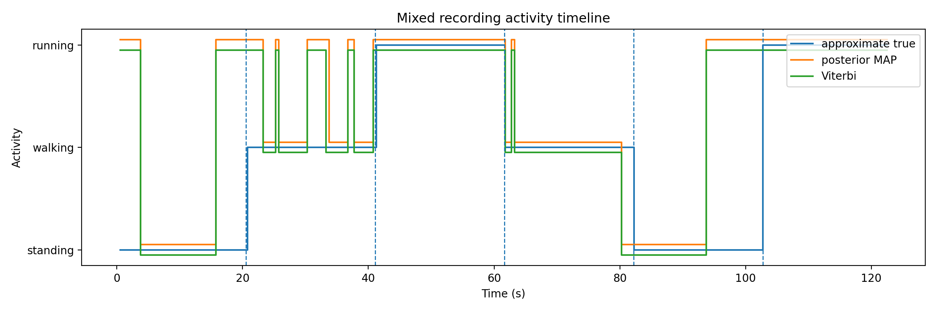
Section 4 - Mixed test sequence
The decoded trajectory follows the intended activity order, but some confusion appears near standing segments and transitions.
16 / 23

Slide 17
Section 5 - Accuracy and baseline comparison
Final numeric results
Posterior MAP: 84.4%
Viterbi: 85.0%
Independent Gaussian: 82.6%
Scored windows: 167
The HMM improves over the independent Gaussian baseline, mainly by adding temporal persistence through the transition matrix.
17 / 23

Slide 18
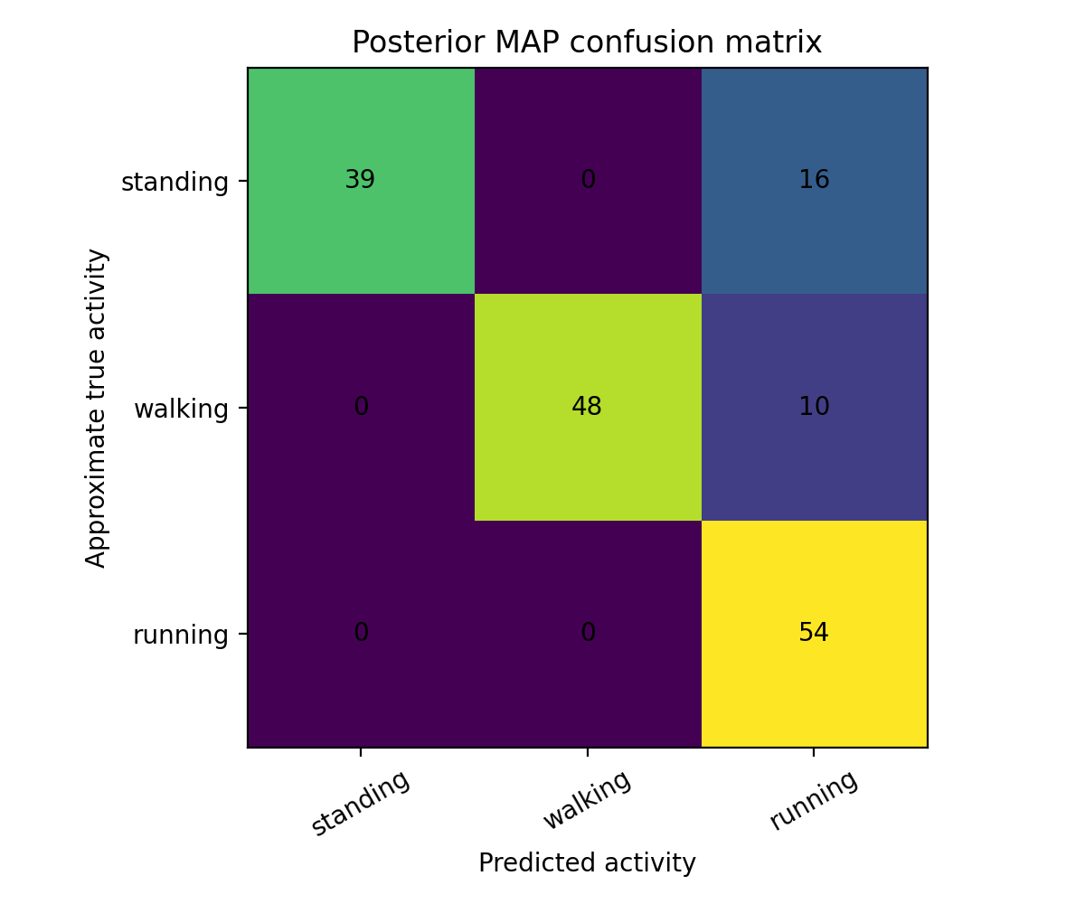
Section 5 - Confusion matrix
Main observations
• running: reliable
• walking: mostly correct
• main error: standing → running
• boundary uncertainty likely contributes
The standing-running confusion should not be interpreted only as an emission-model weakness; approximate transition labels may contribute.
18 / 23

Slide 19
Section 5 - Error analysis
Likely causes
What worked well?
• approximate equal-duration ground truth
• activity changes not exactly aligned with segment boundaries
• phone handling at start and end
• transient motion during standing segments
• window features separated the three activity levels
• Baum-Welch increased the likelihood
• Viterbi gave the best approximate accuracy
• HMM outperformed the non-temporal baseline
Final interpretation
The result is a working proof of concept: the classifier captures the activity sequence, while the remaining errors mostly occur where the reference labels are least certain.
19 / 23

Slide 20
Section 5 - Limitations
Dataset limitations
Model limitations
• only one user
• one phone placement
• three single-activity recordings per class
• one mixed test sequence
• no exact manual timestamps for transitions
• off-diagonal transitions are weakly informed
• overlapping windows are not independent
• magnitude features discard directional information
• Gaussian emissions are simple approximations
Future improvement
A stronger evaluation would use multiple mixed recordings, several users, exact transition timestamps, and possibly richer orientation-aware features.
20 / 23

Slide 21
Reproducibility package
Component
Included material
Code
executed Jupyter notebook
Data
raw sensor logs in data/raw/
Results
plots and CSV files in results/
Report
report PDF, LaTeX source, and presentation file
Instructions
README.md and requirements.txt
How to reproduce
Install the packages from requirements.txt and run the notebook from the project root. The notebook regenerates preprocessing, training, decoding, evaluation, and plots.
21 / 23

Slide 22
Conclusion
What was achieved?
Final result
• phone accelerometer data were recorded
• a 3-state Gaussian-emission HMM was trained
• Baum-Welch EM refined the model
• Forward-Backward and Viterbi decoding were evaluated
The best approximate mixed-test accuracy was 85.0% using Viterbi decoding.
The HMM outperformed the independent Gaussian baseline by using temporal persistence.
Main takeaway
The project demonstrates a complete and reproducible HMM-based activity recognition pipeline, while clearly stating the limitations caused by a small dataset and approximate mixed-test labels.
22 / 23

Slide 23
Thank you for your attention.
Questions are welcome.
23 / 23

