Slide 1
DESIGN AND IMPLEMENTATION OF A FACE MASK DETECTION SYSTEM
BY
OBIDINMA PAUL OZIOMA
(SCI/018/18794)
SUPERVISED
BY
DR . A.O. AKINWUNMI

Slide 2
OUTLINE
This presentation entails the following:
Introduction
Statement of problem
Scope
Project aim and objectives
Significance of project
Literature review
Methodology/Design
System requirements
Implementation
Result
Conclusion
References

Slide 3
INTRODUCTION
The COVID-19 pandemic has motivated the research community to aid front-line medical service staff with cutting-edge research for mitigation, detection, and prevention of the virus according to Boccaletti. S et al., (2020). Artificial intelligence is already being applied in different sectors of combating the COVID-19 pandemic. This is just another instance where the priceless ingenuity of AL can be used.

Slide 4
STATEMENT OF PROBLEM
Wearing face masks is essential in the fight against COVID-19. Rules and laws were made and enforced to a certain degree but due to various reasons such as human error or public apathy, these rules were not well imposed.
The computing age is meant to improve the efficiency of the current methods and with the introduction of a face mask Detection system, this issue can be solved with ease and with more proficiency.

Slide 5
SCOPE
This project cover selecting, training and testing a model that can be used at the entrances to schools, hospitals, places of worship, offices, and other locations where there is a need to control the use of face masks and where there is a higher risk of COVID-19 infection.
This project focuses on the analysis and model alone. It doesn’t include building an application.

Slide 6
PROJECT AIM
This project aims to design and implement a system for facemask detection.

Slide 7
PROJECT OBJECTIVES
The Objectives of the study are as follows:
Collection of the data needed for the model;
train a model for facemask detection;
test a model for facemask detection;
evaluate a model for facemask detection.

Slide 8
LITERATURE REVIEW
S/N | Author(s) | Workdone
1 | Rahman, M. M., Manik, M. M. H., Islam, M. M., Mahmud, S., Kim, J. H., 2020 | They published a document aimed at developing a system for determining whether a person uses a mask or not and informing the relevant authority in the smart city network. The convolutional neural network (CNN) learning algorithm extracts features from images, after which those features are learned through multiple hidden layers.
2 | T. Meenpal, A. Balakrishnan, A. Verma, 2019 | They introduced semantic segmentation, a model for face detection used in an image by categorizing each pixel into face and non-face. It efficiently creates a binary classifier and then recognizes that fragment into chunks. The design allows you to create accurate face masks for human objects from RGB images containing localized objects.
3 | Vinitha, V., & Velantina, V., 2020 | They published one article in which, using a deep learning algorithm and computer vision, they proposed a system that focuses on how to distinguish a person with a masked face in an image/video stream. Libraries like Tensor flow, Open CV, Keras, and PyTorch are being used.

Slide 9
SIGNIFICANCE OF STUDY
With every day that goes by, the world becomes more and more technologically inclined. Because of this, people are taking advantage of this in problem-solving and the issue of wearing face masks needs to be solved in the same manner.
Creating a face mask detection system is therefore very relevant and allows and aims for simplicity and efficiency. If we also consider the cost estimation for implementing the project, it will be almost no cost as most of the infrastructures and organizations around the world already have a camera installed in public places.
It also aims for speed, efficiency and adequate accuracy.

Slide 10
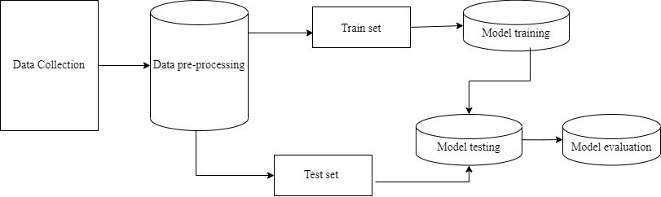
METHODOLOGY

Slide 11
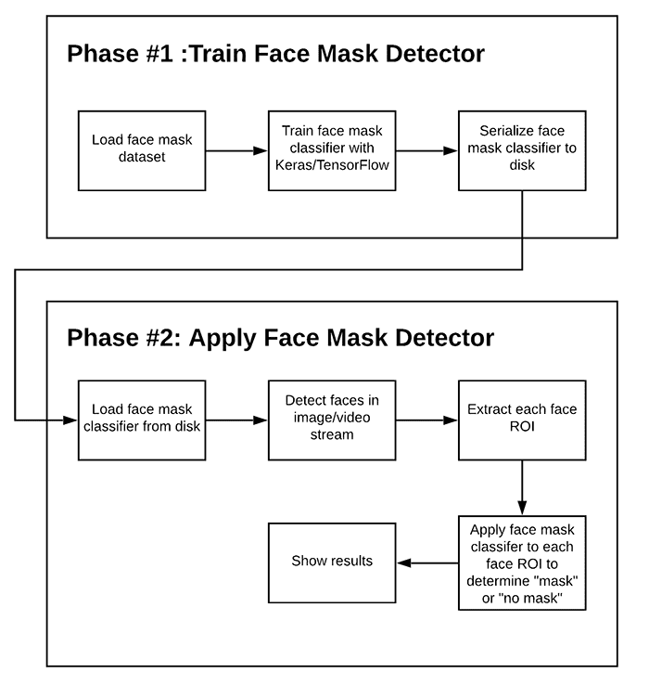
METHODOLOGY

Slide 12
SYSTEM REQUIREMENTS
The hardware requirements include the following:
A laptop or desktop computer (preferably 64-bits).
A webcam.
RAM: Eight gigabytes minimum.
Processor: Intel Core i5, 2.4 GHz minimum.

Slide 13
SYSTEM REQUIREMENTS
The software requirements include the following:
Operating system: Windows 10 or higher
Python (Installed)
An open-source integrated development environment (IDE) such as Pycharm, Jupyter notebook etc.

Slide 14
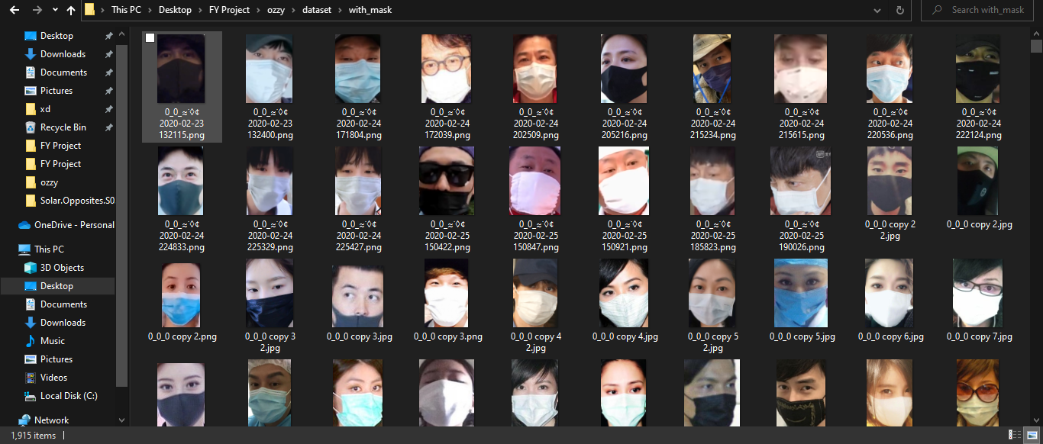
DATASET COLLECTION

Slide 15
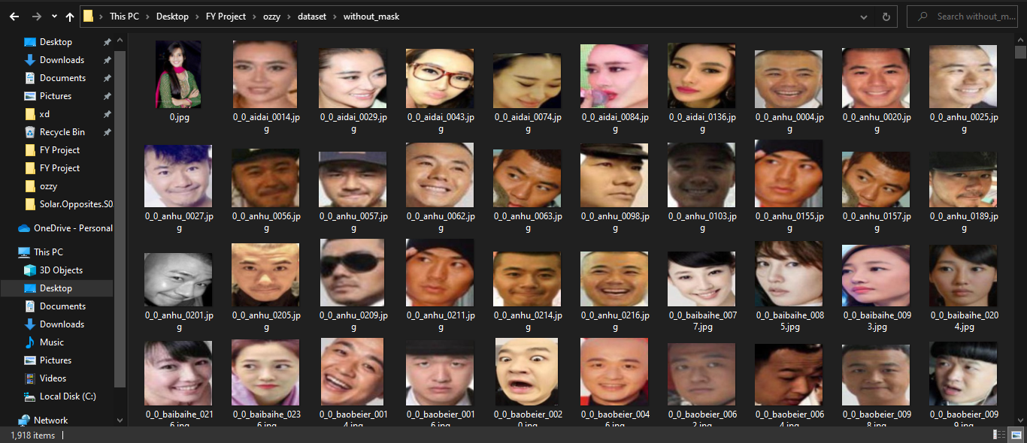
DATASET COLLECTION

Slide 16
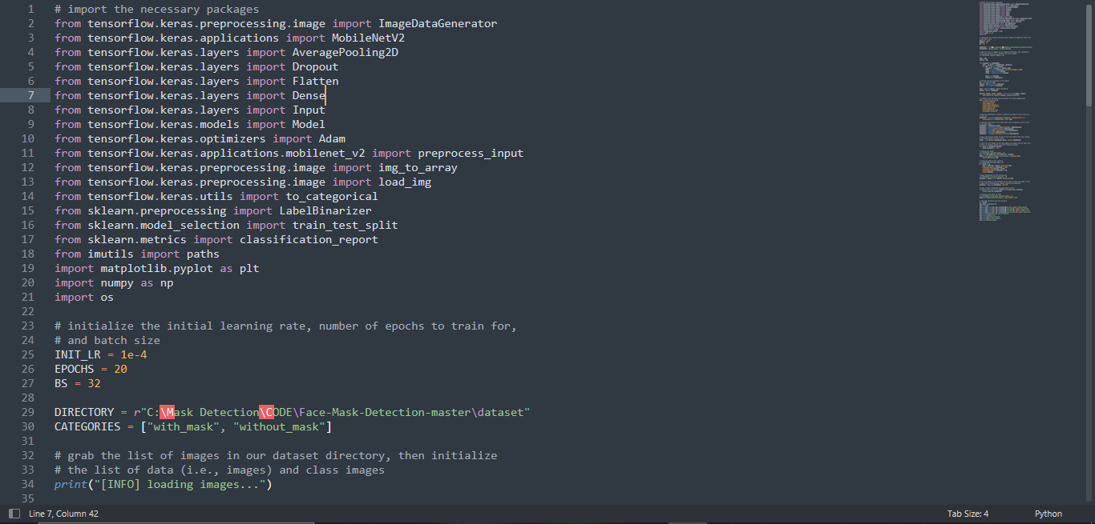
LIBRARIES EMPLOYED

Slide 17
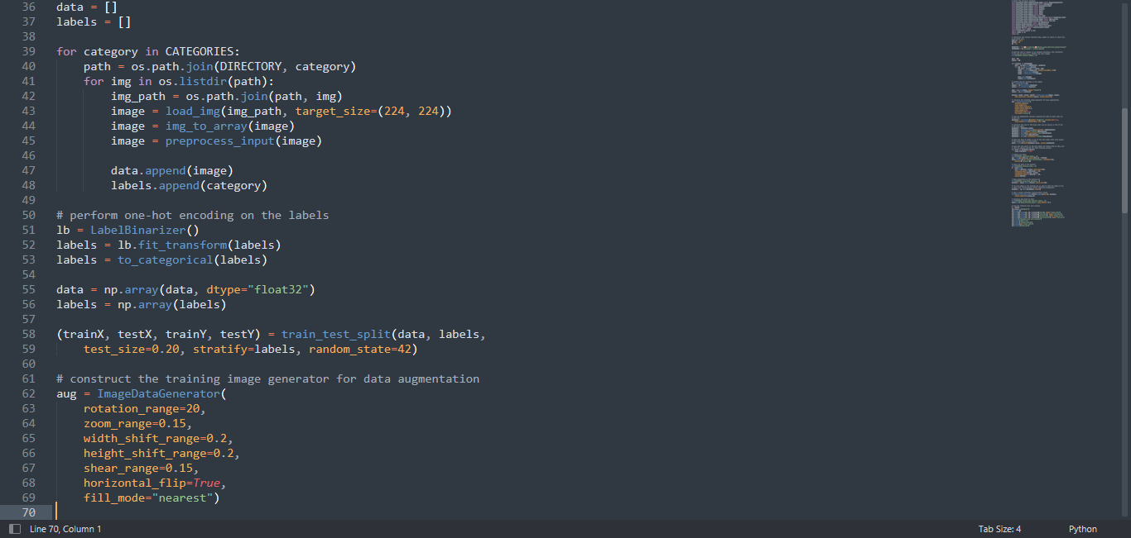
MODEL TRAINING

Slide 18
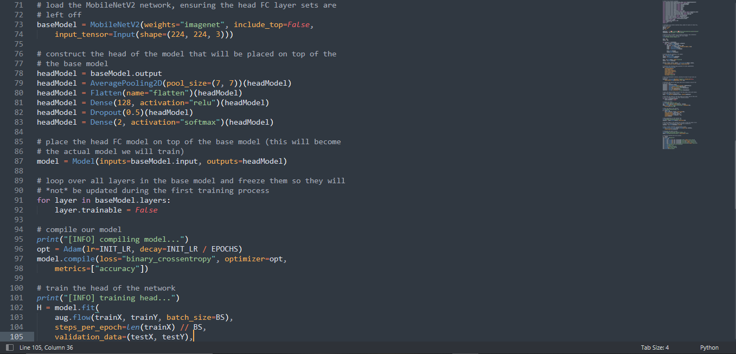
MODEL TRAINING

Slide 19
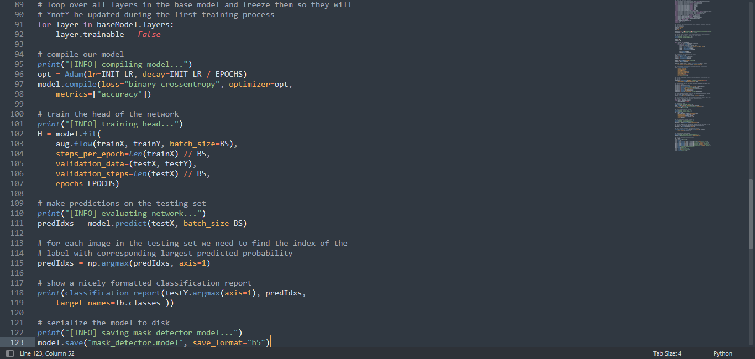
MODEL TRAINING

Slide 20
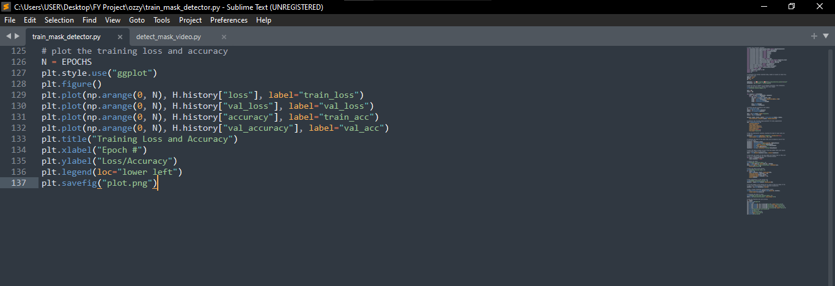
MODEL EVALUATION

Slide 21
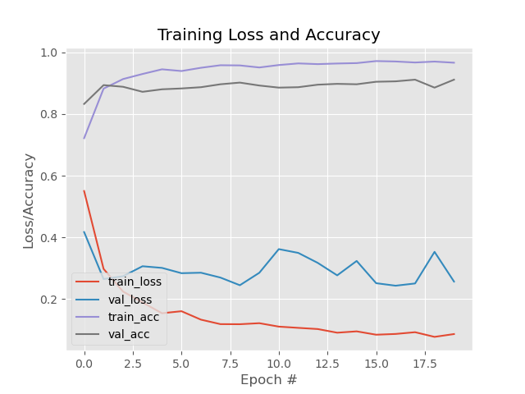
MODEL EVALUATION

Slide 22
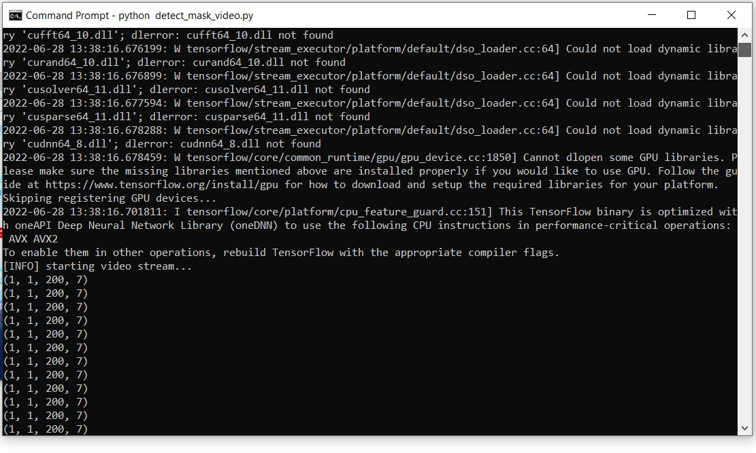
MODEL TESTING

Slide 23
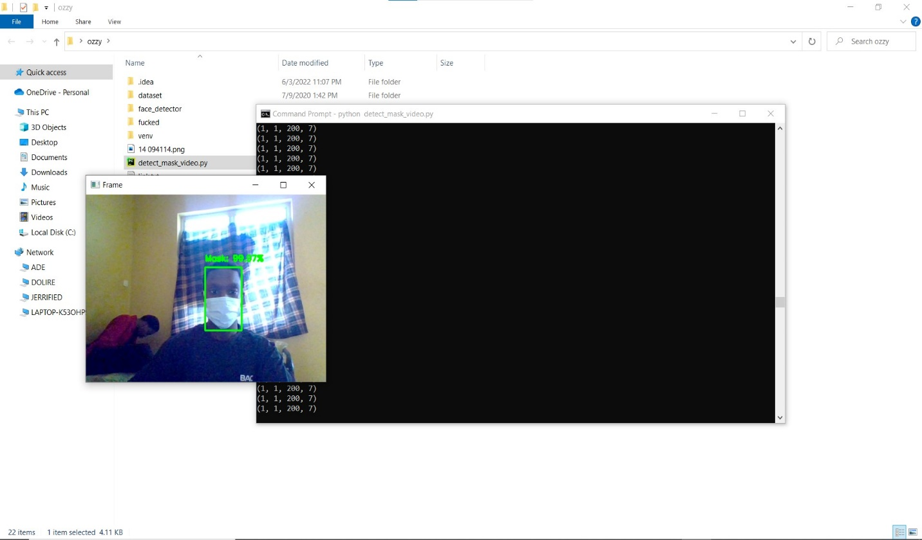
MODEL TESTING

Slide 24
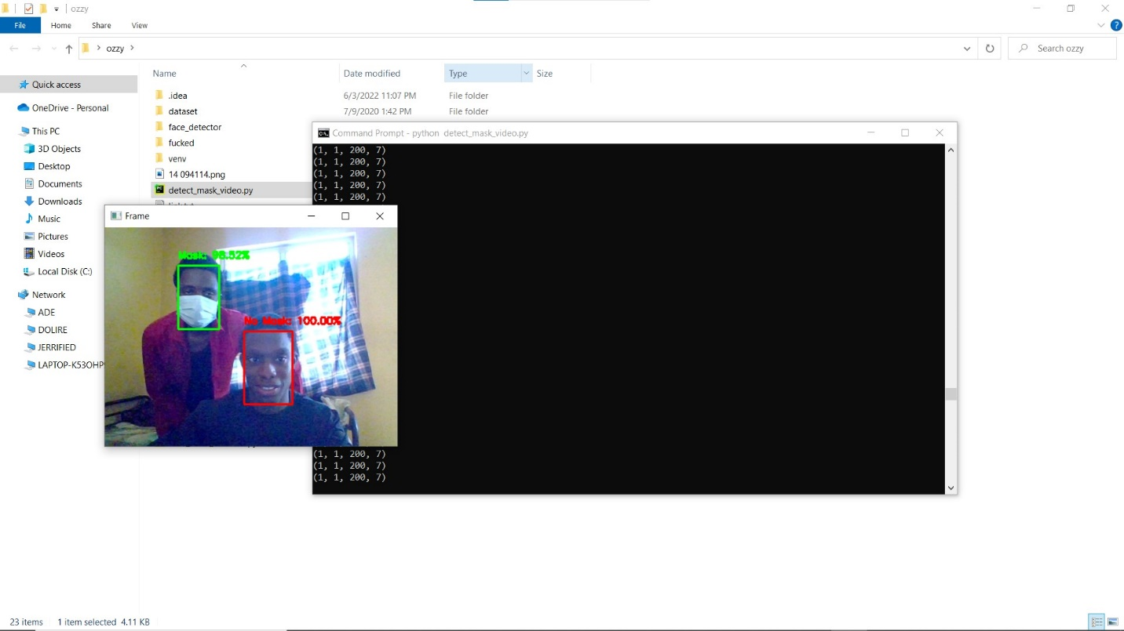
MODEL TESTING

Slide 25
CONTRIBUTION TO KNOWLEDGE
The notable contribution of this research work shows how an aspect of Computer science (artificial intelligence) can be used in different aspects of our lives. With the model like this, we can curb the spread of the coronavirus disease in public areas substantially and use it to regulate the wearing of face masks where it is needed.

Slide 26
RECOMMENDATION
This project can be fine-tuned and tweaked to get higher and improved speed, accuracy and compatibility and it can also be deployed into some embedded systems and on other platforms like mobile apps, CCTV systems, web apps, etc.

Slide 27
Conclusion
Due to new trends in technology, a revolutionary face mask detector has been developed that may benefit public health. A real dataset is used to train the model. In order to determine whether or not people were wearing face masks, we employed OpenCV, tensor flow, Keras, and CNN. live videos were used to evaluate the models. The model's correctness has been attained, and it is continually optimized as we construct an accurate answer by adjusting the hyperparameters. This particular model may be used as an example of an edge analytics use case. The development of a technology that can determine whether someone is wearing a face mask and permit their admission would be very beneficial to the society.

Slide 28
REFERENCES
Real-Time Implementation of AI-Based Face Mask Detection. https://www.hindawi.com/journals/sp/2021/8340779
Detection with Deep Learning: The Definitive Guide - https://tryolabs.com/blog/2017/08/30/object-detection-an-overview-in-the-age-of-deep-learning
Classifying images using Keras MobileNet and TensorFlow.js - https://gogul.dev/software/mobile-net-tensorflow-js
Vinitha.V and Velantina.V, International Research Journal of Engineering and Technology (IRJET), “Covid-19 facemask detection with deep learning and computer vision,” Aug, 2020.
List Of Top 5 Algorithms In Computer Science And Machine Learning - https://www.nytoday.org/list-of-top-5-algorithms-in-computer-science-and-machine-learning
Adrian Rosebrock, “COVID-19: Face Mask Detector with OpenCV, Keras/TensorFlow, and Deep Learning,” May 4, 2020. [Online].

Slide 29


